Slide 1
EE 421 / CS 425 Digital System Design Laboratory 1
Fall 2024
Shahid Masud

Slide 2
Lab Course Learning Objectives
Describe, Simulate and Debug combinational and sequential digital systems using SystemVerilog hardware description language (Design Capture).
Understand Design Flow and EDA tools for Simulation and Synthesis of FPGA design of digital systems.
Implement and test digital systems on FPGA platforms (hardware boards).

Slide 3
Course Outline and Grading Scheme
Lab Completion (10 to 11 Labs): 50%
Lab Attendance (1% each lab)
TA grades the Task Completion (2% each lab)
Submitting Reports and Observations, as required (2% each lab)
Lab Projects (1 to 2): 30%
SystemVerilog coding and Testbench
Simulation
Synthesis
FPGA prototyping
Project report
Presentation
Lab (Midterm) Exam: 20%
MS Grading: Final Grade is Combined (80% Theory, 20% Lab)

Slide 4
Today’s Topics
Learning Objectives
Lab Course Outline and Grading
RTL Design - Introduction
Design Flow – from idea to product
Step through EDA tools
Introduction to SystemVerilog and Design Methodology
Tools Installation

Slide 5
RTL View of Digital System Design
Engineering System has Inputs and Outputs
RTL = Register Transfer Logic
Input
Register
Combinational Logic Cloud
Output
Register
External
Input
External
Output
This is One RTL Module
Trigger
Trigger
A Complex Digital System has many RTL Modules

Slide 6
RTL Design with a Pipeline Cut
Pipelined RTL
RTL = Register Transfer Logic
Input
Register
Combinational Logic Cloud
Output
Register
External
Input
Input
Register
Combinational Logic
Pipeline
Register
Combinational Logic
Output
Register
External
Input
External
Output
External
Output
Trigger 1
Trigger 2
Pipeline
Cut
Trigger 1
Trigger 2
Trigger 3
Pipeline Cut
What is achieved?

Slide 7
Design Flow – from idea to product
Product
Description
High-Level Specifications
Testing and Verification
Customer
(Mobile Phone Company)
Sales Team and Senior Managers
Engineering Staff
Chip / FPGA Manufactured
Modular Specifications
Engineering EDA Steps (next slide)

Slide 8





Step Through EDA Tools
Design Capture
Text Editor
Functional Simulation
Questa
Synthesis
Xilinx Vivado
Post-Synthesis Simulation
Questa
Timing, Power, Area
Place and Route
Xilinx Vivado
Product FPGA / ASIC

Slide 9
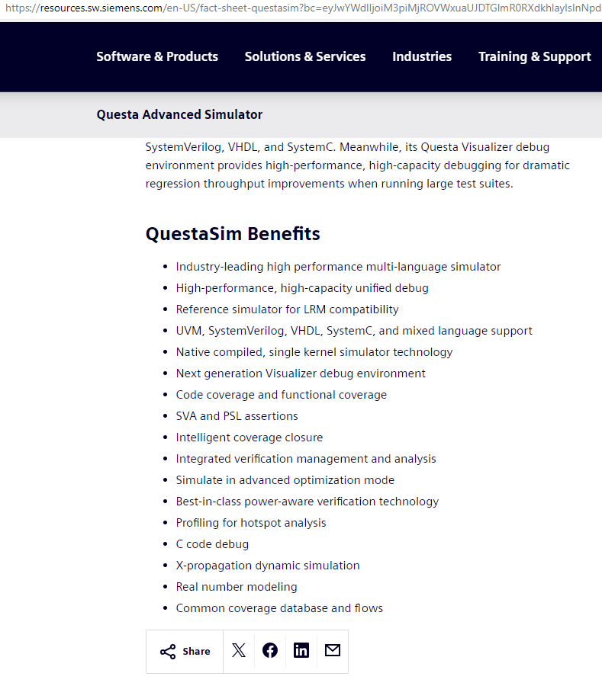
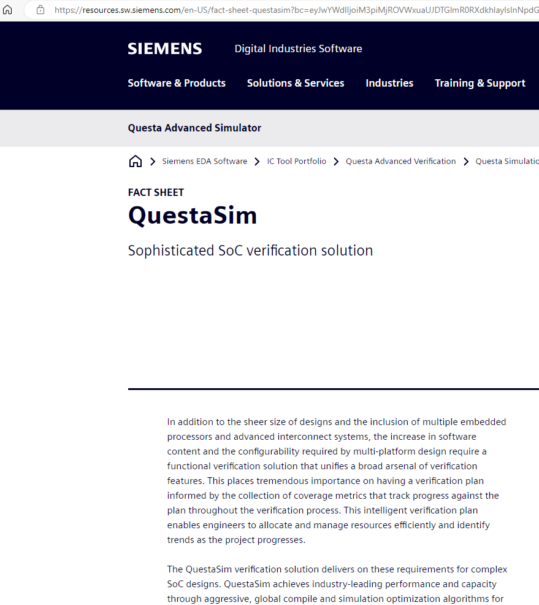
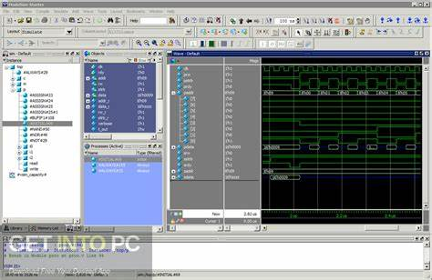




Simulation Tool Questa

Slide 10
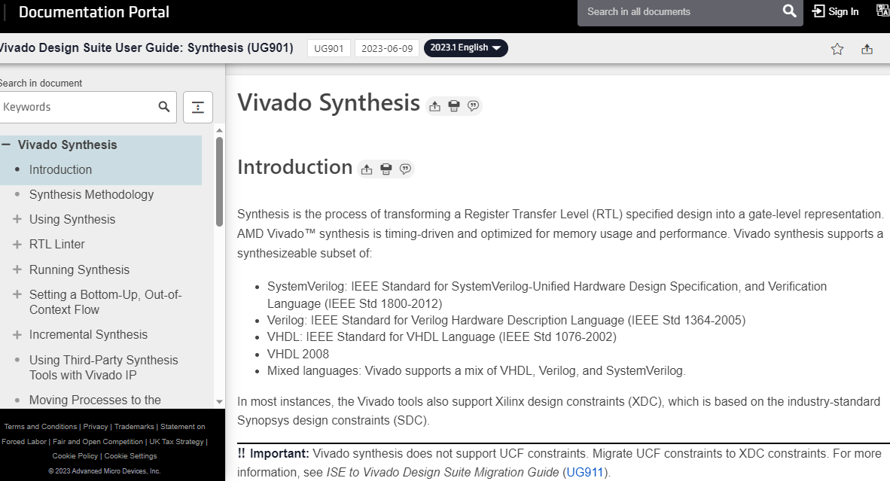


Synthesis Tool Xilinx Vivado

Slide 11
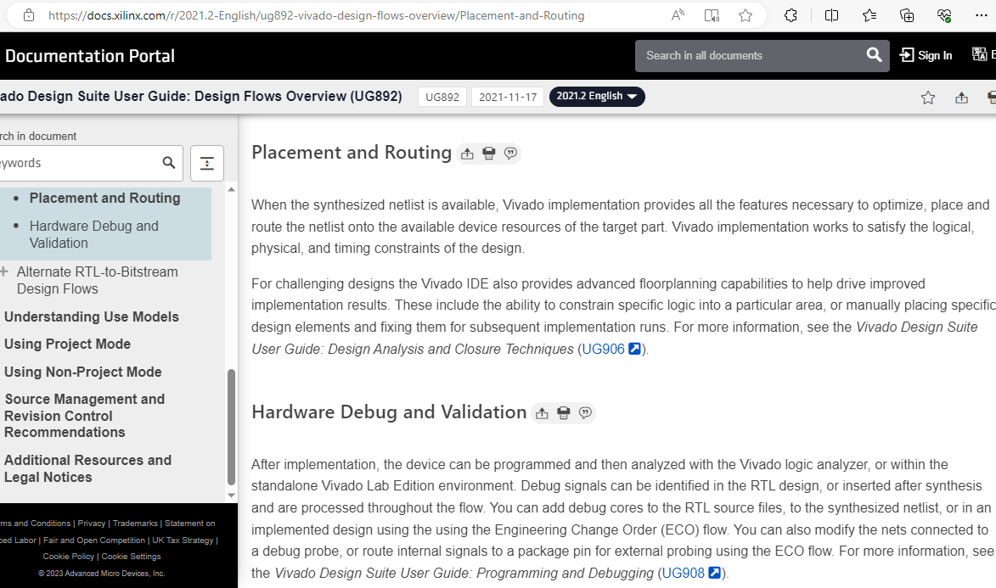


Place and Route – Xilinx (FPGA) Technology

Slide 12
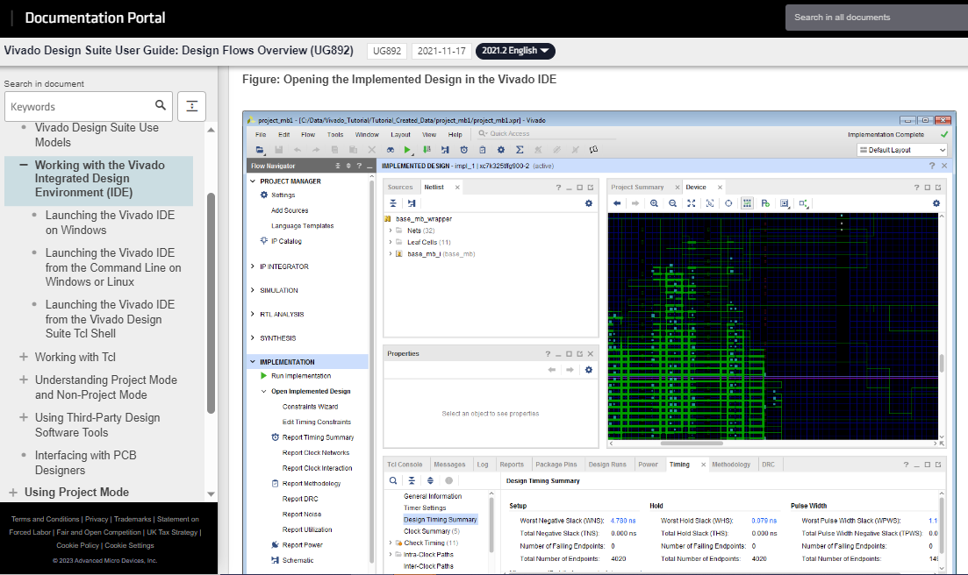
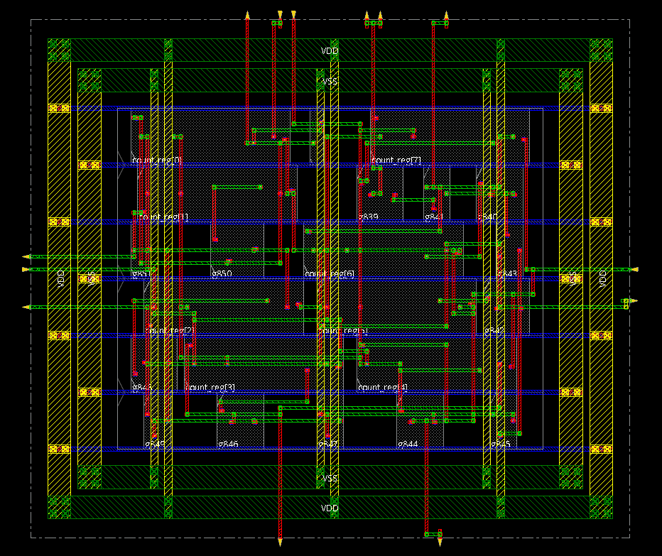
Post Layout Design on Xilinx FPGA

Slide 13
Hardware Description Languages - SystemVerilog
Specialized Computer Language for Capturing Hardware Design Idea
Can be used to describe structure and behavior of digital circuits
HDL include notion of hardware specific time or delay
They have support for Concurrency which is peculiar to hardware
Remember 3 distinct features of HDL not available in other
Programming languages

Slide 14
SystemVerilog
Verilog is a Hardware Description Language that was Standardized by IEEE through Standard IEEE-1364-2001, first proposed in 1995
Most Verilog constructs can be Simulated and Synthesized
System Verilog includes some extensions for high-level object-oriented design and first became IEEE standard in 2008
VHDL is another HDL (Very High-Speed Integrated Circuit HDL), 1987
VHDL is strictly typed language and allows complex data types
Both Verilog and VHDL are used worldwide
SystemVerilog is becoming popular as it incorporates UVM features for verification; latest IEEE Standard 1800-2023, previous 2017, 2012

Slide 15
Design Capture in SystemVerilog HDL
SystemVerilog Allows Design Capture at Various Hierarchy Levels:
Switch Level (NMOS and PMOS transistors)
Gate Level (Describing Circuit as Logic Gates)
Basic Functions of Gates are available as Primitives
Data Flow (RTL) Level Design
Behaviour Level Design
The Design is captured in a text file or it can be obtained from
schematic diagram
CMOS VLSI
Design
Structural
Design like
Schematic

Slide 16
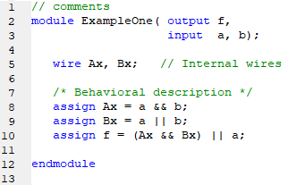
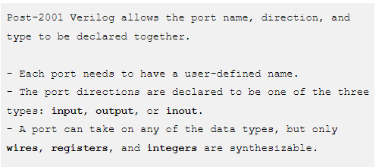
SystemVerilog Syntax

Slide 17
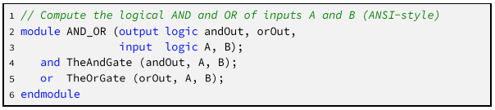
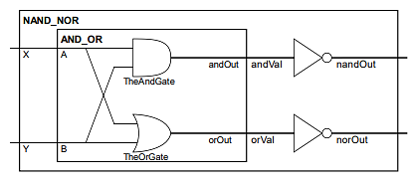
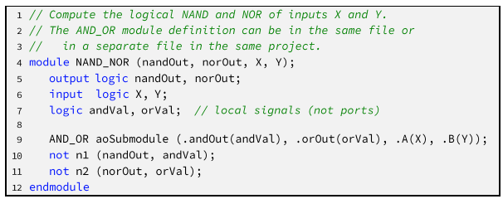


Structural SystemVerilog (port mapping)
Components available in library are port mapped
Also an example of Hierarchical Design

Slide 18
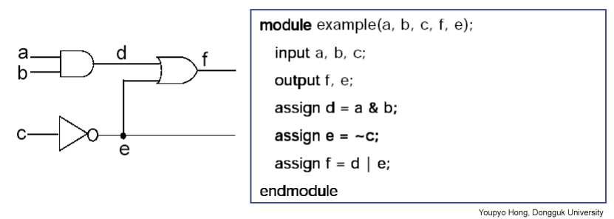
Behavioral SystemVerilog (assign statement)
This is the Highest Level of Abstraction in HDL
Different Circuit blocks can be represented as Functions, Tasks and Hierarchical Modules
‘Assign’ and ‘Always’ are relevant constructs

Slide 19
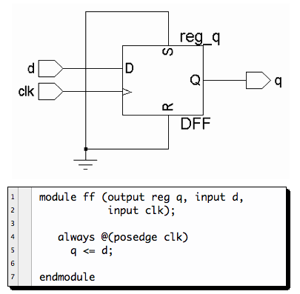
RTL in SystemVerilog (always blocks)
RTL =Register Transfer Level
Module is described in Verilog in the form of Data Flow
Signals are assigned by the data operation
Design is Implemented using Concurrent Assignments
‘Always’ and ‘Clk’ are relevant constructs

Slide 20
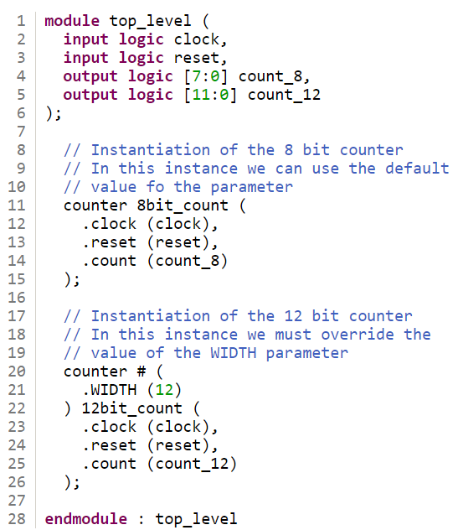
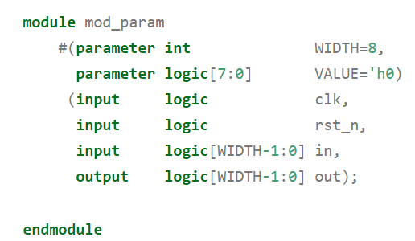
Modular Approach in SystemVerilog
Module is a basic building block in SystemVerilog
Module can be a collection of multiple low level logic blocks
Modules are interconnected through Port Interface
Internal functionality of any Module can be altered without affecting any other Module

Slide 21
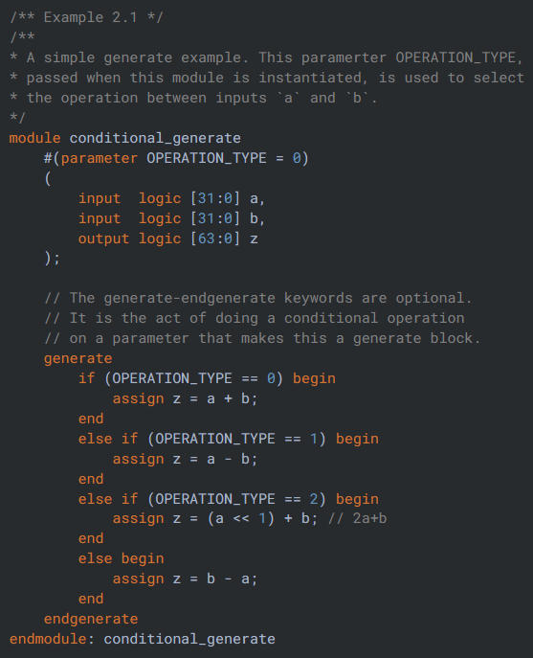
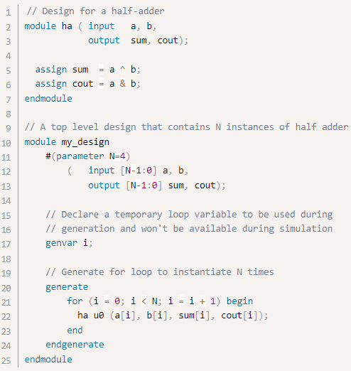
Use of Parameter and Generate in SystemVerilog

Slide 22
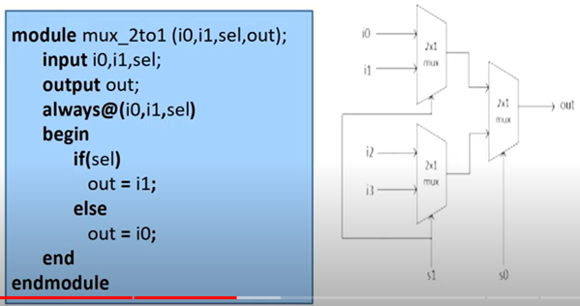
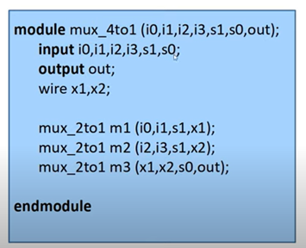
Hierarchical Approach in SystemVerilog
4 to 1 MUX using 2 to 1 MUX
Instantiation allows creation of Hierarchy in SystemVerilog.
The Modules that are used in another Module are called Instances or Instantiation.
Nesting of Modules is not permitted as it is Hardware Design.
One Module can be used in many other Modules through Instantiation
Design Reuse

Slide 23
Design Abstraction in SystemVerilog
Two Design Methodologies
Top-Down Methodology
We define the top-level block and identify the Sub Blocks
needed to build the top-level block
These Sub Blocks are further divided until we come to Leaf
Cells which cannot be further Sub Divided
Bottom-Up Methodology
We first Identify the Building Blocks (Leaf Cells) that are
available to us in a library
We build bigger blocks using these Building Blocks
The process continues until we reach the Top-Level block

Slide 24
Test Bench in HDL
Used for Functional as well as Post-Synthesis Testing
Timing Information can be added through Gate Models
Stimulus through Test Bench or External File
Design Under Test DUT
Monitor
Timing Diagrams, File Comparison

Slide 25
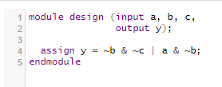
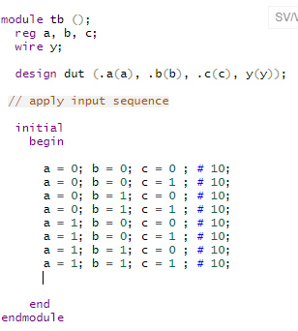
Writing Test Benches in SystemVerilog
Wrapper SV Module
Stimulus
Signals
Input Ports
SV Module
Clock
Instantiation
Screen Display
Or File Write
Output Ports
SV = SystemVerilog file extension

Slide 26
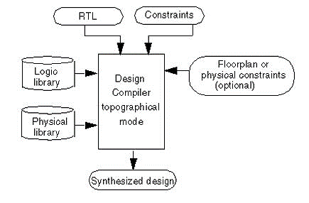
RTL Synthesis

Slide 27
Lab 1 Task – EDA Tools Installation
Refer to Lab Manual 1 and Appendix A
--------------- for own learning ---------------------
SystemVerilog language https://www.chipverify.com/tutorials/systemverilog
Online EDA tools (iverilog) for simulation and testing
https://courses.edaplayground.com/home

