Slide 1
Lecture 21
EE 421 / CS 425
Digital System Design
Fall 2024
Shahid Masud

Slide 2
Topics
Special Features in FPGA
Sequential Implementation on CLB
Memory
Multipliers
DSP Slices
FIR and Symmetric Filters
QUIZ 4 TODAY

Slide 3
Specialized Modules in FPGAs
Dedicated Memory
  Single Port and Dual Port Embedded Memory Blocks – Block RAM
Dedicated Arithmetic Units
  Adders, Multipliers, Multipliers – Accumulators, Fast Carry Logic
Digital Signal Processing Blocks – DSP Slice
  FFT Butterfly Modules, FIR / IIR Filters,
  IP Core Libraries for Encryption, Video Compression, Cloud Applications, etc.
Embedded Processors
  PowerPC, Microblaze, NIOS, ARM, MIPS, etc.
Content Addressable Memory (CAM)
  used in Branch Prediction, Caches inside CPU
More and more features keep appearing in new FPGA devices
  High Speed Interfaces, Security Features, RISC-V Support, etc.

Slide 4
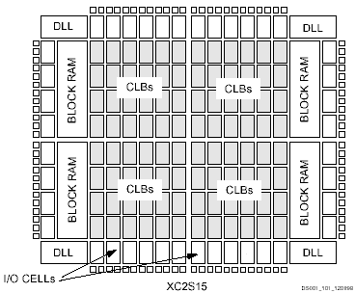
Xilinx Spartan Architecture
Block RAM ?
DLL = Delay Locked Loop
For Clock Management

Slide 5
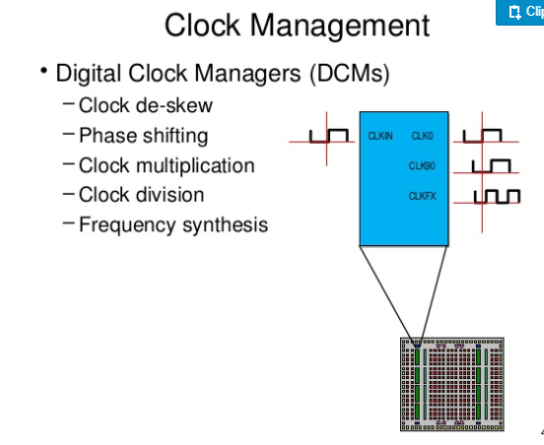
Digital Clock Module in Xilinx FPGA

Slide 6
Implementation of memory in FPGA
Using LUT in CLBs – Distributed RAM
Instantiating Block RAMs
Provision of Dual port memory in modern FPGA

Slide 7
Sequential Circuits in FPGA
DFF1
DFF2
DFF3
DFF4
D1=Q4
D2=Q1
D3=Q2
D4=Q3
D1 Q
D2 Q
D3 Q
D4 Q
Clk
LUT4
X Fn Gen
DFF
LUT4
X Fn Gen
DFF
X1
.
.
X4
X1
.
.
X4
LUT4
Y Fn Gen
DFF
LUT4
Y Fn Gen
DFF
Y1
.
.
Y4
Y1
.
.
Y4

Slide 8
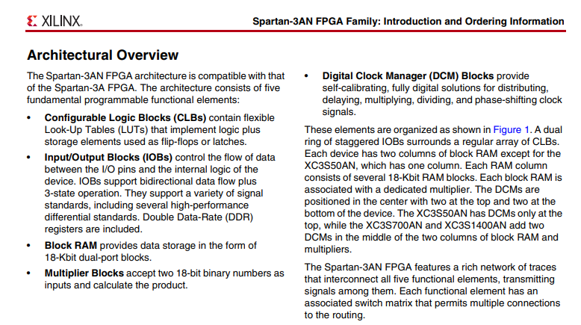
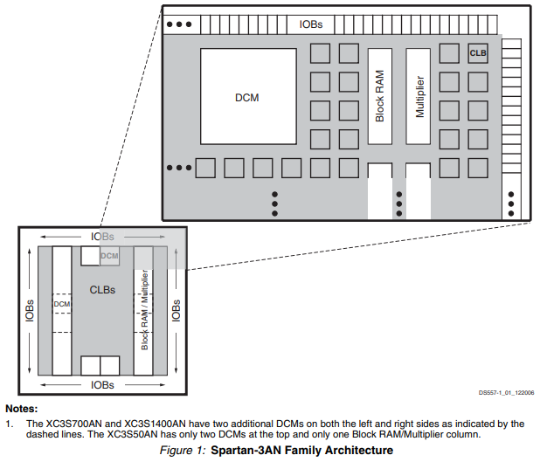
Multiplier Blocks – Xilinx Spartan-3AN

Slide 9
DSP Features in modern FPGA
Example FIR Filter Implementation

Slide 10
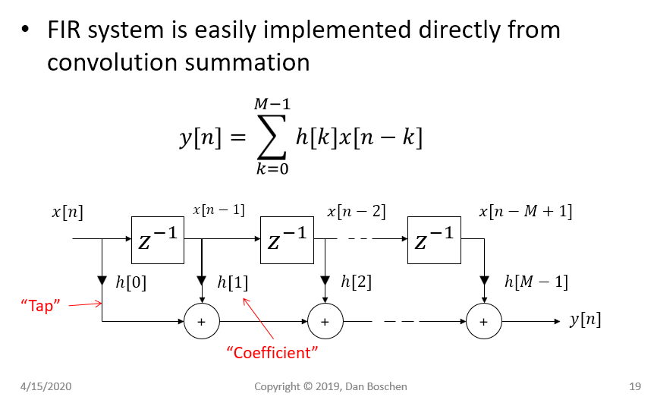
FIR Filter Design
Registers For Delay
Multipliers

Slide 11
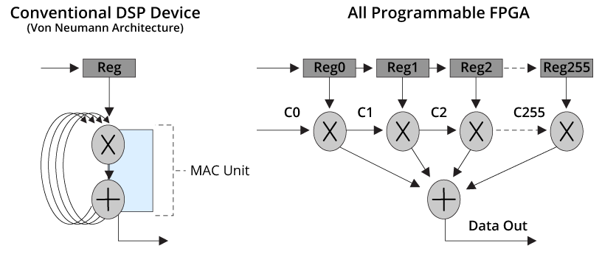
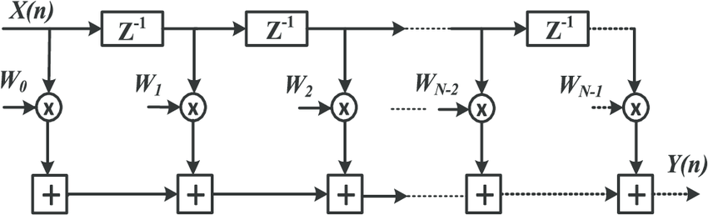
Implementation of DSP Filters
Implementation of FIR filters in Digital Signal Processing
FIF filter mapping on
Software Programmable Device
FIF filter mapping on
a configurable Hardware Device

Slide 12
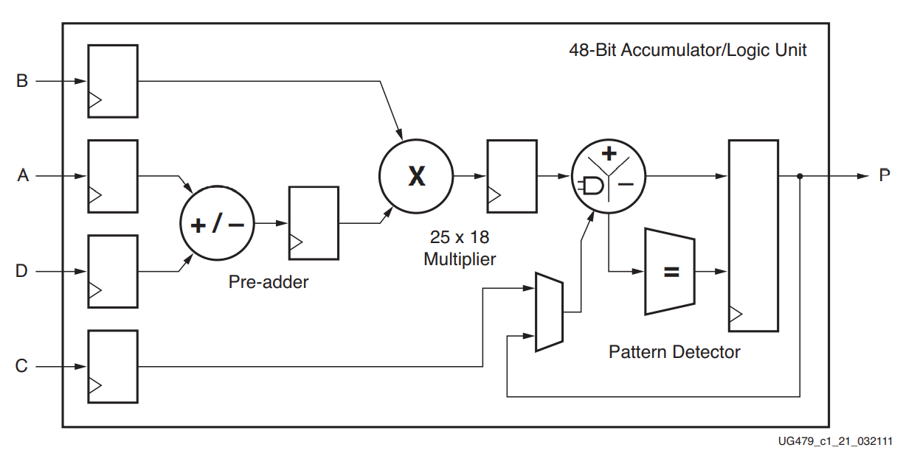
Basic Xilinx DSP48 Slice Architecture

Slide 13
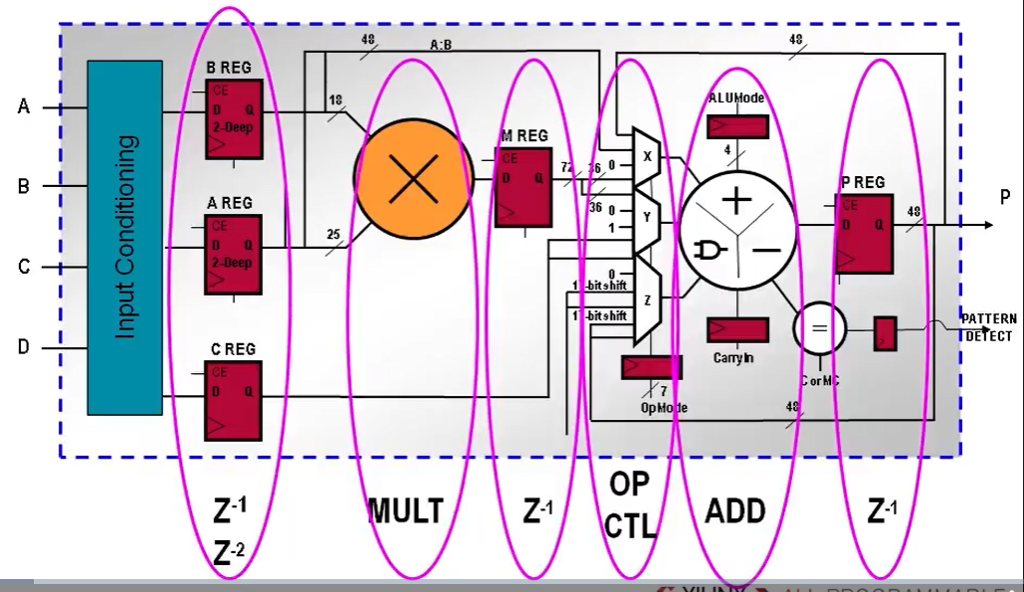
DSP Slice Features

Slide 14
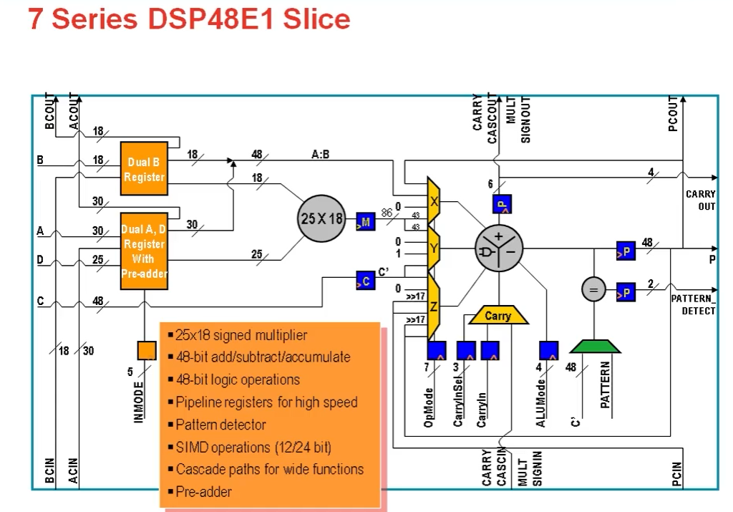
Example of DSP Slice and Features

Slide 15
Xilinx DSP48 Slice Functionality
25 x 18 two’s complement multiplier
48-bit Accumulator
Power saving Pre-Adder for symmetric FIR filter implementation
Single-Instruction-Multiple-Data (SIMD) arithmetic unit
Dual 24-bit or Quad 12-bit Add/Sub/Acc
Optional Logic Unit with 10 different operations on two operands
Pattern Detector for convergent or symmetric rounding
96-bit wide Logic functions in conjunction with
Pattern Detector and Logic Unit
Optional Pipelining and Dedicated Buses for Cascading

Slide 16
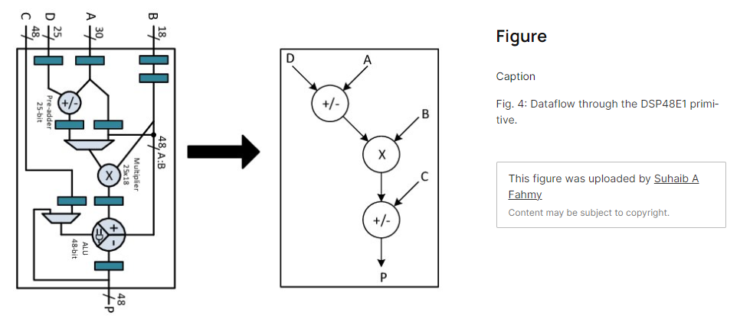
Mapping Add and Mult on DSP Slice

Slide 17
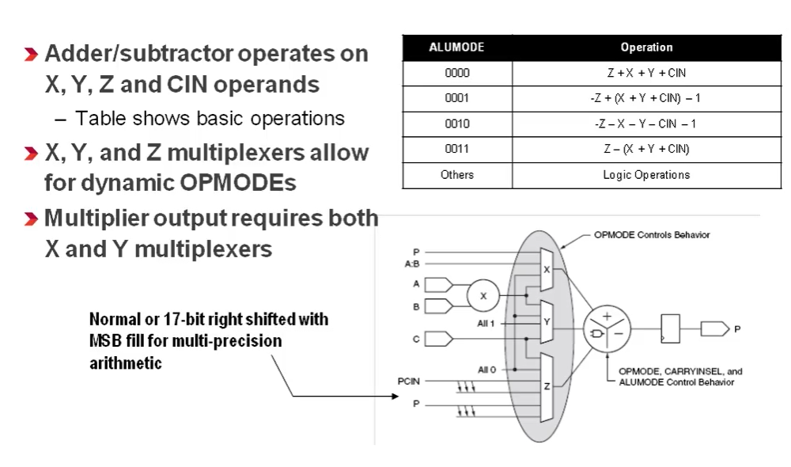
X, Y and Z Multiplexer

Slide 18
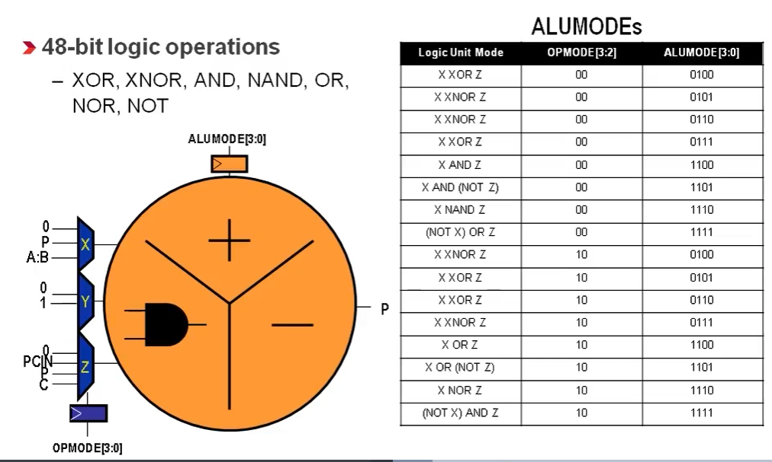
Two Input Logic Functions in DSP Slice

Slide 19
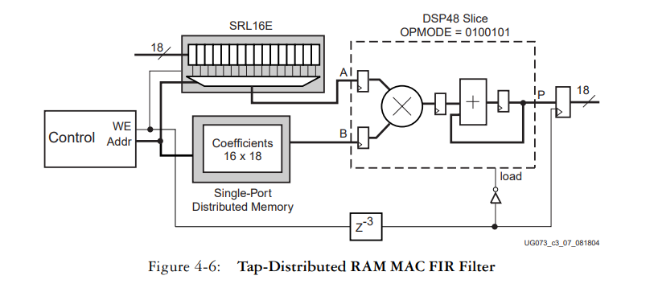
An Implementation of FIR using RAM

Slide 20
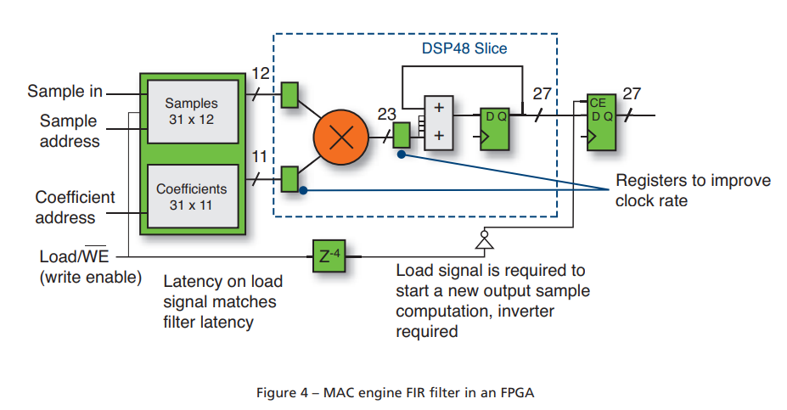
MAC Engine for FIR Filter in FPGA

Slide 21
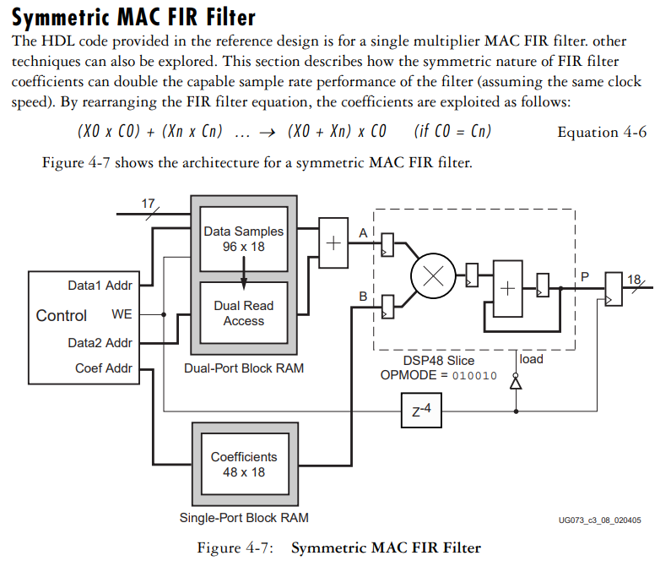
Symmetric FIR

Slide 22
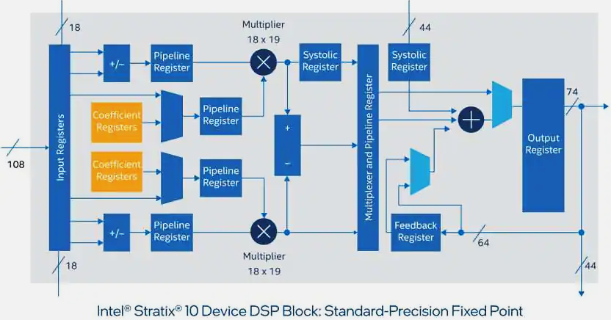
Intel Stratix Slice
Intel Stratix DSP Block – Fixed Point

Slide 23
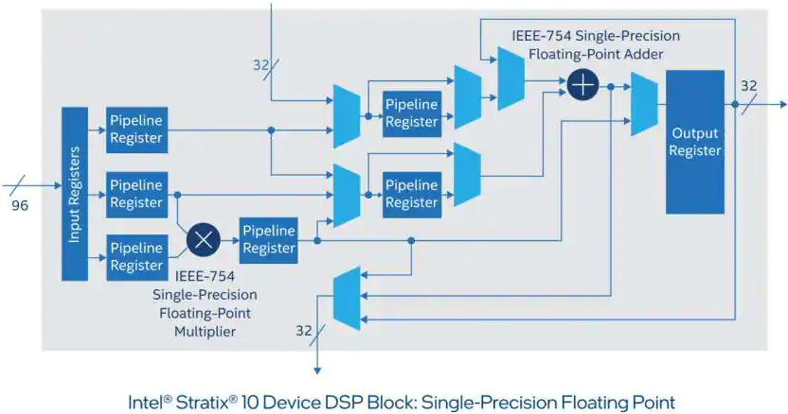
Intel Stratix DSP Slice with Floating Point
Intel Stratix DSP with Floating Point Support

Slide 24
Further Reading
https://www.xilinx.com/video/fpga/7-series-dsp-resources.html

