Slide 1
Lecture 6
EE 421 / CS 425
Digital System Design
Fall 2024
Shahid Masud

Slide 2
Topics
Topics remaining from previous lecture on Glitches and Hazards
----------
Review of Sequential Digital Logic Circuits
Basics of Latches
Basics of Flipflops
Setup and Hold Times
D Flipflop
Clock Issues

Slide 3
Latches and Flipflops - Definitions
Latches: Level Sensitive storage elements; that can transition at any point in time
Flipflops: Edge Sensitive storage elements, that transition at clock edges, either rising or falling
Asynchronous Sequential Logic: Based on latches and un-clocked transitions
Synchronous Sequential Logic: Based on flipflops and only clocked transitions

Slide 4
Fundamental Element – SR Latch
R (reset)
Q
S (set)
Q
Complement
Q’
R (reset)
Q’
S (set)
SR Latch Using 2 Input NOR Gate – Function Table
SR Latch Using 2 Input NAND Gate – Function Table
S (Set) | R (Reset) | Q | Condition
0 | 0 | Q (=1 after S=1, R=0) | Hold
0 | 0 | Q (=0 after S=0, R=1) | Hold
0 | 1 | 0 | Reset
1 | 0 | 1 | Set
1 | 1 | 0 | Not Allowed
S | R | Q | Condition
0 | 0 | 1 | Not Allowed
0 | 1 | 1 | Set
1 | 0 | 0 | Reset
1 | 1 | Q (=0 after S=1, R=0) | Hold
1 | 1 | Q (=1 after S=0, R=1) | Hold
RACE
Condition
RACE
Condition

Slide 5
Transparent Latch
An additional ‘Enable’ input is provided
Definition: Output of Transparent Latch changes in response to the data input only when the Latch is ‘Enabled’.
Changes in input are straight away visible at the output

Slide 6
Transparent Latch Circuit
Timing Diagram – With Input Inverter
Data
S
Data
U
Q_Out
D
Enable (Level)
Enable
R
V
SR Latch With Enable (Without Inverter)
En | S | R | Next State of Q
0 | X | X | No Change
1 | 0 | 0 | No Change
1 | 0 | 1 | Q=0; Reset State
1 | 1 | 0 | Q=1; Set State
1 | 1 | 1 | Not Allowed
Q_Out
Latched
time
When Enable is ‘0’; U=‘1’ and V=‘1’; Hold Condition in SR Latch
Only these two states are valid when inverter is inserted

Slide 7
D Flipflop from Transparent Latch
Preset
D
S
Q
D
D Flipflop
Q
Clock Edges
Q’
Q’
Clk
R
Clear
NOTE: Usually a Master-Slave Arrangement is used where output is available after clock goes 0 to 1 to 0
C
R
Unipolar
Conversion
(from pulse shaping circuit)
Clock edges
RC Differentiator
Bi-polar pulses

Slide 8
Timing Definitions
Setup Time: The duration of time the Data needs to be present before the arrival of clock.
Any Data activity, in tandem with clock edge, violates setup time and will not be recorded in the D flipflop
Hold Time: The time for which data has to remain stable after the removal of clock edge.
If the Data changes too soon, the internal circuit may not have settled with the new value.

Slide 9
Setup and Hold Times
Clock transition
From 0 to 1
Clock rising edge
Data change
t setup
t hold
Data removed
time
Maximum clock frequency has to be slower than (t setup + t hold) to maintain correct data
These timings needed both ways, slow data and fast clock; as well as slow clock and fast data

Slide 10
Timing in a simple frequency divider
Propagation Delay tp
Clk
Preset
Q
D
D Flipflop
Q
D
tp
Clk
Q’
tc
Clear
If the current output of flipflop is 1, a value of 0 will appear at D after propagation delay of inverter
Assuming that next active edge of clock arrives after setup time has elapsed, the output of flipflop will go to 0
A continuous waveform with period twice the period of Clk is observed at Q

Slide 11

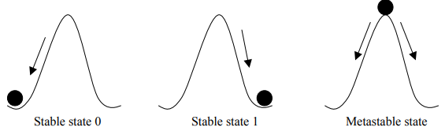
Metastable State
Given a pulse input:
Output reaches a value (or oscillates) somewhere in-between
‘0’ and ‘1’ and stays there, neither ‘0’ nor ‘1’, for some noticeable time
Why?
Too small pulse violates setup and hold times
Too less drive strength available to overcome the intermediate
state
A
U
V
B
Imagine a circuit like this

Slide 12
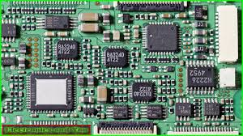



Clock - Problems
Issues:
Too much load
on Clock Input Pin
2. Variable path delay to
Different Chips in circuit
3. Path is prone to picking
up noise from surrounding
Clock is an essential
Signal in Synchronous
Digital Systems
External Clock
Input PIN

Slide 13
Clock Distribution Circuit
Qualities of a Good Clock Signal:
Clock has to reach each and every module of a complex circuit
Clock needs very high signal drive strength
Clock Edge has to appear at the same instant across all modules (skew)
Clock should be stable and free from jitter (time variations along stable reference point)

Slide 14
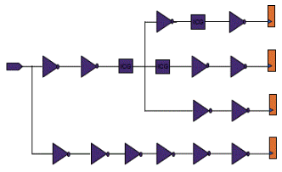
Clock Tree Synthesis
Clock tree synthesis is performed during the physical design process considering the effects of place and route, channel impedance, parasitic loads, etc.
Then through the insertion of buffers or inverters along the clock paths, it minimize or balances skew of important clock signal chains, build a clock tree that achieves proper timing across the entire design.
Ref: https://www.system-to-asic.com/blog/what-is-asic-design/

Slide 15
Some Techniques for Clock Distribution
X
Module 1
Module 1+1
Module 1
Module 1
Module 1
Module 1
Module 1
Module 1
Buffer
Insertion
H-Tree Clock Synthesis
Path is balanced through
Tree structure
Module 1
Module 1
Module 1
Module 1
Module 1
Module 1
Module 1
Module 1
CLK
H Tree Clock Distribution Network
Buffer Insertion for Delay Balancing in un-balanced trees

Slide 16
Hierarchical Clock
Module 2
Module 2
Buffer based Path
Delay Balancing
Module 2
Module 2
Module 2
Module 2
Driver and
Buffer
CLK
Two Level Distributed Clock Buffering

