Slide 1
VLSI Design EE 523
Spring 2026
Shahid Masud
Lecture 7
LTSpice Examples

Slide 2
Topics for lecture 6
MOS transistor theory and operation
Mathematical Equations for:
  Gate Capacitance, and charge stored
  Velocity of electron forming current flow
  W, L ratios in MOS
Schokley model of MOSFET:
  Equation for current Ids in three regions of operation
Quiz 1 today
Readings: Chapter 2 of textbook

Slide 3
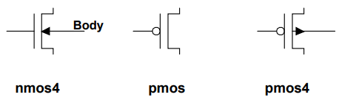
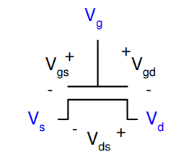
MOS Transistor with Zero Bias Voltages
symbols
Gate
Poly-Si
SiO₂
Source
Drain
n+
n+
n+
n+
ϴ ϴ ϴ ϴ ϴ ϴ
Id = ?
ϴ ϴ ϴ ϴ ϴ ϴ
p substrate
Ꚛ Ꚛ Ꚛ Ꚛ Ꚛ Ꚛ Ꚛ Ꚛ Ꚛ Ꚛ Ꚛ Ꚛ Ꚛ Ꚛ Ꚛ Ꚛ Ꚛ Ꚛ Ꚛ Ꚛ Ꚛ Ꚛ Ꚛ Ꚛ Ꚛ
Bulk or Substrate

Slide 4
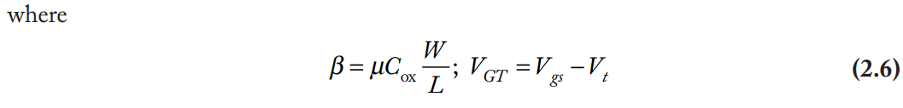
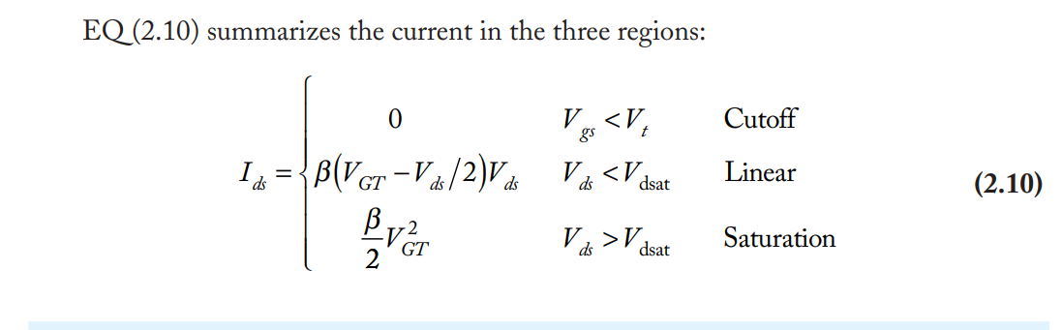
Shockley Model for CMOS Transistor

Slide 5
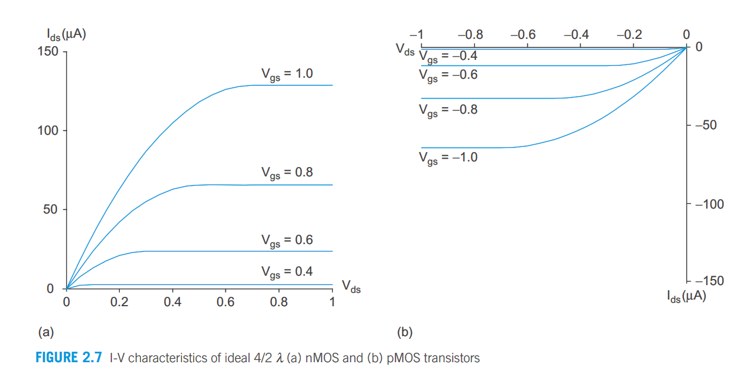
CMOS Output Characteristics

Slide 6
Detailed Device Models

Slide 7
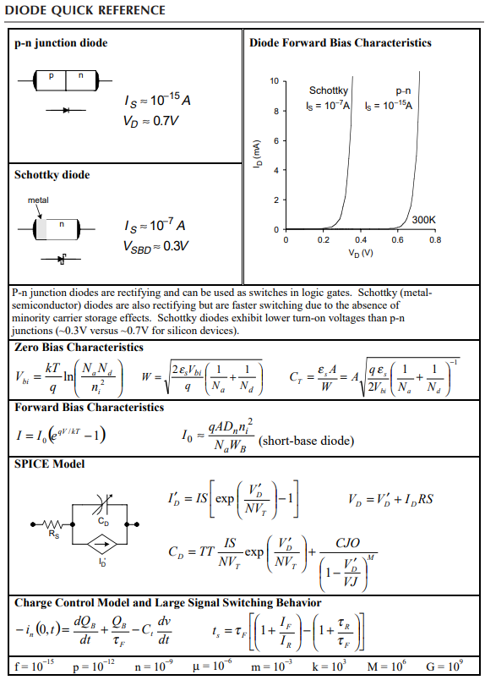
Diode at a glance

Slide 8
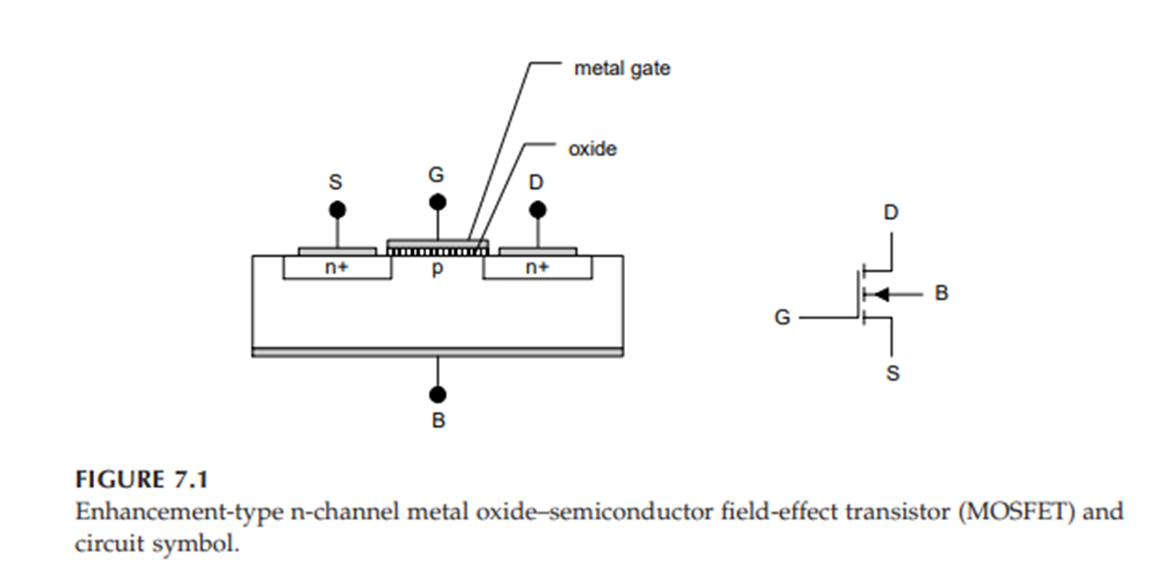
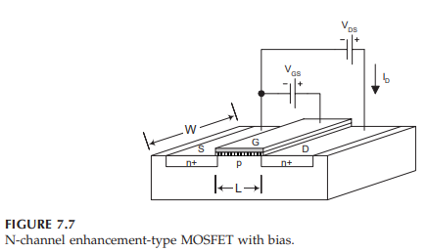
NMOS Transistor W and L and Biasing

Slide 9
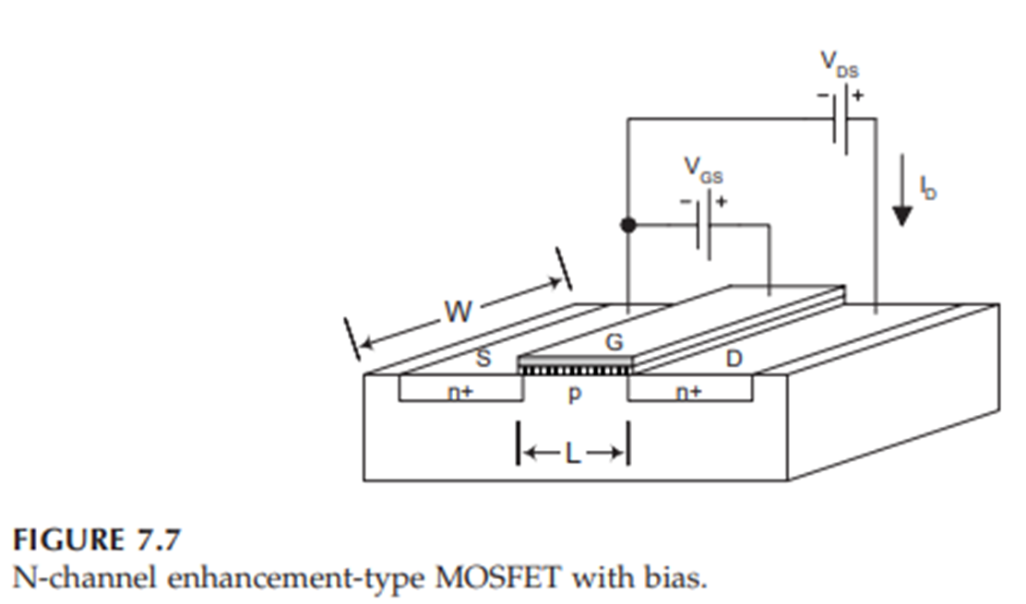
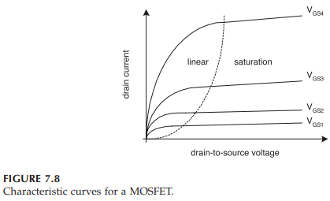
Characteristic curves of MOS

Slide 10
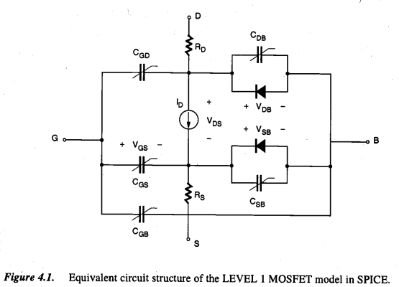
Spice Model of MOS transistor

Slide 11
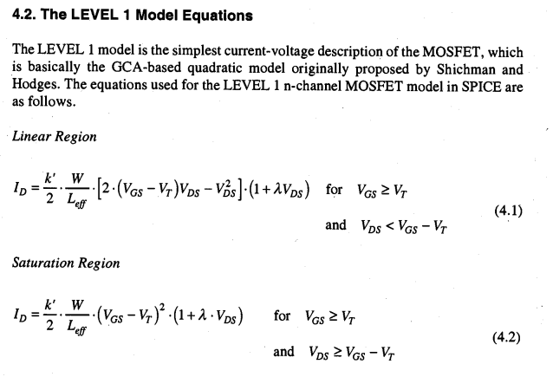
NMOS Model Equations – near to real behavior

Slide 12
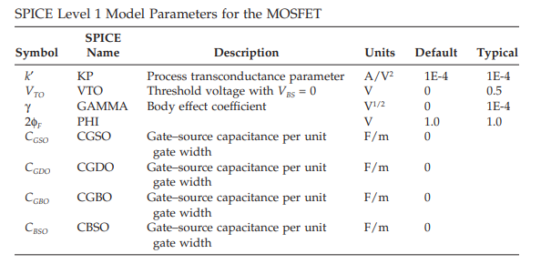
Some parameters of NMOS Level 1 model

Slide 13
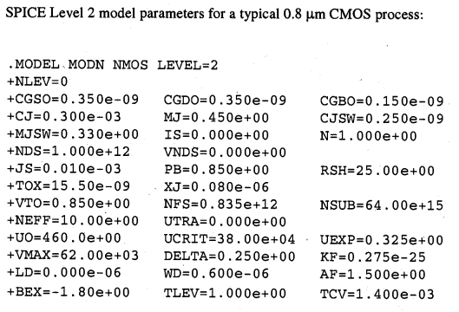
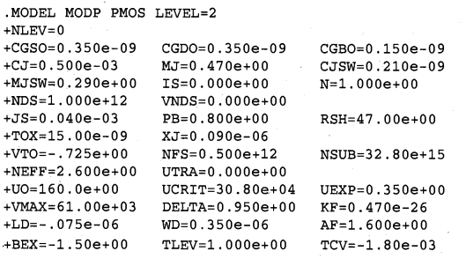




Some parameters of MOS Level 2 model

Slide 14
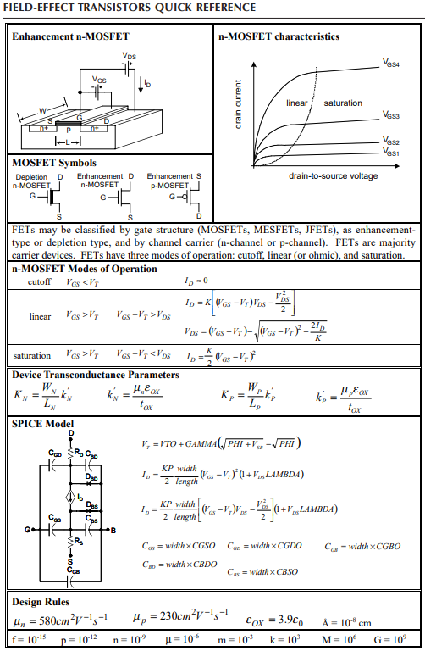
MOS reference

Slide 15
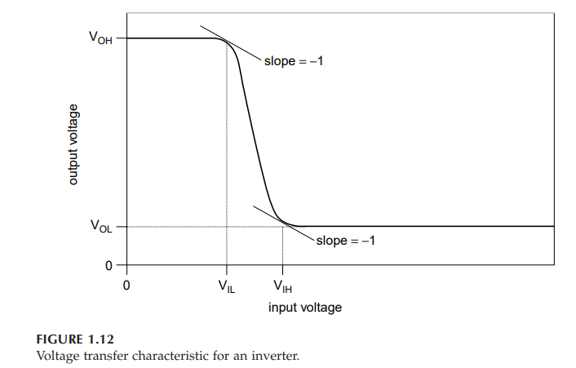
CMOS Inverter characteristics

Slide 16
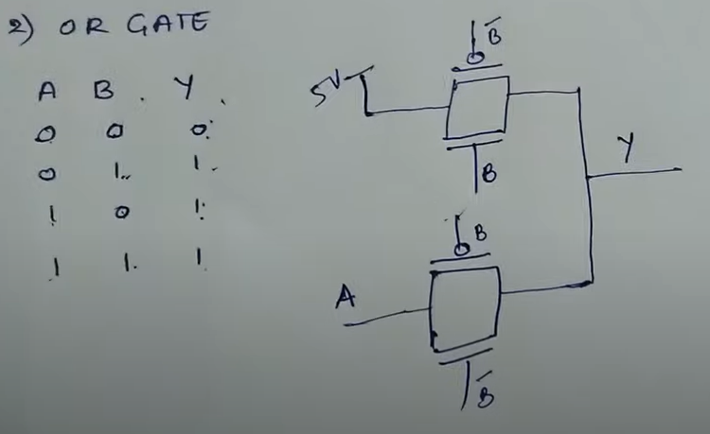
OR gate using transmission gate logic

Slide 17
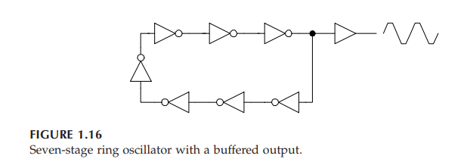
Make a CMOS Inv based Oscillator

Slide 18
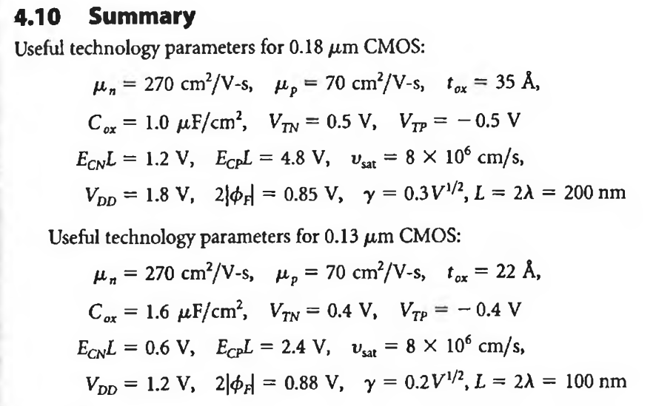
Important Parameters 0.18u

Slide 19
Getting Started with LTSpice

Slide 20
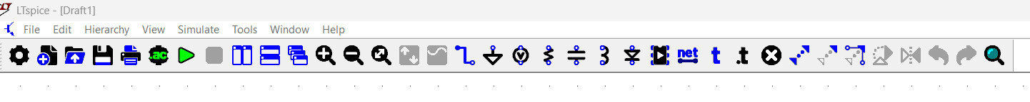
LTSpice Interface Startup Screen
Zoom and Pan
Windows tiling
Configure
Analysis
Draw wires and ground
Get different components
Labels, Directives,
Comments
Delete Something
Start new / open
Run
Simulation

Slide 21
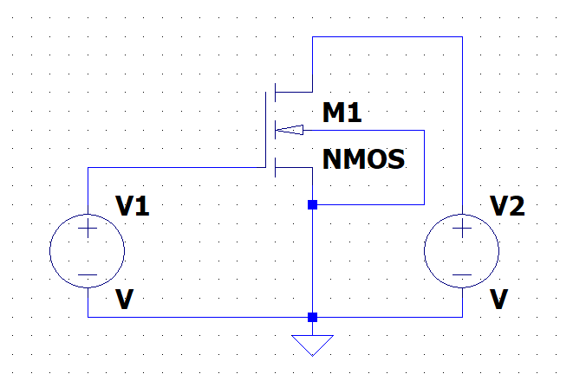
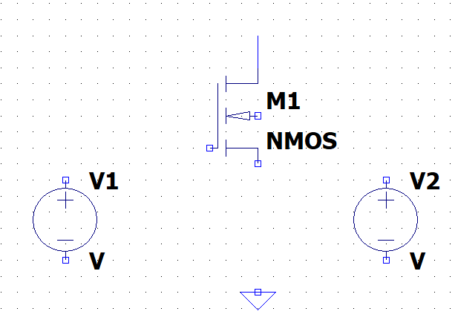
Make NMOS Circuit
We can find NMOS (3 Terminal) and NMOS4 (4 Terminal) in the Default Component Library

Slide 22
Before Analysis
Case 1: Default Component Library
Configure all voltage sources
Configure all devices e.g. transistors

Slide 23
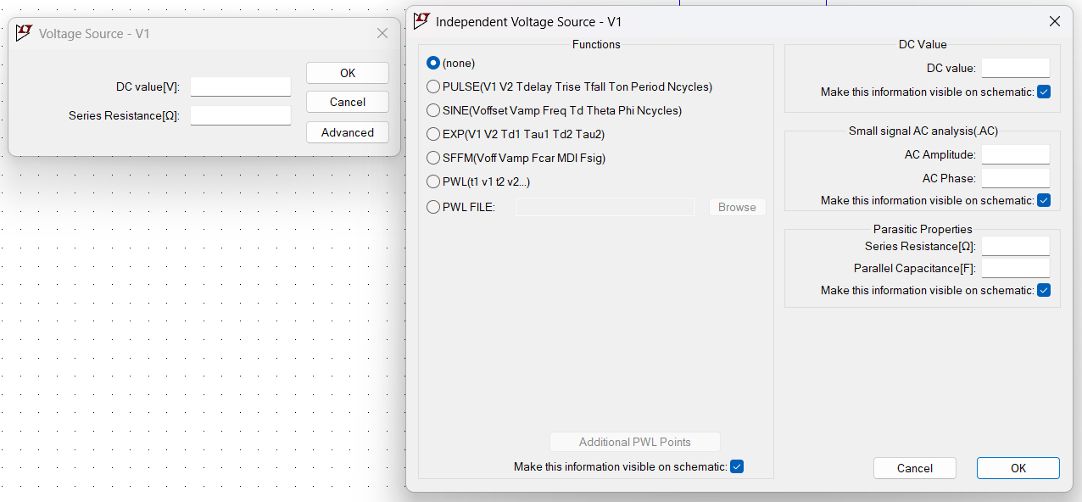
Right Click on Voltage Source → Advanced

Slide 24
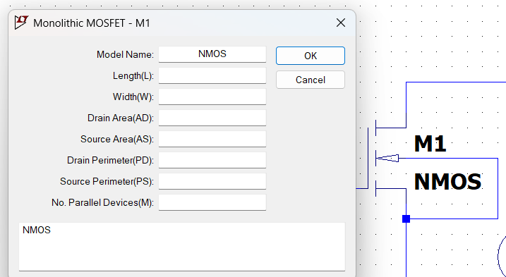
Right Click on NMOS Transistor to Configure
Change “M1” label by Right Click
Change “NMOS” label by Right Click

Slide 25
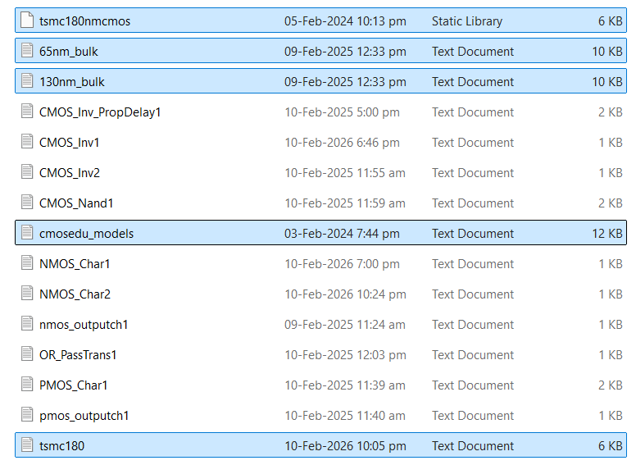
Adding Device Models for VLSI
Model files Highlighted text files in folder
Make a working folder on Desktop
Put model files in this folder
You can configure paths and colours in
Tools → Settings
Some model file needs to be included
In the Spice Deck

Slide 26
How do Device Model files look like
Examine cmosedu_models.txt file
We find following models:
.MODEL N_1u NMOS LEVEL = 3
.MODEL P_1u PMOS LEVEL = 3
.model N_50n nmos level = 54
.model P_50n pmos level = 54
Examine tsmc180.txt file
We find following models:
.MODEL NMOS NMOS (LEVEL = 49
.MODEL PMOS PMOS (LEVEL = 49
.model N_50n nmos level = 54
.model P_50n pmos level = 54
Examine other model files:
tsmcnmcmos.lib
130nm_bulk.txt
…..
So on

Slide 27
How to add in LTSpice and Do Basic Simulations
Use Spice Directive
.inc cmosedu_models.txt
FOR Transistor Characteristics
We need to SWEEP VDS and VGS and get NMOS operating curves
Use either these Spice Directives:
Approach 1: Give DC Sweep to both voltages
.dc VDS 0 2.5 0.1 VGS 0 2.5 0.25
Approach 2: Give a variable name {VGIN} to VGS, use .STEP and .dc
.dc VDS 0 1.8 0.1
.STEP PARAM VGIN 0.0 1.8 0.2

Slide 28
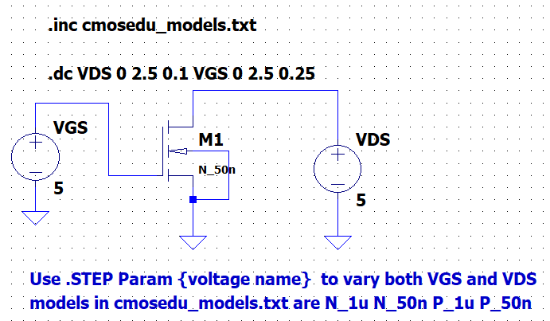
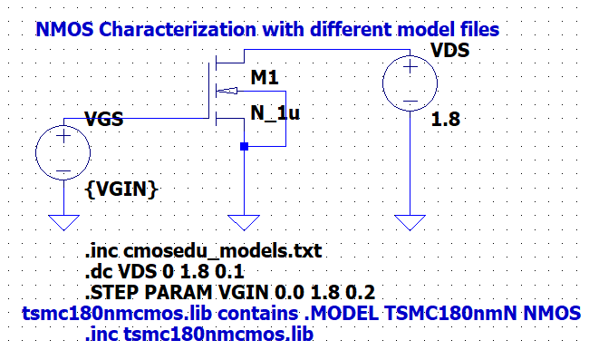
Examples of Sweeping Voltages
Blue text is ‘Comment’

Slide 29

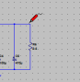
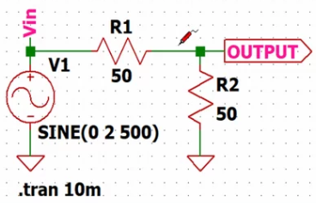
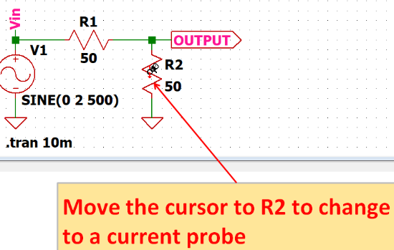
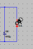
How to Simulate and View Waveforms
Press Green Triangle to ‘RUN’ simulation
A blank window will appear over the circuit
Bring cursor over a wire or a source
Either voltage probe or current probe will show
Pressing mouse will select that value for display

Slide 30
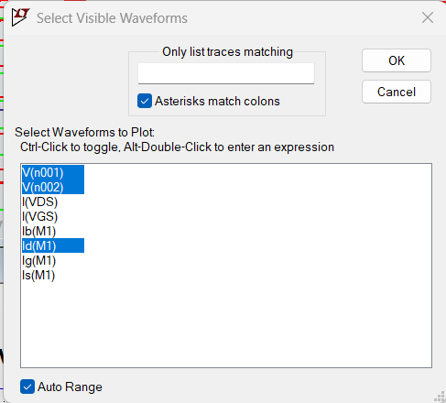
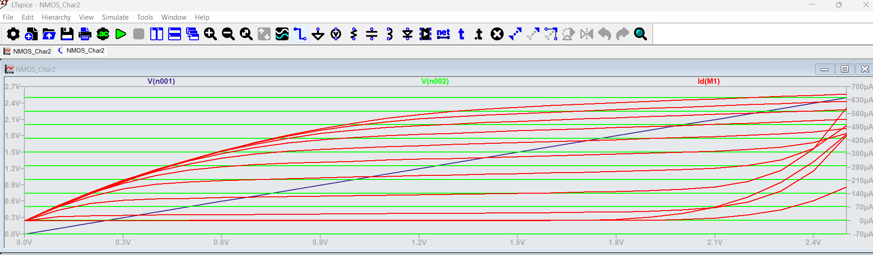
Waveform Display – As selected by Probes
Use View → Visible Traces
Select the Waveforms that you want to Display

Slide 31
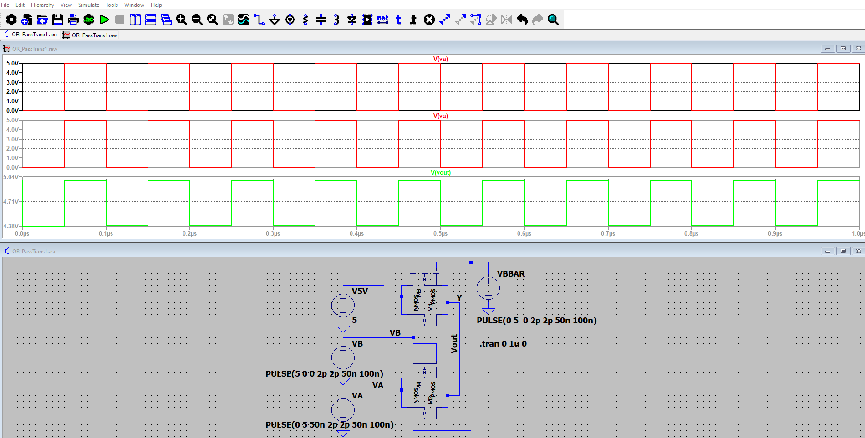
View Plots in Separate Window Panes
After Running Simulation:
Right Click on Waveform Window
There is option to Add new pane
First click on new pane and then
Add wave through probe on circuit

Slide 32
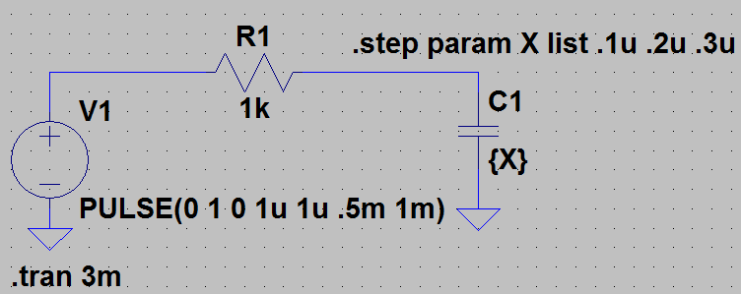
Different Values can be Stepped using .STEP

Slide 33
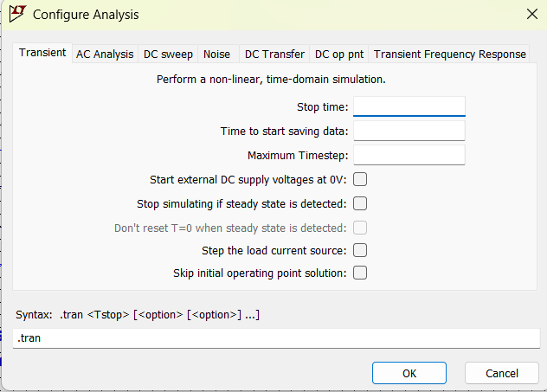
Different types of Circuit Analysis
https://www.allaboutcircuits.com/technical-articles/how-to-perform-transient-analysis-noise-simulation-LTspice/
https://www.cxi1.co.uk/ltspice/transient.htm
https://www.allaboutcircuits.com/technical-articles/intermediate-ltspice-tutorial/
https://www.allaboutcircuits.com/technical-articles/basic-circuit-simulation-with-ltspice/
LTspice XVII Tutorial | Spiceman

Slide 34
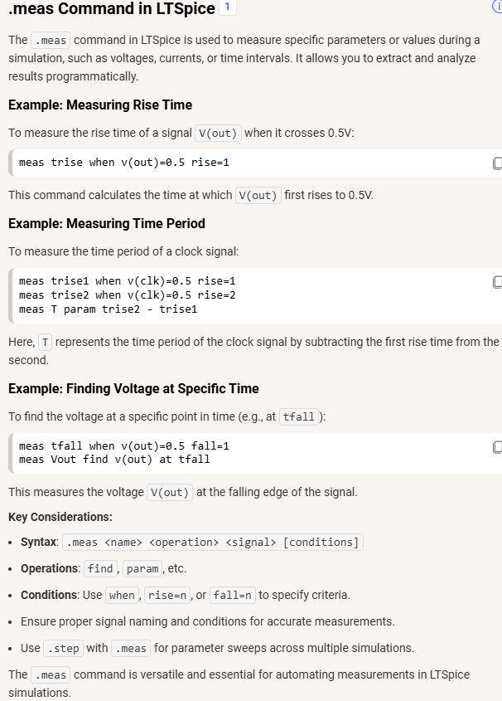
.meas statement for waveforms
.measure/.meas : LTspice -- Evaluate User-Defined Electrical Quantities | Spiceman

Slide 35
Reading and Book
Textbook Chapter

