Slide 1
VLSI Design EE 523
Spring 2026
Shahid Masud
Lecture 4

Slide 2
Topics for lecture 4
Simple working models for NMOS and PMOS as switch
Pass Transistor Logic using simple CMOS models
  Difference between restoring and non restoring logic
  Pass transistor characteristics, Vtn and |Vtp|
Making 2:1 MUX using pass transistor logic
Design of a CMOS Tri-state inverter
Make a D-Latch using pass transistor logic
Introducing MOS transistor theory – applying voltages at gate, drain, source and bulk terminals and observe different effects and regions
Study different logic designs made from Pass transistors and Transmission gates
Quiz Next week

Slide 3
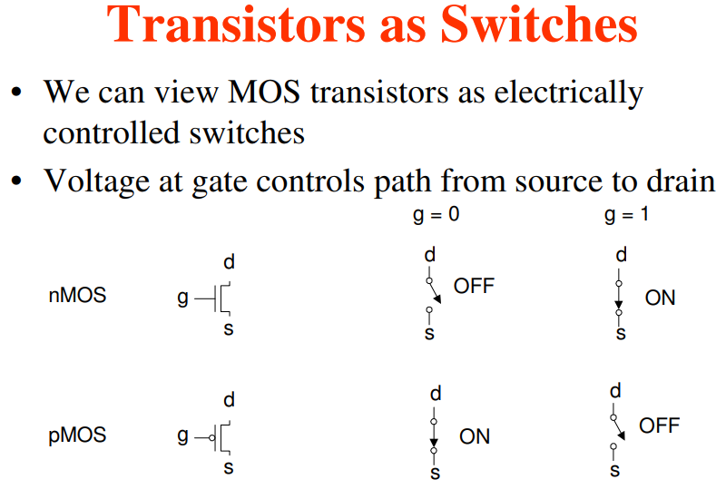
Basic Switching Operation of MOSFET
What is CMOS?
vs
NMOS or PMOS

Slide 4
Weak and Strong Switches
nMOS transistors are great at passing a strong 0 but not so good at passing a 1, which becomes weak.
On the other hand, pMOS transistors are good at passing a strong 1 but pass a weak 0.
When you combine nMOS and pMOS transistors in parallel, you get a transmission gate. This gate can pass both 0s and 1s effectively, making it a better switch for signals.

Slide 5
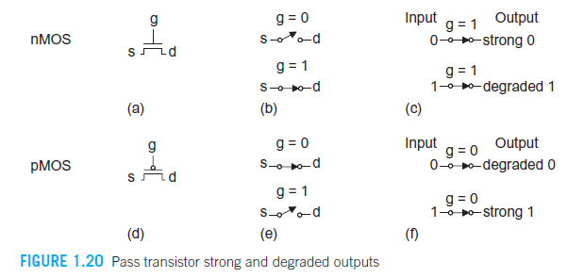
Strong 1 and Weak 1

Slide 6
Signal Strength in CMOS technology
NMOS Transistors
nMOS devices are great for pulling a signal low. When you apply a high voltage to the gate of an nMOS transistor, it allows current to flow from the drain to the source, effectively grounding the output and driving the signal towards 0V (logic LOW). This makes nMOS transistors strong pull-down devices. However, when you try to use nMOS to pass a HIGH signal, it tends to degrade slightly due to the threshold voltage drop, which is why the output might not reach the full supply voltage.
PMOS Transistors
pMOS transistors, on the other hand, are excellent at pulling a signal high. When you apply a low voltage to the gate, it creates a conductive path for current to flow from the source to the drain, driving the output to the supply voltage (logic HIGH). This makes pMOS transistors strong pull-up devices. However, similar to nMOS, pMOS transistors are weaker at passing a LOW signal, as there can be a slight voltage drop.
Signal Strength in CMOS Logic
When we combine nMOS and pMOS in complementary pairs, as we do in CMOS technology, you get the best of both worlds. The nMOS transistor handles the pull-down operation efficiently, and the pMOS transistor handles the pull-up operation. This ensures strong signal levels for both HIGH and LOW states without significant degradation, which is why CMOS circuits are so reliable and widely used.

Slide 7
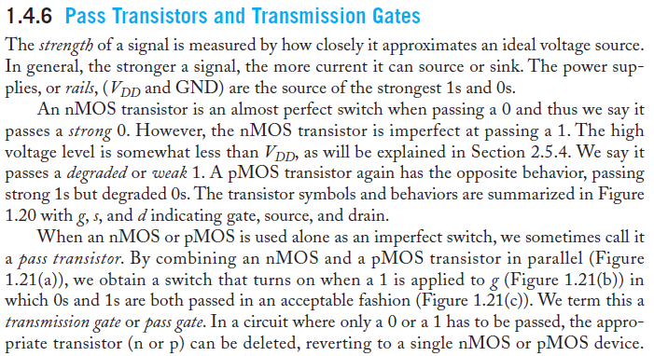





Pass Transistor Switches using NMOS and PMOS
From textbook

Slide 8
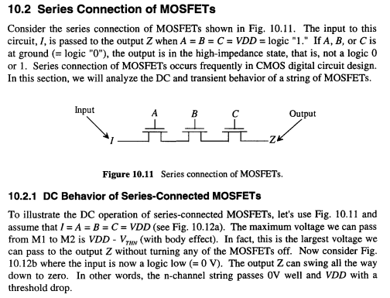


Series Connected MOSFET Switches

Slide 9
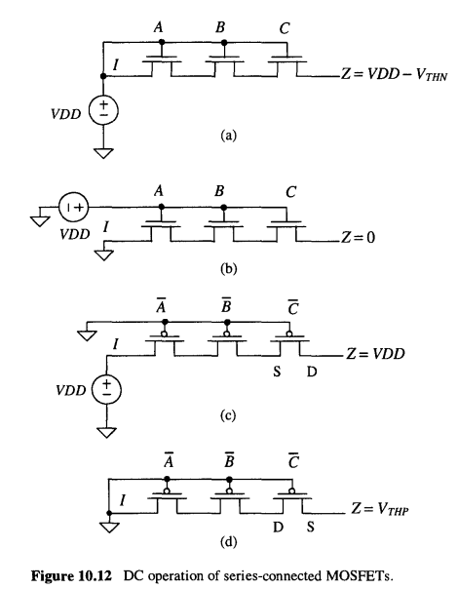


Some Examples of Pass-Transistor Logic

Slide 10
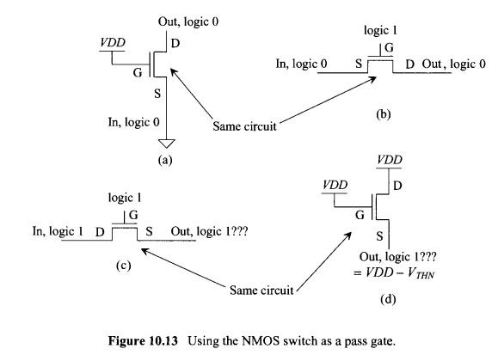
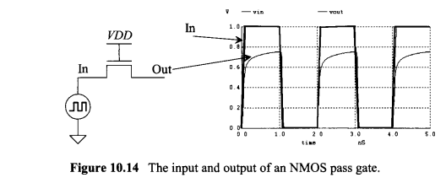
Switch Behaviour of MOSFET

Slide 11
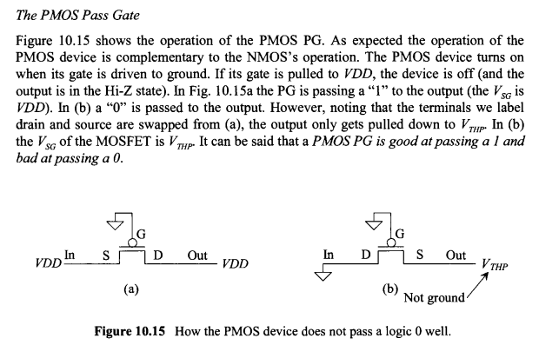
The Pass Transistor Gate

Slide 12
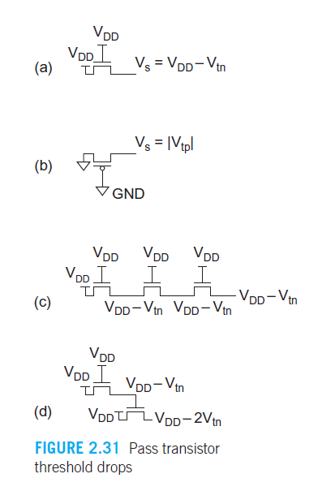
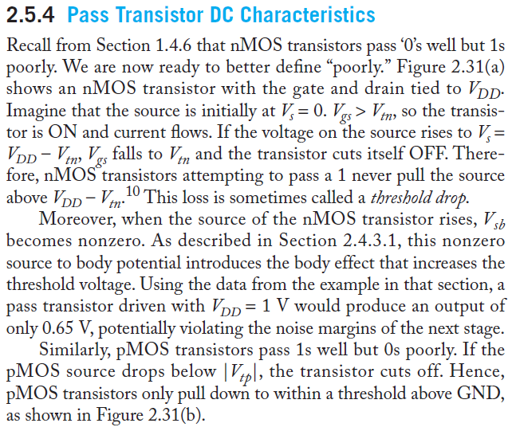

NMOS Threshold drop in Pass Transistor
Discuss later
too

Slide 13
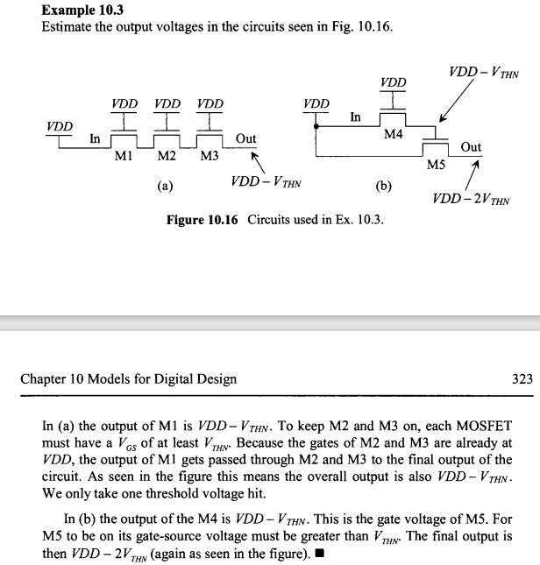
NMOS vs PMOS as Switch

Slide 14
Strong 1 and Weak 1

Slide 15
Logic Circuits made from CMOS Switches

Slide 16
Examples of Simple CMOS Gates

Slide 17
Reading and Book
Textbook can be downloaded online “CMOS VLSI Design by Weste and Harris, 4th Edition”
Readings from Chapter 1, starting portion of Chapter 2
For quiz, prepare from chapter 1 and lecture notes

