Slide 1
VLSI Design EE 523
Spring 2026
Shahid Masud
Lecture 3

Slide 2
Topics for lecture 3
Some solved examples from Lecture 2
Simple working models for NMOS and PMOS transistors as switches
Making logic gates from simple CMOS models
  Inverter
  Nand
  Nor
  AND-NOR combined gate
Pass Transistor Logic using simple CMOS models
  Non-restoring and Restoring switches
Reading from Weste and Harris ‘CMOS VLSI Design’ textbook: Chapter 1

Slide 3
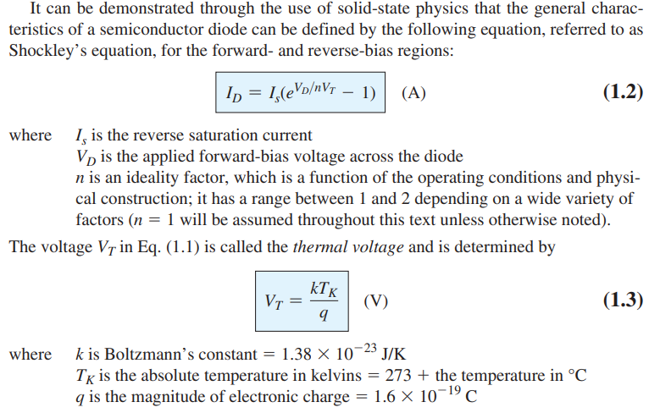
Basic Diode Shockley Equations

Slide 4
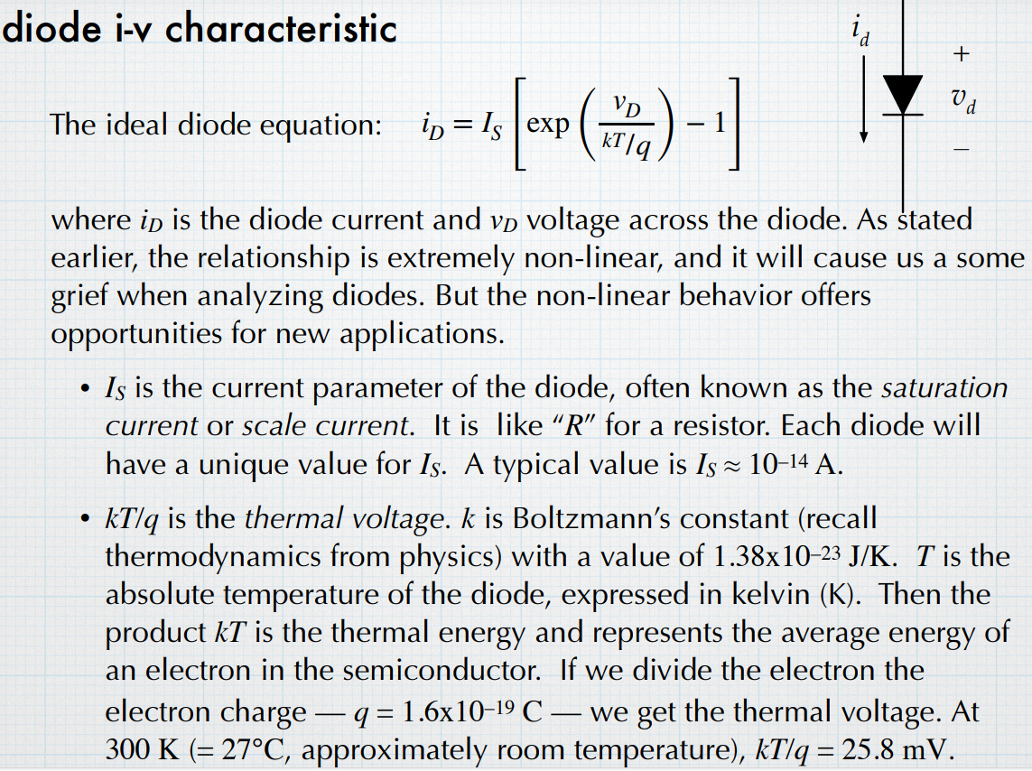
Diode i-v characteristics

Slide 5
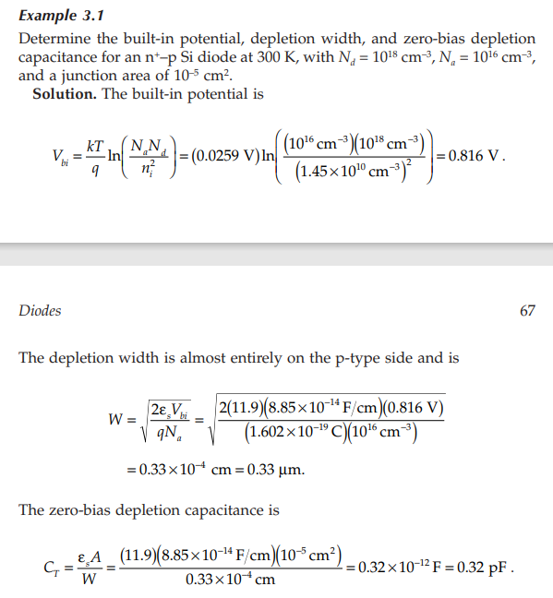
Diode Calculations

Slide 6
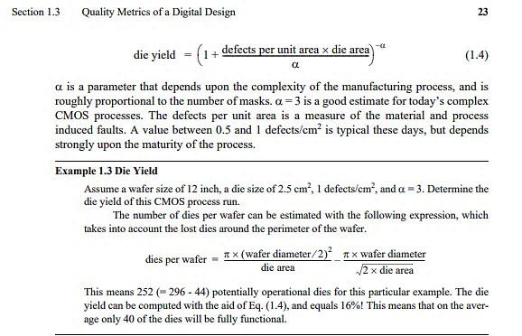
Die Yield

Slide 7
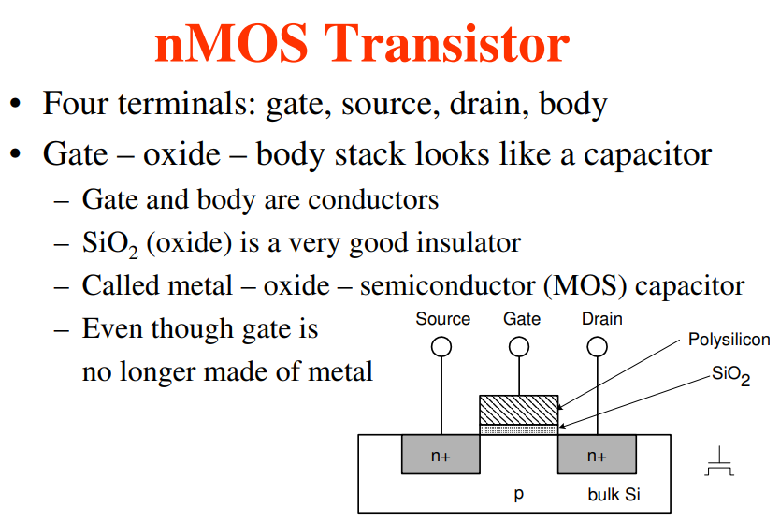
MOSFET Fabrication

Slide 8
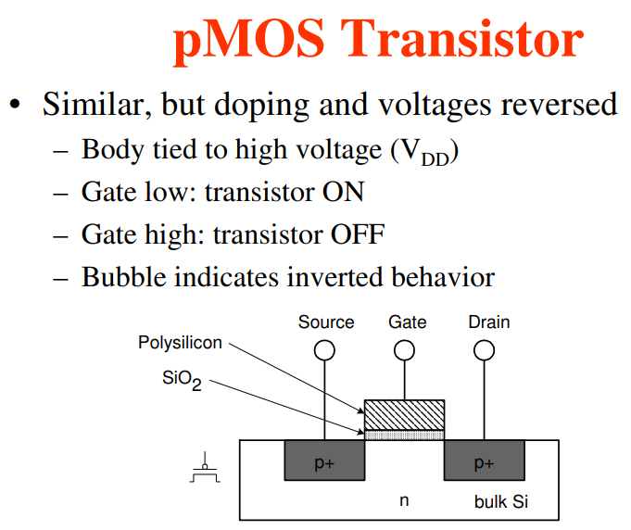
PMOS Transistor Fabrication

Slide 9
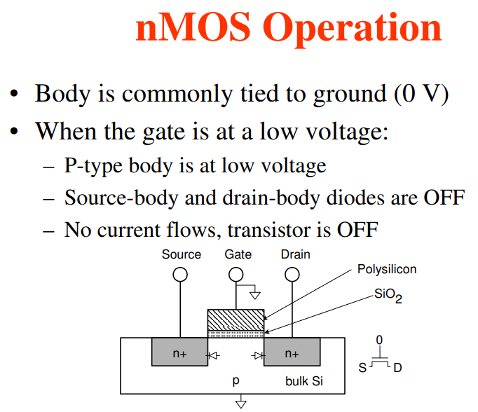
Basic NMOSFET with no Bias

Slide 10
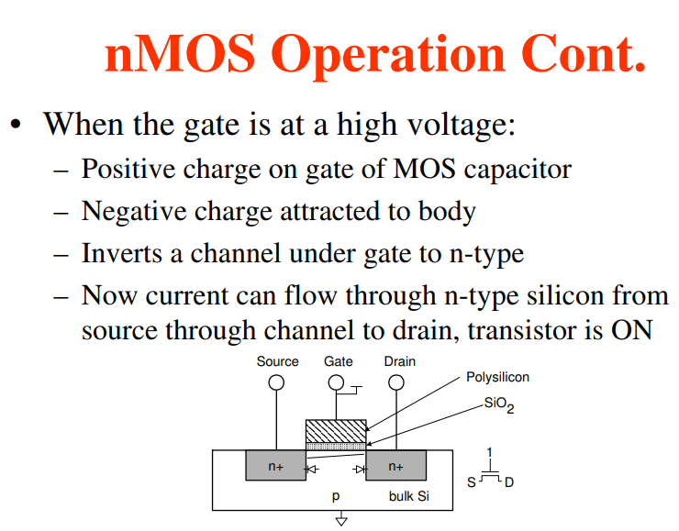
NMOS with Bias

Slide 11
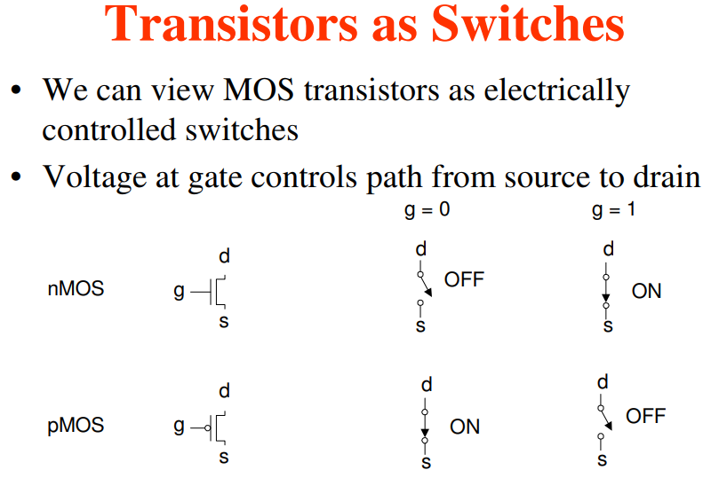
Basic Switching Operation of MOSFET
What is CMOS?
vs
NMOS or PMOS

Slide 12
Logic Circuits made from CMOS Switches

Slide 13
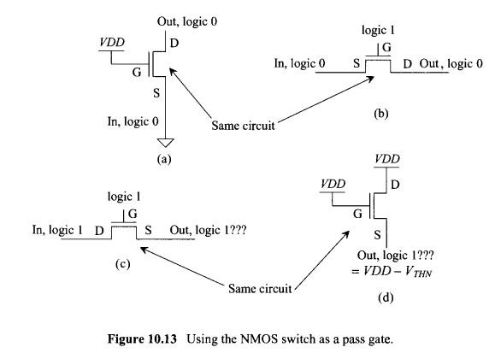
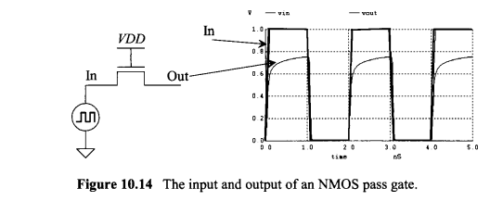
Switch Behaviour of MOSFET

Slide 14
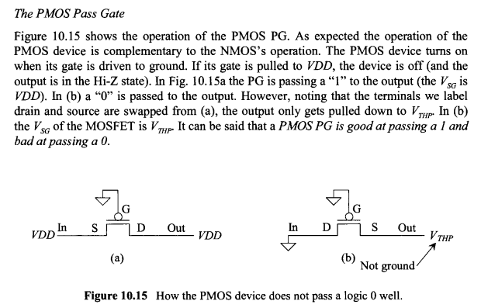
The Pass Transistor Gate

Slide 15
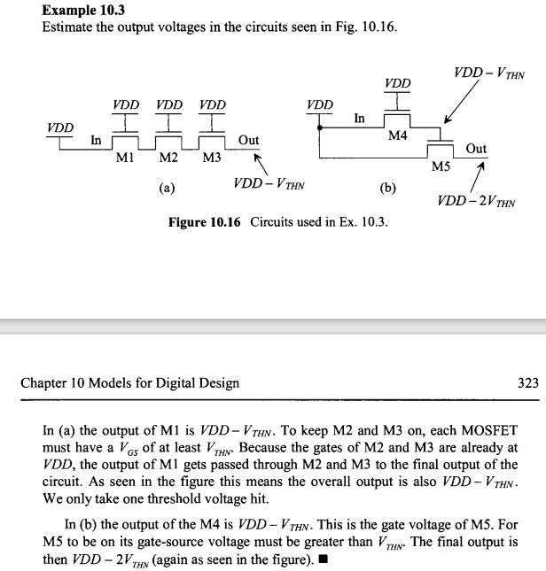
NMOS vs PMOS as Switch

Slide 16
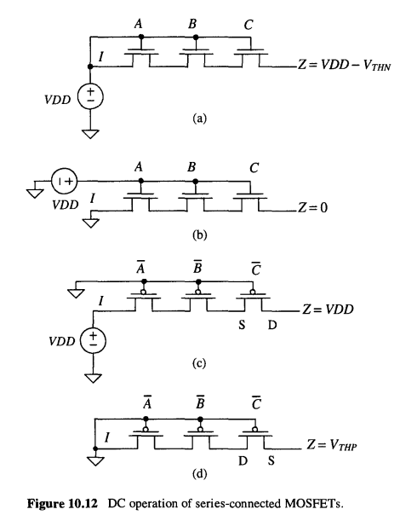
Some Examples of Pass-Transistor Logic

Slide 17
Readings
Chapter 1
Textbook 3rd Edition, CMOS VLSI Design A Circuits and Systems Perspective, Weste and Harris

