Slide 1
VLSI Design EE 523
Spring 2025
Shahid Masud
Lecture 12

Slide 2
Topics for lecture 12
RC model of CMOS gates
Elmore Delay Model
Calculate tpdr and tpdh of unit inverter
Calculate tpdr and tpdh of Nand gate using Elmore
Introduce Logical Effort LE
How does W and L of CMOS transistors effect timing
Quiz 2 was held

Slide 3
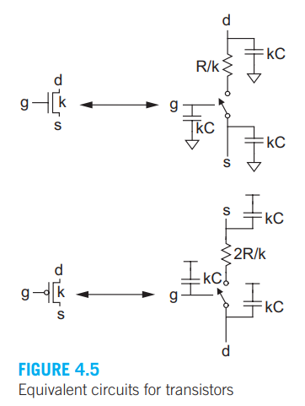
RC Equivalent Circuits for MOSFET

Slide 4
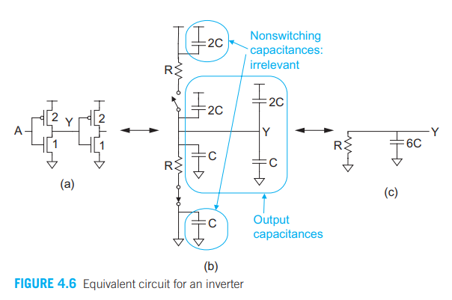
RC Model of Inverter

Slide 5
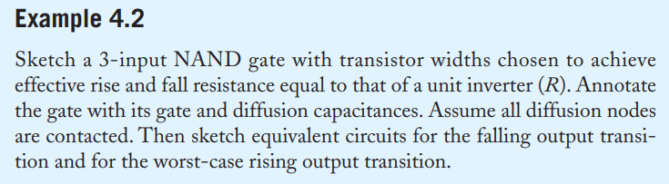
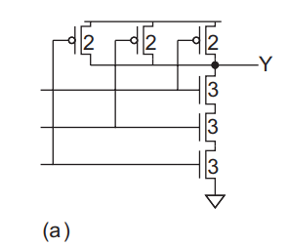
Annotating Sizes of MOSFETs
Look at Sizes of NMOS and PMOS

Slide 6
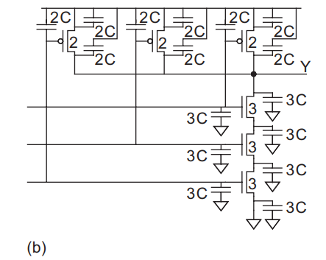
From Sizes to Distributed Capacitances

Slide 7
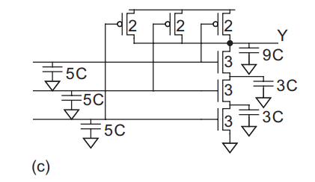
Distributed Capacitance to Lumped Capacitance

Slide 8
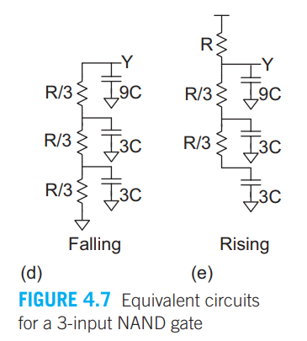
Lumped Capacitance to RC Model

Slide 9
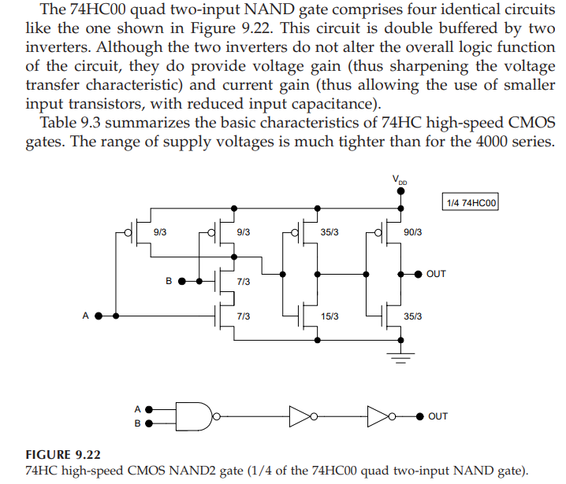
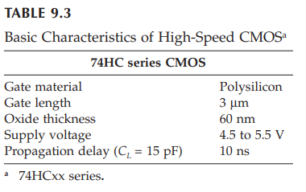
Real-world 74HC00

Slide 10
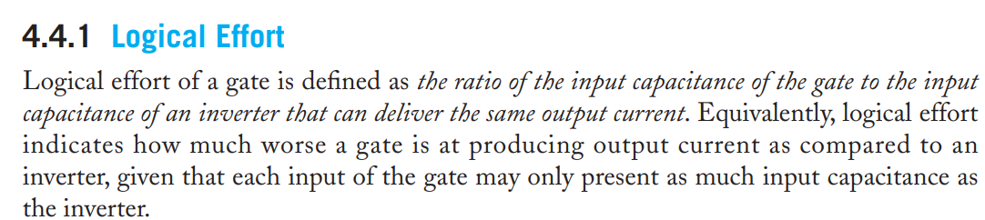
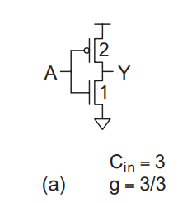
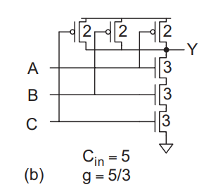
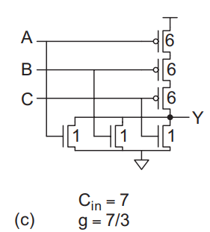
Logical Effert - Definition

Slide 11
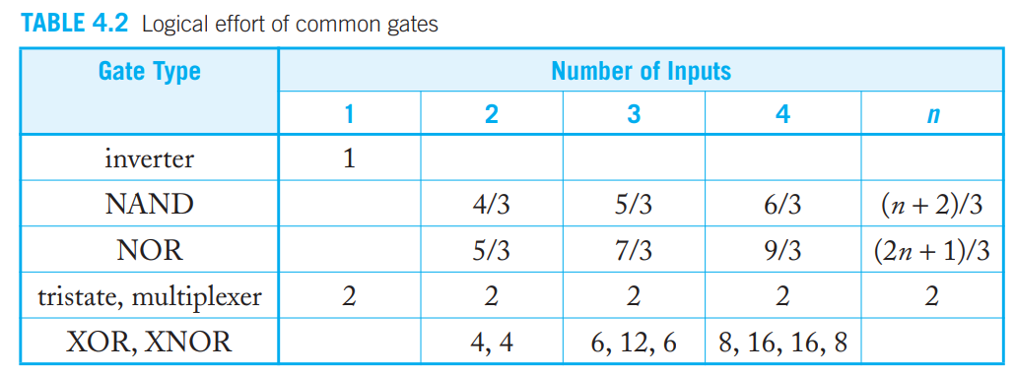
Logical Effort of Common Gates

Slide 12
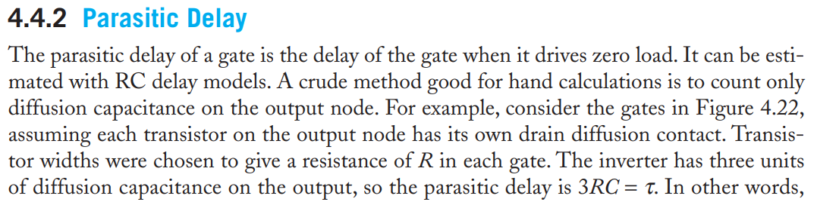
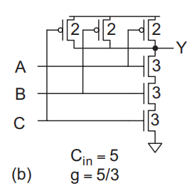
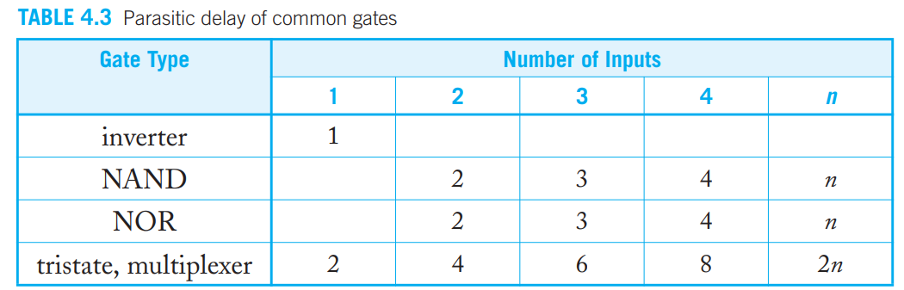
Parasitic Delay

Slide 13
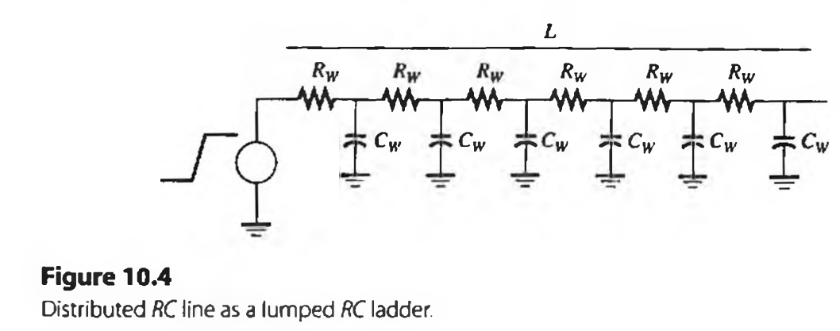
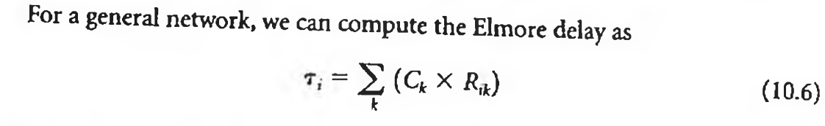
Elmore Delay (no branches)

Slide 14
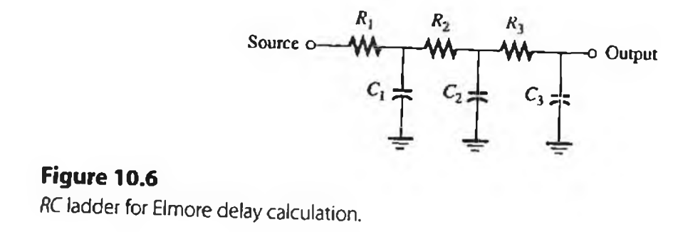
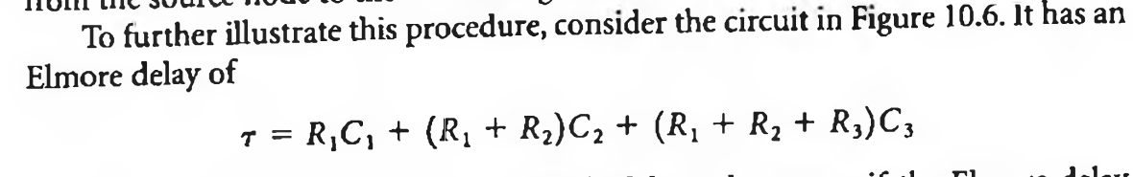
Elmore Delay example

Slide 15
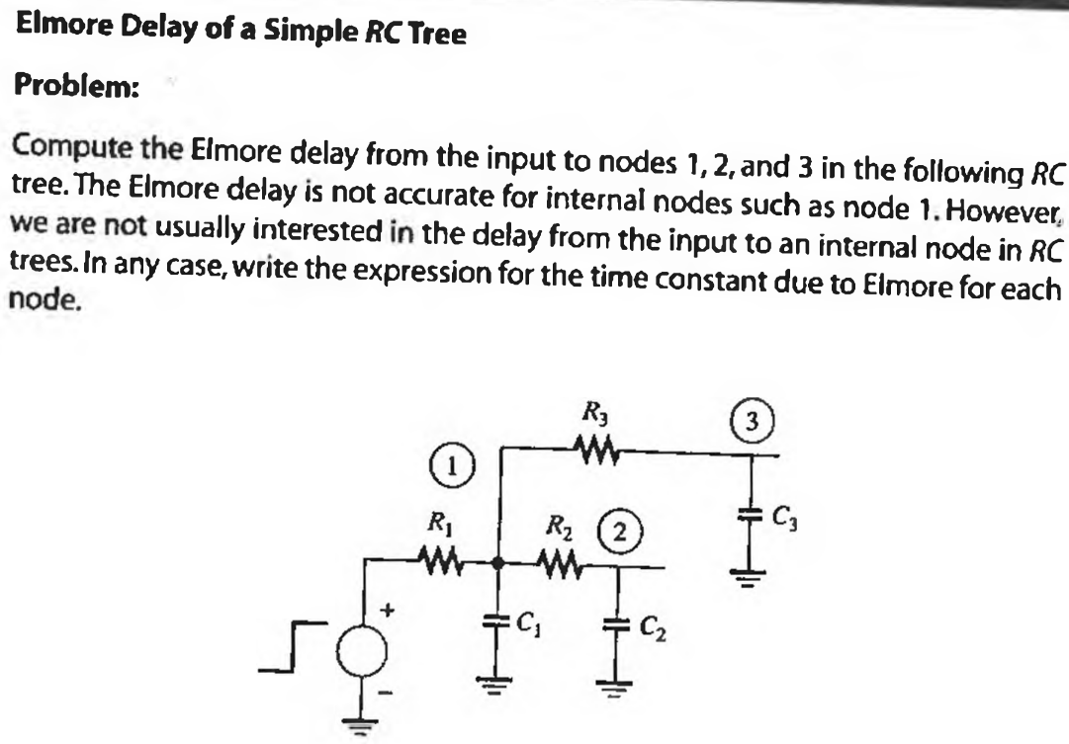
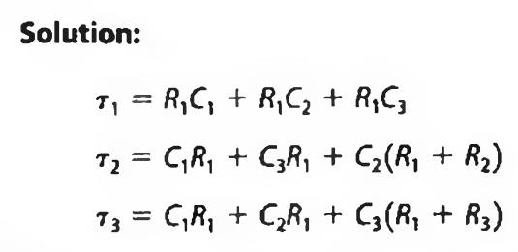
Elmore Delay with Branches

Slide 16
Reading and Book
Textbook can be downloaded online “CMOS VLSI Design by Weste and Harris, 4th Edition”
Readings from Chapter 4

