Slide 1
VLSI Design EE 523
Spring 2025
Shahid Masud
Lecture 19

Slide 2
Topics for lecture 19
Solve Examples from Last Lecture
Interconnect Modelling and examples
How to deal with Coupling effects?
---------------------
Combinational Circuit Design Styles
  Pseudo NMOS
  Cascode / Differential Circuits
Quiz After Eid Break
Lab in Week 12

Slide 3
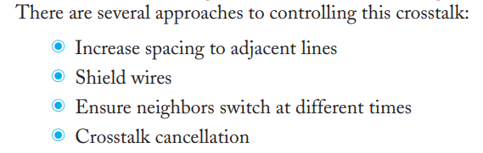
Reducing Crosstalk

Slide 4
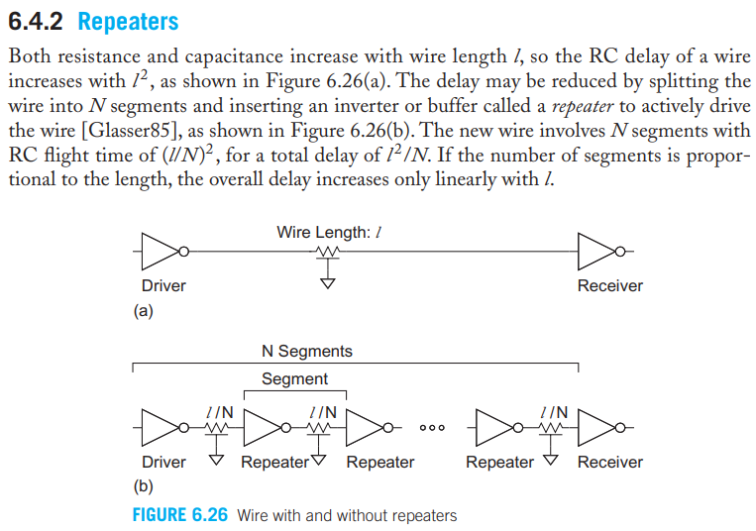
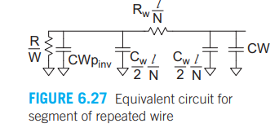
Concept of Repeaters

Slide 5

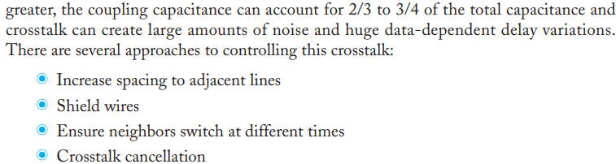
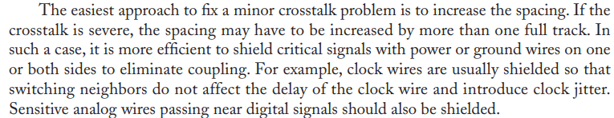
Crosstalk Control

Slide 6
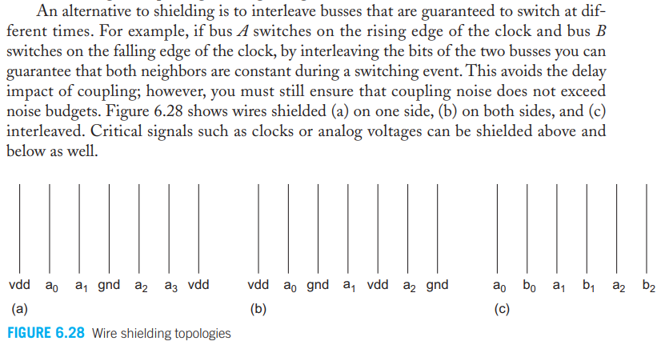
Shielding Topologies

Slide 7
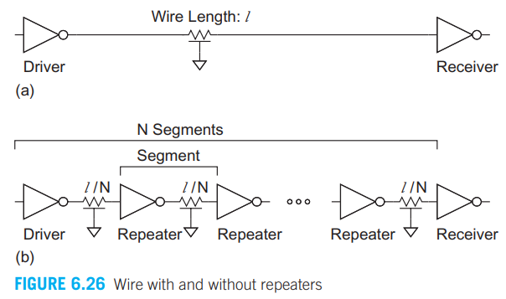
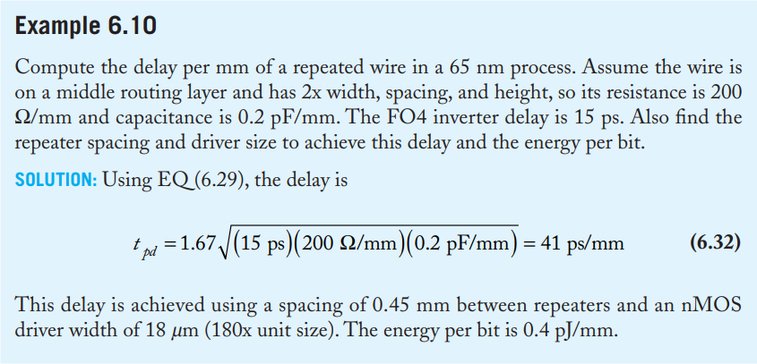
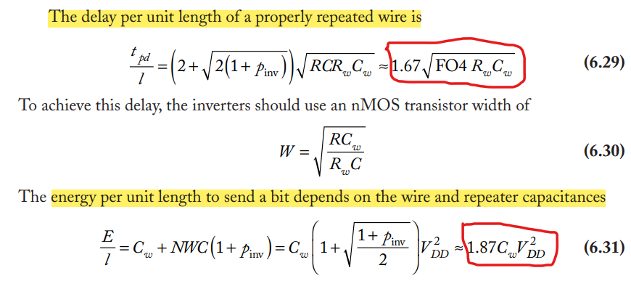
Repeaters Example

Slide 8
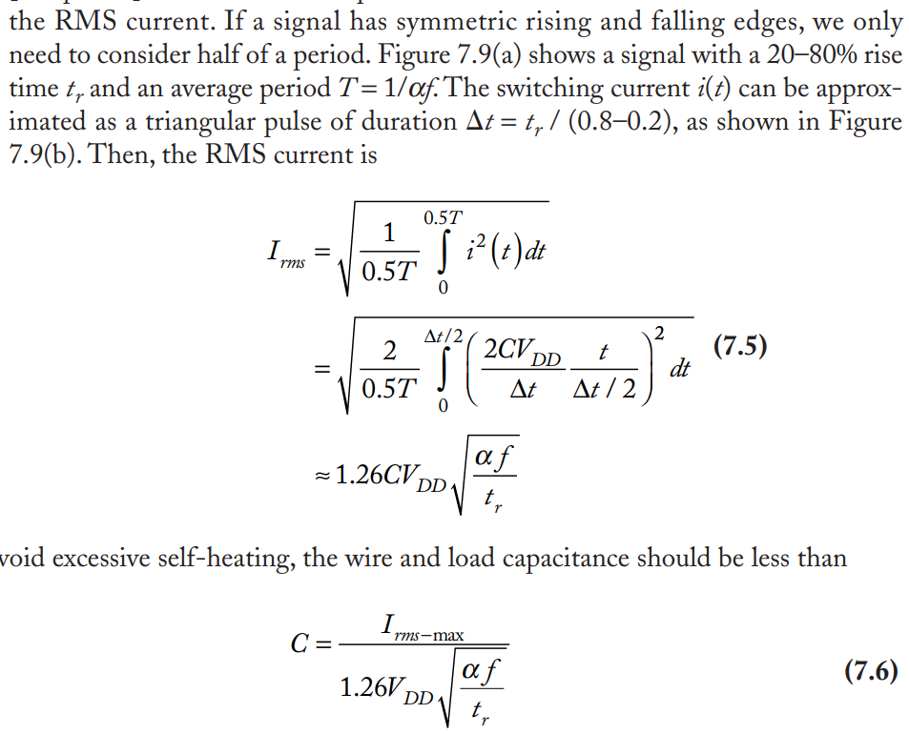
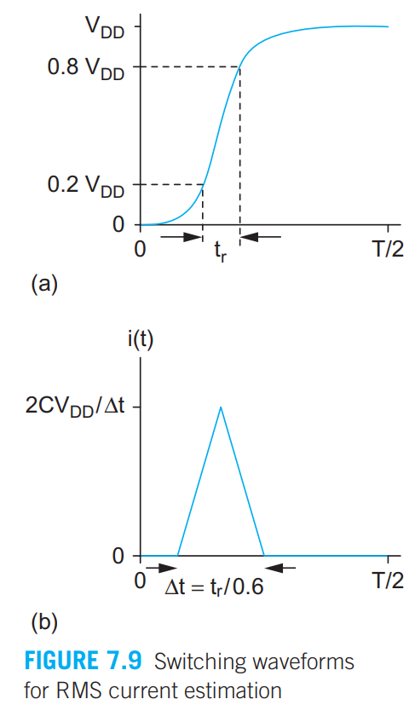
RMS Current Estimation

Slide 9
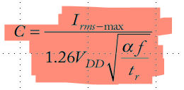
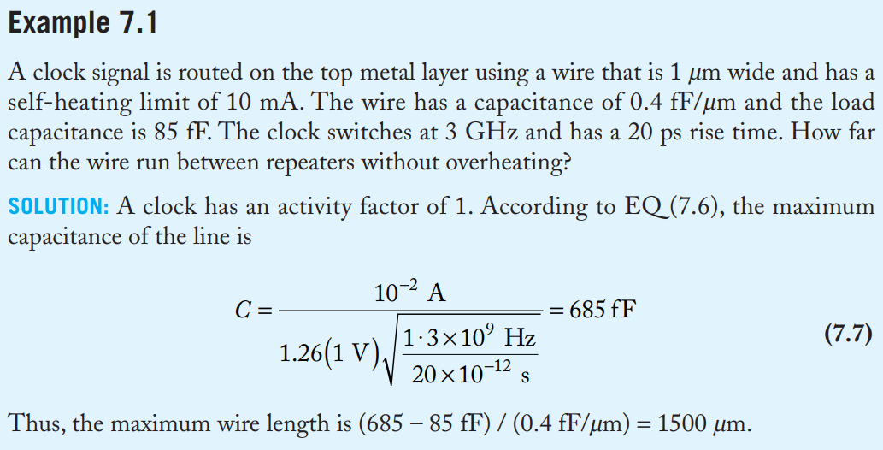
Example of Self Heating Calculation

Slide 10
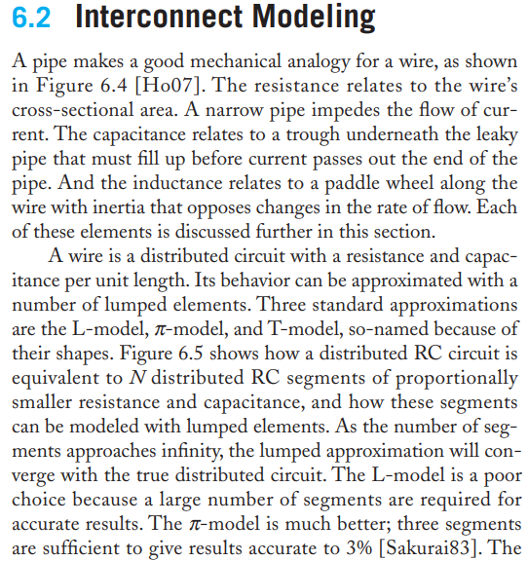
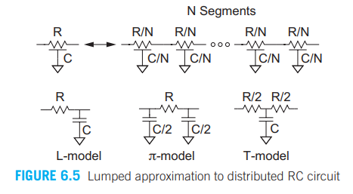
Interconnect Modelling

Slide 11
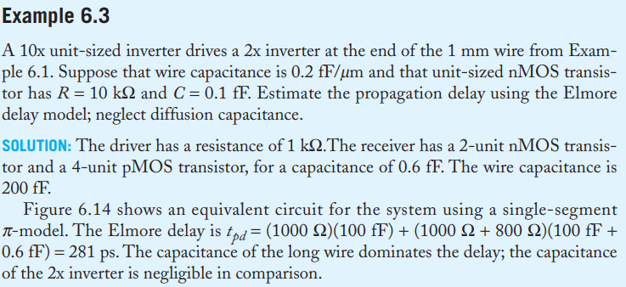
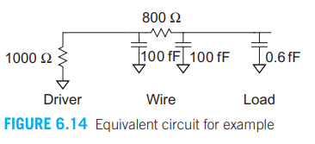
Example of Pi Model

Slide 12
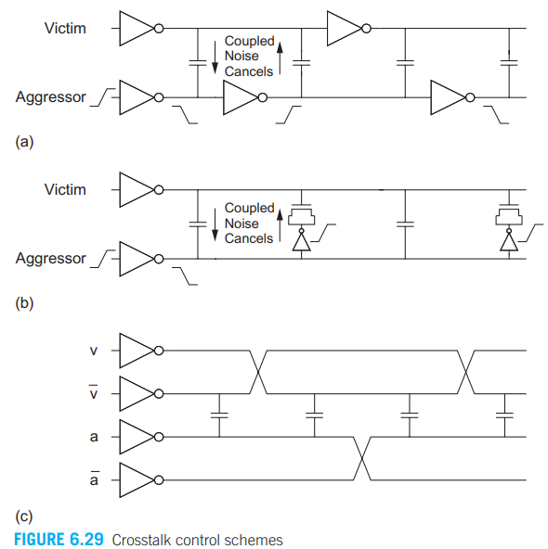
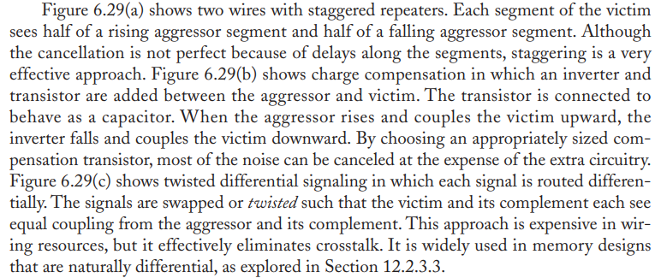
Active Techniques for Crosstalk Control

Slide 13
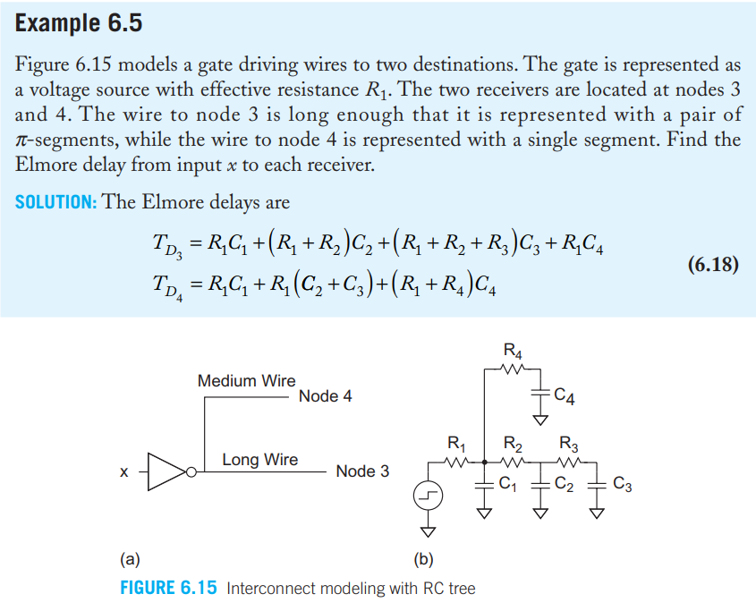
Interconnect E.g.

Slide 14
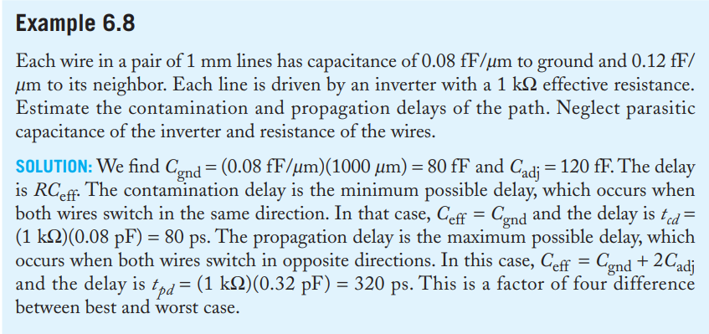
Interconnect Example 2

Slide 15
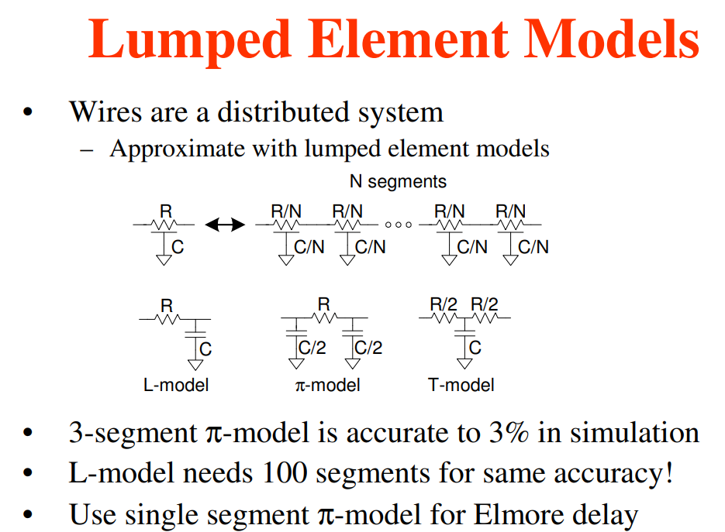
Examples of Pi Model

Slide 16
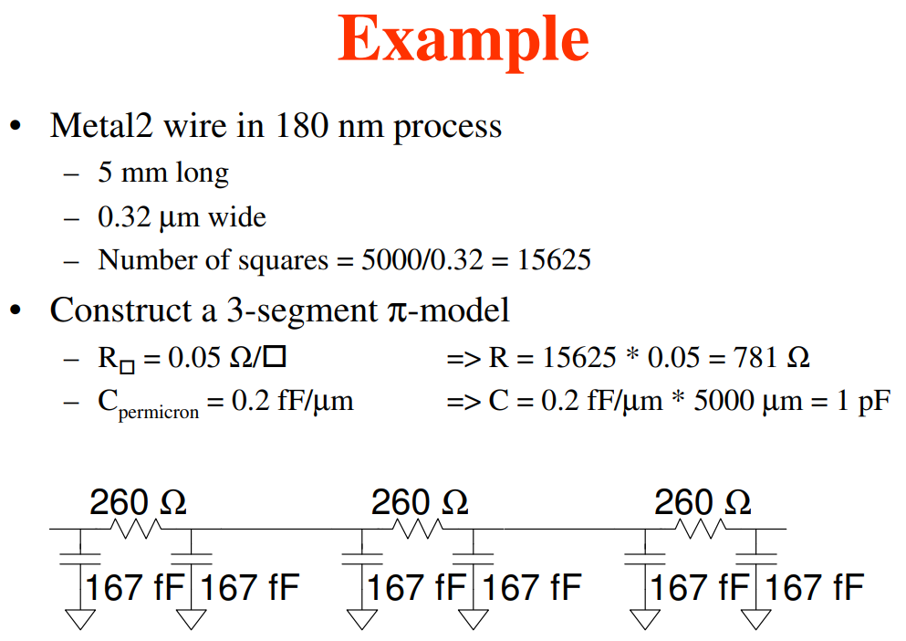
Example of making a Pi Model

Slide 17
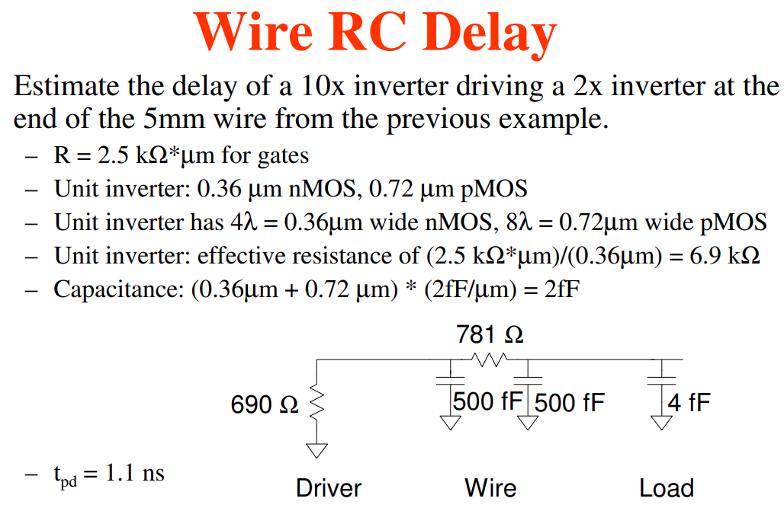
Example of Wire RC Delay

Slide 18
Interconnect E.g.

Slide 19
Interconnect Capacitance Coupling Example 2

Slide 20
Combinational Gates Design
From Chapter 9 of textbook

Slide 21
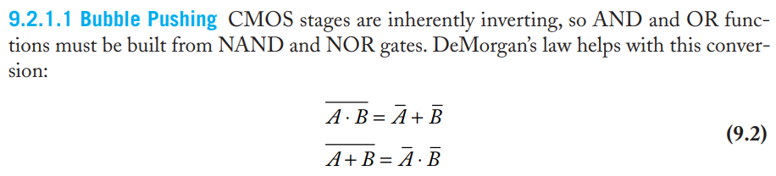
Bubble Pushing
Start with network of AND / OR gates
Convert to NAND / NOR + inverters
Push bubbles around to simplify logic
  Remember DeMorgan’s Law

Slide 22
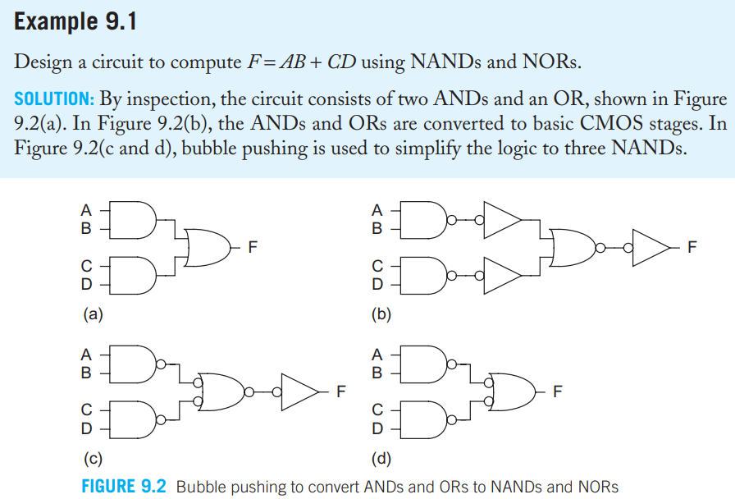
Example – Bubble Pushing Simplification

Slide 23
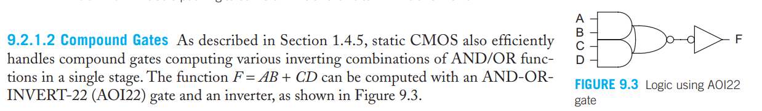
AOI Compound Gates

Slide 24
Compound Gates, LE and Parasitic
Logical Effort of compound gates

Slide 25
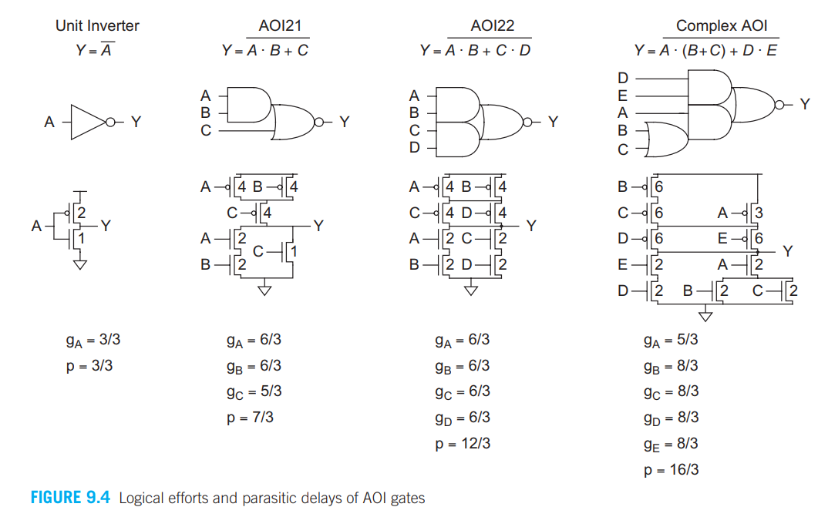
Logical Effort and Parasitic Delay of AOI

Slide 26
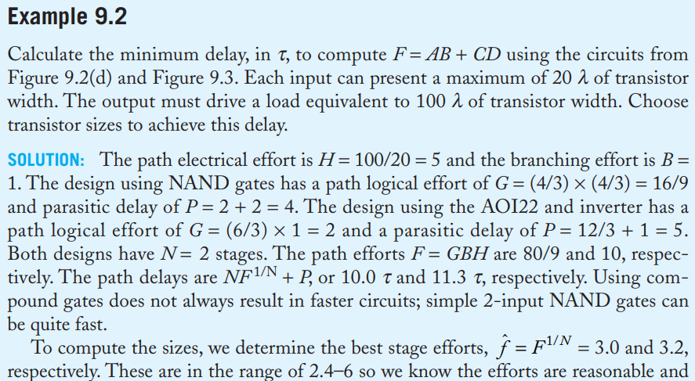
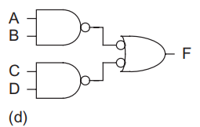
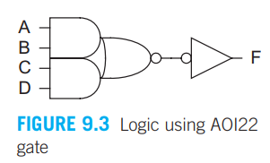
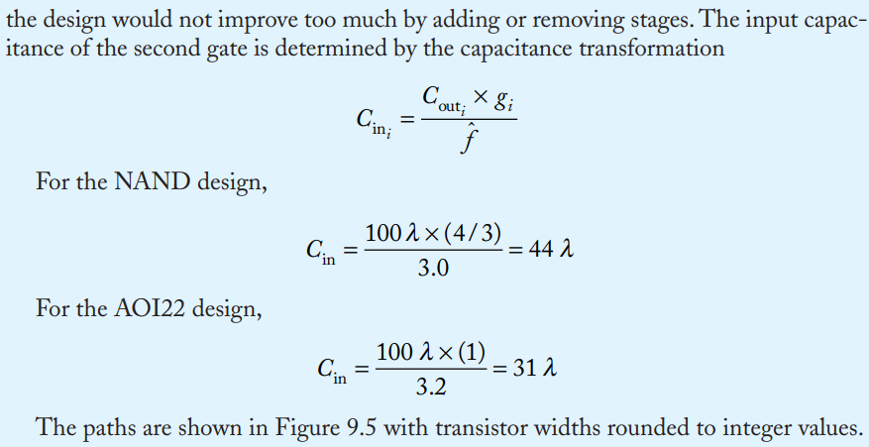
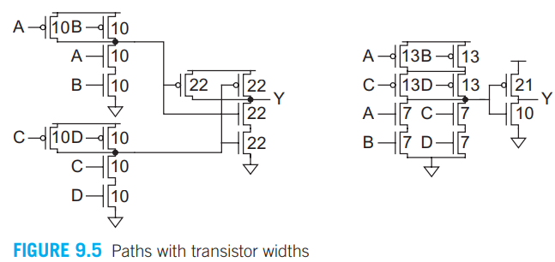
Example AOI Delay

Slide 27
Example of AOI Compound Gate
The multiplexer has a maximum input capacitance of 16 units on each input. It must drive a load of 160 units. Estimate the delay of the two designs.
H = 160 / 16 = 10 B = 1 N = 2

Slide 28
Readings
Reliability is a section in Chapter 7 of textbook ‘CMOS VLSI Design’ by Weste and Harris
Interconnects are in Chapter 6 of textbook ‘CMOS VLSI Design’ by Weste and Harris
Combinational Logic Gates Design is in Chapter 9 of Course Text book

