Slide 1
EE 421 / CS 425
Digital System Design
Laboratory 5
Fall 2023
Shahid Masud

Slide 2
Today’s Topics
Behavior Description of Digital Systems
Use reg data type
Now we can use always, case, switch, if then else, do while, constructs, etc.
Blocking and Non-Blocking Statements

Slide 3



Design Capture in Verilog HDL
Verilog Allows Design Capture at Various Hierarchy Levels:
Switch Level (NMOS and PMOS transistors)
Gate Level (Describing Circuit as Logic Gates)
  Data Flow (RTL Sequential) Level
Dataflow (Combinational)
Behavior Level
The Design is Captured in a text file or obtained from
schematic diagram
This Photo by Unknown Author is licensed under CC BY-NC

Slide 4
always statement (infer combinational)
As the name suggests, an always block executes always
Unlike initial blocks which execute only once (at the start of simulation)
A second difference is that an always block should have a sensitivity list associated with it
The sensitivity list is the one which tells the always block when to execute the block of code
The @ symbol after reserved word ' always', indicates the condition in parenthesis after symbol @
reg y;
wire a, b, sel;
always @ (a or b or sel)
begin
y = 0;
if (sel == 0) y = a;
else y = b;
end
The ports a, b, sel are of type wire
The output from always blocks is y of type reg

Slide 5

always statement (infer sequential)
There are two types of sensitivity list:
level-sensitive (for combinational circuits) and
edge-sensitive (for flip-flops)
The code below is the same 2×1 MUX but the output y is now a flip-flop output
always @ (*) // * means all the variables are in sensitivity list
// This can only be used in combinational always block
always @ (posedge clk) //can be posedge or negedge
begin
if (reset == 0) y <= 0;
else if (sel == 0) y <= a;
else y <= b;
end
y must be type reg

Slide 6
always statement (with delay)
This is used in testbench
We can have an always block without sensitivity list but with a delay
always
begin
#5 clk = ~clk;
end

Slide 7
Blocking assignment
Blocking assignment (=)
Evaluation and assignment are immediate
Use Blocking assignment while designing combinational circuits
always @ (*) //* means re-evaluate combinational on any variable change
begin
x = a | b; // 1. evaluate [a | b], assign result to x
y = a ^ b ^ c; // 2. evaluate [a ^ b ^ c], assign result to y
z = b & ~ c; // 3. evaluate [b & (~c)], assign result to z
end

Slide 8
Non-Blocking assignment
Non-blocking assignment (<=)
All assignments deferred to end of simulation time step
after RHS of all expressions have been evaluated
always @ (a or b or c) //re-evaluate when a or b or c changes
begin
x <= a | b; // 1. evaluate [a | b], but defer assignment to x
y <= a ^ b ^ c; // 2. evaluate [a ^ b ^ c], but defer assignment to y
z <= b & ~c; // 3. evaluate [b & (~c)], but defer assignment to z
// 4. end of time step: assign new values to x, y, and z
end

Slide 9
Compare Blocking and Non-Blocking assignment
Use non-blocking statements while designing sequential circuits.
always @ (posedge clk)
begin
q1 <= in;
q2 <= q1; // uses old q1
out <= q2; // uses old q2
end
//------------
always @ (posedge clk)
begin
q1 = in;
q2 = q1; // uses new q1
out = q2; // uses new q2
end

Slide 10
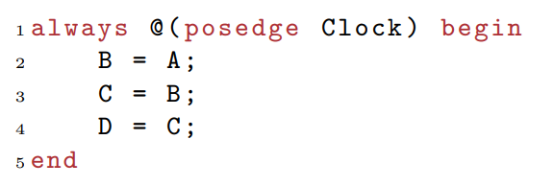
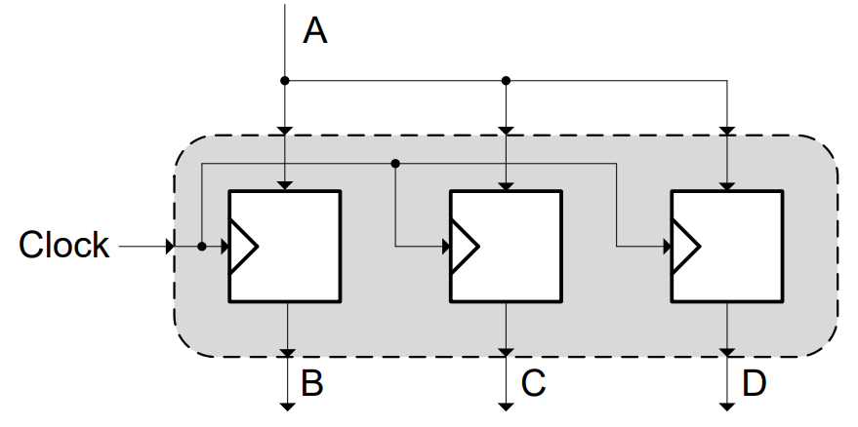
What type of circuit will we get?
always @(posedge clk)
begin
B <= A;
C <= B;
D <= C;
end
What will we get?
Hint (Shift Registers?)
Three Parallel Registers

Slide 11
Use of case statement
The case statement compares 0, 1, x, and z values in the expression and the alternative
The Bit-widths of signals should match for correct evaluation
module mux4_to_1 (out, i0, i1, i2, i3, s1, s0);
output out;
input i0, i1, i2, i3;
input s1, s0;
reg out; //type reg
always @ (s1 or s0 or i0 or i1 or i2 or i3) //sensitivity list
case ({s1, s0}) //switch based on concatenation of control signals
2’d0 : out = i0;
2’d1 : out = i1;
2’d2 : out = i2;
2’d3 : out = i3;
default: $display(“invalid control signal”);
endcase
endmodule

Slide 12
Use of while loop statements
The keyword while is used to specify this loop
The while loop executes until the while-expression becomes false
If the loop is entered when the while-expression is false, the loop is not executed at all
multiple statements are grouped typically using keywords begin and end
begin
count = 0;
while (count < 128) // execute loop till count is 127, exits @ 128
begin
$display (“count = %d”, count);
count = count+1;
end
end

Slide 13
Using for loop in Verilog
The keyword for is used to specify this loop. The for loop contains three parts:
An initial condition
A check to see if the terminating condition is true
A procedural assignment to change value of the control variable
for loops are generally used when there is a fixed beginning and end to the loop
If the loop is simply looping on a certain condition, it is better to use the while loop
begin
for (i = 0; i < 32; i = i + 2) // initialize all even location with 0
state[i] = 0;
for (i = 1; i < 32; i = i + 2) // initialize all odd location with 1
state[i] = 1;
end

Slide 14
Using repeat loop
The keyword repeat is used for this loop
The repeat construct executes the loop a fixed number of times
A repeat construct cannot be used to loop on a general logical expression,
a while loop is used for that purpose
A repeat construct must contain a number, which can be a constant, a variable, or a signal value.
However, if the number is a variable or signal value,
it is evaluated only when the loop starts and not during the loop execution
repeat (128)
begin
$display (“count = %d”, count);
count = count+1;
end
$display is for simulation

Slide 15
Use of forever loop
Used typically in testbench to generate periodic signals
The keyword forever is used to express this loop
The loop does not contain any expression and executes forever until the $finish is encountered
A forever loop can be exited by use of the disable statement
A forever loop is typically used in conjunction with timing control constructs
// Clock generation
// Use forever loop instead of always block
reg clock; //clock is type reg
initial
begin
clock = 1’b0;
forever #10 clock = ~clock; // clock with period of 20 units
end

Slide 16
Deliverables for Lab 5

