Slide 1
CS / EE 320
Computer Organization and Assembly Language
Lecture 19
Spring 2024
Shahid Masud
Topics: Examples of Pipelining Hazards and Performance, Branch Prediction in Pipelining

Slide 2
Topics
Removal of Data Hazards - Examples
Control Hazards in Pipelined MIPS
Branch Predictors
  Static – Compiler level
    Branch Always Taken, Never Taken, Forward Taken, Backward Taken, etc.
    Some improvement over no prediction
Dynamic Branch Predictors
Efficient Pipeline utilization in Superscalar Architectures
Pipeline Improvements through Loop Unrolling
QUIZ NEXT Week

Slide 3
Question 1 Eliminate Data Hazard using NOP
Given Code
lw $t0, 0($s0)
lw $t1, 0($t0)
lw $t2, 0($t1)
addi $t2, $t2, 5
sw $t2, 0($t1)
addi $s0, $s0, 4
add $t6, $t4, $t5
Show Dependence
lw $t0, 0($s0)
lw $t1, 0($t0)
lw $t2, 0($t1)
addi $t2, $t2, 5
sw $t2, 0($t1)
addi $s0, $s0, 4
add $t6, $t4, $t5
With NOP for hazard removal
lw $t0, 0($s0)
NOP
NOP
lw $t1, 0($t0)
NOP
NOP
lw $t2, 0($t1)
NOP
NOP
addi $t2, $t2, 5
NOP
NOP
sw $t2, 0($t1)
addi $s0, $s0, 4
add $t6, $t4, $t5

Slide 4
Question 2 Eliminate Data Hazard using NOP
Given Code
addi $sp, $sp-8
sw $s0, 0($sp)
sw $ra, 4($sp)
add $s0, $t0, $t7
sub $a0, $s0, $t3
lw $s0, 0($sp)
lw $ra, 4($sp)
addi $sp, $sp, 8
Jr $ra
Show Dependence
addi $sp, $sp-8
sw $s0, 0($sp)
sw $ra, 4($sp)
add $s0, $t0, $t7
sub $a0, $s0, $t3
lw $s0, 0($sp)
lw $ra, 4($sp)
addi $sp, $sp, 8
Jr $ra
With NOP
addi $sp, $sp-8
NOP
NOP
sw $s0, 0($sp)
sw $ra, 4($sp)
add $s0, $t0, $t7
NOP
NOP
sub $a0, $s0, $t3
lw $s0, 0($sp)
lw $ra, 4($sp)
addi $sp, $sp, 8
NOP
Jr $ra

Slide 5
Question 3 Eliminate Data Hazard using Reordering
Given Code
# a=b+e; c=b+f
lw $t1, 0($t0)
lw $t2, 4($t0)
add $t3, $t1, $t2
sw $t3, 12($t0)
lw $t4, 8($t0)
add $t5, $t1, $t4
sw $t5, 16($t0)
Show Dependence
lw $t1, 0($t0)
lw $t2, 4($t0)
add $t3, $t1, $t2
sw $t3, 12($t0)
lw $t4, 8($t0)
add $t5, $t1, $t4
sw $t5, 16($t0)
With Reordering
lw $t1, 0($t0)
lw $t2, 4($t0)
lw $t4, 8($t0)
add $t3, $t1, $t2
sw $t3, 12($t0)
# lw $t4, 8($t0)
add $t5, $t1, $t4
sw $t5, 16($t0)
Stall
Stall

Slide 6
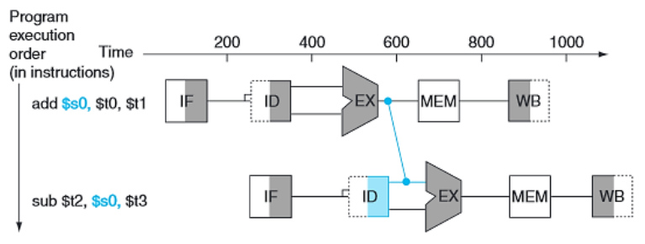
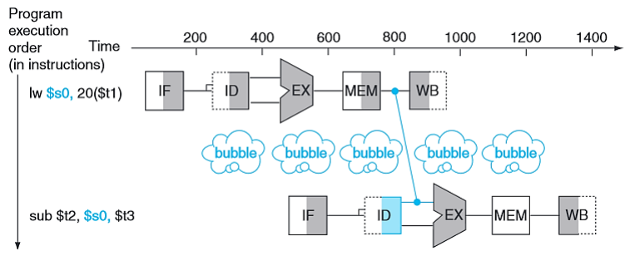
Forwarding Types
Memory Forwarding
ALU Forwarding

Slide 7
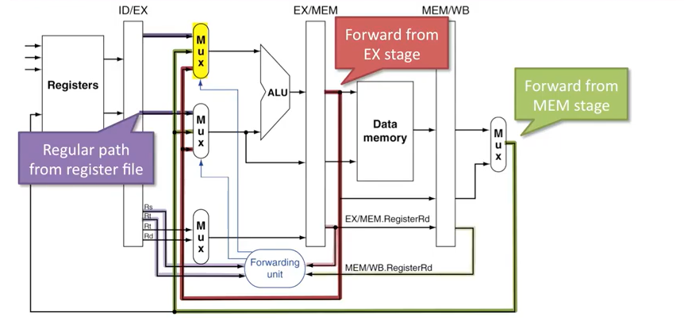
Forwarding Paths in MIPS Pipeline

Slide 8
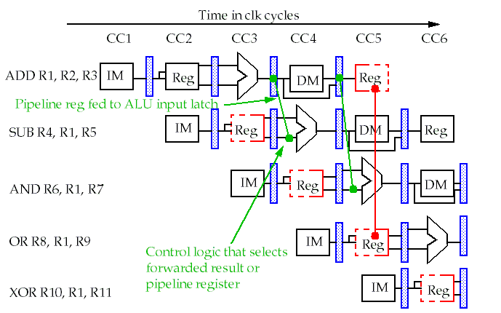
Forwarding Possibility

Slide 9
Question 4 Eliminate Data Hazard with Forwarding & NOP
Given Code
lw $t0, 0($s0)
lw $t1, 0($t0)
lw $t2, 0($t1)
addi $t2, $t2, 5
sw $t2, 0($t1)
addi $s0, $s0, 4
add $t6, $t4, $t5
Show Dependence
lw $t0, 0($s0)
lw $t1, 0($t0)
lw $t2, 0($t1)
addi $t2, $t2, 5
sw $t2, 0($t1)
addi $s0, $s0, 4
add $t6, $t4, $t5
With NOP
lw $t0, 0($s0)
NOP
lw $t1, 0($t0)
NOP
lw $t2, 0($t1)
NOP
addi $t2, $t2, 5
sw $t2, 0($t1)
addi $s0, $s0, 4
add $t6, $t4, $t5
Forwarding:
After Mem
After ALU
RF R/W

Slide 10
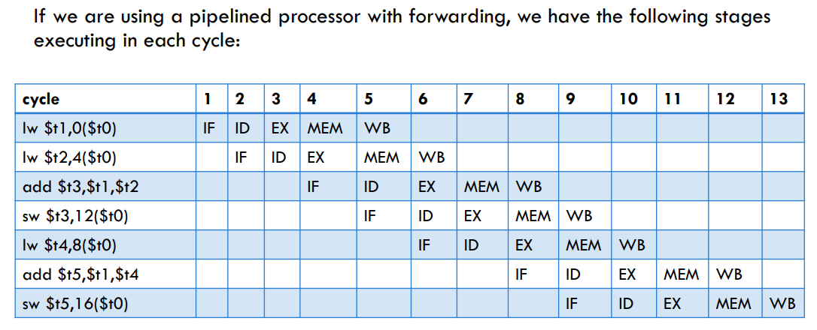
Instruction Execution on Pipeline Diagram / Table

Slide 11
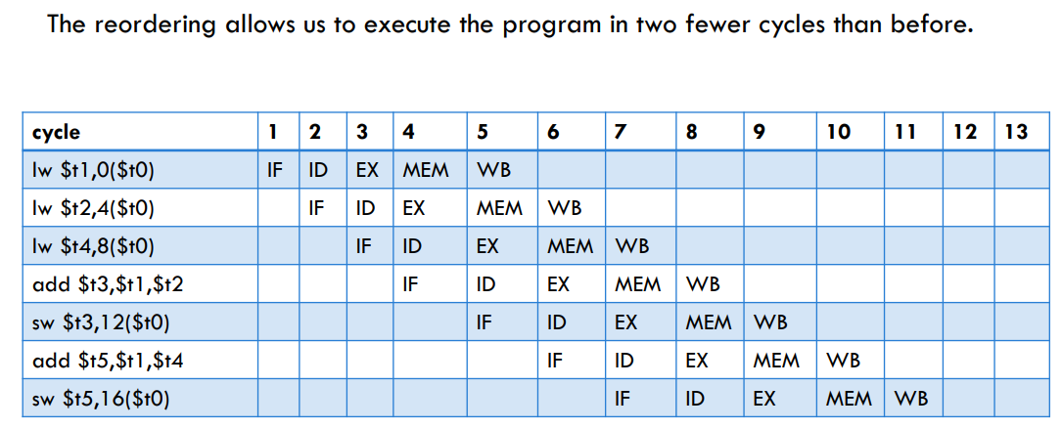
Instruction Execution with Forwarding & Reordering

Slide 12
Question 5 Eliminate Data Hazard with Forwarding & NOP
Given Code
lw $t0, 0($a0)
add $t2, $t0, $a1
addi $t2, $zero, 4
addi $t1, $zero, 2
sll $t1, $t1, 2
add $t1, $a0, $t1
sw $t2, 0($t1)
jr $ra
Show Dependence
lw $t0, 0($a0)
add $t2, $t0, $a1
addi $t2, $zero, 4
addi $t1, $zero, 2
sll $t1, $t1, 2
add $t1, $a0, $t1
sw $t2, 0($t1)
jr $ra
With NOP
lw $t0, 0($a0)
NOP
add $t2, $t0, $a1
addi $t2, $zero, 4
addi $t1, $zero, 2
sll $t1, $t1, 2
add $t1, $a0, $t1
sw $t2, 0($t1)
jr $ra
Forwarding:
After Mem
After ALU
RF R/W
Only One NOP,
With Forwarding

Slide 13
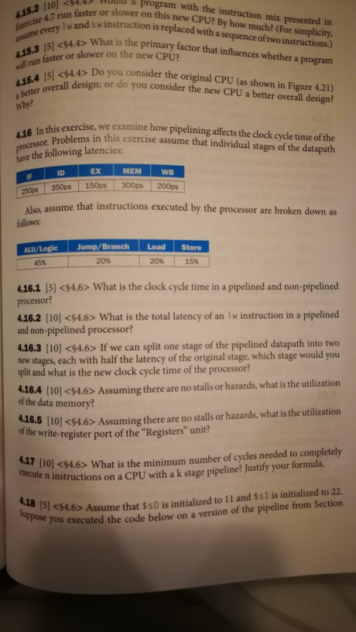
Question 4.16 from 6th Ed P&H

Slide 14
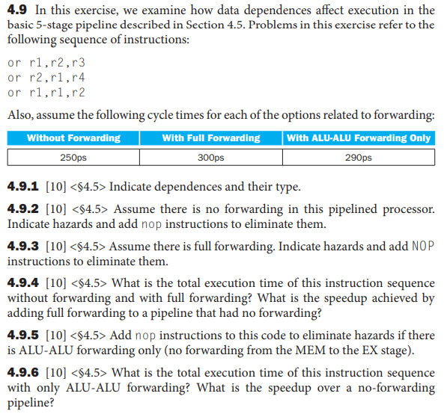
End of Chapter Questions – Example 2

Slide 15
Template of Pipelining Timing Diagram
Cycles → | Cyc 1 | Cyc 2 | Cyc 3 | Cyc 4 | Cyc 5 | Cyc 6 | Cyc 7 | Cyc 8 | Cyc 9 | Cyc 10 | Cyc 11 | Cyc 12 | Cyc 13 | Cyc 14 | Cyc 15
Instructions ↓
INSTR 1 | IF | ID | EX | MEM | WB

Slide 16
Pipelining and Branch Instructions

Slide 17
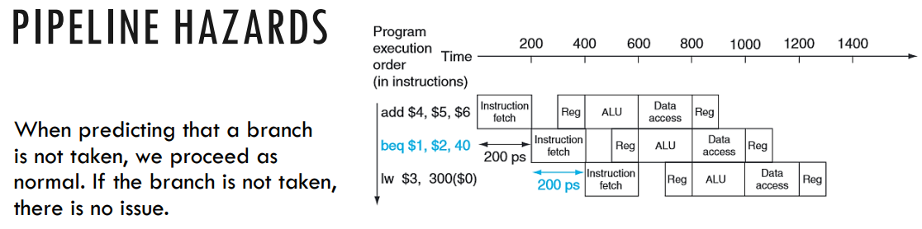
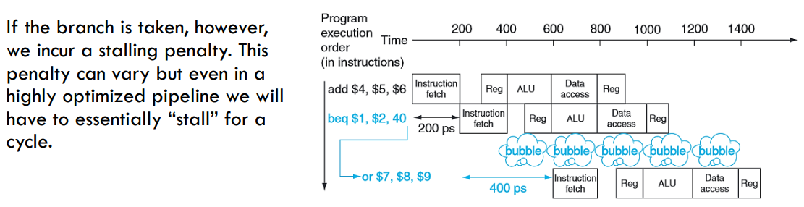
Branch Penalty

Slide 18
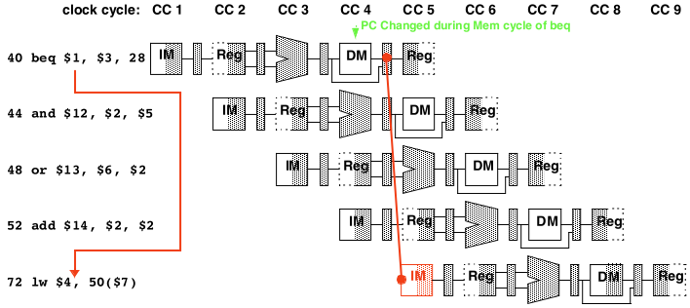
How Branches Impact Pipelined Instructions?
If branch condition true, must skip 44, 48, 52
  But, these have already started down the pipeline
  They will complete unless we do something about it
How do we deal with this?
  We’ll consider 2 possibilities

Slide 19
Data Hazards for Branches
If a comparison register is a destination of 2nd or 3rd preceding ALU instruction
add $1, $2, $3
IF
ID
EX
MEM
WB
add $4, $5, $6
IF
ID
EX
MEM
WB
…
IF
ID
EX
MEM
WB
beq $1, $4, target
IF
ID
EX
MEM
WB
Can resolve using forwarding

Slide 20
Data Hazards for Branches
If a comparison register is a destination of preceding ALU instruction or 2nd preceding load instruction
  Need 1 stall cycle
lw $1, addr
IF
ID
EX
MEM
WB
add $4, $5, $6
IF
ID
EX
MEM
WB
beq stalled
IF
ID
beq $1, $4, target
ID
EX
MEM
WB

Slide 21
Data Hazards for Branches
If a comparison register is a destination of immediately preceding load instruction
  Need 2 stall cycles
lw $1, addr
IF
ID
EX
MEM
WB
beq stalled
IF
ID
beq stalled
ID
beq $1, $0, target
ID
EX
MEM
WB

Slide 22
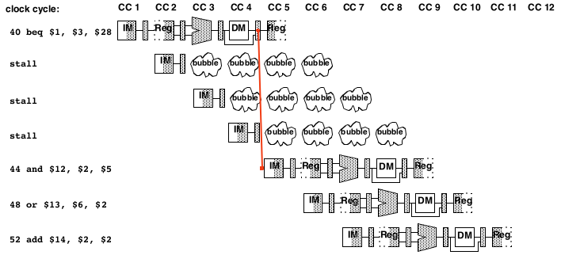
Branch Hazards – One possibility Always Stall
Branch not taken
  Still must wait 3 cycles
  Time lost
  Could have spent CCs fetching, decoding next instructions
Branch
Penalty

Slide 23
Dealing with branch hazards – Some Prediction
On average, branches are taken ½ the time
  If branch not taken…
    Continue normal processing
  Else, if branch is taken…
    Need to flush improper instruction from pipeline
One approach:
  Always assume branch will NOT be taken
    Cuts overall time for branch processing in ½
  If prediction is incorrect, just flush the pipeline

Slide 24
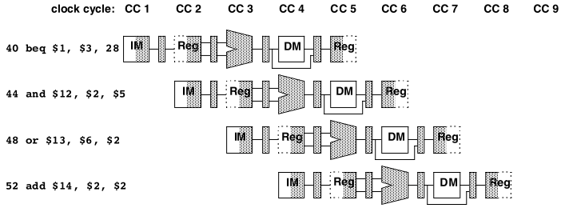
Impact of “predict not taken”
Execution proceeds normally – no penalty

Slide 25
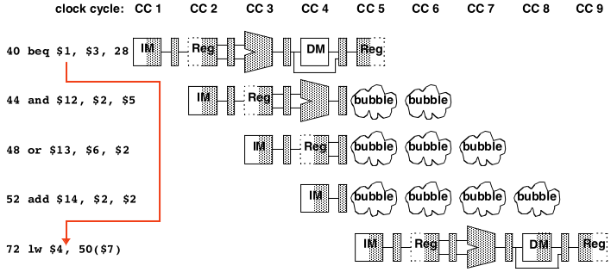
Impact of “predict not taken”
Bubbles injected into 3 stages during cycle 5

Slide 26
Fundamental lesson(s)
Pipelining changes the timing as to when the result(s) of an instruction are produced
Additional HW is needed to ensure that the correct program results are produced while maintaining the speedups offered from the introduction of pipelining
We must also account for the efficient pipelining of control instructions (e.g. beq) to preserve performance gains and program correctness

Slide 27
Branch Prediction

Slide 28
Introduction to Branch Prediction
In branch prediction, we attempt to predict the branching decisions and act accordingly.
When we assumed the branch wasn’t taken, we were making a simple static prediction.
In dynamic branch prediction, we look up the address of the instruction to see if the branch was taken last time. If so, we will predict that the branch will be taken again and optimistically fetch the instructions from the branch target rather than the subsequent instructions.

Slide 29
Speculation vs Branch Prediction
Definition: Instead of adding NOP bubble, try running potential instructions instead
Speculation: Run an instruction that may not be the right one to be executing
Branch Prediction - Choose which possible instruction to run:
  Static Branch Prediction – Fixed prediction scheme
  Dynamic Branch Prediction – Prediction depends upon recent Branch decisions

Slide 30
Branch Prediction
Guess possible outcome of Branch Instruction
  Technique is called “branch predicting”; needs 2 parts:
    “Predictor” to guess where / if instruction will branch
      (and to where)
    “Recovery Mechanism”:
      i.e. a way to fix your mistake
  Prior strategy: (Static)
    Predictor: always guess branch never taken
    Recovery: flush instructions if branch taken
  Alternative: accumulate info. in IF stage as to… (Dynamic)
    Whether or not for any particular PC value a branch was taken next
    To where it is taken
    How to update with information from later stages

Slide 31
Static Branch Prediction
Choose a method of Branch Prediction independent of the code running “Static Branch Prediction”:
  Assume Branches are Never Taken
  Assume Branches are Always Taken
  Assume Forward Branches are Taken and Backward Branches are Not Taken
Speculatively load next instruction as per above scheme
Properties of overall code and program need to be studied to come up with a good Static Prediction

Slide 32
Dynamic Branch Prediction
Choose a method for speculative instruction based on evaluating the code that is running:
  (m,n) Branch Predictors
  Tournament Branch Predictors
  Percepton Branch Predictors
(m,n) Predictor looks at some past Branch Decisions
Tournament Predictor can select between (m,n) and Static Predictor based on some algorithm, also looking at code
Perceptron Predictor in modern hardware looks at surrounding code (before and after branch) and how it could impact Branch Decisions

Slide 33
Dynamic Branch Predictors Requirement
1-Bit and 2-Bit Branch Predictors
(m,n) branch predictors that consider multiple loops in programs
Branch History Table
Cache memory for Branch Target Addresses
State Machines of 1-Bit and 2-Bit Predictors

Slide 34
Branch Prediction Buffer
A branch prediction buffer is a small memory indexed by the lower portion of the address of the branch instruction. The memory simply contains one bit indicating whether the branch was taken last time or not.
It’s just a simple mechanism that might give us a hint as to what the right decision might be.
Note:
The buffer is shared between branches with the same lower addresses. A buffer value may reflect another branch instruction.
The branch instruction may simply make a different decision than it did before.

Slide 35
1 Bit Branch Prediction

Slide 36
A Branch Predictor
Normal PC
value
MUX
PC
Instruction
Memory
Guess Branch
Branch
Prediction
Logic
Branch
Update
Info
Guess where to Branch

Slide 37
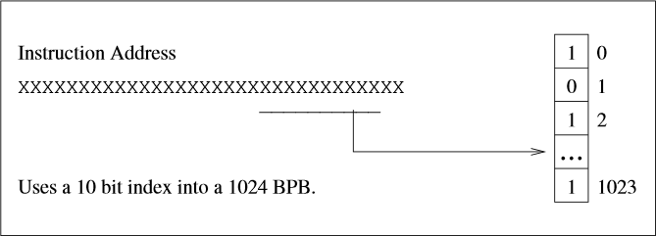
1 Bit Branch Prediction Buffer
Here’s how the 1-bit branch prediction buffer works:
Each element in the buffer contains a single bit indicating whether the branch prediction was taken last time.
We make our prediction based on the bit found in the buffer.
If the prediction turns out to be incorrect, then we flip the bit in the buffer and correct the pipeline.

Slide 38
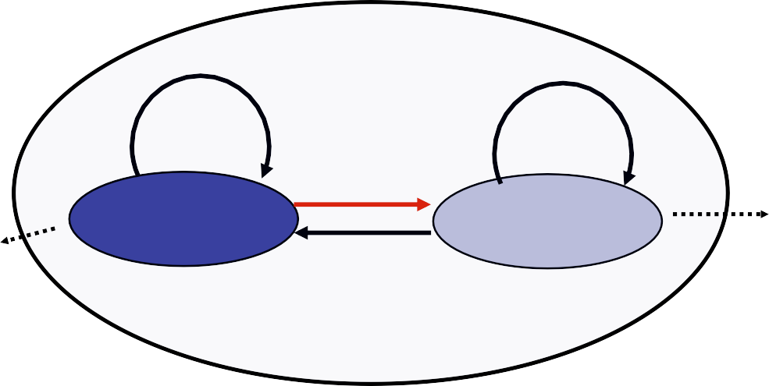
Predictor for a Single Branch
1-bit prediction
Feedback
T
NT
NT
1
0
Predict Taken
Predict Taken
T

Slide 39


Branch History Table of 1-bit Predictor
BHT also called branch prediction buffer
Can use only one 1-bit predictor, but accuracy is low
BHT: use a table of simple predictors, indexed by bits from PC
More entries, more cost, but less conflicts, higher accuracy
BHT can contain complex predictors
K-bit
Branch
address
₂k
Prediction

Slide 40
Example of Branch Prediction 1 Bit
Consider a loop that branches nine times in a row, then is not taken once. What is the prediction accuracy for this branch, assuming the prediction bit for this branch remains in the prediction buffer?
int i = 0; do{
/* loop body */ i = i + 1
}while(i < 10);
add $t0, $0, $0
/* loop body*/
L1:
addi $t0, $t0, 1 slti $t1, $t0, 10 bne $t1, $0, L1
The prediction behavior will mispredict on both the first and last loop iterations.
The last loop iteration prediction happens because we’ve already taken the branch nine-times so far.
The first loop iteration happens because the bit was flipped on the last iteration of the previous execution.
So, the prediction accuracy is 80%.

Slide 41
1 bit Branch Prediction Weakness
Example:
– in a loop, 1-bit BHT will cause 2 mispredictions
Consider a loop of 9 iterations before exit:
for (…){
for (i=0; i<9; i++) a[i] = a[i] * 2.0;
}
  End of loop case, when it exits instead of looping as before
  First time through loop on next time through code, when it predicts exit instead of looping
  Only 80% accuracy even if loop 90% of the time

Slide 42
2 Bit Branch Prediction

Slide 43
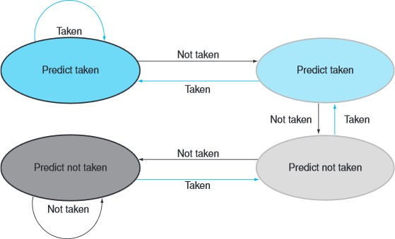
2 Bit Branch Prediction
To increase this prediction accuracy, we can use a 2-bit prediction buffer.
In the 2-bit scheme, a prediction must be wrong twice before the bit is flipped.
This way, a branch that strongly favors a particular decision will be wrong only once.
We can access the buffer during the IF stage to determine whether the next instruction needs to be calculated or we can continue with sequential execution.

Slide 44
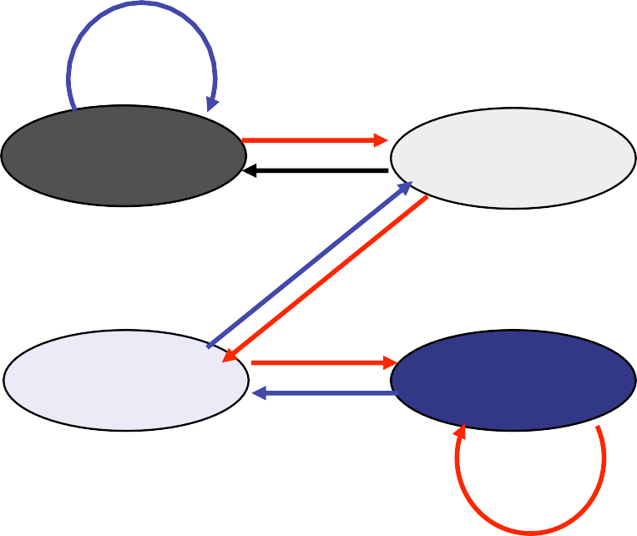
Using a 2-bit saturating counter
Solution: 2-bit scheme where change prediction only if get misprediction twice:
T
NT
T
T NT
Predict Taken
11
10
Predict Taken
NT
T
Predict Not Taken
01
00
Predict Not Taken
NT
Blue: stop, not taken
Gray: go, taken
Adds hysteresis to decision making process

Slide 45
Readings
Chap 4, P&H Textbook

