Slide 1
CS / EE 320
Computer Organization and Assembly Language
Spring 2023
Lecture 27
Shahid Masud
Topics: Direct Memory Access (DMA),
Virtual Memory (VM)

Slide 2
Topics
QUIZ 6
NEXT
LECTURE
Direct Memory Access DMA
  Concept
  Controller
  3 Configurations
  3 Modes
Introduction to Virtual Memory
  Mapping Physical to Virtual
  Page Tables
  Role of Hard Disk

Slide 3
DIRECT MEMORY ACCESS DMA

Slide 4
Input / Output and DMA
I/O Modules
Programmed I/O
Interrupt-Driven I/O
Direct Memory Access✓
Review
CH06

Slide 5
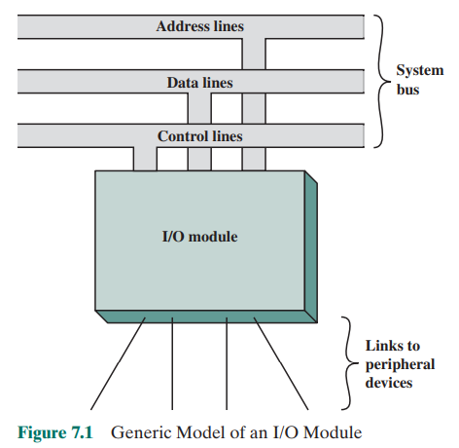
Generic I/O Module

Slide 6
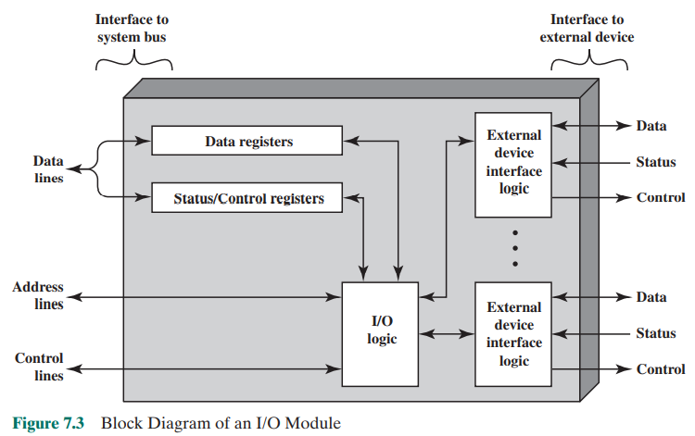
Block Diagram of a Typical I/O Module
External
Peripheral
Side
CPU
Side

Slide 7
I/O Channel vs I/O Controllers
An I/O Module that can take on most of the detailed processing burden
This presents a high-level interface to the processor
A primitive or simple I/O module is called ‘I/O Controller’ or ‘Device Controller’
Personal Computers have I/O Controllers and Main Frames have I/O Channels Or I/O Processors

Slide 8
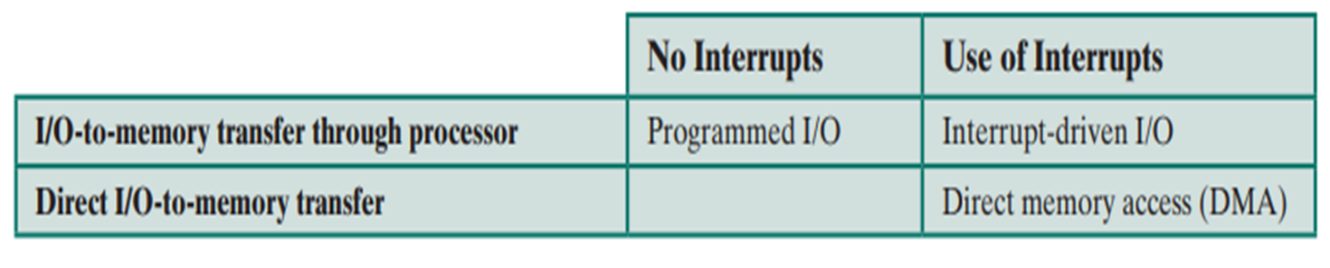
Fundamental Input Output Techniques
Programmed I/O
Interrupt driven I/O
Direct Memory Access (DMA)

Slide 9
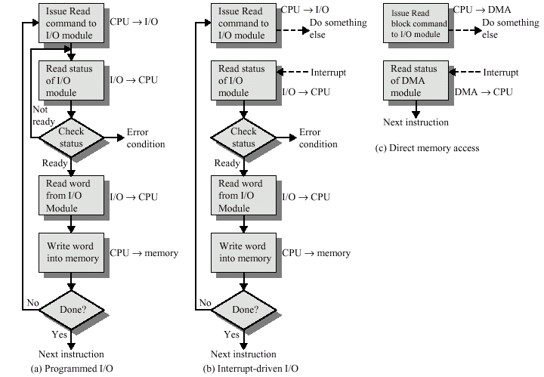
Flowchart of Three I/O Techniques
Programmed
I/O
Direct Memory Access I/O
Interrupt Driven I/O

Slide 10
Drawback in I/O Techniques
Interrupt Driven I/O is more efficient than Simple programmed I/O,
but still requires active intervention of the processor to transfer data between memory and an I/O module, and any data transfer traverses a path through the processor.
Both have two drawbacks:
The I/O Transfer rate is limited by the speed with which the processor
can test and service a device.
The processor is tied up in managing an I/O transfer, a number of
Instructions must be executed for each I/O transfer.

Slide 11
What is DMA
It is often necessary to transfer data to or from an interface at data rates higher
than those possible using simple programmed I/O loops.
What is Direct Memory Access?
Hardware Mechanism that allows peripheral components to transfer their
I/O data directly to and from Main Memory without involving main CPU.
Why is Direct Memory Access Important?
Use of DMA can greatly increase throughput to and from a device because a
great deal of computation overhead is eliminated.
What is the downside of DMA?
Additional hardware support is required in the form of ‘DMA Controller’.
This controller steals cycles from CPU. Extra synchronization mechanism is needed
to distinguish between update and non-updated RAM areas.

Slide 12
DMA Operation
What is Direct Memory Access?
DMA is a capability provided by some computer bus architectures, including PCI, PCMCIA and CardBus, which allows data to be sent directly from an attached device
to the memory on the host, freeing the CPU from involvement with the data transfer and thus improving the host's performance.
DMA Programming
The programming of a device's DMA controller is hardware specific. Normally, the OS needs to have the local
device address, the physical memory address on the PC, and the size of the memory block to transfer.
Then the register that initiates the transfer is set.

Slide 13
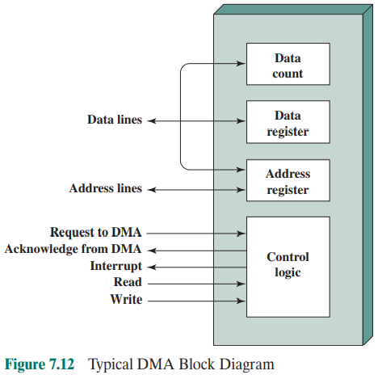
Typical DMA Block

Slide 14
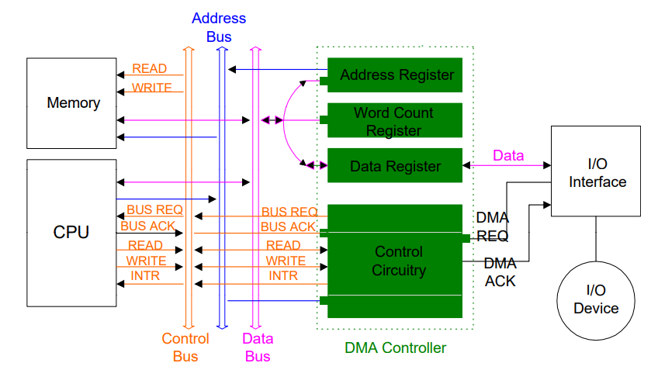
DMA Controller Connections to CPU and I/O

Slide 15
How to DMA?
The starting location in memory to read from, or write to, is communicated
on data bus and stored by the DMA module in its address registers.
The number of words to be read or written is communicated via the
data bus and stored in data count register of DMA.
The processor then continues with other work.
The DMA module transfers entire block of data, one word at a time,
directly to or from memory without going through the processor.
When the transfer is complete, the DMA module sends an interrupt to
the processor.
The processor is involved only at the beginning and end of data
transfer operation.

Slide 16
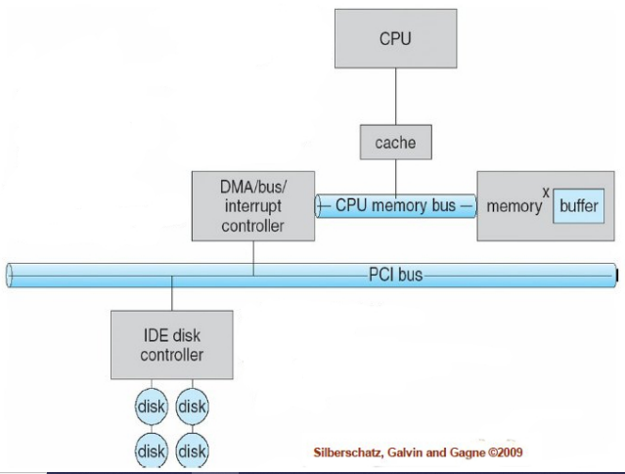
Basic DMA Architecture

Slide 17
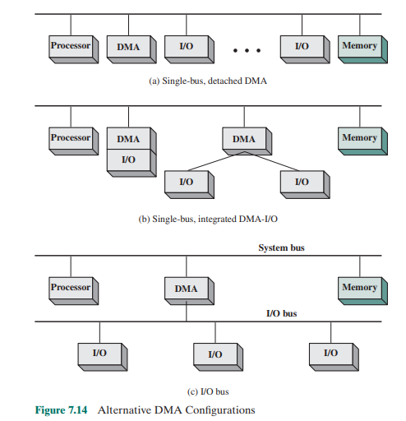
DMA Configurations
Single Bus Detached DMA
Single Bus Integrated DMA-I/O
DMA through I/O Bus

Slide 18
DMA Configurations (1)
DMA
Controller
I/O
Device
I/O
Device
Main
Memory
CPU
Single Bus, Detached DMA controller
Each transfer uses bus twice
  I/O to DMA then DMA to memory
CPU is suspended twice

Slide 19
DMA Configurations (2)
DMA
Controller
DMA
Controller
Main
Memory
CPU
I/O
Device
I/O
Device
I/O
Device
Single Bus, Integrated DMA controller
Controller may support >1 device
Each transfer uses bus once
  DMA to memory
CPU is suspended once

Slide 20
DMA Configurations (3)
System Bus
CPU
DMA
Controller
Main
Memory
I/O Bus
I/O
Device
I/O
Device
I/O
Device
I/O
Device
Separate I/O Bus
Bus supports all DMA enabled devices
Each transfer uses Bus only once
  DMA to memory
CPU is suspended once

Slide 21
Data Read in DMA
Example of Input
Device driver allocates a DMA Buffer, sends a
signal to device indicating where to send data, then sleeps.
2. Device writes data to DMA Buffer, raises interrupt when
Finished.
3. Interrupt handler gets data from DMA Buffer, acknowledges
Interrupt, awakens software to process the data.

Slide 22
Data Arrived for DMA
Hardware raises an interrupt to announce that new data has arrived
Interrupt handler associates a buffer, tells the hardware where to transfer the data
Device writes the data to the buffer, raises another interrupt when transfer is done
Interrupt handler dispatches the new data, awakens any relevant process and takes care of housekeeping

Slide 23
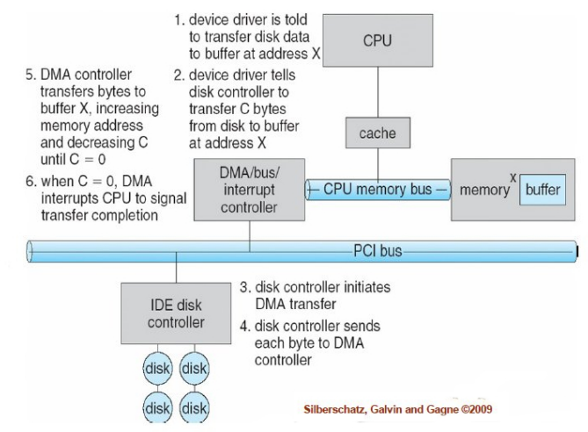
DMA Transfer - Graphically

Slide 24
DMA Channels
The 8237 DMA controller provided by IBM (International Business Machines) is a peripheral interface circuit for allowing peripheral devices to directly transfer data to or from main memory.
It includes four independent channels and may be expanded to any number of channels by cascading additional controller chips.
In the IBM architecture, two DMA controllers are used. One DMA controller is used for byte transfers, and the second DMA controller is user for word (16-bit) transfers.

Slide 25
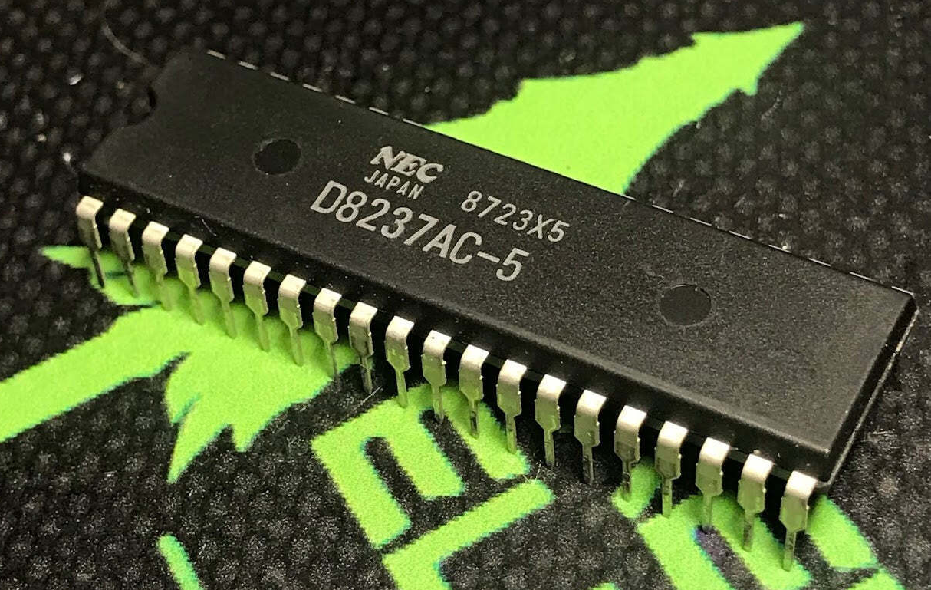
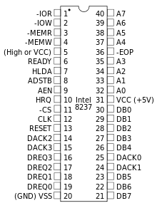
The Intel 8237 DMA Controller Chip
The 8237 Features:
Single - One DMA cycle, one CPU cycle interleaved until address counter reaches zero
Block - Transfer progresses until the word count reaches zero or the EOP signal goes active
Demand - Transfers continue until TC or EOP goes active or DRQ goes inactive. The CPU is permitted to use the bus when no transfer is requested.
Cascade - Used to cascade additional DMA controllers. DREQ and DACK is matched with HRQ and HLDA from the next chip to establish a priority chain. Actual bus signals is executed by cascaded chip.
Memory-to-memory transfer can be performed. The channel 0 Current Address register is the source for the data transfer and channel 1 and the transfer terminates when Current Word Count register becomes 0.

Slide 26
DMA Units of Transfer
Single
A single byte (or word) is transferred. The DMA must release and re-acquire the bus for each additional byte. This is commonly-used by devices that cannot transfer the entire block of data immediately. The peripheral will request the DMA each time it is ready for another transfer.
Block/Demand
Once the DMA acquires the system bus, an entire block of data is transferred, up to a maximum of 64K. If the peripheral needs additional time, it can assert the READY signal to suspend the transfer briefly.

Slide 27
DMA Advantages
DMA is fast because a dedicated piece of hardware transfers data from one computer location to another and only one or two bus read/write cycles are required per piece of data transferred.
DMA is usually required to achieve maximum data transfer speed, and thus is useful for high-speed data acquisition devices.
DMA also minimizes latency in servicing a data acquisition device because the dedicated hardware responds more quickly than interrupts, and transfer time is short.

Slide 28
DMA Disadvantages
Cost of DMA hardware.
DMA is useful only for DATA commands. All non-data commands have to be executed by CPU.
Data has to be stored in continuous locations in memory.
CPU's intervention is required for initializing DMA logic for every continuous data block transfer.

Slide 29
Different Modes of DMA operation
During the DMA Transfer, CPU can perform only those operation in which it doesn’t require the access of System Bus which means mostly CPU will be in blocked state.
For how much time CPU remains in the blocked state will depend upon the following modes of DMA Transfer and after that CPU will take back control of system buses from DMAC.
There are three different modes of DMA operations:
Burst Mode
Cycle stealing Mode
Transparent Mode

Slide 30
Burst Mode of DMA (Demand Mode)
In burst mode, the DMA controller gets the system bus charge, after transfer completion, it will release system bus.
In burst mode, a whole block of data is shared in one contiguous sequence. Since the DMA controller is allowed access to the system buses by the CPU, it sends all bytes of data in the data block and then yield control of the system buses back to the CPU.
This mode is beneficial for loading programs or data records into memory.
The CPU has to wait till that process finishes.
This is the quickest mode of DMA Transfer since at once a huge amount of data is being transferred.

Slide 31
Cycle Stealing Mode of DMA (Byte Mode)
In cycle stealing mode, the CPU gets forced by DMA controller to stop the operation and withdraw the control from bus for a short period of time.
The DMA will release the bus and will request the system bus, like this, DMA will use the cycle clock for sending data bytes.
It already issues requests via BR, sharing one byte of information per request
Slow IO device will take some time to prepare data (or word) and within that time CPU keeps the control of the buses.
Once the data or the word is ready, CPU gives back control of system buses to DMA Controller for 1-cycle in which the prepared word is transferred to memory.
As compared to Burst mode, this mode is slow since it requires some time which is actually consumed by I/O device while preparing the data.
Once the DMA controller is granted access to the system bus by the CPU, it transfer one byte of data then it releases the memory access to CPU. Again, for another byte of transfer, it must acquire bus access by CPU via BR and BG signal (BUS REQUEST and BUS GRANT). For Every Byte of Transfer, it acquires bus access and releases it until entire Block of Data Transferred.
DMA controllers can operate in a cycle stealing mode in which they take over the bus for each byte of data to be transferred and then return control to the CPU.

Slide 32
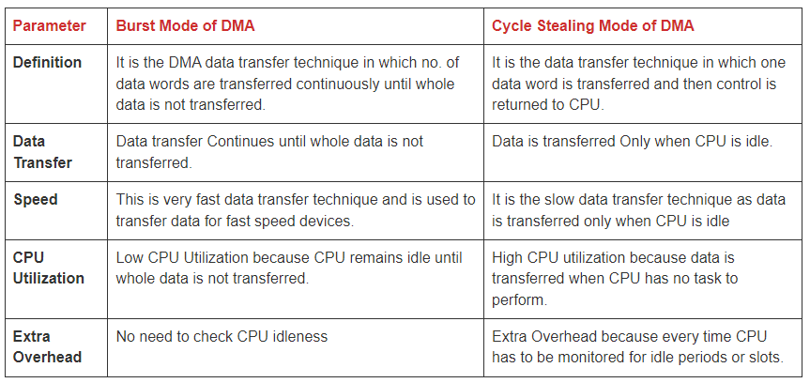
Comparing Burst Mode and Cycle Stealing Mode of DMA

Slide 33
Transparent (Interleaving) Mode of DMA
In transparent mode, the DMA controller will use system bus when the processor does not need system bus.
Whenever CPU does not require the system buses then only control of buses will be given to DMA Controller.
In this mode, CPU will not be blocked due to DMA at all.
This is the slowest mode of DMA Transfer since DMA Controller has to wait for so long time to just even get the access of system buses from the CPU itself.
The primary advantage of transparent mode is that the CPU never stops executing its programs and the DMA transfer is free in terms of time.
While the disadvantage is that the hardware needs to determine when the CPU is not using the system buses, which can be complex.

Slide 34
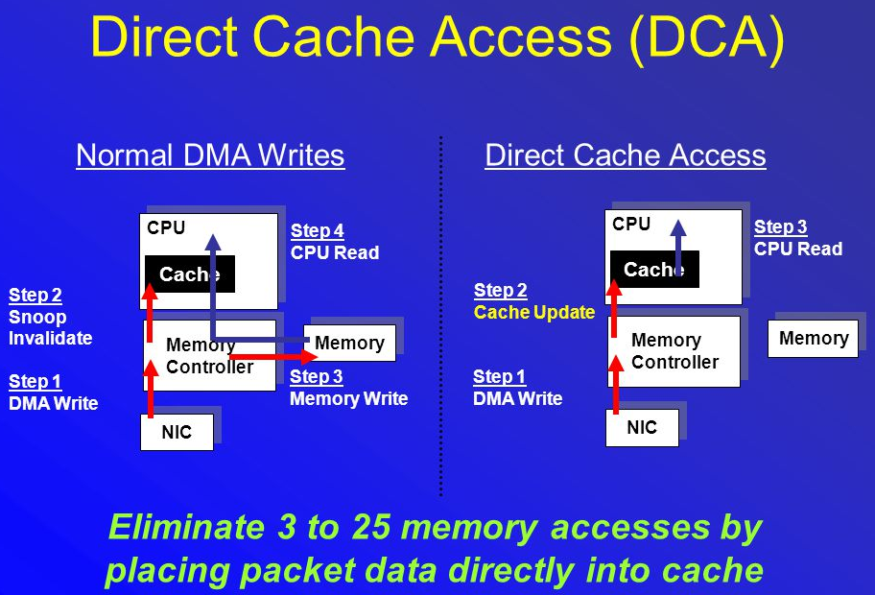
Direct Cache Access
The I/O Channel allows access to the level of cache that is closest to Main Memory
Could be L2 or L3 cache.
Usually, a packet-based data transfer is used.

Slide 35
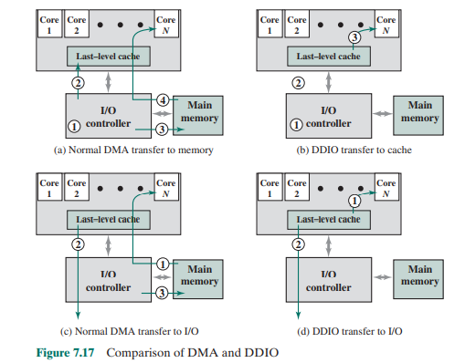
DMA and DDIO
DDIO = Direct Data I/O
CPU caches are used as the primary source and destination for I/O, allowing network interface controllers (NICs) to DMA directly to the Last level cache (L3 cache) of local CPUs and avoid costly fetching of the I/O data from system RAM.
As a result,
DDIO reduces the overall I/O processing latency,
allows processing of the I/O to be performed entirely in-cache,
prevents the available RAM bandwidth/latency from becoming a performance bottleneck,
and may lower the power consumption by allowing RAM to remain longer in low-powered state.

Slide 36
VIRTUAL MEMORY

Slide 37
Three problems in Memory
Not Enough RAM in computer. We want to be able to run programs even if we don’t have enough physical memory installed
Holes in Address Space – Run multiple programs, then close some of them. Chunks of distributed un-used memory spaces are apparent
Programs overwriting each other – how to provide Security
VIRTUAL MEMORY uses Indirection – Addresses that program use are artificially MAPPED to real address in Memory. We can control where the memory goes and how to use it
PAGE TABLE and TRANSLATIONS – how the mappings are done and stored
Also need to worry how Virtual Memory interacts with Caches

Slide 38
Problems in using Shared Address Space
Program 1
Depending upon how programs
were called and removed, we may
run out of continuous RAM space
Though smaller spaces may exist.
This is called Holes.
Same Physical Spaces maybe
Overwritten causing Security
Issues.
1 GB
2
3
4
5
6
7
8
Physical RAM
Program 2
Program 3

Slide 39
Idea of Virtual Memory
Give each program its own Virtual Memory Space
Separately map each program’s virtual memory space to RAM’s physical memory space
Use Disk space if RAM space runs out
Mapping gives us flexibility how we use Physical RAM space

Slide 40
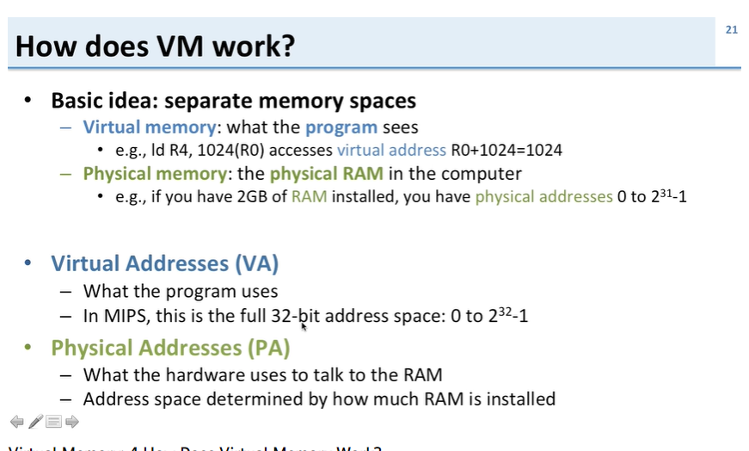
How does Virtual Memory work?

Slide 41
What is Virtual Memory?
An illusion of a memory much larger than the physical (main) memory
  Large virtual address space, in spite of limited physical address space
  Both spaces divided into equal sized pages ‐ an alternative of this is segmentation, in which division is on the logical boundaries
  There may be multiple virtual spaces, one for each program

Slide 42
Virtual Memory and Hard Disk
Implemented using hard disk drive
  Each virtual page has a place on the disk
  Some of these may also be in the main memory
  The subset present in the main memory changes from time to time as per the need
ISA must support large address spaces
Hardware + software take care of the rest

Slide 43
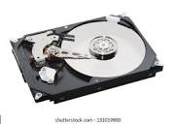
Indirection in Virtual Memory
With Virtual Memory, Program Address MAPS to RAM Address
30-bit physical RAM Addr Space 1GB
32-bit program address space 4GB
MAP
VM Maps some of Program Addr
Space to Disk. The program is
brought into RAM when needed and some
existing ones move to Disk - SWAPPING

Slide 44
Solving problem of holes in memory and security
Each Program has its own MAPPING
We can map a program’s address to RAM address in any way
RAM Address
Program 1
MAP 1
Each VM MAP uses a
Unique area in RAM so
Data stays independent
and Secure
Program 2
MAP 2

Slide 45
Virtual to Physical mapping
Virtual addresses Physical addresses Address translation
Disk addresses

Slide 46
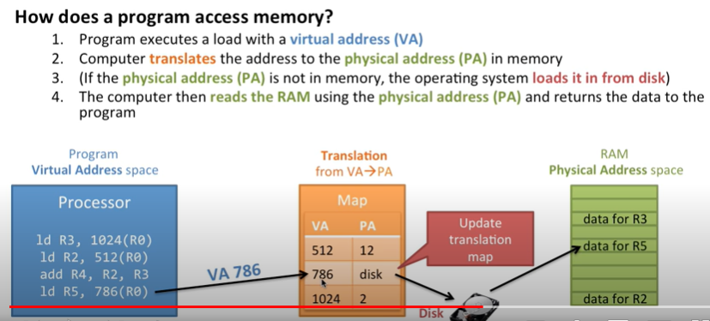
Address Update in Map Table

Slide 47
Virtual Memory Concept
Use main memory as a “cache” for secondary (disk) storage
  Managed jointly by CPU hardware and the operating system (OS)
Programs share main memory
  Each gets a private virtual address space holding its frequently used code and data
  Protected from other programs
CPU and OS translate virtual addresses to physical addresses
  VM “block” is called a page
  VM translation “miss” is called a page fault

Slide 48
Readings
Chap 5, 6 of P&H Textbook
Acknowledgement: Youtube channel of David Schaffer

