Slide 1
CS / EE 320
Computer Organization and Assembly Language
Lecture 25
Spring 2024
Shahid Masud
Topics: Cache/Memory Update Strategies, Cache Performance, Multi Level Caches

Slide 2
Topics
Examples of calculating different parameters in Cache Design
Cache Replacement: LRU, LFU, FIFO, Random schemes
Cache Writes – Write Back and Write Through schemes
Some Examples of Cache Performance
Introduction to Multi-level Caches
Examples of Cache Performance
Quiz 6 Next Monday

Slide 3
Dealing with Cache Miss and Cache Line Replacement

Slide 4
Cache Misses
On cache hit, CPU proceeds normally
On cache miss
  Stall the CPU pipeline
  Fetch block from next level of hierarchy
  Instruction cache miss
    Restart instruction fetch
  Data cache miss
    Complete data access

Slide 5
Sources of Misses
Compulsory misses (aka cold start misses)
  First access to a block
Capacity misses
  Due to finite cache size
  A replaced block is later accessed again
Conflict misses (aka collision misses)
  In a non-fully associative cache
  Due to competition for entries in a set
  Would not occur in a fully associative cache of the same total size

Slide 6
Replacement Algorithms (1) Direct mapping
No choice
Each block only maps to one line
Replace that line

Slide 7
Replacement Algorithms (2)
Associative & Set Associative
Hardware implemented algorithm (speed)
Least Recently used (LRU)
e.g. in 2 way set associative
  Which of the 2 block is lru?
First in first out (FIFO)
  replace block that has been in cache longest
Least frequently used
  replace block which has had fewest hits
Random

Slide 8
Write Policy
Must not overwrite a cache block unless main memory is up to date
Multiple CPUs may have individual caches
I/O may address main memory directly

Slide 9
Write-through scheme
All writes go to main memory as well as cache
Multiple CPUs can monitor main memory traffic to keep local (to CPU) cache up to date
Lots of traffic
Slows down writes

Slide 10
Write-Through
On data-write hit, could just update the block in cache
  But then cache and memory would be inconsistent
Write through: also update memory
But makes writes take longer
  e.g., if base CPI = 1, 10% of instructions are stores, write to memory takes 100 cycles
    Effective CPI = 1 + 0.1×100 = 11
Solution: write buffer
  Holds data waiting to be written to memory
  CPU continues immediately
    Only stalls on write if write buffer is already full

Slide 11
Write-back
Updates initially made in cache only
Update bit for cache slot is set when update occurs
If block is to be replaced, write to main memory only if update bit is set
Other caches get out of sync
I/O must access main memory through cache
N.B. 15% of memory references are writes

Slide 12
Write-Back
Alternative: On data-write hit, just update the block in cache
  Keep track of whether each block is dirty
When a dirty block is replaced
  Write it back to memory
  Can use a write buffer to allow replacing block to be read first

Slide 13
Write Miss
What should happen on a write miss?
Alternatives for write-through
  Allocate on miss: fetch the block
  Write around: don’t fetch the block
    Since programs often write a whole block before reading it (e.g., initialization)
For write-back
  Usually fetch the block

Slide 14
Block Placement
Determined by associativity
  Direct mapped (1-way associative)
    One choice for placement
  n-way set associative
    n choices within a set
  Fully associative
    Any location
Higher associativity reduces miss rate
  Increases complexity, cost, and access time

Slide 15
Cache Design Trade-offs
Design change | Effect on miss rate | Negative performance effect
Increase cache size | Decrease capacity misses | May increase access time
Increase associativity | Decrease conflict misses | May increase access time
Increase block size | Decrease compulsory misses | Increases miss penalty. For very large block size, may increase miss rate due to pollution.

Slide 16
Cache Control
Example cache characteristics
  Direct-mapped, write-back, write allocate
  Block size: 4 words (16 bytes)
  Cache size: 16 KB (1024 blocks)
  32-bit byte addresses
  Valid bit and dirty bit per block
  Blocking cache
    CPU waits until access is complete
31
10
9
4
3
0
Tag
Index
Offset
18 bits
10 bits
4 bits

Slide 17
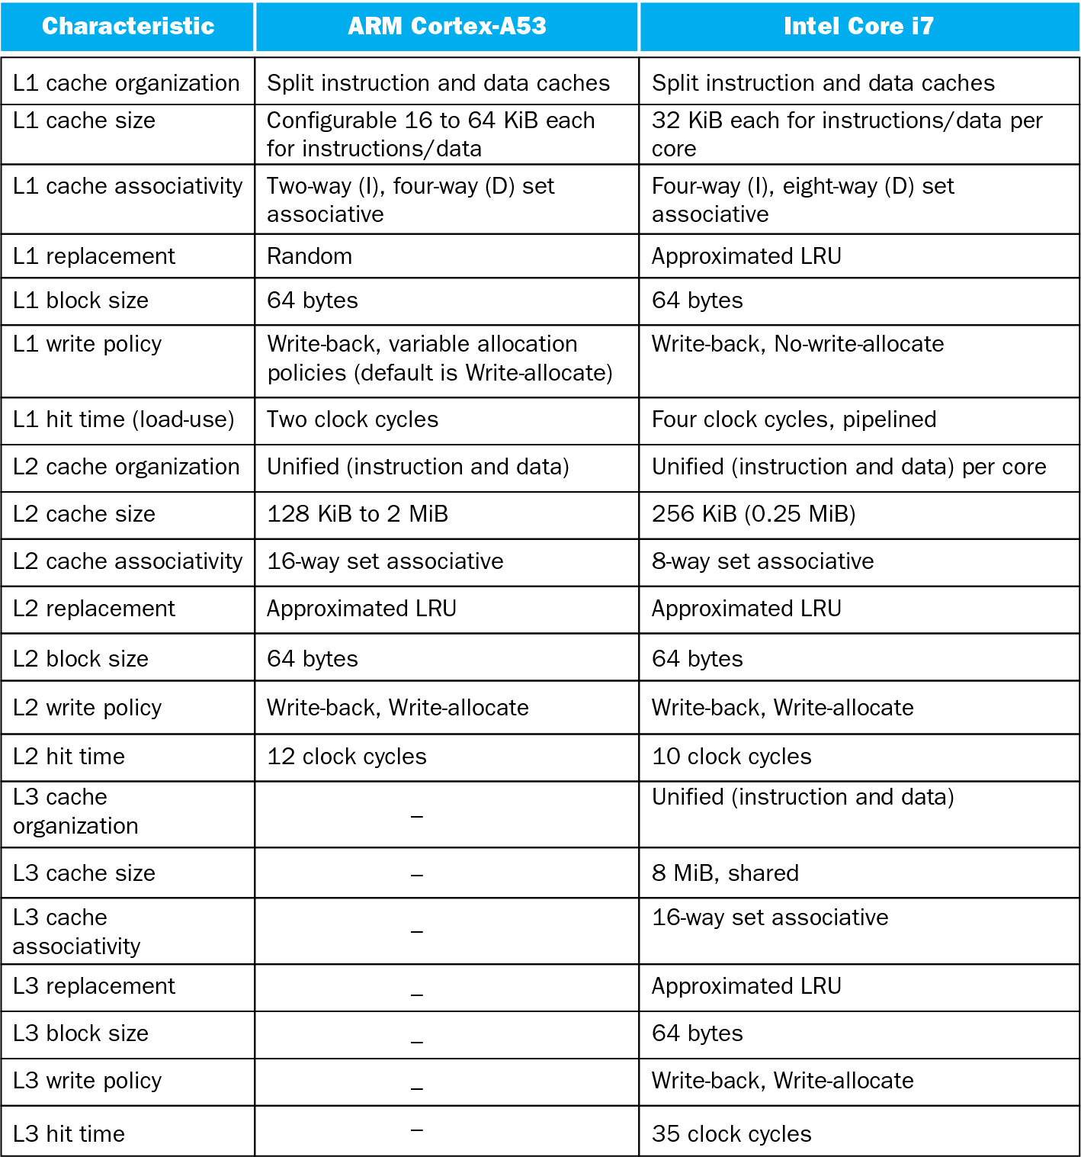
Multilevel On-Chip Caches

Slide 18
Concluding Remarks
Fast memories are small, large memories are slow
  We really want fast, large memories
  Caching gives this illusion
Principle of locality
  Programs use a small part of their memory space frequently
Memory hierarchy
  L1 cache ↔ L2 cache ↔ … ↔ DRAM memory ↔ disk
Memory system design is critical for multiprocessors

Slide 19
Multi Level Caches
Performance of Cache and Memory System
Examples of Cache Performance

Slide 20
Example 1 of Cache Performance
Question
Given that:
T1 is access time from Cache = 0.01 μsec
T2 is access time from Main Memory = 0.1 μsec
95% accesses are from Cache
5% accesses are from Main Memory
Find the Average Time seen by CPU to Access one word?
T2
0.1
Access Time
Avg Access Time with Cache
Close to fast
Cache
0.015
Solution
Average time to access one word:
Tavg= (0.95 x 0.01) + (0.5 x 0.1)
Tavg= 0.095 + 0.0055
Tavg= 0.015 μsec
T1
0.05

Slide 21
Split Caches
Separate Cache for Instructions and Data to take advantage of pipelining
In case the program has too many localized accesses to data only or instructions only,
Then there may be no performance improvement
Instruction Cache
Main
Memory
CPU
Data
Cache

Slide 22
Multilevel Caches
Primary cache attached to CPU
  Small, but fast
Level-2 cache services misses from primary cache
  Larger, slower, but still faster than main memory
Main memory services L-2 cache misses
Some high-end systems include L-3 cache

Slide 23
Multi Level Caches
Main purpose is to reduce Miss Penalty
Main
Memory
L2
CPU
L1
Small transfer
In Bytes or Words
Bigger transfer
In lines and blocks
Bigger Blocks
of Transfer

Slide 24
Multi Level Caches - Performance
T1 Access Time
T2 Access Time
TM Access Time
CPU
References
CPU
L1
(1 – H1) references
L2
Main
Mem
(1 – H2) references
H1 hit ratio
at L1
H2 hit ratio
at L2
Average Access Time in Multilevel Cache:
Tavg = T1 + (1 – H1) x T2 + (1 – H1) x (1 – H2) x TM
(1 – H1) = miss rate at L1 = MRL1
Tavg = T1 + MRL1 x T2 + MRL1 x MRL2 x TM
MRL1 x MRL2 = Global Miss Rate at L2

Slide 25
Example 1, find Tavg in 2 level cache
CPU generates 100 memory references. 80 are hit in L1, 20 are miss in L1. 16 are hit in L2 and 4 are miss in L2. Access time of L1 is 1 cycle. Access time of L2 is 10 cycles. Access time of Main Mem is 100 cycle. Find average memory access time Tavg?
Tavg = T1 + MRL1 x T2 + MRL1 x MRL2 x TM
=1 + (20/100) x 10 + [(20/100)x(4/20)] x 100
=1 + 2 + 4 = 6 cycles Avg Access time
Note:
MRL1 = Miss Rate at Cache L1

Slide 26
Example 2, find Tavg in 2 level cache
CPU generates 1000 memory references. Number of Miss in L1 is 40. Number of miss in L2 is 20. Access time of L1 is 1 cycle. Access time of L2 is 10 cycle. Find Tavg when Miss Penalty of L2 is 100 cycle.
T1 = 1 cycle
T2 Access Time
TM Access Time
CPU
1000
L1
(1 – H1) = 40 references
L2
(1 – H2) = 20 references
Main
Mem
Local Miss
Rate L1 = 40
Local Miss
Rate L2 = 20
Tavg = T1 + MRL1 x T2 + MRL1 x MRL2 x TM
=1 + (40/1000) x 10 + [(40/1000) x (20/40)] x 100
=1 + 0.4 + 2 = 3.4 cycles Avg Access time

Slide 27
Measuring Cache Performance
Components of CPU time
  Program execution cycles
    Includes cache hit time
  Memory stall cycles
    Mainly from cache misses
With simplifying assumptions:

Slide 28
Cache Performance Example
Given
  I-cache miss rate = 2%
  D-cache miss rate = 4%
  Miss penalty = 100 cycles
  Base CPI (ideal cache) = 2
  Load & stores are 36% of instructions
Miss cycles per instruction
  I-cache: 0.02 × 100 = 2
  D-cache: 0.36 × 0.04 × 100 = 1.44
Actual CPI = 2 + 2 + 1.44 = 5.44
  Ideal CPU is 5.44/2 =2.72 times faster

Slide 29
Average Memory Access Time
Hit time is also important for performance
Average memory access time (AMAT)
  AMAT = Hit time + Miss rate × Miss penalty
Example
  CPU with 1ns clock, hit time = 1 cycle, miss penalty = 20 cycles, I-cache miss rate = 5%
  AMAT = 1 + 0.05 × 20 = 2ns
    2 cycles per instruction

Slide 30
Performance Summary
When CPU performance increased
  Miss penalty becomes more significant
Decreasing base CPI
  Greater proportion of time spent on memory stalls
Increasing clock rate
  Memory stalls account for more CPU cycles
Can’t neglect cache behavior when evaluating system performance

Slide 31
Multilevel Cache CPI Example
Given
  CPU base CPI = 1, clock rate = 4GHz
  Miss rate/instruction = 2%
  Main memory access time = 100ns
With just primary cache
  Miss penalty = 100ns/0.25ns = 400 cycles
  Effective CPI = 1 + 0.02 × 400 = 9

Slide 32
Readings
Chap 5 of P&H Textbook

