Slide 1
CS/EE 320 Computer Organization and Assembly Language Spring 2024
Lecture 5
Shahid Masud

Slide 2
Topics
Basic Working of Von-Neumann Stored Program Computer
Registers Available Inside CPU: MBR, MAR, IR, AC, PC, etc.
Instruction Execution Cycle Simple – Fetch, Decode, Execute
Detailed Instruction Execution Cycle with Operand Fetch and Storage of Results, Sequential Processing
Introducing Assembly Language Instructions
QUIZ 1

Slide 3
Basic Computer Operations
Memory
CPU
Instruction
Codes
CPU
Instruction Interpreter
Sequence of Arithmetic and Logic Operations
Data
Results
Control
Data
General Purpose ALU Functions
Results
I/O Module

Slide 4
Features of Von-Neuman Architecture
Data and Instructions are stored in a single read / write Memory
Contents of Memory are Addressable by Location Address irrespective of stored Contents
Execution of program occurs in a Sequential Fashion unless Modified through Branch instructions

Slide 5



Essential Registers in a CPU
REGISTERS IN CPU
ABBREVIATION | FULL NAME
PC | Program Counter
IR | Instruction Register
ALU | Arithmetic Logic Unit
ACC | Accumulator
MAR | Memory Address Register
MBR | Memory Buffer Register
I/O AR | I/O Address Register
I/O BR | I/O Buffer Register
CPU with Registers
DATA
BUS
ADDRESS
BUS
CONTROL
BUS
Main Memory
˸
Instruction 1
Instruction 2
Instruction 3
˸
Data 1
Data 2
Data 3
˸
PC
MAR
ADDRESS BUS
IR
MBR
DATA BUS
ALU
I/O AR
I/O BR
ACC
CONTROL BUS
Purpose of CPU registers?
Buffer = temporary storage

Slide 6
PC, IR and AC Registers
PC (Program Counter) Register always holds the value of next instruction to be fetched
PC is incremented by ‘1’ address after each instruction to point to next location in instruction memory
To alter the sequence of operation, a new value is loaded into the PC
IR (Instruction Register) Register holds the fetched instruction
The contents of IR are examined to determine the ALU and Control operation required from this instruction
AC (Accumulator) register stores results from ALU or other operations inside CPU

Slide 7
Typical Actions by CPU
CPU Actions fall in four categories:
  Processor – Memory data movement
  Processor – I/O data movement
  Data Processing using ALU
  Control operation to alter the sequence of program execution

Slide 8
Basic Instruction Cycle
Start
Fetch Next Instruction
Execute Instruction
Halt
Fetch
Cycle
Decode
Execute
Cycle
The instruction fetch and execute is repeated until the end of program
Execution may involve several operations depending upon nature of instruction

Slide 9
Instruction Cycle State Diagram
Proc ↔ Mem
Proc ↔ I/O
Operations
Operand
Store
Instruction Fetch
Operand
Fetch
Instruction Address Calculation
Instruction Operation Decoding
Operand Address Calculation
Data Operation
Operand Address Calculation
Internal CPU Operations
Q: Why does Operand Address Calculation appear twice in state diagram:
A: A single instruction may require read, write or both operations

Slide 10


Instruction Execution Steps
PC gives address of instr to be fetched from memory.
After fetching, the instruction op code is decoded. The processor identifies number of operations. If operand is needed from memory, then its address is calculated.
Operand fetching process is repeated until all operands are fetched from memory.
Data operation is performed in ALU and result is produced in ACC.
If the result is stored in a register than instruction ends here.
If the destination of result is in memory then destination address is calculated and result moved to memory.
In tandem, the PC is incremented by ‘1’ (or 4?) to determine address of next instruction.
Instruction cycle is repeated for further instructions.

Slide 11
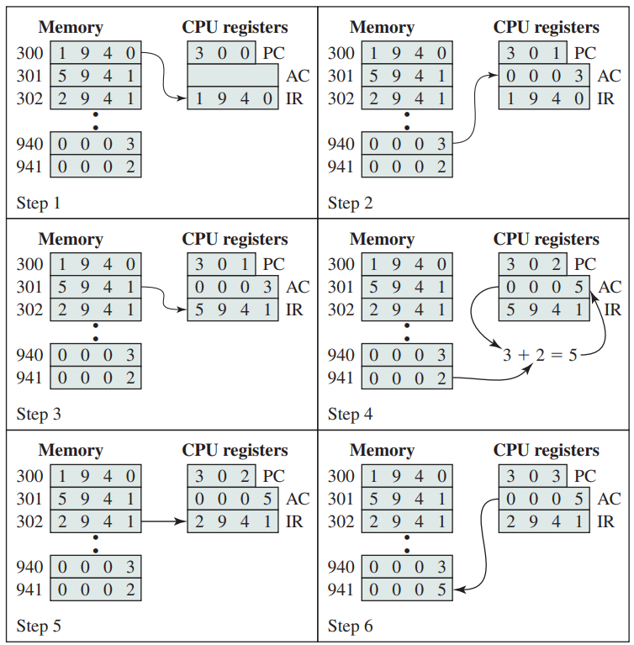
An Example of Program Execution Cycle
Step 1
Step 2
Sequence of Operation
Opcode determines that
AC is to be loaded from memory
Then ADD instruction
Then AC stored in location 941
? CPU needs more than one
Register to store second operand
Step 3
Step 4
Step 5
Step 6

Slide 12
How is an Assembly Instruction Formed?
As an example:
8 bits
24 bits
Opcode | Address / Data
32 bits
What happens with the full range of Address or Data ?
Answer: Different Addressing Modes

Slide 13
Readings
Chapter 2 of P&H Textbook

