Slide 1
Computer Organization and Assembly Language CS / EE 320 Spring 2024
Shahid Masud
Lecture 7

Slide 2
Topics
Working of MIPS Assembly Instructions
Jump Instructions
Branch Instructions
Examples of Different Instruction Type
Addressing Modes
Interrupt Processing
Control Instruction

Slide 3
Jump Instructions in MIPS ISA
J jump to 26-bit Address
JAL jump and link, return address stored in register ra
JAL is the only instruction that can access PC
JR jump to register ra, to return after processing JAL
JALR jump and link automatically to subroutine address and return address stored in ra

Slide 4
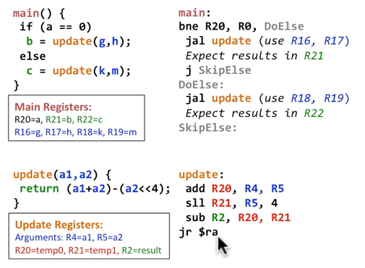
Procedure Call Example

Slide 5
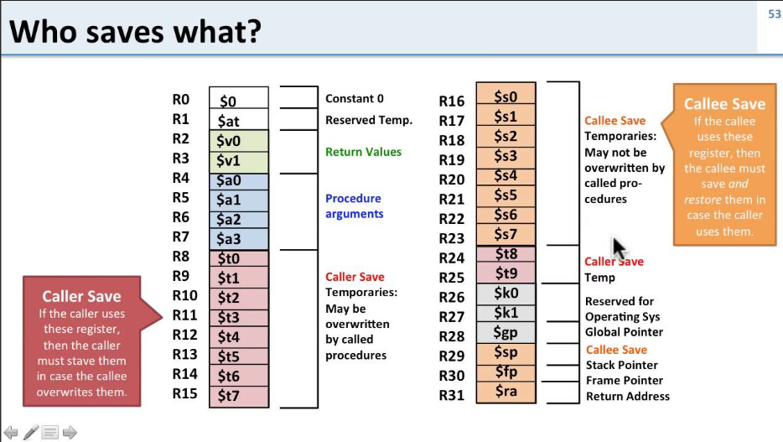
Register Convention – Caller and Callee
Ref: youtube channel of David Black-Schaffar

Slide 6
MIPS Instruction Format and Registers
Name | Fields |  |  |  |  |  | Comments
Field Size | 6 bits | 5 bits | 5 bits | 5 bits | 5 bits | 6 bits | All instr are 32 bits long
R Format | op | rs | rt | rd | shamt | funct | Arithmetic Instructions
I Format | Op | rs | rt | Address / Immediate (16 bits) |  |  | Transfer, Branch Instructions
J Format | Op | Target address (26 bits) |  |  |  |  | Jump Instructions
MIPS has 3 Instruction Formats, viz a viz Registers
R: operation 3 Registers 0 immediate
I: operation 2 Registers 16 bit immediate
J: jump 0 Registers 26 bit immediate

Slide 7
Immediate Instruction Example
Addi R6, R0, 100
R0 is constant Zero
Immediate Register has value 100 Decimal
Convert to Binary 16 bits
Sign Extend to full 32 bits
ALU adds sign extended (100) to Zero and stores result in register R6

Slide 8
Addi Instruction with a Negative Immediate
R3 = 12
addi R4, R3, -12
R3 is a 32 bit register contains 12 =
0000 0000 0000 0000 0000 0000 0000 1100
16 bit Immediate value -12 =
̶ (0000 0000 0000 1100)
-12 in Two’s Complement (with Sign Extension) =
1111 1111 1111 1111 1111 1111 1111 0100
Add Result → R4 = all Zeros
sign extension

Slide 9
Addresses in Branches and Jumps
Branch Instructions
bne/beq I-Format 16 bit Immediate
j J-Format 26 bit Immediate
But addresses are 32-bits, so:
Treat bne / beq as relative offset and add to current PC
Treat j as absolute value by replacing 26 bits of the PC

Slide 10
Evaluating PC from Immediate Address
The address provided by Jump Instruction can be ‘26 bits’
The address provided by Branch (bne, beq) Instruction can be ‘16 bits’
But all registers and memory addresses are 32 bits: So,
Branch
Jump
Current 32 bit PC
Current 32 bit PC
+ 4
26 bit Immediate
00
Sign Extend
16 bit Immediate
00
= Next 32 bit PC
00
= Next 32 bit PC
00

Slide 11
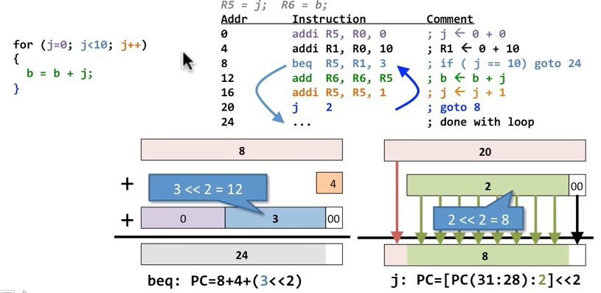
Loops and Jump Instructions - Example

Slide 12
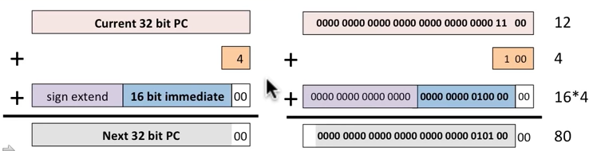
Example of Branch Destination
Instruction: bne R0, R1, 16 # Current Address is ‘12’
Question: What is the destination address when Branch is Taken?

Slide 13
Branch Addressing
Branch instructions specify
Opcode, two registers, target address
Most branch targets are near branch
Forward or backward
op
rs
rt
constant or address
6 bits
5 bits
5 bits
16 bits
PC-relative addressing
Target address = PC + offset × 4
PC already incremented by 4 by this time

Slide 14
Jump Addressing
Jump (j and jal) targets could be anywhere in text segment
Encode full address in instruction
op
address
6 bits
26 bits
(Pseudo) Direct jump addressing
Target address = PC_{31…28} : (address × 4)

Slide 15
Target Addressing Example
Loop code from earlier example
Assume Loop at location 80000
Loop: sll $t1, $s3, 2 | 80000 | 0 | 0 | 19 | 9 | 4 | 0
add $t1, $t1, $s6 | 80004 | 0 | 9 | 22 | 9 | 0 | 32
lw $t0, 0($t1) | 80008 | 35 | 9 | 8 | 0
bne $t0, $s5, Exit | 80012 | 5 | 8 | 21 | 2
addi $s3, $s3, 1 | 80016 | 8 | 19 | 19 | 1
j Loop | 80020 | 2 | 20000
Exit: … | 80024

Slide 16
Addressing Modes

Slide 17
Addressing Modes in Assembly Language
Immediate
Direct
Indirect
Register
Register Indirect
Displacement
Stack

Slide 18
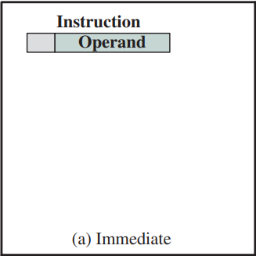
Immediate Addressing
The operand value is present in the instruction as Immediate
Operand = A
Mode is used to define Constants or Set Initial Values of Variables
Mostly, Immediate value is stored in 2’s Complement form
Advantage is that no other memory reference is required other than Instruction Fetch
Disadvantage is the limited range of address and data that can be specified in Immediate field

Slide 19
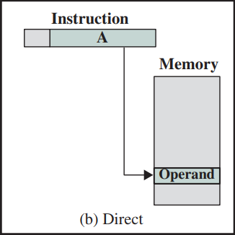
Direct Addressing
Address field contains Effective Address of Operand
It requires only one memory reference and no special calculations
Disadvantage is limited address space can be specified

Slide 20
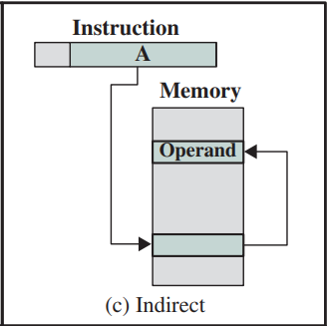
Indirect Addressing
The address field in Instruction refers to the address of a word in memory which in turn contains full-length address of the operand
Advantage is that full range of memory is accessible
Disadvantage is that two memory references are needed to fetch operand

Slide 21
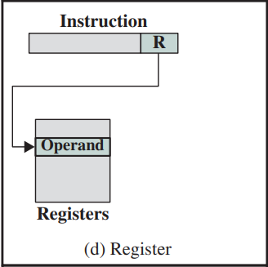
Register based Addressing
The address field in Instruction refers to a Register location
Effective Address is stored in this register
Advantage is that register access is fast and only one memory reference is needed to Fetch the operand
Disadvantage is that number of registers is limited so only few registers can be used for this addressing mode

Slide 22
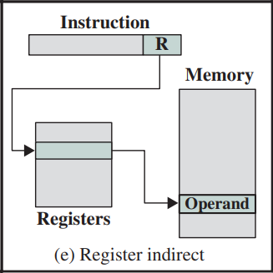
Register Indirect
The address field refers to a Register that contains Memory Address of operand
Limited number of registers is a constraint
Only one memory reference is needed to Fetch the operand

Slide 23
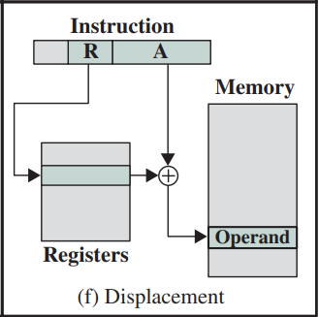
Displacement
Effective Address of operand is calculated by adding contents of ‘A’ Field in Instruction with contents of ‘R’ Register
The operand is then fetched from the Effective Address
Variants of this mode are:
PC Relative Addressing
Base Register Addressing (e.g. initial value in a String)
Indexing (storing in a sequence etc.)

Slide 24
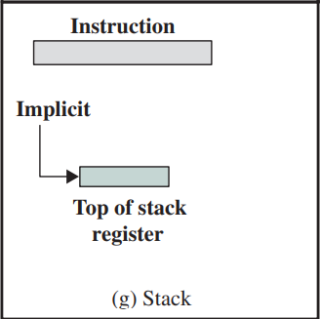
Stack based Addressing
Stack is a linear array of locations, also called ‘LIFO’ Last In
First Out queue
A Stack Pointer Register always contains address of the top of
the Stack
Implied Addressing uses Stack Pointer
Some Displacement could also be added to the Stack Pointer

Slide 25
Addressing Modes - Summary
Abbreviations:
A = Contents of Address field inside an Instruction
R = Contents of an Address field inside an Instruction that refers to a Register
(X) = contents contained in memory location X or register X
EA = Effective Address
Mode | Method | Advantage | Disadvantage
Immediate | Operand = A | No memory Reference | Limited Operand magnitude
Direct | EA = A | Simplicity | Limited address space
Indirect | EA = (A) | Large Address space | Multiple memory references
Register | EA = R | No memory reference | Limited Address space
Register Indirect | EA = (R) | Large Address space | Extra memory reference
Displacement | EA = A + (R) | Flexibility | Complexity
Stack | EA = top of stack, stack pointer | No memory reference | Limited usage and capability

Slide 26
Interrupts Processing

Slide 27
Interrupts
Mechanism by which other modules (e.g. I/O) may interrupt normal sequence of processing
Program Exception
e.g. overflow, division by zero
Timer
Generated by internal processor timer
Used in pre-emptive multi-tasking
I/O
from I/O controller
Hardware failure
e.g. memory parity error

Slide 28
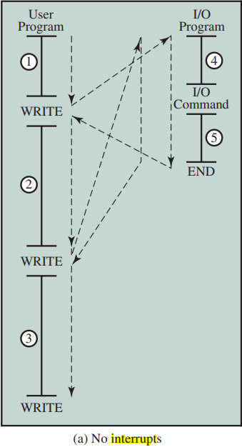
Normal Program Flow Control

Slide 29
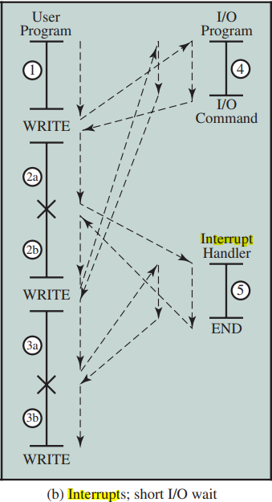
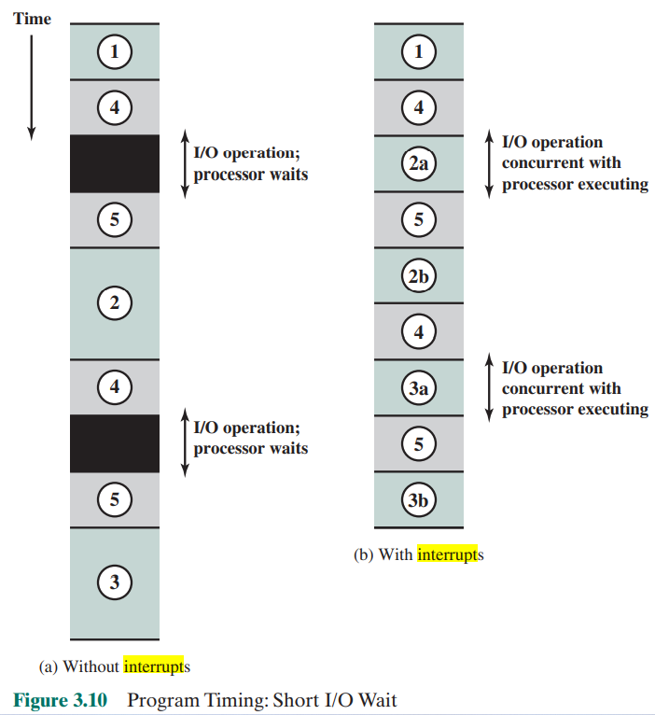
Program Timing: Short I/O Wait

Slide 30
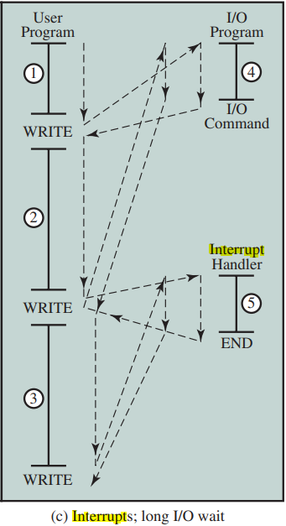
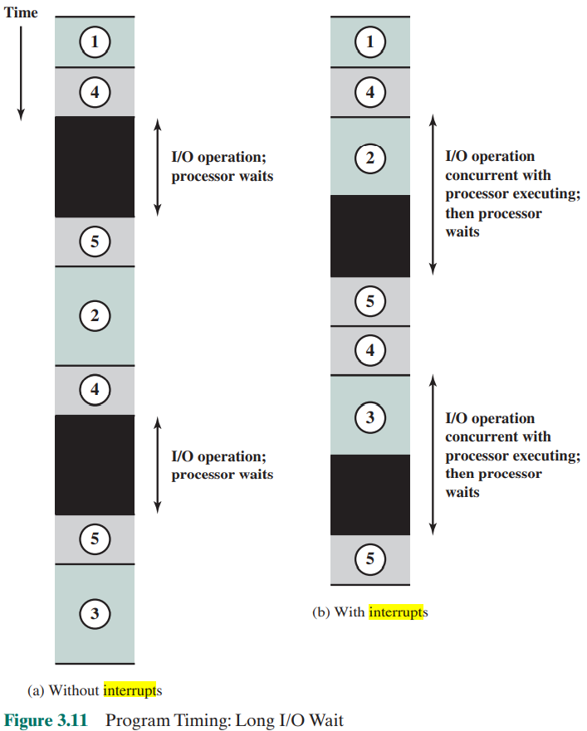
Program Timing: Long I/O Wait

Slide 31
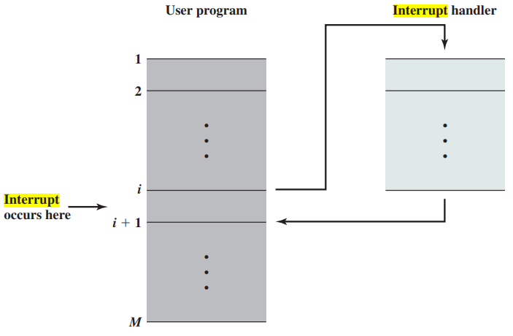
Transfer of Control via Interrupt

Slide 32
Interrupt Cycle
Added to instruction cycle
Processor checks for interrupt
Indicated by an interrupt signal
If no interrupt, fetch next instruction
If interrupt pending:
Suspend execution of current program
Save context
Set PC to start address of interrupt handler routine
Process interrupt
Restore context and continue interrupted program

Slide 33
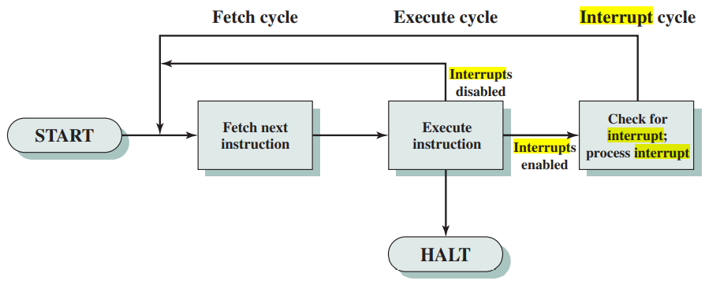
Instruction Cycle with Interrupts (Simplified)

Slide 34
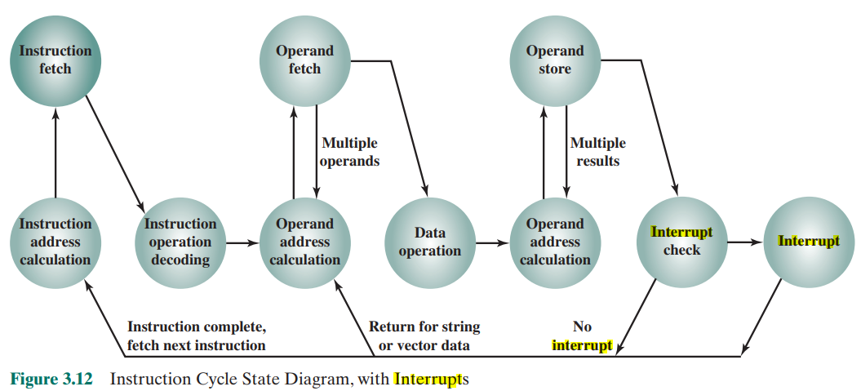
Instruction Cycle (with Interrupts) - State Diagram

Slide 35
Multiple Interrupts
Disable interrupts
Processor will ignore further interrupts whilst processing one interrupt
Interrupts remain pending and are checked after first interrupt has been processed
Interrupts handled in sequence as they occur
Define priorities
Low priority interrupts can be interrupted by higher priority interrupts
When higher priority interrupt has been processed, processor returns to previous interrupt

Slide 36
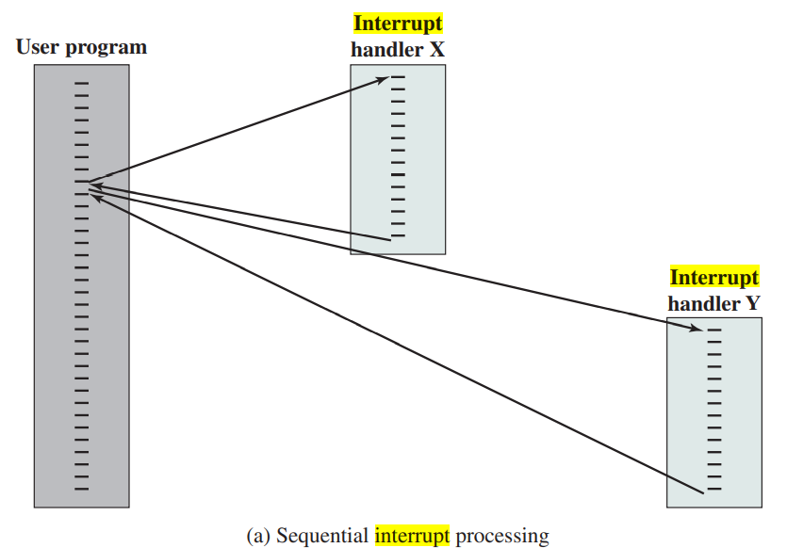
Multiple Interrupts - Sequential

Slide 37
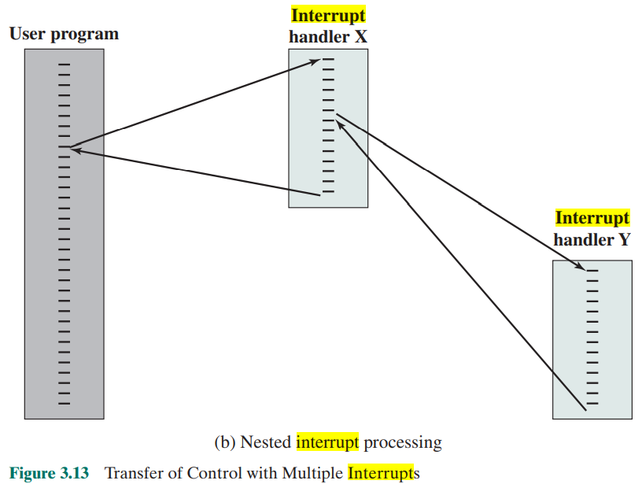
Multiple Interrupts - Nested

Slide 38
Interrupt Processing - Summary
Important Concepts:
Polled Approach vs Interrupt Approach
Exceptions and Interrupt Handling through Interrupt Servicing
Dealing with Multiple Interrupts through Nesting, Priority and Masking
Instruction Cycle including Interrupt Processing
Interrupt Service Routine ISR
Concept of Stack to store CPU Status, stack pointer $sp, LIFO

Slide 39
Readings
P&H Text Book, Chapter 2 and Appendix A
William Stallings books to read about Addressing Modes and Interrupts

