Slide 1
CS / EE 320
Computer Organization and Assembly Language
Spring 2024
Lecture 13
Shahid Masud
Topics: Topics: Introduction to CPU Design – Simple 1 Bit ALU

Slide 2
Topics
Start Chapter 4 of P&H Textbook
Some material in Appendix B of P&H Textbook, search Internet
Digital Elements that Preserve States (D Flip Flops)
CPU visualization as Combinational Element placed between two state elements, the Data path and Control path
Develop a 1 Bit ALU and scale up to 32 Bits
Basic Operations of ALU, AND,OR, ADD, SUB, NAND, NOR, Zero Detect, Compare, Overflow Detect
QUIZ 3 TODAY

Slide 3
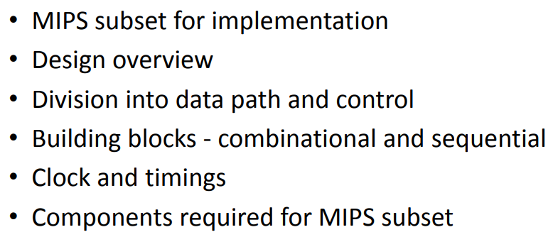
Simple Processor Design

Slide 4
Combinational Elements
AND-gate
  Y = A & B
Adder
  Y = A + B
A
+
Y
B
A
Y
B
Arithmetic/Logic Unit
  Y = F(A, B)
Multiplexer
  Y = S ? I1 : I0
A
I0
M
u
x
Y
Y
ALU
I1
B
S
F

Slide 5
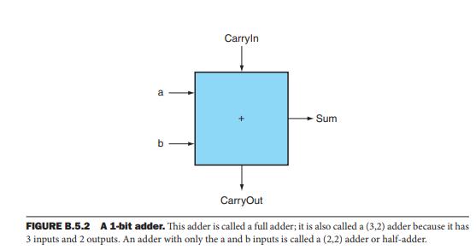
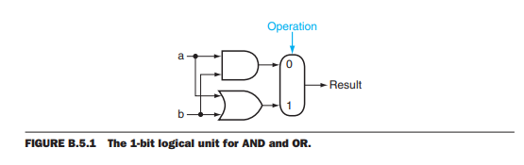
Building Blocks for 1 Bit ALU

Slide 6
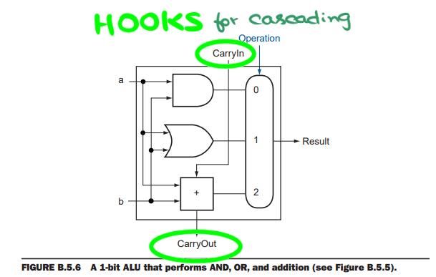
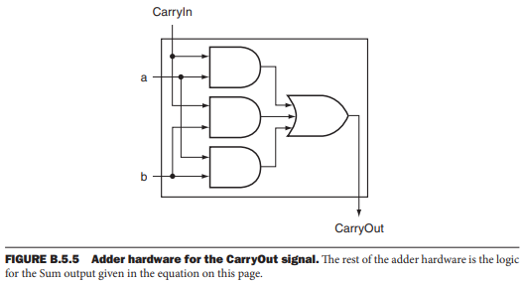
Carry Out and simple 1 Bit ALU

Slide 7
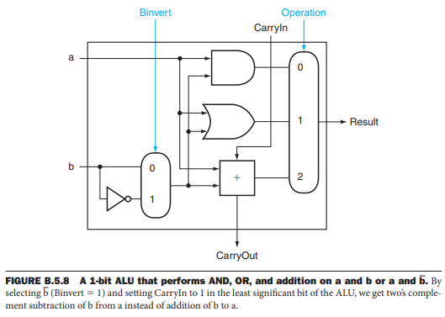
Simple 1 Bit ALU

Slide 8
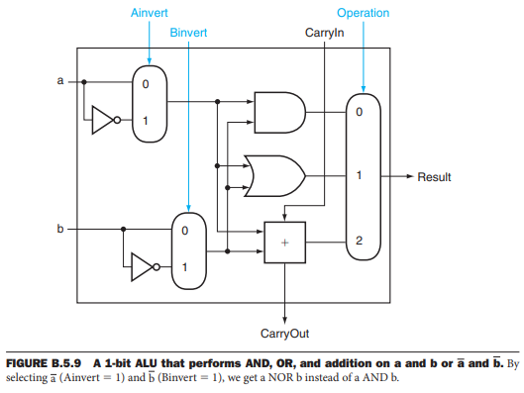
Some more functions in 1 Bit ALU

Slide 9
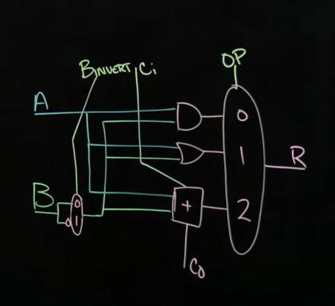
Developing Adder and Subtractor
AND
OR
ADD
SUB

Slide 10
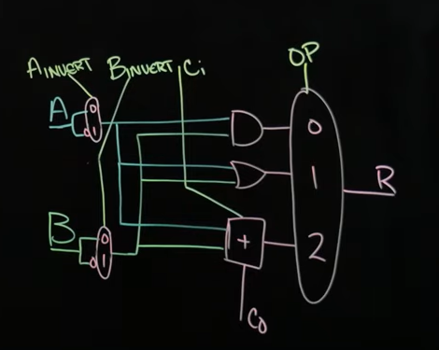
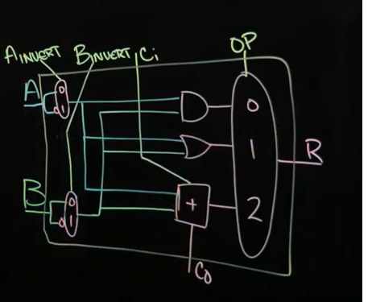
NAND and NOR added to 1 bit ALU
AND
OR
ADD
SUB
NAND
NOR

Slide 11
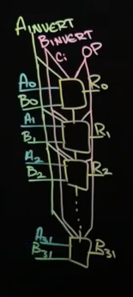
Repeat 32 ALU to make a 32 Bit ALU

Slide 12
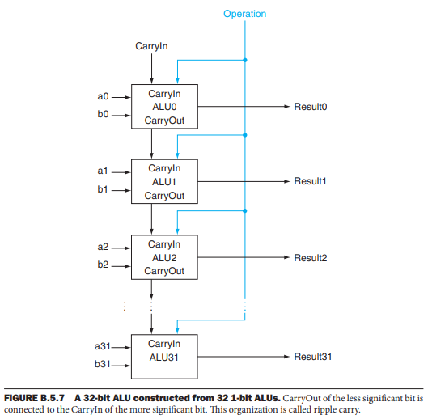
32 Bit Adder and Carry Chain

Slide 13
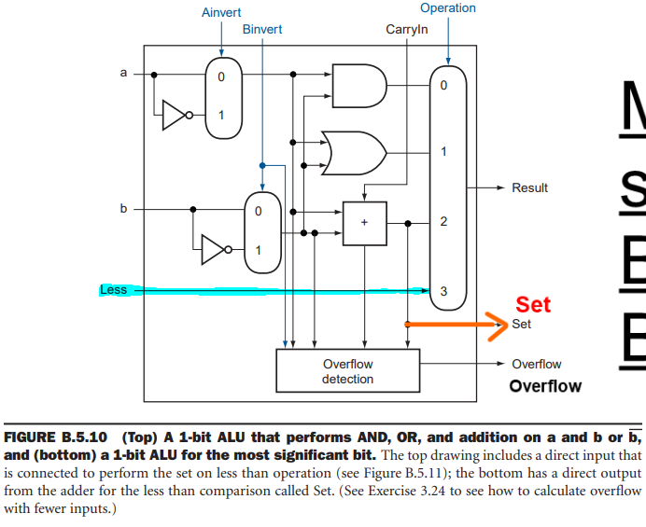
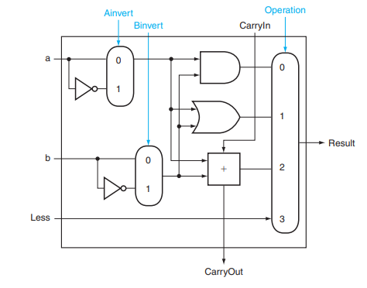
1 Bit ALU with Overflow, Set on less than

Slide 14
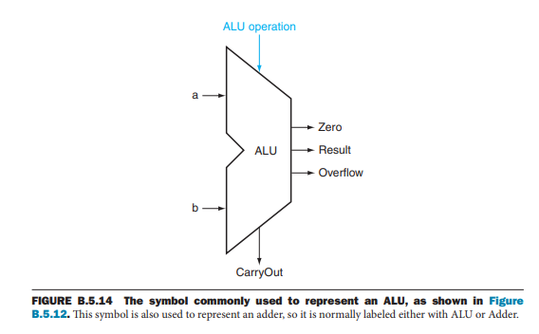
Symbol of 1 Bit ALU

Slide 15
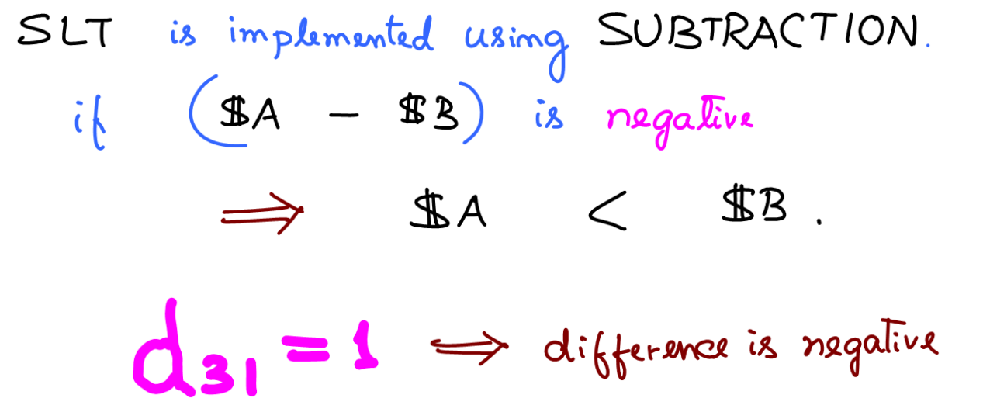
Set Less Than SLT instruction

Slide 16
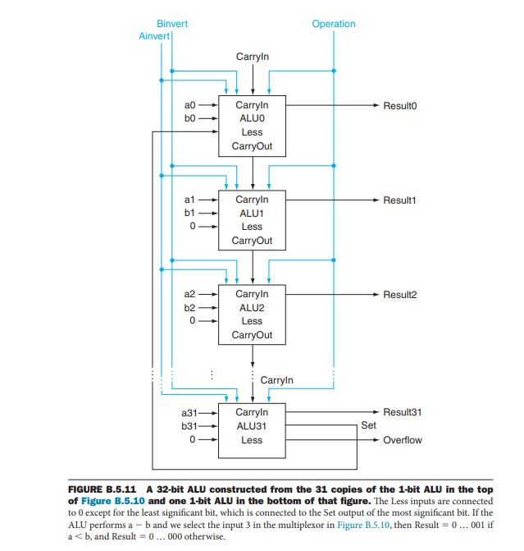
‘Less’ than Instruction

Slide 17
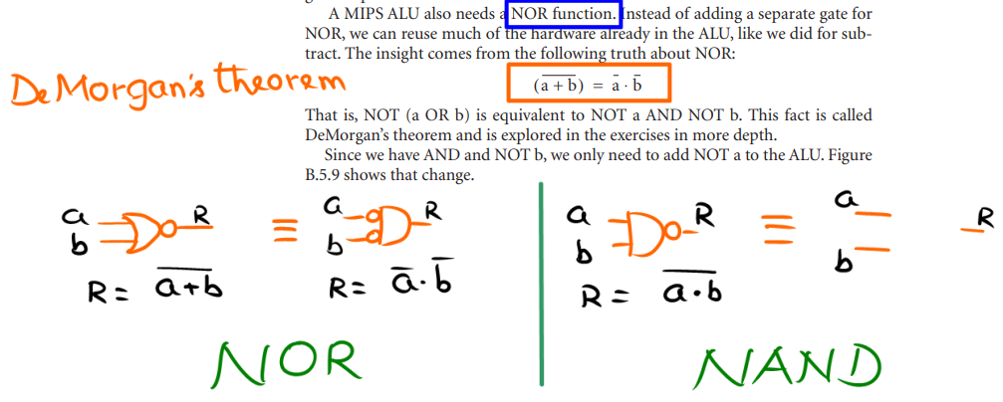
Nor and Nand Instructions

Slide 18
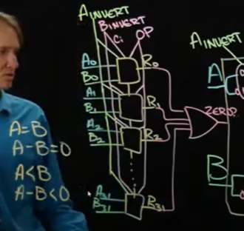
Adding Compare Instructions
Detect Zero
Use Adder and Subtractor
To Determine Sign of MSB.
This gives indication of
what number is bigger

Slide 19
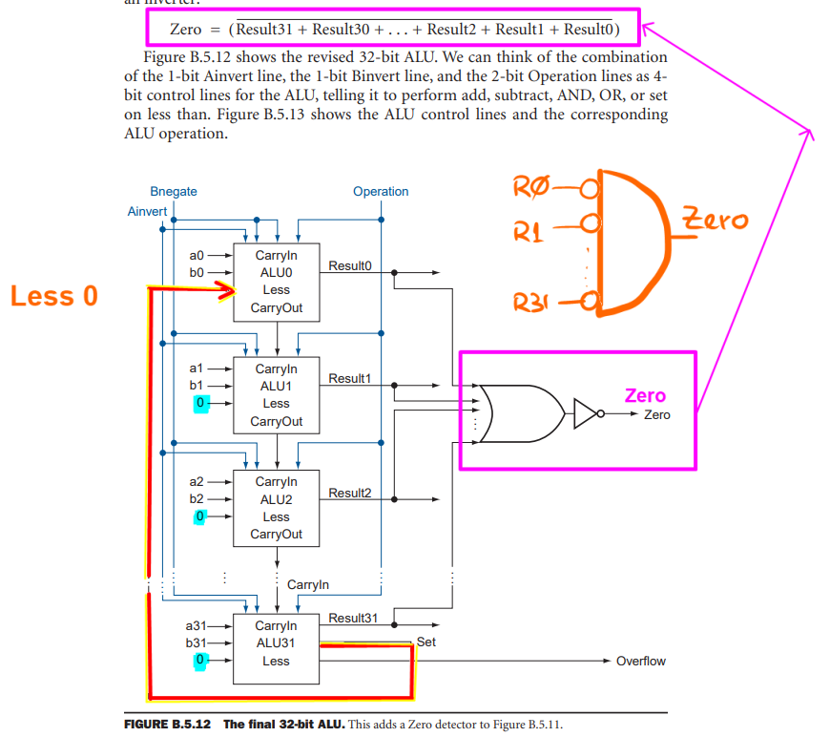
Zero detector Instruction

Slide 20
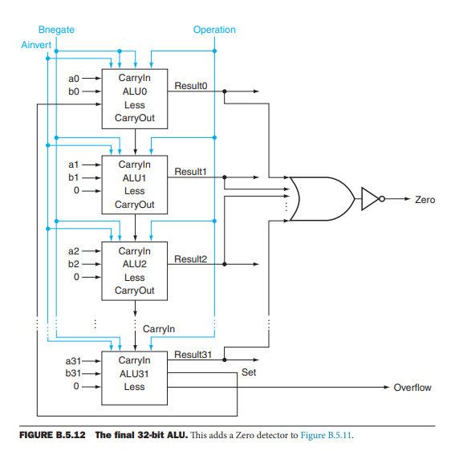
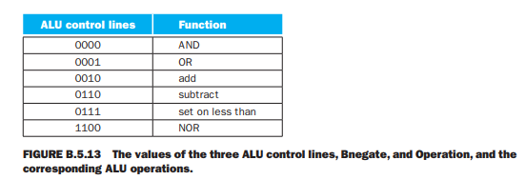
Final ALU

Slide 21
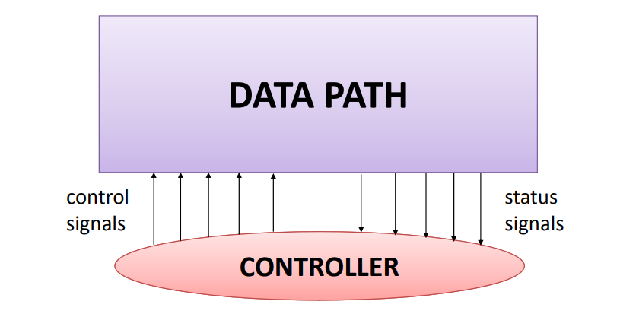
Data path and Control path in a CPU

Slide 22
Building a Datapath
Datapath
  Elements that process data and addresses
  in the CPU
    Registers, ALUs, mux’s, memories, …
We will build a MIPS datapath incrementally
  Refining the overview design

Slide 23
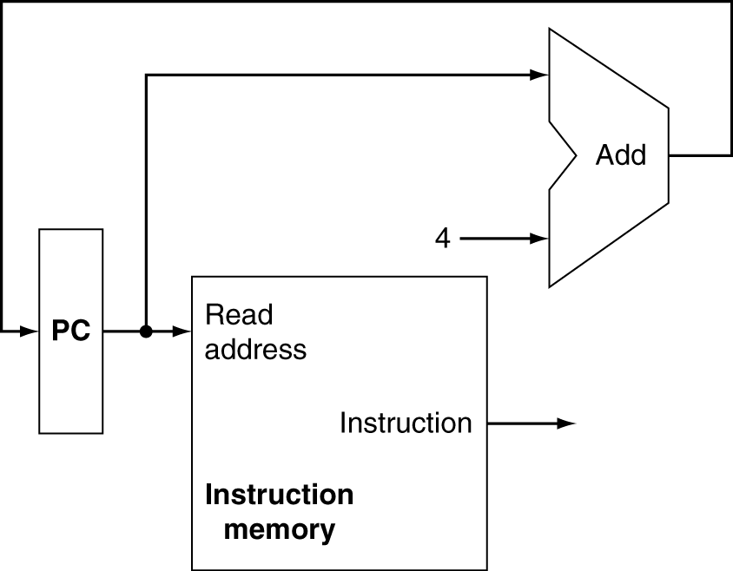
Instruction Fetch
Increment by 4 for next instruction
32-bit register

Slide 24
Readings
Chap 4 of P&H Textbook
Appendix B of P&H Textbook

