Slide 1
CS / EE 320
Computer Organization and Assembly Language
Spring 2024
Lecture 24
QUIZ 5
Today
Shahid Masud
Topics: Direct Mapped Cache, Associative and Set Associative Caches, Cache Miss Processing, Example questions, Cache Performance

Slide 2
Topics
Example of Direct Mapped Caches
Associative Cache Design
Set Associative Cache Design
Examples of calculating different parameters in Cache Design
Cache Replacement: LRU, LFU, FIFO, Random schemes
Cache Writes – Write Back and Write Through schemes
Some Examples of Cache Performance
Introduction to Multi-level Caches (examples in next lecture)

Slide 3
Principle of Locality
Programs access a small proportion of their address space at any time
Temporal locality
  Items accessed recently are likely to be accessed again soon
  e.g., instructions in a loop, induction variables
Spatial locality
  Items near those accessed recently are likely to be accessed soon
  E.g., sequential instruction access, array data

Slide 4
Cache Memory

Slide 5
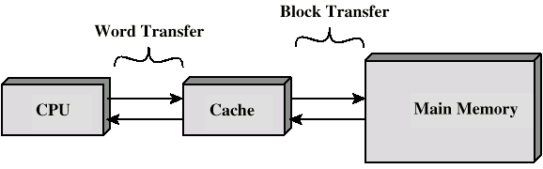
Cache and Memory
Small amount of fast memory
Sits between normal main memory and CPU
May be located on CPU chip or module
Transfer in
Bytes or Words
Transfer in
Lines or Blocks
Small, Fast, Expensive
Big, Slow and Low Cost

Slide 6
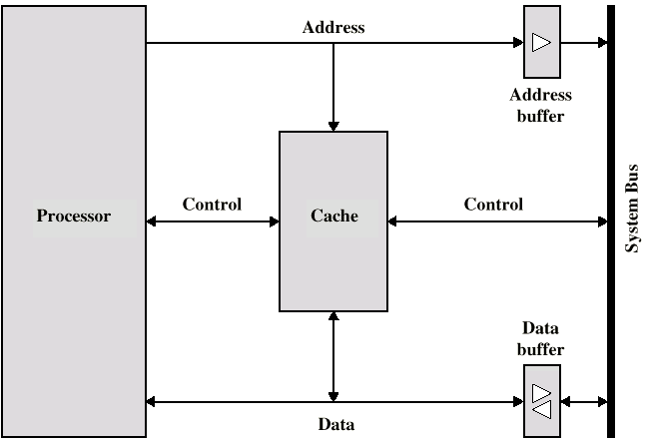
Typical Cache Connections

Slide 7
Cache operation - Overview
CPU requests contents of memory location
Check cache for this data
If present, get from cache (fast)
If not present, read required block from main memory to cache
Then deliver from cache to CPU
Cache includes tags to identify which block of main memory is in each cache slot

Slide 8
Cache Design Parameters – will discuss today
Size and Capacity
  How many lines?
  How many Words per line?
Mapping Function
  Direct, Associative, Set Associative
Replacement Algorithm
  LRU, FIFO, etc.
Write Policy
  Write Through vs Write Back
Number of Caches
  Levels of Caches

Slide 9
Direct Mapped Cache

Slide 10
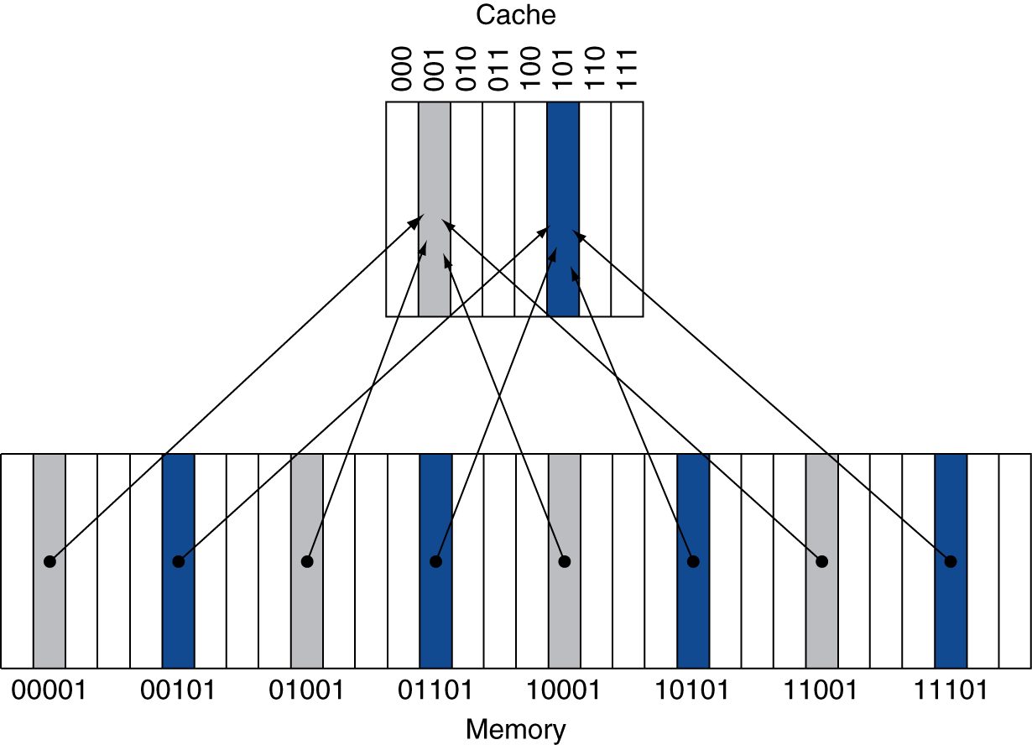
Direct Mapped Cache
Location determined by address
Direct mapped: only one choice
  (Block address) modulo (No. of Blocks in cache)
No of Blocks is a power of 2
Use low-order address bits

Slide 11
Direct Mapping Address Structure Example
Tag s-r
Line or Slot r
Word w
8
14
2
24 bit address
2 bit word identifier (4 byte block)
22 bit block identifier
  8 bit tag (=22-14)
  14 bit slot or line
No two blocks in the same line have the same Tag field
Check contents of cache by finding line and checking Tag

Slide 12
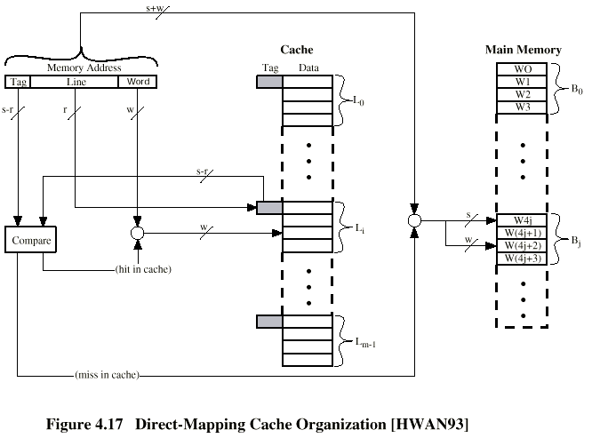
Direct Mapping Cache Organization – Read / Write

Slide 13
Mapping Function
Cache of 64 Kilo Byte
Cache block of 4 bytes
  i.e. cache is 16k (2¹⁴) lines of 4 bytes
16 Mega Bytes main memory
24 bit address
  (2²⁴=16M)

Slide 14
Direct Mapping Pros & Cons
Simple
Inexpensive
Fixed location for given block
  If a program accesses 2 blocks that map to the same line repeatedly, cache misses are very high

Slide 15
Block Size Considerations
Larger blocks should reduce miss rate
  Due to spatial locality
But in a fixed-sized cache
  Larger blocks ⇒ fewer of them
    More competition ⇒ increased miss rate
  Larger blocks ⇒ pollution
Larger miss penalty
  Can override benefit of reduced miss rate
  Early restart and critical-word-first can help

Slide 16
Tags and Valid Bits
How do we know which particular block is stored in a cache location?
  Store block address as well as the data
  Actually, only need the high-order bits
  Called the tag
What if there is no data in a location?
  Valid bit: 1 = present, 0 = not present
  Initially 0

Slide 17
Cache Example
8-blocks, 1 word/block, direct mapped
Initial state
Index | V | Tag | Data
000 | N
001 | N
010 | N
011 | N
100 | N
101 | N
110 | N
111 | N
V = Valid shows required data already present in cache or not

Slide 18
Cache Example
Word addr | Binary addr | Hit/miss | Cache block
22 | 10 110 | Miss | 110
Line Index | V | Tag | Data
000 | N
001 | N
010 | N
011 | N
100 | N
101 | N
110 | Y | 10 | Mem[10110]
111 | N

Slide 19
Cache Example
Word addr | Binary addr | Hit/miss | Cache block
26 | 11 010 | Miss | 010
Line Index | V | Tag | Data
000 | N
001 | N
010 | Y | 11 | Mem[11010]
011 | N
100 | N
101 | N
110 | Y | 10 | Mem[10110]
111 | N

Slide 20
Associative Mapped Cache

Slide 21
Associative Mapping
A main memory block can load into any line of cache
Memory address is interpreted as tag and word
Tag uniquely identifies block of memory
Every line’s tag is examined for a match
Cache searching gets expensive

Slide 22
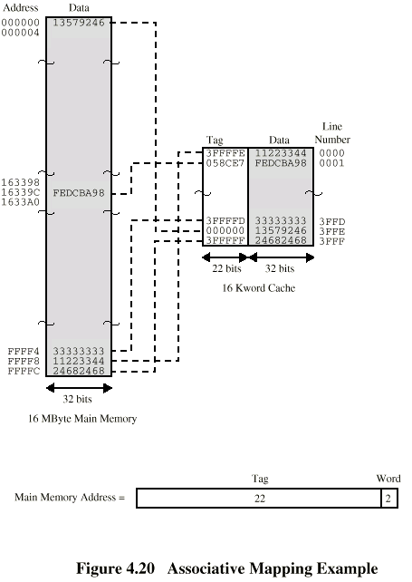
Associative Mapping Example

Slide 23
Associative Mapping Address Structure
Word
2 bit
Tag 22 bit
22 bit tag stored with each 32 bit block of data
Compare tag field with tag entry in cache to check for hit
Least significant 2 bits of address identify which byte (8bit) is required from 32 bit data block
e.g. (based 16 number (4bit))
  Address Tag Data Cache line
  FFFC FFFC 24682468 3FFF

Slide 24
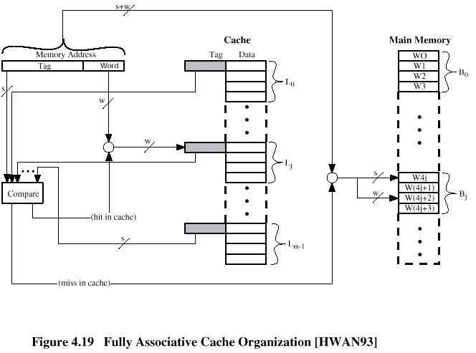
Fully Associative Cache Organization – Read / Write

Slide 25
How Much Associativity
Increased associativity decreases miss rate
  With diminishing returns
Example: Simulation of a system with 64KB D-cache, 16-word blocks, SPEC2000
  1-way: 10.3%
  2-way: 8.6%
  4-way: 8.3%
  8-way: 8.1%

Slide 26
Set Associative Mapped Cache

Slide 27
Set Associative Mapping
Cache is divided into a number of sets
Each set contains a number of lines
A given block maps to any line in a given set
  e.g. Block B can be in any line of set i
e.g. 2 lines per set
  2 way associative mapping
  A given block can be in one of 2 lines in only one set

Slide 28
Associative Caches (and Set Associative)
Fully associative
  Allow a given block to go in any cache entry
  Requires all entries to be searched at once
  Comparator per entry (expensive)
n-way set associative
  Each set contains n entries
  Block number determines which set
    (Block number) modulo (#Sets in cache)
  Search all entries in a given set at once
  n comparators (less expensive)

Slide 29
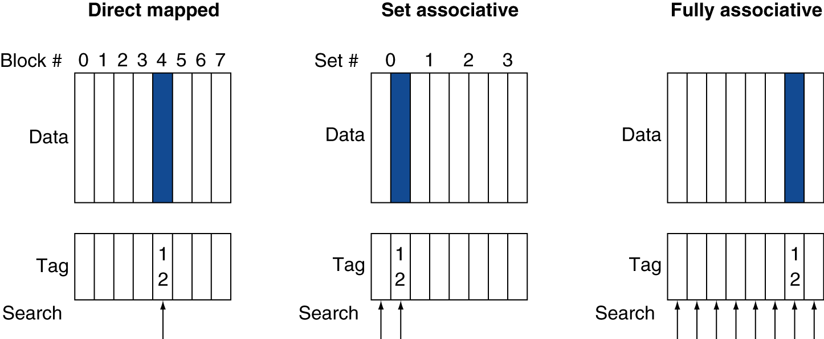
Associative Cache Example

Slide 30
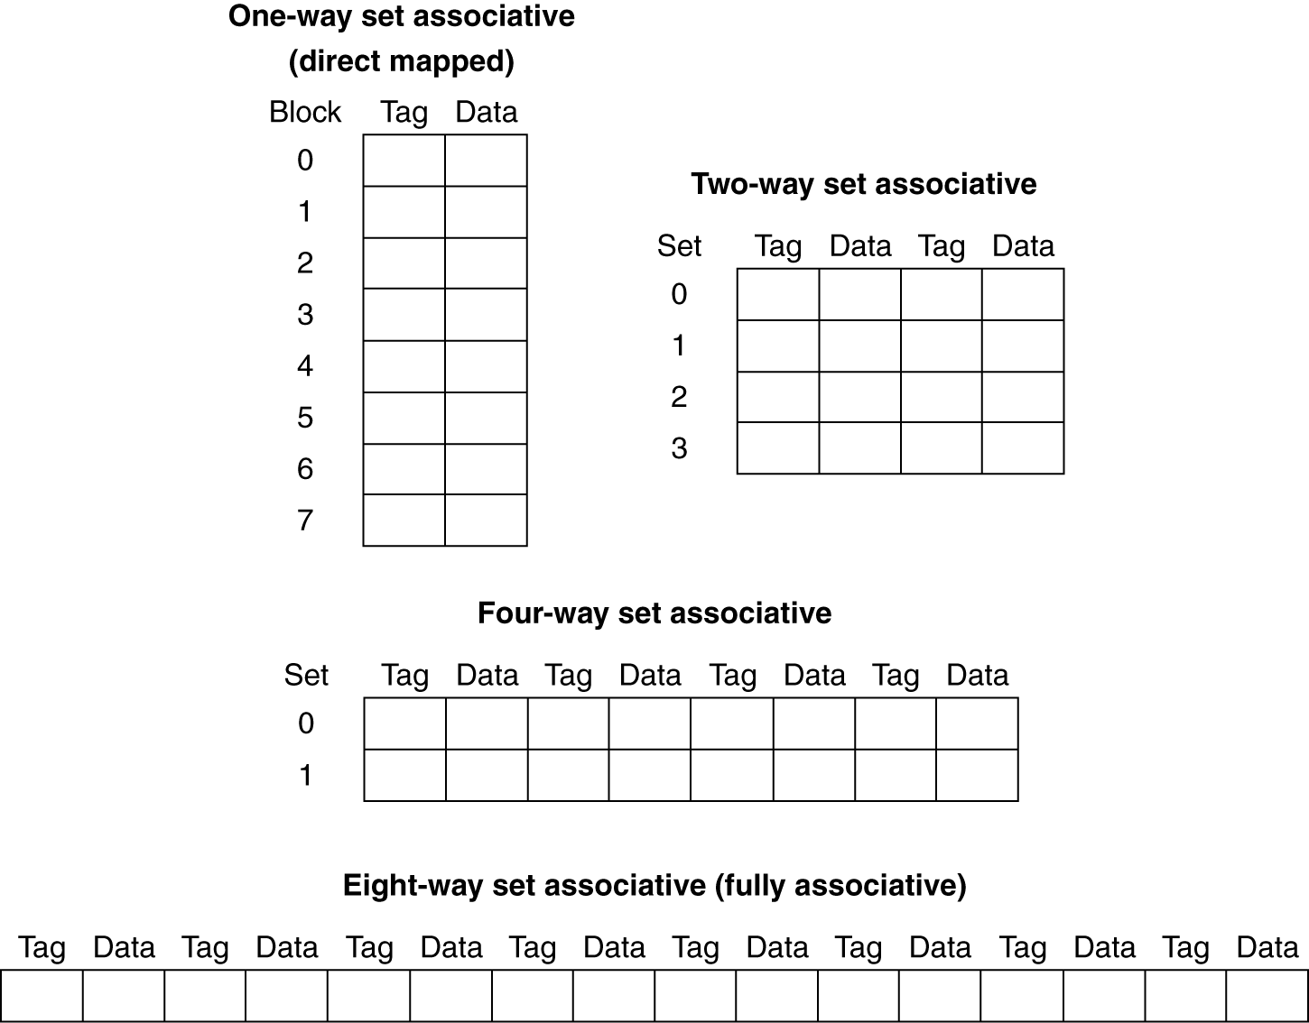
Spectrum of Associativity
For a cache with 8 entries

Slide 31
Associativity Example
Compare 4-block caches
  Direct mapped, 2-way set associative,
  fully associative
  Block access sequence: 0, 8, 0, 6, 8
Direct mapped
Block address | Cache index | Hit/miss | Cache content after access
 |  |  | 0 | 1 | 2 | 3
0 | 0 | miss | Mem[0]
8 | 0 | miss | Mem[8]
0 | 0 | miss | Mem[0]
6 | 2 | miss | Mem[0] |  | Mem[6]
8 | 0 | miss | Mem[8] |  | Mem[6]

Slide 32
Associativity Example
2-way set associative
Block address | Cache index | Hit/miss | Cache content after access
 |  |  | Set 0 |  | Set 1
0 | 0 | miss | Mem[0]
8 | 0 | miss | Mem[0] | Mem[8]
0 | 0 | hit | Mem[0] | Mem[8]
6 | 0 | miss | Mem[0] | Mem[6]
8 | 0 | miss | Mem[8] | Mem[6]
Fully associative
Block address |  | Hit/miss | Cache content after access
0 |  | miss | Mem[0]
8 |  | miss | Mem[0] | Mem[8]
0 |  | hit | Mem[0] | Mem[8]
6 |  | miss | Mem[0] | Mem[8] | Mem[6]
8 |  | hit | Mem[0] | Mem[8] | Mem[6]

Slide 33
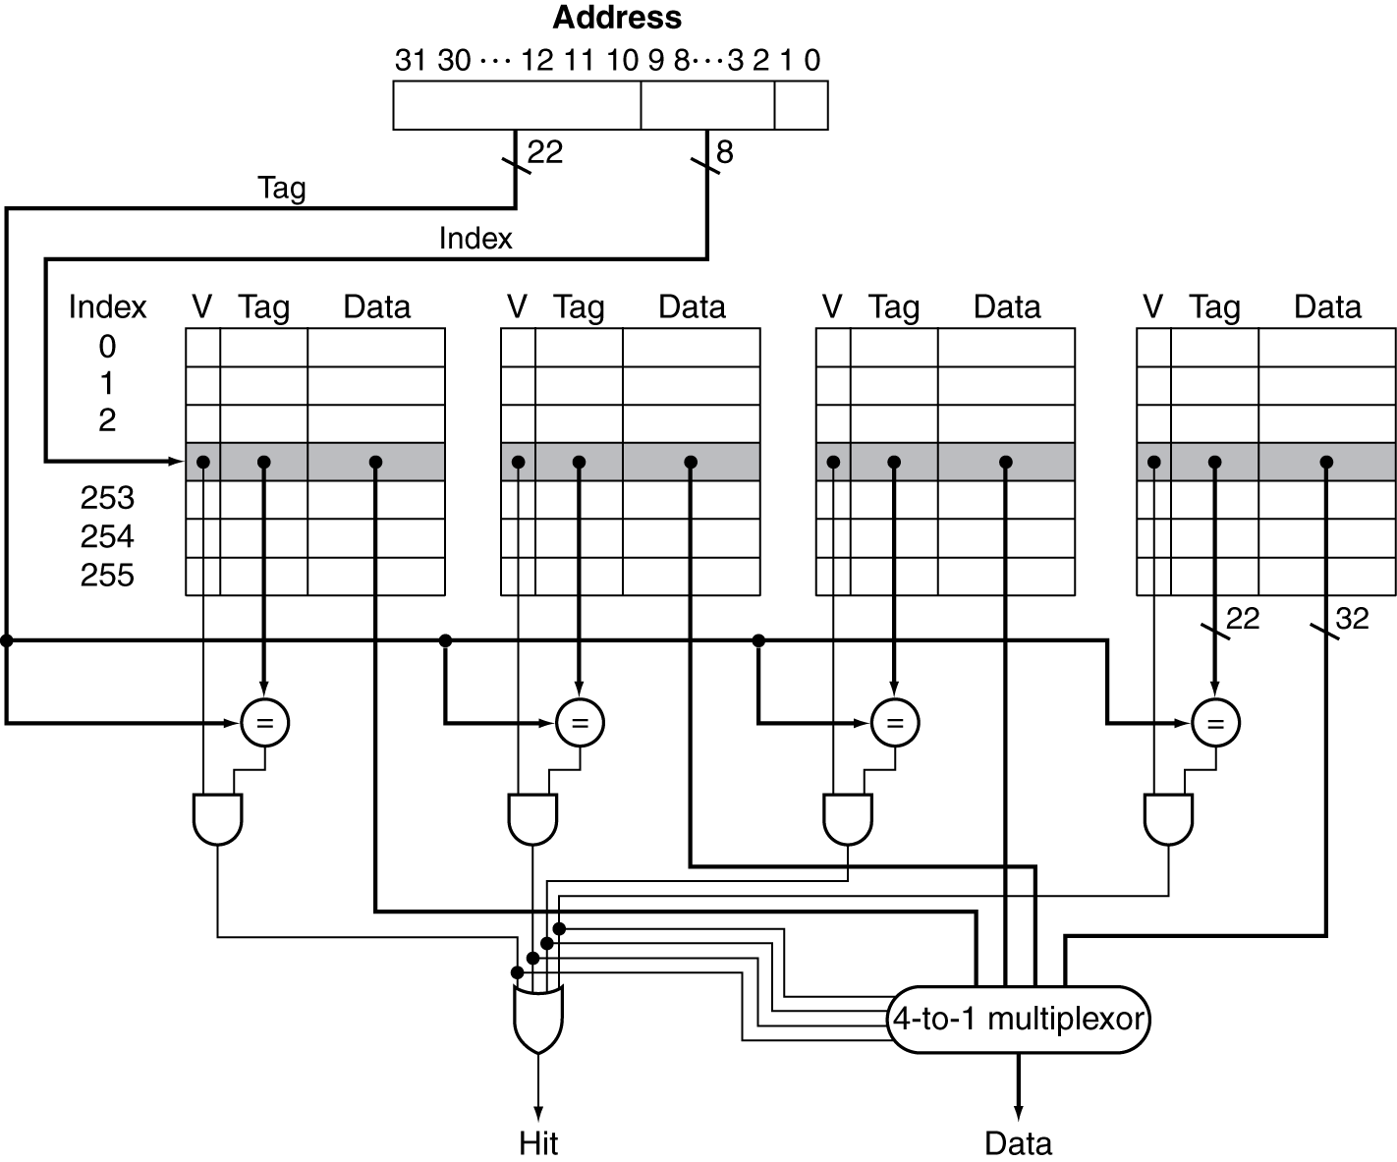
Set Associative Cache Organization

Slide 34
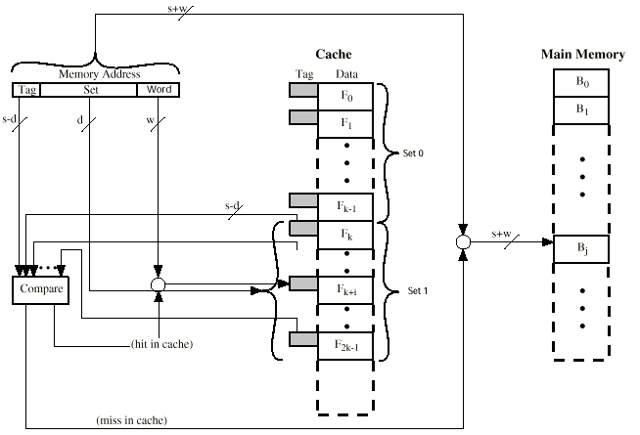
Set Associative Cache Organization

Slide 35
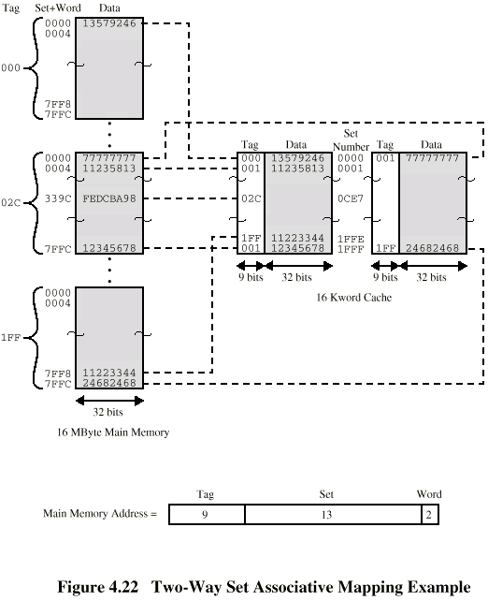
Two Way Set Associative Mapping Example

Slide 36
Set Associative Mapping Address Structure
Word
2 bit
Tag 9 bit
Set 13 bit
Use set field to determine cache set to look in
Compare tag field to see if we have a hit
e.g.
  Address Tag Data Set number
  1FF 7FFC 1FF 12345678 1FFF
  001 7FFC 001 11223344 1FFF

Slide 37
Dealing with Cache Miss and Cache Line Replacement

Slide 38
Cache Misses
On cache hit, CPU proceeds normally
On cache miss
  Stall the CPU pipeline
  Fetch block from next level of hierarchy
  Instruction cache miss
    Restart instruction fetch
  Data cache miss
    Complete data access

Slide 39
Sources of Misses
Compulsory misses (aka cold start misses)
  First access to a block
Capacity misses
  Due to finite cache size
  A replaced block is later accessed again
Conflict misses (aka collision misses)
  In a non-fully associative cache
  Due to competition for entries in a set
  Would not occur in a fully associative cache of the same total size

Slide 40
Replacement Algorithms (1) Direct mapping
No choice
Each block only maps to one line
Replace that line

Slide 41
Replacement Algorithms (2)
Associative & Set Associative
Hardware implemented algorithm (speed)
Least Recently used (LRU)
e.g. in 2 way set associative
  Which of the 2 block is lru?
First in first out (FIFO)
  replace block that has been in cache longest
Least frequently used
  replace block which has had fewest hits
Random

Slide 42
Write Policy
Must not overwrite a cache block unless main memory is up to date
Multiple CPUs may have individual caches
I/O may address main memory directly

Slide 43
Write through
All writes go to main memory as well as cache
Multiple CPUs can monitor main memory traffic to keep local (to CPU) cache up to date
Lots of traffic
Slows down writes

Slide 44
Write-Through
On data-write hit, could just update the block in cache
  But then cache and memory would be inconsistent
Write through: also update memory
But makes writes take longer
  e.g., if base CPI = 1, 10% of instructions are stores, write to memory takes 100 cycles
    Effective CPI = 1 + 0.1×100 = 11
Solution: write buffer
  Holds data waiting to be written to memory
  CPU continues immediately
    Only stalls on write if write buffer is already full

Slide 45
Write back
Updates initially made in cache only
Update bit for cache slot is set when update occurs
If block is to be replaced, write to main memory only if update bit is set
Other caches get out of sync
I/O must access main memory through cache
N.B. 15% of memory references are writes

Slide 46
Write-Back
Alternative: On data-write hit, just update the block in cache
  Keep track of whether each block is dirty
When a dirty block is replaced
  Write it back to memory
  Can use a write buffer to allow replacing block to be read first

Slide 47
Write Miss
What should happen on a write miss?
Alternatives for write-through
  Allocate on miss: fetch the block
  Write around: don’t fetch the block
    Since programs often write a whole block before reading it (e.g., initialization)
For write-back
  Usually fetch the block

Slide 48
Block Placement
Determined by associativity
  Direct mapped (1-way associative)
    One choice for placement
  n-way set associative
    n choices within a set
  Fully associative
    Any location
Higher associativity reduces miss rate
  Increases complexity, cost, and access time

Slide 49
Cache Design Trade-offs
Design change | Effect on miss rate | Negative performance effect
Increase cache size | Decrease capacity misses | May increase access time
Increase associativity | Decrease conflict misses | May increase access time
Increase block size | Decrease compulsory misses | Increases miss penalty. For very large block size, may increase miss rate due to pollution.

Slide 50
Cache Control
Example cache characteristics
  Direct-mapped, write-back, write allocate
  Block size: 4 words (16 bytes)
  Cache size: 16 KB (1024 blocks)
  32-bit byte addresses
  Valid bit and dirty bit per block
  Blocking cache
    CPU waits until access is complete
31
10
9
4
3
0
Tag
Index
Offset
18 bits
10 bits
4 bits

Slide 51
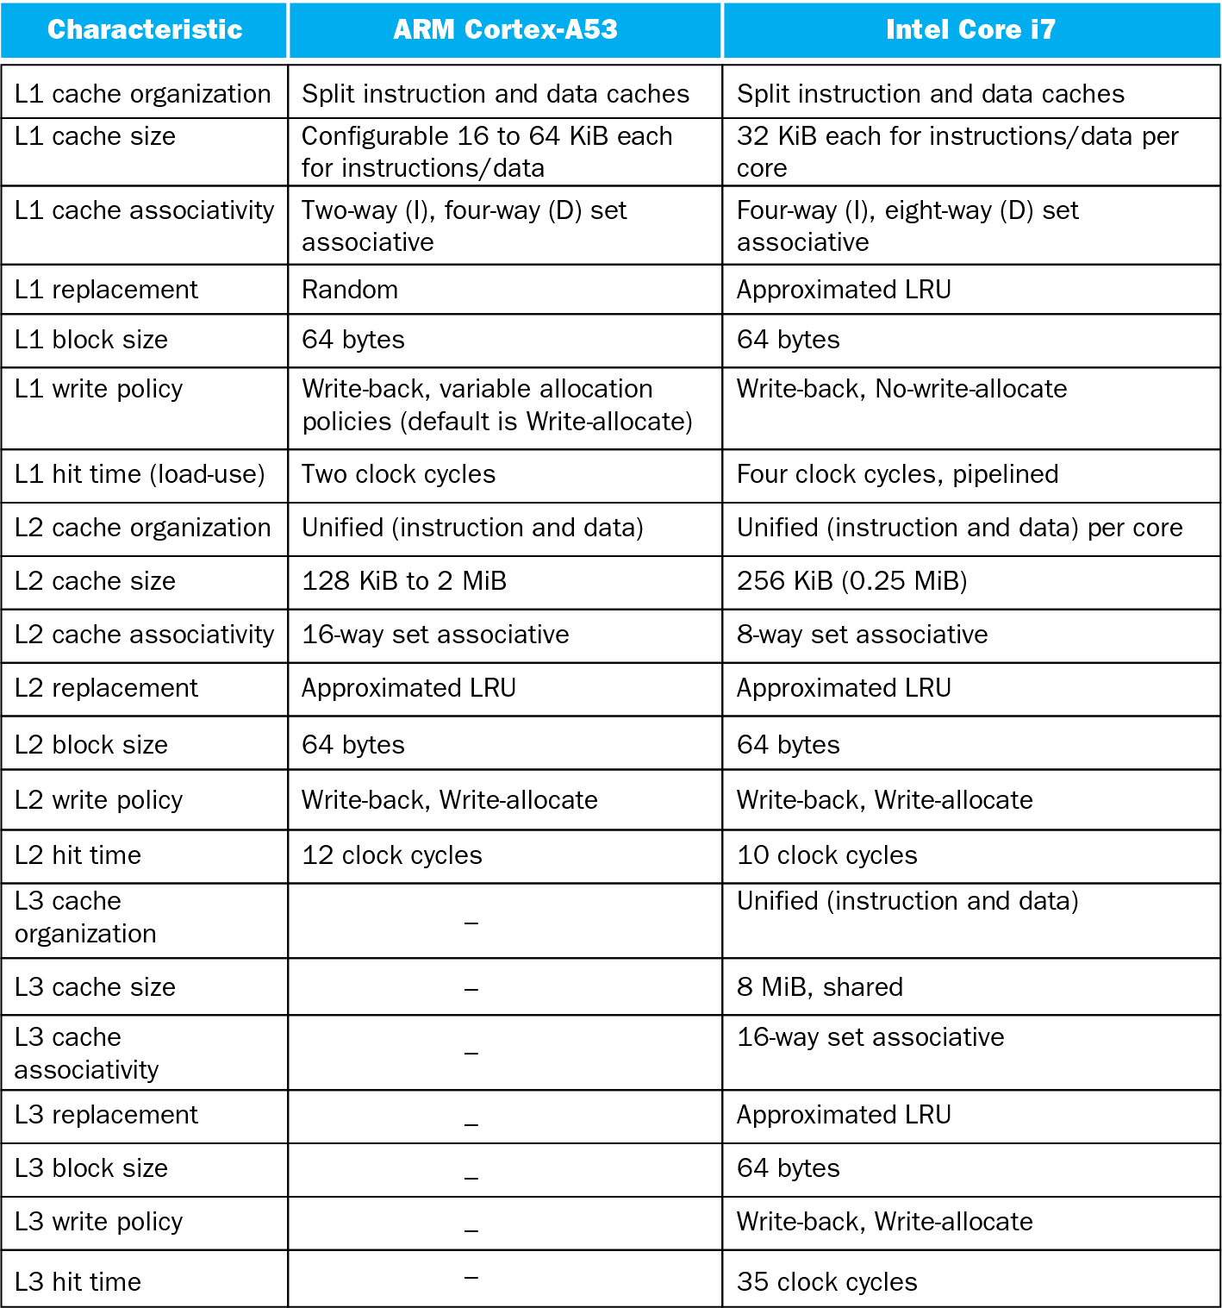
Multilevel On-Chip Caches

Slide 52
Concluding Remarks
Fast memories are small, large memories are slow
  We really want fast, large memories
  Caching gives this illusion
Principle of locality
  Programs use a small part of their memory space frequently
Memory hierarchy
  L1 cache ↔ L2 cache ↔ … ↔ DRAM memory ↔ disk
Memory system design is critical for multiprocessors

Slide 53
Readings
Chap 5 of P&H Textbook

