Slide 1
CS / EE 320
Computer Organization and Assembly Language
Spring 2024
Lecture 18
Shahid Masud
Topics: 5 stage pipelined MIPS, pipeline hazards

Slide 2
Topics
Hazards in Pipelining
Structural Hazards due to hardware constraints, Von-Neuman, Memory access limitations, etc.
Data Hazards
  Stall operation
  Forwarding Operation
Control Hazards
  Branch Prediction
Examples of Different Types of Hazards
Pipeline Diagrams of Different Types of Hazards

Slide 3
Pipeline Hazards

Slide 4
Problems in Pipelined CPU Architecture
Limits to pipelining: Hazards prevent next instruction from executing during its designated clock cycle:
  Structural hazards: HW cannot support this combination of instructions (single person to fold and put clothes away)
  Data hazards: Instruction depends on result of prior instruction still in the pipeline (missing clothes)
  Control hazards: Pipelining of branches & other instructions that change the PC
  Common solution is to “stall” the pipeline until the hazard is resolved, inserting one or more “bubbles” in the pipeline

Slide 5
Data Hazards – in a nutshell
Cause Stalls in Pipelines as Data required by succeeding instructions in pipeline is not yet available in memory or registers
Following measures are possible to ensure correct operation and improve CPU throughput:
  Introducing NOP instructions that add wait states in pipelines
  Instruction Re-ordering so that instructions without Dependencies are processed earlier to allow sufficient time for Depenedencies
  Equip ALU with Forwarding where ALU output can be directly connected to
  ALU input to handle data dependencies
Look at some code examples to improve throughput using NOP and Forwarding

Slide 6
MIPS CPU with Pipeline
Comprises Five distinct stages, one operation step per stage
  IF: Instruction fetch from memory
  ID: Instruction decode & register read
  EX: Execute operation or calculate address
  MEM: Access memory operand
  WB: Write result back to register

Slide 7
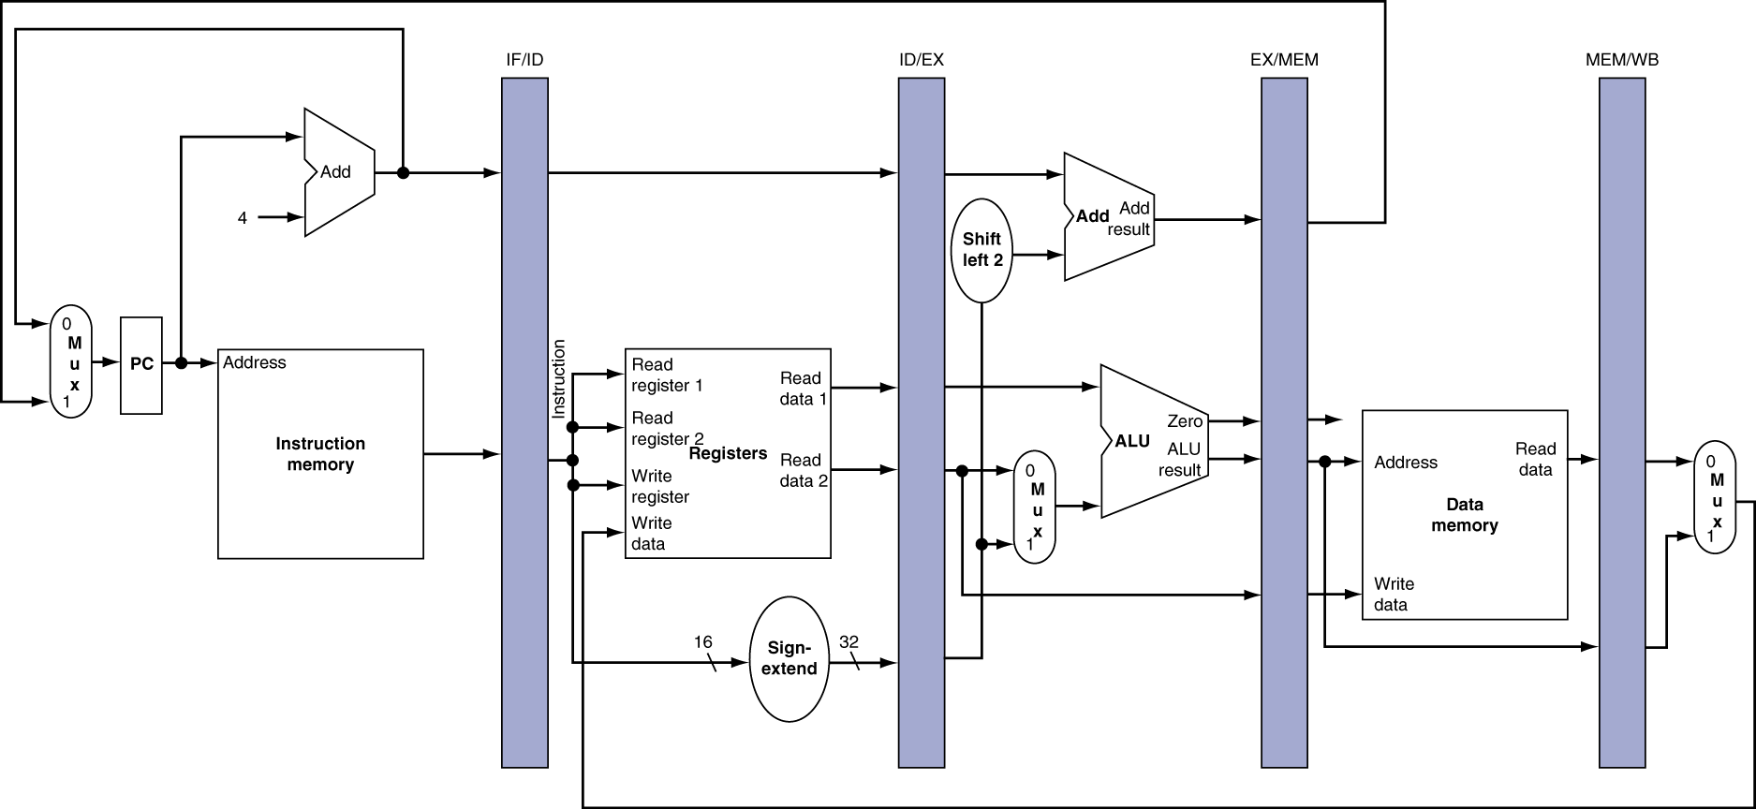
Pipeline Registers in MIPS CPU
Need registers between stages
  To hold information produced in previous cycle, required in subsequent cycles

Slide 8
The Basic Pipeline For MIPS – Simplified Diagram
Cycle 1
Cycle 2
Cycle 3
Cycle 4
Cycle 5
Cycle 6
Cycle 7
I
n
s
t
r.
O
r
d
e
r
Ifetch
Reg
ALU
DMem
Reg
Ifetch
Reg
ALU
DMem
Reg
Ifetch
Reg
ALU
DMem
Reg
Ifetch
Reg
ALU
DMem
Reg

Slide 9
Structural Hazard

Slide 10
Structural Hazards - Reason
Conflict situation for use of a hardware resource
In MIPS pipeline with a single memory
  Load/store requires data access
  Instruction fetch would have to stall for that cycle
    Would cause a pipeline “bubble”
Hence, pipelined data paths require separate instruction/data memories
  Or separate instruction/data caches

Slide 11
Structural hazards
If not all possible combinations of instructions can be executed, structural hazards occur
Pipelines stall result of this hazard, CPI increased from the usual “1”
Avoid structural hazards by duplicating resources
– e.g. an ALU to perform an arithmetic operation and an adder to increment PC

Slide 12
Common Structural Hazards
Some common Structural Hazards:
Memory – same memory for reads and writes
Floating point - Since many floating point instructions require many cycles, it’s easy for them to interfere with the other
Same reasoning for other special hardware units
Structural hazards are reduced with these rules:
Each instruction uses a resource at most once
Always use the resource in the same pipeline stage
Use the resource for one cycle only
(More in the pipeline diagrams in following slides)

Slide 13
Structural Hazards
Time (clock cycles)
Cycle 1
Cycle 2
Cycle 3
Cycle 4
Cycle 5
Cycle 6
Cycle 7
When two or more different instructions want to use same hardware resource in the same cycle
e.g., MEM uses the same memory port as IF as shown in this slide
I
n
s
t
r.
O
r
d
e
r
Load
Ifetch
Reg
ALU
DMem
Reg
Instr 1
Ifetch
Reg
ALU
DMem
Reg
Instr 2
Ifetch
Reg
ALU
DMem
Reg
Instr 3
Ifetch
Reg
ALU
DMem
Reg
Instr 4
Ifetch
Reg
ALU
DMem
Reg

Slide 14
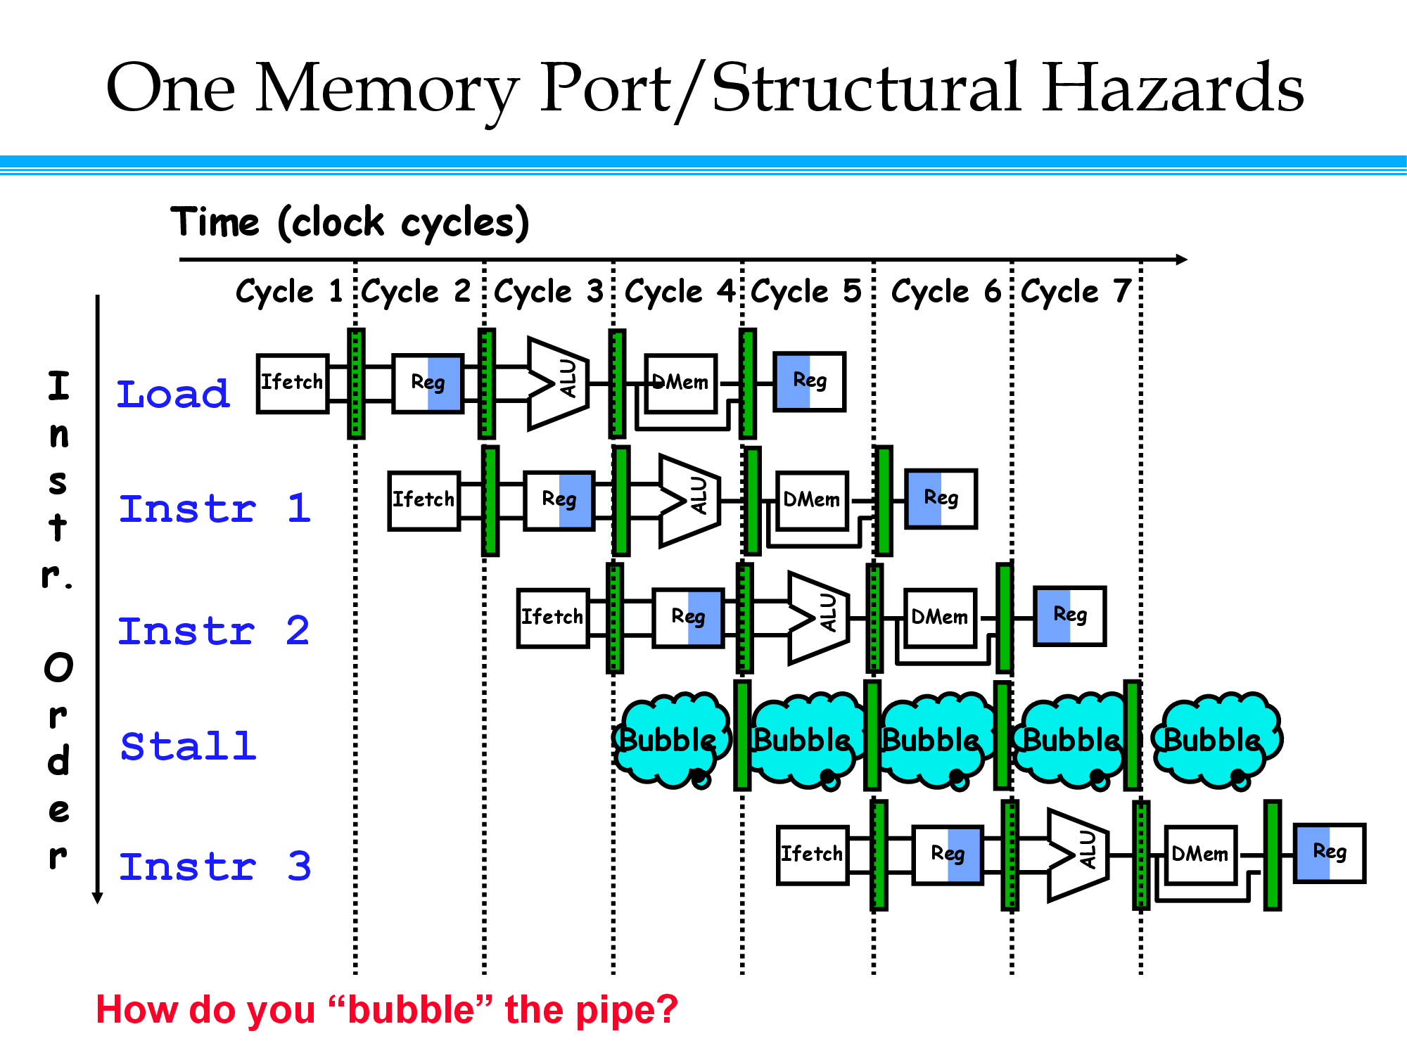

Slide 15
Or, alternatively – in a table
Clock Number
Inst. # | 1 | 2 | 3 | 4 | 5 | 6 | 7 | 8 | 9 | 10
LOAD | IF | ID | EX | MEM | WB
Inst. i+1 |  | IF | ID | EX | MEM | WB
Inst. i+2 |  |  | IF | ID | EX | MEM | WB
Inst. i+3 |  |  |  | stall | IF | ID | EX | MEM | WB
Inst. i+4 |  |  |  |  |  | IF | ID | EX | MEM | WB
Inst. i+5 |  |  |  |  |  |  | IF | ID | EX | MEM
Inst. i+6 |  |  |  |  |  |  |  | IF | ID | EX
LOAD instruction “steals” an instruction fetch cycle which will cause the pipeline to stall.
Thus, no instruction completes on clock cycle 8

Slide 16
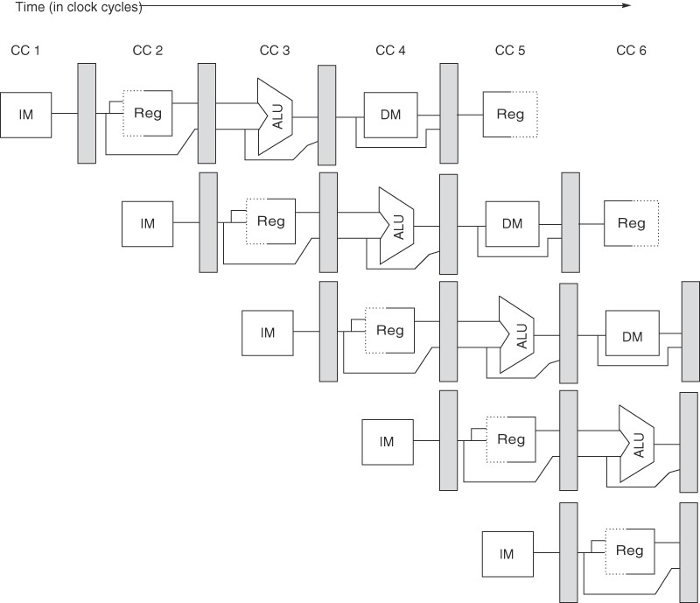


Structural Hazards
1. Unified memory for instruction and data
2. Register file with shared read/write access ports
R1 Mem[R2]
R3 Mem[R20] R6 R4-R5
R7 R1+R0
Separate inst. and data memories.

Slide 17


Structural Hazards
Structural Hazard due to Register file with shared read/write access ports
R1 Mem[R2]
R3 Mem[R20] R6 R4-R5
R7 R1+R0
Solution:
Register access in half cycles.

Slide 18
What is realistic solution of Structural Hazard?
Answer: Add more hardware.
  (especially for the memory access example – i.e. the common case)
    CPI degrades quickly from our ideal ‘1’ for even the simplest of cases…

Slide 19
Data Hazard

Slide 20
Data Hazards
These occur when, at any time, there are instructions active that need to access the “same data (memory or register) locations ”.
Where there’s real trouble is when we have two instructions:
instruction A
instruction B
and B manipulates (reads or writes) data before A does.
This violates the order of the instructions, since the architecture implies that A completes entirely before B is executed.

Slide 21
Data hazards
These exist because of pipelining
Why do they exist???
  Pipelining changes "when" data operands are read and written
  Order differs from order seen by sequentially executing instructions on non-pipelined machine
Consider this example:
  ADD R1, R2, R3
  SUB R4, R1, R5
  AND R6, R1, R7
  OR R8, R1, R9
– XOR R10, R1, R11
All instructions after ADD use result of ADD
ADD writes the register in WB but SUB needs it in ID.
This is a data hazard

Slide 22
Illustrating a Data Hazard
CC 1 CC 2 CC 3 CC 4
CC 5 CC 6
ADD R1, R2, R3
Mem
Reg
ALU
DM
Reg
SUB R4, R1, R5
Mem
Reg
ALU
DM
Reg
AND R6, R1, R7
Mem
Reg
ALU
DM
OR R8, R1, R9
Mem
Reg
ALU
XOR R10, R1, R11
Mem
Reg
Time
ADD instruction causes a hazard in next 3 instructions because register not written until after those 3 read it.

Slide 23
Data Hazard Types
There are actually 3 different kinds of data hazards:
  Read After Write (RAW)
  Write After Write (WAW)
  Write After Read (WAR)
Common in MIPS Pipelined CPU

Slide 24
Read after write (RAW) hazards
With RAW hazard, instruction j tries to read a source operand before instruction i writes it.
Thus, j would incorrectly receive old or incorrect value
Example:
…
j
i
…
i: ADD R1, R2, R3
j: SUB R4, R1, R6
Instruction j is a read instruction issued after i
Instruction i is a write instruction issued before j
We Can use "stalling" or "forwarding" to resolve this hazard

Slide 25
Data Hazards on Pipeline Diagram
Time (clock cycles)
IF
ID/RF
EX
MEM
WB
I
n
s
t
r.
O
r
d
e
r
add r1,r2,r3
Ifetch
Reg
ALU
DMem
Reg
sub r4,r1,r3
Ifetch
Reg
ALU
DMem
Reg
and r6,r1,r7
Ifetch
Reg
ALU
DMem
Reg
or r8,r1,r9
Ifetch
Reg
ALU
DMem
Reg
xor r10,r1,r11
Ifetch
Reg
ALU
DMem
Reg
The use of the result of the ADD instruction in the next three instructions causes a hazard, since the register is not written until after those instructions read it.

Slide 26
Data Hazards – possible solution
Forwarding is the concept of making data available to the input of the ALU for subsequent instructions, even though the generating instruction hasn’t gotten to WB in order to write the memory or registers.
Forwarding To Avoid
Data Hazard
Time (clock cycles)
I
n
s
t
r.
O
r
d
e
r
add r1,r2,r3
Ifetch
Reg
ALU
DMem
Reg
sub r4,r1,r3
Ifetch
Reg
ALU
DMem
Reg
and r6,r1,r7
Ifetch
Reg
ALU
DMem
Reg
or r8,r1,r9
Ifetch
Reg
ALU
DMem
Reg
xor r10,r1,r11
Ifetch
Reg
ALU
DMem
Reg
Discussed Later

Slide 27
Data Hazards – RAW Example
Read After Write (RAW)
Instr_{J} tries to read operand before Instr_{I} writes it
Caused by a “Dependence” (in compiler nomenclature). This hazard results from an actual need for communication.
Execution Order is:
Instr_{I}
Instr_{J}
I: add r1,r2,r3
J: sub r4,r1,r3

Slide 28
Data Hazards – WAR Example
Write After Read (WAR)
Instr_{J} tries to write operand before Instr_{I} reads i
  Gets wrong operand
  Called an “anti-dependence” by compiler writers.
  This results from reuse of the name “r1”.
Can’t happen in MIPS 5 stage pipeline because:
  All instructions take 5 stages, and
  Reads are always in stage 2, and
  Writes are always in stage 5
Execution Order is:
Instr_{I}
Instr_{J}
I: sub r4,r1,r3
J: add r1,r2,r3
K: mul r6,r1,r7

Slide 29
Data Hazards – WAW Example
Write After Write (WAW)
Instr_{J} tries to write operand before Instr_{I} writes it
  Leaves wrong result ( Instr_{I} not Instr_{J} )
Called an “output dependence” by compiler writers
This also results from the reuse of name “r1”.
Can’t happen in MIPS 5 stage pipeline because:
  All instructions take 5 stages, and
  Writes are always in stage 5
Will see WAR and WAW in later more complicated pipes
Execution Order is:
Instr_{I}
Instr_{J}
I: sub r1,r4,r3
J: add r1,r2,r3
K: mul r6,r1,r7

Slide 30
Data Hazard and Stall

Slide 31
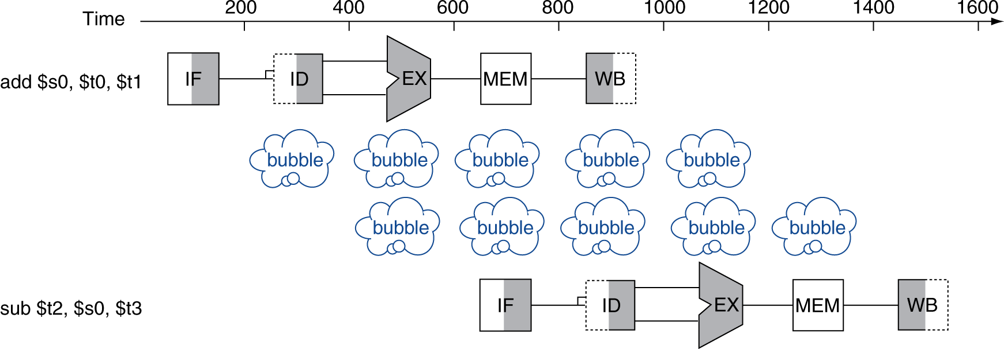
Data Hazards – Stall - Bubble
An instruction depends on completion of data access by a previous instruction
  add $s0, $t0, $t1
  sub $t2, $s0, $t3

Slide 32
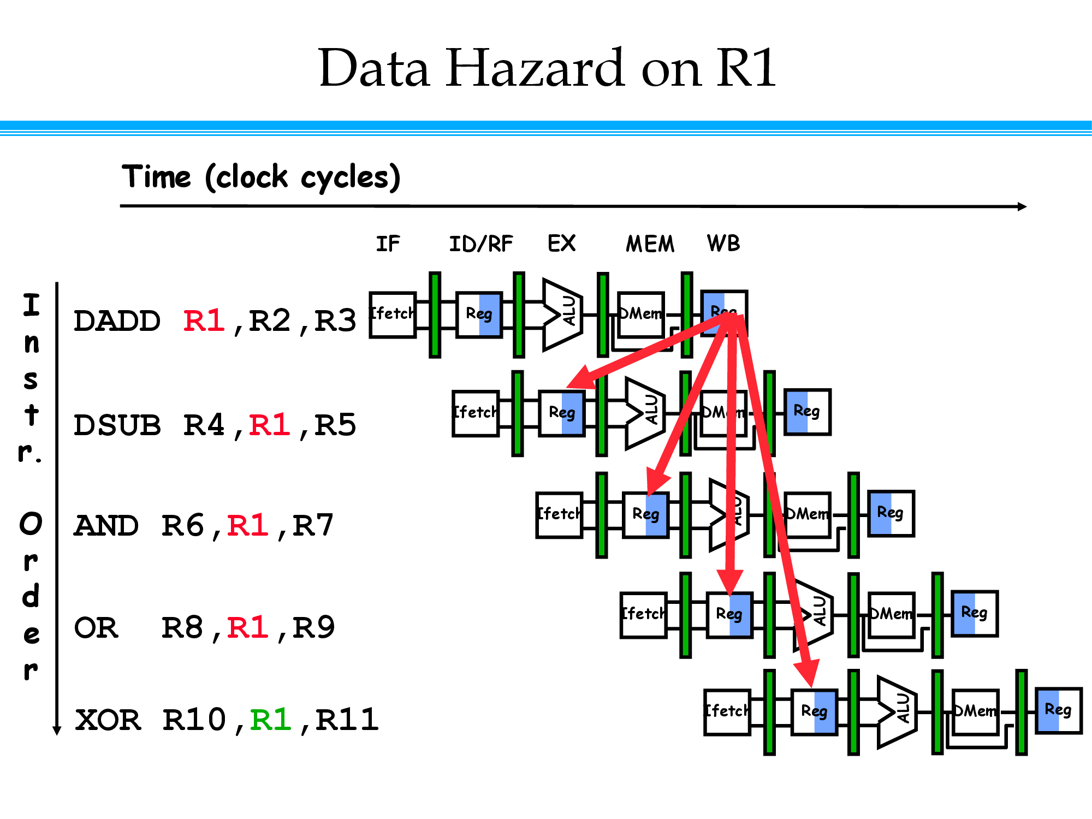

Slide 33
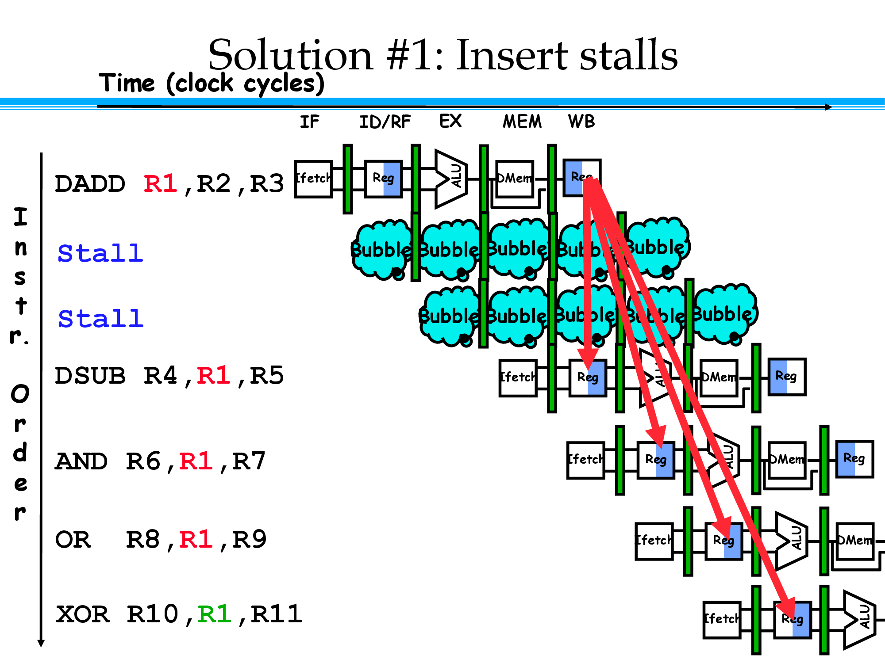

Slide 34
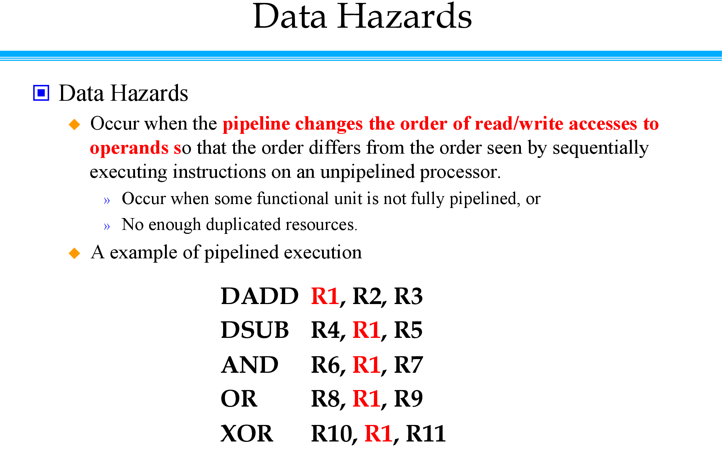

Slide 35
Data Hazards – table representation
This is another representation of the stall.
LW R1, 0(R2) | IF | ID | EX | MEM | WB
SUB R4, R1, R5 |  | IF | ID | EX | MEM | WB
AND R6, R1, R7 |  |  | IF | ID | EX | MEM | WB
OR R8, R1, R9 |  |  |  | IF | ID | EX | MEM | WB
LW R1, 0(R2) | IF | ID | EX | MEM | WB
SUB R4, R1, R5 |  | IF | ID | stall | EX | MEM | WB
AND R6, R1, R7 |  |  | IF | stall | ID | EX | MEM | WB
OR R8, R1, R9 |  |  |  | stall | IF | ID | EX | MEM | WB

Slide 36
Memory Data Hazards - RAW
Like register hazards, we can also have memory hazards
  RAW:
    store R1, 0(SP)
    load R4, 0(SP)
 | 1 | 2 | 3 | 4 | 5 | 6
Store R1, 0(SP) | F | D | EX | M | WB
Load R1, 0(SP) |  | F | D | EX | M | WB
In simple pipeline, memory hazards are easy to address
  In order, one at a time, read & write in same stage
In general though, more difficult than register hazards

Slide 37
Data Hazards and the Compiler
Compiler should be able to help eliminate some stalls caused by data hazards
i.e. compiler could restrict generating a LOAD instruction that is immediately followed by instruction that uses result of LOAD’s destination register

Slide 38
What about Control Logic in Hazard?
For MIPS integer pipeline, all data hazards can be checked during ID phase of pipeline
If data hazard, instruction stalled before its issued
Whether forwarding is needed can also be determined at this stage, controls signals set (discussed later)
If hazard detected, control unit of pipeline must stall pipeline and prevent instructions in IF, ID from advancing

Slide 39
Hazards vs. Dependencies
dependence: fixed property of instruction stream
  (i.e., program)
hazard: property of program and processor organization
  implies potential for executing things in wrong order
    potential only exists if instructions can be simultaneously “in-flight” in the pipeline
    property of dynamic distance between instructions vs. pipeline depth
For example, can have RAW dependence with or without hazard
  depends on pipeline

Slide 40
Some Situations of “Dependence” that cause Hazard
Situation | Example | Action
No Dependence | LW R1, 45(R2) ADD R5, R6, R7 SUB R8, R6, R7 OR R9, R6, R7 | No hazard possible because no dependence exists on R1 in the immediately following three instructions.
Dependence requiring stall | LW R1, 45(R2) ADD R5, R1, R7 SUB R8, R6, R7 OR R9, R6, R7 | Comparators detect the use of R1 in the ADD and stall the ADD (and SUB and OR) before the ADD begins EX
Dependence overcome by forwarding (comes later) | LW R1, 45(R2) ADD R5, R6, R7 SUB R8, R1, R7 OR R9, R6, R7 | Comparators detect the use of R1 in SUB and forward the result of LOAD to the ALU in time for SUB to begin with EX
Dependence with accesses in order | LW R1, 45(R2) ADD R5, R6, R7 SUB R8, R6, R7 OR R9, R1, R7 | No action is required because the read of R1 by OR occurs in the second half of the ID phase, while the write of the loaded data occurred in the first half.

Slide 41
Forwarding or Bypassing

Slide 42
Forwarding
Problem illustrated previously can be solved
– with forwarding
E.g. Can we move the result from EX/MEM register to the beginning of ALU (where SUB needs it)?
  Yes!
Generally speaking:
  Forwarding occurs when a result is passed directly to functional unit that requires it.
  Result goes from output of one unit to input of another

Slide 43
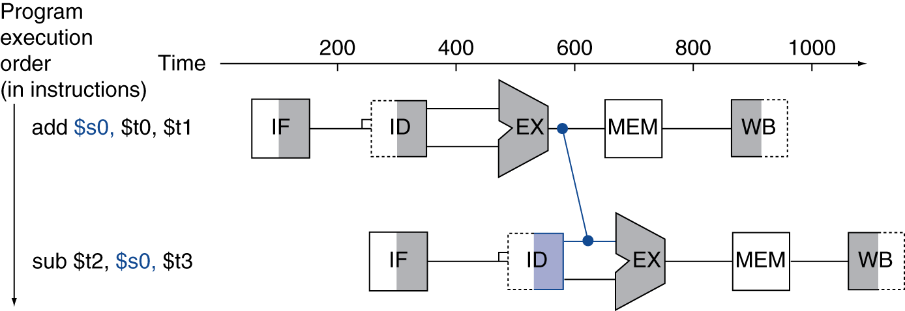
Forwarding (or Bypassing)
Use result when it is computed
  Don’t wait for it to be stored in a register
  Requires extra connections in the datapath

Slide 44
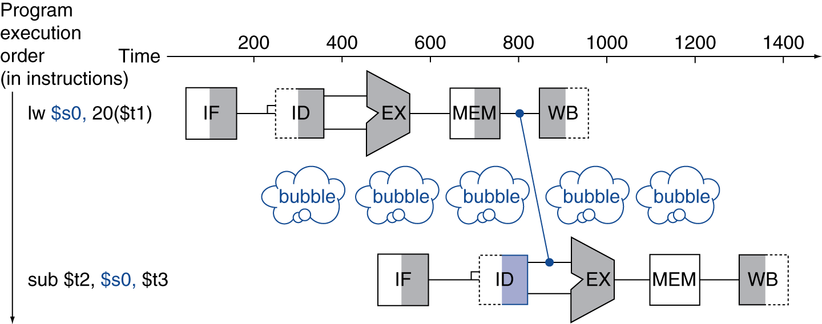
Load-Use Data Hazard
Can’t always avoid stalls by forwarding
  If value not computed when needed
  Can’t forward backward in time!

Slide 45
Where can we Introduce Forwarding? Example
ADD R1, R2, R3
Mem
Reg
ALU
DM
Reg
SUB gets info. from EX/MEM pipe register
SUB R4, R1, R5
Mem
Reg
ALU
DM
Reg
AND gets info. from MEM/WB pipe register
AND R6, R1, R7
Mem
Reg
ALU
DM
OR R8, R1, R9
Mem
Reg
ALU
OR gets info. by forwarding from register file
XOR R10, R1, R11
Mem
Reg
Time
Rule of thumb:
If line goes “forward” you can do forwarding.
If its drawn backward, it’s physically impossible.

Slide 46
Forwarding doesn’t always Work
cyc 1 cyc 2 cyc 3 cyc 4 cyc 5
LW R1, 0(R2)
IM
Reg
ALU
DM
Reg
Load has a latency that forwarding can’t solve.
SUB R4, R1, R5
IM
Reg
ALU
DM
Pipeline must stall until hazard cleared (starting with instruction that wants to use data until source produces it).
AND R6, R1, R7
IM
Reg
ALU
OR R8, R1, R9
IM
Reg
Time
Can’t get data to subtract as result needed at beginning of CC 4, but not produced until end of CC 4

Slide 47
Solution to this complex situation
LW R1, 0(R2)
IM
Reg
ALU
DM
Reg
SUB R4, R1, R5
IM
Reg
ALU
DM
Bubble
AND R6, R1, R7
IM
ALU
Bubble
Reg
OR R8, R1, R9
Bubble
IM
Reg
Time
Insertion of bubble causes Number of cycles for completing this sequence to grow by 1

Slide 48
Data Hazards
Simple Solution to RAW
Hardware detects RAW and stalls
Assumes register written then read each cycle
  - low cost to implement, simple
  - reduces IPC
Minimizing RAW stalls
Bypass / forward / short­circuit (“forwarding”)
Use data before it is in the register
  - reduces/avoids stalls
  - complex

Slide 49
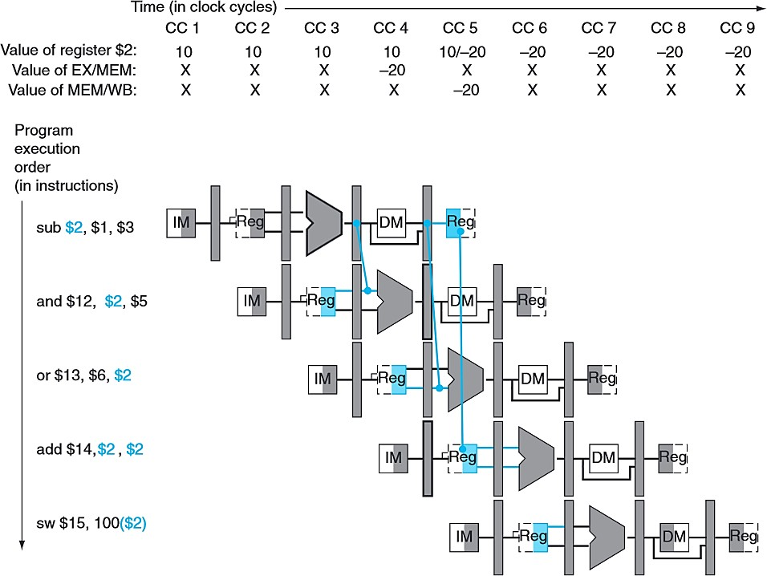
Data Hazard and Forwarding - Example
Note the change in our dependency diagram . Now , we can s ee that the inputs to the ALU are dependent on pipeline registers rather than the results of the WB stage.
Forwarding works by allowing us to grab the inputs of the ALU not only from the ID/EX pipeline register, but from any other pipeline register.

Slide 50
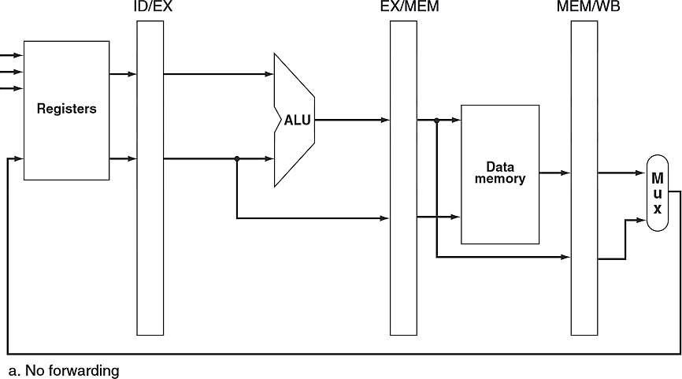
MIPS CPU Pipelined - Without Forwarding
MIPS pipelined datapath which has no support for forwarding

Slide 51
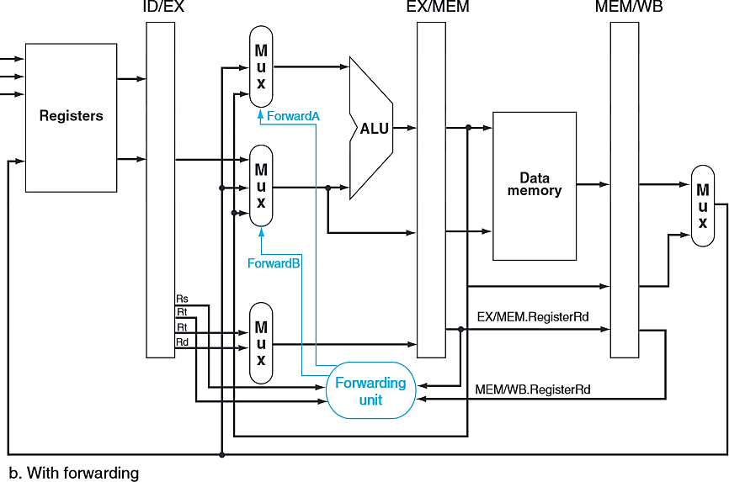
MIPS CPU Pipeline and With Forwarding
Now with forwarding!
Instead of directly piping the ID/EX pipeline register values into the ALU, we now have multiplexors that allow us to choose where the input should come from.
EX/MEM.WriteReg
MEM/WB.WriteReg

Slide 52
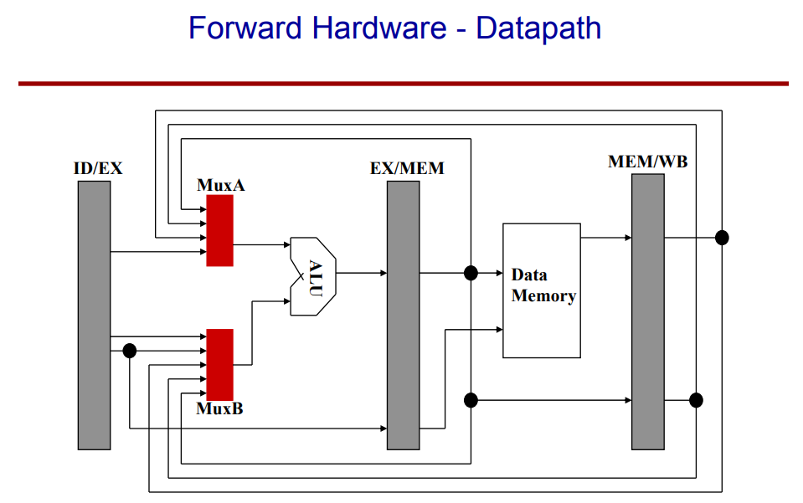
Forwarding Implementation

Slide 53
Data Hazard and Stall

Slide 54
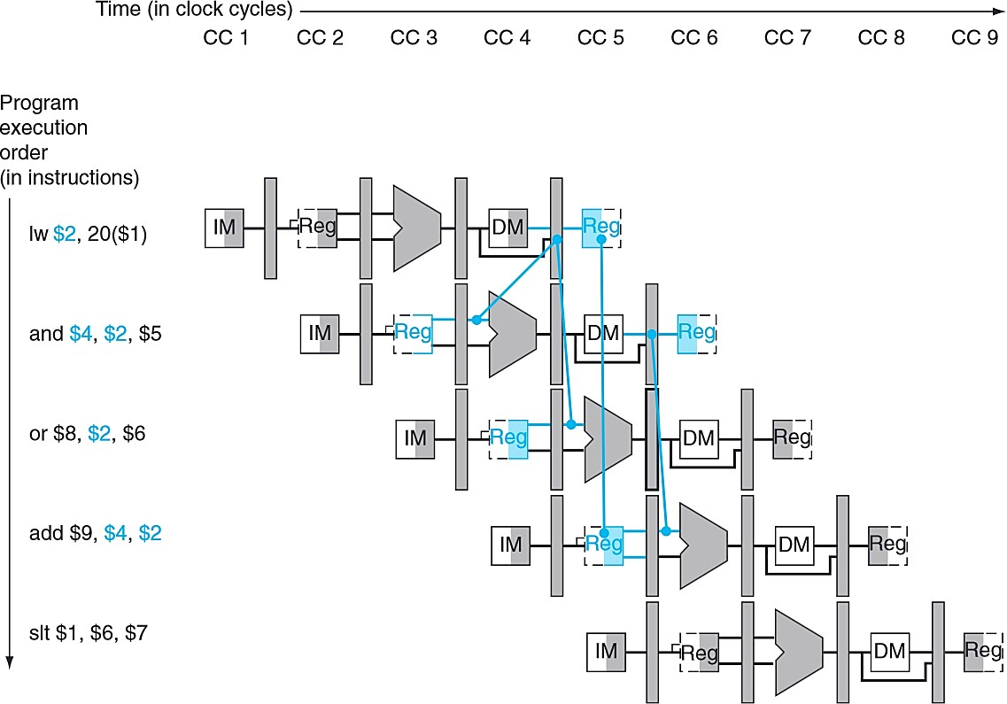
Data Hazards and Stalls - Example
Consider the following sequence of instructions.
lw $2, 20($1)
and | $4, | $2, | $5
or | $8, | $2, | $6
add | $9, | $4, | $2
slt | $1, | $6, | $7
Even with forwarding, our dependency from a load word instruction goes backward in time.

Slide 55
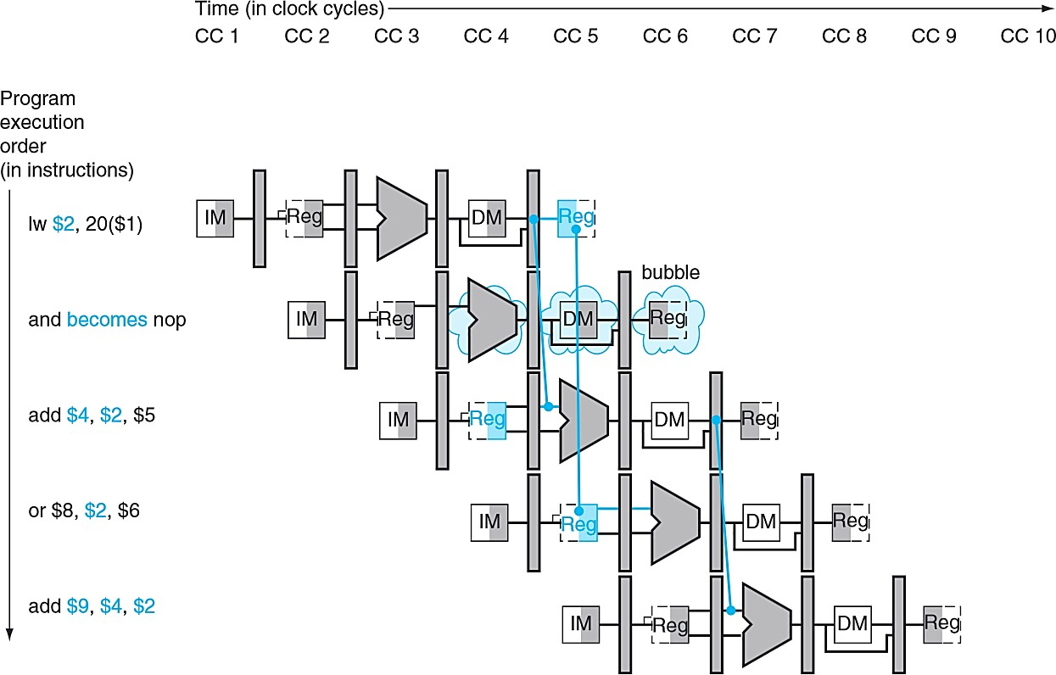
Data Hazard and Stall – Another Example

Slide 56
CONTROL HAZARDS

Slide 57
Branch / Control Hazards
So far, we’ve limited discussion of hazards to:
  Arithmetic/logic operations (remember Forwarding)
  Data transfers (remember Data Hazards)
Also need to consider hazards involving branches:
– Example:
40: beq | $1, $3, 28 | # (28 leads to address 72)
44: and | $12, $2, $5
48: or | $13, $6, $2
52: add | $14, $2, $2
72: lw | $4, 50($7)
How long will it take before the branch decision takes effect?
– What happens in the meantime?

Slide 58
Control Hazards
Arise in Conditional Branch and Jump Instructions
By the time Branch conditions are evaluated and new PC is updated (in case Branch Taken), there are already two further instructions in the pipeline. This slows down CPU throughput.
Objective is to handle Branches so that the pipeline stages are not wasted.
Two Broad Techniques:
  Speculation – Eg. Assume Branch Always Taken or Branch Never Taken
  Branch Prediction – Predict likely outcome of Branch Instructions to reduce wasted time cycles in pipelines
Will be studied further

Slide 59
Introduction to Branch Prediction
In branch prediction, we attempt to predict the branching decisions and act accordingly.
When we assumed the branch wasn’t taken, we were making a simple static prediction. Luckily, the performance cost on a 5-stage pipeline is low but on a deeper pipeline with many more stages, that could be a huge performance cost!
In dynamic branch prediction, we look up the address of the instruction to see if the branch was taken last time. If so, we will predict that the branch will be taken again and optimistically fetch the instructions from the branch target rather than the subsequent instructions.

Slide 60
Readings
Chap 4 of P&H Textbook

