Slide 1
VLSI Design EE 523 Spring 2024
Shahid Masud
Lecture 17

Slide 2
Topics for lecture 17
Some solved examples of Power Dissipation in CMOS circuits
Introduce Reliability, Circuit Life in CMOS chips
Latchup problem in CMOS

Slide 3
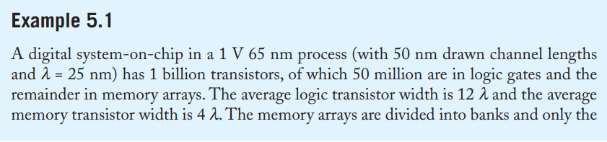
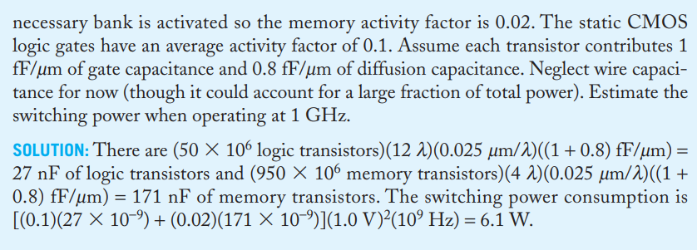
Eg from text book regarding activity factor

Slide 4
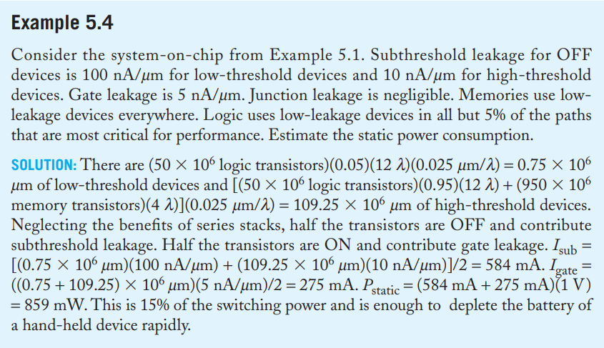
Eg related to Leakage current and Static Power

Slide 5
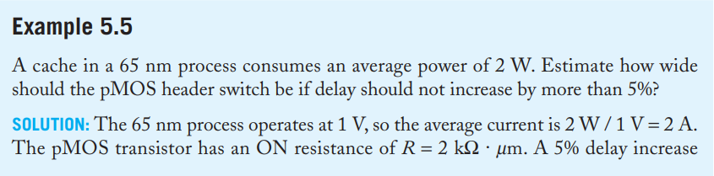
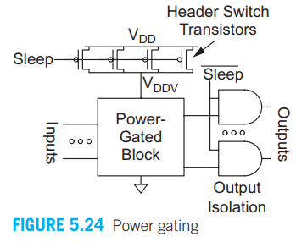
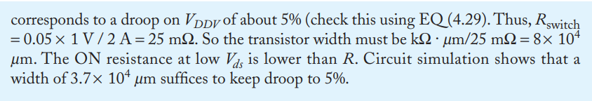
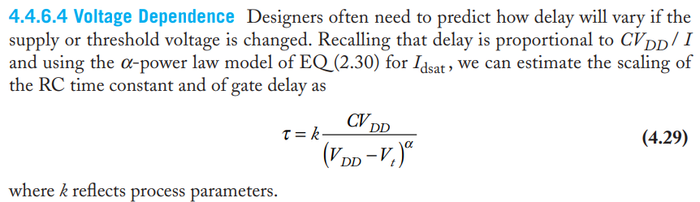
Power Header Switch Sizing

Slide 6
Readings
Chapter 5 of textbook ‘CMOS VLSI Design’ by Weste and Harris related to Power Dissipation in CMOS circuits

