Slide 1
EE 421 / CS 425
Digital System Design
Laboratory 4
Fall 2023
Shahid Masud

Slide 2
Today’s Topics
Dataflow modeling in Verilog
Behavior Description of Digital Systems
High level constructs help in testing and simulation
Modeling Delays in wires, gates and functional blocks

Slide 3

Design Capture in Verilog HDL
Verilog Allows Design Capture at Various Hierarchy Levels:
Switch Level (NMOS and PMOS transistors)
Gate Level (Describing Circuit as Logic Gates)
  Data Flow (RTL Sequential) Level
Dataflow Level
Behavior Level
The Design is Captured in a text file or obtained from
schematic diagram

Slide 4


Verilog Syntax
In new syntax, the input, output is defined as above.
In old syntax, this definition was after the module (…);
input a, b, …..;
output c,d,….;

Slide 5
Examples of assign statements
wire Out;
assign Out = A & B;
assign {COut, Sum} = A + B + CIn;
wire #50 Out = A & B;
 | module delay_test( input a, // Assume a=0 initialized at time '0' input b, // Assume b=1 initialized at time ‘0’ output reg c, output reg d ); initial begin #20 c = (a|b); //a|b gets evaluated after 20ns and gets assigned to ‘c’ immediately d = #50 (a&b); //a&b gets evaluated at time 20ns but gets assigned to ‘c’ after 70ns (20ns+50ns) end endmodule

Slide 6
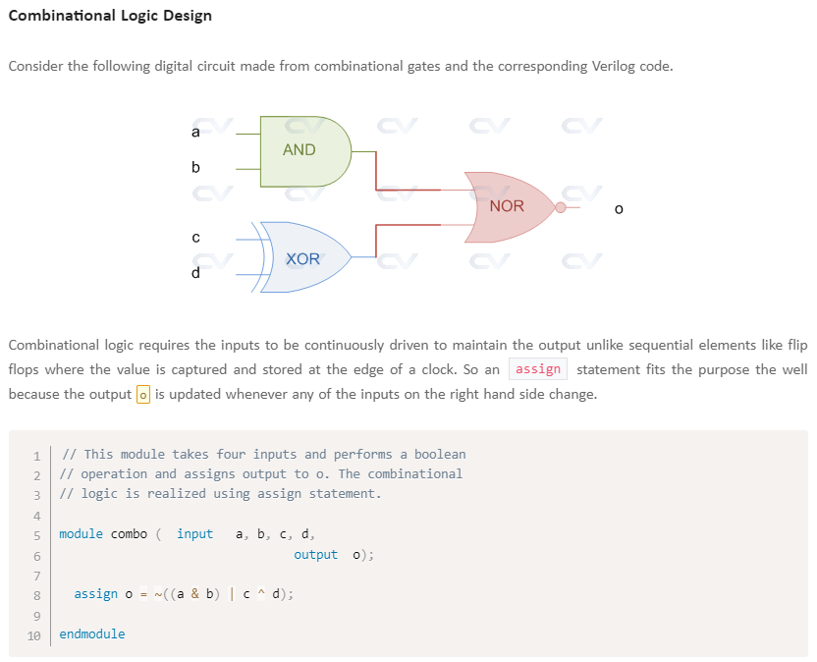

Slide 7
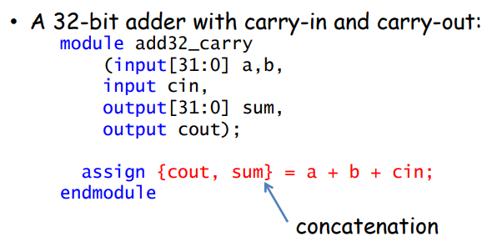
4 Bit and 32 Bit Full Adders using assign
module adder (sum_out, carry_out, carry_in, ina, inb) ;
output [3:0] sum_out;
input [3:0] ina, inb;
output carry_out;
input carry_in;
wire carry_out, carry_in;
wire[3:0] sum_out, ina, inb;
assign {carry_out, sum_out} = ina + inb + carry_in;
endmodule

Slide 8
Using a ternary ?: operator
output = <expression> ? <value if true> : <value if false>;
//you can use an assign statement with ternary operator ?:,
//if you want it to remain as a wire type:
assign x = (val==0) ? a : (val==1) ? b : 'bx ;
module tristatebuffer( );
reg data_in, enable;
wire pad;
assign pad = (enable) ? data_in : 1'bz;
//When enable is 1, the pad is assigned the value of data_in, and when enable is 0, the pad is tristated.

Slide 9
Mux using assign
assign q = addr ? b : a;
assign q = addr[1] ? (addr[0] ? d : c) : (addr[0] ? b : a);

Slide 10
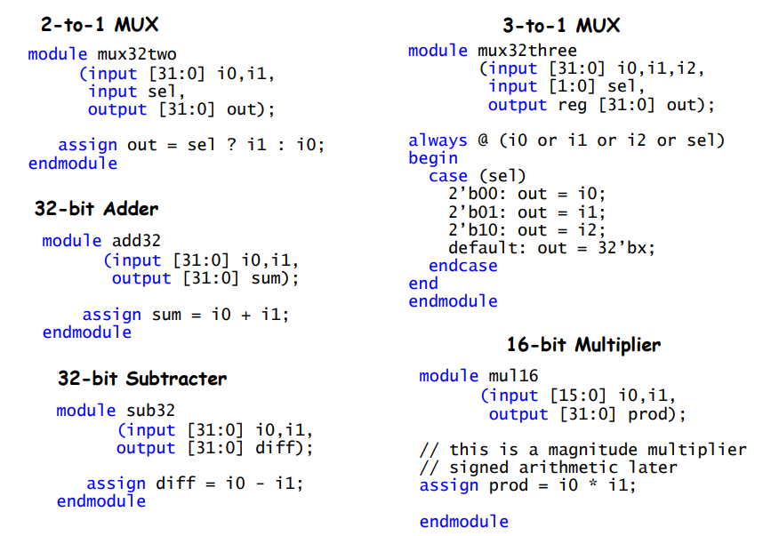
ALU Modules using assign

Slide 11
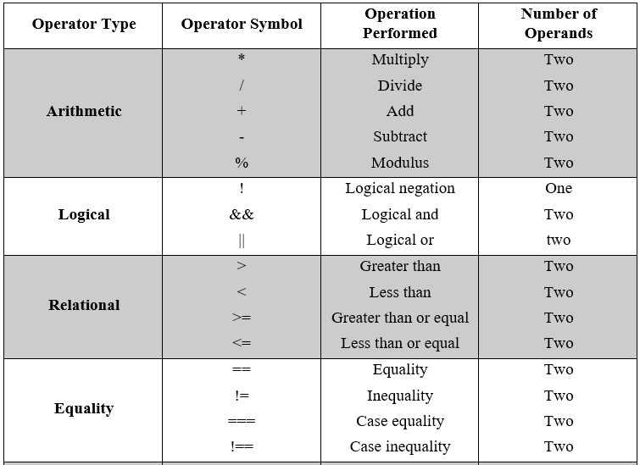
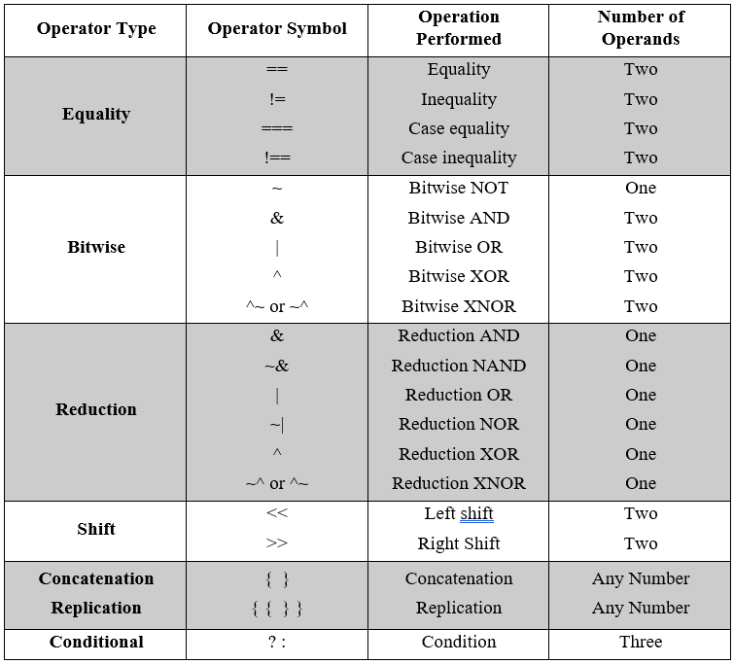
Possible operators in assign

Slide 12
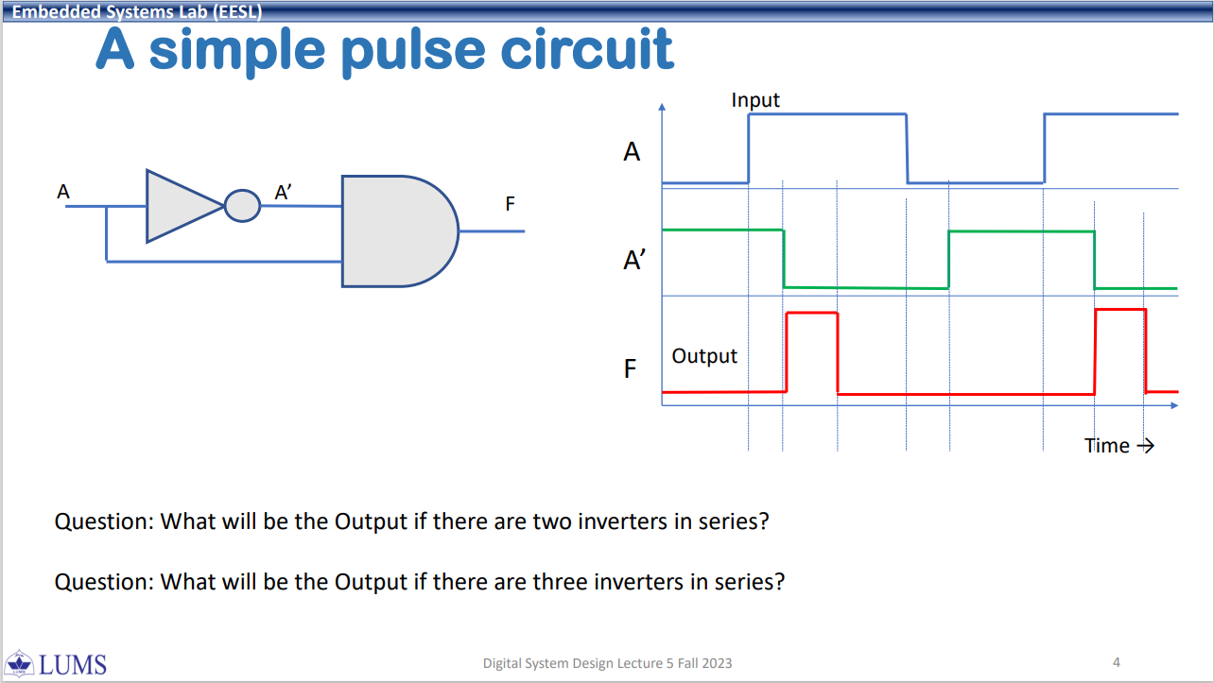
From lecture 5 in class
How will you model this
with delays?

