Slide 1
Computer Organization and Assembly Language CS / EE 320 Spring 2024
Lecture 1
Shahid Masud

Slide 2
Difference between Computer Organization and Computer Architecture
Architecture: View from outside, high level specs (Programs looking towards CPU Instructions)
Organization: View from Inside (CPU looking outwards towards buses, memory and peripherals)

Slide 3
Performance Graphs from the report of National Academy, USA
‘The Future of Computer Performance
Game Over or Next Lavel
Ed. Samuel H Fuller

Slide 4
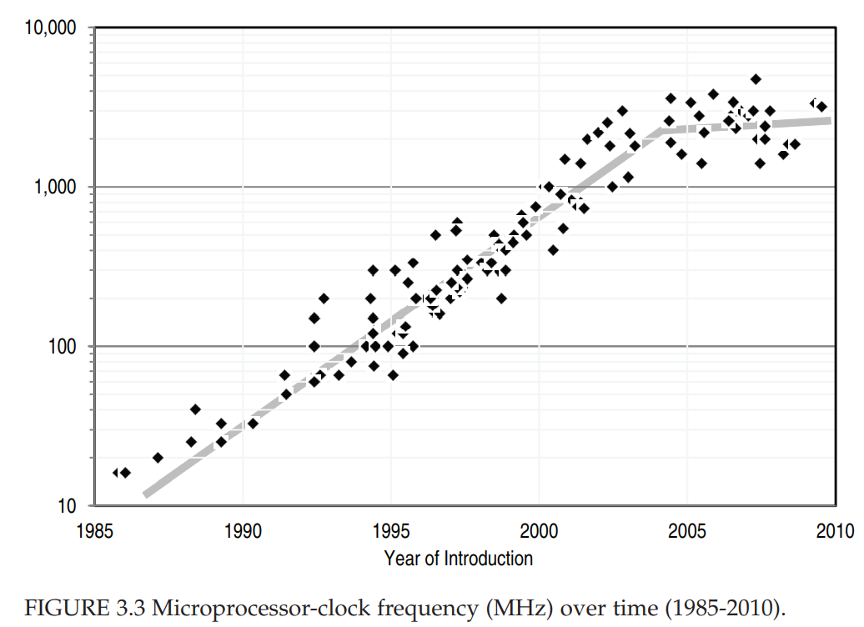

Slide 5
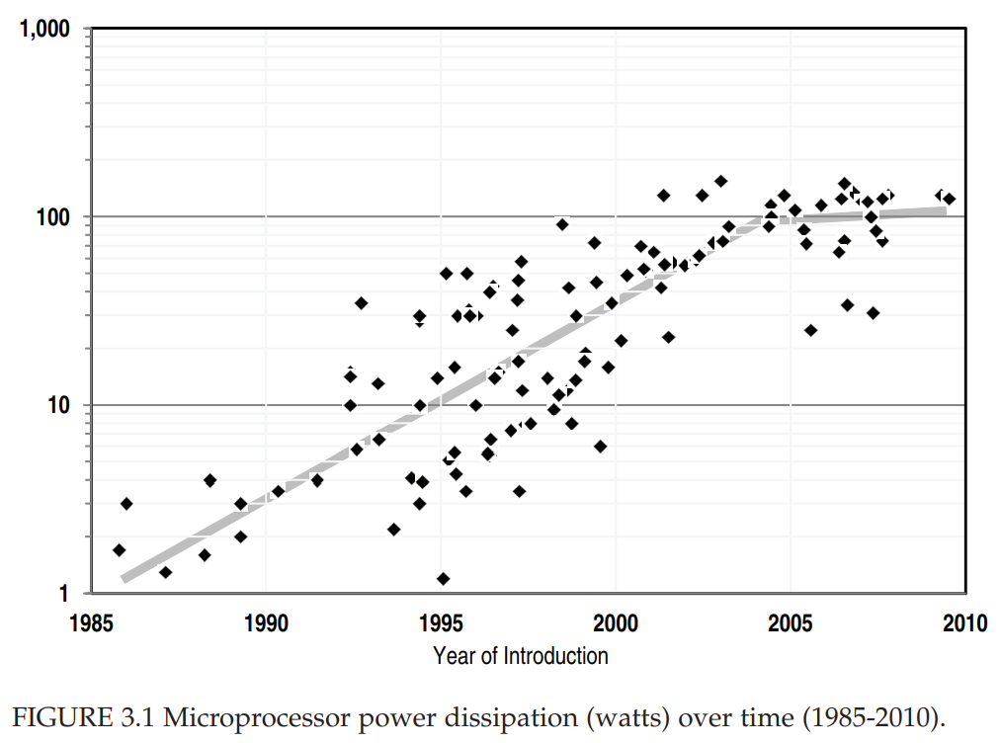

Slide 6
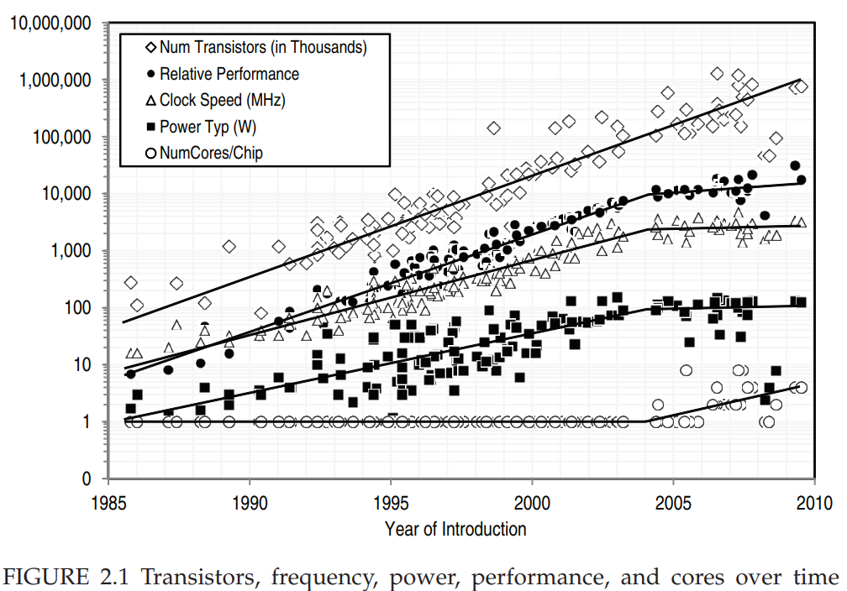

Slide 7
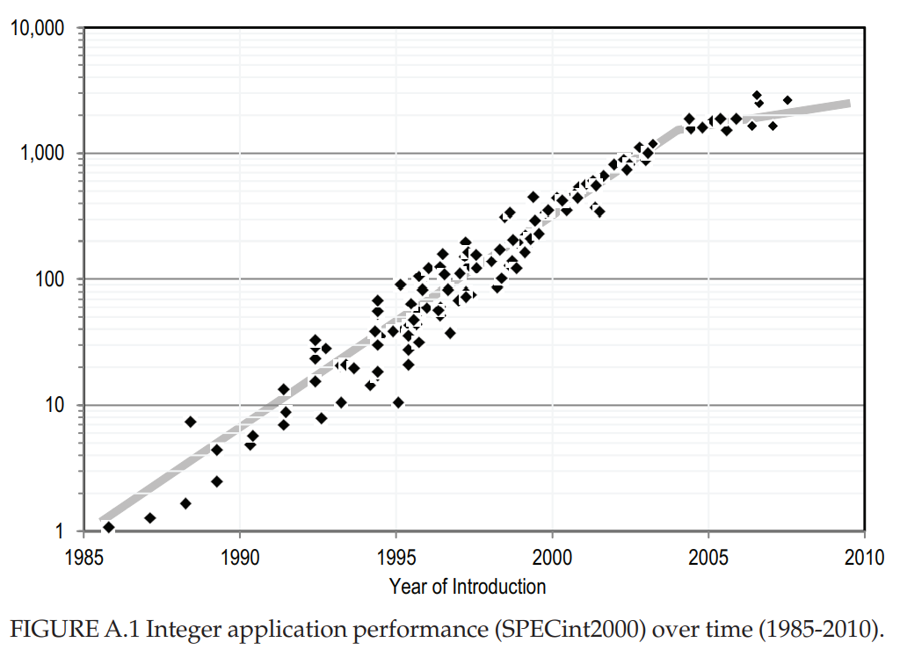

Slide 8
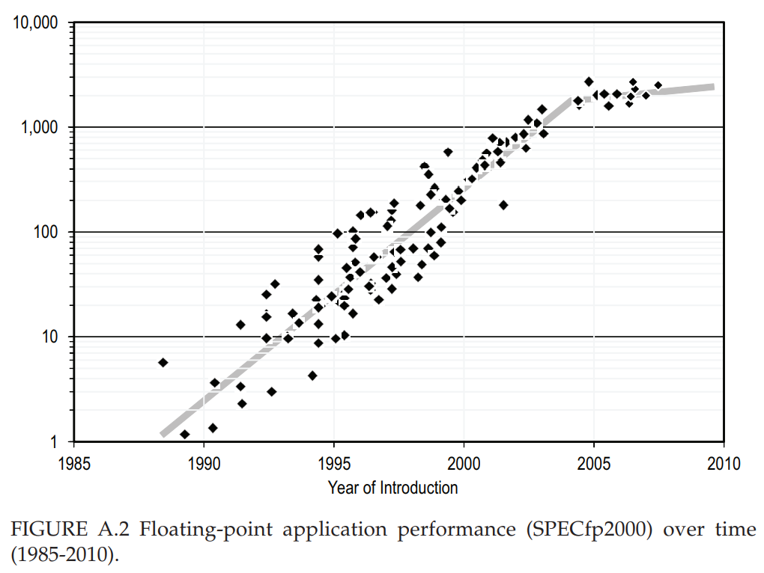

Slide 9
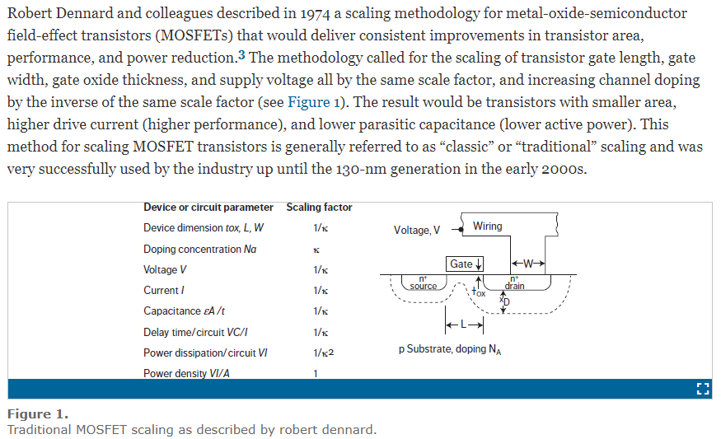
Dennard Scaling

Slide 10
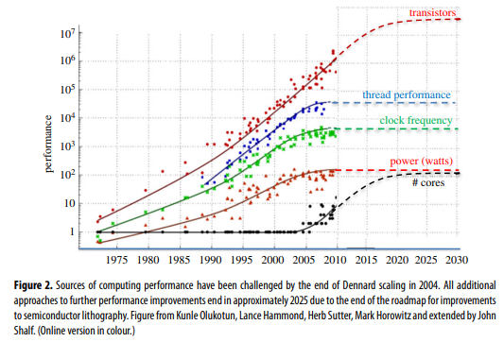
Depiction of Dennard Scaling Effects

Slide 11
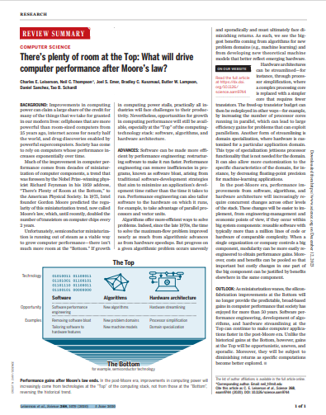
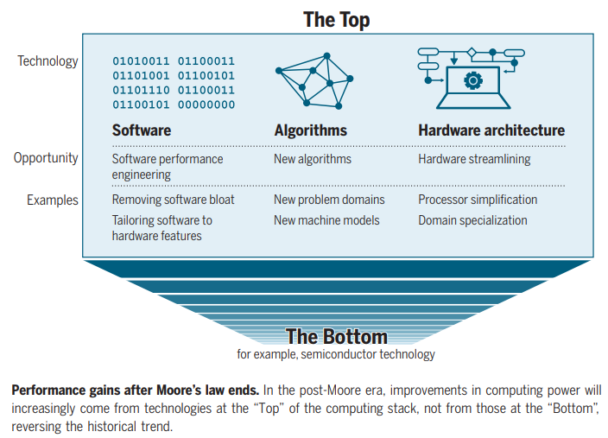
Future Improvements in Computer Performance
Ref: Leiserson et al., Science 368, 1079 (2020) 5 June 2020

Slide 12
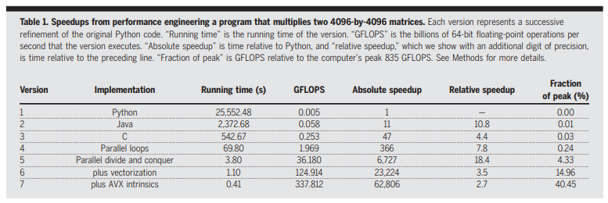
Example of Performance Gains through Architecture
AVX = Intel Advanced Vector Extension

Slide 13

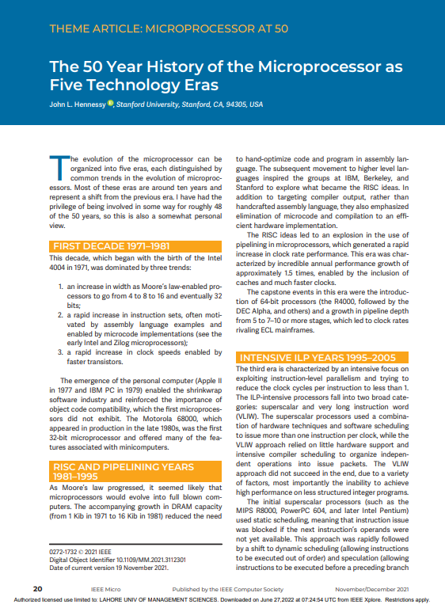
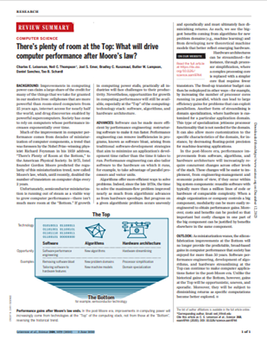
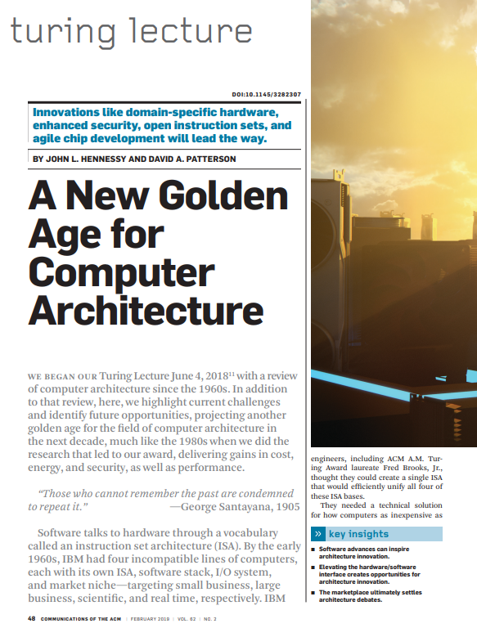
Look at some recent research papers for inspiration

Slide 14
Topics
1. Discussion on Moore’s Law, through paper ‘MORE THAN MOORE’ by M. Mitchell Waldrop, published
In Nature, February 2016
2. Computer Performance Graphs from National Academy, USA, report
3. Introduction to the specialization area of ‘Computer Architecture’ through paper by
Hennessy and Patterson, ‘A New Golden Age for Computer Architecture’, published in Communications
of the ACM, February 2019, pages 48 to 60.
Important Directions for Computers of the future:
Moore’s Law failing to keep up
Domain Specific Architectures
Enhanced security features inside microprocessors
Open Instruction Sets and Extension of Instruction Sets through Customized Accelerators
Agile Hardware Design for Microprocessors
Combination of Domain Specific Languages and Domain Specific Architectures
4. Intel Processor Timeline
5. Reviewed course outline including detailed topics and grading breakup of lectures and labs.

Slide 15
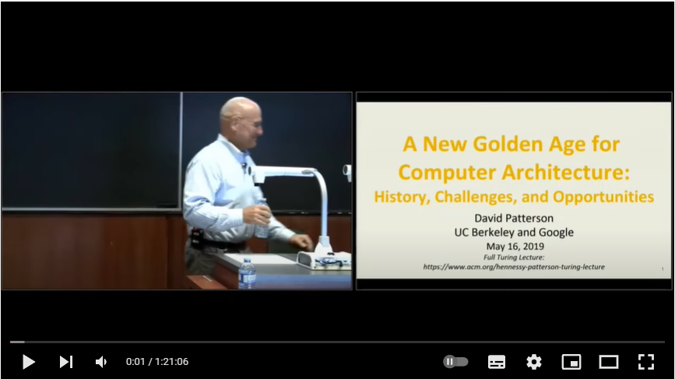
Video of Turing Lecture by Patterson, 2019
David Patterson - A New Golden Age for Computer Architecture: History, Challenges and Opportunities – YouTube

