Slide 1
VLSI Design EE 523
Spring 2024
Shahid Masud
Lecture 19

Slide 2
Topics for lecture 19
Interconnect Modelling
Cross Talk
How to deal with Coupling effects?
Some examples
---------------------
Combinational Circuit Design Styles
  Pseudo NMOS
  Cascode / Differential Circuits
Quiz Next Tuesday
Lab coming Thursday

Slide 3
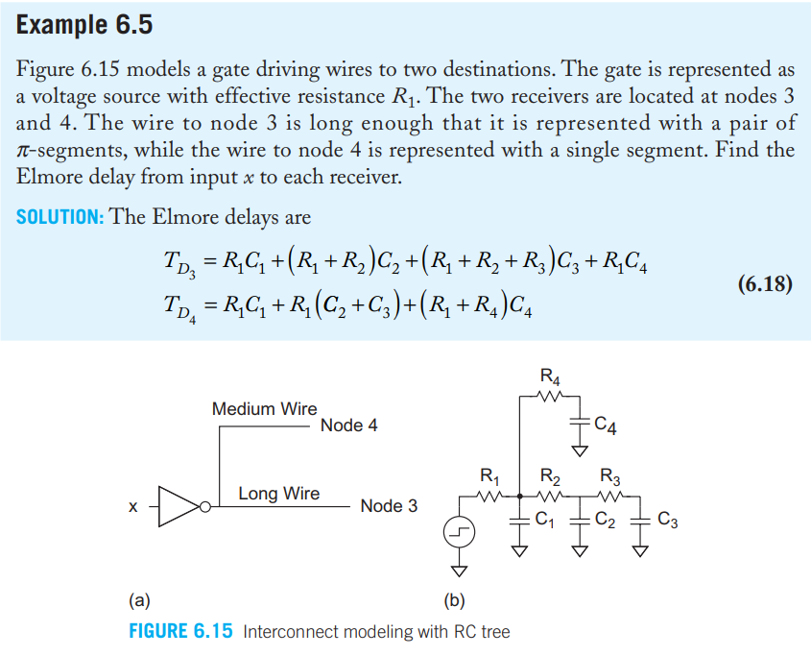
Interconnect E.g.

Slide 4
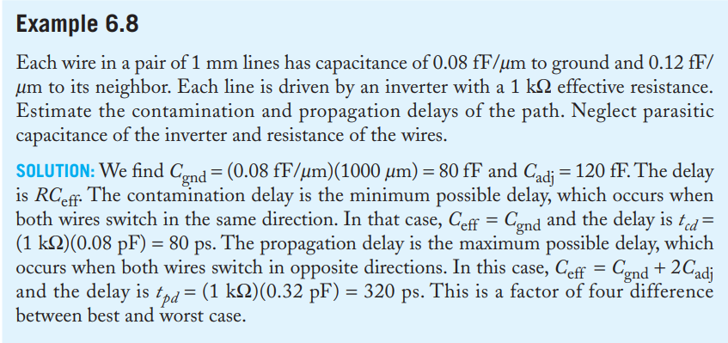
Interconnect Example 2

Slide 5
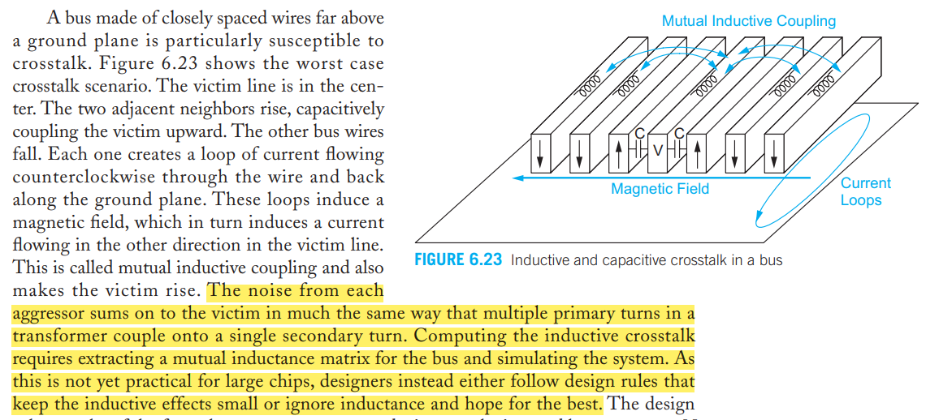
Inductance Coupling in Wires

Slide 6
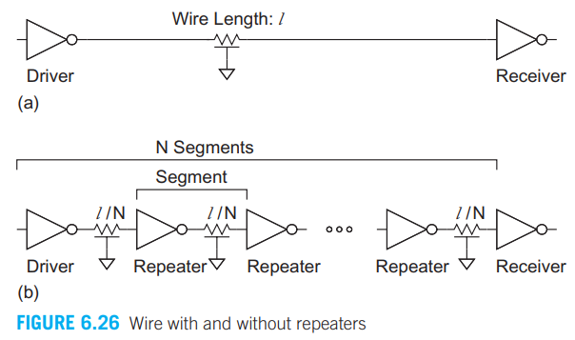
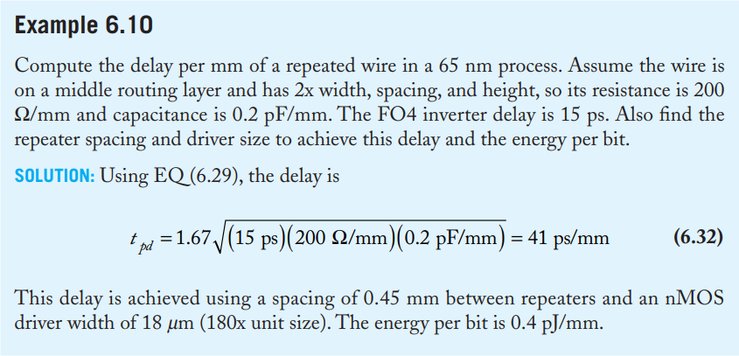
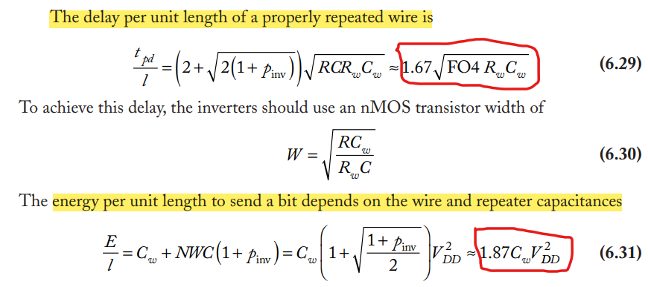
Repeaters Example

Slide 7
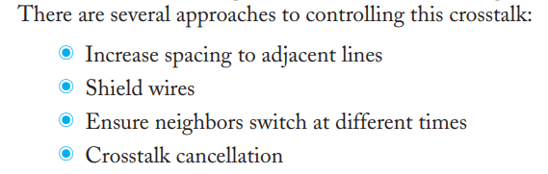
Reducing Crosstalk

Slide 8
Readings
Interconnects are in Chapter 6 of textbook ‘CMOS VLSI Design’ by Weste and Harris
Combinational Logic Styles are in Chapter 9 of text book

