Slide 1
CS / EE 320 Computer Organization and Assembly Language Spring 2024 Lecture 17
Shahid Masud
Topics: From Single Cycle MIPS to Multicyle MIPS, Pipelining

Slide 2
Topics
Timing calculations in Single-Cycle Simple MIPS CPU
How to add pipelining in simple MIPS CPU
Detailed analysis of 5-Stage Pipelined MIPS CPU
Calculations Throughput, Latency, Critical Path of 5-Stage MIPS CPU
Design of individual Pipelined stages in a 5-Stage MIPS CPU
Hazards in Pipelined MIPS CIPS
Structural Hazard (Hardware Related)
Data Hazard (Due to Assembly program)
Control Hazard (Architecture related)

Slide 3
SIMPLE MIPS WITH NO PIPELINE

Slide 4
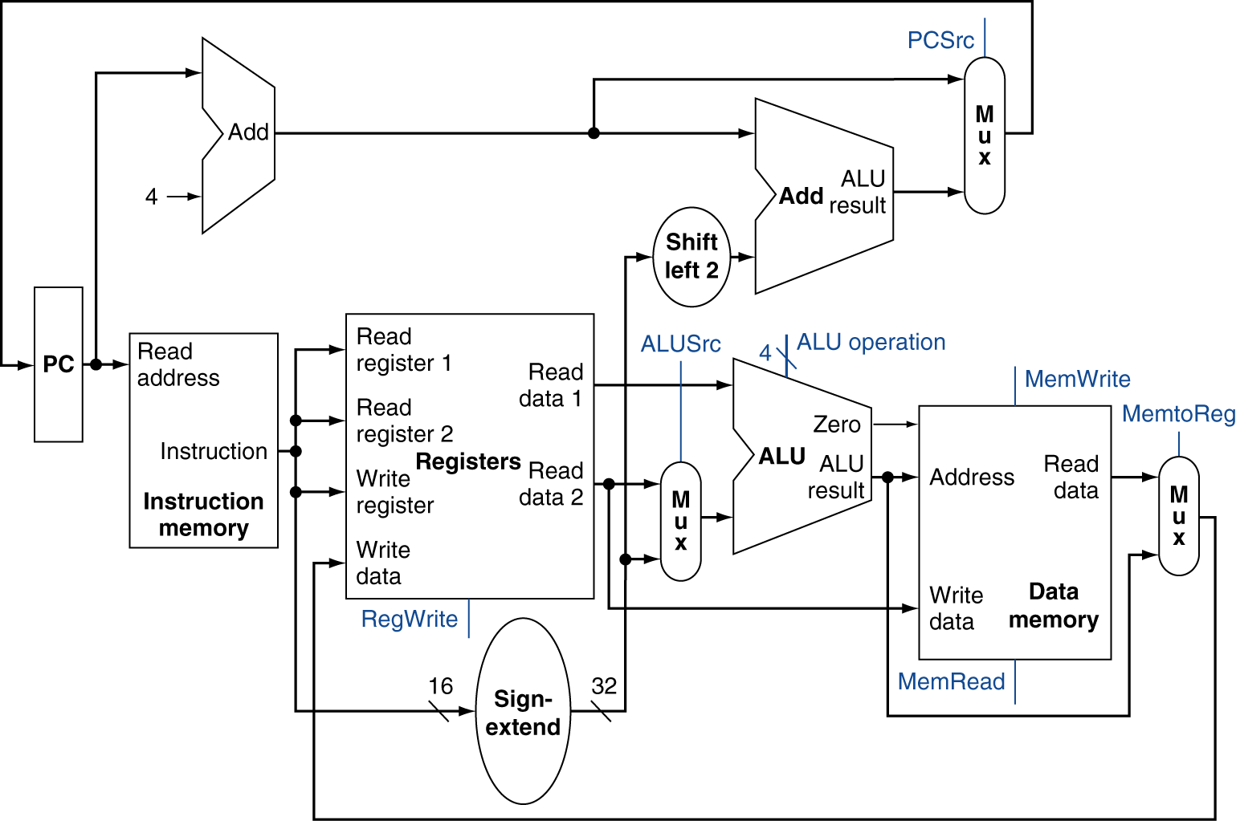
Full Datapath – for practice of connections

Slide 5
Full Datapath

Slide 6










Full Datapath – for practice of connections

Slide 7
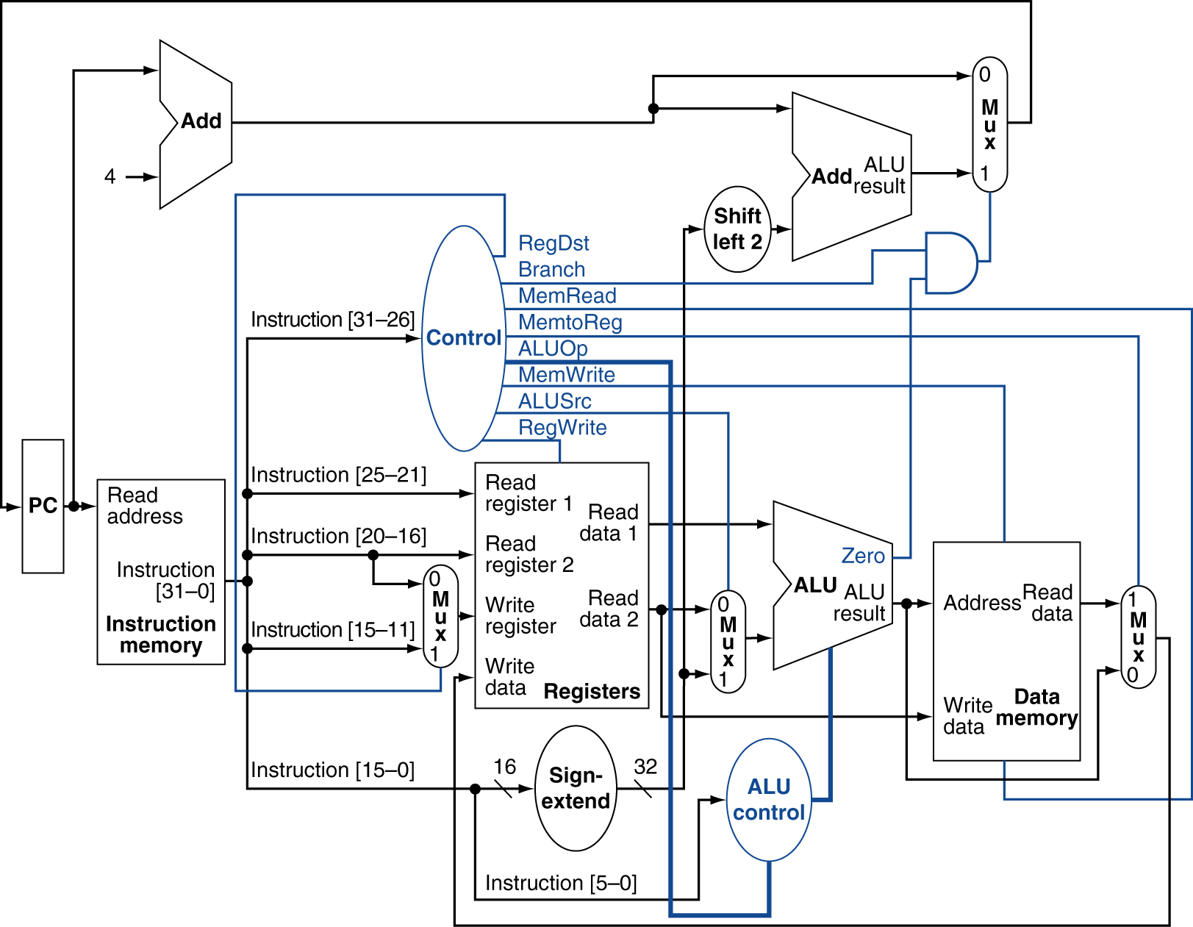
MIPS Datapath With Control

Slide 8
BASICS OF PIPELINING

Slide 9
What Is Pipelining
Laundry Example
Ann, Brian, Cathy, Dave each have one load of clothes to wash, dry, and fold
Washer takes 30 minutes
Dryer takes 40 minutes
“Folding” takes 20 minutes
One load takes 90 minutes
A
B
C
D

Slide 10
What Is Pipelining
6 PM
7
8
9
10
11
Midnight
Time
30
40
20
30
40
20
30
40
20
30
40
20
T
a
s
k
O
r
d
e
r
A
B
C
D
Sequential laundry takes 6 hours for 4 loads
If they learned pipelining, how long would laundry take?

Slide 11
Pipelining Lessons
Pipelining doesn’t help latency of single task, it helps throughput of entire workload
Pipeline rate limited by slowest pipeline stage
Multiple tasks operating simultaneously
Potential speedup = Number pipe stages
Unbalanced lengths of pipe stages reduces speedup
Time to “fill” pipeline and time to “drain” it reduces speedup
6 PM
7
8
9
Time
T
a
s
k
O
r
d
e
r
30
40
40
40
40
20
A
B
C
D

Slide 12
Introducing Pipelining for MIPS

Slide 13



















Single-cycle MIPS RISC Architecture
D Example: simple MIPS architecture
Critical path includes all of the processing steps
Controller
Write Back
PC
Inst.
Memory
Register File
ALU
Data Memory
Inst. Fetch
Inst. Decode
Execute
Memory

Slide 14





Execution on Single-cycle MIPS Architecture
D Example program
CT=6ns; CPU Time = 5 x 1 x 6ns = 30ns
AND R1,R2,R3
How to improve?
XOR R4,R2,R3
SUB R5,R1,R4 ADD R6,R1,R4 MUL R7,R5,R6
CPU Time = IC x CPI x CT
Time

Slide 15
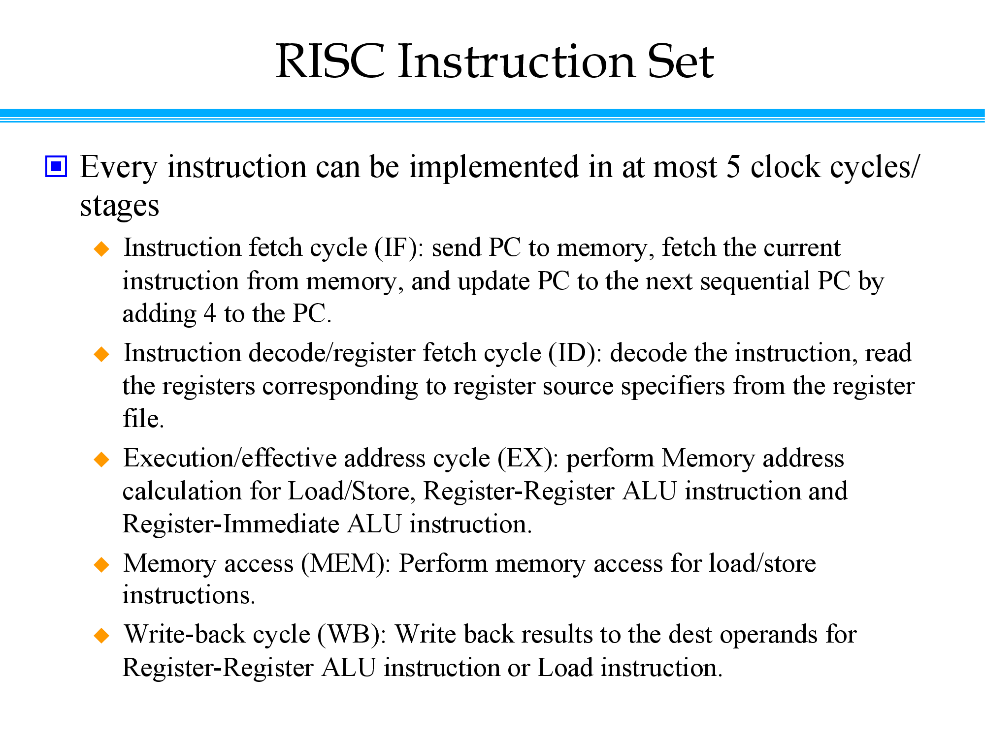

Slide 16

Re-Using Idle Resources
D Each processing step finishes in a fraction of a cycle
Idle resources can be reused for processing next instruction
Controller
Write Back
PC
Inst.
Memory
Register File
ALU
Data Memory
Inst. Fetch
Inst. Decode
Execute
Memory

Slide 17

























Non Pipeline Architecture
D Example program
CT=1.5ns; CPU Time = 5 x 5 x 1.5ns = 37.5ns > 30ns
WORSE!!
AND R1,R2,R3
XOR R4,R2,R3
SUB R5,R1,R4 ADD R6,R1,R4 MUL R7,R5,R6
CPU Time = IC x CPI x CT
Time

Slide 18
Developing a Multi‐cycle Data Path
5

Slide 19
Develop Simple Five Stage MIPS Pipeline
D A pipelined load-store architecture that processes up to one instruction per cycle
Controller
Write Back
PC
Inst.
Memory
Register File
ALU
Data Memory
Inst. Fetch
Inst. Decode
Execute
Memory

Slide 20
















Identify Distinct Processing Stages in Architecture
Five stage pipeline
Critical path determines the cycle time
0.7ns
Write Back
PC
Inst.
Memory
Register File
ALU
Data Memory
Inst. Fetch
Inst. Decode
Execute
Memory
1.5ns
1.05ns
1.25ns
1.5ns

Slide 21
Identify CPU Operations where Pipeline Registers could be Inserted

Slide 22
Recap - Full Datapath

Slide 23
Instruction Fetch
D Read an instruction from memory (I-Memory)
Use the program counter (PC) to index into the I- Memory
Compute New PC (NPC) by incrementing current PC
What about branches?
(later?)
D Update pipeline registers
Write the instruction into the pipeline registers

Slide 24























Instruction Fetch
clock
Branch Target
clock
PC
+
NPC
NPC = PC + 4
4
Why increment by 4?
Instruction
Memory
Pipeline Register

Slide 25
Instruction Decode
D Generate control signals for the opcode bits
D Read source operands from the register file (RF)
Use the specifiers for indexing RF
How many read ports are required?
D Update pipeline registers
Send the operand and immediate values to next stage
Pass control signals and NPC to next stage

Slide 26




















Instruction Decode
target
NPC
NPC
reg
Register File
Instruction
reg
decode
ctrl
Pipeline Register
Pipeline Register

Slide 27
Execute Stage
D Perform ALU operation
Compute the result of ALU
Operation type: control signals
First operand: contents of a register
Second operand: either a register or the immediate value
Compute branch target
Target = NPC + immediate
D Update pipeline registers
Control signals, branch target, ALU results, and destination

Slide 28



























Execute Stage
NPC
Target
+
reg
ALU
Res
reg
reg
ctrl
ctrl
Pipeline Register
Pipeline Register

Slide 29
Memory Access
D Access data memory
Load/store address: ALU outcome
Control signals determine read or write access
D Update pipeline registers
ALU results from execute
Loaded data from D-Memory
Destination register

Slide 30






Memory Access
Target
Res
Res
addr
reg
Memory
Dat
data
data
ctrl
ctrl
Pipeline Register
Pipeline Register

Slide 31
Register Write Back
D Update register file
Control signals determine if a register write is needed
Only one write port is required
Write the ALU result to the destination register, or
Write the loaded data into the register file

Slide 32
Improving Resource Utilization

Slide 33
Improving CPU Resource Utilization
Efficient MIPS CPU Design
Can we eliminate two adders?
How to share (or reuse) a resource (say ALU) in different clock cycles?
Store results in registers.
Of course, more multiplexing may be required!
Resources in this design: RF, ALU, MEM.

Slide 34

























Single Cycle Datapath
ins[25‐0]
28
s2
ja[31‐0]
1
0
PC+4[31‐28]
0
1
4
+
s2
+
ins[25‐21]
rad1 rad2 wad
ins[20‐16]
rd1 rd2
RF
ad
PC
ins
0
ins[15‐11]
1
0
ALU
ad
rd
1
IM
wd
1
DM
wd
0
16
ins[15‐0]
sx

Slide 35






Merge IM and DM, Rearrange Diagram
ins[25‐0]
28
s2
ja[31‐0]
0
0
PC+4[31‐28]
1
1
4
+
s2
+
ins[25‐21]
rad1 rad2 wad wd
ins[20‐16]
rd1 rd2
RF
ad
rd
PC
Mem
wd
0
ins[15‐11]
1
0
ALU
1
16
ins[15‐0]
sx

Slide 36












Combine Adders - Rearrange Diagram
ins[25‐0]
28
s2
ja[31‐0]
1
0
PC+4[31‐28]
0
1
ins[25‐21]
rad1 rad2
ad
rd
ins[20‐16]
rd1
PC
Mem
wd
0
ins[15‐11]
1
rd2
0
ALU
wad
_{wd} RF
4
1
16
ins[15‐0]
sx
s2

Slide 37










Introduce registers
ins[25‐0]
28
s2
ja[31‐0]
1
0
PC+4[31‐28]
0
1
ins[25‐21]
A
IR
rad1 rad2
rd1
ad
rd
ins[20‐16]
B
PC
Mem
wd
0
ins[15‐11]
1
rd2
0
ALU
wad
_{wd} RF
4
1
RES
^{DR} ins[15‐0]
16
sx
s2

Slide 38






Introduce ALU multiplexers at Input and Output
ins[25‐0]
28
s2
ja[31‐0]
PC+4[31‐28]
ins[25‐21]
A
0
2
IR
ins[20‐16]
rad1
rd1
ad
rd
rad2
B
1
0
ALU
1
PC
Mem
wd
0
ins[15‐11]
1
rd2
wad
0
_{wd} RF
4
1
RES
^{DR} ins[15‐0]
16
sx
s2

Slide 39

























Final: Efficient Multi‐Cycle Data Path
Mux at Memory Input
Mux at Register File Input
One memory for lw / sw
One ALU for EXE and Address Calculation
Several MUXes introduced
ins[25‐0]
28
ja[31‐0]
s2
PC[31‐28]
0
ins[25‐21]
A
2
0
IR
rad1
rd1
ad
rd
ins[20‐16]
rad2
B
1
1
PC
1
Mem
wd
0
wad wd
rd2
ALU
ins[15‐11]
RF
0
0
1
4
1
2
3
Res
DR
ins[15‐0]
16
sx
s2
1
0

Slide 40
Multi‐cycle Control Path
24

Slide 41
Multi‐cycle Control Design
Break instructions into cycles
Put cycle sequences together
Control signal groups and micro operations
Control states and signal values
Control state transitions

Slide 42
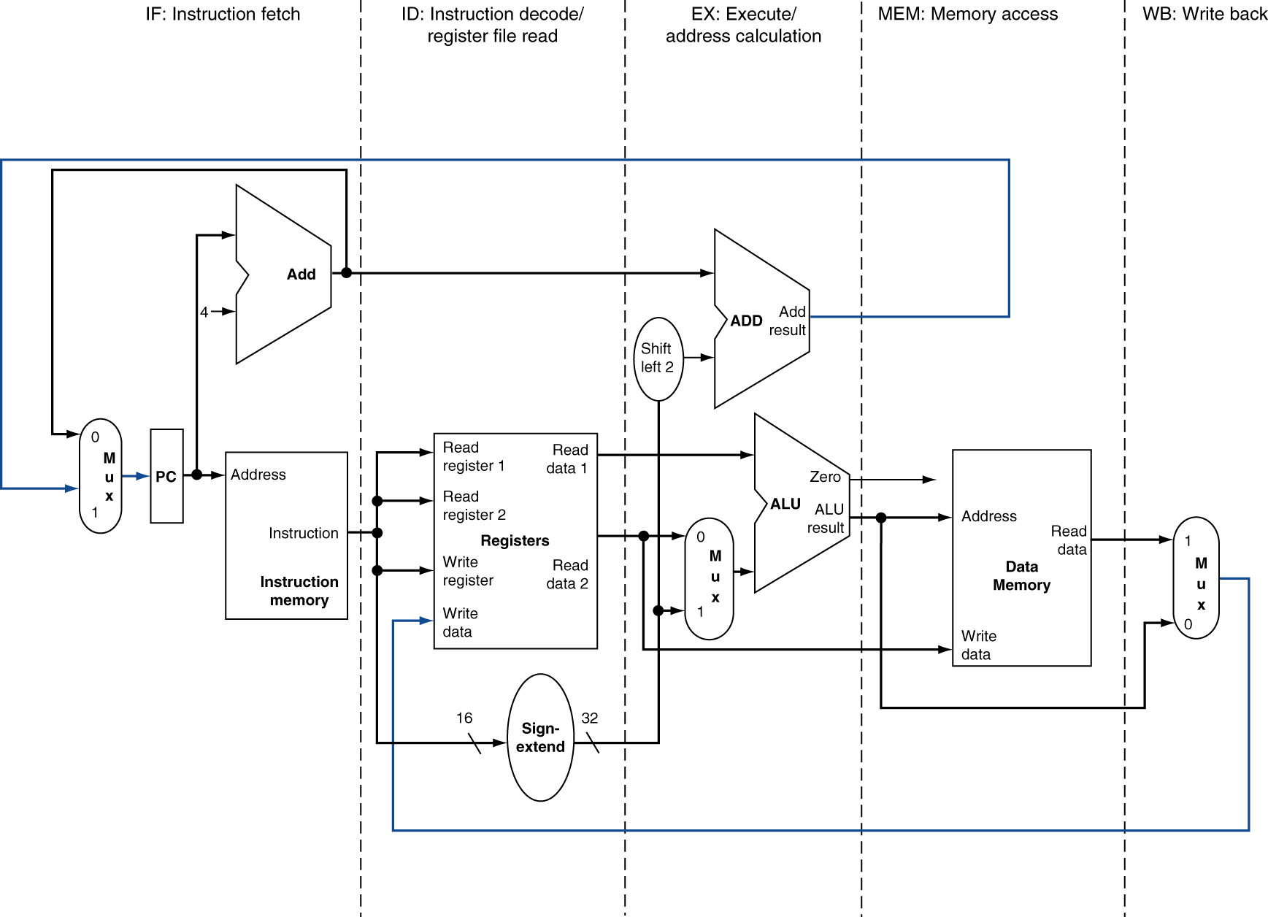
MIPS Pipelined Datapath
MEM
Right-to-left flow leads to hazards
WB

Slide 43
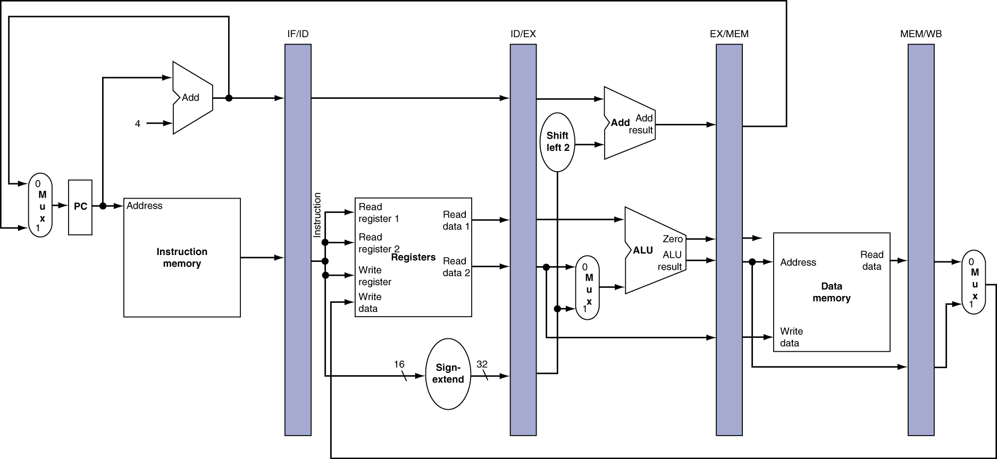
Pipeline registers
Need registers between stages
To hold information produced in previous cycle

Slide 44
Pipeline Operation
Cycle-by-cycle flow of instructions through the pipelined datapath
“Single-clock-cycle” pipeline diagram
Shows pipeline usage in a single cycle
Highlight resources used
c.f. “multi-clock-cycle” diagram
Graph of operation over time
We’ll look at “single-clock-cycle” diagrams for load & store

Slide 45
RF is two operations in One Clock Cycle
Assume Write is when clock is going up
Assume Read is when Clock is going down
(you can assume otherwise too, but two operations in one clock cycle)
Write on this
Edge
Read on this
Edge
Clock Edges

Slide 46
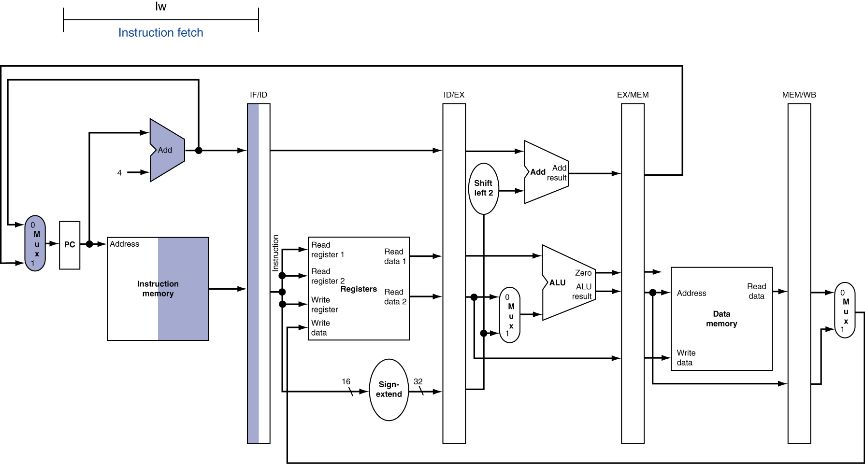
IF for Load, Store, …

Slide 47
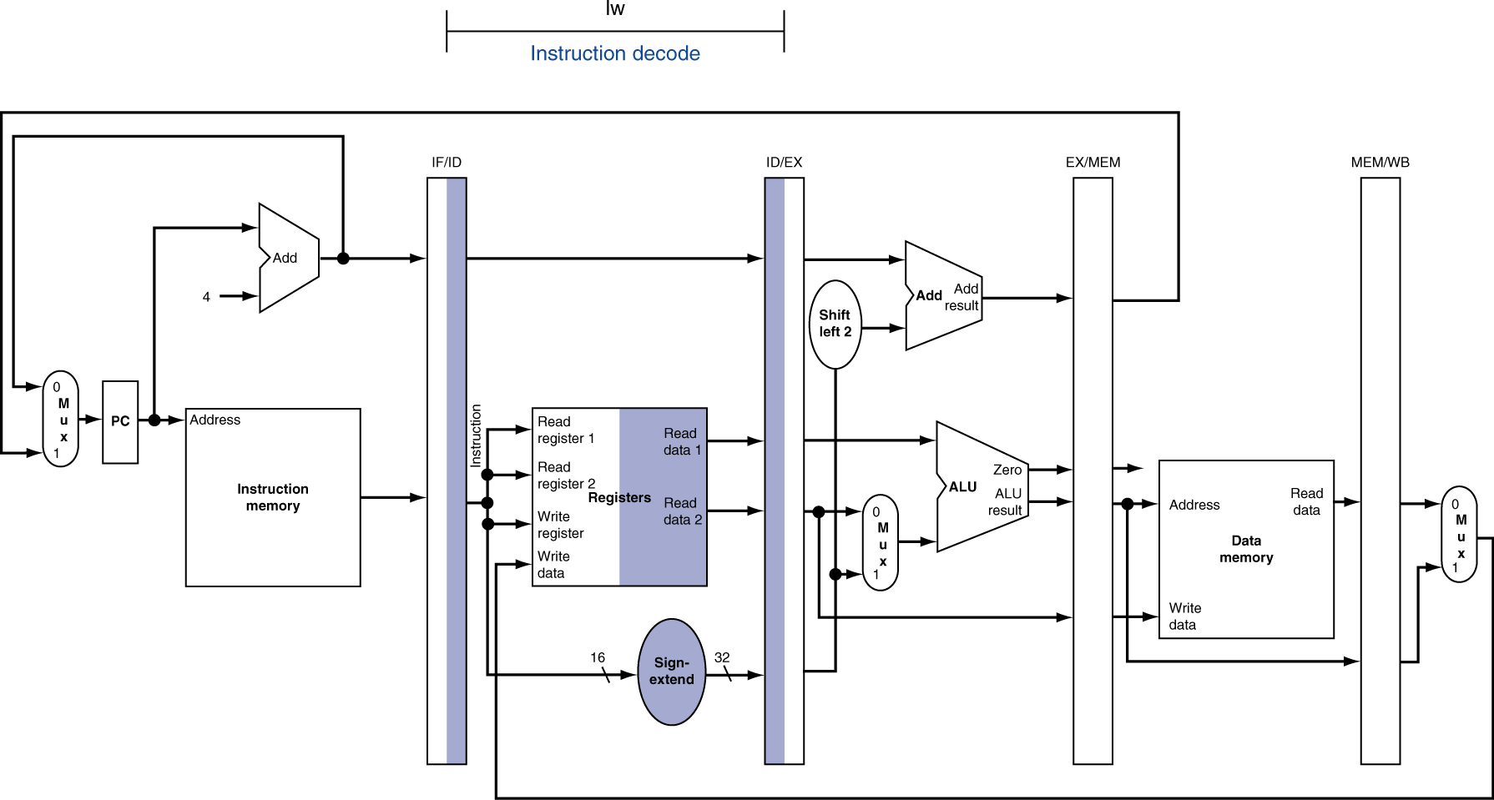
ID for Load, Store, …

Slide 48
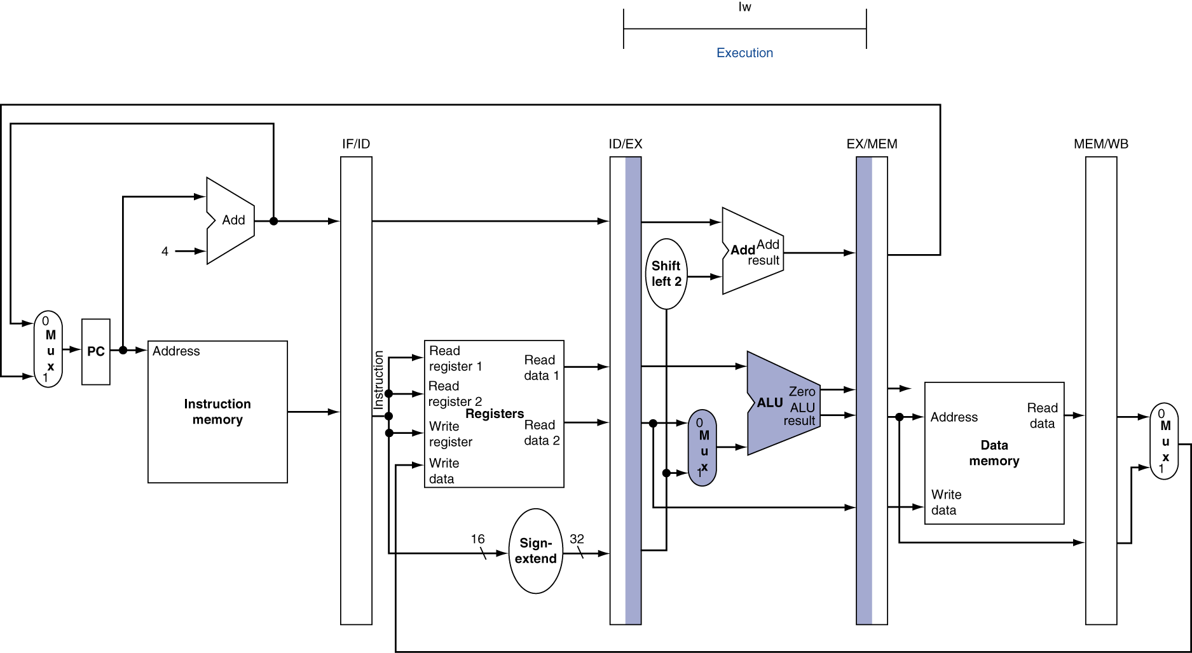
EX for Load

Slide 49
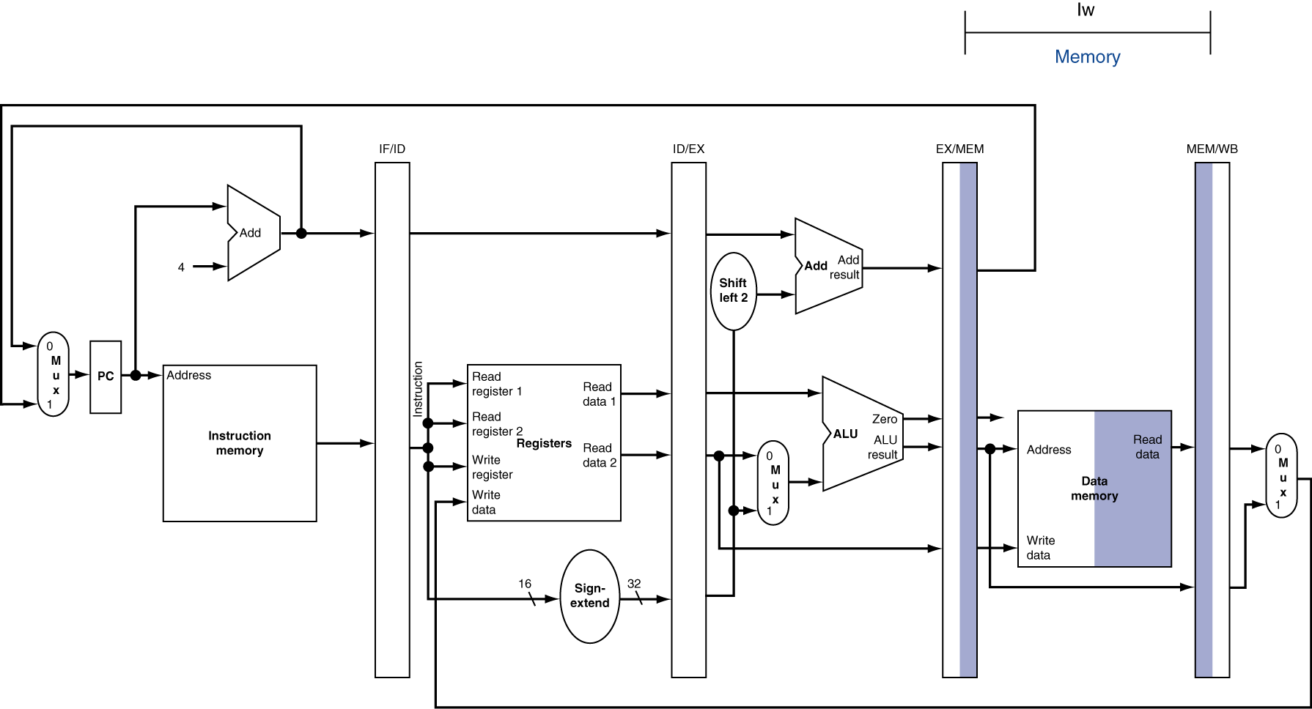
MEM for Load

Slide 50
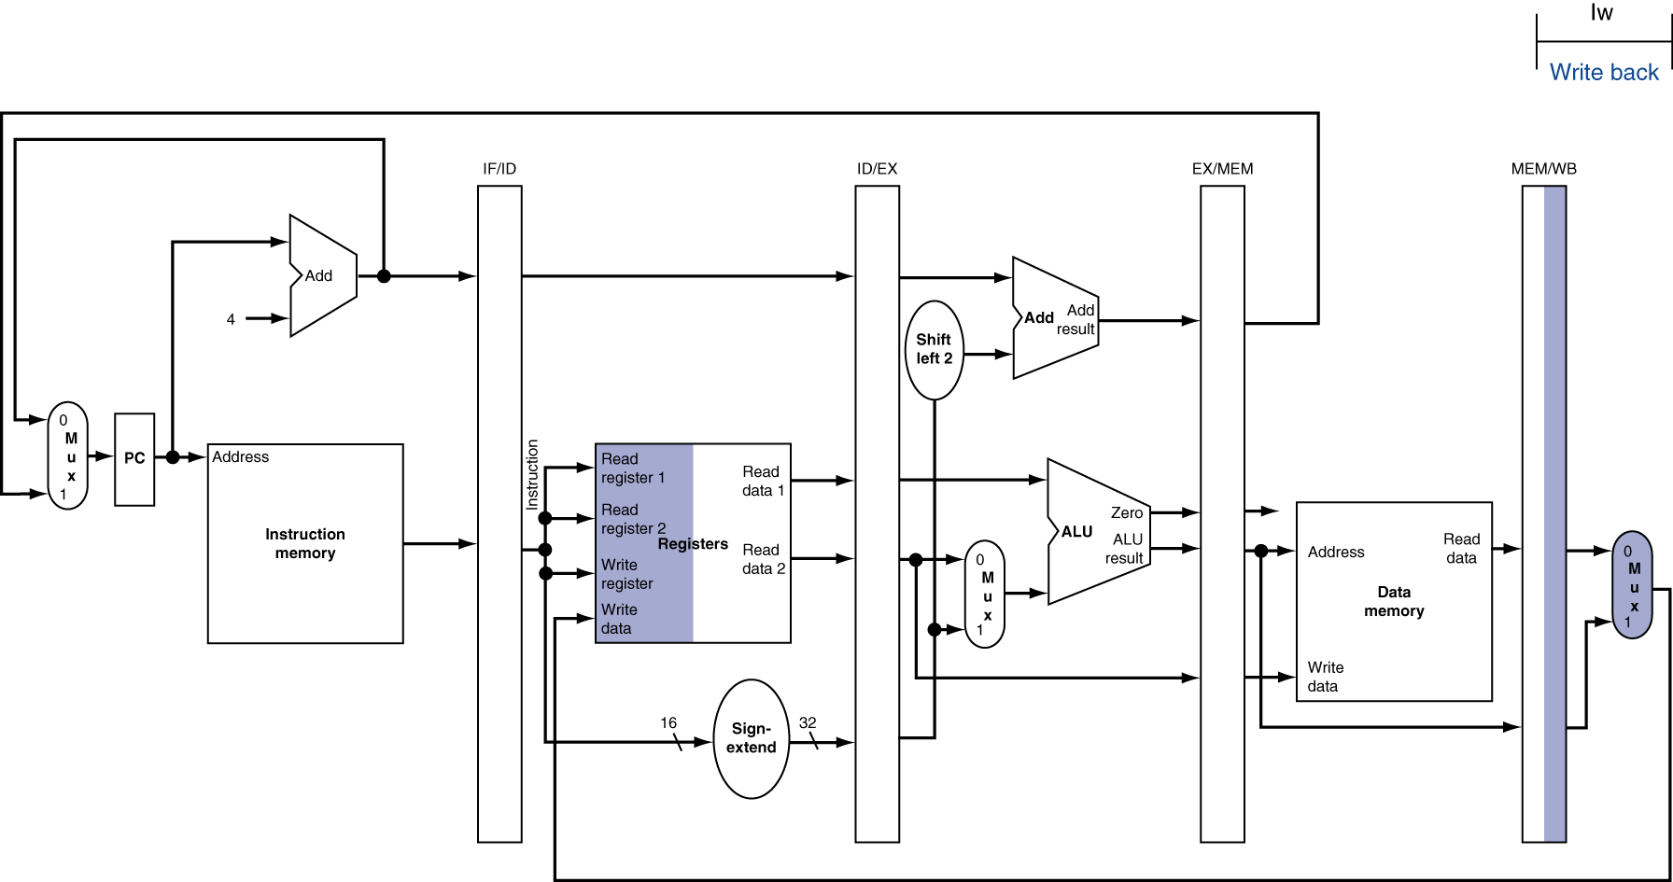
WB for Load
Register
Write

Slide 51

EX for Store

Slide 52
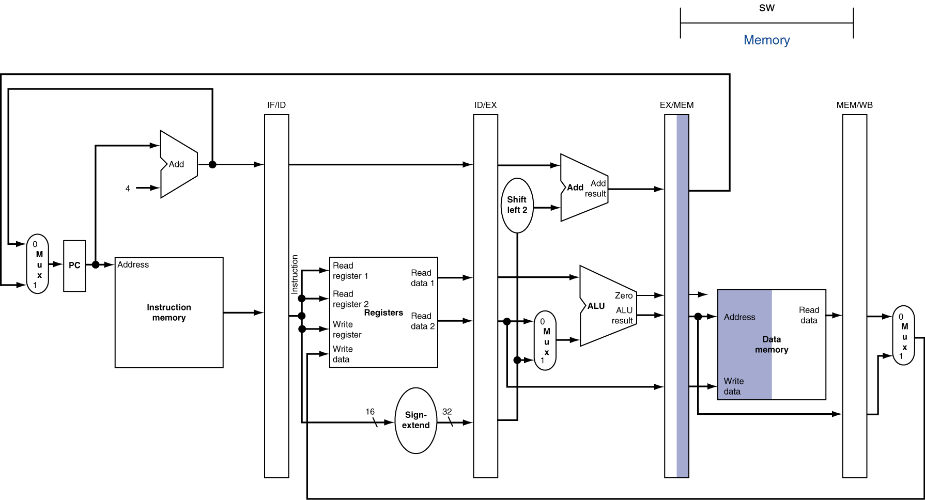
MEM for Store

Slide 53
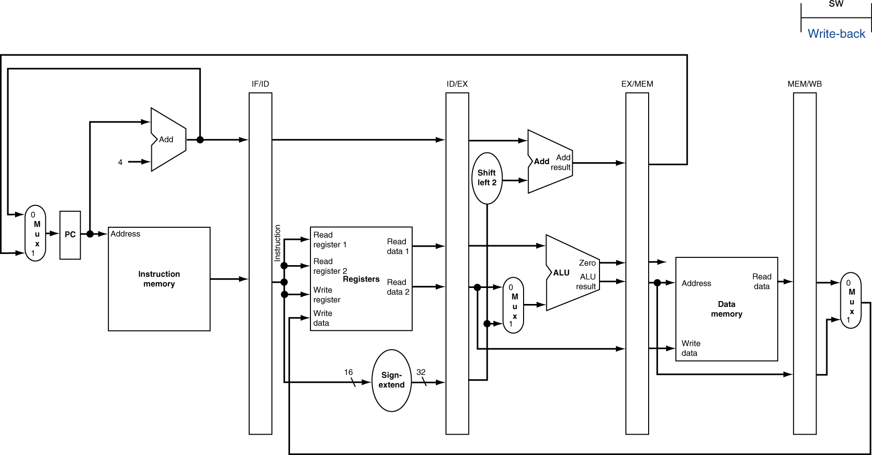
WB for Store

Slide 54
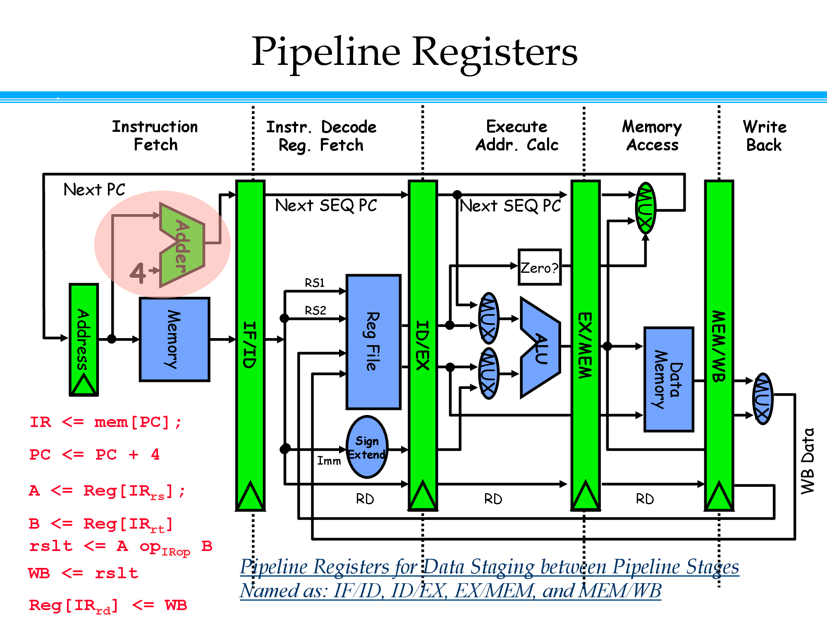

Slide 55
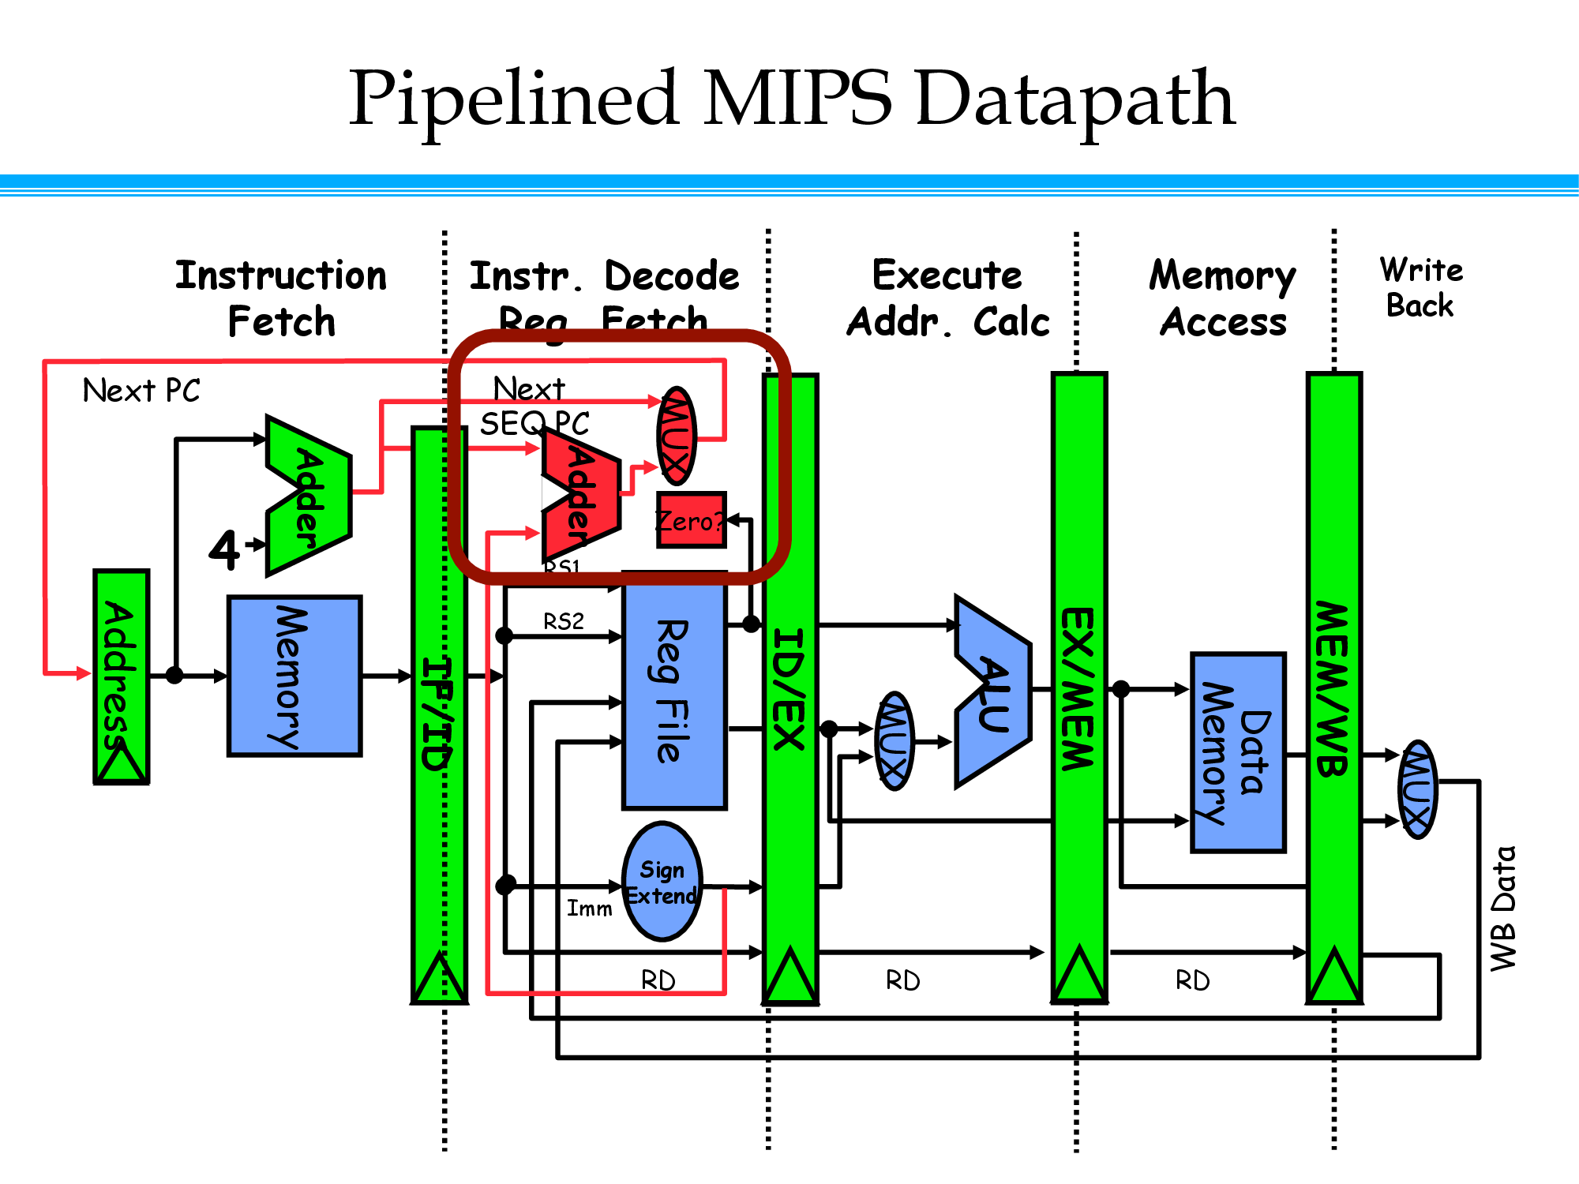

Slide 56
The Basic Pipeline For MIPS – Simplified Diagram
Cycle 1
Cycle 2
Cycle 3
Cycle 4
Cycle 5
Cycle 6
Cycle 7
I
n
s
t
r.
O
r
d
e
r
Ifetch
Reg
ALU
DMem
Reg
Ifetch
Reg
ALU
DMem
Reg
Ifetch
Reg
ALU
DMem
Reg
Ifetch
Reg
ALU
DMem
Reg

Slide 57
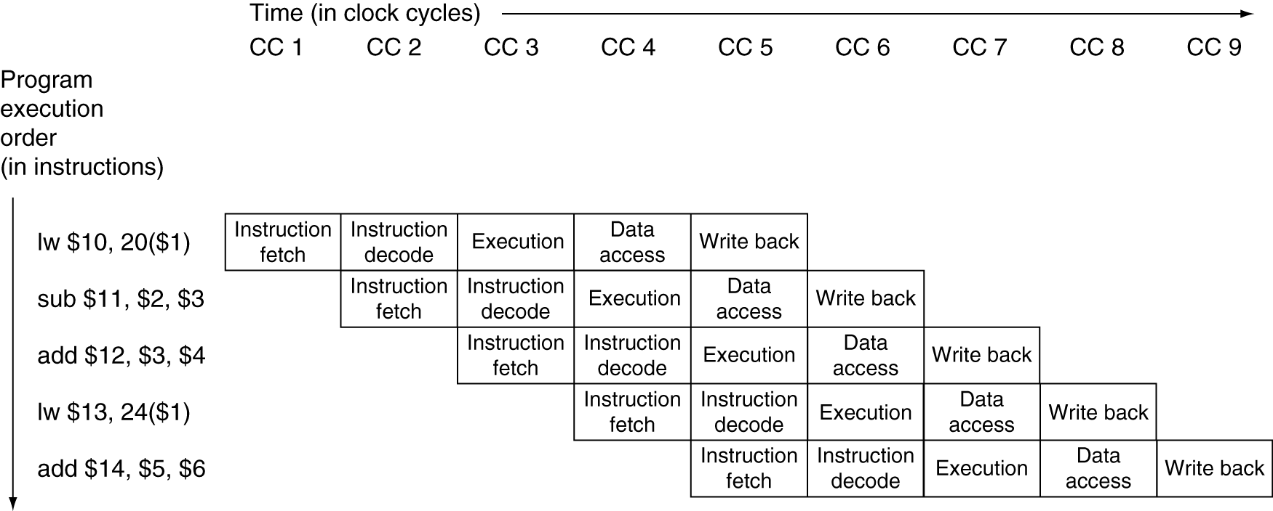
Multi-Cycle Pipeline Diagram
Traditional form

Slide 58
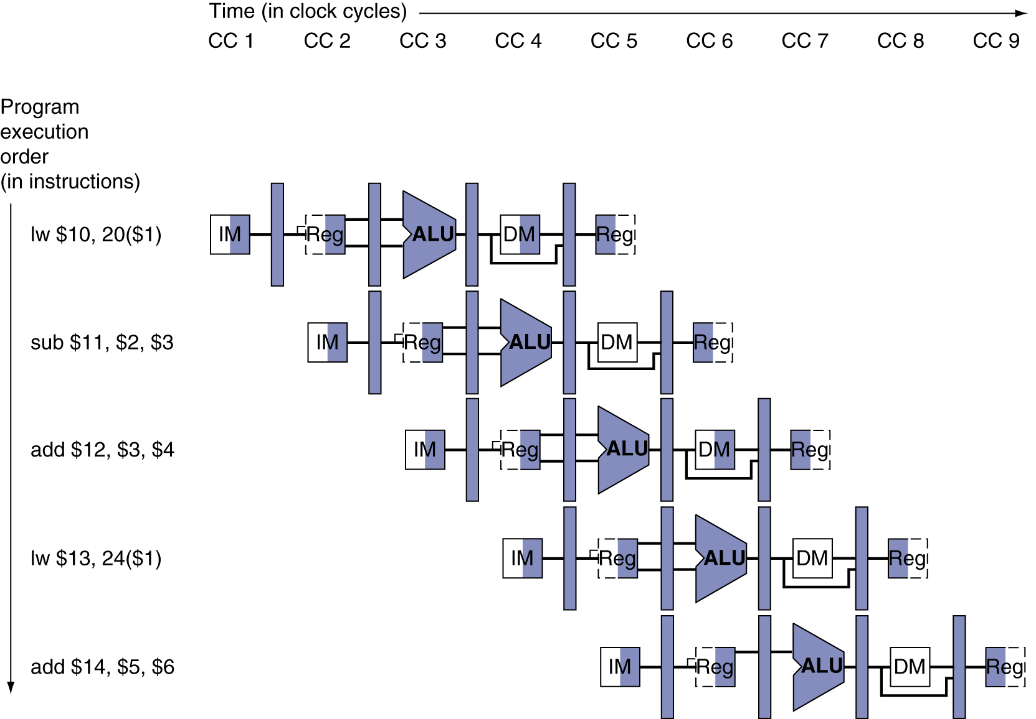
Multi-Cycle Pipeline Diagram
Form showing resource usage for different instructions

Slide 59
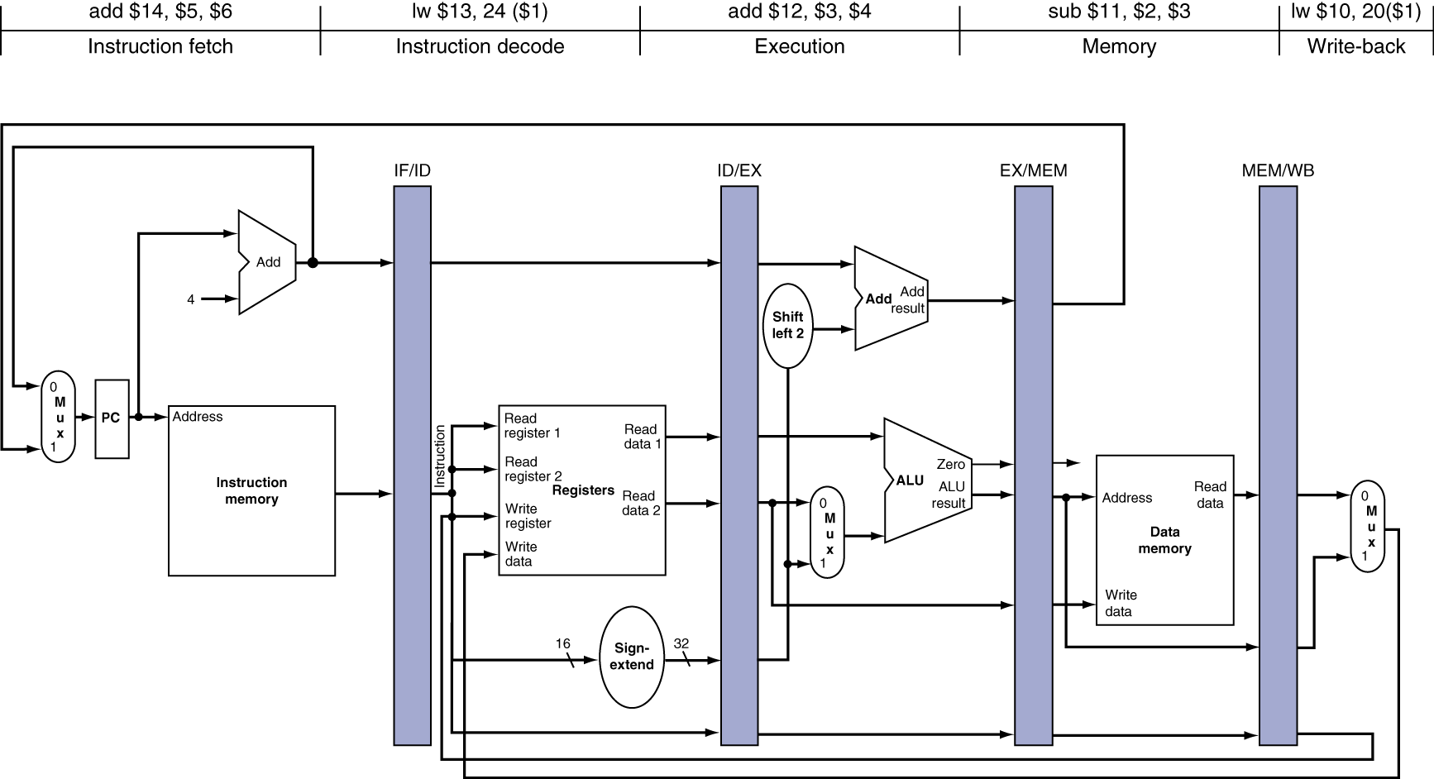
Single-Cycle Pipelined Diagram
State of pipeline in a given cycle

Slide 60
Pipeline Performance Estimation

Slide 61
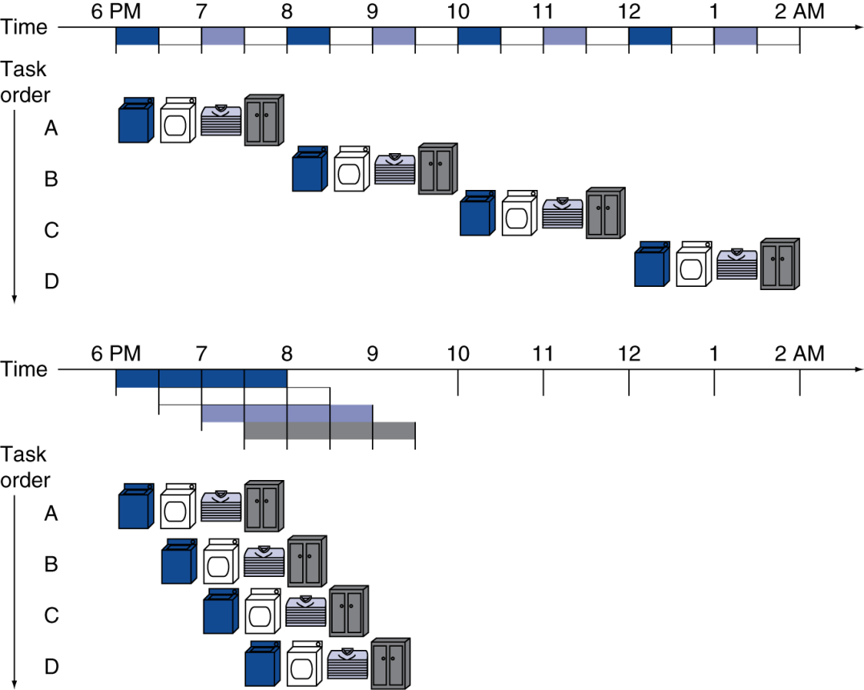
Pipelining Analogy
Pipelined laundry: overlapping execution
Parallelism improves performance
Four loads:
Speedup = 8/3.5 = 2.3

Slide 62




















Pipelined Architecture
D Example program
CT=1.5ns; CPU Time = 9 x 1 x 1.5ns = 13.5ns
AND R1,R2,R3
What is the cost of pipelining?
XOR R4,R2,R3
SUB R5,R1,R4 ADD R6,R1,R4 MUL R7,R5,R6
CPU Time = IC x CPI x CT
Time

Slide 63
Pipeline Performance
Assume time for stages is
100ps for register read or write
200ps for other stages
Compare pipelined datapath with single-cycle datapath
Instr | Instr fetch | Register read | ALU op | Memory access | Register write | Total time
lw | 200ps | 100 ps | 200ps | 200ps | 100 ps | 800ps
sw | 200ps | 100 ps | 200ps | 200ps |  | 700ps
R-format | 200ps | 100 ps | 200ps |  | 100 ps | 600ps
beq | 200ps | 100 ps | 200ps |  |  | 500ps

Slide 64
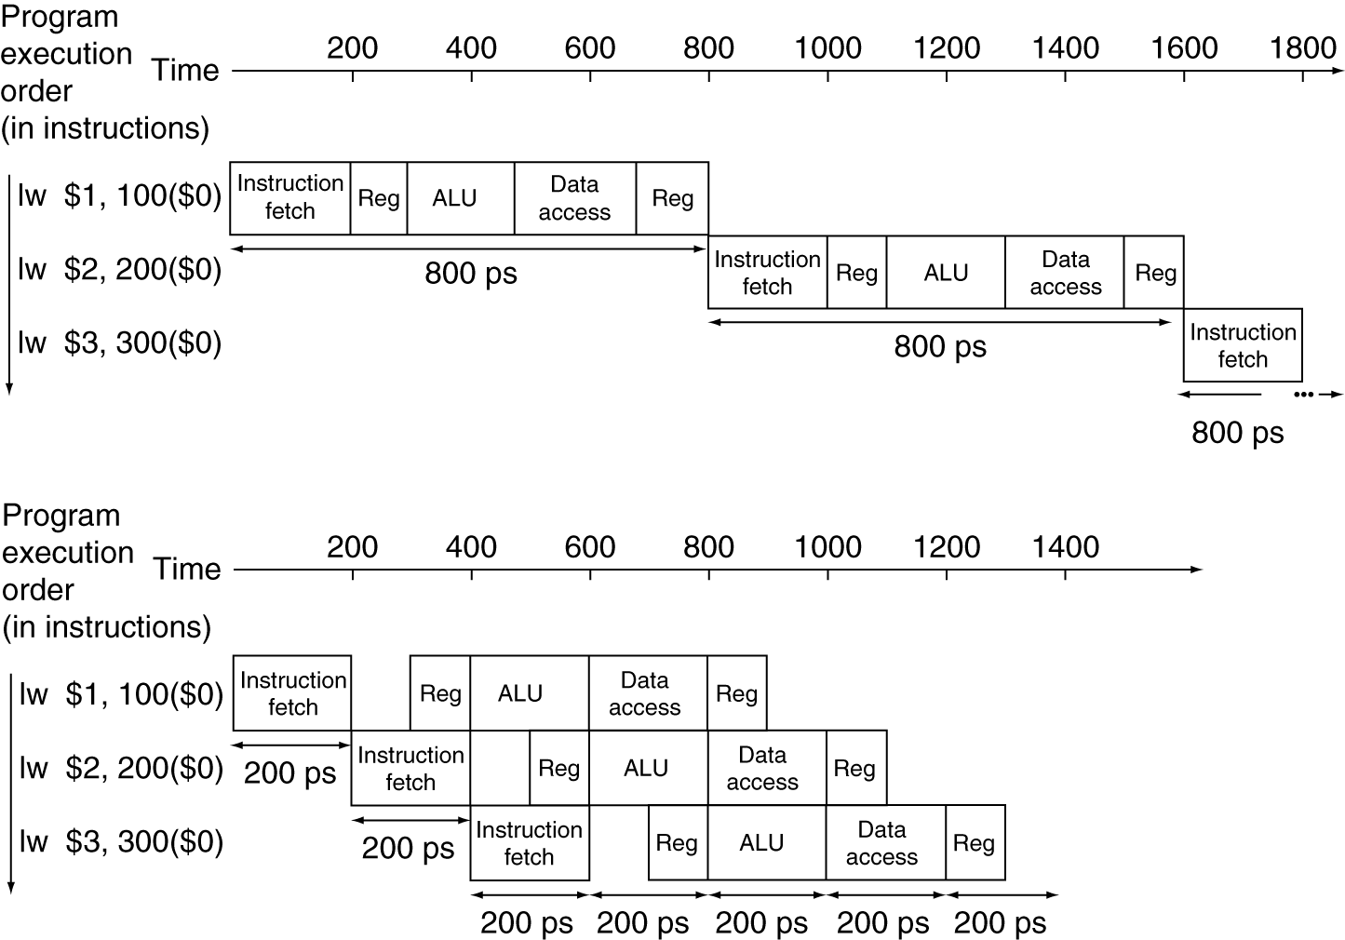
Pipeline Performance
Single-cycle (T_{c}= 800ps)
Pipelined (T_{c}= 200ps)

Slide 65
Pipelined Control

Slide 66
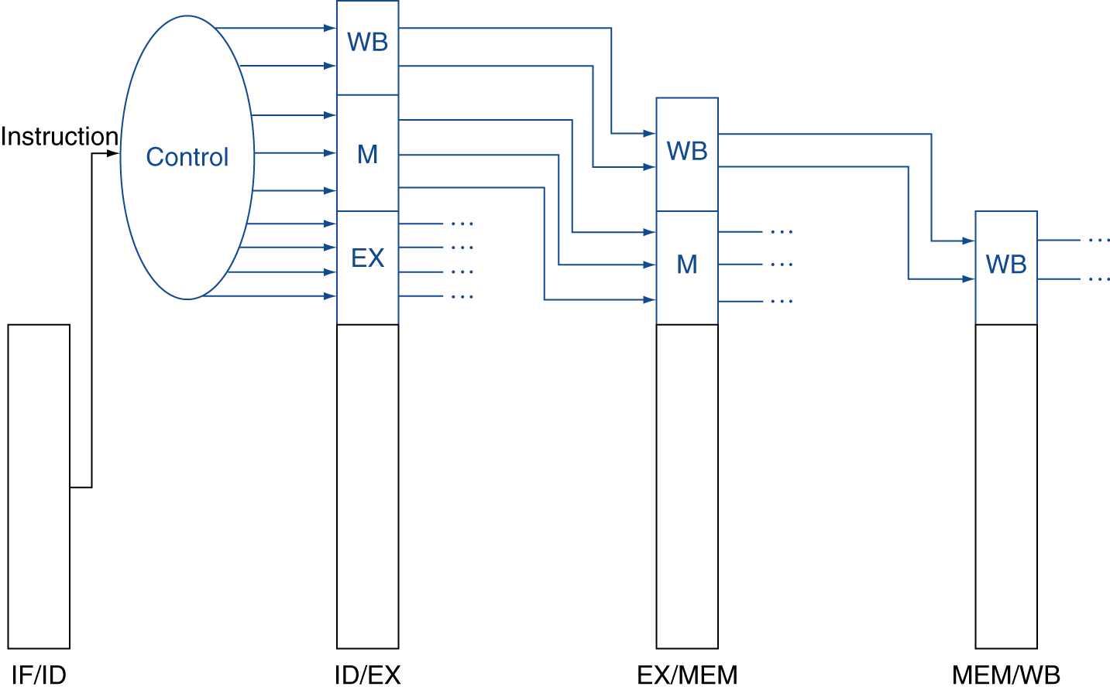
Pipelined Control
Control signals derived from instruction
As in single-cycle implementation

Slide 67
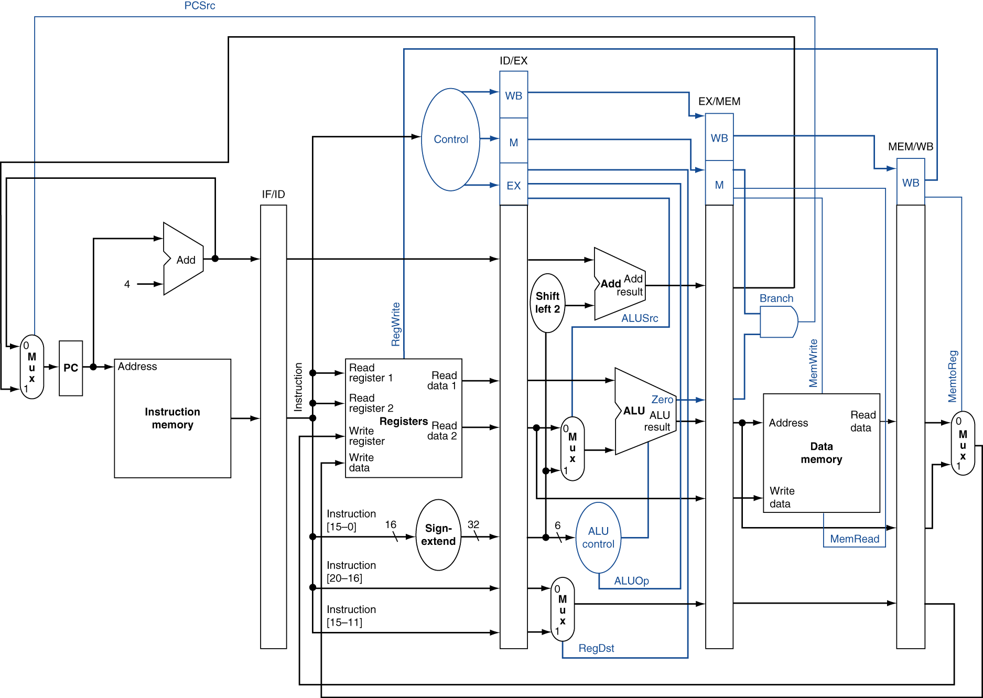
Pipelined Control with Connections

Slide 68
Readings
Chap 4 of P&H Textbook

