Slide 1
CS / EE 320
Computer Organization and Assembly Language
Spring 2023
Lecture 21
Shahid Masud
Topics: Memory Hierarchy, Memory Cell Technology, Memory Array Architecture

Slide 2
Topics
Examples of memory organization in memory array chip architecture using row and column decoders
Levels of memory w.r.t. different technology, capacity, performance
Concept of Lines in Cache and Blocks in main memory to capitalize on temporal and spatial locality
Memory Hierarchy and CPU Connection
QUIZ 4 TODAY

Slide 3
Memory Hierarchy

Slide 4
Computer Memory Combination
Registers
  In CPU
Internal or Main memory
  May include one or more levels of cache
  “RAM”
External memory
  Backing store

Slide 5
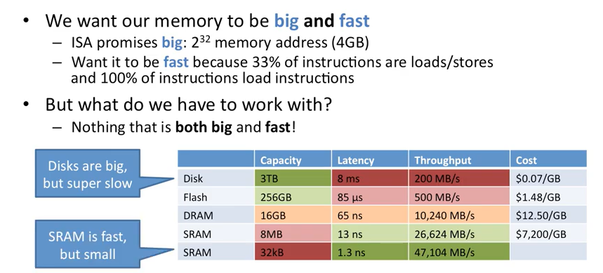
Ideal Memory Requirement

Slide 6
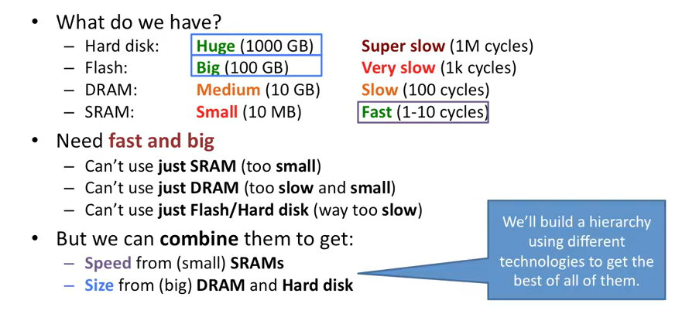
Why do we need different types of Memory?

Slide 7
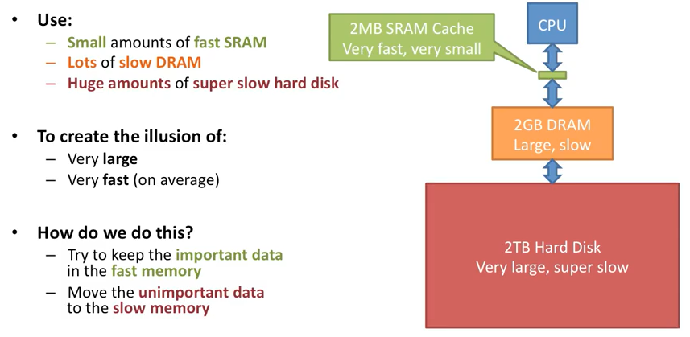
The Memory Hierarchy

Slide 8
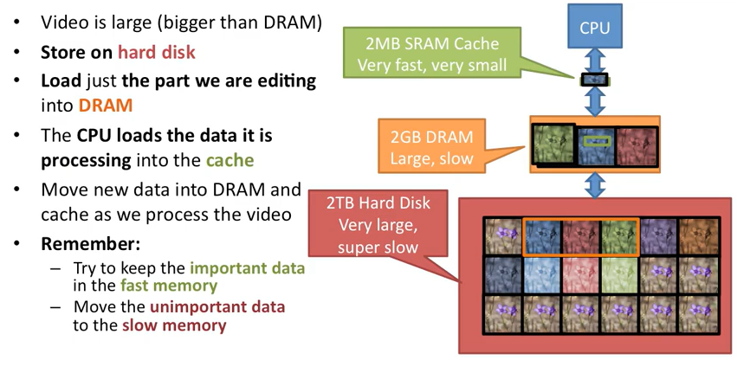
Example of Memory Hierarchy – Video Processing

Slide 9
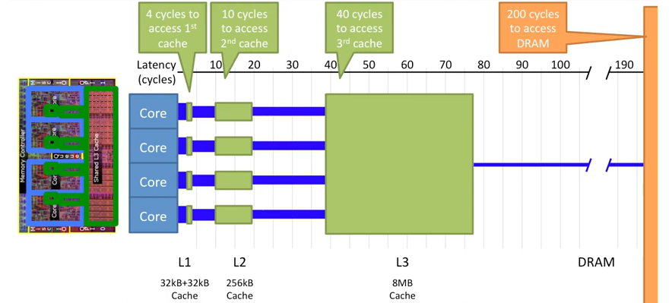
Intel Memory Hierarchy

Slide 10
Fast but Expensive?
It is possible to build a computer which uses only static RAM (see later)
This would be very fast
This would need no cache
  How can you cache cache?
This would cost a very large amount

Slide 11
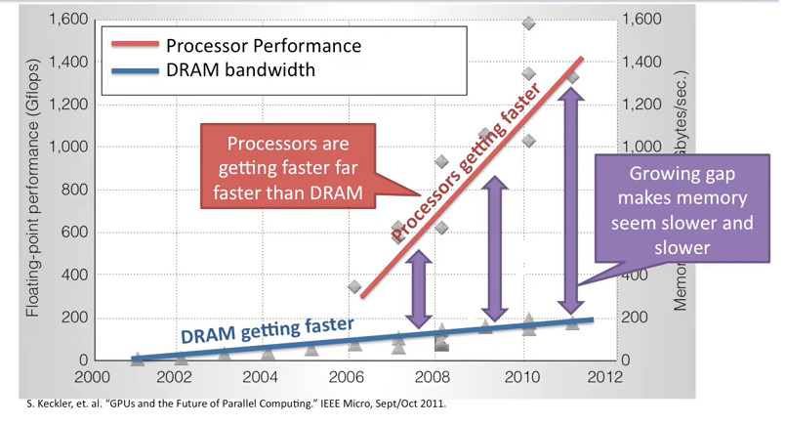
Problem with Memory and Moore’s Law

Slide 12
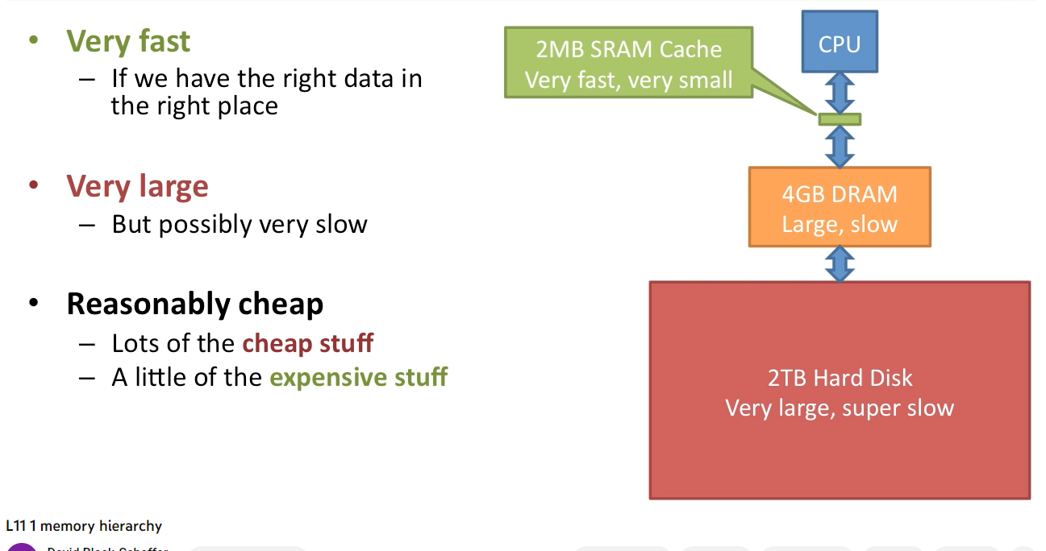
Advantages of Memory Hierarchy

Slide 13
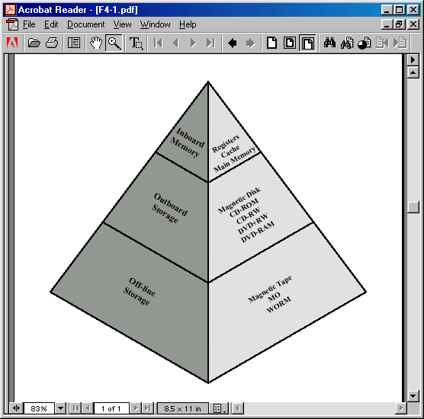
Memory Hierarchy in a Computer System

Slide 14
Hierarchy List
C
A
P
A
C
I
T
Y
Registers
L1 Cache
L2 Cache
Main memory
Disk cache
Disk
Optical
Tape
S
P
E
E
D

Slide 15
Memory Types and Performance

Slide 16
Characteristics of Memory Types
Location – CPU, Internal, External
Capacity
Unit of transfer
Access method
Performance
Physical type
Physical characteristics
Organisation

Slide 17
Unit of Memory Transfer
Internal
  Usually governed by data bus width
External
  Usually a block which is much larger than a word
Addressable unit
  Smallest location which can be uniquely addressed
  Word internally
  Cluster on disks

Slide 18
Performance
Access time
  Time between presenting the address and getting the valid data
Memory Cycle time
  Time may be required for the memory to “recover” before next access
  Cycle time is access + recovery
Transfer Rate
  Rate at which data can be moved

Slide 19
Memory Performance - Mathematically
Access Time
  Time between address appearing on address lines and data coming out from memory cells to data lines for RAM and vice versa.
Memory Cycle Time
  (Access Time + Extra time) before a second read / write can take place.
Transfer Rate
  For RAM $T_{R}=\frac{1}{Cycle Time}$
  For non-RAM $T_{N}=T_{A}+\frac{N}{R}$
    Where T_{N} = Avg time to read or write N bits
    T_{A} = Avg Access Time
    N = number of bits
    R = Transfer Rate in bits / second

Slide 20
Physical Types of Memory
Semiconductor
  RAM
Magnetic
  Disk & Tape
Optical
  CD & DVD
Physical Properties
  Volatility
  Eraseable
  Power and Access

Slide 21
Semiconductor Memory, RAM and ROM
RAM
  Misnamed as all semiconductor memory is random access
  Read/Write
  Volatile
  Temporary storage
  Static or dynamic
ROM
  Permanent storage
  Microprogramming (see later)
  Library subroutines
  Systems programs (BIOS)
  Function tables

Slide 22
Static RAM
Bits stored as on/off switches
No charges to leak
No refreshing needed when powered
More complex construction
Larger per bit
More expensive
Does not need refresh circuits
Faster
Cache

Slide 23
Dynamic RAM
Bits stored as charge in capacitors
Charges leak
Need refreshing even when powered
Simpler construction
Smaller per bit
Less expensive
Need refresh circuits
Slower
Main memory

Slide 24
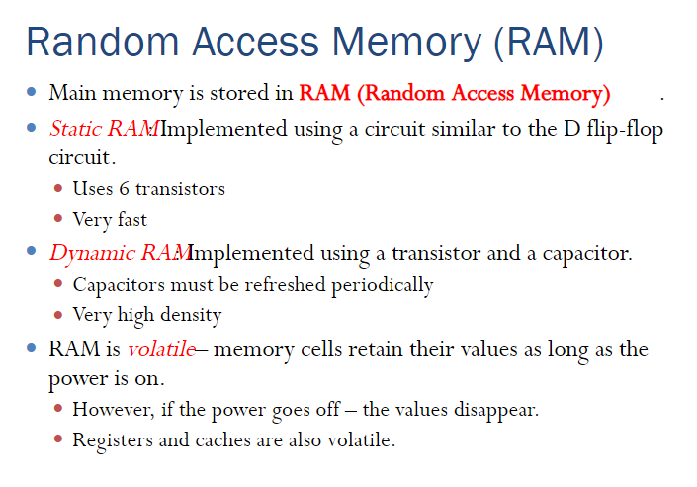
RAM Memory

Slide 25
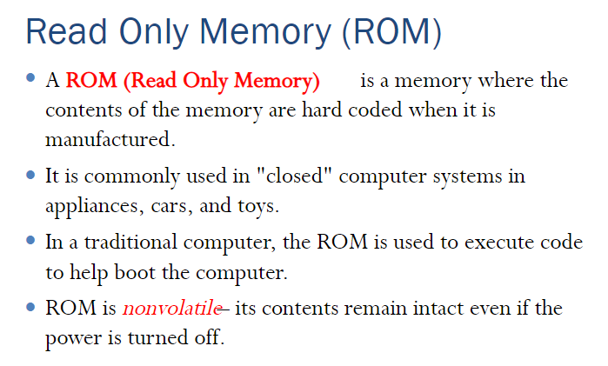
ROM Memory

Slide 26
Types of ROM
Written during manufacture
  Very expensive for small runs
Programmable (once)
  PROM
  Needs special equipment to program
Read “mostly”
  Erasable Programmable (EPROM)
    Erased by UV
  Electrically Erasable (EEPROM)
    Takes much longer to write than read
  Flash memory
    Erase whole memory electrically

Slide 27
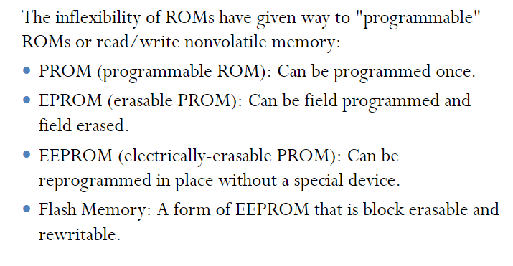
PROM / FLASH Memory

Slide 28
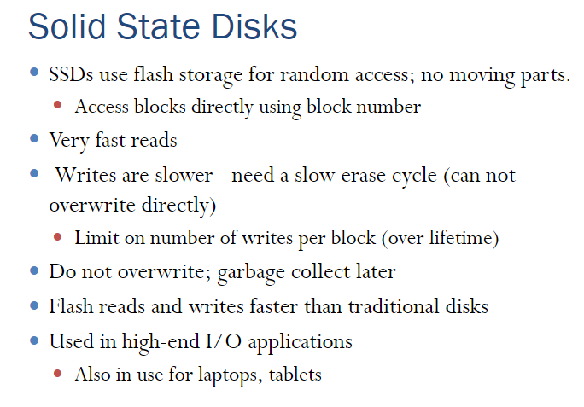
SSD Memory

Slide 29
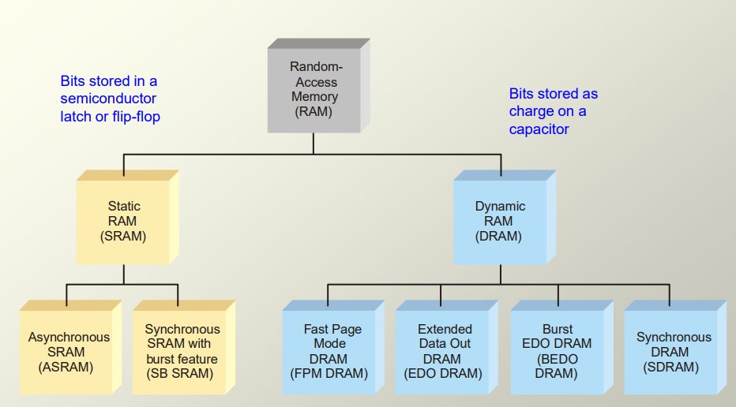
Types of RAM Memory

Slide 30
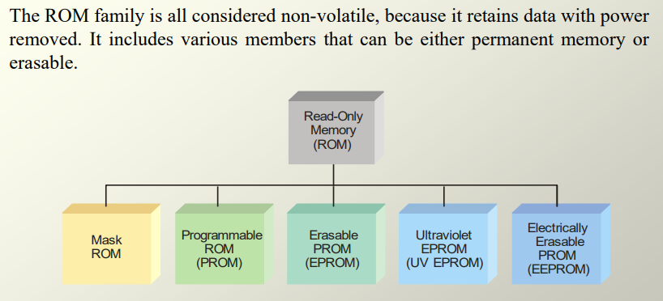
Types of ROM Memory

Slide 31
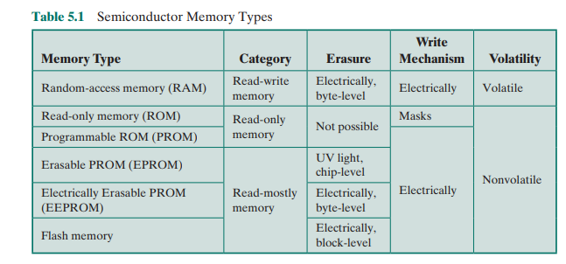
Semiconductor Memory Types - Summary

Slide 32
Memory Construction

Slide 33
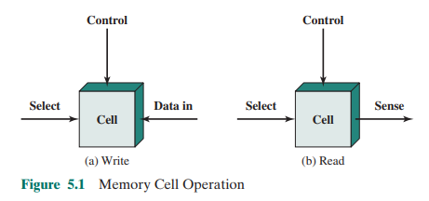
Memory Cell Operation

Slide 34
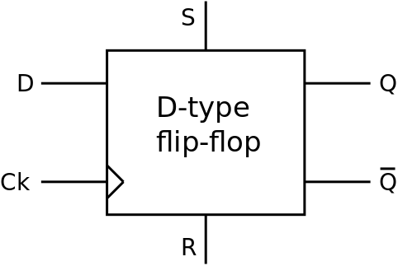
Simplest Digital Storage Element – D Flipflop
“D Latch” is a type of storage without a ‘Clock’. Instead it has an ‘Enable’ signal.

Slide 35
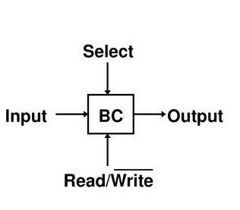
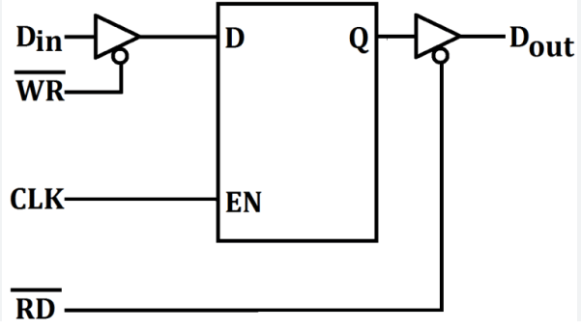
Memory Cell Design
Cell

Slide 36
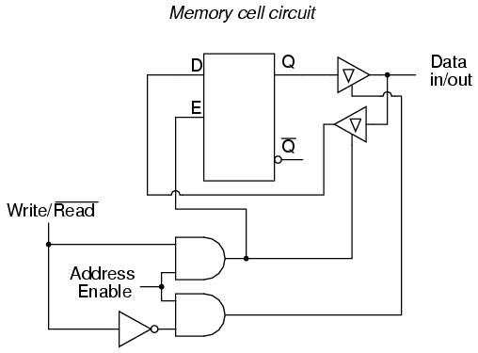
Asynchronous Memory Cell using D Latch
D
Latch
No Clock
Only Enable Signal

Slide 37
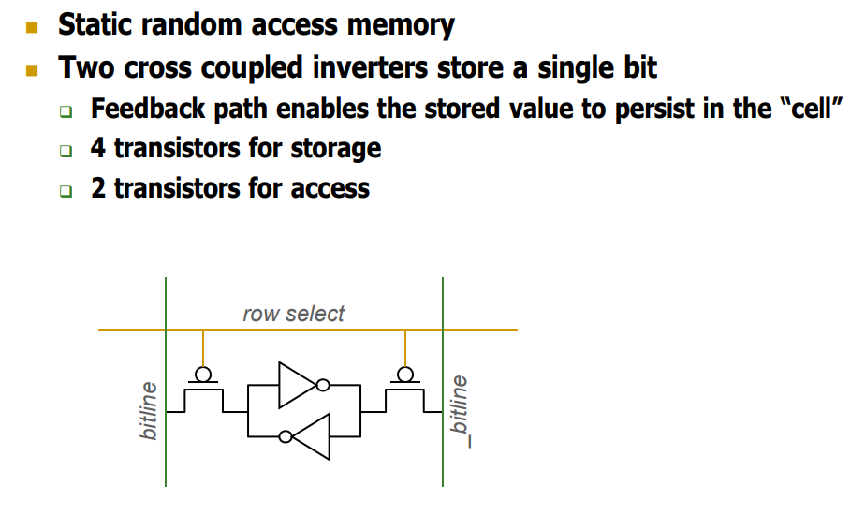
SRAM Cell Technology

Slide 38
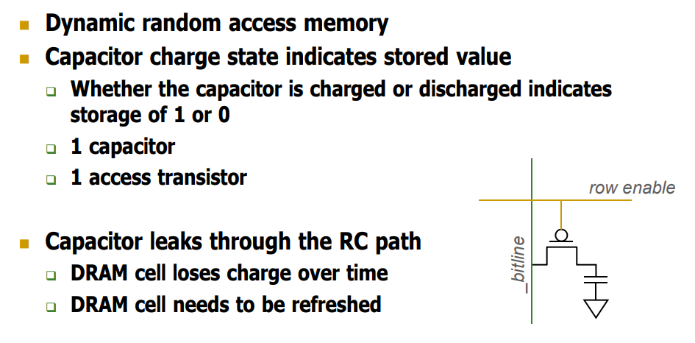
DRAM Cell Technology

Slide 39
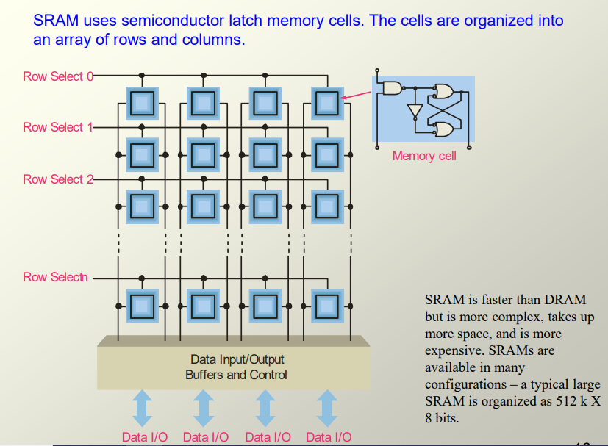
Memory Cell Organization

Slide 40
Readings
Chap 5 of P&H Textbook
Acknowledge: Youtube channel David Black-Schaffer for some diagrams

