Slide 1
Computer Organization and Assembly Language
CS / EE 320
Spring 2025
Lecture 4
Shahid Masud

Slide 2
Topics
Solve Examples of Performance Measurement Techniques
  Amdahl’s Law, Calculate Speedup S, parallelizing variable K, etc.
  Examples Calculation of Computer Performance
Number System Conversion Binary, Decimal, Hexadecimal
Little Endian, Big Endian location
Memory Map and Calculate Different Segments in Hexadecimal and Decimal
QUIZ 1 next week

Slide 3
Amdahl’s Law as Measure of Performance

Slide 4
Accelerators, Multiprocessors and Multicores
Performance Enhancement through:
  Custom Hardware Accelerators
  Instruction Set Extension
Multicore Microprocessors
  More than one processor per chip
Requires explicitly parallel programming
  Compare with instruction level parallelism
    Hardware executes multiple instructions at once
    Hidden from the programmer
  Hard to do
    Programming for performance
    Load balancing
    Optimizing communication and synchronization

Slide 5
Scenarios for Amdahl’s Law
Scenario 1
Scenario 2
Program
Program
Portion of program
is executed fast here
Compiler and OS
Main Program
FunctionCall
CPU
Co-processor or Accelerator
Fast Buses
CPU1
CPU2
CPU3
CPU4
Special / Complex operations:
Floating point
Matrix multiplication
Convolution for AI
Hashing for Crypto
Program is executed over multiple CPU in parallel

Slide 6
Amdahl’s Law for Enhanced Performance
Gives an idea of improvement in a program when more cores and additional hardware functionality is added.
Separates the fraction of program code that can be parallelized / improved and the fraction that cannot be parallelized / improved.
$$Speedup=\frac{Performance after enhancement}{Performance before enhancement}=\frac{Execution time before enhancement}{Execution time after enhancement}$$

Slide 7
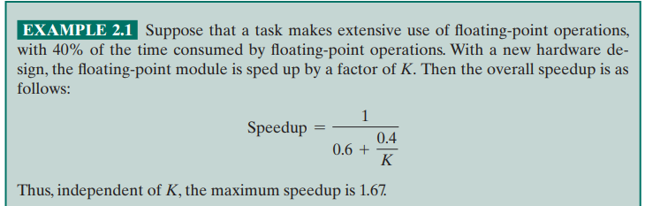
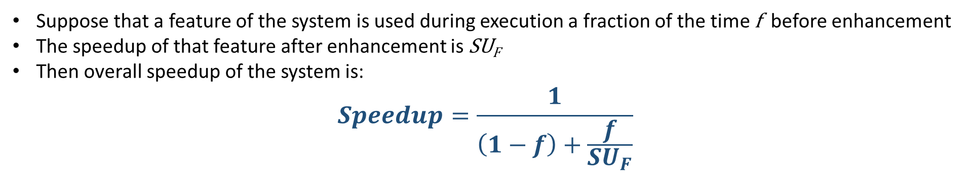
Formula for Amdahl’s Law for Customized Speedup
Suppose that a feature of the system is used during execution a fraction of the time f before enhancement
The speedup of that feature after enhancement is SU_{F}
Then overall speedup of the system is:
$$Speedup=\frac{1}{\left(1−f\right)+\frac{f}{{SU}_{F}}}$$

Slide 8
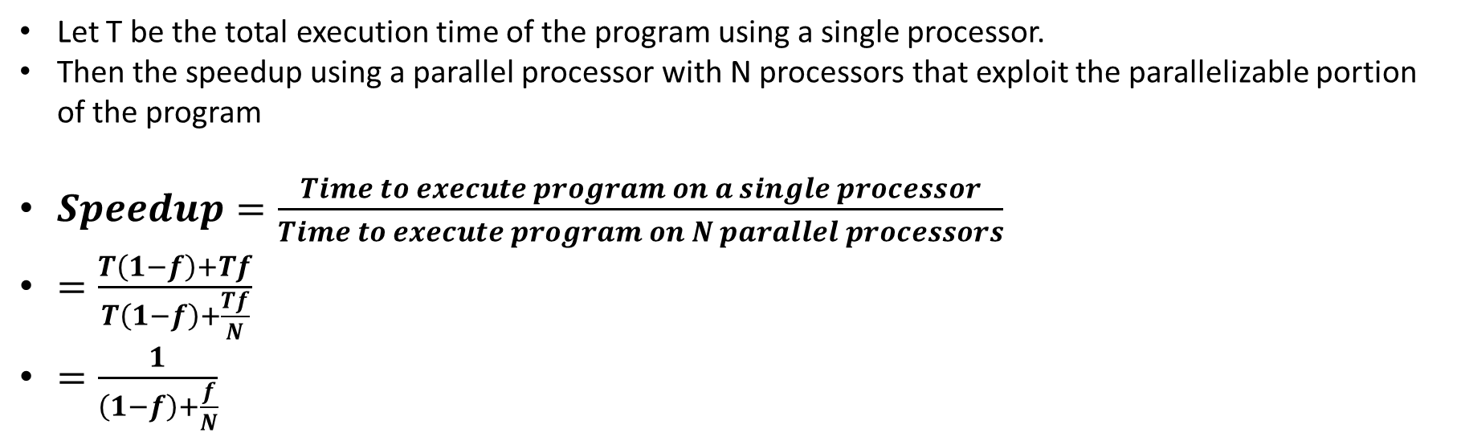
Amdahl’s Law for Multicore / Parallel Processing
Let T be the total execution time of the program using a single processor.
Then the speedup using a parallel processor with N processors that exploit the parallelizable portion of the program
$Speedup=\frac{Time to execute program on a single processor}{Time to execute program on N parallel processors}$
$=\frac{T\left(1−f\right)+Tf}{T\left(1−f\right)+\frac{Tf}{N}}$
$=\frac{1}{\left(1−f\right)+\frac{f}{N}}$
Important Observation:
When f is small, the use of parallel processors has little effect
As N approaches infinity, speedup is bound by 1/(1-f), so that there are diminishing returns for more processors

Slide 9
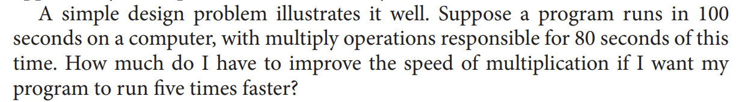
Question using Amdahl’s Law

Slide 10
Problem with Amdahl’s Law
Improving one aspect of a computer and expecting a proportional improvement in overall performance
$$T_{improved}=\frac{T_{affected}}{improvement factor}+T_{unaffected}$$

Slide 11
Practice Amdahl’s Law Questions
Question 1:
Suppose that a computing task makes extensive use of Floating point (FP) computations with 40% execution time consumed in FP. With a new co-processor, the FP is sped up by a factor k. What is the maximum speed up possible with this FP co-processor.
Question 2:
A program takes 100 sec to run on a computer. 80 sec out of 100 sec are spent on multiplication operation. How much speed of multiplication has to improve to make program execute 5 times faster.

Slide 12
Number System Conversion
Decimal to Binary Conversion
Binary to Decimal Conversion
Binary to Hexadecimal Conversion
Hexadecimal to Binary Conversion

Slide 13
Approximations in Huge Binary Numbers
2¹⁰ is approximately 1 Kilo (approx 1x10³)
2²⁰ is approximately 1 Mega (approx 1x10⁶)
2³⁰ is approximately 1 Giga (approx 1x10⁹)

Slide 14
Problem in Big-Endian, Little Endian
A CPU Register R0 is 32-bits wide.
It has data “1A2B3C4D” Hex.
Store the data in an 8-bit wide RAM that has 4 locations.
Store in Big-Endian style
Store in Little-Endian Style
Location | Big Endian RAM
3
2
1
0
CPU Register
R0 Contents
1A 2B 3C 4D
MSB LSB
Location | Little Endian RAM
3
2
1
0

Slide 15
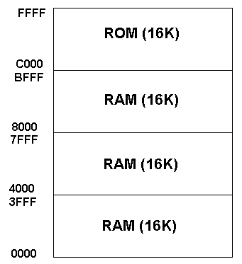
Memory Map Example 1

Slide 16
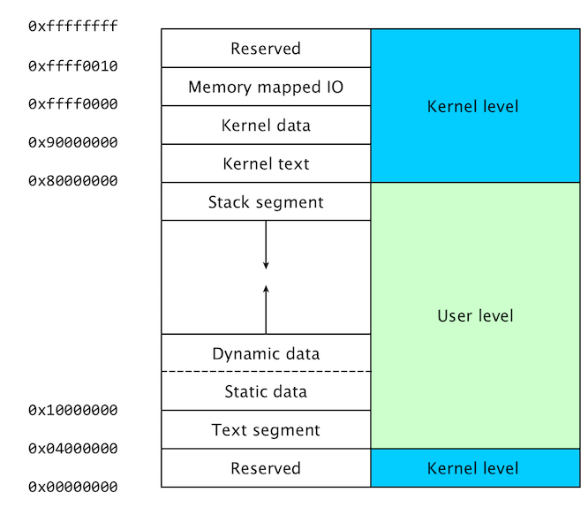
Memory Map
Example 2

Slide 17
Example of Memory Map Computation
Question 1: In the MIPS memory map, find the space of memory available in kernel data segment, closest to (i) Mbyte and (ii) GByte
Solution:
Find the difference using starting and ending locations in kernel data seg:
(0xFFFF 0000) – (0x9000 0000) = (0x 6FFF 0000)
Write in binary:
0110 1111 1111 1111 0000 0000 0000 0000
Rewriting, inserting markers at 2¹⁰, 2²⁰, 2³⁰
01 | 10 1111 1111 | 11 11 00 00 00 | 00 0000 0000
In HEX this is 0x6FF Mbyte and Decimal is 1.56 Gbyte
0x6FF is approx (6x16² + 15x16¹ + 15x16⁰) = 1791 decimal
So in Mbyte the answer is approx 1791 MByte

Slide 18
Some Examples of CPI, MIPS, Amdahl’s Law etc.

Slide 19
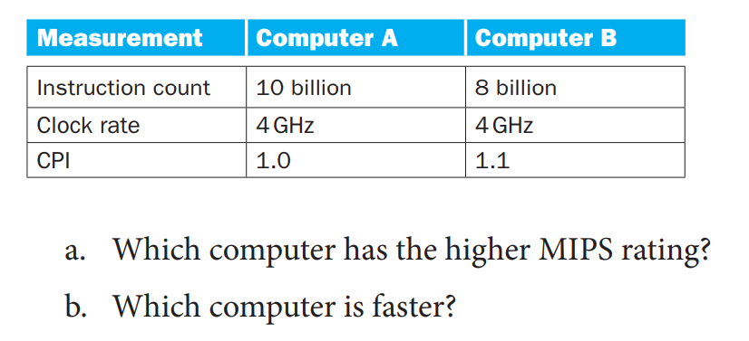
Question 1
$$MIPS rate= \frac{I_{c}}{T×{10}^{6}}=\frac{f}{CPI×{10}^{6}}$$

Slide 20
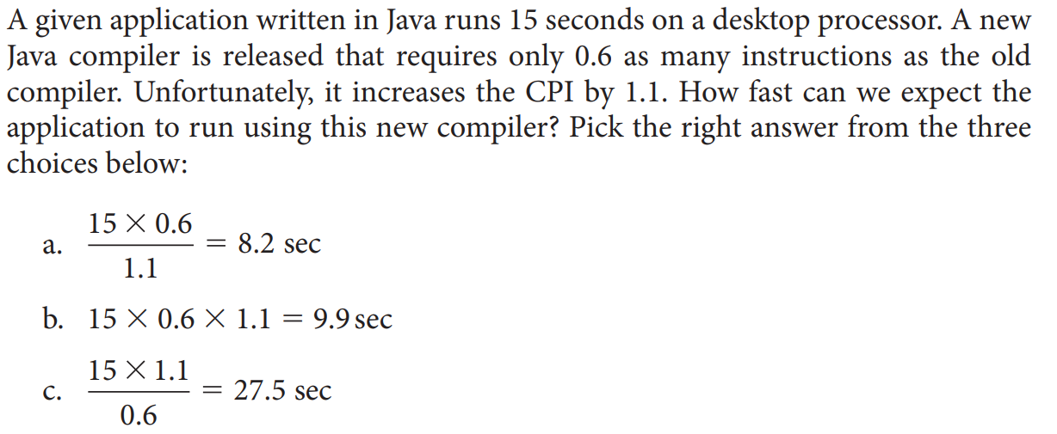
Question 2
$$Clock Cycles=Instruction Count×Cycles per Instruction$$
$$CPU Time=Instruction Count×CPI×Clock Cycle Time$$
$$=\frac{Instruction Count×CPI}{Clock Rate}$$

Slide 21
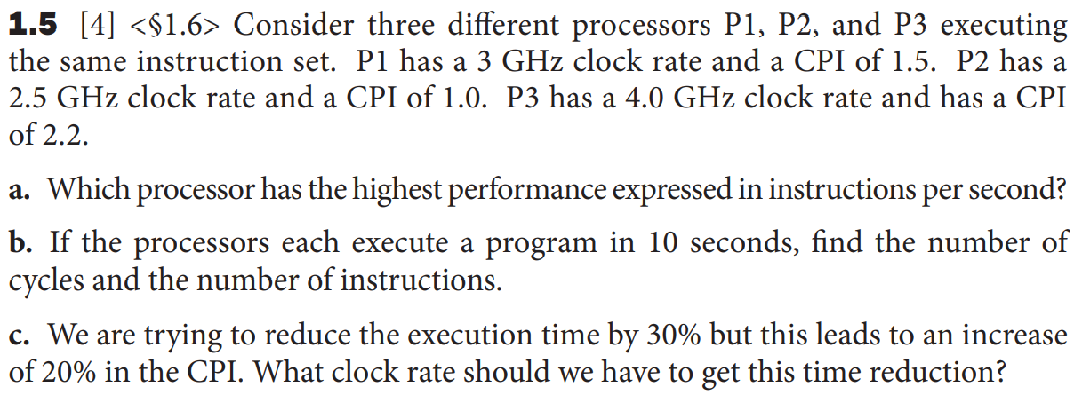
Question 3

Slide 22
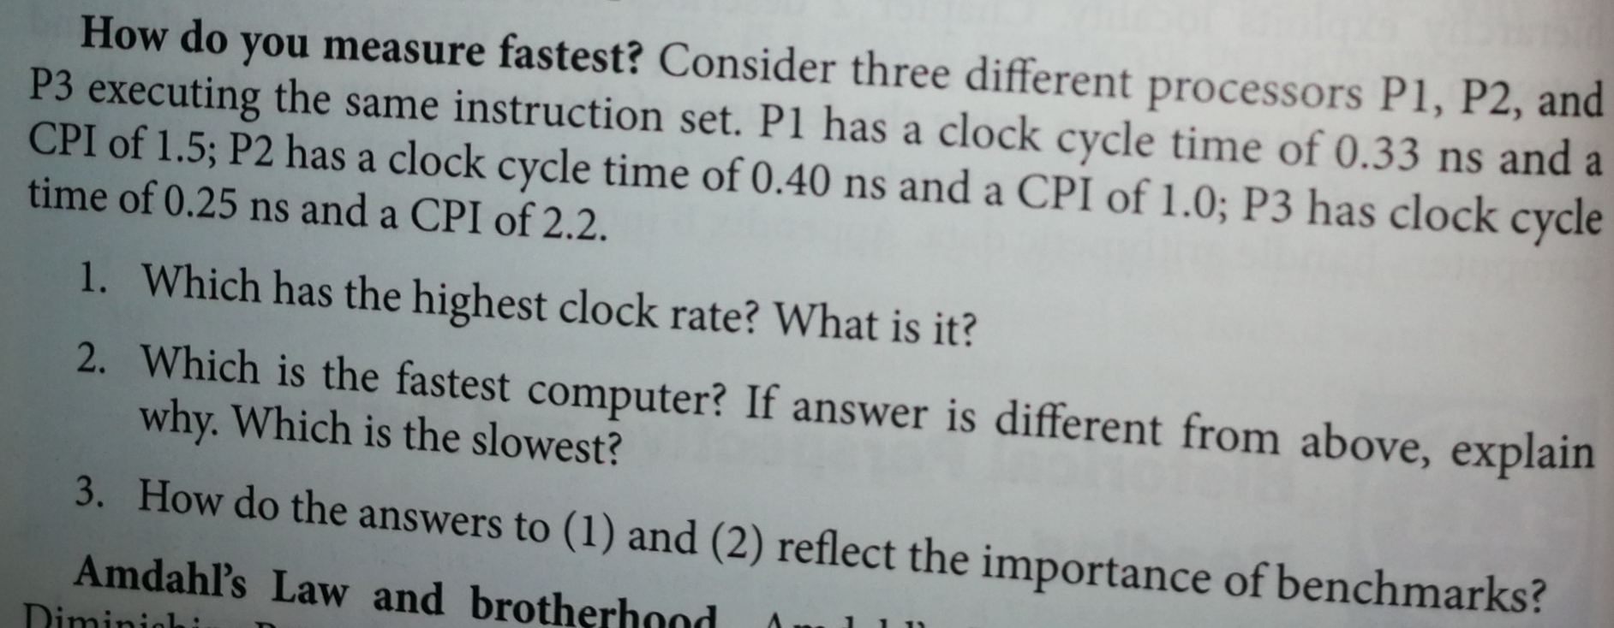
Question 4

Slide 23
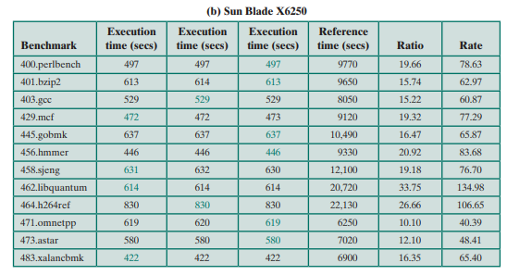
Spec Benchmark Question
Question: Given output of running Spec Benchmarks; find the Spec Rating of this computer?
Hint: Use Geometric Mean to combine all individual rates in last column and come up with one rating

Slide 24
Memory Map Questions
Binary to Decimal and Hex and back conversions
Examples of memory map computations

Slide 25
Recap of Topics for QUIZ 1
Von-Neuman Stored Program Architecture
Post-Moore’s Law Computing – RISC, Multicores
Post-PC Era – Open ISA RISC-V, DSA Google Tensor, Model Based Software Development Tensor Flow, Agile Reconfigurable Computing
Performance of Computers
  MIPS, CPI, Execution Time, Power Dissipation, Benchmarks
Amdahl’s Law for Parallel Processing
Conversion of Binary, Hex and Decimal number system
Memory Map - Introduction

Slide 26
Readings
P&H Textbook, Sections 1.6 to the end of chapter 1
See end of chapter questions from P&H textbook

