Slide 1

CS/EE 320 Computer Organization and Assembly Language Spring 2025
Shahid Masud
Lecture 9

Slide 2
Topics
Logic and Arithmetic Instructions in Assembly Language
Binary Numbers, Logic Design and Boolean Algebra
Basic digital logic functions Invert, AND, OR, NAND, NOR
Half-Adder (without Carry-In)
1-bit Full Adder (with Carry-In)
Making 2’s Complement Subtractor from Full-Adder
Design of 1-bit ALU containing AND gate, OR gate, Full Adder
Quiz 2 next lecture

Slide 3
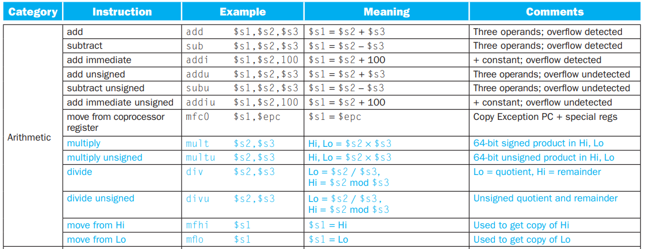
MIPS Arithmetic Instructions

Slide 4
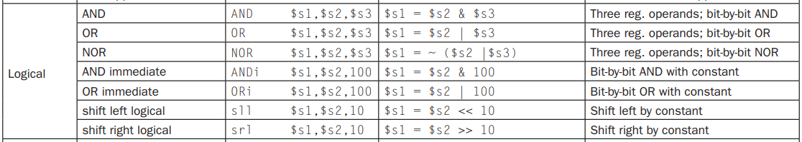
MIPS Logical Instructions

Slide 5
Arithmetic for Computers
Operations on integers
  Addition and subtraction
  Multiplication and division
  Dealing with overflow
Floating-point real numbers (later)
  Representation and operations

Slide 6
Basic Logic Operations in CPU
Functions Through Logic Gates
  NOT
  AND
  OR
  NOR
  NAND
  XOR

Slide 7
Gates (Primary Gates)
Inverter
A | F
0 | 1
1 | 0
A
F
Two Input AND Gate
A | B | F
0 | 0 | 0
0 | 1 | 0
1 | 0 | 0
1 | 1 | 1
A
F
B
Two Input OR Gate
A | B | F
0 | 0 | 0
0 | 1 | 1
1 | 0 | 1
1 | 1 | 1
A
F
B
PHYSICAL GATES

Slide 8
Gates (Compound Gates)
Two Input NAND Gate
A
A
A | B | F
0 | 0 | 1
0 | 1 | 1
1 | 0 | 1
1 | 1 | 0
F
→
B
F
B
AND Gate followed by Inverter
Two Input NOR Gate
A | B | F
0 | 0 | 1
0 | 1 | 0
1 | 0 | 0
1 | 1 | 0
A
F
B
OR Gate followed by Inverter

Slide 9
Complex Gates – the XOR and XNOR
Two Input Exclusive OR Gate
A
$$F=\overline{A}B+A\overline{B}$$
$F=A⨁$B
F
B
A | B | F
0 | 0 | 0
0 | 1 | 1
1 | 0 | 1
1 | 1 | 0

Slide 10
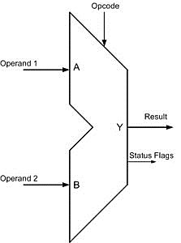
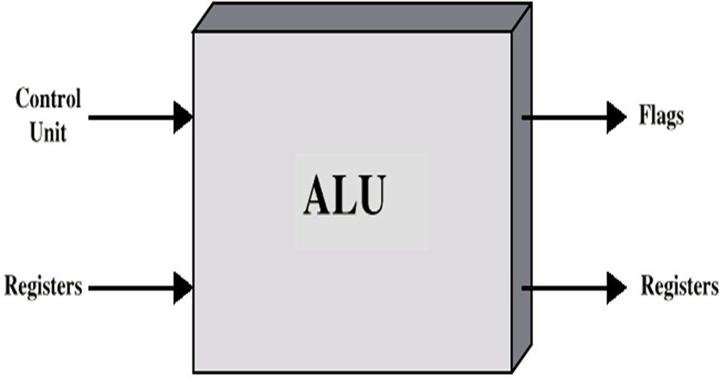
Arithmetic & Logic Unit
Does all calculations
Everything else in the computer is there to service this unit
Handles integers
May handle floating point (real) numbers
May be separate FPU (maths co-processor)
May be on chip separate FPU (Eg. 486DX)

Slide 11
ALU in Load/Store Architecture
32 bit CPU Registers
External
Memory
CPU Register 1
ALU
CPU Register 3
CPU Register 2

Slide 12
Number Systems
  ALU does calculations with binary numbers
Decimal number system
  Uses 10 digits (0,1,2,3,4,5,6,7,8,9)
  In decimal system, a number 84, e.g., means
  84 = (8x10) + 4
  4728 = (4x1000)+(7x100)+(2x10)+8
  Base or radix of 10 → each digit in the number is multiplied by 10 raised to a power corresponding to that digit’s position
  E.g. 83 = (8x10¹)+ (3x10⁰)
  4728 = (4x10³)+(7x10²)+(2x10¹)+(8x10⁰)

Slide 13
Binary Number System
Uses only two digits, 0 and 1
It is base or radix of 2
Each digit has a value depending on its position:
  10₂ = (1x2¹)+(0x2⁰) = 2₁₀
  11₂ = (1x2¹)+(1x2⁰) = 3₁₀
  100₂ = (1x2²)+ (0x2¹)+(0x2⁰) = 4₁₀
  1001.101₂ = (1x2³)+(0x2²)+ (0x2¹)+(1x2⁰)
  +(1x2⁻¹)+(0x2⁻²)+(1x2⁻³) = 9.625₁₀

Slide 14
Decimal to Binary conversion
Integer and fractional parts are handled separately,
  Integer part is handled by repeating division by 2
  Factional part is handled by repeating multiplication by 2
E.g. convert decimal 11.81 to binary
  Integer part 11
  Factional part .81

Slide 15
Decimal number to Binary
Fractional values, e.g.
  472.83 = (4x10²)+(7x10¹)+(2x10⁰)+(8x10⁻¹)+(3x10⁻²)
  In general, for the decimal representation of
  X = {… x₂x₁x_{0.}x₋₁x₋₂x₋₃ … }
  X = ∑_{i} x_{i}10^{i}
Whole Number Part
Fractional Part

Slide 16
Decimal to Binary conversion example
e.g. 11.81 to 1011.11001 (approx)
  11/2 = 5 remainder 1
  5/2 = 2 remainder 1
  2/2 = 1 remainder 0
  1/2 = 0 remainder 1
  Binary number 1011
  .81x2 = 1.62 integral part 1
  .62x2 = 1.24 integral part 1
  .24x2 = 0.48 integral part 0
  .48x2 = 0.96 integral part 0
  .96x2 = 1.92 integral part 1
  Binary number .11001 (approximate)

Slide 17
Hexadecimal Notation
Compact representation of bus information
Use 16 digits, (0,1,3,…9,A,B,C,D,E,F)
1A₁₆ = (1₁₆ x 16¹)+(A₁₆ x 16º)
= (1₁₀ x 16¹)+(10₁₀ x 16⁰)=26₁₀
Convert group of four binary digits to/from one hexadecimal digit,
  0000=0; 0001=1; 0010=2; 0011=3; 0100=4; 0101=5; 0110=6; 0111=7; 1000=8; 1001=9; 1010=A; 1011=B; 1100=C; 1101=D; 1110=E; 1111=F;
e.g.
  1101 1110 0001. 1110 1101 = DE1.DE

Slide 18
Integer Representation +/- numbers
Only have 0 & 1 to represent everything
Positive numbers stored in binary
  e.g. 41=00101001
No minus sign
No period
How to represent negative number?
  Sign-Magnitude
  Two’s compliment

Slide 19
Sign-Magnitude Representation
Add one extra bit on MSB to represent sign
Left most bit is sign bit
0 means positive
1 means negative
+18 = 00010010
-18 = 10010010
Problems
  Need to consider both sign and magnitude in arithmetic
  Two representations of zero (+0 and -0)

Slide 20
Two’s Compliment Representation
+3 = 00000011
+2 = 00000010
+1 = 00000001
+0 = 00000000
-1 = 11111111
-2 = 11111110
-3 = 11111101

Slide 21
2’s Compliment Number System
One representation of zero
Arithmetic works easily, use same hardware as positive numbers
Negating is fairly easy (2’s compliment operation)
  3 = 00000011
  Boolean complement gives 11111100
  Add +1 to LSB 11111101

Slide 22
Range of 2’s Compliment Numbers
8 bit 2’s compliment
  +127 = 01111111 = 2⁷ -1
  -128 = 10000000 = -2⁷
16 bit 2’s compliment
  +32767 = 011111111 11111111 = 2¹⁵ - 1
  -32768 = 100000000 00000000 = -2¹⁵

Slide 23
Different word lengths in 2’s Compliment
Positive number pack with leading zeros
+18 = 00010010 (in 8 bits)
+18 = 00000000 00010010 (in 16 bits)
Negative numbers pack with leading ones
-18 = 10010010 (in 8 bits)
-18 = 11111111 10010010 (in 16 bits, notice sign bit replication)
i.e. pack higher bits with MSB (sign bit)

Slide 24
Negation Special Case 1
0 = 00000000
Bitwise not 11111111
Add 1 to LSB +1
Result 1 00000000
Overflow is ignored, so:
- 0 = 0 OK!

Slide 25
Negation Special Case 2
-128 = 10000000
bitwise not 01111111
Add 1 to LSB +1
Result 10000000
So:
-(-128) = -128 Problem here!
Monitor MSB (sign bit)
It should change during negation
>> There is no representation of +128 in this case. (no +2^{n})

Slide 26
Addition and Subtraction
Normal binary addition
0011 0101 1100
+0100 +0100 +1111
-------- ---------- ------------
0111 1001 = overflow 11011
Monitor sign bit for overflow (sign bit change as adding two positive numbers or two negative numbers.)
Subtraction: Take twos compliment of subtrahend then add to minuend
  i.e. a - b = a + (-b)
So we only need addition and complement circuits

Slide 27
Combined Adder and 2’s Complement Subtraction
Word 1
Word 2
For 2’s Complement,
Select the path through inverter and
Cin = ‘1’
MUX
Select (Add / Sub)
+
Cin
MUX
‘0’
‘1’
Select ‘1’ for 2’s Complement
Result

Slide 28
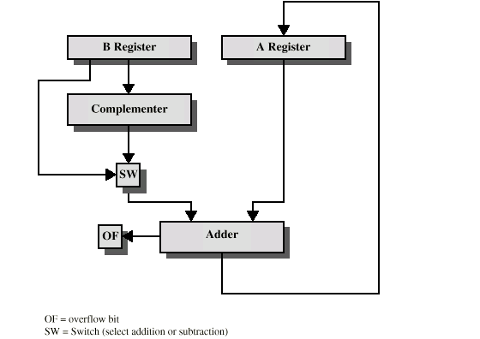
Hardware for Addition and Subtraction

Slide 29
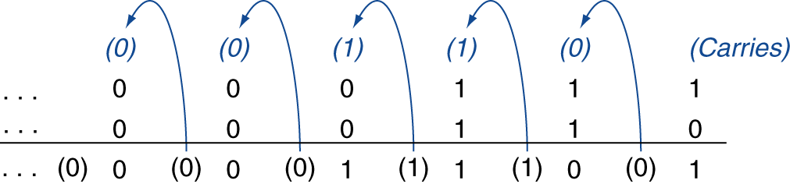
Integer Addition - Overflow
Example: 7 + 6
Overflow if result is out of range
  Adding +ve and –ve operands, no overflow
  Adding two +ve operands
    Overflow if result sign is 1
  Adding two –ve operands
    Overflow if result sign is 0

Slide 30
Integer Subtraction - Overflow
Add negation of second operand
Example: 7 – 6 = 7 + (–6)
  +7: 0000 0000 … 0000 0111
  –6: 1111 1111 … 1111 1010
  +1: 0000 0000 … 0000 0001
Overflow if result is out of range
  Subtracting two +ve or two –ve operands, no overflow
  Subtracting +ve from –ve operand
    Overflow if result sign is 0
  Subtracting –ve from +ve operand
    Overflow if result sign is 1

Slide 31

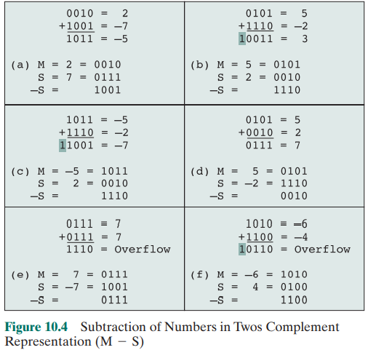
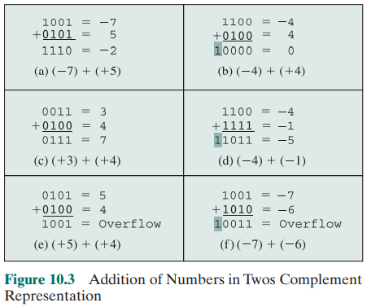
Overflow in Addition / Subtraction

Slide 32
CPU Dealing with Overflow
Some languages (e.g., C) ignore overflow
  Use MIPS addu, addui, subu instructions
Other languages (e.g., Ada, Fortran) require raising an exception
  Use MIPS add, addi, sub instructions
  On overflow, invoke exception handler
    Save PC in exception program counter (EPC) register
    Jump to predefined handler address
    mfc0 (move from coprocessor reg) instruction can retrieve EPC value, to return after corrective action

Slide 33
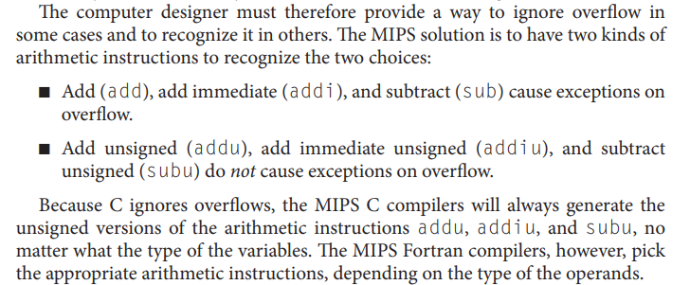
MIPS Instructions and Overflow

Slide 34
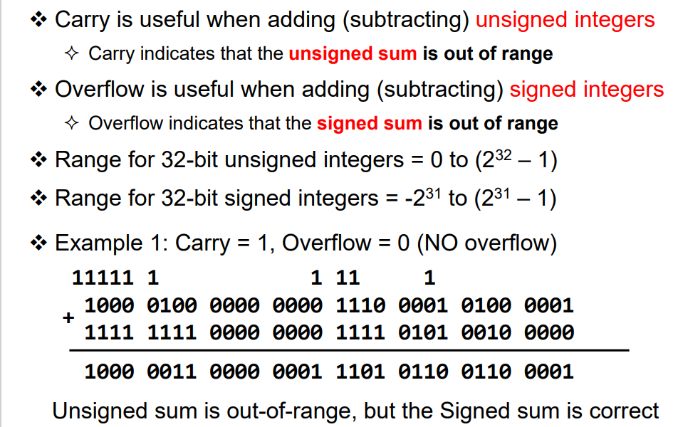
Carry vs Overflow

Slide 35
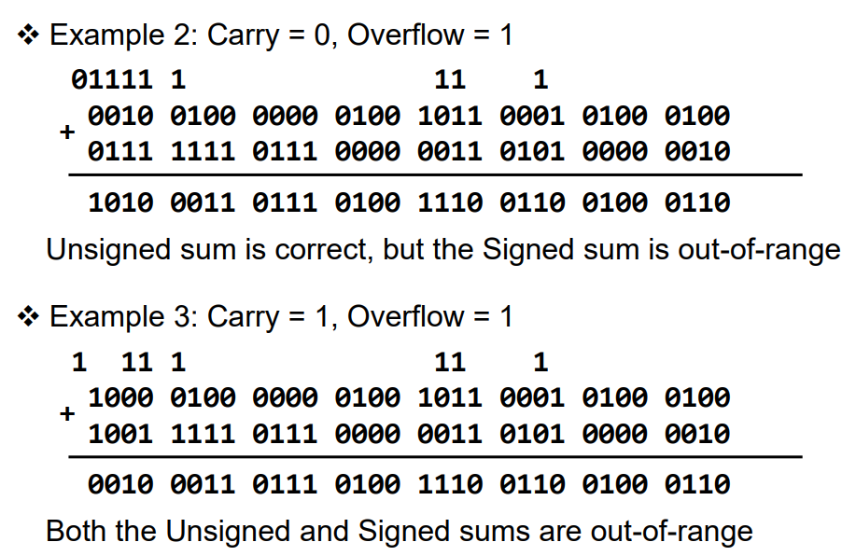
Another Example of Carry and Overflow

Slide 36
Logic Circuit of Adder / Subtractor

Slide 37
1 Bit Full Adder Circuit
Truth table represents behaviour of inputs and outputs
A | B | Cin | Sum | Cout
0 | 0 | 0 | 0 | 0
0 | 0 | 1 | 1 | 0
0 | 1 | 0 | 1 | 0
0 | 1 | 1 | 0 | 1
1 | 0 | 0 | 1 | 0
1 | 0 | 1 | 0 | 1
1 | 1 | 0 | 0 | 1
1 | 1 | 1 | 1 | 1
A
Full Adder
Circuit
Sum
B
Cout
Cin
Sum Si=Xi ⨁ Yi ⨁ Ci
Boolean Expression:
Ci+1 = Xi.Yi + Ci (Xi ⨁ Yi)

Slide 38
Full Adder Implementation using Logic Gates
A
A
B
B
A
Cout
Sum
Cin
Cin
B
Sum = $A⨁$B $⨁$Cin
Cin
Cout = $A$B $+ACin+BCin$

Slide 39
Array of Adders?
Usually, data types defined in any program are 8 bits, 16 bits or 32 bits
We need array of arithmetic and logic circuits to perform ALU operation on
CPU registers
Xi
Yi
1 bit
Full
Adder
Ci+1
Ci
Si

Slide 40
Multiple Bits – Ripple Carry Adder
Input Numbers {X3 X2 X1 X0} and {Y3 Y2 Y1 Y0}, Carry Input Cin
X3
Y3
X2
Y2
X1
Y1
X0
Y0
Cin
Full
Adder
Full
Adder
Full
Adder
Full
Adder
C4
C2
C2
C2
C2
C1
C1
C0
S3
S2
S1
S0
Cout
Sum Bits {S3 S2 S1 S0}
MSB ….…. LSB

Slide 41
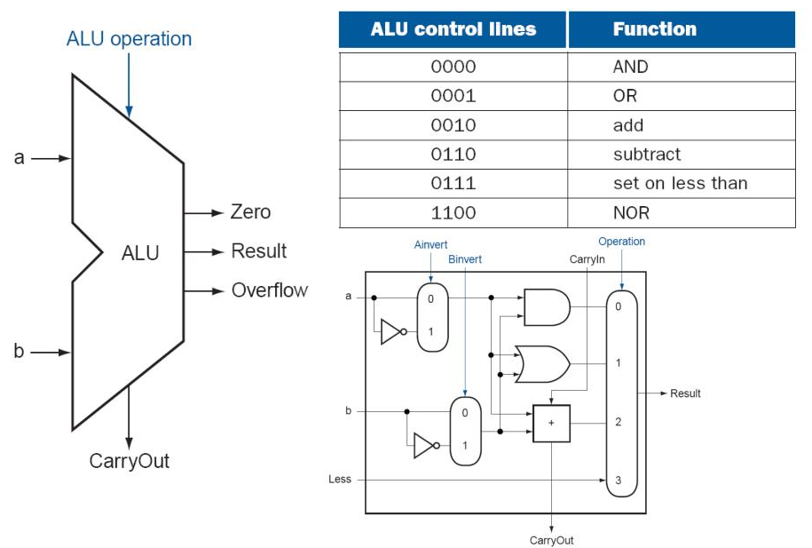
Simple ALU Architecture

Slide 42
Readings
P&H Textbook Chapter 3
Search Appendix C P&H Textbook online; this contains useful background material
on digital logic, ALU and related stuff

