Slide 1
CS / EE 320
Computer Organization and Assembly Language
Lecture 25
Spring 2025
Shahid Masud
Topics: Cache/Memory Update Write Strategies, Cache Performance, Multi Level Caches, CD ROM Technology

Slide 2
Topics
Cache Writes – Write Back and Write Through schemes
Examples of calculating different parameters in Cache Design
Some Examples of Cache Performance
Introduction to Multi-level Caches
Examples of Cache Performance
---
Maybe CD ROM Technology
Quiz 5 Next Lecture

Slide 3
Dealing with CPU Writes to Memory and Caches

Slide 4
Write Policy
Must not overwrite a cache block unless main memory is up to date
Multiple CPUs may have individual caches
I/O may address main memory directly

Slide 5
Write-through scheme
All writes go to main memory as well as cache
Multiple CPUs can monitor main memory traffic to keep local (to CPU) cache up to date
Lots of traffic
Slows down writes

Slide 6
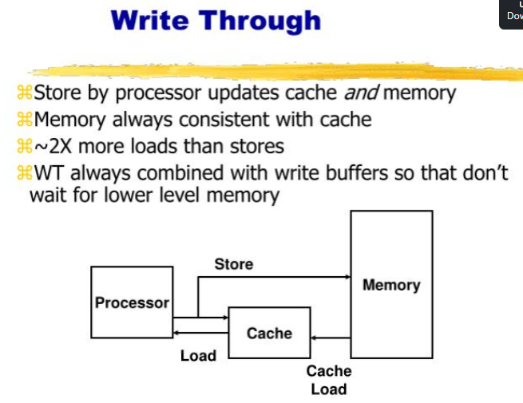


Write Through - Diagram

Slide 7

Write-Through and Write Buffer
On data-write hit, could just update the block in cache
  But then cache and memory would be inconsistent
Write-through: also update memory
But makes writes take longer
  e.g., if base CPI = 1, 10% of instructions are stores, write to memory takes 100 cycles
    Effective CPI = 1 + 0.1×100 = 11
Solution: write buffer
  Holds data waiting to be written to memory
  CPU continues immediately
    Only stalls on write if write buffer is already full

Slide 8
Write-back
Updates initially made in cache only
Update bit for cache slot is set when update occurs
If block is to be replaced, write to main memory only if update bit is set
Other caches get out of sync
I/O must access main memory through cache
N.B. 15% of memory references are writes

Slide 9
Write-Back
Alternative: On data-write hit, just update the block in cache
  Keep track of whether each block is dirty
When a dirty block is replaced
  Write it back to memory
  Can use a write buffer to allow replacing block to be read first

Slide 10
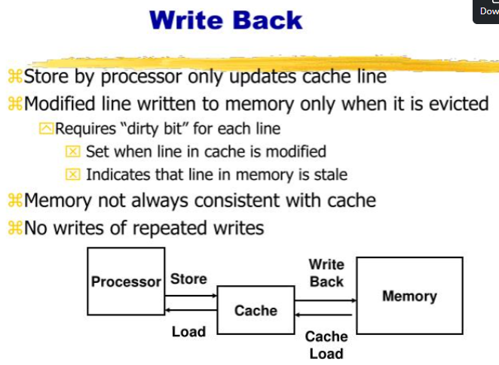
Write Back Diagram

Slide 11
Write Miss
What should happen on a write miss?
Alternatives for write-through
  Allocate on miss: fetch the block
  Write around: don’t fetch the block
    Since programs often write a whole block before reading it (e.g., initialization)
For write-back
  Usually fetch the block

Slide 12
Cache Design Trade-offs
Design change | Effect on miss rate | Negative performance effect
Increase cache size | Decrease capacity misses | May increase access time
Increase associativity | Decrease conflict misses | May increase access time
Increase block size | Decrease compulsory misses | Increases miss penalty. For very large block size, may increase miss rate due to pollution.

Slide 13
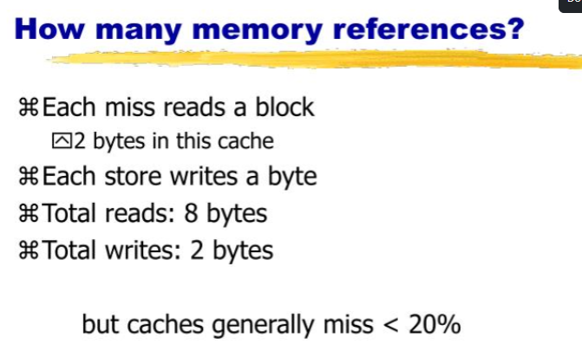
Number of Memory References

Slide 14
Multi Level Caches
Performance of Cache and Memory System
Examples of Cache Performance

Slide 15
Split Caches
Separate Cache for Instructions and Data to take advantage of pipelining
In case the program has too many localized accesses to data only or instructions only,
Then there may be no performance improvement
Instruction Cache
Main
Memory
CPU
Data
Cache

Slide 16
Example 1 of Cache Performance
Question
Given that:
T1 is access time from Cache = 0.01 μsec
T2 is access time from Main Memory = 0.1 μsec
95% accesses are from Cache
5% accesses are from Main Memory
Find the Average Time seen by CPU to Access one word?
T2
0.1
Access Time
Avg Access Time with Cache
Close to fast
Cache
0.015
Solution
Average time to access one word:
Tavg= (0.95 x 0.01) + (0.5 x 0.1)
Tavg= 0.095 + 0.0055
Tavg= 0.015 μsec
T1
0.05

Slide 17
Multilevel Caches
Primary cache attached to CPU
  Small, but fast
Level-2 cache services misses from primary cache
  Larger, slower, but still faster than main memory
Main memory services L-2 cache misses
Some high-end systems include L-3 cache

Slide 18
Multi Level Caches
Main purpose is to reduce Miss Penalty
Main
Memory
L2
CPU
L1
Small transfer
In Bytes or Words
Bigger transfer
In lines and blocks
Bigger Blocks
of Transfer

Slide 19
Multi Level Caches - Performance
T1 Access Time
T2 Access Time
TM Access Time
CPU
References
CPU
L1
(1 – H1) references
L2
(1 – H2) references
Main
Mem
H1 hit ratio
at L1
H2 hit ratio
at L2
Average Access Time in Multilevel Cache:
Tavg = T1 + (1 – H1) x T2 + (1 – H1) x (1 – H2) x TM
(1 – H1) = miss rate at L1 = MRL1
Tavg = T1 + MRL1 x T2 + MRL1 x MRL2 x TM
MRL1 x MRL2 = Global Miss Rate at L2

Slide 20
Example 1, find Tavg in 2 level cache
CPU generates 100 memory references. 80 are hit in L1, 20 are miss in L1. 16 are hit in L2 and 4 are miss in L2. Access time of L1 is 1 cycle. Access time of L2 is 10 cycles. Access time of Main Mem is 100 cycle. Find average memory access time Tavg?
Tavg = T1 + MRL1 x T2 + MRL1 x MRL2 x TM
=1 + (20/100) x 10 + [(20/100)x(4/20)] x 100
=1 + 2 + 4 = 6 cycles Avg Access time
Note:
MRL1 = Miss Rate at Cache L1

Slide 21
Example 2, find Tavg in 2 level cache
CPU generates 1000 memory references. Number of Miss in L1 is 40. Number of miss in L2 is 20. Access time of L1 is 1 cycle. Access time of L2 is 10 cycle. Find Tavg when Miss Penalty of L2 is 100 cycle.
T1 = 1 cycle
T2 Access Time
TM Access Time
CPU
1000
L1
(1 – H1) = 40 references
L2
(1 – H2) = 20 references
Main
Mem
Local Miss
Rate L1 = 40
Local Miss
Rate L2 = 20
Tavg = T1 + MRL1 x T2 + MRL1 x MRL2 x TM
=1 + (40/1000) x 10 + [(40/1000) x (20/40)] x 100
=1 + 0.4 + 2 = 3.4 cycles Avg Access time

Slide 22
Measuring Cache Performance
Components of CPU time
  Program execution cycles
    Includes cache hit time
  Memory stall cycles
    Mainly from cache misses
With simplifying assumptions:

Slide 23
Cache Performance Example
Given
  I-cache miss rate = 2%
  D-cache miss rate = 4%
  Miss penalty = 100 cycles
  Base CPI (ideal cache) = 2
  Load & stores are 36% of instructions
Miss cycles per instruction
  I-cache: 0.02 × 100 = 2
  D-cache: 0.36 × 0.04 × 100 = 1.44
Actual CPI = 2 + 2 + 1.44 = 5.44
  Ideal CPU is 5.44/2 =2.72 times faster

Slide 24
Average Memory Access Time
Hit time is also important for performance
Average memory access time (AMAT)
  AMAT = Hit time + Miss rate × Miss penalty
Example
  CPU with 1ns clock, hit time = 1 cycle, miss penalty = 20 cycles, I-cache miss rate = 5%
  AMAT = 1 + 0.05 × 20 = 2ns
    2 cycles per instruction

Slide 25


Performance Summary
When CPU performance increased
  Miss penalty becomes more significant
Decreasing base CPI
  Greater proportion of time spent on memory stalls
Increasing clock rate
  Memory stalls account for more CPU cycles
Can’t neglect cache behavior when evaluating system performance

Slide 26
Multilevel Cache CPI Example
Given
  CPU base CPI = 1, clock rate = 4GHz
  Miss rate/instruction = 2%
  Main memory access time = 100ns
With just primary cache
  Miss penalty = 100ns/0.25ns = 400 cycles
  Effective CPI = 1 + 0.02 × 400 = 9

Slide 27
Optical Drives CD / DVD

Slide 28
Optical Storage CD-ROM
Originally for audio
650Mbytes giving over 70 minutes audio
Polycarbonate coated with highly reflective coat, usually aluminum
Data stored as pits
Read by reflecting laser
Constant packing density
Constant linear velocity

Slide 29
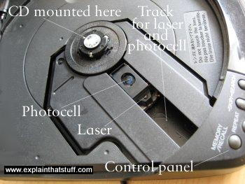
CD Components

Slide 30
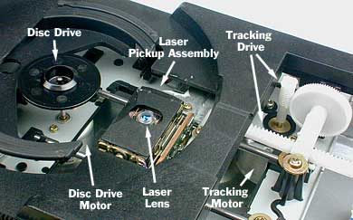
Inside a CD Player
CD Components

Slide 31
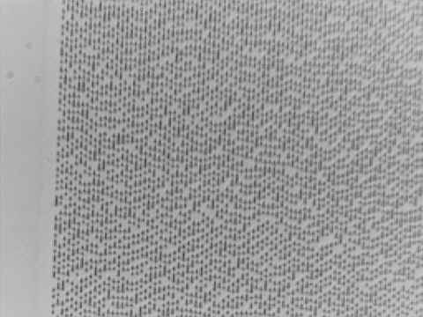
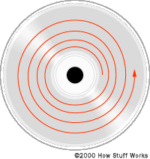
CD Under a Microscope
CD Surface
Spiral track
Track direction
Low-magnification (×32) image of a CD showing an edge of the data zone.

Slide 32
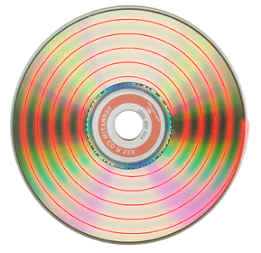
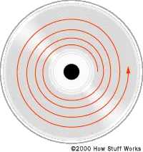
Sprial Track of CD

Slide 33
Track Density and Data Density
The CD is 12 cm in diameter, 1.2 mm thick, has a center hole 1.5 cm in diameter, and spins at a constant linear velocity (CLV) or constant angular velocity (CAV).
There is only one track on the optical disk and all data are stored in a spiral of about 2 billion small pits on the surface. There are about 30,000 windings on a CD - all part of the same track. This translates into about 16,000 tracks per inch and an areal density of 1 Mb/mm².
The total length of the track on a CD is almost 3 miles.

Slide 34
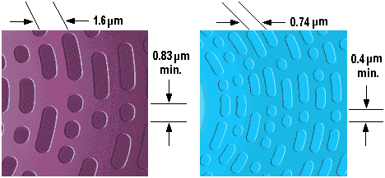


CD Versus DVD
Track Density CD vs DVD

Slide 35
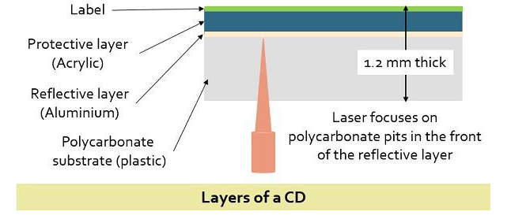
CD in Cross-section
Surface Layers
A CD can store up to 74 minutes of music, so the total amount of digital data that must be stored on a CD is:
2 channels × 44,100 samples/channel/second × 2 bytes/sample × 74 minutes × 60 seconds/minute = 783,216,000 bytes
To fit more than 783 megabytes onto a disk only 12 cm in diameter requires that the individual bits be very small.

Slide 36
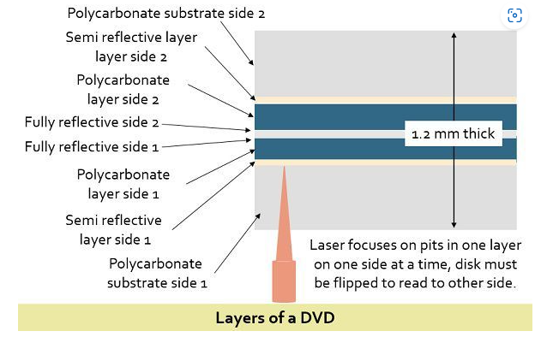
Layers of a DVD

Slide 37
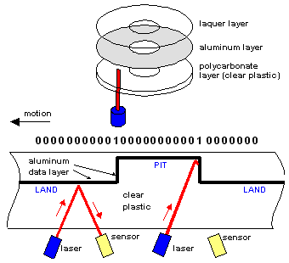
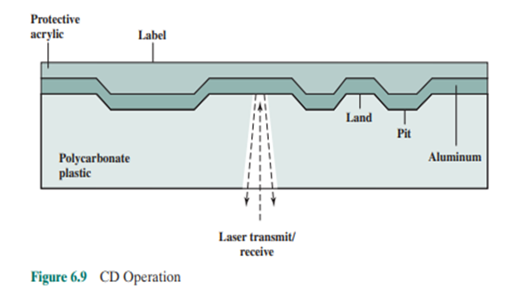
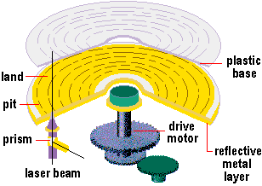
CD Mechanism
Digital data are carved into the disc as pits (low
spots) and lands (high spots). As the laser shines into the moving pits and lands, a sensor detects a change in reflection when it encounters a
transition from pit to land or land to pit.
Each transition is a 1. The lack of transitions are
0s. There is only one laser in a drive. Two are
used here to illustrate the difference in reflection.

Slide 38
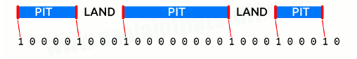
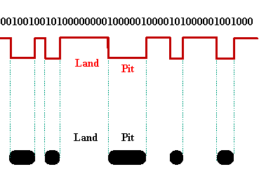
Translating Binary Digits to Pits
Data Format

Slide 39
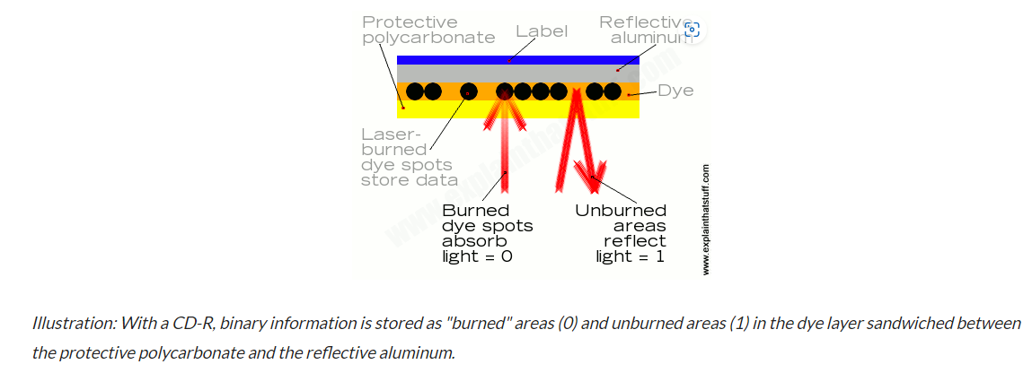
Storage Write and Read Principle

Slide 40
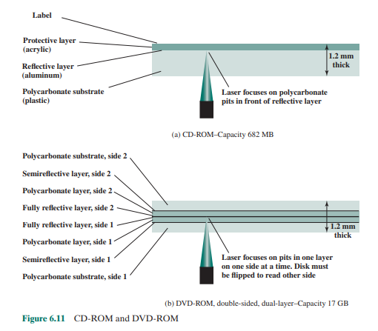
CD and DVD Read Details

Slide 41
CD-ROM Drive Speeds
Audio is single speed
  Constant linear velocity
  1.2 ms⁻¹
  Track (spiral) is 5.27km long
  Gives 4391 seconds = 73.2 minutes
  Date 176.4 K bytes/s total capacity 774.57 M Bytes
Other speeds are quoted as multiples
e.g. 24x ~= 4 M Bytes/s (data transfer rate)
The quoted figure is the maximum the drive can achieve

Slide 42
CD-ROM Format Frame
00
FF
x 10
00
Layered
ECC
Sec
Mode
Data
Min
Sector
12 byte
Sync
4 byte
Id
2048 byte
288 byte
2352 byte Packet
Mode 0=blank data field
Mode 1=2048 byte data+error correction
Mode 2=2336 byte data

Slide 43
Random Access on CD-ROM
Difficult
Move head to rough position
Set correct speed
Read address
Adjust to required location

Slide 44
Readings
Chap 5 of P&H Textbook

