Slide 1

CS / EE 320
Computer Organization and Assembly Language
Spring 2025
Lecture 13
Shahid Masud
Topics: Introduction to Full CPU Design – Simple 1 Bit ALU, Scaling to 32 Bit ALU

Slide 2
Topics
Start Chapter 4 of P&H Textbook
Some material in Appendix B of P&H Textbook, search Internet
Digital Elements that Preserve States (D Flip Flops)
CPU visualization as Combinational Element placed between two state elements, the Data path and Control path
Develop a 1 Bit ALU and scale up to 32 Bits
Basic Operations of ALU, AND,OR, ADD, SUB, NAND, NOR, Zero Detect, Compare, Overflow Detect
QUIZ 3 NEXT LECTURE

Slide 3
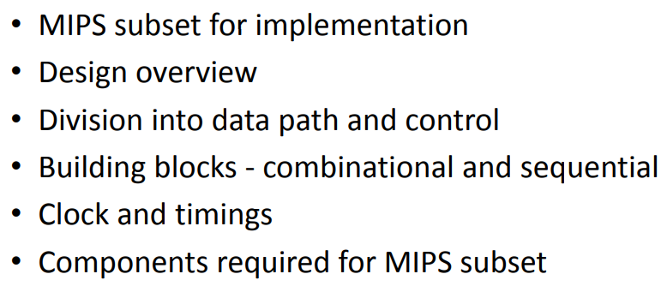
Simple Processor Design

Slide 4
Combinational Elements
AND-gate
  Y = A & B
Adder
  Y = A + B
A
+
Y
B
A
Y
B
Arithmetic/Logic Unit
  Y = F(A, B)
Multiplexer
  Y = S ? I1 : I0
A
I0
M
u
x
Y
Y
ALU
I1
B
S
F

Slide 5
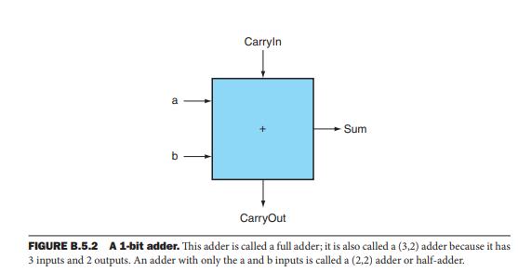
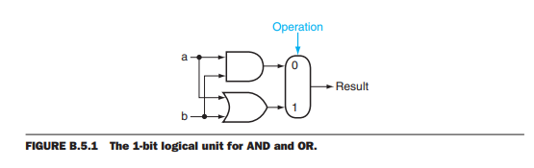
Building Blocks for 1 Bit ALU

Slide 6
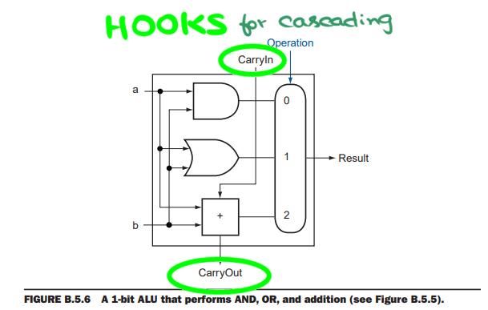
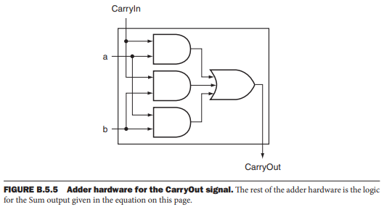
Carry Out and simple 1 Bit ALU

Slide 7
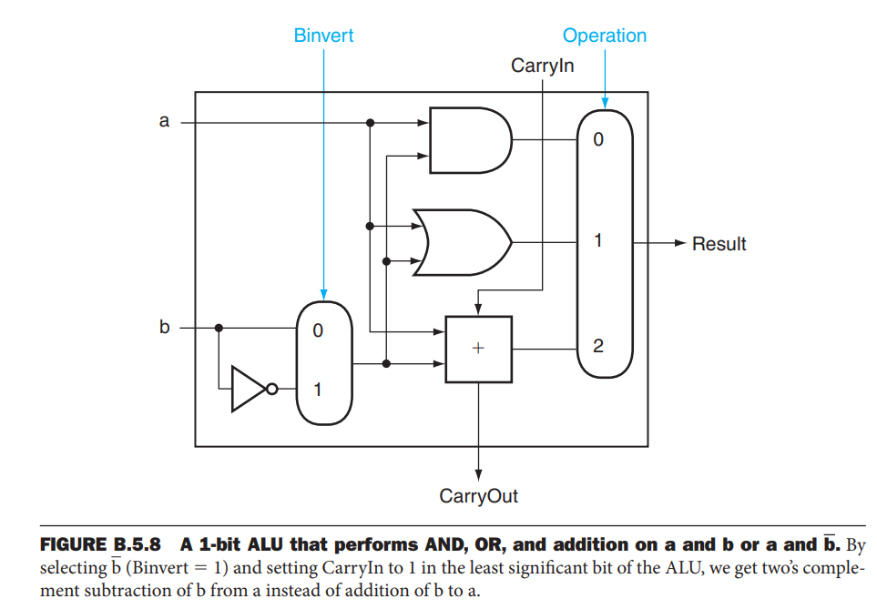
Building Blocks for 1 Bit Adder and some logic

Slide 8
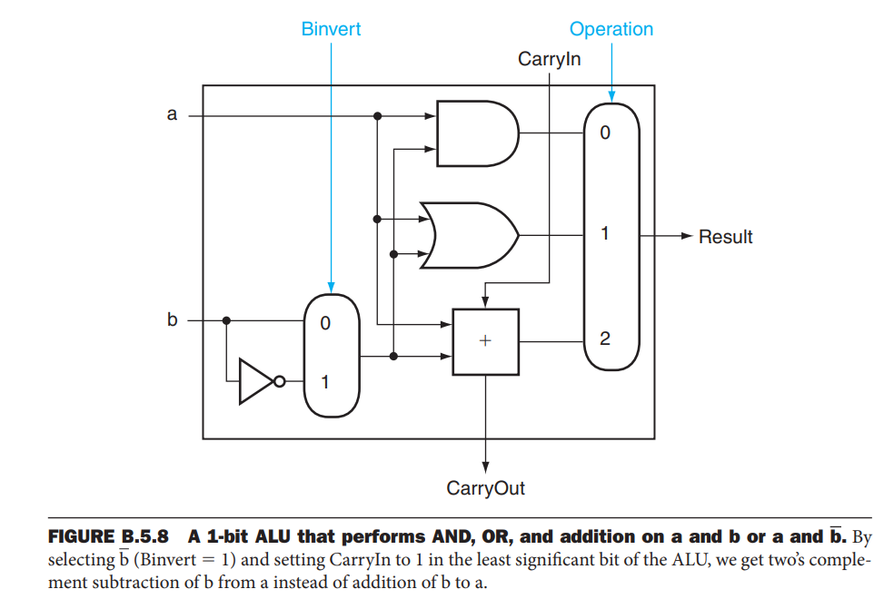
Simple 1 Bit ALU

Slide 9
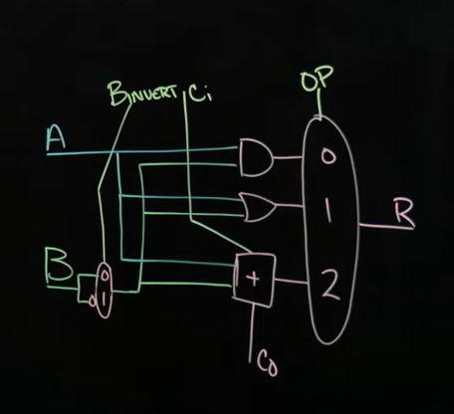
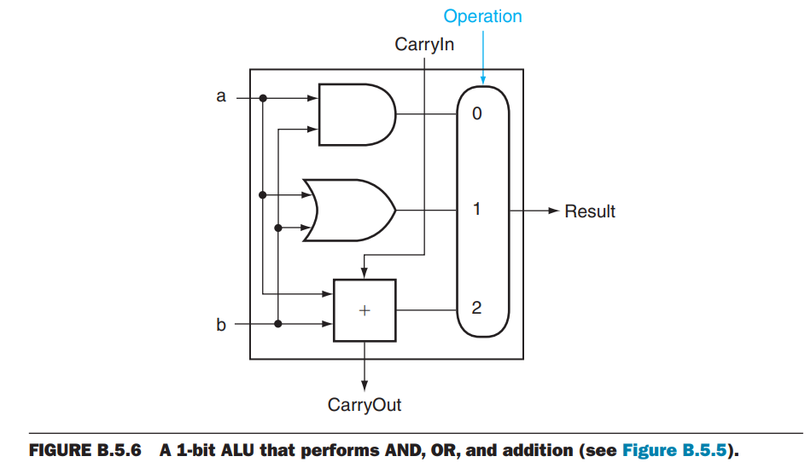
Developing Adder and Subtractor
AND
OR
ADD
SUB

Slide 10
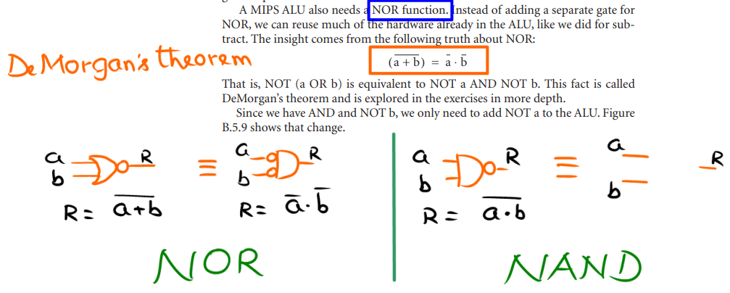
Nor and Nand Instructions

Slide 11
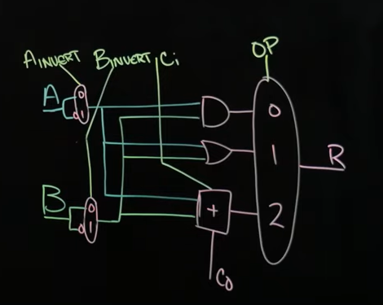
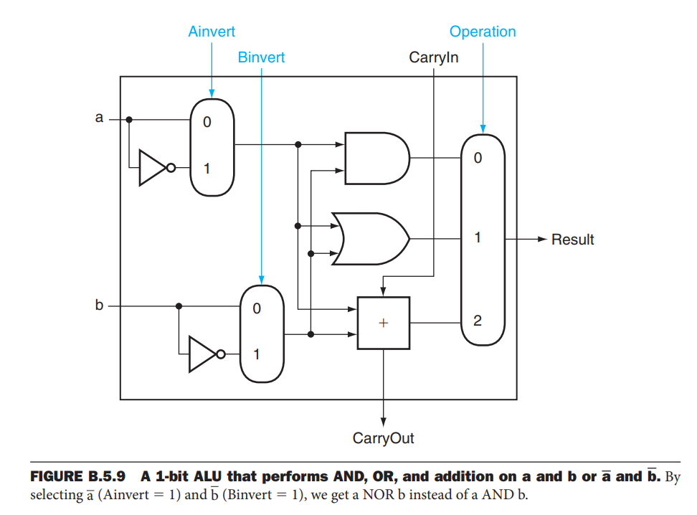
NAND and NOR added to 1 bit ALU
AND
OR
ADD
SUB
NAND
NOR

Slide 12
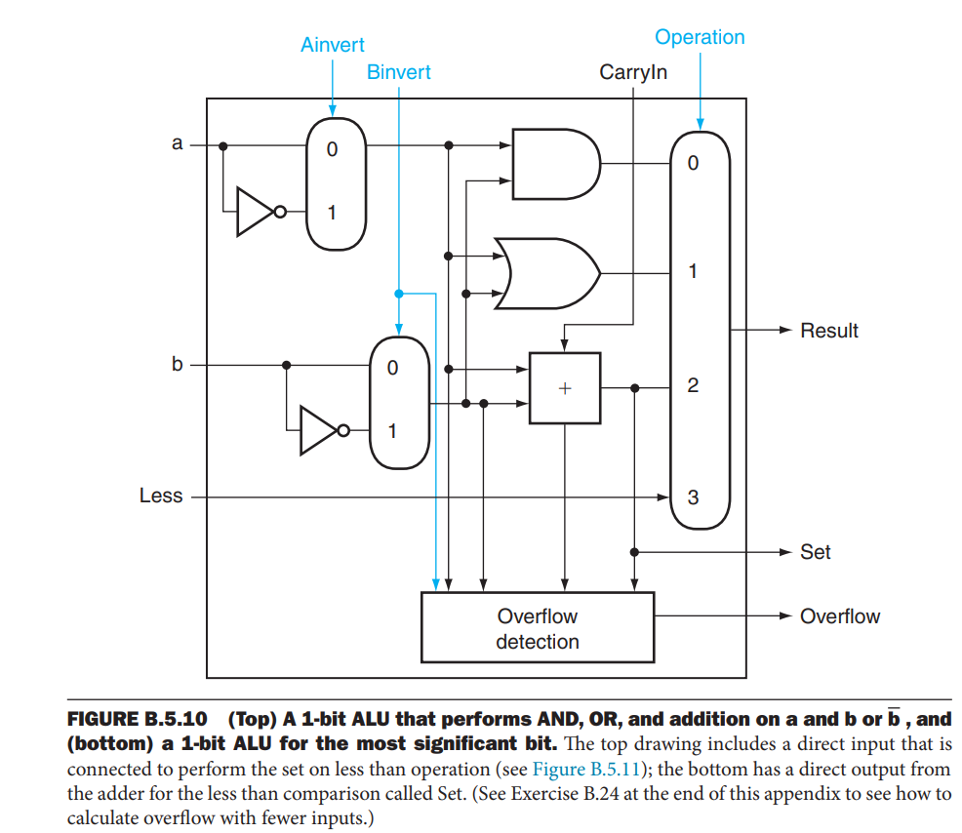
1 Bit ALU with Overflow

Slide 13
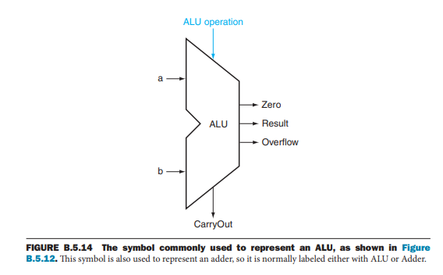
Symbol of 1 Bit ALU

Slide 14
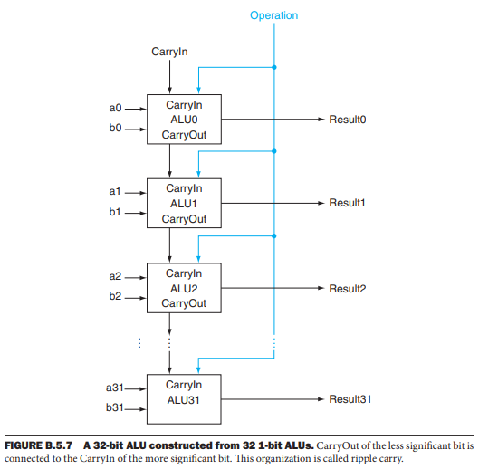
32 Bit Adder and Carry Chain

Slide 15
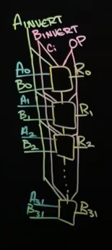
Repeat 32 ALU to make a 32 Bit ALU

Slide 16
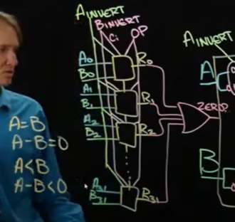
Adding Compare Instructions
Detect Zero
Use Adder and Subtractor
To Determine Sign of MSB.
This gives indication of
what number is bigger

Slide 17
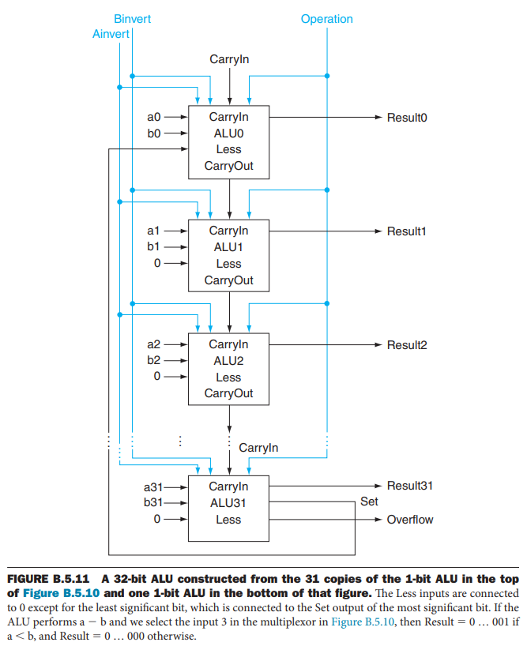
‘Less’ than Instruction

Slide 18
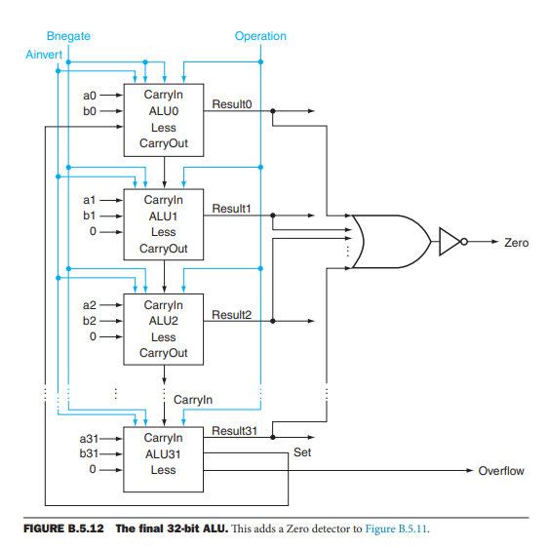
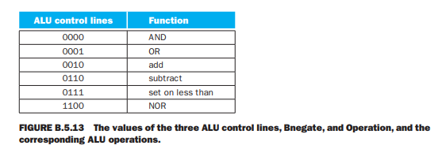
Final ALU

Slide 19
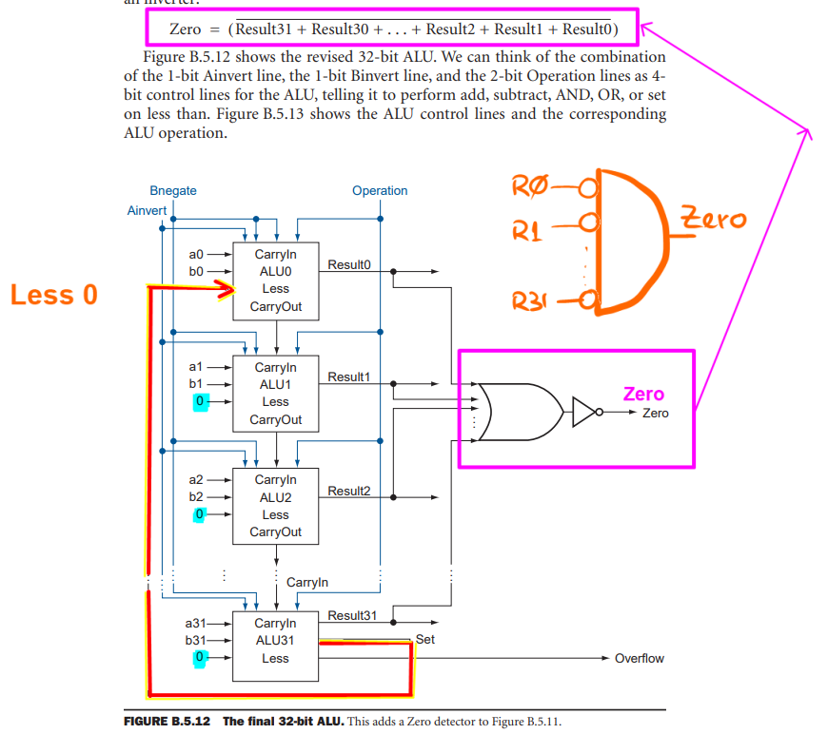
Zero detector Instruction

Slide 20
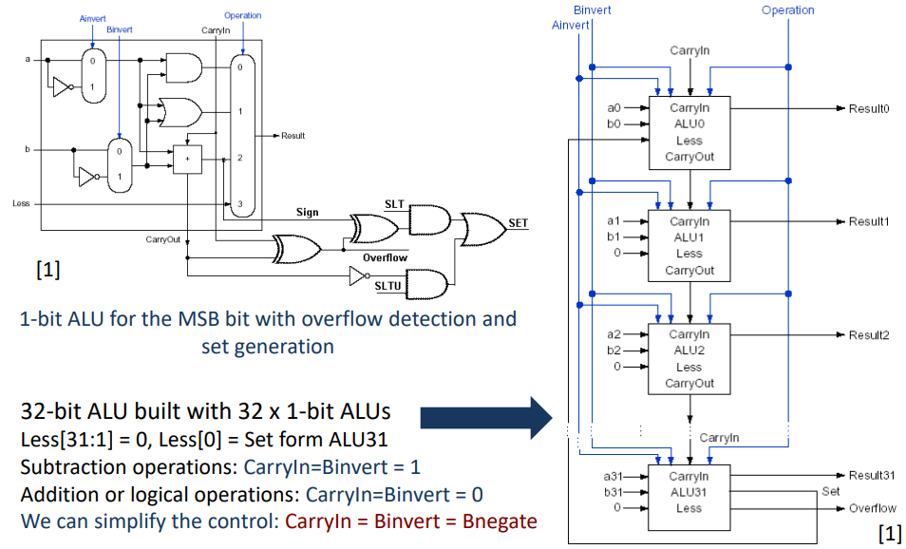
Showing Overflow and Set circuit

Slide 21
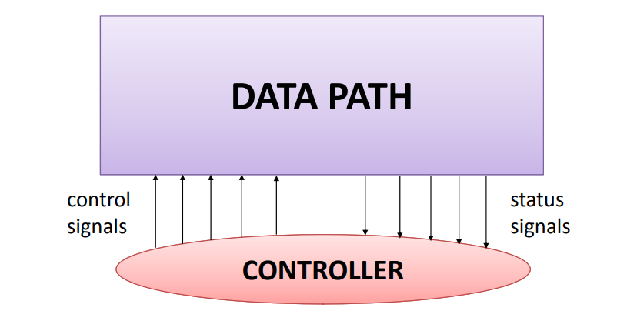
Data path and Control path in a CPU

Slide 22
Building a Datapath
Datapath
  Elements that process data and addresses
  in the CPU
    Registers, ALUs, mux’s, memories, …
We will build a MIPS datapath incrementally
  Refining the overview design

Slide 23
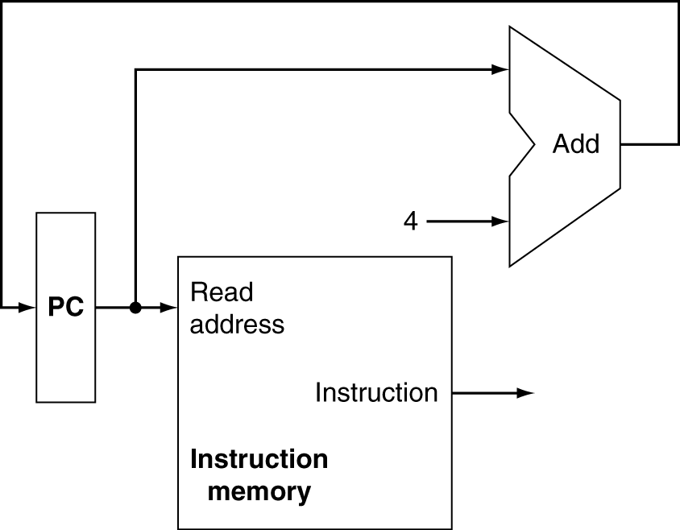
Instruction Fetch
Increment by 4 for next instruction
32-bit register

Slide 24
Load / Store / Add / Sub / Logic / slt Instructions
Look at Building Blocks of MIPS Implementation
Study two MIPS implementations
  A simplified version
  A more realistic pipelined version
Simple subset, shows most aspects
  Memory reference: lw, sw
  Arithmetic/logical: add, sub, and, or, slt
  Control transfer: beq, j

Slide 25
Instruction Execution
PC → instruction memory, fetch instruction
Register numbers → register file, read registers
Depending on instruction class
  Use ALU to calculate
    Arithmetic result
    Memory address for load/store
    Branch target address
  Access data memory for load/store
  PC ← target address or PC + 4

Slide 26
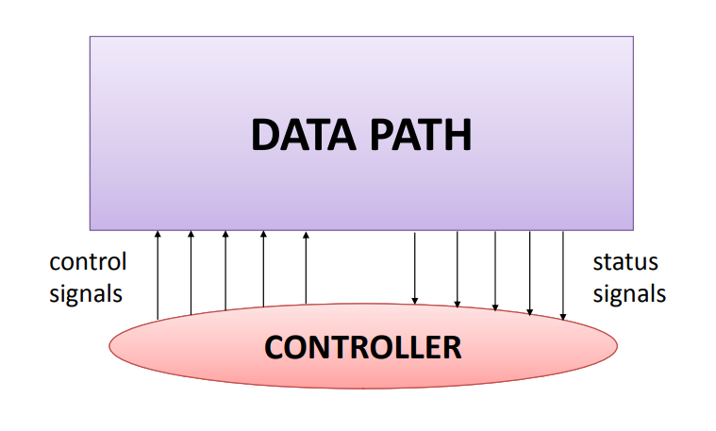
CPU consists of Data path and Control path

Slide 27
Building a Datapath
Datapath
  Elements that process data and addresses
  in the CPU
    Registers, ALUs, mux’s, memories, …
We will build a MIPS datapath incrementally
  Refining the overview design

Slide 28
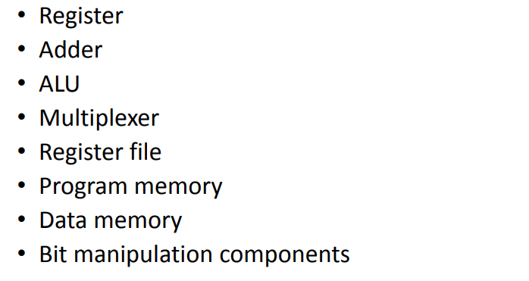
Components for Building MIPS CPU

Slide 29
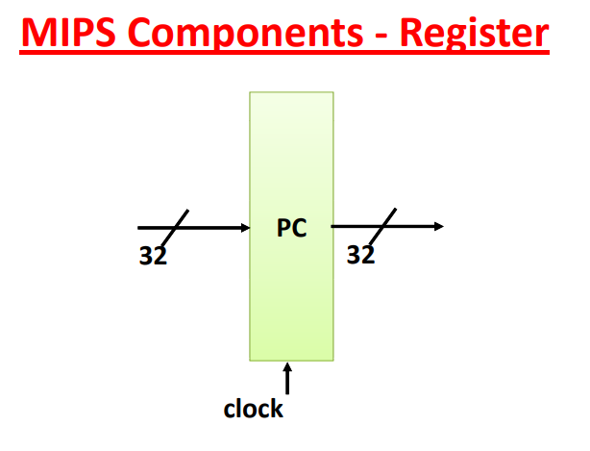
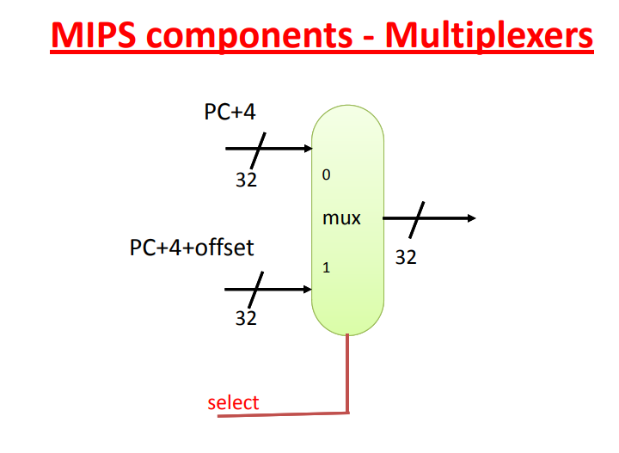
MIPS Components - 1

Slide 30
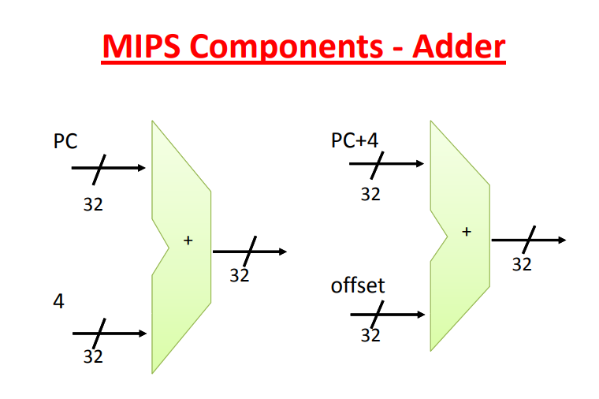
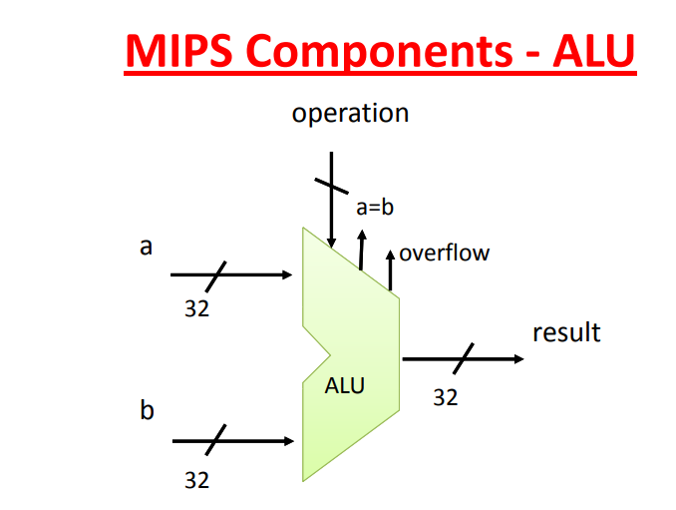
MIPS Components - 2

Slide 31
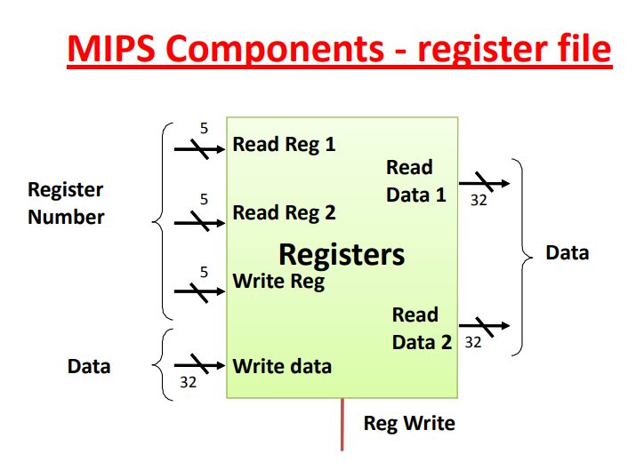
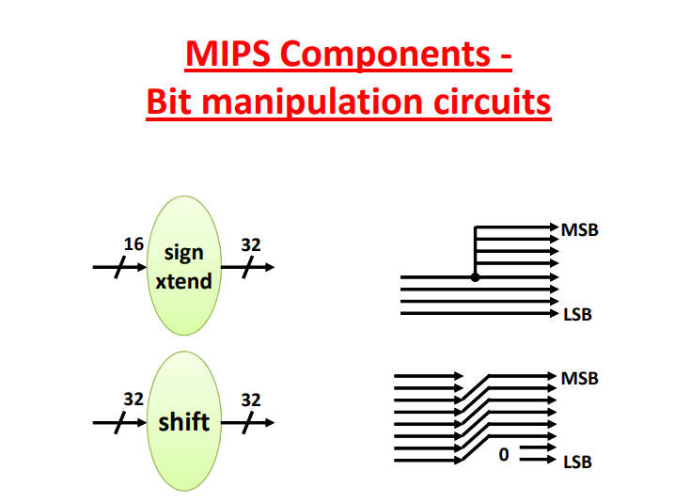
MIPS Components - 3

Slide 32
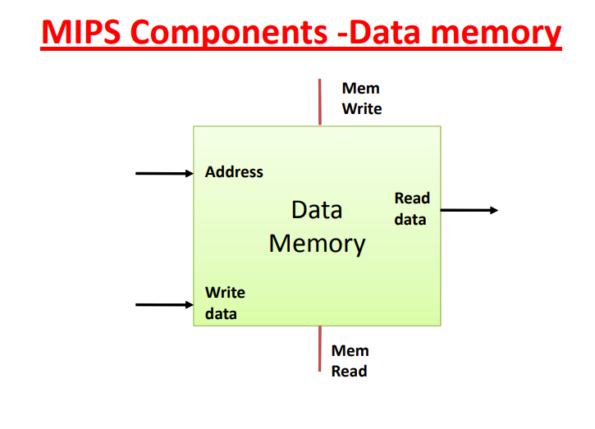
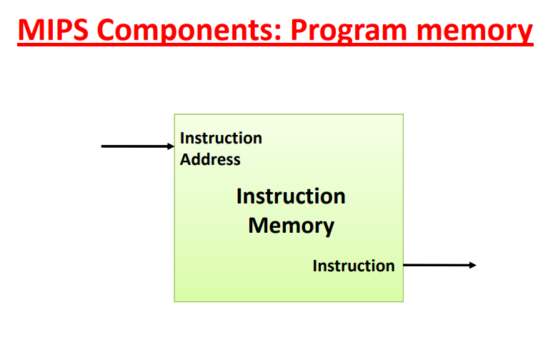
MIPS Components - 4

Slide 33
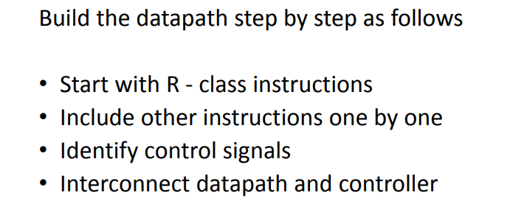
Build MIPS Data path – Step by Step

Slide 34
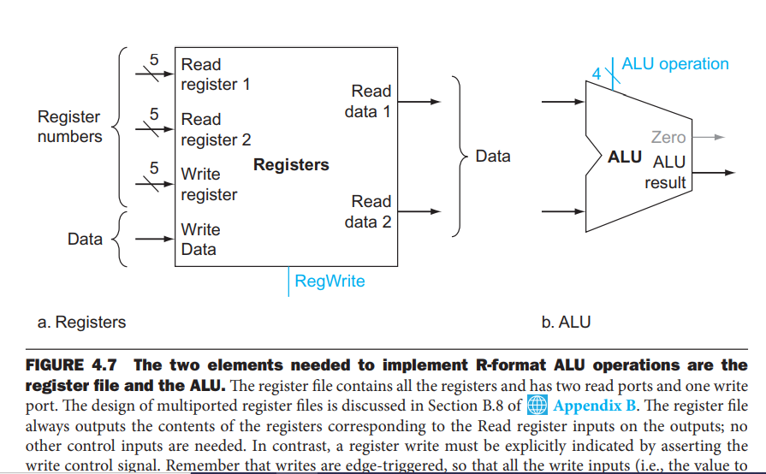
Two Components for R format ALU

Slide 35
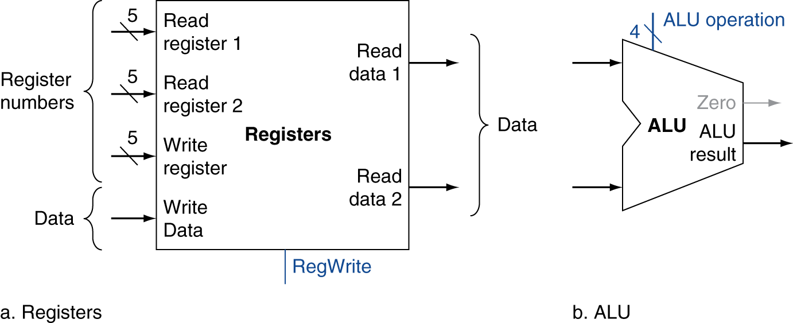
R-Format Instructions
Read two register operands
Perform arithmetic/logical operation
Write register result

Slide 36
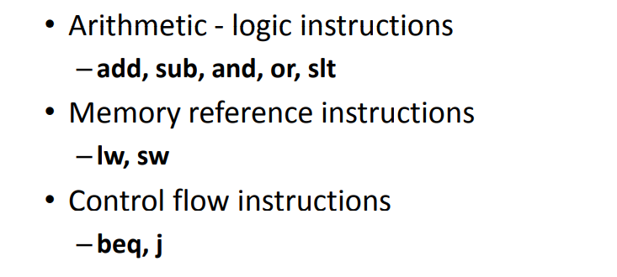
MIPS Subset of R format to start implementation

Slide 37
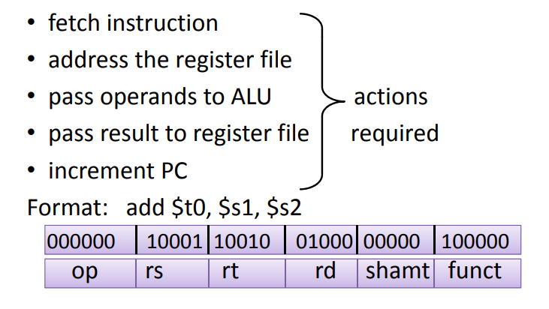
Develop Data path for add, sub, and, or, slt

Slide 38
Instruction Fetch
Increment by 4 for next instruction
32-bit register

Slide 39
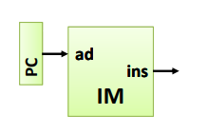
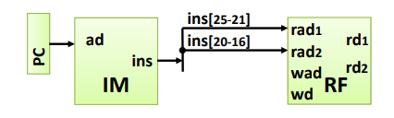
Basic CPU Operations - 1
Fetching Instruction
Addressing Register File

Slide 40
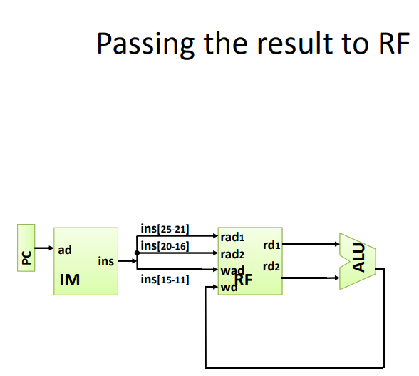
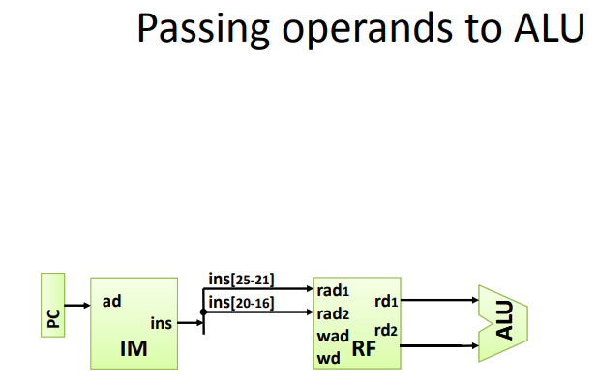
Basic CPU Operations - 2
Passing the Result to Register File
Passing Operands to ALU

Slide 41
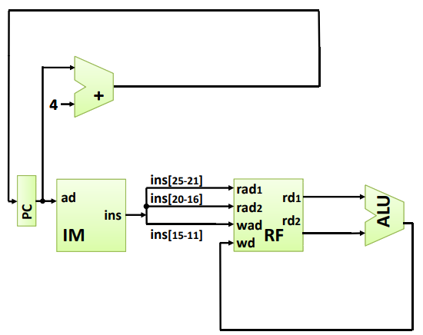
Basic CPU Operations - 3
Incrementing PC

Slide 42
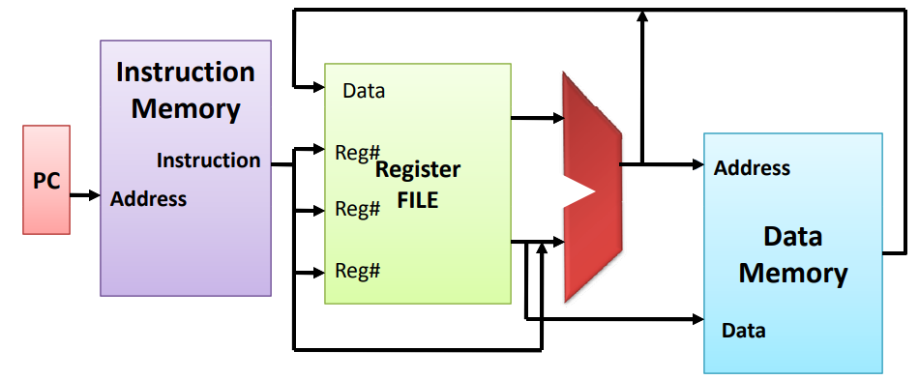
Overview of Simple CPU Design for R Format

Slide 43
Readings
Chap 4 of P&H Textbook
Appendix B of P&H Textbook

