Slide 1
CS / EE 320
Computer Organization and Assembly Language
Spring 2025
Lecture 14
Shahid Masud
Topics: Building a Single Cycle MIPS CPU

Slide 2
Important Announcement
Midterm Exam next week

Slide 3
Topics
Review Basic ALU Design (see Lecture 13 slides)
Scale 1 Bit ALU to 32 Bits
Building blocks of MIPS CPU
Architecture of simple instructions in Single Cycle MIPS
  J jump instruction
  ADD instruction
  ADDI instruction
  BEQ instruction
  LW load word instruction
  SW store word instruction
Putting together a single cycle Simple MIPS CPU Architecture
Quiz 3 today
Midterm Exam Next Week
As much as possible, before the quiz

Slide 4
Instruction Execution
Instruction Fetch → Instruction Decode → Instruction Execute
PC → instruction memory, fetch instruction
Register numbers → register file, read registers
Depending on instruction class
  Use ALU to calculate
    Arithmetic result
    Memory address for load/store
    Branch target address
Access data memory for load/store
PC ← target address or PC + 4 after current Fetch

Slide 5
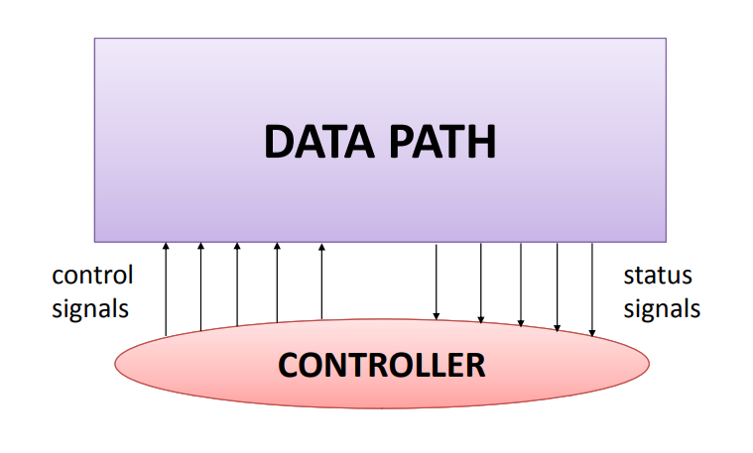
CPU consists of Data path and Control path

Slide 6
Building a Datapath
Datapath
  Elements that process data and addresses
  in the CPU
    Registers, ALUs, mux’s, memories, …
We will build a MIPS datapath incrementally
  Refining the basic design
We will start with a Single Cycle MIPS Processor

Slide 7
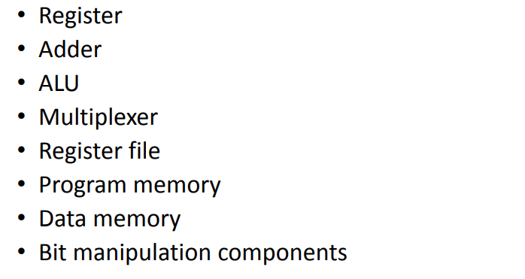
Components for Building MIPS CPU

Slide 8
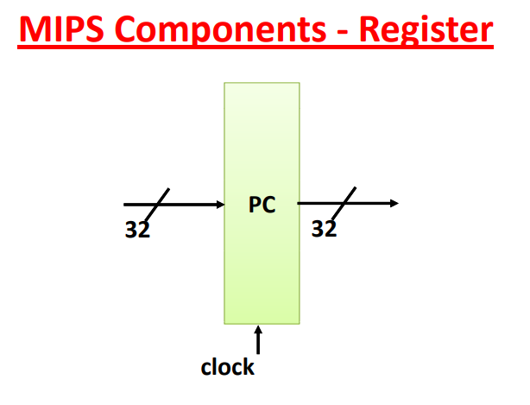
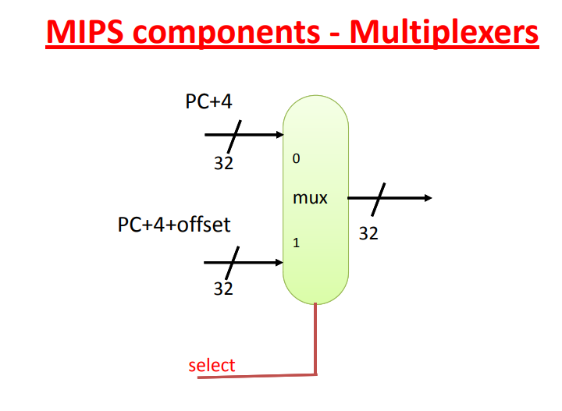
MIPS Components - 1

Slide 9
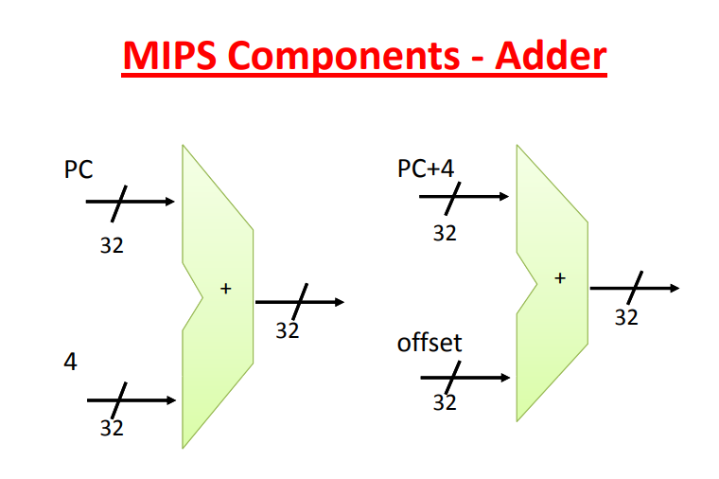
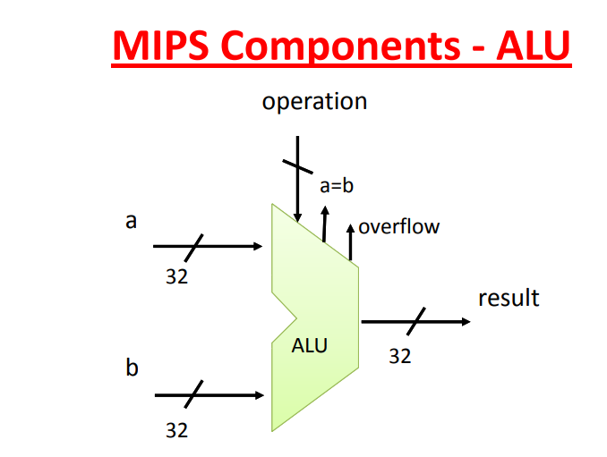
MIPS Components - 2

Slide 10
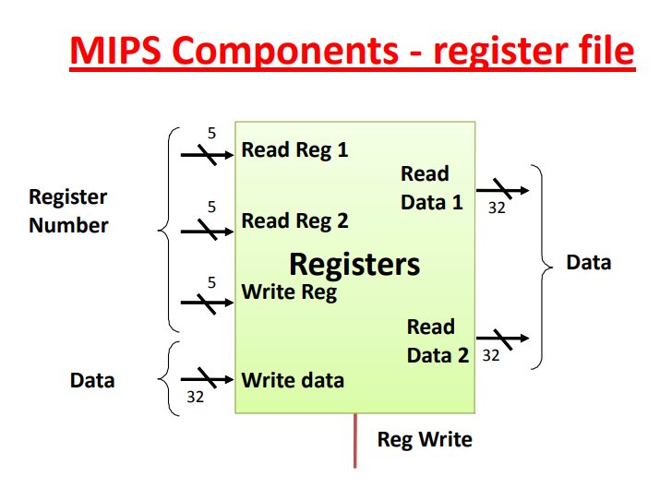
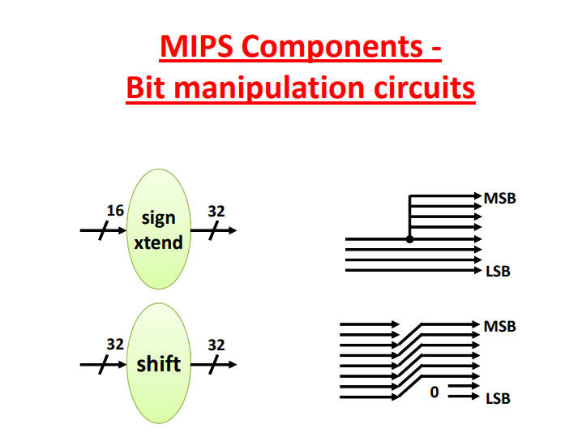
MIPS Components - 3

Slide 11
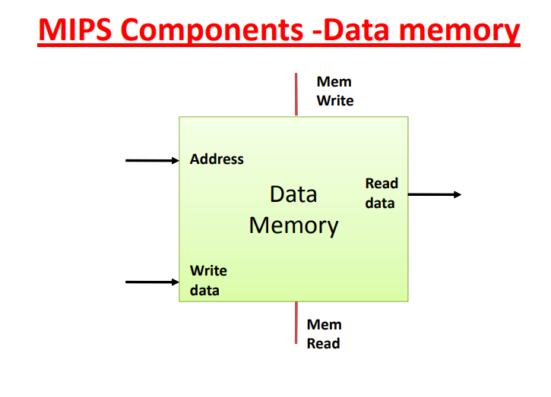
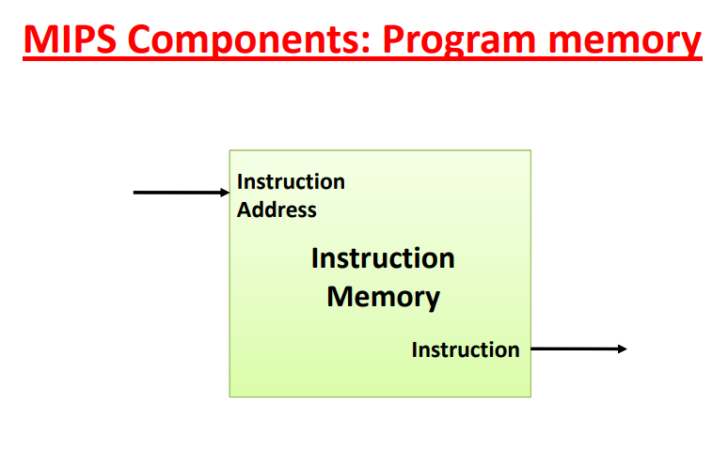
MIPS Components - 4

Slide 12
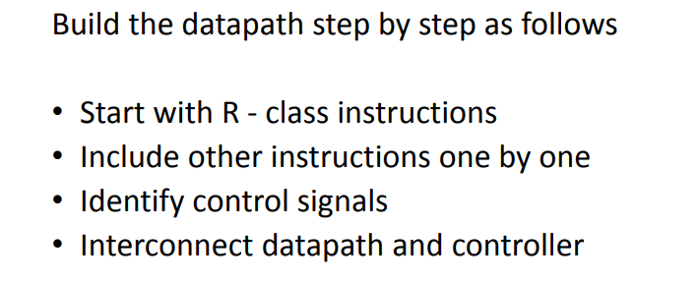
Build MIPS Data path – Step by Step

Slide 13
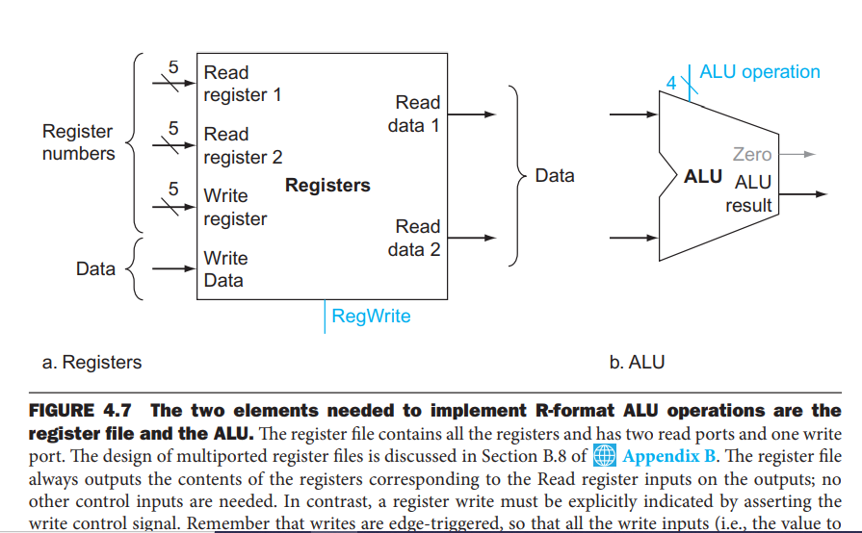
Two Components for R format CPU

Slide 14
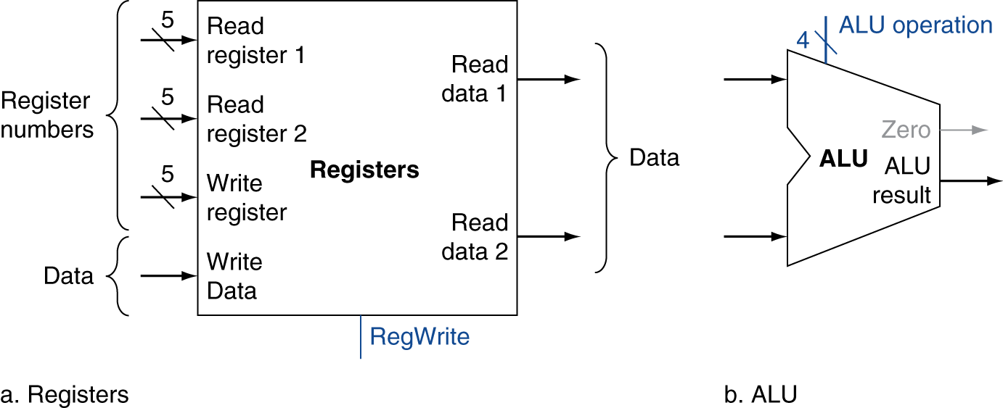
R-Format Instructions
Read two register operands
Perform arithmetic/logical operation
Write register result

Slide 15
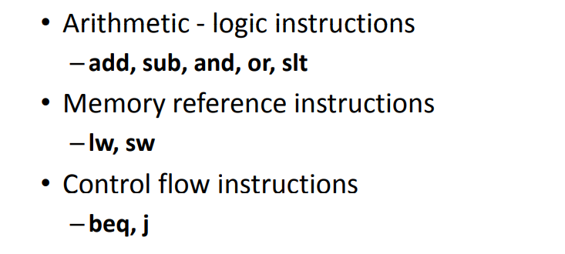
MIPS Subset of R format to start implementation

Slide 16
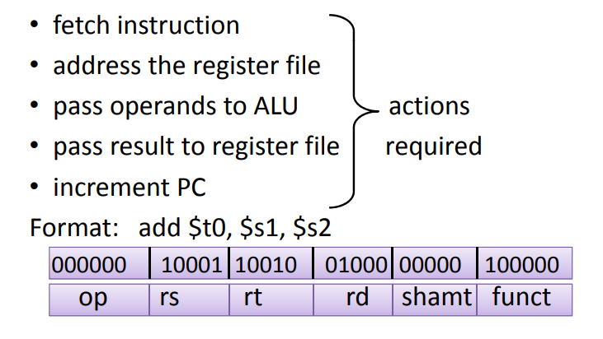
Develop Data path for add, sub, and, or, slt

Slide 17
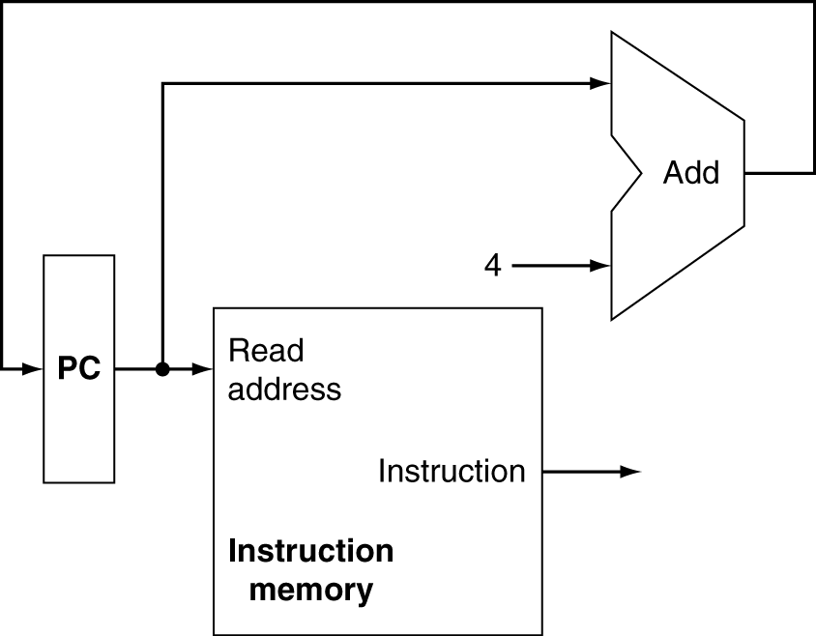
Instruction Fetch – PC Register operation
Increment by 4 for next instruction
32-bit register

Slide 18
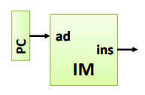
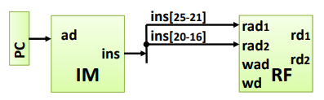
Basic CPU Operations - 1
Fetching Instruction
Addressing Register File

Slide 19
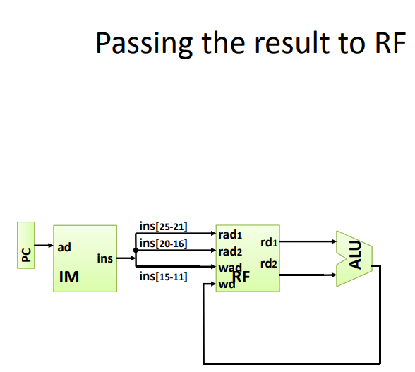
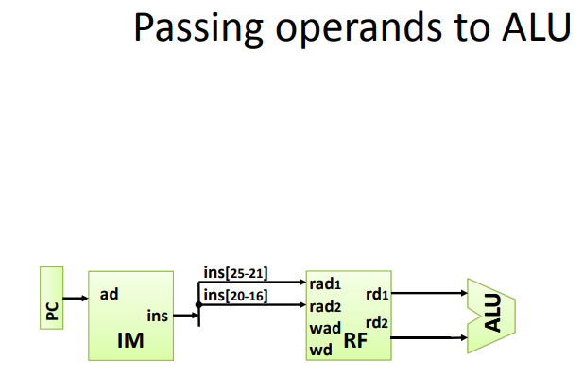
Basic CPU Operations - 2
Passing the Result to Register File
Passing Operands to ALU

Slide 20
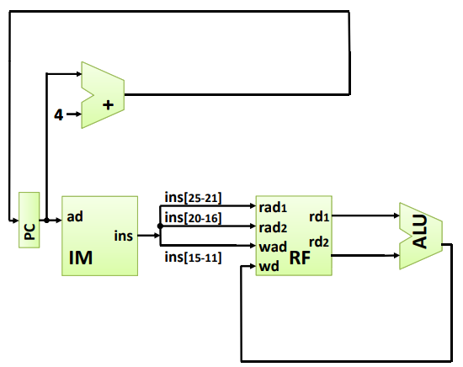
Basic CPU Operations - 3
Incrementing PC

Slide 21
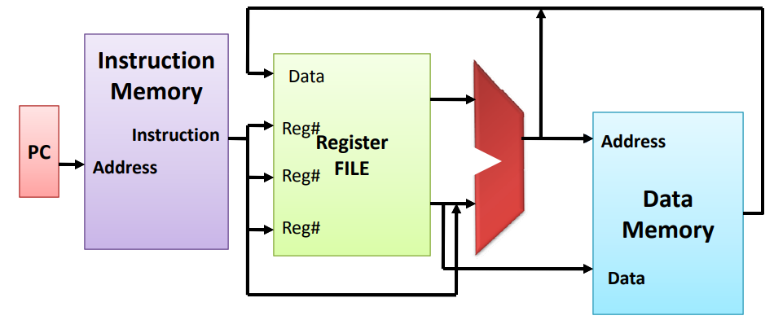
Overview of Simple CPU Design for R Format

Slide 22










Overview of Simple CPU Design for R Format

Slide 23
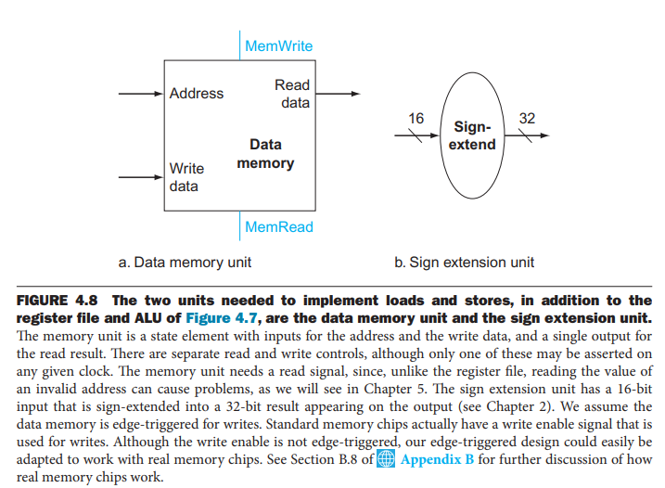
Two Components for lw and sw instructions
Read register operands
Calculate address using 16-bit offset
  Use ALU, but sign-extend offset
Load: Read memory and update register
Store: Write register value to memory

Slide 24
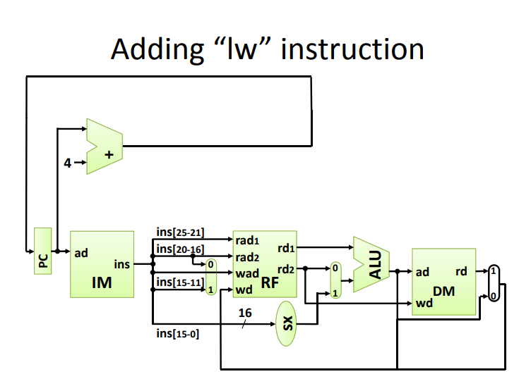
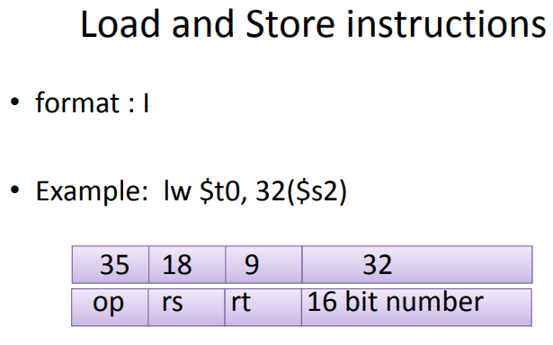





Implement the “lw” Instruction
Adding “lw” Instruction

Slide 25
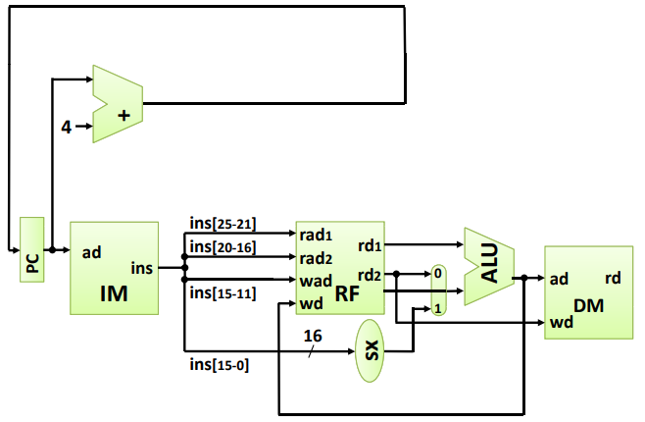
Implement the “sw” Instruction
Adding “sw” Instruction

Slide 26
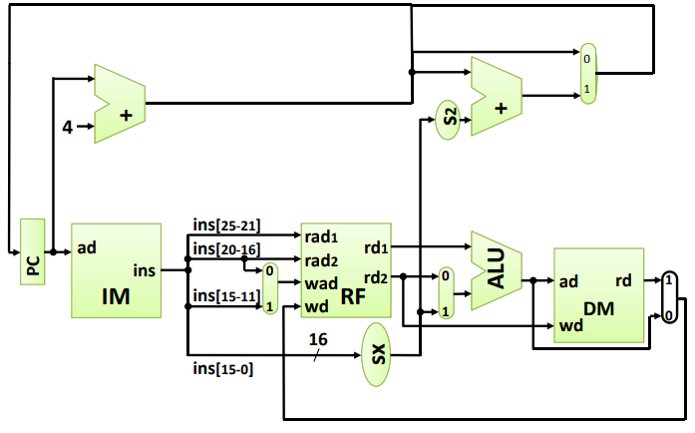
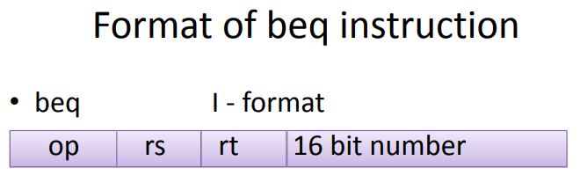
Implement “beq” Instruction
Adding “beq” Instruction

Slide 27
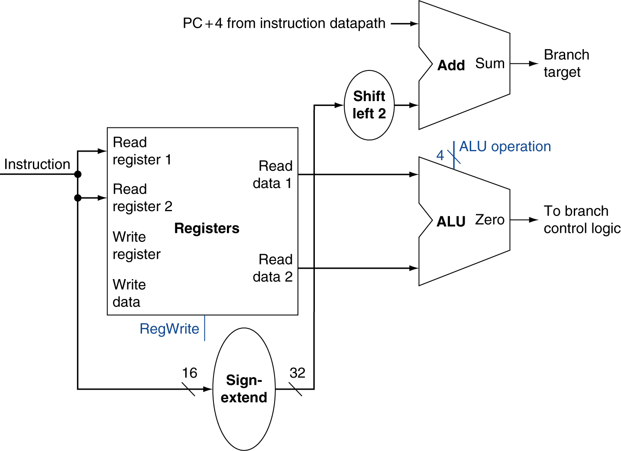
Branch Instructions
Just
re-routes wires
Sign-bit wire replicated

Slide 28
Implementing Jumps
Jump
2
address
31:26
25:0
Jump uses word address
Update PC with concatenation of
  Top 4 bits of old PC
  26-bit jump address
  00
Need an extra control signal decoded from opcode

Slide 29
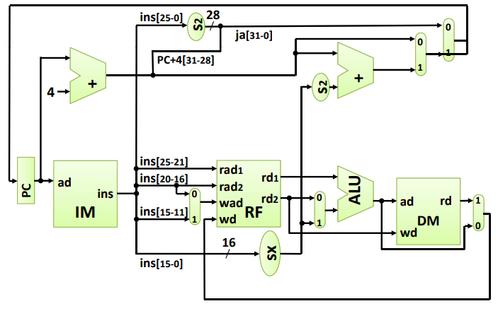
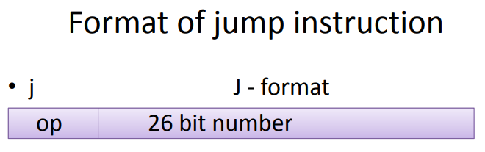
Implement Jump “j” instruction
Adding “j” Instruction

Slide 30
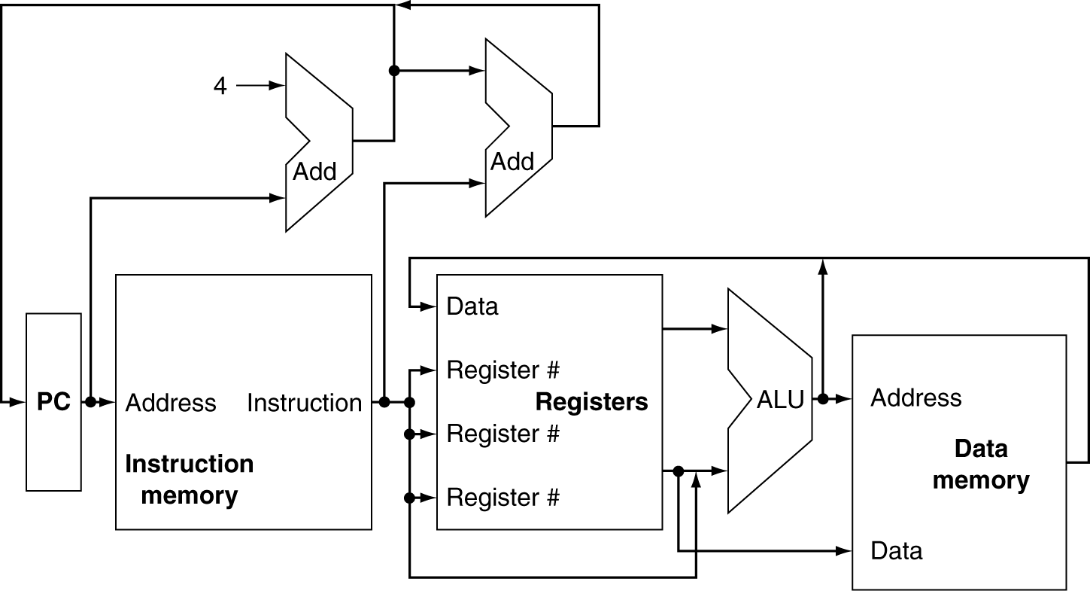
Basic CPU Overview

Slide 31
Multiplexers
Can’t just join wires together
  Use multiplexers

Slide 32
Branch Instructions
Read register operands
Compare operands
  Use ALU, subtract and check Zero output
Calculate target address
  Sign-extend displacement
  Shift left 2 places (word displacement)
  Add to PC + 4
    Already calculated by instruction fetch

Slide 33
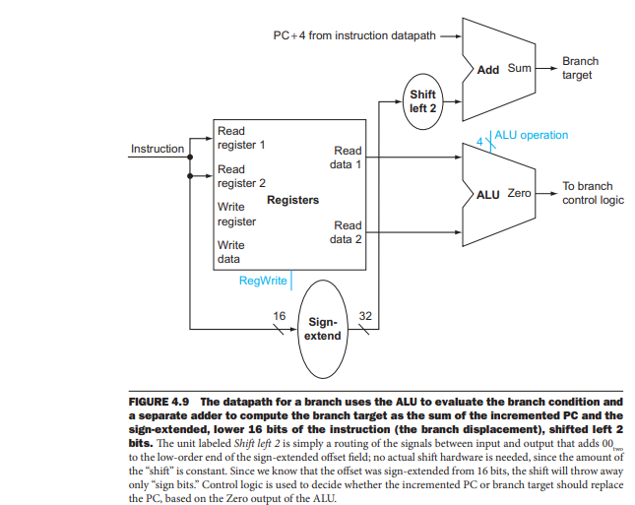
Data path for Branch Instruction

Slide 34
Composing the Elements
First-cut data path does an instruction in one clock cycle
  Each datapath element can only do one function at a time
  Hence, we need separate instruction and data memories
Use multiplexers where alternate data sources are used for different instructions

Slide 35
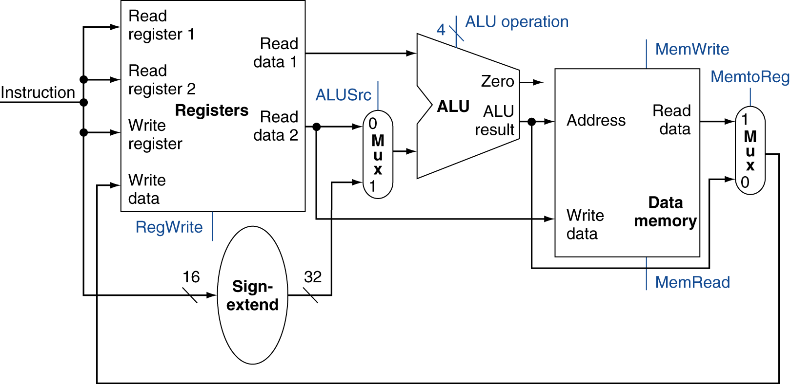
R-Type/Load/Store Datapath

Slide 36
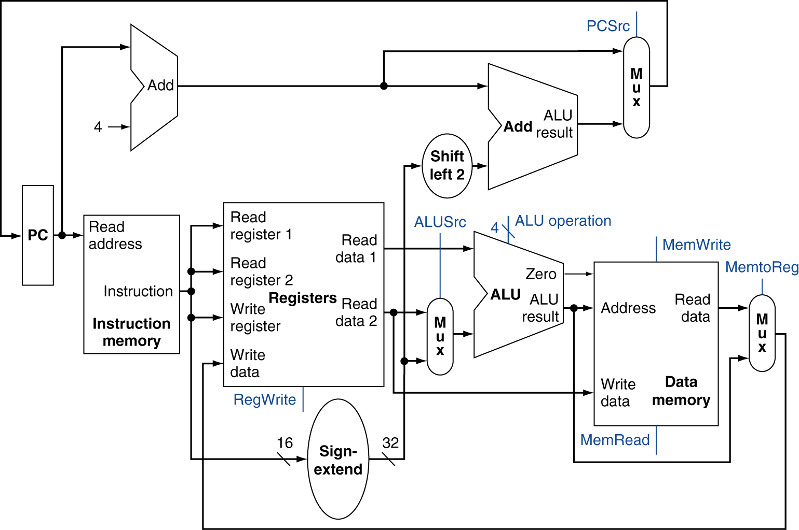
Full Datapath

Slide 37
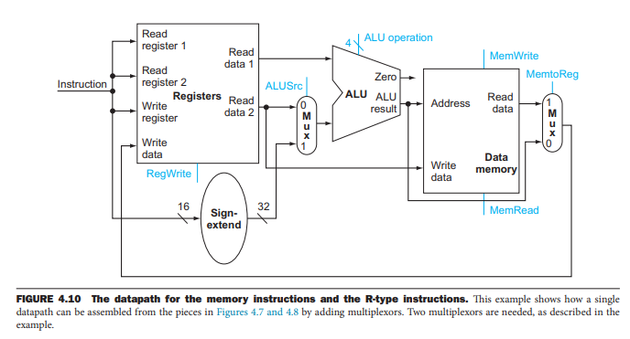
Data path for Memory Instructions

Slide 38
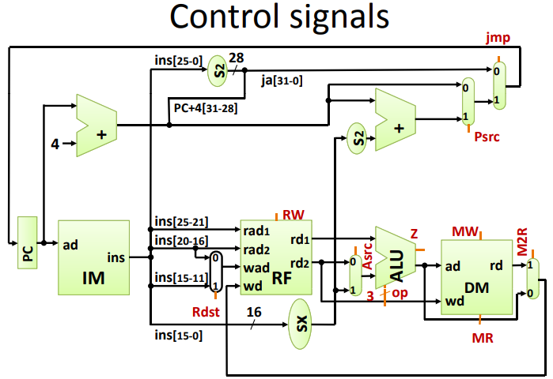
Identify Control Signals for Simple CPU

Slide 39
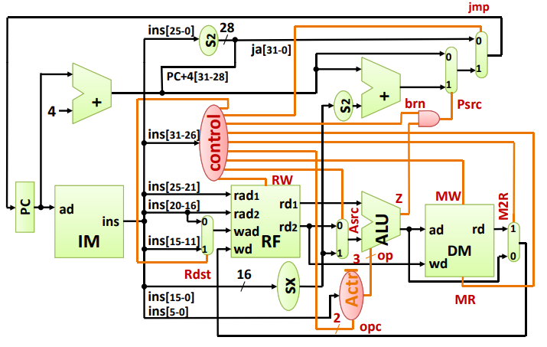
Combining Data path and Control path signals

Slide 40
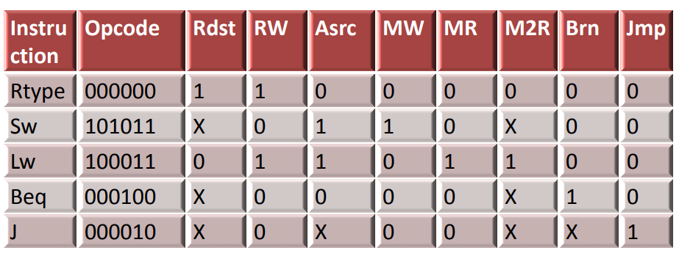
Control words in Simple MIPS CPU

Slide 41
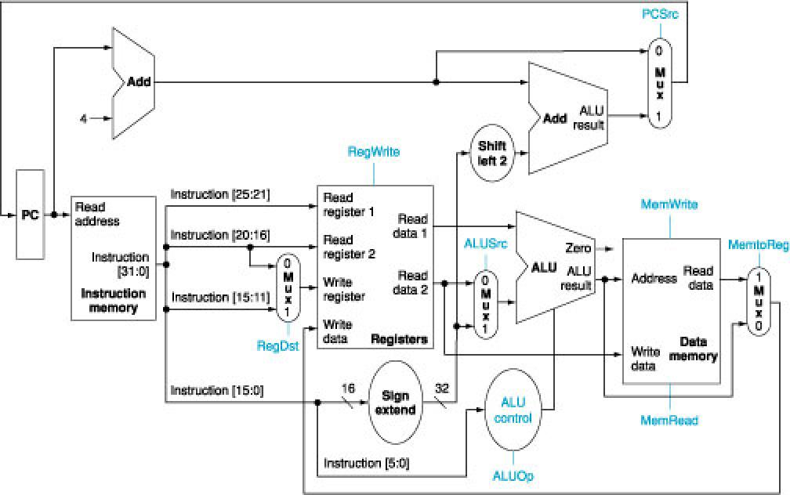
Control Signals needed in MIPS (P&H book style)

Slide 42
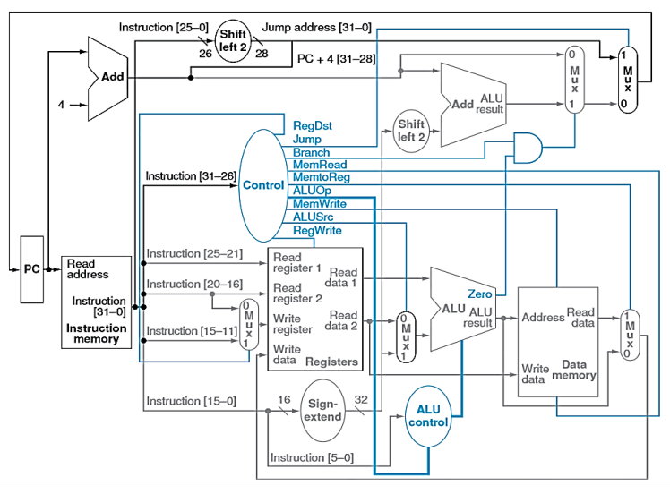
Data path with Control Signals in simple MIPS

Slide 43
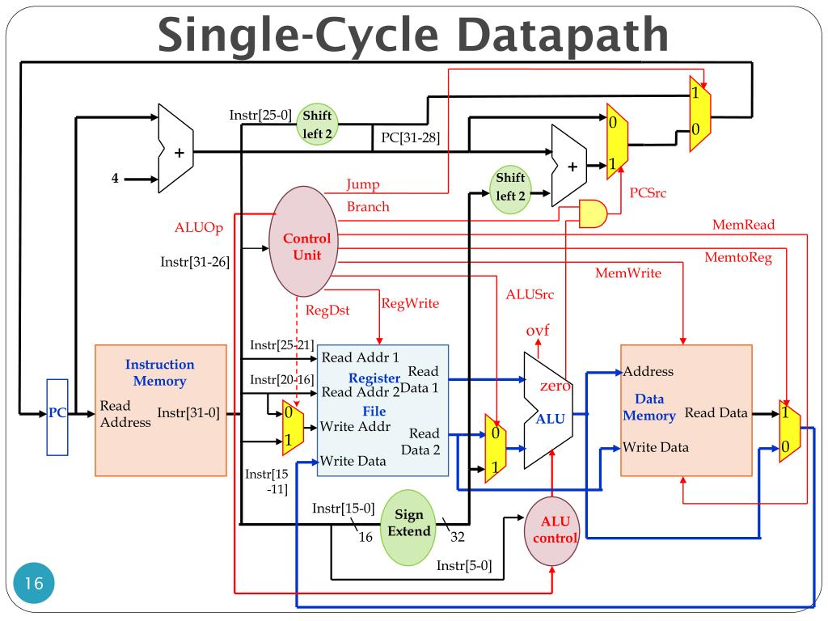
Another (clear) View of Control Signals

Slide 44
The Main Control Unit
Control signals derived from instruction
R-type
0
rs
rt
rd
shamt
funct
31:26
25:21
20:16
15:11
10:6
5:0
Load/
Store
35 or 43
rs
rt
address
31:26
25:21
20:16
15:0
Branch
4
rs
rt
address
31:26
25:21
20:16
15:0
opcode
always read
read, except for load
write for R-type and load
sign-extend and add

Slide 45
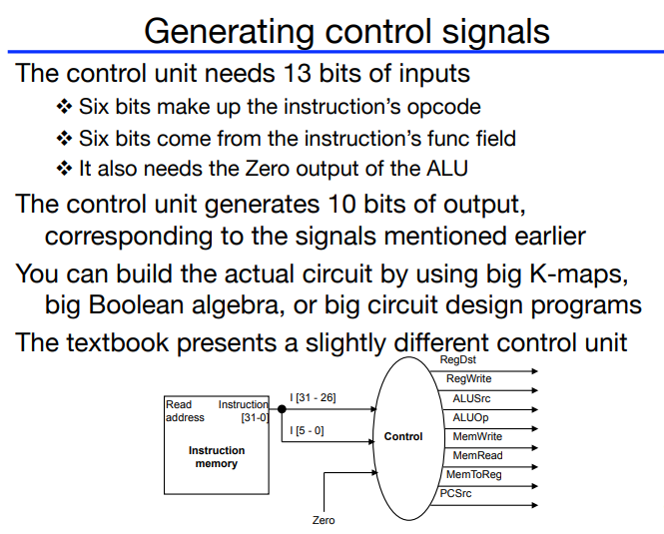
Generating Control Signals

Slide 46
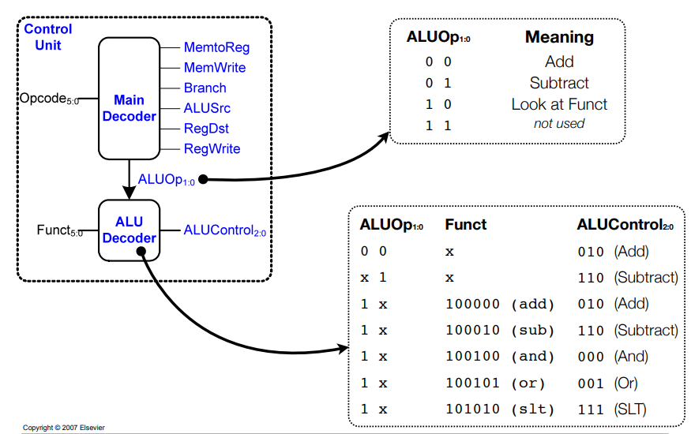
Control words with ALU Op codes

Slide 47
ALU Control
Assume 2-bit ALUOp derived from opcode
  Combinational logic derives ALU control
opcode | ALUOp | Operation | funct | ALU function | ALU control
lw | 00 | load word | XXXXXX | add | 0010
sw | 00 | store word | XXXXXX | add | 0010
beq | 01 | branch equal | XXXXXX | subtract | 0110
R-type | 10 | add | 100000 | add | 0010
 |  | subtract | 100010 | subtract | 0110
 |  | AND | 100100 | AND | 0000
 |  | OR | 100101 | OR | 0001
 |  | set-on-less-than | 101010 | set-on-less-than | 0111

Slide 48
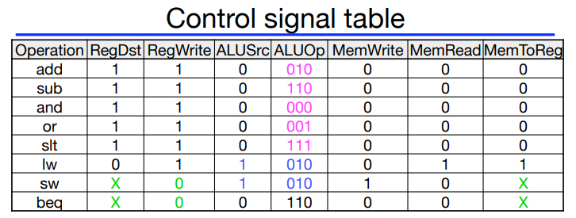
Control words for different Instructions

