Slide 1
CS/EE 320 Computer Organization and Assembly Language Spring 2024
Lecture 5
Shahid Masud

Slide 2
Topics
Basic Working of Von-Neumann Stored Program Computer
Registers Available Inside CPU: MBR, MAR, IR, AC, PC, etc.
Instruction Execution Cycle Simple – Fetch, Decode, Execute
Detailed Instruction Execution Cycle with Operand Fetch and Storage of Results, Sequential Processing
Introducing Assembly Language Instructions
Identify Assembly Language Instruction from Machine code
Register files and Memory Access
Addressing Constraints in R and I Type MIPS Instructions
Calculating Addresses in Different types of Instructions
QUIZ 1 next lecture

Slide 3
Basic Computer Operations
Memory
CPU
Instruction
Codes
CPU
Instruction Interpreter
Sequence of Arithmetic and Logic Operations
Data
Results
Control
Data
General Purpose ALU Functions
Results
I/O Module

Slide 4
Features of Von-Neuman Architecture
Data and Instructions are stored in a single read / write Memory
Contents of Memory are Addressable by Location Address irrespective of stored Contents
Execution of program occurs in a Sequential Fashion unless Modified through Branch instructions

Slide 5



Essential Registers in a CPU
REGISTERS IN CPU
ABBREVIATION | FULL NAME
PC | Program Counter
IR | Instruction Register
ALU | Arithmetic Logic Unit
ACC | Accumulator
MAR | Memory Address Register
MBR | Memory Buffer Register
I/O AR | I/O Address Register
I/O BR | I/O Buffer Register
CPU with Registers
DATA
BUS
ADDRESS
BUS
CONTROL
BUS
Main Memory
˸
Instruction 1
Instruction 2
Instruction 3
˸
Data 1
Data 2
Data 3
˸
PC
MAR
ADDRESS BUS
IR
MBR
DATA BUS
ALU
I/O AR
I/O BR
ACC
CONTROL BUS
Purpose of CPU registers?

Slide 6
PC, IR and AC Registers
PC (Program Counter) Register always holds the value of next instruction to be fetched
PC is incremented by ‘1’ address after each instruction to point to next location in instruction memory
To alter the sequence of operation, a new value is loaded into the PC
IR (Instruction Register) Register holds the fetched instruction
The contents of IR are examined to determine the ALU and Control operation required from this instruction
AC (Accumulator) register stores results from ALU or other operations inside CPU

Slide 7
Typical Actions by CPU
CPU Actions fall in four categories:
  Processor – Memory data movement
  Processor – I/O data movement
  Data Processing using ALU
  Control operation to alter the sequence of program execution

Slide 8
Basic Instruction Cycle
Start
Fetch Next Instruction
Execute Instruction
Halt
Fetch
Cycle
Execute
Cycle
Decode
The instruction fetch and execute is repeated until the end of program
Execution may involve several operations depending upon nature of instruction

Slide 9
Instruction Cycle State Diagram
Proc ↔ Mem
Proc ↔ I/O
Operations
Operand
Store
Instruction Fetch
Operand
Fetch
Instruction Address Calculation
Instruction Operation Decoding
Operand Address Calculation
Data Operation
Operand Address Calculation
Internal CPU Operations
Q: Why does Operand Address Calculation appear twice in state diagram:
A: A single instruction may require read, write or both operations

Slide 10


Instruction Execution Steps
PC gives address of instr to be fetched from memory.
After fetching, the instruction op code is decoded. The processor identifies number of operations. If operand is needed from memory, then its address is calculated.
Operand fetching process is repeated until all operands are fetched from memory.
Data operation is performed in ALU and result is produced in ACC.
If the result is stored in a register than instruction ends here.
If the destination of result is in memory then destination address is calculated and result moved to memory.
In tandem, the PC is incremented by ‘1’ (or 4?) to determine address of next instruction.
Instruction cycle is repeated for further instructions.

Slide 11
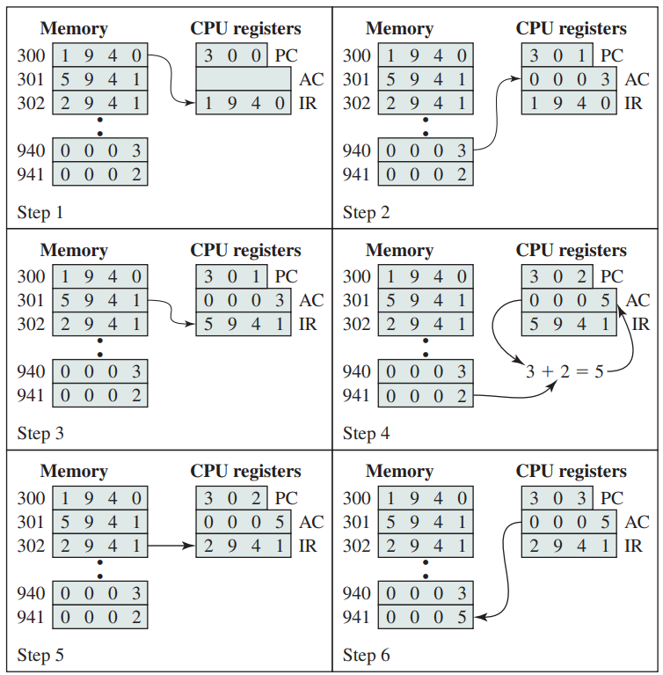
An Example of Program Execution Cycle
Step 1
Step 2
Sequence of Operation
Opcode determines that
AC is to be loaded from memory
Then ADD instruction
Then AC stored in location 941
? CPU needs more than one
Register to store second operand
Step 3
Step 4
Step 5
Step 6

Slide 12
How is an Assembly Instruction Formed?
As an example:
8 bits
24 bits
Opcode | Address / Data
32 bits
What happens with the full range of Address or Data ?
Answer: Different Addressing Modes

Slide 13
Walking through Program Execution
Current
Instruction
Current Instruction (IR)
Read
Instruction
 | Memory
0 | Load r0
1 | Program
2 | program
3 | …..
4 | …..
5
6
7
What does the processor do?
Load the instruction from memory
Determine what operation to perform
Find out where the data is located
Perform the operation
Determine the next instruction
Repeat this process over and over
Next
Instruction
 | Register File
0 | R0
1 | R1
2 | R2 ……
3 | 32 registers
Control
If/Else/
loop
Which Data
To use
Read/Write
Data
Result
ALU
Compute, Logical
Operation

Slide 14
Register Convention in MIPS Assembly
Name | Register No. | Usage
$zero | 0 | Constant Value 0
$v0 - $v1 | 2 – 3 | Values for results and expression evaluation
$a0 - $a3 | 4 – 7 | arguments
$t0 - $t7 | 8 – 15 | Temporary storage
$s0 – Ss7 | 16 – 23 | Saved
$t8 - $t9 | 24 – 25 | More temporary storage
$gp | 28 | Global pointer
$sp | 29 | Stack pointer
$fp | 30 | Frame pointer
$ra | 31 | Return address
$at | 1 | Reserved for Assembler use
Few Special Registers:
PC (Program Counter)
Hi and Lo results of
Multiplication
FP Floating Point
Control Registers for
Error and Exception Status

Slide 15
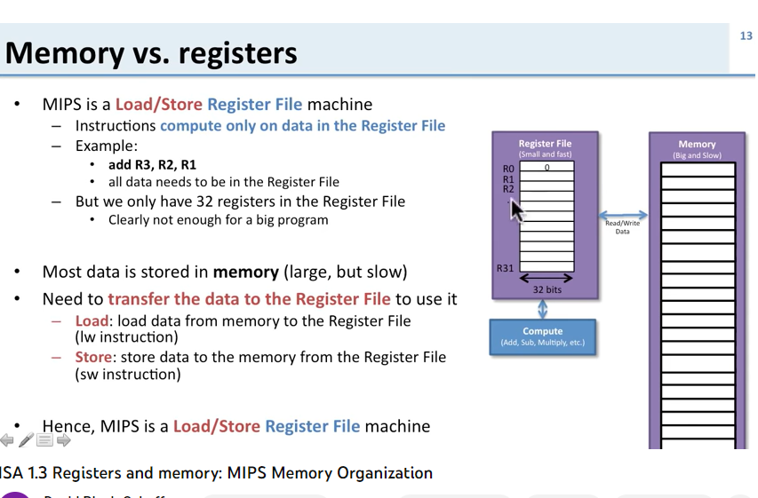
Load / Store Architecture
Memory (RAM)
(big and slow)
Register File
(small and fast)
Loc | data
0 | Byte 0
1 | Byte 1
2 | Byte 2
3 | Byte 3
4 | Byte 4
… | ….
ff… | Byte ff….
R0 | 0
R1
R2
…
R31
Read /
Write
32 bits
Compute in ALU
(Add, Sub, Mult, Div)

Slide 16
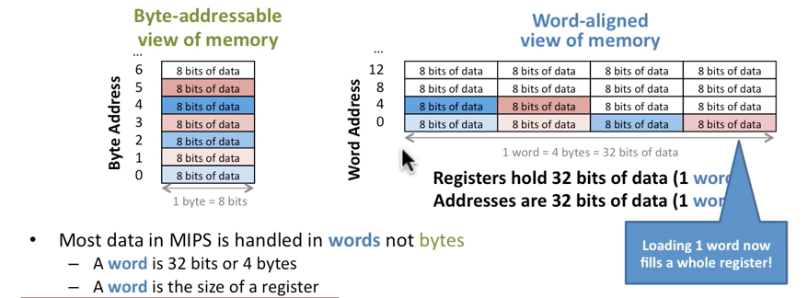
Word Aligned Memory Access
What are last 2 bits of Word Addresses?

Slide 17
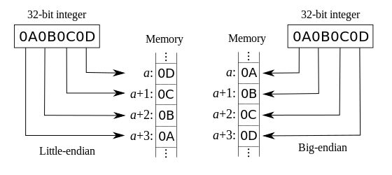
Memory Address in Big Endian and Little Endian

Slide 18
Register File and Memory Access in MIPS
MIPS is Characterized by Load Store Architecture
MIPS has a Word Aligned Memory Access
MIPS has a ‘Big Endian’ Register to Memory transfer

Slide 19
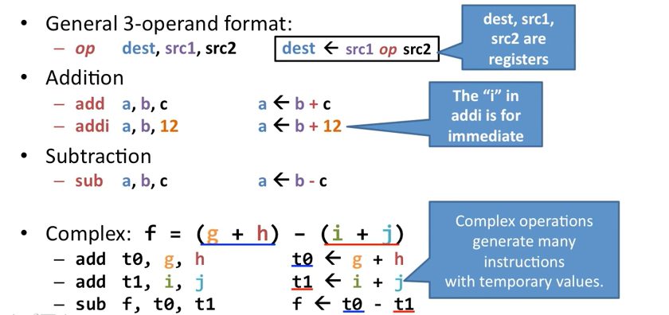
Starting with MIPS Instructions

Slide 20
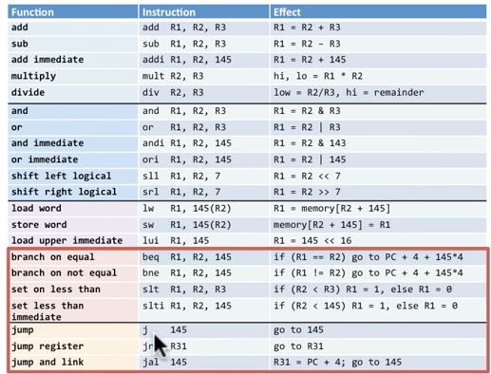
Three main types of MIPS Instructions
Data Operations
Arithmetic (add, sub, …)
Logical (and, nor, xor, …)
Data Transfer
Load (mem to reg, …)
Store (reg to mem, …)
Sequencing
Branch (conditional, =0, …)
Jump (unconditional, …)

Slide 21
MIPS R Format Instructions
op
rs
rt
rd
shamt
funct
6 bits
5 bits
5 bits
5 bits
5 bits
6 bits
Instruction fields
  op: operation code (opcode)
  rs: first source register number
  rt: second source register number
  rd: destination register number
  shamt: shift amount
  funct: function code (extends opcode)

Slide 22
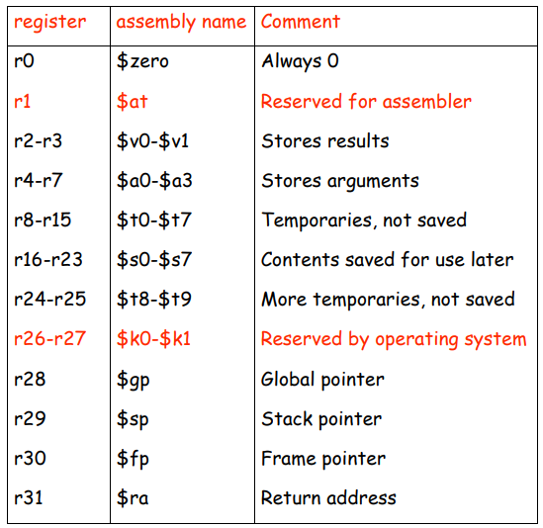
Register numbering for
R type instructions

Slide 23
R Format Instruction Example
op
rs
rt
rd
shamt
funct
6 bits
5 bits
5 bits
5 bits
5 bits
6 bits
add $t0, $s1, $s2
special
$s1
$s2
$t0
0
add
0
17
18
8
0
32
000000
10001
10010
01000
00000
100000
00000010001100100100000000100000₂ = 02324020₁₆

Slide 24
Dealing with Constant Values
E.g., program has variables x=1, y=4, f=3, etc.
First way: First load all constants into registers:
  Not so many registers
  Instructions Cycles are wasted
Second way: Use ‘i’ instructions such as addi, subi where a constant can be made part of instruction:
E.g. addi R29, R29, 4
But R type instructions do not have so many bits in each field
Solution: Use I type instructions with immediate data value

Slide 25
Some examples of R type instructions from MIPS reference sheet

Slide 26
MIPS I-format Instructions
op
rs
rt
constant or address
6 bits
5 bits
5 bits
16 bits
Immediate arithmetic and load/store instructions
  rt: destination or source register number
  Constant: –2¹⁵ to +2¹⁵ – 1
  Address: offset added to base address in rs

Slide 27
I Type MIPS Instruction Example
Instructions with Immediate Data Type
Example: Determine Machine code for this
Assembly Language Instruction:
lw $t0, 1002($s2) ; load word into $t0
op | rs | rt | 16 bit constant offset
100011 | 10010 | 01000 | 0000001111101010
Control module in CPU tells the ALU to take first operand from Register file and the
second operand from the Instruction (available in IR register)
The 16 bit Offset in I type instructions can refer to ‘Data’ or ‘Address’. Both are treated
separately

Slide 28
Logical Operations
Instructions for bitwise manipulation
Operation | C | Java | MIPS
Shift left | << | << | sll
Shift right | >> | >>> | srl
Bitwise AND | & | & | and, andi
Bitwise OR | | | | | or, ori
Bitwise NOT | ~ | ~ | nor
Useful for extracting and inserting groups of bits in a word

Slide 29
Shift Operations
op
rs
rt
rd
shamt
funct
6 bits
5 bits
5 bits
5 bits
5 bits
6 bits
shamt: how many positions to shift
Shift left logical
  Shift left and fill with 0 bits
  sll by i bits multiplies by 2^{i}
Shift right logical
  Shift right and fill with 0 bits
  srl by i bits divides by 2^{i} (unsigned only)

Slide 30
AND Operations
Useful to mask bits in a word
  Select some bits, clear others to 0
and $t0, $t1, $t2
$t2
0000 0000 0000 0000 0000 1101 1100 0000
$t1
0000 0000 0000 0000 0011 1100 0000 0000
$t0
0000 0000 0000 0000 0000 1100 0000 0000

Slide 31
OR Operations
Useful to include bits in a word
  Set some bits to 1, leave others unchanged
or $t0, $t1, $t2
$t2
0000 0000 0000 0000 0000 1101 1100 0000
$t1
0000 0000 0000 0000 0011 1100 0000 0000
$t0
0000 0000 0000 0000 0011 1101 1100 0000

Slide 32
NOT Operations
Useful to invert bits in a word
  Change 0 to 1, and 1 to 0
MIPS has NOR 3-operand instruction
  a NOR b == NOT ( a OR b )
nor $t0, $t1, $zero
Register 0: always read as zero
$t1
0000 0000 0000 0000 0011 1100 0000 0000
$t0
1111 1111 1111 1111 1100 0011 1111 1111

Slide 33
Readings
Chapter 2 of P&H Textbook

