Slide 1
CS / EE 320
Computer Organization and Assembly Language
Spring 2025
Lecture 11
Shahid Masud
Topics: Introduction to Floating Point Numbers, Basic Operations

Slide 2
Topics
Introduction to Floating Point Numbers
Conversion from Decimal to Floating Point
IEEE 754 Floating Point Standard Representation
Concept of Normalization
Concept of Biased Exponent
Different Precision Specification in IEEE 754
Range and Accuracy Calculations in Floating Point Standard
Special Representations NaN, Inf, etc.
Quiz Next Week

Slide 3
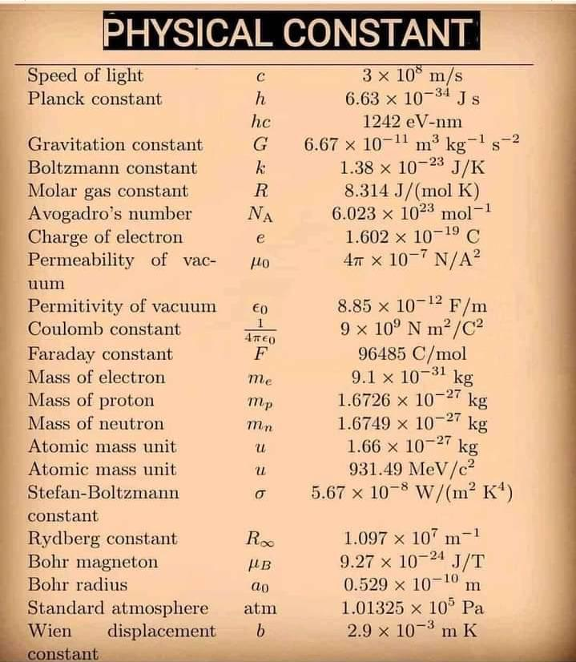
Common
Physical
Constants
Mostly Floating-Point Numbers

Slide 4
Floating Point
Representation for non-integral numbers
  Including very small and very large numbers
Like scientific notation
  –2.34 × 10⁵⁶
  +0.002 × 10^{–4}
  +987.02 × 10⁹
In binary
  ±1.xxxxxxx₂ × 2^{yyyy}
Types float and double in C for different accuracy
Normalized?
Not Normalized?

Slide 5
Floating Point
Three fields in Floating Point Numbers
Sign bit
Exponent
Significand or Mantissa
+/- .significand x 2^{exponent}
Point is actually fixed somewhere between sign bit and body of mantissa
Exponent indicates place value (point position)

Slide 6
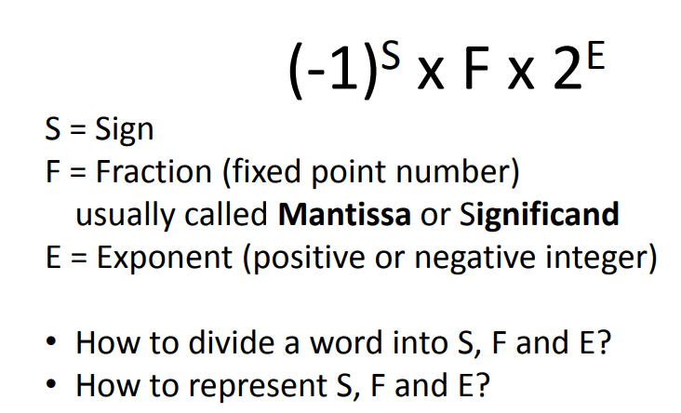
Floating Point Representation

Slide 7
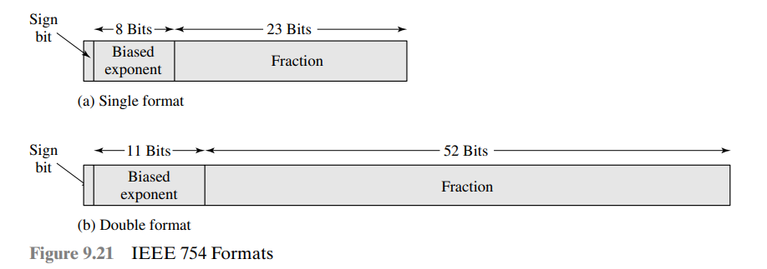
IEEE 754 Standard Specific
Standard for floating-point storage
32 and 64 bit standards
8 and 11 bit exponent respectively
Extended formats (both mantissa and exponent) for intermediate results
Representation: sign, exponent, faction
  0: 0, 0, 0
  -0: 1, 0, 0
  Special:
    Plus infinity: 0, all 1s, 0
    Minus infinity: 1, all 1s, 0
    NaN; 0 or 1, all 1s, =! 0. etc.

Slide 8
Floating Point Standard
Defined by IEEE Std 754-1985
Developed in response to divergence of representations
  Portability issues for scientific code
Now almost universally adopted
Three representations in latest IEEE 754 standard:
  Half precision (16-bit)
  Single precision (32-bit)
  Double precision (64-bit)

Slide 9
IEEE Floating-Point Format
single: 8 bits
double: 11 bits
single: 23 bits
double: 52 bits
S
Exponent
Fraction
S: sign bit (0 ⇒ non-negative, 1 ⇒ negative)
Normalize significand: 1.0 ≤ |significand| < 2.0
  Always has a leading pre-binary-point 1 bit, so no need to represent it explicitly (hidden bit)
  Significand is Fraction with the “1.” restored
Exponent: excess representation: actual exponent + Bias
  Ensures exponent is unsigned
  Single: Bias = 127; Double: Bias = 1203

Slide 10
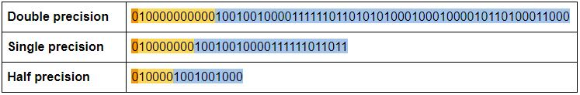
IEEE 754 Precision types
Name | Significand Bits | Exponent Bits | Exponent Bias
Half Precision | 11 | 5 | +15
Single Precision | 24 | 8 | +127
Double Precision | 53 | 11 | +1023
Quadruple Precision | 113 | 15 | +16383

Slide 11
Floating-Point Example
What number is represented by the single-precision float
11000000101000…00
  S = 1
  Fraction = 01000…00₂
  Fxponent = 10000001₂ = 129
x = (–1)¹ × (1 + 01₂) × 2^{(129 – 127)}
  = (–1) × 1.25 × 2²
  = –5.0

Slide 12
Normalization
FP numbers are usually normalized
i.e. Exponent is adjusted so that leading bit (MSB) of mantissa is 1
Since it is always 1 there is no need to store it
(Scientific notation where numbers are normalized to give a single digit before the decimal point e.g. 3.123 x 10³)

Slide 13
Floating-Point Example
Represent –0.75
  –0.75 = (–1)¹ × 1.1₂ × 2^{–1}
  S = 1
  Fraction = 1000…00₂
  Exponent = –1 + Bias
    Single: –1 + 127 = 126 = 01111110₂
    Double: –1 + 1023 = 1022 = 01111111110₂
Single: 1011111101000…00
Double: 1011111111101000…00

Slide 14
Some Examples of Converting to FP
Convert given Decimal number to Floating Point Representation
Convert to Decimal Representation from Floating Point

Slide 15
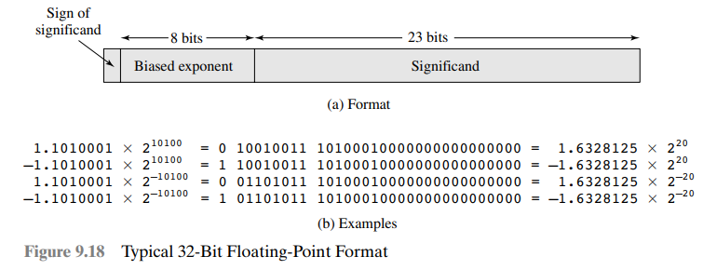
Some Floating-Point Conversions

Slide 16
Examples of Floating Point Representation
-(13.45)₁₀
= (1101.01 1100 1100 1100 ……..)² ; this is un-normalized
= (1.10101 1100 1100 1100 1100 1) x 2³; normalized
Fraction part is 10101 1100 1100 1100 1
Biased Exponent is 3+127 = 130
Sign = 1
5.0345
= 101 . 0000 1000 1101 0100 1111 110; this is un-normalized
= 1. 01 0000 1000 1101 0100 1111 110 x 2²; normalized
Biased Exponent = 2+127 = 129 = (1000 0001)₂
Fraction = 01 0000 1000 1101 0100 1111 110
Sign = 0

Slide 17
Single-Precision Range
Exponents 00000000 and 11111111 reserved
Smallest value
  Exponent: 00000001
  ⇒ actual exponent = 1 – 127 = –126
  Fraction: 000…00 ⇒ significand = 1.0
  ±1.0 × 2^{–126} ≈ ±1.2 × 10^{–38}
Largest value
  exponent: 11111110
  ⇒ actual exponent = 254 – 127 = +127
  Fraction: 111…11 ⇒ significand ≈ 2.0
  ±2.0 × 2⁺¹²⁷ ≈ ±3.4 × 10⁺³⁸

Slide 18
Double-Precision Range
Exponents 0000…00 and 1111…11 reserved
Smallest value
  Exponent: 00000000001
  ⇒ actual exponent = 1 – 1023 = –1022
  Fraction: 000…00 ⇒ significand = 1.0
  ±1.0 × 2^{–1022} ≈ ±2.2 × 10^{–308}
Largest value
  Exponent: 11111111110
  ⇒ actual exponent = 2046 – 1023 = +1023
  Fraction: 111…11 ⇒ significand ≈ 2.0
  ±2.0 × 2⁺¹⁰²³ ≈ ±1.8 × 10⁺³⁰⁸

Slide 19
Floating-Point Precision
Relative precision
  all fraction bits are significant
  Single: approx 2^{–23}
    Equivalent to 23 × log₁₀2 ≈ 23 × 0.3 ≈ 6 decimal digits of precision
  Double: approx 2^{–52}
    Equivalent to 52 × log₁₀2 ≈ 52 × 0.3 ≈ 16 decimal digits of precision

Slide 20
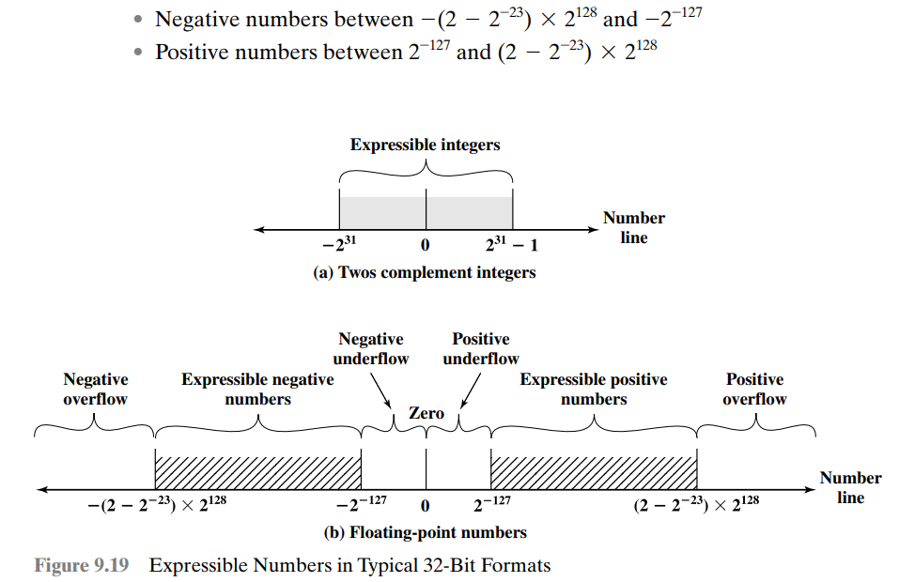
Expressible Numbers

Slide 21
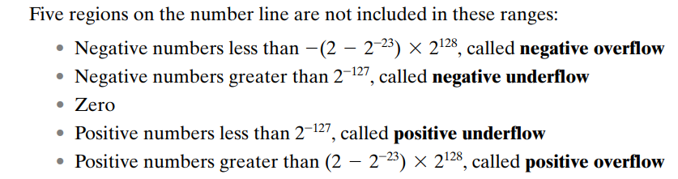
More about range of Floating-Point numbers

Slide 22
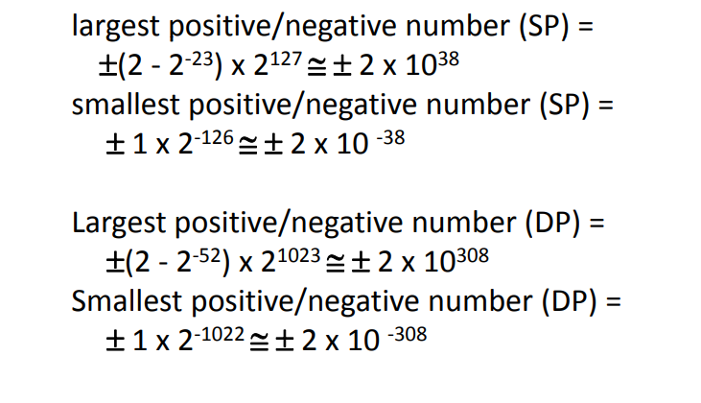
Overflow and Underflow in Floating-Point

Slide 23
Representation of Infinity and NaN
Exponent = 111...1, Fraction = 000...0
  ±Infinity
  Can be used in subsequent calculations, avoiding need for overflow check
Exponent = 111...1, Fraction ≠ 000...0
  Not-a-Number (NaN)
  Indicates illegal or undefined result
    e.g., 0.0 / 0.0
  Can be used in subsequent calculations

Slide 24
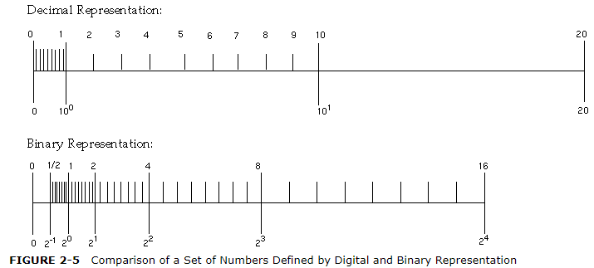
Uneven Distribution in Floating Point

Slide 25
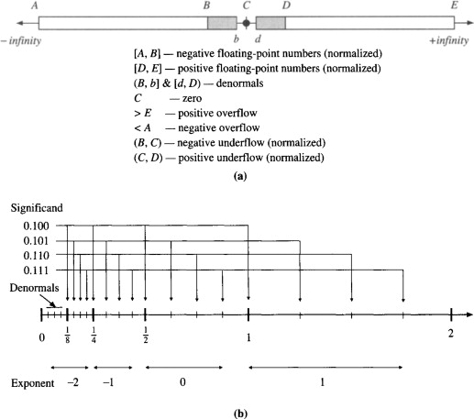
Floating Point – Denormals and Distribution

Slide 26
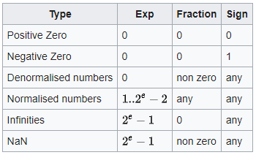
Special Representation – Subnormal
Zero: Zero is a special value denoted with an exponent field of 0 and a mantissa of 0.
Denormalized: If the exponent is all zeros, but the mantissa is not then the value
is a denormalized number
Infinity: The values +infinity and -infinity are denoted with an exponent of all
ones and a mantissa of all zeros. The sign bit distinguishes between negative
infinity and positive infinity. Being able to denote infinity as a specific value is
useful because it allows operations to continue past overflow situations. Operations
with infinite values are well defined in IEEE.
Indeterminate: The value indeterminate is represented by an exponent of all ones,
a mantissa with a leading one followed by all zeros, and a sign bit of one. This value
is used to represent results that are indeterminate, such as (infinity - infinity), or (0 x infinity).
Not A Number: The value NaN (Not a Number) is used to represent a value that is an
error of some form. This is represented with an exponent field of all ones and
a zero sign bit or a mantissa that it not 1 followed by zeros.

Slide 27
Denormal Numbers
Exponent = 000...0 ⇒ hidden bit is 0
Smaller than normal numbers
  allow for gradual underflow, with diminishing precision
Denormal with fraction = 000...0
Two representations of 0.0!

Slide 28

IEEE 754 Floating-Point Representation
Single Precision IEEE 754
Sign | Exponent | Fraction
1 bit | 8 bits | 23 bits
G R S
Guard Bits
32 bits
For Accuracy
Double Precision IEEE 754
Sign | Exponent | Fraction
1 bit | 11 bits | 52 bits
G R S
Guard Bits
64 bits

Slide 29
Floating-Point Arithmetic – Basics
N=(-1)^{S} x (1+F)x2E
A signed-magnitude system for the fractional part and a biased notation for the exponent
Three subfields
  Sign S
  Fraction F (or Significand or Mantissa)
  Exponent E
Sign bit is 0 for positive numbers, 1 for negative numbers
Fractions always start from 1.xxxx, hence the integer 1 is not written (register has xxxx)
Exponent is biased by +127 (add 127 to whatever is in register bits)
Normalize: Express numbers is the standard format by shifting of bits and
adding / subtracting from Exponent register

Slide 30
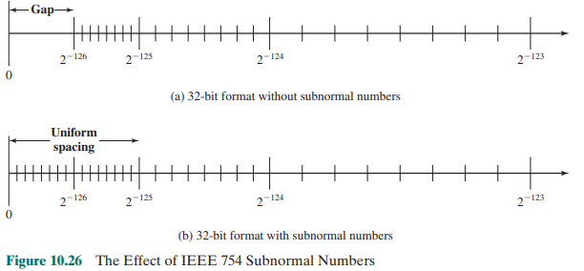
Subnormal or Denormal Numbers

Slide 31
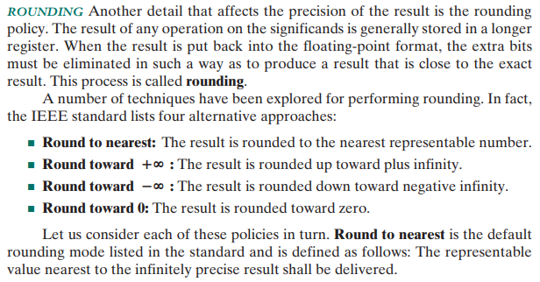
Rounding Policy

Slide 32
Accurate Arithmetic
IEEE Std 754 specifies additional rounding control
  Extra bits of precision (guard, round, sticky)
  Choice of rounding modes
  Allows programmer to fine-tune numerical behavior of a computation
Not all FP units implement all options
  Most programming languages and FP libraries just use defaults
Trade-off between hardware complexity, performance, and market requirements

Slide 33
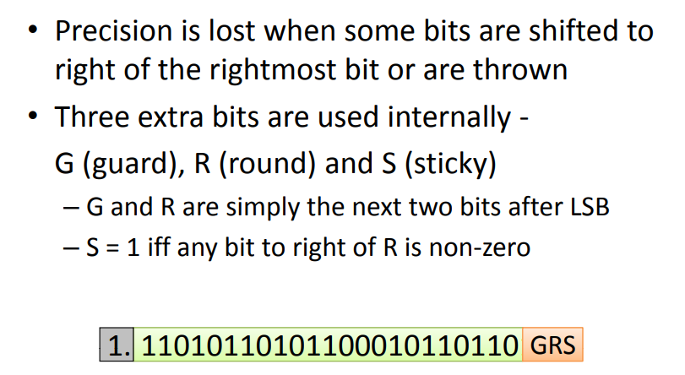
Accuracy in Floating Point

Slide 34
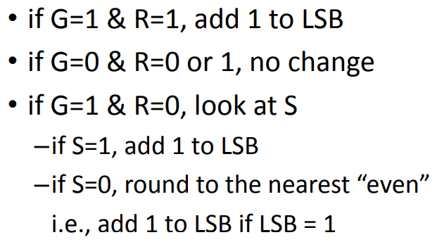
Rounding Scheme in Floating Point

Slide 35
Another view of Rounding Scheme
G Guard | R Round | S Sticky | Rounding Applied
0 | 0 | 0 | Truncate
0 | 0 | 1 | Truncate
0 | 1 | 0 | Truncate
0 | 1 | 1 | Truncate
1 | 0 | 0 | Round to Even
1 | 0 | 1 | Round Up
1 | 1 | 0 | Round Up
1 | 1 | 1 | Round Up
S = OR (All bits in S and to the right of S)
Round to Even:
If S = 0, do nothing
If S = 1, add +1

Slide 36
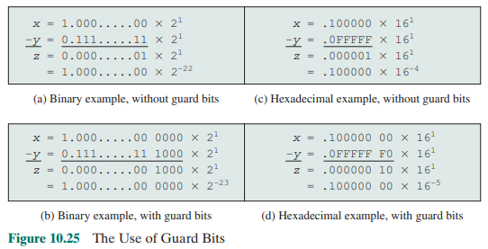
The Use of Guard Bits

Slide 37
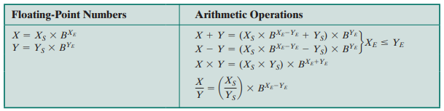
Floating-Point Arithmetic Operations

Slide 38
Floating-Point Addition – Decimal example
Consider a 4-digit decimal example
  9.999 × 10¹ + 1.610 × 10^{–1}
1. Align decimal points
  Shift number with smaller exponent
  9.999 × 10¹ + 0.016 × 10¹
2. Add significands
  9.999 × 10¹ + 0.016 × 10¹ = 10.015 × 10¹
3. Normalize result & check for over/underflow
  1.0015 × 10²
4. Round and renormalize if necessary
  1.002 × 10²

Slide 39
Floating-Point Addition – Binary example
Consider a 4-digit binary example
  1.000₂ × 2^{–1} + –1.110₂ × 2^{–2} (0.5 + –0.4375)
1. Align binary points
  Shift number with smaller exponent
  1.000₂ × 2^{–1} + –0.111₂ × 2^{–1}
2. Add significands
  1.000₂ × 2^{–1} + –0.111₂ × 2–1 = 0.001₂ × 2^{–1}
3. Normalize result & check for over/underflow
  1.000₂ × 2^{–4}, with no over/underflow
4. Round and renormalize if necessary
  1.000₂ × 2^{–4} (no change) = 0.0625

Slide 40
FP Arithmetic Add / Subtract
Check for zeros
Align significands (adjusting exponents)
Add or subtract significands
Normalize result

Slide 41
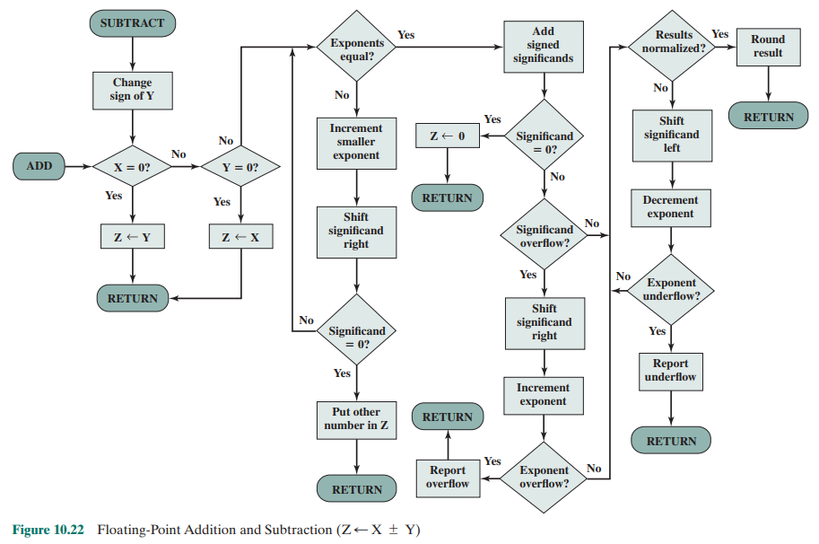
Floating Point Adder Flowchart

Slide 42
Readings
Chapter 3, P&H Textbook

