Slide 1

Assembly Language Laboratory 1
CS/EE 320 Computer Organization and Assembly Language
Shahid Masud
Spring 2025

Slide 2
Topics
Resources we will use in lab
Where does Assembly Language fit in software and hardware?
What does an Assembler do? and Linker? – The HW / SW Interface
Some Assemblers and Simulators for MIPS Architecture
Number and Data Formats in MIPS Assembly
Program and Data Storage in Memory

Slide 3
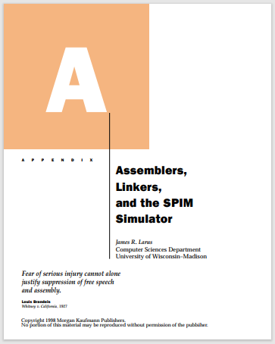
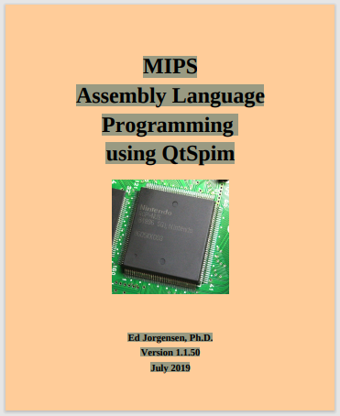
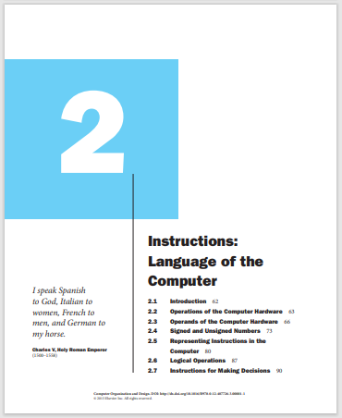
Resources We Will use
Appendix A: Assemblers, Linkers and the SPIM Simulator, written by J. R. Larus, Microsoft Research, part of Patterson and Hennessy book
Book: MIPS Assembly Language Programming using QtSpim, by Ed Jorgensen, Version 1.1.50, July 2019 (available online)
Chap 2, P&H Book, “Instructions: Language of the Computer”

Slide 4
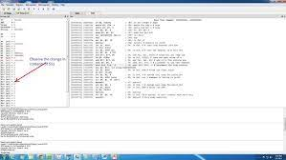
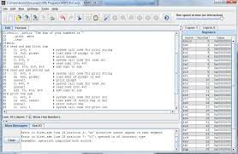
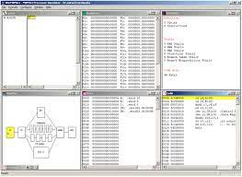
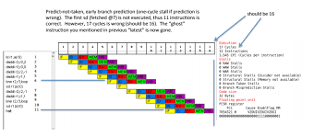
Lab Resources - Software
QTSpim or MARS Assembler for Assembly Language Programming
Edu64MIPS or WinMIPS64 for Architecture Simulations

Slide 5
How to Talk to a Microprocessor?
CPU
Computers work in Digital World
Computers using Binary Numbers to represent any information, program, variables, data, etc.
Binary numbers have only two values ‘0’ and ‘1’ (and a third state ‘Z’ for open circuit)
Only Binary data ‘1’ and ‘0’ is stored in memory in the form of computer program or data
Microprocessors ONLY understand Binary numbers
The program stored in memory in terms of ‘1’ and ‘0’ is called “Machine Language”
Machine Language is specific to a microprocessor
ALU
Micro-processor
Address Bus
Input device
Control Unit
Output device
Data Bus
Register Array
Control Bus
Memory unit
μP talks through buses
Typical Von-Neumann Computer Architecture
Look at the direction of buses

Slide 6
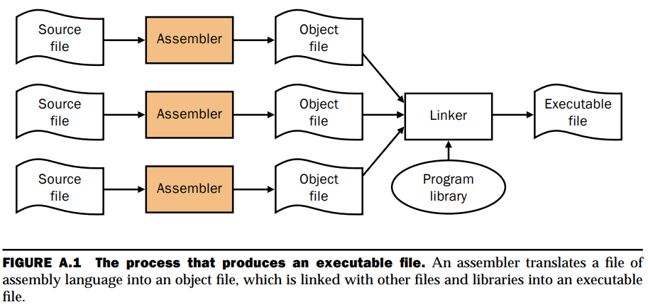
Mapping Computer Programming Language to Microprocessor
text
Binary
text
Assembly language is used when the (i) execution speed or (ii) memory storage of programs is very important

Slide 7
The Compiler Process
Source File: In C, Python, Fortran, Pascal, etc. (why not Java?)
Compiler breaks each line of HLL code to several lines of Assembly Language code
Assembler: Converts Assembly code programs to Object File
Linker: Combines all Object Files to produce executable machine code for full program
Compiler − − − →

Slide 8
What does an Assembler do?
An Assembler translates a file of Assembly language statements into an Object file of binary machine instructions and binary data.
The translation process has two major parts:
  The first step is to find memory locations with labels so the relationship between symbolic names and addresses is known when instructions are translated
  The second step is to translate each assembly statement by combining the numeric equivalents of opcodes, register specifiers, and labels into legal instructions
The Assembler produces an output file, called an object file, which contains the machine instructions, data, and bookkeeping information
Program library contains pre-written routines

Slide 9
What does a linker do?
Linker is a tool that merges the object files
Linker performs following tasks:
■ Searches the program libraries to find library routines used by the program
■ Determines the memory locations that code from each module will occupy and relocates its instructions by adjusting absolute references
■ Resolves references among files
■ Ensures that a program contains no undefined labels

Slide 10
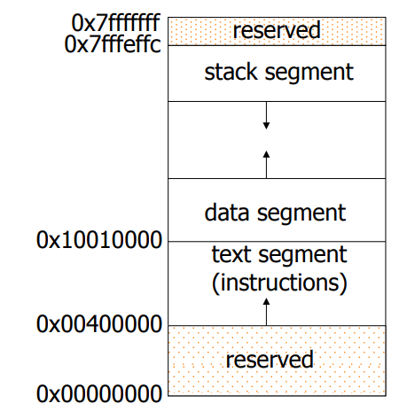
Memory Mapping in MIPS
The first part, near the bottom of the address space (starting at address 400000hex), is the text segment, which holds the program’s instructions.
The second part, above the text segment, is the data segment, which is further divided into two parts.
  Static data (starting at address 10000000hex) contains objects whose size is known to the compiler and whose lifetime—the interval during which a program can access them—is the program’s entire execution.
  Immediately above static data is dynamic data. This data, as its name implies, is allocated by the program as it executes.
The third part, the program stack segment, resides at the top of the virtual address space (starting at address 7fffffffhex). Like dynamic data, the maximum size of a program’s stack is not known in advance. As the program pushes values on the stack, the operating system expands the stack segment down, towards the data segment.
32 bits
Address space

Slide 11
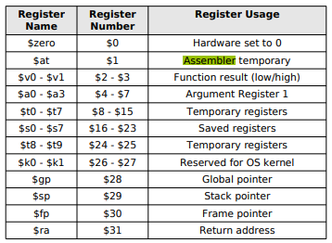
Registers in MIPS
The MIPS CPU contains 32 general-purpose registers that are numbered 0–31.
Register $0 always contains the hardwired value 0.
Registers $at (1), $k0 (26), and $k1 (27) are reserved for the assembler and operating system and should not be used by user programs or compilers.
Registers $a0 – $a3 (4–7) are used to pass the first four arguments to routines (remaining arguments are passed on the stack).
Registers $v0 and $v1 (2, 3) are used to return values from functions.
Registers $t0–$t9 (8–15, 24, 25) are caller-saved registers that are used to hold temporary quantities that need not be preserved across calls.
Registers $s0–$s7 (16–23) are callee-saved registers that hold long lived values that should be preserved across calls.
Register $gp (28) is a global pointer that points to the middle of a 64K block of memory in the static data segment.
Register $sp (29) is the stack pointer, which points to the first free location on the stack.
Register $fp (30) is the frame pointer.
The jal instruction writes register $ra (31), return address from a procedure call.
a.k.a. Register File
$t temporary registers – not preserved across procedure calls
$s saved registers – preserved across system calls
$a, $v – used in arithmetic functions

Slide 12
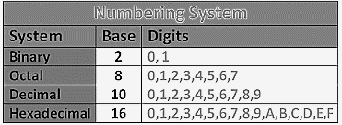
Binary, Decimal and Hexadecimal Numbers
Binary | Decimal | Hexadecimal
0000 | 0 | 0
0001 | 1 | 1
0010 | 2 | 2
0011 | 3 | 3
0100 | 4 | 4
0101 | 5 | 5
0110 | 6 | 6
0111 | 7 | 7
1000 | 8 | 8
1001 | 9 | 9
1010 | 10 | A
1011 | 11 | B
1100 | 12 | C
1101 | 13 | D
1110 | 14 | E
1111 | 15 | F

Slide 13
Binary to Hex and Back
Hex Representation is Compact and Clear
A B C 4 5 6 7 F
Binary Representation is
Cluttered and prone to confusion
1010 1011 1100 0100 0101 0110 0111 1111

Slide 14
Register Usage in MIPS
CPU Registers Width 32 bits
0 0 0 0 | 0 0 0 0 | 0 0 0 0 | 0 0 0 0 | 0 0 0 0 | 0 0 0 0 | 0 0 0 0 | 0 0 1 0
Bit 32
Bit 16
Bit 8
Bit 0
MSB
Most Significant Bit
LSB
Least Significant Bit
Byte (8 bits)
Half Word (16 bits)
Word (32 bits)
Size | Size | Unsigned Int Range | Signed Int Range
Byte | 2⁸ | 0 to 255 | -128 to +127
Half Word | 2¹⁶ | 0 to 65,535 | -32,768 to +32,767
Word | 2³² | 0 to 4,294,967,295 | -2,147,483,648 to +2,147,483,647

Slide 15
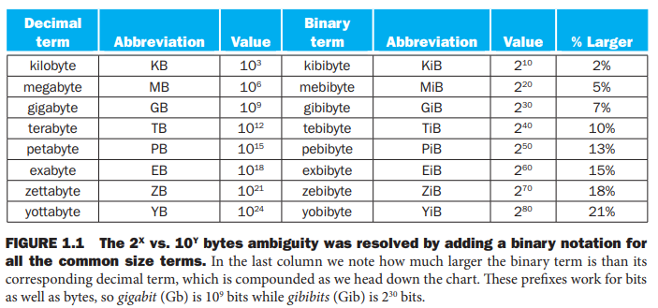
The Scale in Computing

Slide 16



External Memory vs CPU Registers
Register File
Location | Memory Data 8-bits
2³²-1 | 1110 1001
2³²-2 | 1010 0111
…. | ….
…. | ….
7 | ….
6 | ….
5 | ….
4 | ….
3 | 0100 1001
2 | 1001 1100
1 | 0101 1011
0 | 0000 0010
Location | 32-bit Registers Data
R0 | 0x 499C 5B02
R1 | 0x 025B 9C49
R2
….
….
….
….
R29
R30
R31
4,294,967,295
Remember: blocks
Word
Boundary

Slide 17
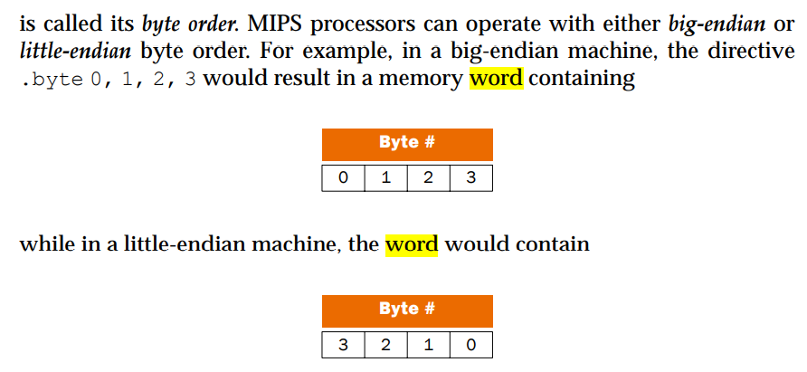
Byte Order: Big or Little – Endian
Big Endian => Lowest Significant Byte in
Word is
Stored in Highest Byte Location (4)
Little Endian => Lowest Significant Byte
in Word is
Stored in Lowest Byte Location (0)

Slide 18
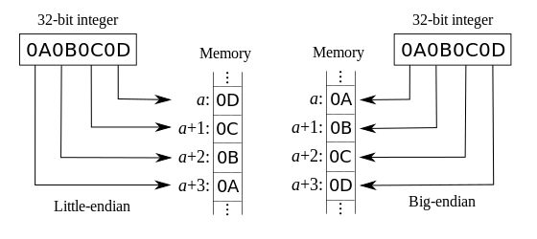
Memory Address in Big Endian and Little Endian

Slide 19
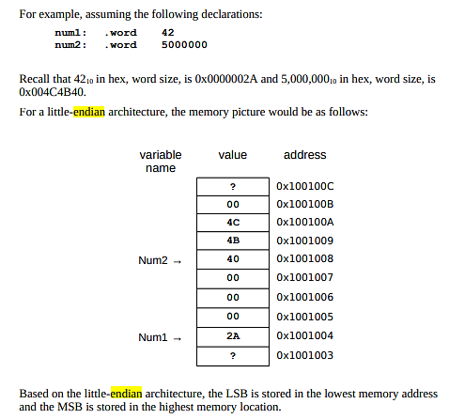
Memory Map in Little Endian

