Slide 1
CS / EE 320
Computer Organization and Assembly Language
Lecture 20
Spring 2025
Shahid Masud
Topics: Branch Prediction Techniques

Slide 2
Topics
Static and Dynamic Branch Prediction – some review
1-Bit and 2-Bit Branch Prediction
(m,n), Global and Tournament Predictors
How to construct a Branch History Table
Operation and Advantage of Branch History Table
Performance Evaluation of Branch Prediction in Pipelined CPU
Loop Unrolling
Speculation, ILP, etc.
Some example questions
Quiz After
Eid Break

Slide 3
Static and Dynamic Branch Prediction
In deeper and superscalar pipelines, branch penalty is more significant
Use dynamic prediction
Branch prediction buffer (aka branch history table)
Indexed by recent branch instruction addresses
Stores outcome (taken/not taken)
To execute a branch
  Check table, expect the same outcome
  Start fetching from fall-through or target
  If wrong, flush pipeline and flip prediction

Slide 4
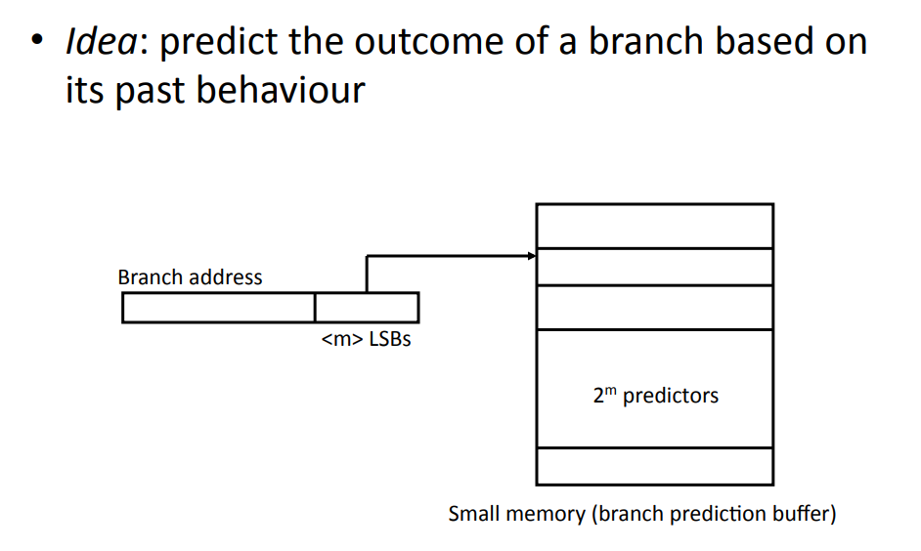
What is Dynamic Branch Prediction?

Slide 5
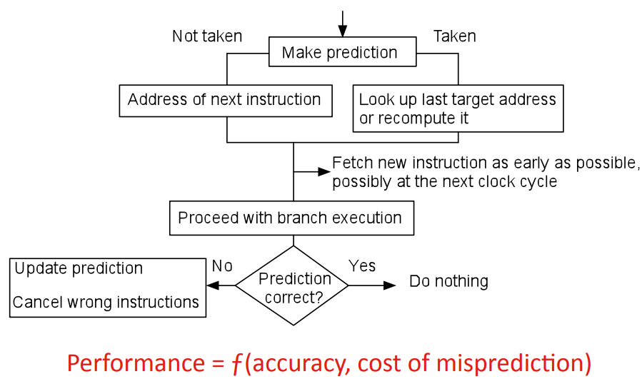
Flowchart of Dynamic Branch Prediction

Slide 6
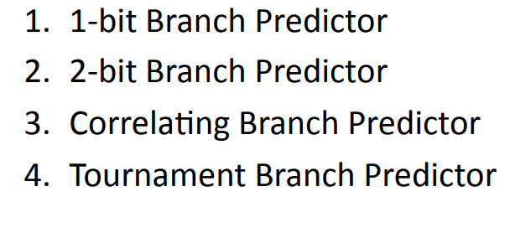
Popular Branch Prediction Schemes

Slide 7
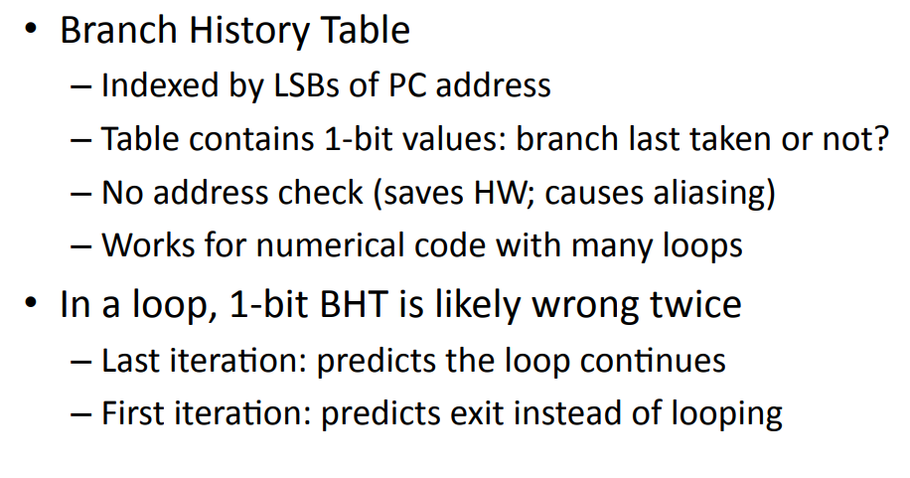
What is a 1-bit Branch Predictor?

Slide 8
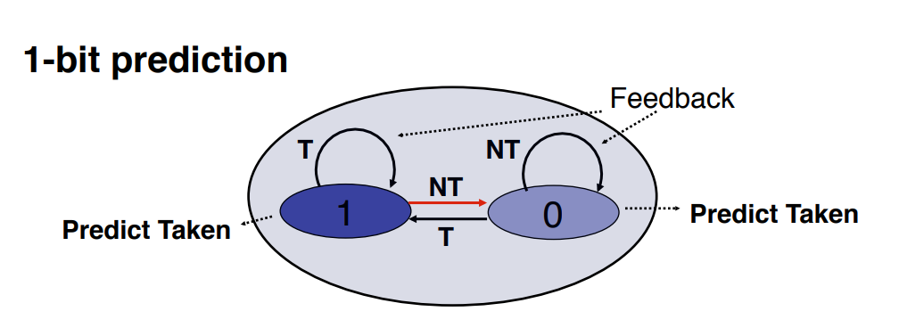
1-Bit Branch Predictor

Slide 9
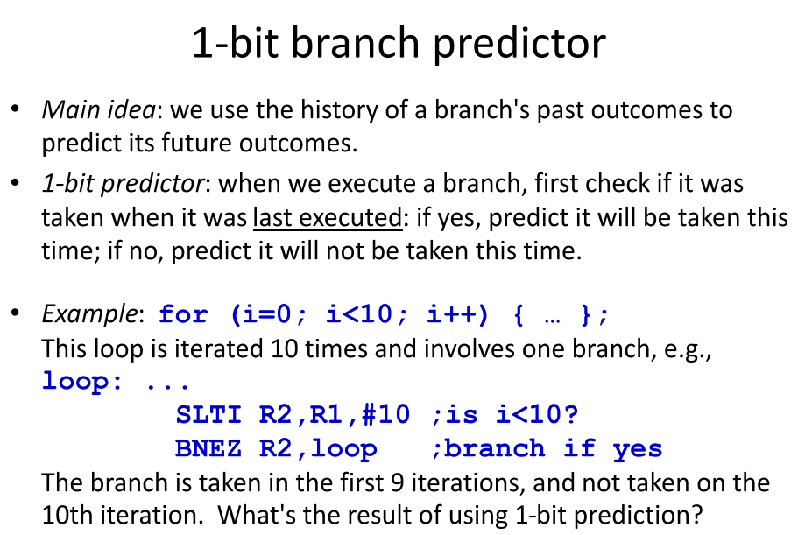
Example of 1-Bit Predictor

Slide 10
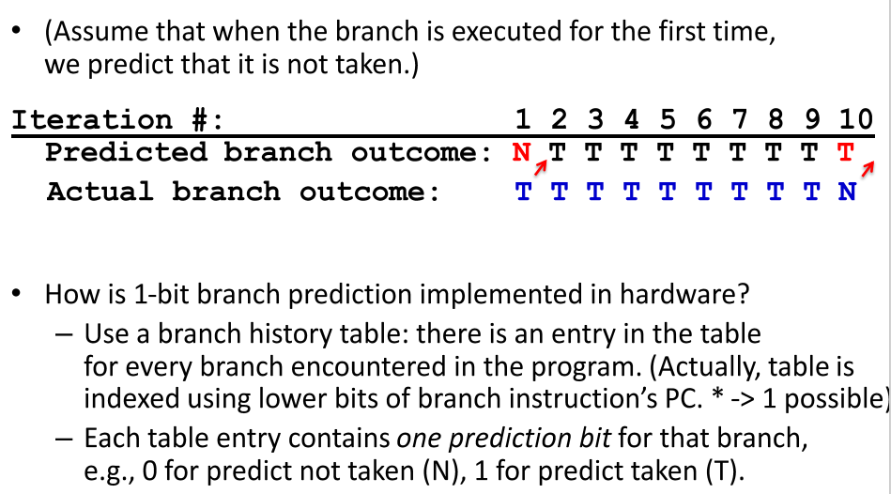
Contd – 1-Bit Predictor

Slide 11
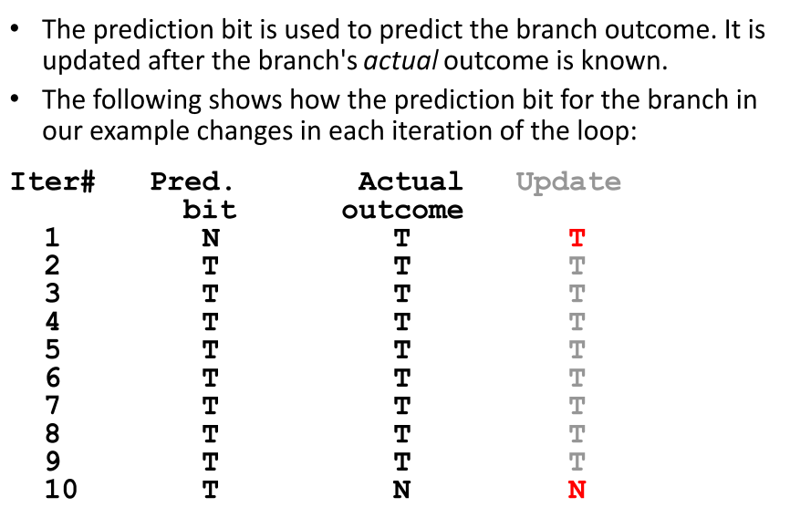
How the Predictor bit changes?

Slide 12
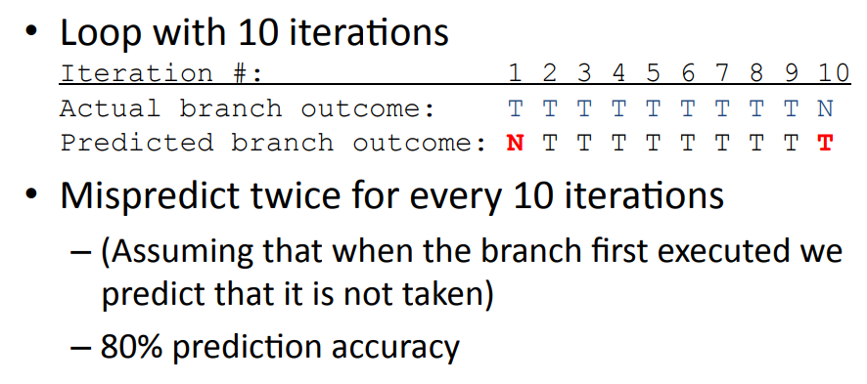
Example of 1-Bit Branch Predictor

Slide 13
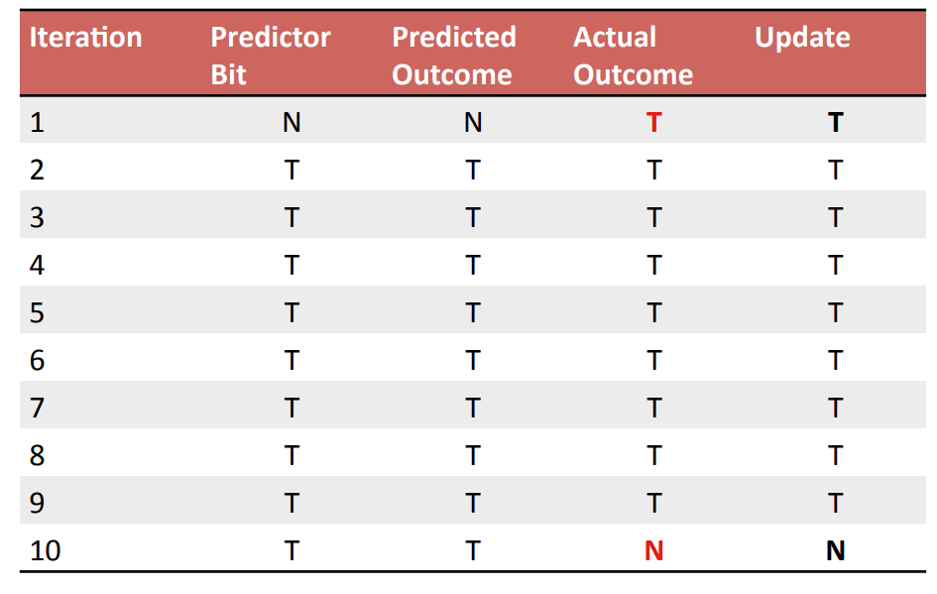
Updating 1-Bit Branch Predictor

Slide 14
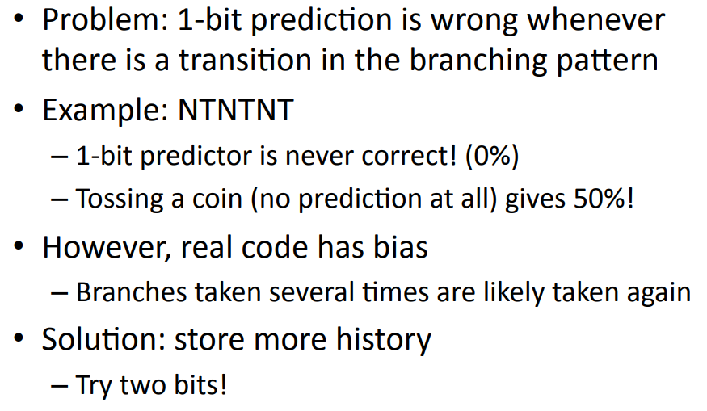
Problem with 1-Bit Branch Predictor

Slide 15
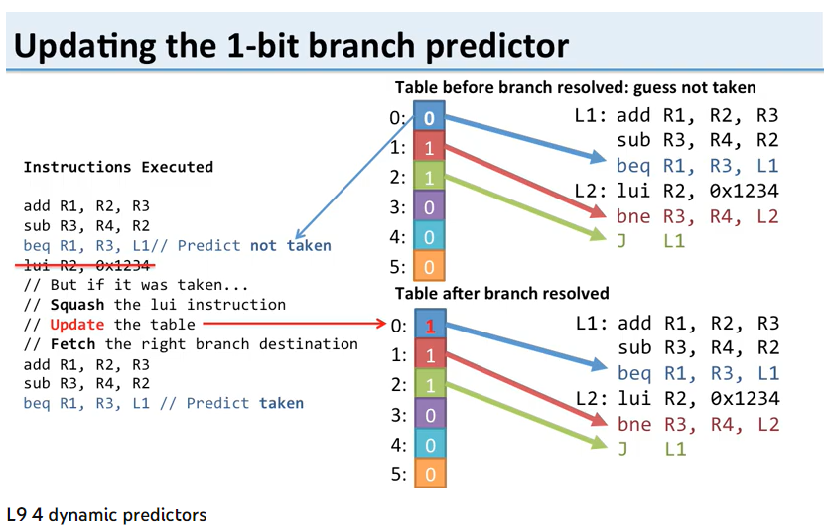
1-Bit Branch Prediction and History Table

Slide 16
2-Bit Branch Prediction

Slide 17
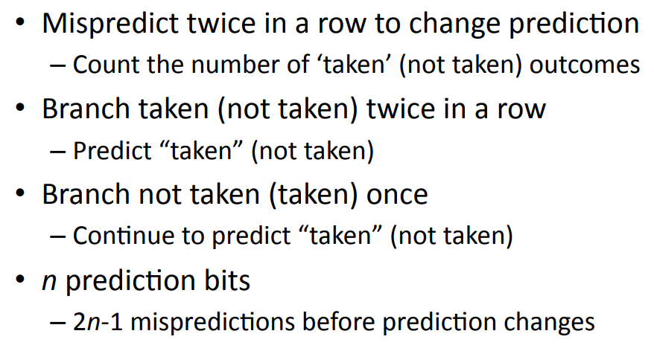
What is 2-Bit Branch Prediction?

Slide 18
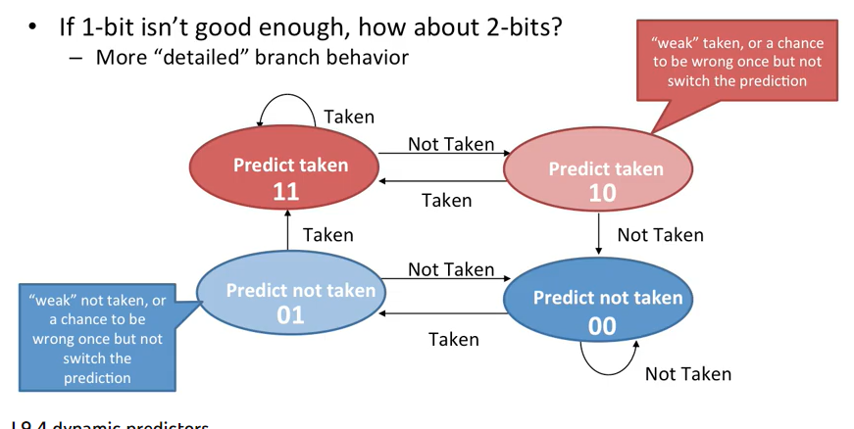
2-Bit Branch Prediction

Slide 19
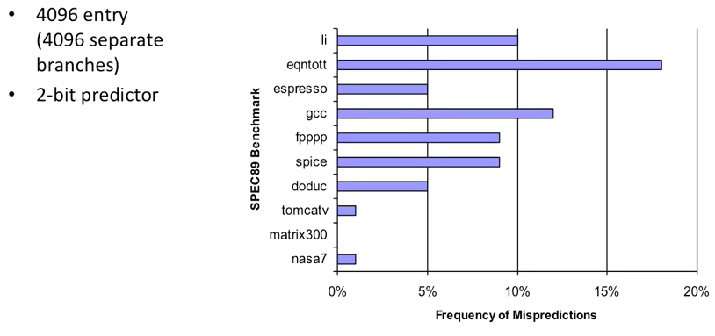
Improvement through 2-Bit Predictor using Benchmarks

Slide 20
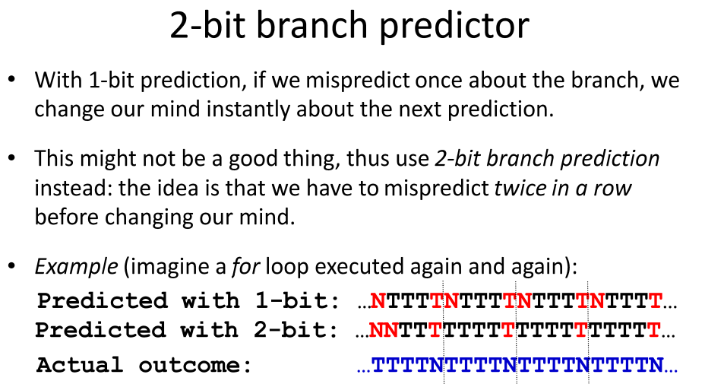
2-Bit Predictor

Slide 21
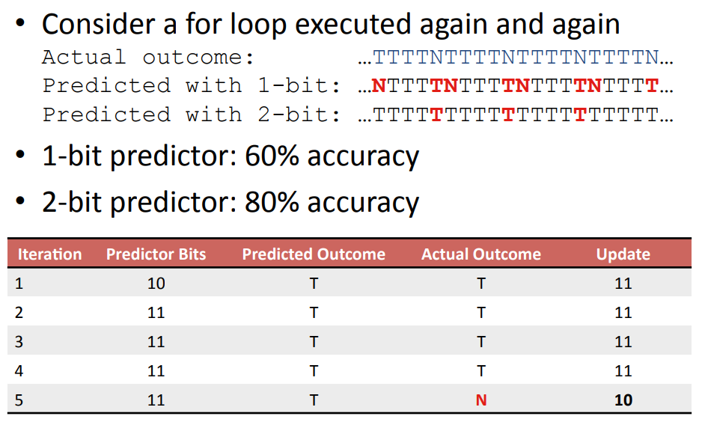
Example of 2-Bit Branch Prediction

Slide 22
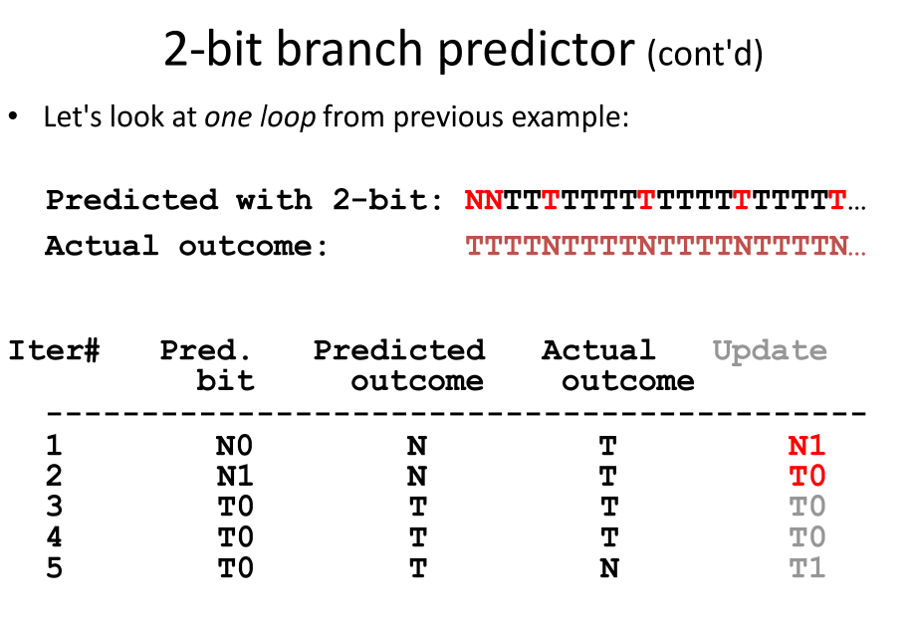
2-Bit Prediction Example

Slide 23
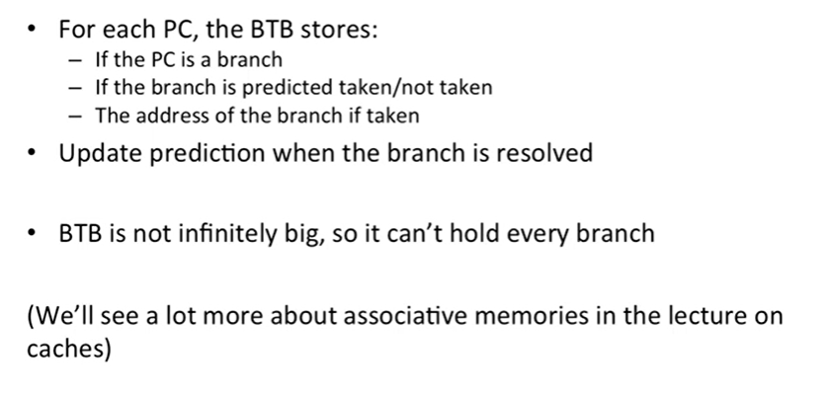
Branch Target Buffer (BTB)

Slide 24
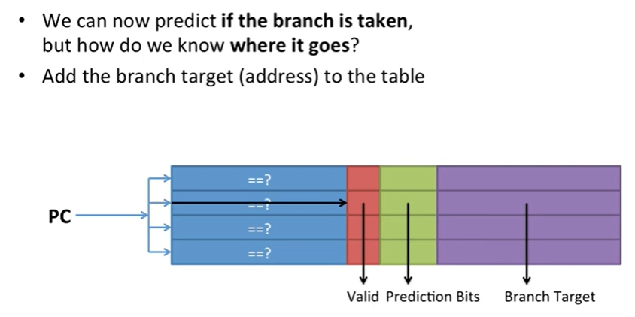
Make a Branch Target Buffer

Slide 25
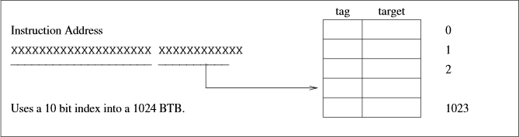
Branch Target Buffer – Advantage in ID Stage
Even if we can predict a branch will be taken, we cannot write the branch target to PC until the ID stage. Therefore, we have a 1- cycle stall on predict-taken branches.
To avoid this, we use a branch target buffer. A branch target buffer contains a tag (the higher bits of the instruction) and the target address of the branch.
If the BPB predicts the branch is taken, and the higher order bits of the instruction match the BTB tag, then we write the target to PC.

Slide 26
Branch Target Buffer Operation
Branch Target Buffer (BTB): Address of branch index to get prediction AND branch address (if taken)
– Note: must check for branch match now, since can’t use wrong branch address
Example: BTB combined with BHT
Branch PC Predicted PC
PC of instruction FETCH
=?
Extra prediction state bits
Yes: instruction is branch and use predicted PC as next PC
No: branch not
predicted, proceed normally
(Next PC = PC+4)

Slide 27
Correlating Branch Prediction

Slide 28
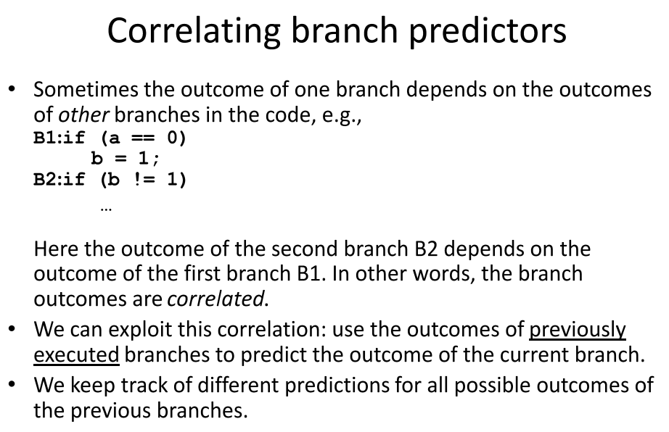
Correlating Branch Predictor

Slide 29
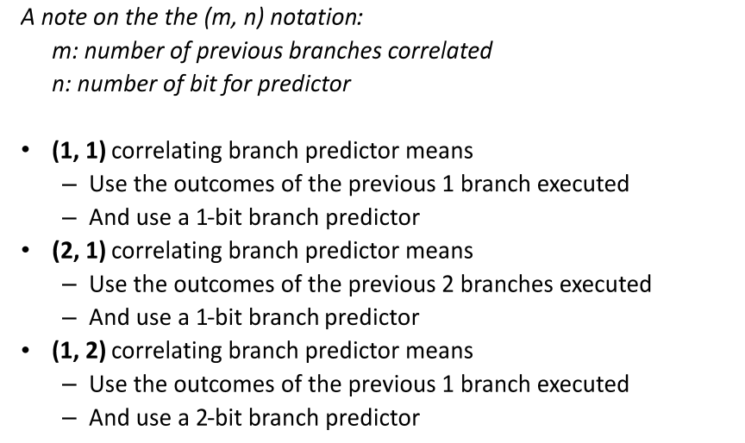
Principle of Correlating Predictor

Slide 30
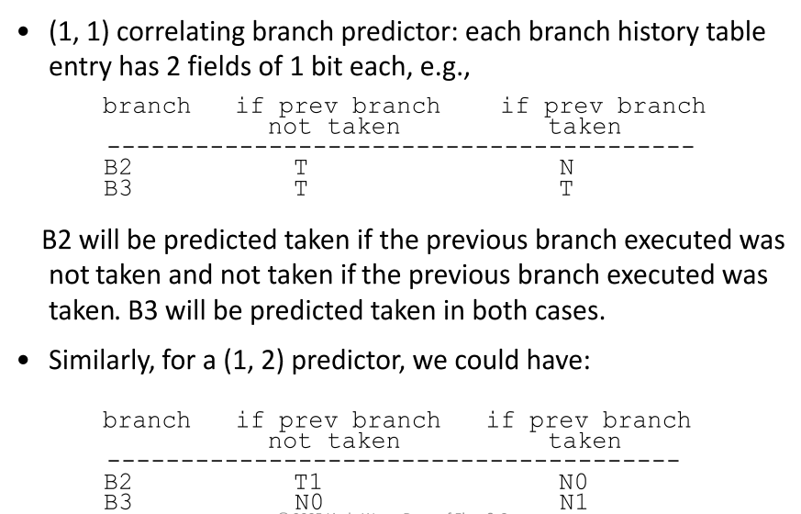
Example of Correlating Branch Predictor

Slide 31
Tournament Branch Prediction

Slide 32
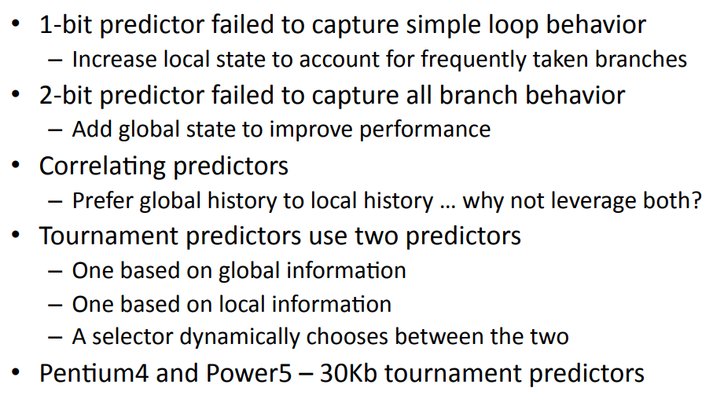
Introducing Tournament Branch Prediction

Slide 33
Tournament Branch Predictor
Chooses between a local predictor and a global predictor on a per-branch basis
Keeps a table of n-bit branch predictors indexed by the last m global branch results
Uses a table of n-bit branch predictors indexed by the last k local branch results
Uses another n-bit predictor to choose between the local and global predictors for each branch instruction

Slide 34
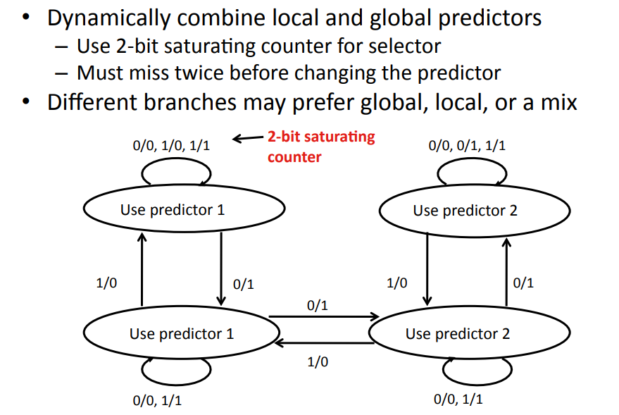
Tournament Predictor State Diagram

Slide 35
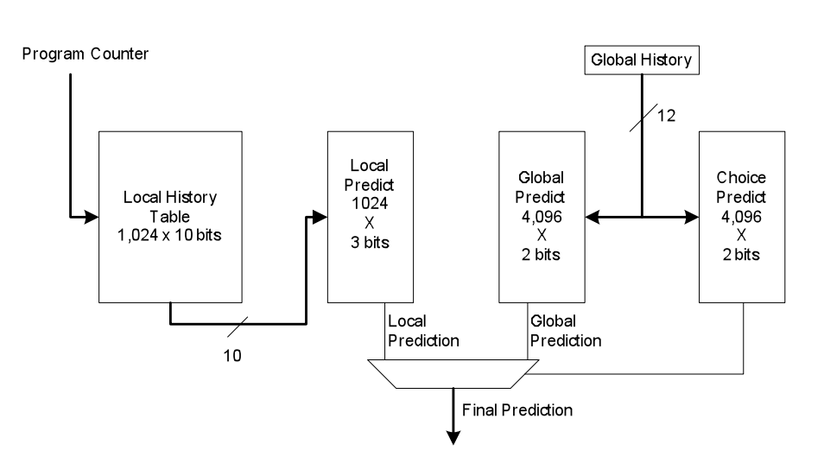
Alpha processor Tournament Predictor

Slide 36
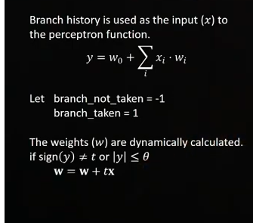
Perceptron Based Branch Prediction

Slide 37
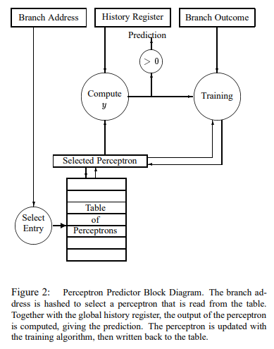
Perceptron Predictor Diagram
Ref:
Dynamic Branch Prediction with
Perceptrons
Daniel A. Jim´enez,
Calvin Lin
The University of Texas at Austin

Slide 38
Pipelining in Loop Unrolling

Slide 39
Loop Unrolling
Replicate loop body to expose more parallelism
  Reduces loop-control overhead
Use different registers per replication
  Called “register renaming”
  Avoid loop-carried “anti-dependencies”
    Store followed by a load of the same register
    Aka “name dependence”
      Reuse of a register name

Slide 40
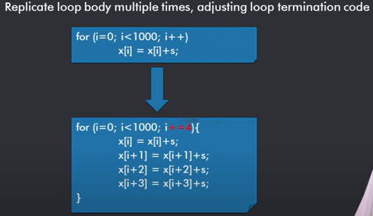
Loop Unrolling in C Code

Slide 41
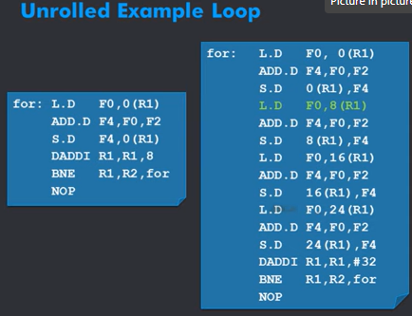
Loop Unrolled in Assembly Language

Slide 42
Another Assembly Lange E.g. Of Loop Unrolling
An Array Sum Loop
The following C code will compute the sum of the entries in a 100-entry vector A.
double arraySum = 0;
for (int i = 0; i < 100; i++) {
arraySum += A[i];
}
MIPS assembly language code initializations
The code below omits the loop initializations:
Initialize loop count ($7) to 100.
Initialize arraySum ($f10) to 0.
Initialize A[i] pointer ($5) to the base address of A.
MIPS assembly language code for Array Sum Loop
loop3:
l.d $f10, 0($5) ; $f10 ← A[i]
add.d $f8, $f8, $f10 ; $f8 ← $f8 + A[i]
addi $5, $5, 8 ; increment pointer for A[i]
addi $7, $7, -1 ; decrement loop count
test:
bgtz $7, loop3 ; Continue if loop count > 0
The addi instructions in this code are loop maintenance: advancing addresses and counting iterations.
Unrolled Assembly code on next slide

Slide 43
Unrolled Assembly Code from previous slide
The Array Sum Loop Unrolled
This is the same code with loop unrolling with a loop unrolling factor of 4.
Notice that the displacements in the loads are incremented by the compiler in the second, third, and fourth copies of the original loop body instructions. The immediate values in the addi instructions have been multiplied by 4 so that the effect of one iteration in the unrolled loop is the same as 4 iterations of the original loop.
Notice that branches and loop maintenance instructions have been reduced by a factor of 4.
loop3:
l.d $f10, 0($5) ; iteration with displacement 0
add.d $f8, $f8, $f10
l.d $f10, 8($5) ; iteration with displacement 8
add.d $f8, $f8, $f10
l.d $f10, 16($5) ; iteration with displacement 16
add.d $f8, $f8, $f10
l.d $f10, 24($5) ; iteration with displacement 24
add.d $f8, $f8, $f10
addi $5, $5, 32
addi $7, $7, -4
test:
bgtz $7, loop3 ; Continue loop if $7 > 0

Slide 44
Pipelining in Loop Unrolling
Unroll few sequential instructions by a small loop unrolling factor k.
Use instruction re-ordering and register-renaming to reduce dependencies.
Thus NOP wait will not be required within the unrolled portion of loop.

Slide 45
Loop Unrolling Example
 | ALU/branch | Load/store | cycle
Loop: | addi $s1, $s1,–16 | lw $t0, 0($s1) | 1
 | nop | lw $t1, 12($s1) | 2
 | addu $t0, $t0, $s2 | lw $t2, 8($s1) | 3
 | addu $t1, $t1, $s2 | lw $t3, 4($s1) | 4
 | addu $t2, $t2, $s2 | sw $t0, 16($s1) | 5
 | addu $t3, $t4, $s2 | sw $t1, 12($s1) | 6
 | nop | sw $t2, 8($s1) | 7
 | bne $s1, $zero, Loop | sw $t3, 4($s1) | 8
IPC = 14/8 = 1.75
  Closer to 2, but at cost of registers and code size

Slide 46
Instruction-Level Parallelism (ILP)
Pipelining: executing multiple instructions in parallel
To increase ILP
  Deeper pipeline
    Less work per stage ⇒ shorter clock cycle
  Multiple issue
    Replicate pipeline stages ⇒ multiple pipelines
    Start multiple instructions per clock cycle
    CPI < 1, so use Instructions Per Cycle (IPC)
    E.g., 4GHz 4-way multiple-issue
      16 BIPS, peak CPI = 0.25, peak IPC = 4
    But dependencies reduce this in practice

Slide 47
What is Multiple Issue?
Static multiple issue
  Compiler groups instructions to be issued together
  Packages them into “issue slots”
  Compiler detects and avoids hazards
Dynamic multiple issue
  CPU examines instruction stream and chooses instructions to issue each cycle
  Compiler can help by reordering instructions
  CPU resolves hazards using advanced techniques at runtime

Slide 48
Speculation
“Guess” what to do with an instruction
  Start operation as soon as possible
  Check whether guess was right
    If so, complete the operation
    If not, roll-back and do the right thing
Common to static and dynamic multiple issue
Examples
  Speculate on branch outcome
    Roll back if path taken is different
  Speculate on load
    Roll back if location is updated

Slide 49
Compiler/Hardware Speculation
Compiler can reorder instructions
  e.g., move load before branch
  Can include “fix-up” instructions to recover from incorrect guess
Hardware can look ahead for instructions to execute
  Buffer results until it determines they are actually needed
  Flush buffers on incorrect speculation

Slide 50
Speculation and Exceptions
What if exception occurs on a speculatively executed instruction?
  e.g., speculative load before null-pointer check
Static speculation
  Can add ISA support for deferring exceptions
Dynamic speculation
  Can buffer exceptions until instruction completion (which may not occur)

Slide 51
Exceptions in a Pipeline
Another form of control hazard
Consider overflow on add in EX stage
  add $1, $2, $1
  Prevent $1 from being clobbered
  Complete previous instructions
  Flush add and subsequent instructions
  Set Cause and EPC register values
  Transfer control to handler
Similar to mispredicted branch
  Use much of the same hardware

Slide 52
Exception Properties
Restartable exceptions
  Pipeline can flush the instruction
  Handler executes, then returns to the instruction
    Refetched and executed from scratch
PC saved in EPC register
  Identifies causing instruction
  Actually PC + 4 is saved
    Handler must adjust

Slide 53
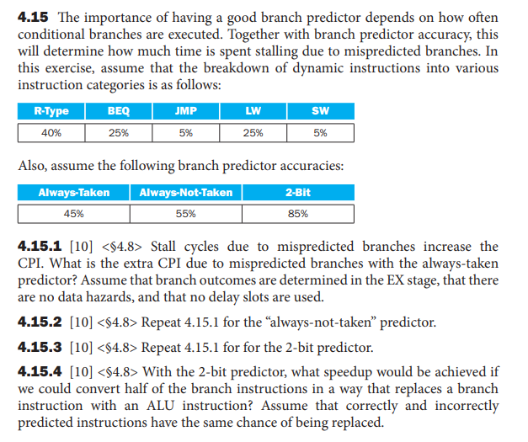
Example Questions - 1

Slide 54
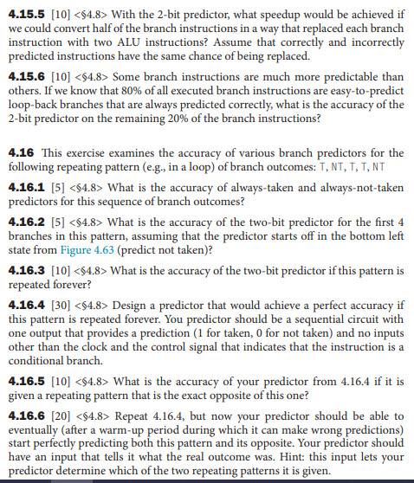
Example Questions - 2

Slide 55
Readings
Chap 4 of P&H Textbook
Examples from Tutorial 5 Exceptions Branch Prediction, McGill University

