Slide 1
CS/EE 320 Computer Organization and Assembly Language Spring 2025
Lecture 6
Shahid Masud

Slide 2
Topics
Identify Assembly Language Instruction from Machine code
Register files and Memory Access
Addressing Constraints in R and I Type MIPS Instructions
Calculating Addresses in Different types of Instructions
Some Examples of Converting Assembly to Machine Code and vice versa
Quiz 1 Today

Slide 3
Walking through Program Execution
Current
Instruction
Current Instruction (IR)
Read
Instruction
 | Memory
0 | Load r0
1 | Program
2 | program
3 | …..
4 | …..
5
6
7
Next
Instruction
What does the processor do?
Load the instruction from memory
Determine what operation to perform
Find out where the data is located
Perform the operation
Determine the next instruction
Repeat this process over and over
 | Register File
0 | R0
1 | R1
2 | R2 ……
3 | 32 registers
Control
If/Else/
loop
Which Data
To use
Read/Write
Data
Result
ALU
Compute, Logical
Operation

Slide 4
Register Convention in MIPS Assembly
Register No. | Name | Usage
0 | $zero | Constant Value 0
1 | $at | Reserved for Assembler use
2 – 3 | $v0 - $v1 | Values for results and expression evaluation
4 – 7 | $a0 - $a3 | arguments
8 – 15 | $t0 - $t7 | Temporary storage
16 – 23 | $s0 – Ss7 | Saved
24 – 25 | $t8 - $t9 | More temporary storage
28 | $gp | Global pointer
29 | $sp | Stack pointer
30 | $fp | Frame pointer
31 | $ra | Return address
Few Special Registers:
PC (Program Counter)
Hi and Lo results of
Multiplication
FP Floating Point
Control Registers for
Error and Exception Status

Slide 5
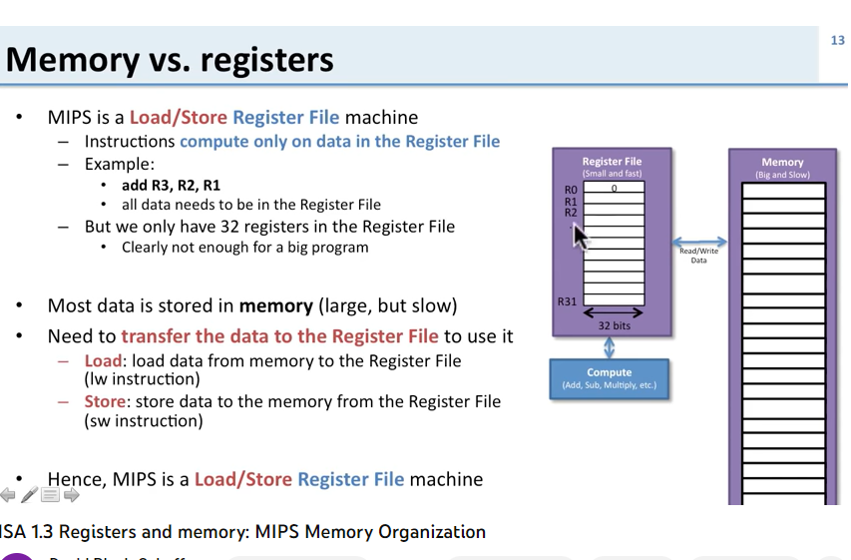
Load / Store Architecture
Memory (RAM)
(big and slow)
Register File
(small and fast)
Loc | data
0 | Byte 0
1 | Byte 1
2 | Byte 2
3 | Byte 3
4 | Byte 4
… | ….
ff… | Byte ff….
R0 | 0
R1
R2
…
R31
Read /
Write
32 bits
Compute in ALU
(Add, Sub, Mult, Div)

Slide 6
Register File and Memory Access in MIPS
MIPS is Characterized by Load Store Architecture
MIPS has a Word Aligned Memory Access
MIPS has a ‘Big Endian’ Register to Memory transfer

Slide 7
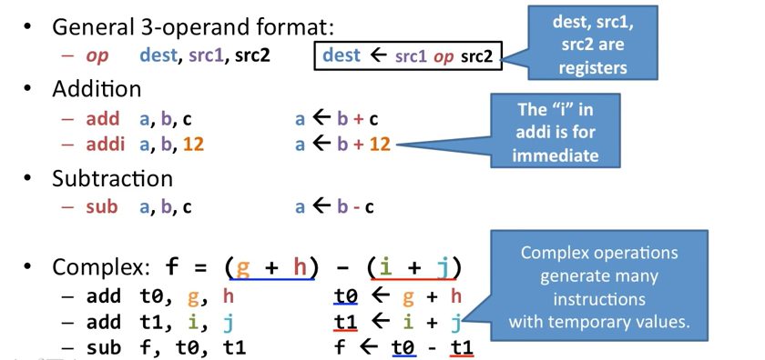
Starting with MIPS Instructions

Slide 8
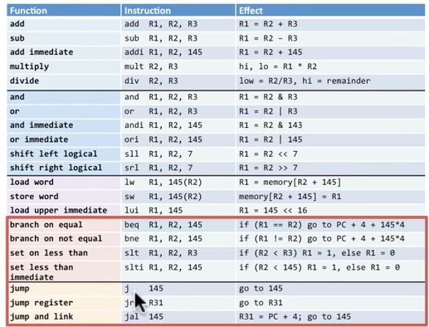
Three main types of MIPS Instructions
Data Operations
Arithmetic (add, sub, …)
Logical (and, nor, xor, …)
Data Transfer
Load (mem to reg, …)
Store (reg to mem, …)
Sequencing / Control
Branch (conditional, =0, …)
Jump (unconditional, …)

Slide 9
MIPS R Format Instructions
op
rs
rt
rd
shamt
funct
6 bits
5 bits
5 bits
5 bits
5 bits
6 bits
Instruction fields
  op: operation code (opcode)
  rs: first source register number
  rt: second source register number
  rd: destination register number
  shamt: shift amount
  funct: function code (extends opcode)

Slide 10
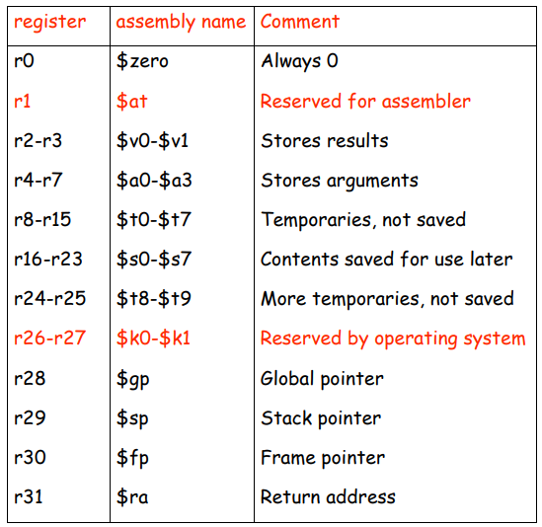
Register numbering for
R type instructions

Slide 11
R Format Instruction Example
op
rs
rt
rd
shamt
funct
6 bits
5 bits
5 bits
5 bits
5 bits
6 bits
add $t0, $s1, $s2
special
$s1
$s2
$t0
0
add
0
17
18
8
0
32
000000
10001
10010
01000
00000
100000
00000010001100100100000000100000₂ = 02324020₁₆

Slide 12
Dealing with Constant Values
E.g., program has variables x=1, y=4, f=3, etc.
First way: First load all constants into registers:
  Not so many registers
  Instructions Cycles are wasted
Second way: Use ‘i’ instructions such as addi, subi where a constant can be made part of instruction:
E.g. addi R29, R29, 4
But R type instructions do not have so many bits in each field
Solution: Use I type instructions with immediate data value

Slide 13
Some examples of R type instructions from MIPS reference sheet

Slide 14
MIPS I-format Instructions
op
rs
rt
constant or address
6 bits
5 bits
5 bits
16 bits
Immediate arithmetic and load/store instructions
  rt: destination or source register number
  Constant: –2¹⁵ to +2¹⁵ – 1
  Address: offset added to base address in rs

Slide 15
I Type MIPS Instruction Example
Instructions with Immediate Data Type
Example: Determine Machine code for this
Assembly Language Instruction:
lw $t0, 1002($s2) ; load word into $t0
op | rs | rt | 16 bit constant offset
100011 | 10010 | 01000 | 0000001111101010
Control module in CPU tells the ALU to take first operand from Register file and the
second operand from the Instruction (available in IR register)
The 16 bit Offset in I type instructions can refer to ‘Data’ or ‘Address’. Both are treated
separately

Slide 16
Logical Operations
Instructions for bitwise manipulation
Operation | C | Java | MIPS
Shift left | << | << | sll
Shift right | >> | >>> | srl
Bitwise AND | & | & | and, andi
Bitwise OR | | | | | or, ori
Bitwise NOT | ~ | ~ | nor
Useful for extracting and inserting groups of bits in a word

Slide 17
Shift Operations
op
rs
rt
rd
shamt
funct
6 bits
5 bits
5 bits
5 bits
5 bits
6 bits
shamt: how many positions to shift
Shift left logical
  Shift left and fill with 0 bits
  sll by i bits multiplies by 2^{i}
Shift right logical
  Shift right and fill with 0 bits
  srl by i bits divides by 2^{i} (unsigned only)

Slide 18
AND Operations
Useful to mask bits in a word
  Select some bits, clear others to 0
and $t0, $t1, $t2
$t2
0000 0000 0000 0000 0000 1101 1100 0000
$t1
0000 0000 0000 0000 0011 1100 0000 0000
$t0
0000 0000 0000 0000 0000 1100 0000 0000

Slide 19
OR Operations
Useful to include bits in a word
  Set some bits to 1, leave others unchanged
or $t0, $t1, $t2
$t2
0000 0000 0000 0000 0000 1101 1100 0000
$t1
0000 0000 0000 0000 0011 1100 0000 0000
$t0
0000 0000 0000 0000 0011 1101 1100 0000

Slide 20
NOT Operations
Useful to invert bits in a word
  Change 0 to 1, and 1 to 0
MIPS has NOR 3-operand instruction
  a NOR b == NOT ( a OR b )
nor $t0, $t1, $zero
Register 0: always read as zero
$t1
0000 0000 0000 0000 0011 1100 0000 0000
$t0
1111 1111 1111 1111 1100 0011 1111 1111

Slide 21
Evaluating PC from Immediate Address
The address provided by Jump Instruction can be ‘26 bits’
The address provided by Branch (bne, beq) Instruction can be ‘16 bits’
But all registers and memory addresses are 32 bits: So,
Branch
Jump
Current 32 bit PC
Current 32 bit PC
+ 4
26 bit Immediate
00
Sign Extend
16 bit Immediate
00
= Next 32 bit PC
00
= Next 32 bit PC
00

Slide 22
MIPS Instruction Formats Summary
Name | Fields |  |  |  |  |  | Comments
Field Size | 6 bits | 5 bits | 5 bits | 5 bits | 5 bits | 6 bits | All instr are 32 bits long
R Format | op | rs | rt | rd | shamt | funct | Arithmetic Instructions
I Format | Op | rs | rt | Address / Immediate |  |  | Transfer, Branch Instructions
J Format | Op | Target address |  |  |  |  | Jump Instructions

Slide 23
Converting Machine Code to Assembly
What is the Assembly Language corresponding to this machine code instruction:
00 af 80 20 Hex
Step 1: Find the Operation fields to determine R, I or J type instruction
First 6 bits from MSB side are all ‘000000’ hence this is R type instruction
Bits 5 – 3 are ‘100’ and bits 2 – 0 are ‘000’
Look up the Funct field in instructions, this is an ‘add’ instruction
Value in rs field is ‘5’, rt field is ‘15’ and rd field is ‘16’
This corresponds to registers ‘$a1’, ‘$t7’ and ‘$s0’ in register file; Verify from table
=> full assembly language instruction is:
add $s0, $a1, $t7; Check register numbering from the table
op | rs | rt | rd | shamt | funct
000000 | 00101 | 01111 | 10000 | 00000 | 100000

Slide 24
Readings
Chapter 2 of P&H Textbook

