Slide 1
CS / EE 320
Computer Organization and Assembly Language
Spring 2025
Lecture 12
Shahid Masud
Topics: Floating Point Arithmetic operations, Hardware Design for Floating Point Arithmetic, MIPS and Floating Point, Rounding and Truncation Operations

Slide 2
Topics
Maintaining Precision through Guard, Round and Sticky (GRS) bits
Arithmetic (Add, Sub, Mul, Div) in FP
Examples of FP Add, Mult process
Floating Point Arithmetic in Hardware
MIPS Provisions for Floating Point Operations
QUIZ 3
NEXT WEEK

Slide 3
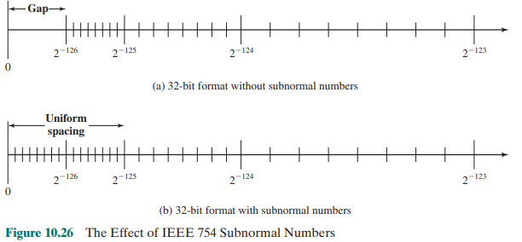
Subnormal or Denormal Numbers

Slide 4

IEEE 754 Floating-Point Representation
Single Precision IEEE 754
Sign | Exponent | Fraction
1 bit | 8 bits | 23 bits
G R S
Guard Bits
32 bits
For Accuracy
Double Precision IEEE 754
Sign | Exponent | Fraction
1 bit | 11 bits | 52 bits
G R S
Guard Bits
64 bits

Slide 5
Accurate Arithmetic
IEEE Std 754 specifies additional rounding control
  Extra bits of precision (guard, round, sticky)
  Choice of rounding modes
  Allows programmer to fine-tune numerical behavior of a computation
Not all FP units implement all options
  Most programming languages and FP libraries just use defaults
Trade-off between hardware complexity, performance, and market requirements

Slide 6
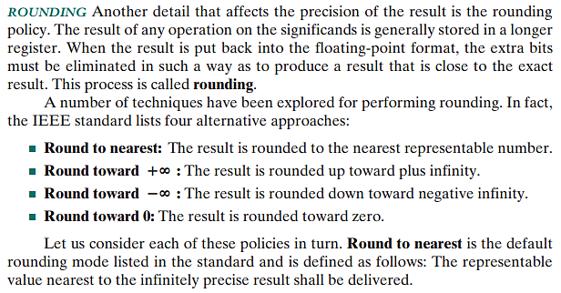
Rounding Policy

Slide 7
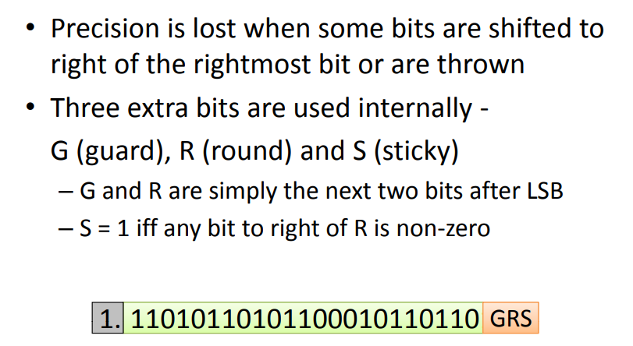
Accuracy in Floating-Point

Slide 8
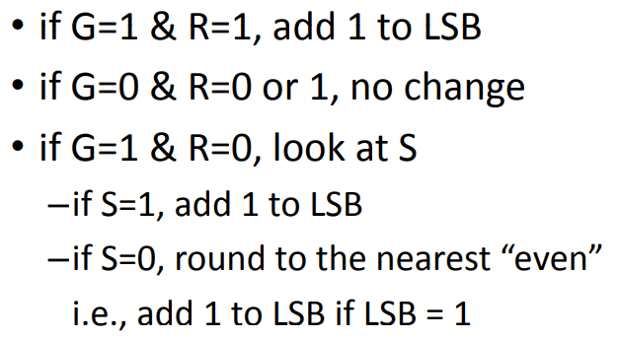
Rounding Scheme in Floating-Point

Slide 9
Another view of Rounding Scheme
G Guard | R Round | S Sticky | Rounding Applied
0 | 0 | 0 | Truncate
0 | 0 | 1 | Truncate
0 | 1 | 0 | Truncate
0 | 1 | 1 | Truncate
1 | 0 | 0 | Round to Even
1 | 0 | 1 | Round Up
1 | 1 | 0 | Round Up
1 | 1 | 1 | Round Up
S = OR (All bits in S and to the right of S)
Round to Even:
If S = 0, do nothing
If S = 1, add +1

Slide 10
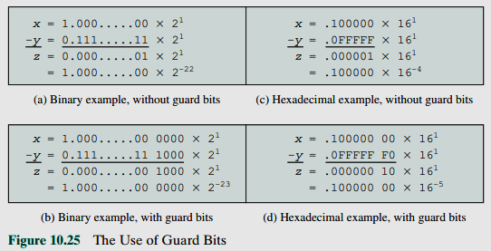
The Use of Guard Bits

Slide 11
Floating-Point Arithmetic – Basics
N=(-1)^{S} x (1+F)x2E
A signed-magnitude system for the fractional part and a biased notation for the exponent
Three subfields
  Sign S
  Fraction F (or Significand or Mantissa)
  Exponent E
Sign bit is 0 for positive numbers, 1 for negative numbers
Fractions always start from 1.xxxx, hence the integer 1 is not written (register has xxxx)
Exponent is biased by +127 (add 127 to whatever is in register bits)
Normalize: Express numbers is the standard format by shifting of bits and
adding / subtracting from Exponent register

Slide 12
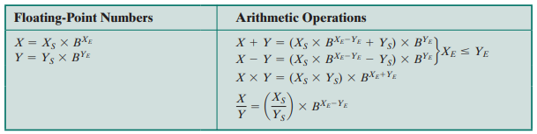
Floating-Point Arithmetic Operations

Slide 13
Floating-Point Addition – Decimal example
Consider a 4-digit decimal example
  9.999 × 10¹ + 1.610 × 10^{–1}
1. Align decimal points
  Shift number with smaller exponent
  9.999 × 10¹ + 0.016 × 10¹
2. Add significands
  9.999 × 10¹ + 0.016 × 10¹ = 10.015 × 10¹
3. Normalize result & check for over/underflow
  1.0015 × 10²
4. Round and renormalize if necessary
  1.002 × 10²

Slide 14
Floating-Point Addition – Binary example
Consider a 4-digit binary example
  1.000₂ × 2^{–1} + –1.110₂ × 2^{–2} (0.5 + –0.4375)
1. Align binary points
  Shift number with smaller exponent
  1.000₂ × 2^{–1} + –0.111₂ × 2^{–1}
2. Add significands
  1.000₂ × 2^{–1} + –0.111₂ × 2–1 = 0.001₂ × 2^{–1}
3. Normalize result & check for over/underflow
  1.000₂ × 2^{–4}, with no over/underflow
4. Round and renormalize if necessary
  1.000₂ × 2^{–4} (no change) = 0.0625

Slide 15
FP Arithmetic Add / Subtract
Check for zeros
Align significands (adjusting exponents)
Add or subtract significands
Normalize result

Slide 16
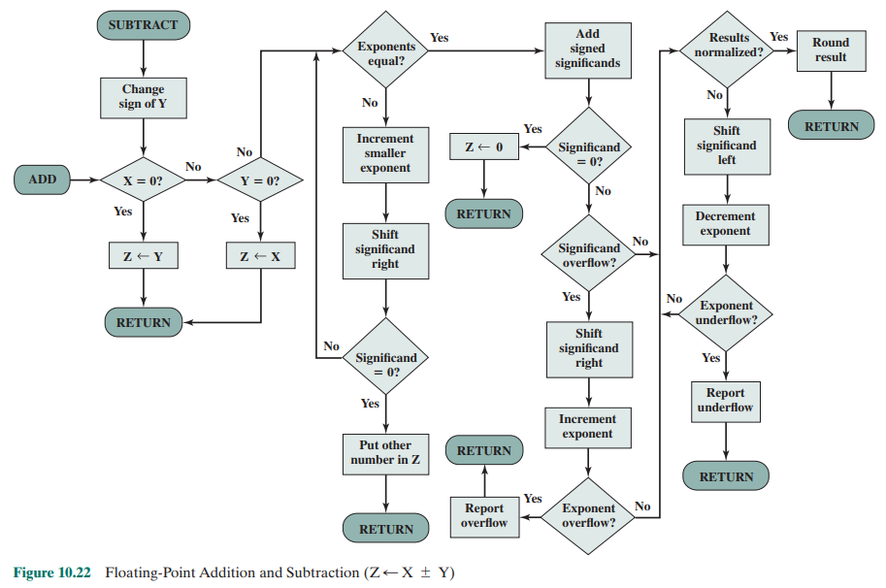
Floating-Point Adder Flowchart

Slide 17
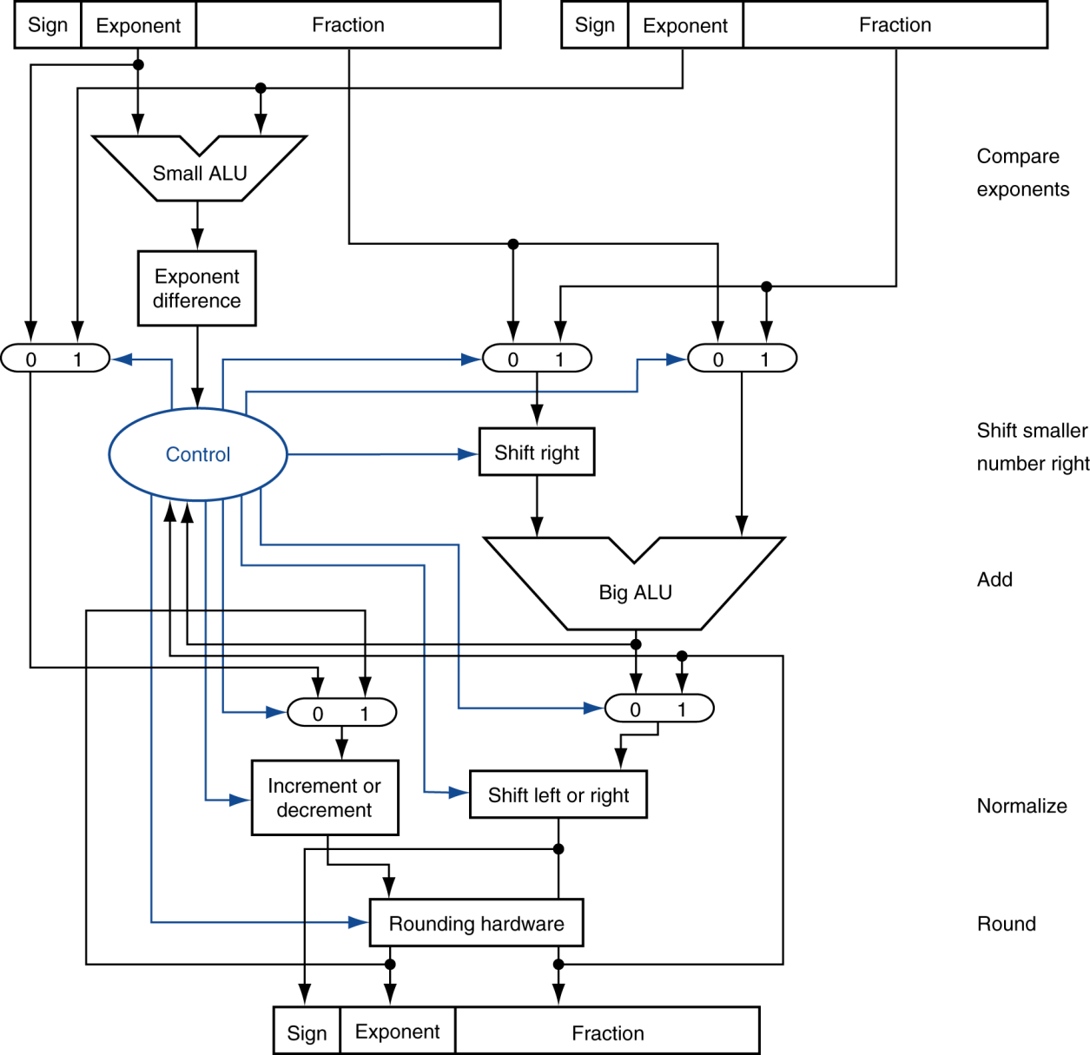
FP Adder Hardware
Step 1
Step 2
Step 3
Step 4

Slide 18
Floating-Point Multiplication
Consider two floating point numbers:
(F₁ x 2^{E1}) and (F₂ x 2^{E2})
The product of these two numbers is:
= (F₁ x 2^{E1}) x (F₂ x 2^{E2})
= (F₁ x F₂) x 2^{(E1+E2)}
= F x 2E
Sign of result depends on Sign of the two numbers

Slide 19
FP Arithmetic Multiply / Divide
Check for zero
Add/subtract exponents
Multiply/divide significands (watch sign)
Normalize
Round
All intermediate results should be in double length storage

Slide 20
Floating-Point Multiplication – Decimal example
Consider a 4-digit decimal example
  1.110 × 10¹⁰ × 9.200 × 10^{–5}
1. Add exponents
  For biased exponents, subtract bias from sum
  New exponent = 10 + –5 = 5
2. Multiply significands
  1.110 × 9.200 = 10.212 ⇒ 10.212 × 10⁵
3. Normalize result & check for over/underflow
  1.0212 × 10⁶
4. Round and renormalize if necessary
  1.021 × 10⁶
5. Determine sign of result from signs of operands
  +1.021 × 10⁶

Slide 21
Floating-Point Multiplication – Binary example
Consider a 4-digit binary example
  1.000₂ × 2^{–1} × –1.110₂ × 2^{–2} (0.5 × –0.4375)
1. Add exponents
  Unbiased: –1 + –2 = –3
  Biased: (–1 + 127) + (–2 + 127) = –3 + 254 – 127 = –3 + 127
2. Multiply significands
  1.000₂ × 1.110₂ = 1.1102 ⇒ 1.110₂ × 2^{–3}
3. Normalize result & check for over/underflow
  1.110₂ × 2^{–3} (no change) with no over/underflow
4. Round and renormalize if necessary
  1.110₂ × 2^{–3} (no change)
5. Determine sign: +ve × –ve ⇒ –ve
  –1.110₂ × 2^{–3} = –0.21875

Slide 22
Floating-Point Multiplication Steps
Normalize the two numbers if not done already
The exponents of the Multiplier (E1) and the multiplicand (E2) bits are added and the base value is subtracted from the added result. The subtracted result is put in the exponential field of the result block → E1+E2-bias
Multiply the two fractions (or significands)
S1, the signed bit of the multiplicand is XOR'd with the multiplier signed bit of S2. The result is put into the resultant sign bit.
The mantissa of the Multiplier (M1) and multiplicand (M2) are multiplied and the result is placed in the resultant field of the mantissa (truncate/round the result for 24 bits) → M1 * M2
If the product is 0, adjust the proper representation of answer to 0
If the product fraction is too big, normalize by shifting it right and incrementing the exponent
If the product fraction is too small, normalize by shifting left and decrementing the exponent
Round to appropriate number of bits. If rounding results in loss of normalization, then first normalize and then do the rounding
If an exponent underflow (below -127) or overflow (above +127) occurs then generate an error condition

Slide 23
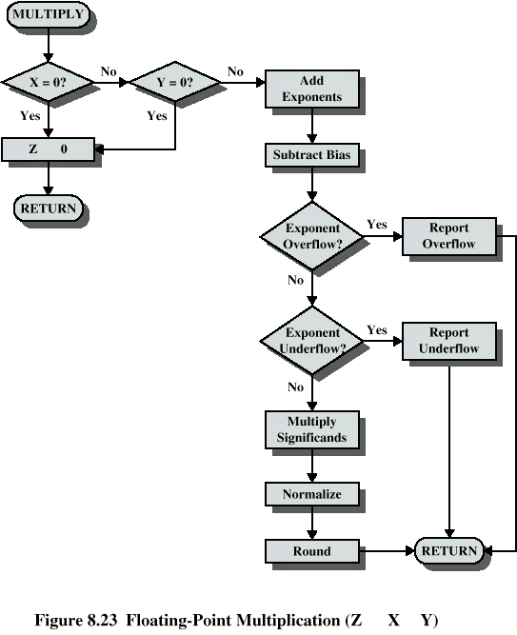
Floating-Point
Multiplication

Slide 24
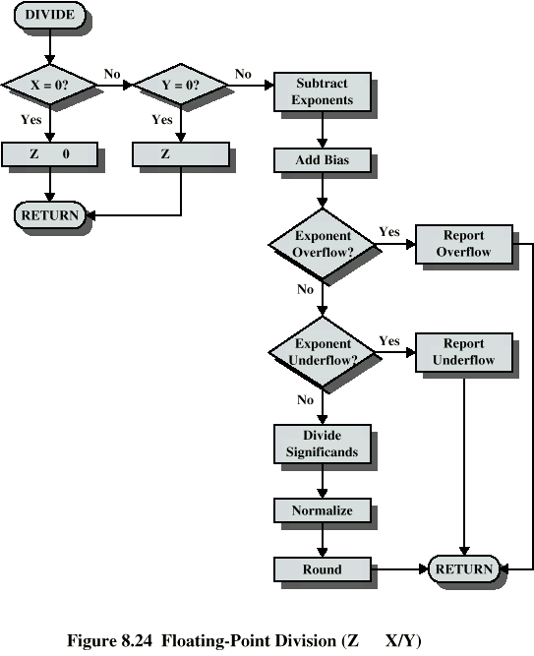
Floating-Point
Division

Slide 25
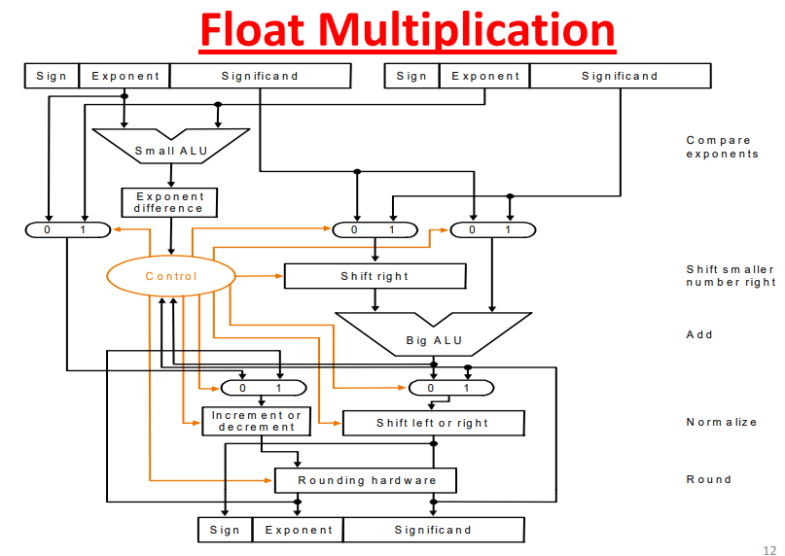
Floating-Point Multiplication Hardware

Slide 26
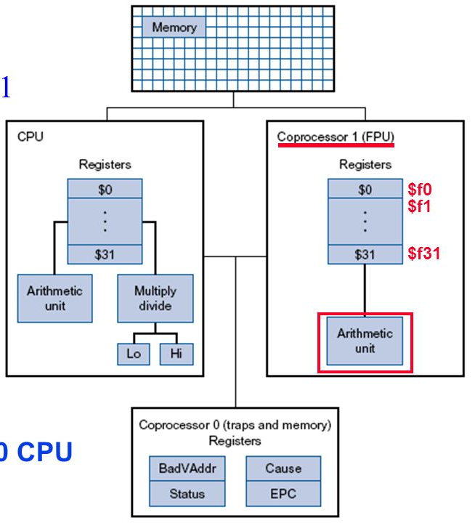
MIPS CPU Organization viz Floating-Point

Slide 27
FP Support in MIPS Assembly
FP hardware is coprocessor 1
  Adjunct processor that extends the ISA
Separate FP registers
  32 single-precision: $f0, $f1, … $f31
  Paired for double-precision: $f0/$f1, $f2/$f3, …
    Release 2 of MIPs ISA supports 32 × 64-bit FP registers
FP instructions operate only on FP registers
  Programs generally don’t do integer ops on FP data, or vice versa
  More registers with minimal code-size impact
FP load and store instructions
  lwc1, ldc1, swc1, sdc1
    e.g., ldc1 $f8, 32($sp)

Slide 28
FP Instructions in MIPS
Single-precision arithmetic
  add.s, sub.s, mul.s, div.s
    e.g., add.s $f0, $f1, $f6
Double-precision arithmetic
  add.d, sub.d, mul.d, div.d
    e.g., mul.d $f4, $f4, $f6
Single- and double-precision comparison
  c.xx.s, c.xx.d (xx is eq, lt, le, …)
  Sets or clears FP condition-code bit
    e.g. c.lt.s $f3, $f4
Branch on FP condition code true or false
  bc1t, bc1f
    e.g., bc1t TargetLabel

Slide 29
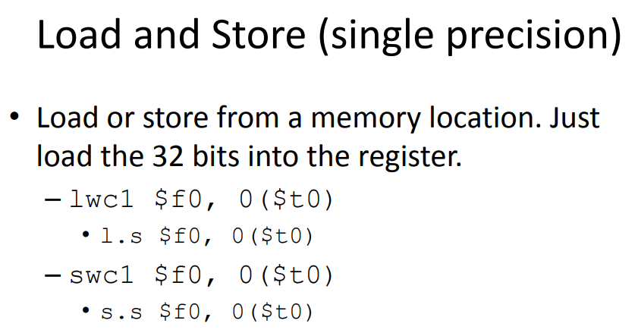
Load / Store in Floating-Point

Slide 30
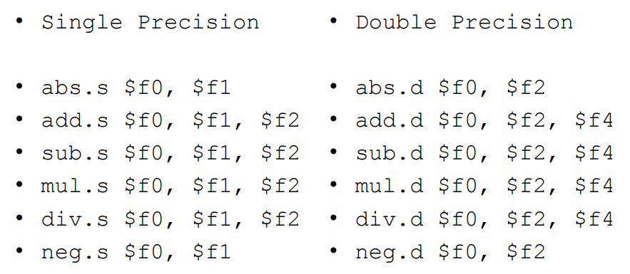
Single and Double Precision FP Arithmetic

Slide 31
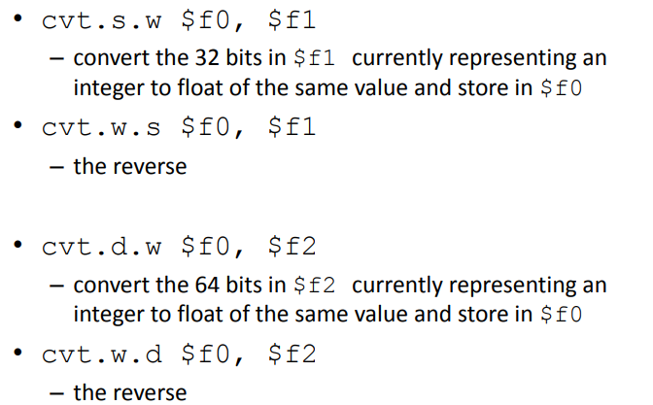
Convert to / from Floating-Point to Integer

Slide 32
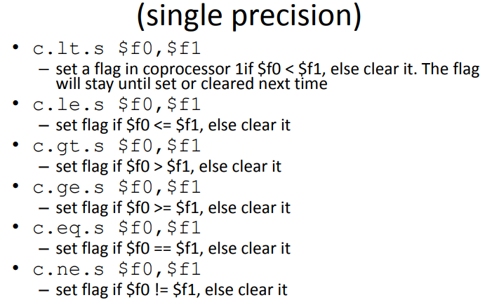
Comparison Instruction in FP

Slide 33
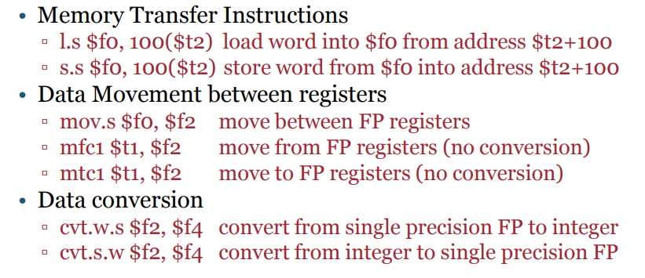
Data Movement in Floating-Point

Slide 34
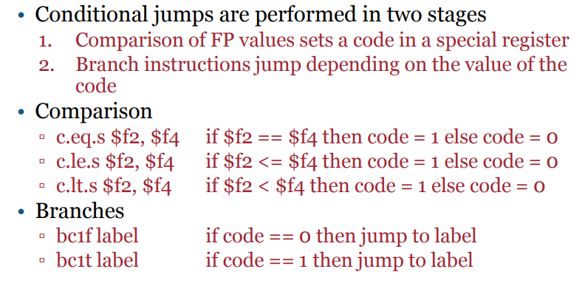
Conditional Branch in Floating-Point

Slide 35
FP Example: °F to °C
C code:
float f2c (float fahr) {
return ((5.0/9.0)*(fahr - 32.0));
}
  fahr in $f12, result in $f0, literals in global memory space
Compiled MIPS code:
f2c: lwc1 $f16, const5($gp)
lwc2 $f18, const9($gp)
div.s $f16, $f16, $f18
lwc1 $f18, const32($gp)
sub.s $f18, $f12, $f18
mul.s $f0, $f16, $f18
jr $ra

Slide 36
FP Example: Array Multiplication
X = X + Y × Z
  All 32 × 32 matrices, 64-bit double-precision elements
C code:
void mm (double x[][],
double y[][], double z[][]) {
int i, j, k;
for (i = 0; i! = 32; i = i + 1)
for (j = 0; j! = 32; j = j + 1)
for (k = 0; k! = 32; k = k + 1)
x[i][j] = x[i][j]
+ y[i][k] * z[k][j];
}
  Addresses of x, y, z in $a0, $a1, $a2, and
  i, j, k in $s0, $s1, $s2

Slide 37
FP Example: Array Multiplication
…
sll $t0, $s0, 5 # $t0 = i*32 (size of row of y)
addu $t0, $t0, $s2 # $t0 = i*size(row) + k
sll $t0, $t0, 3 # $t0 = byte offset of [i][k]
addu $t0, $a1, $t0 # $t0 = byte address of y[i][k]
l.d $f18, 0($t0) # $f18 = 8 bytes of y[i][k]
mul.d $f16, $f18, $f16 # $f16 = y[i][k] * z[k][j]
add.d $f4, $f4, $f16 # f4=x[i][j] + y[i][k]*z[k][j]
addiu $s2, $s2, 1 # $k k + 1
bne $s2, $t1, L3 # if (k != 32) go to L3
s.d $f4, 0($t2) # x[i][j] = $f4
addiu $s1, $s1, 1 # $j = j + 1
bne $s1, $t1, L2 # if (j != 32) go to L2
addiu $s0, $s0, 1 # $i = i + 1
bne $s0, $t1, L1 # if (i != 32) go to L1

Slide 38
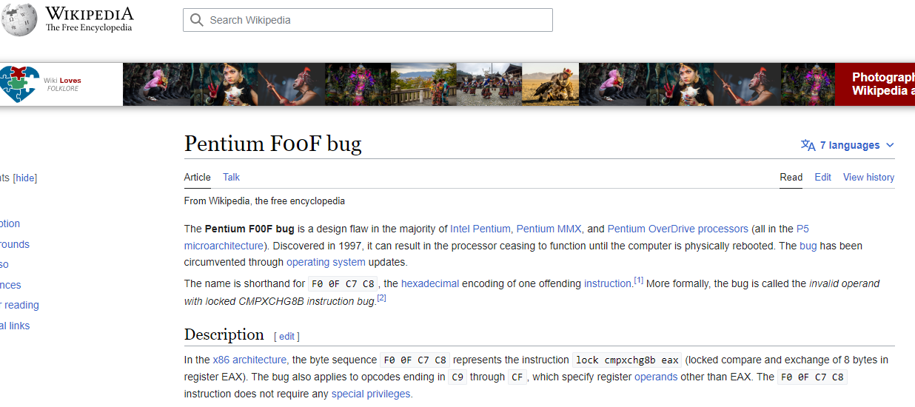
Floating-Point Bug F00F

Slide 39
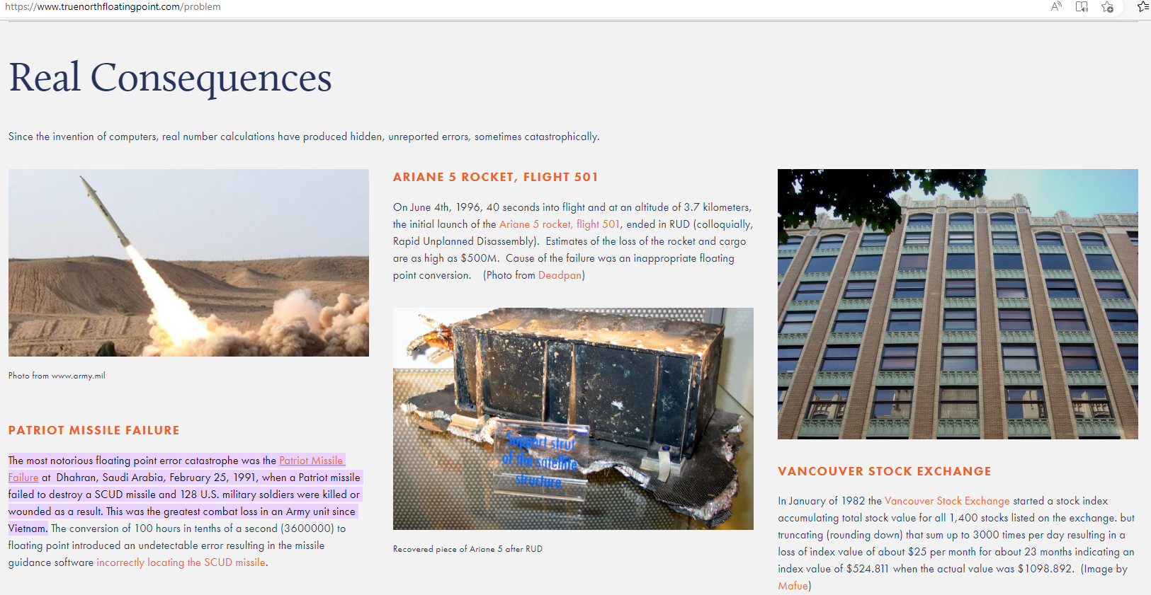
Big News around Floating-Point Errors

Slide 40

MaverickCrunch Problems due to Floating-Point

Slide 41
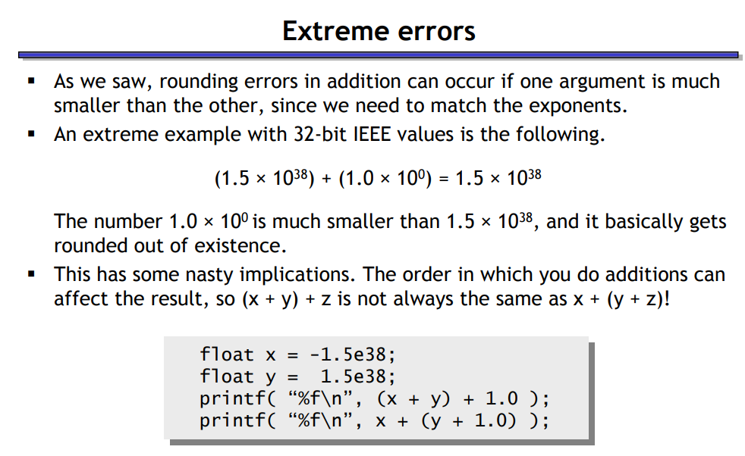
Extreme Multiplication Errors in FP

Slide 42
Readings
Chapter 3, P&H Textbook

