Slide 1
Lecture 3
Computer Organization and Assembly Language CS/EE 320
Shahid Masud
Spring 2025

Slide 2
Topics
Computer Performance Measurement Techniques
  Power Dissipation
  Execution Time
  CPI
  MIPS
  FLOPS
  Amdahl’s Law (parallel and multicore - next lecture)
  SPEC Benchmarks

Slide 3
Von-Neumann ? Computer Architecture
Stored Program concept
Main memory stores programs and data
ALU operating on binary data
Control unit interpreting instructions from memory and executing
Input and output equipment is operated by
control unit
Program is sequentially accessed from memory
Von-Neumann Stored Program Architecture
CPU
(ALU, Registers, Control)
Memory
Hierarchy
Input
and
Output
Addr Bus
Data Bus
Control

Slide 4
Clock in Computer
CPU
Clock
Computer
Clock
Memory
Clock
Time Period in seconds (ms, us, ns)
Clock frequency in Hz (MHz, GHz)
Clock rate in Clock Ticks per second
Synchronous
Digital Systems
Peripheral
Clock

Slide 5
Power Dissipation as Measure of Performance

Slide 6
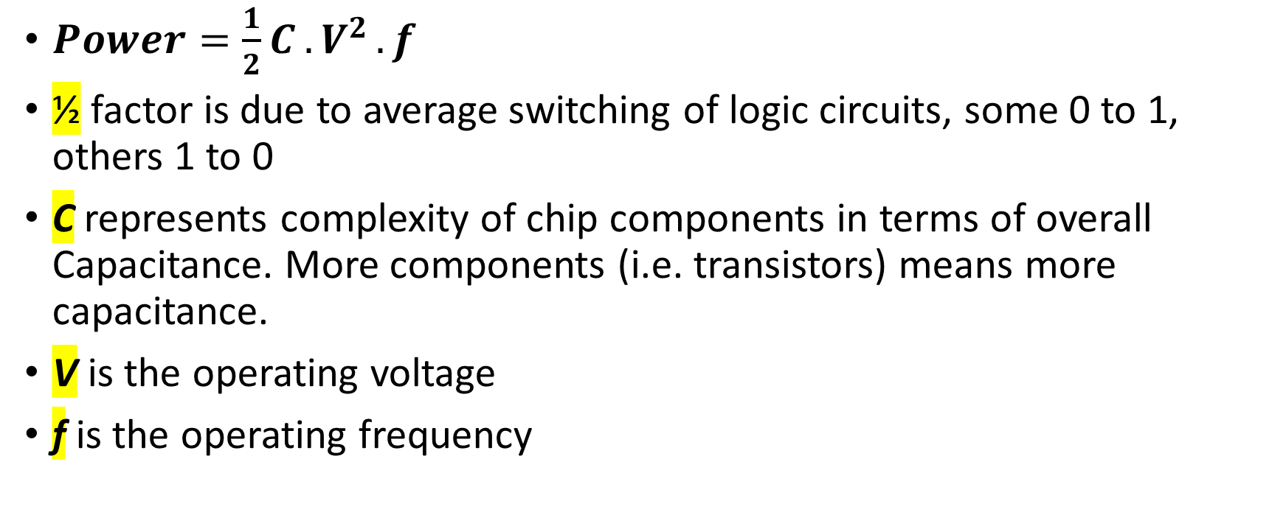
Power Dissipation in Digital Systems
$Power={\frac{1}{2}C}^{ }{.V}^{2}.f$
½ factor is due to average switching of logic circuits, some 0 to 1, others 1 to 0
C represents complexity of chip components in terms of overall Capacitance. More components (i.e. transistors) means more capacitance.
V is the operating voltage
f is the operating frequency

Slide 7

Low Power at Idle
Look back at i7 power benchmark for PC/Laptop
  At 100% load: 258W
  At 50% load: 170W (66%)
  At 10% load: 121W (47%)
Google data center
  Mostly operates at 10% – 50% load
  At 100% load less than 1% of the time
Design processors to make power proportional to load
Range

Slide 8
Execution Time as Measure of Performance

Slide 9
Computer Performance - What do we want to measure?
Execution Time, for User Specific Computing
Number of jobs / tasks completed per unit time, for warehouse or server class computing - Throughput

Slide 10
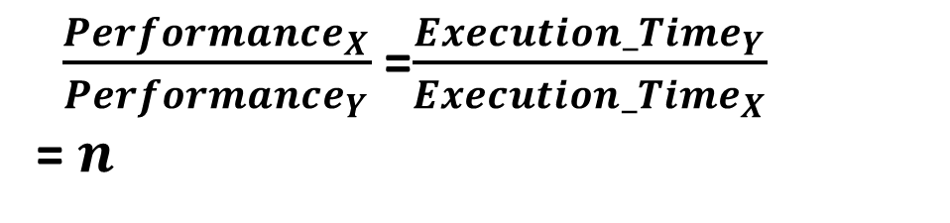
Evaluate Relative Performance
Define Performance = 1/Execution Time
“Computer X is n time faster than Computer Y”
$\frac{{Performance}_{X}}{{Performance}_{Y}}$=$\frac{{Execution_Time}_{Y}}{{Execution_Time}_{X}}$
= $n$
Example: time taken to run a program
  10s on Computer A, 15s on Computer B
  Execution Time_{B} / Execution Time_{A}
  = 15s / 10s = 1.5
  So Computer A is 1.5 times faster than Computer B

Slide 11
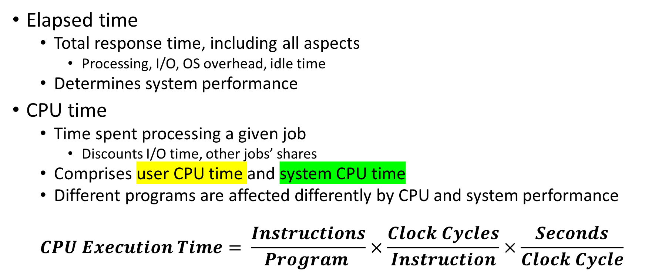
Measuring Performance in terms of CPU Execution Time
Elapsed time
  Total response time, including all aspects
    Processing, I/O, OS overhead, idle time
  Determines system performance
CPU time
  Time spent processing a given job
    Discounts I/O time, other jobs’ shares
  Comprises user CPU time and system CPU time
  Different programs are affected differently by CPU and system performance
  $$CPU Execution Time= \frac{Instructions}{Program }×\frac{Clock Cycles}{Instruction}×\frac{Seconds}{Clock Cycle}$$

Slide 12
CPU Time
$$CPU Execution Time= \frac{Instructions}{Program }×\frac{Clock Cycles}{Instruction}×\frac{Seconds}{Clock Cycle}$$
Performance can be improved by:
  Reducing the number of clock cycles
  Increasing clock rate
  Hardware designer must find trade off of clock rate against cycle count

Slide 13
CPU Time - Example
Computer A: 2.0 GHz clock, 10s CPU time
Designing Computer B:
  Aim for 6s CPU time
  Causes 1.2 × clock cycles
How much fast the clock of Computer B should be?

Slide 14
CPI as Measure of Performance

Slide 15
CPI = Cycles Per Instruction
Each microprocessor specifies the number of Clock Cycles or Clock Ticks that specific type of instructions will consume
CPI is an average number considering occurrence of different types of instructions in a program

Slide 16
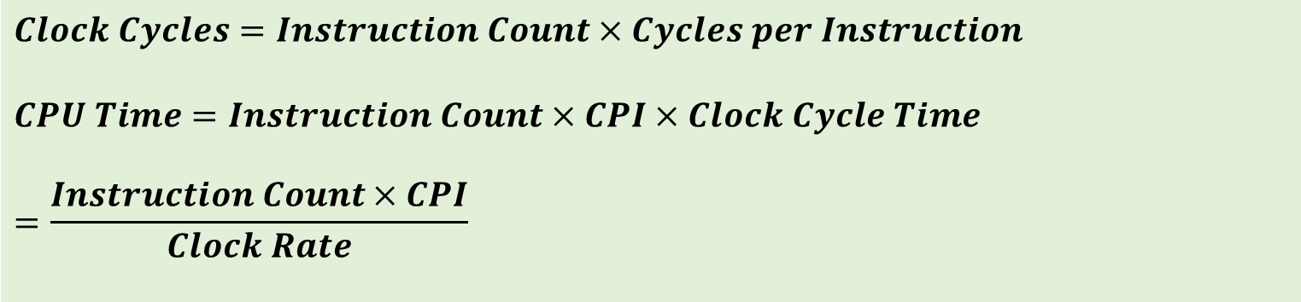
Instruction Count and CPI
$$Clock Cycles=Instruction Count×Cycles per Instruction$$
$$CPU Time=Instruction Count×CPI×Clock Cycle Time$$
$$=\frac{Instruction Count×CPI}{Clock Rate}$$
Instruction Count I_{c} for a program
  Determined by program, ISA and compiler
Average cycles per instruction
  Determined by CPU hardware
  Different instructions have different CPI
  Average CPI affected by instruction mix

Slide 17
CPU Time and CPI Example
Computer A: Cycle Time = 250ps, CPI = 2.0
Computer B: Cycle Time = 500ps, CPI = 1.2
Same ISA
Which computer is faster, and by how much?
A is faster…
…by this much

Slide 18
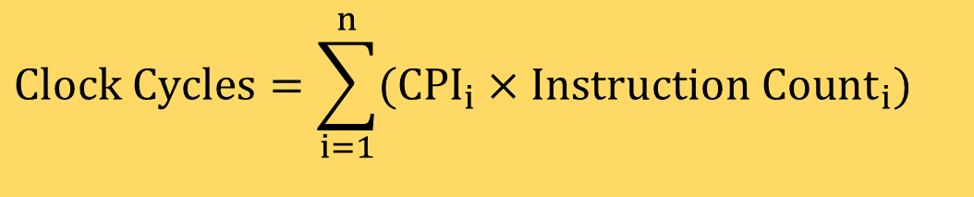
CPI - Averaging
As different instruction classes take different numbers of cycles, we use Average CPI
$$Clock Cycles=\sum_{i=1}^{n}{(CPI_{i}×Instruction Count_{i})}$$

Slide 19
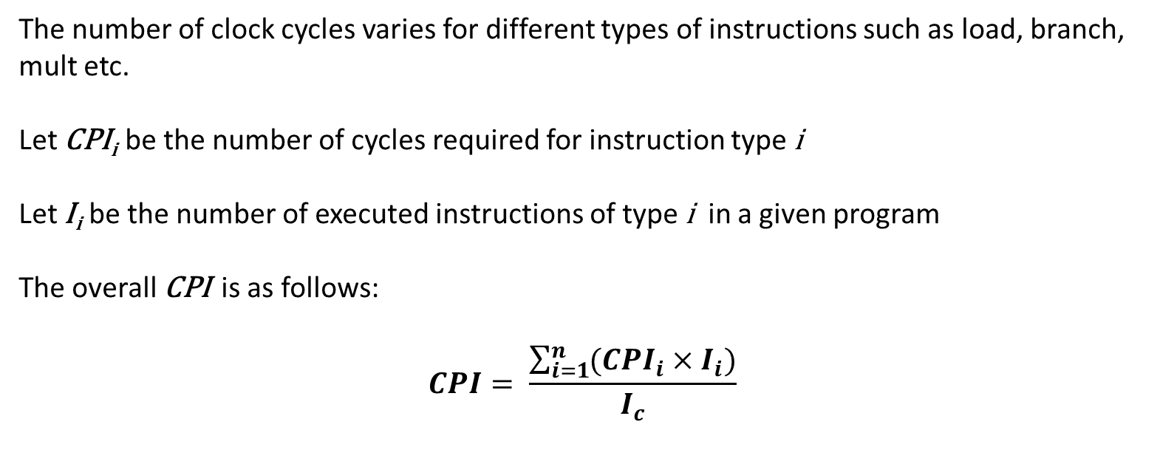
Formula for Overall CPI
The number of clock cycles varies for different types of instructions such as load, branch, mult etc.
Let CPI_{i} be the number of cycles required for instruction type i
Let I_{i} be the number of executed instructions of type i in a given program
The overall CPI is as follows:
$$CPI= \frac{\sum_{i=1}^{n}{({CPI}_{i}×I_{i})}}{I_{c}}$$

Slide 20
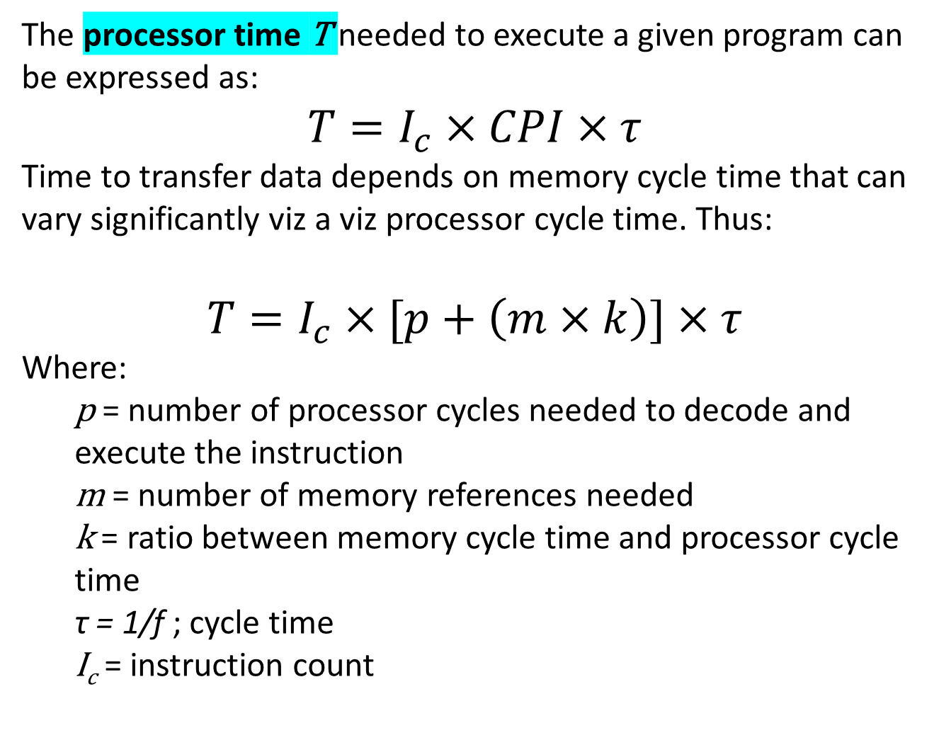
Factors Affecting CPI
The processor time T needed to execute a given program can be expressed as:
$$T=I_{c}×CPI×τ$$
Time to transfer data depends on memory cycle time that can vary significantly viz a viz processor cycle time. Thus:
$$T=I_{c}×[p+\left(m×k\right)]×τ$$
Where:
  p = number of processor cycles needed to decode and execute the instruction
  m = number of memory references needed
  k = ratio between memory cycle time and processor cycle time
  τ = 1/f ; cycle time
  I_{c} = instruction count

Slide 21
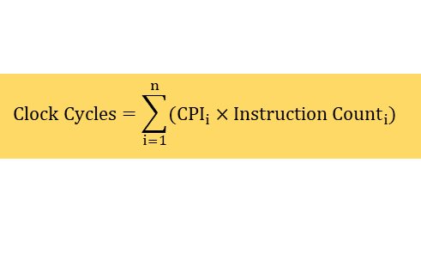
CPI Example
$$Clock Cycles=\sum_{i=1}^{n}{(CPI_{i}×Instruction Count_{i})}$$
Alternative compiled code sequences using instructions in classes (or types) A, B, C
Class | A | B | C
CPI for class | 1 | 2 | 3
I_{C} in sequence 1 | 2 | 1 | 2
I_{C} in sequence 2 | 4 | 1 | 1
Sequence 1: I_{C} = 5
  Clock Cycles
  = 2×1 + 1×2 + 2×3
  = 10
  Avg. CPI = 10/5 = 2.0
Sequence 2: I_{C} = 6
  Clock Cycles
  = 4×1 + 1×2 + 1×3
  = 9
  Avg. CPI = 9/6 = 1.5

Slide 22
MIPS as Measure of Performance

Slide 23


MIPS – Million Instructions Per Second
MIPS is a popular performance measure in RISC processors.
Ideal value is to obtain a CPI of 1.0, million clock cycles would process million instructions
(Microprocessor with Interlocked Pipelining Stages)

Slide 24
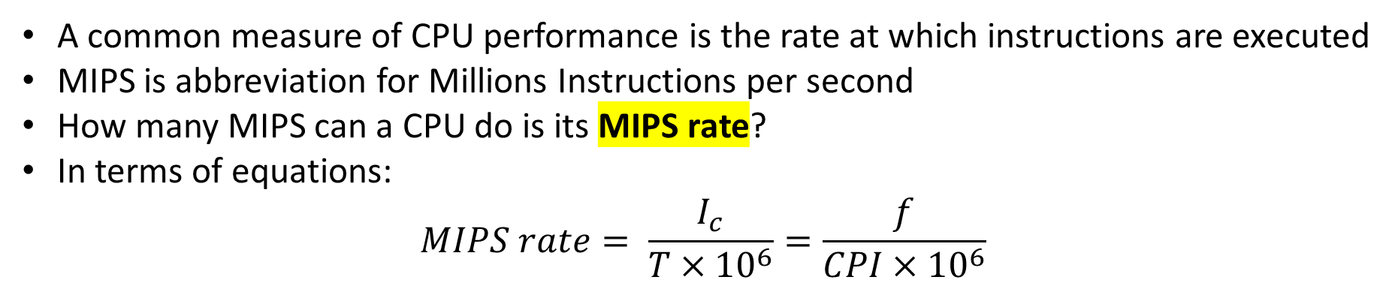
MIPS Formula and Example
A common measure of CPU performance is the rate at which instructions are executed
MIPS is abbreviation for Millions Instructions per second
How many MIPS can a CPU do is its MIPS rate?
In terms of equations:
$$MIPS rate= \frac{I_{c}}{T×{10}^{6}}=\frac{f}{CPI×{10}^{6}}$$

Slide 25
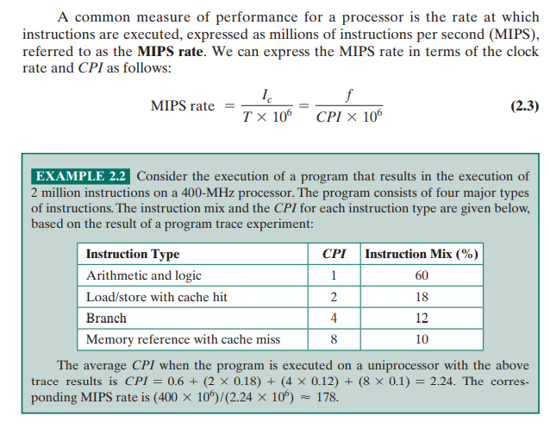
Example of MIPS

Slide 26
Pitfall: MIPS as a Performance Metric
MIPS: Millions of Instructions Per Second
  Doesn’t account for
    Differences in ISAs between computers
    Differences in complexity between instructions
  CPI varies between programs on a given CPU

Slide 27
MFLOPS as Measure of Performance

Slide 28
FLOPS – Floating-Point operations per second
Mega Flops, Giga Flops and Tera Flops are used to measure performance of super computers in Scientific Programming.
$$MFLOPS Rate= \frac{Number of Executed Floating Point Instructions in a Program}{{Execution Time × 10}^{6}}$$
MFLOPS = Millions of Floating Point Operations per second

Slide 29
Benchmarks as Measure of Performance

Slide 30
SPEC Benchmarks
Benchmarks are used to evaluate performance of full computer systems. CPI measure is only for microprocessors.
SPEC benchmarks are standard in Computer Architecture study.
A benchmark contains several programs in a particular class of computing, i.e. integer calculations, floating-point computations, etc.
SPEC Rating = Geometric Mean (N^{th} root) of product of performance obtained from running all programs in a particular class in the benchmark.

Slide 31
Why Benchmarks?
Due to differences in instruction sets, the instruction execution rate is not a
valid means of comparing performance of different architectures in the form of
MIPS or MFLOPS.
Performance of a program may not be useful in determining how that processor
will perform on a very different type of application.
Benchmarks provide guidance to customers to decide which system to buy and
useful support to vendors and designers to design systems that meet benchmark goals
Characteristics of benchmark programs:
  Written in high-level languages hence portable across machines
  Representative of a particular kind of programming domain or paradigm
  Can be measured easily
  It has a wide distribution

Slide 32
SPEC CPU Benchmark
Programs used to measure performance
  Supposedly typical of actual workload
Standard Performance Evaluation Corp (SPEC)
  Develops benchmarks for CPU, I/O, Web, …
SPEC CPU2006
  Elapsed time to execute a selection of programs
    Negligible I/O, so focuses on CPU performance
  Normalize relative to reference machine
  Summarizes geometric mean of performance ratios

Slide 33
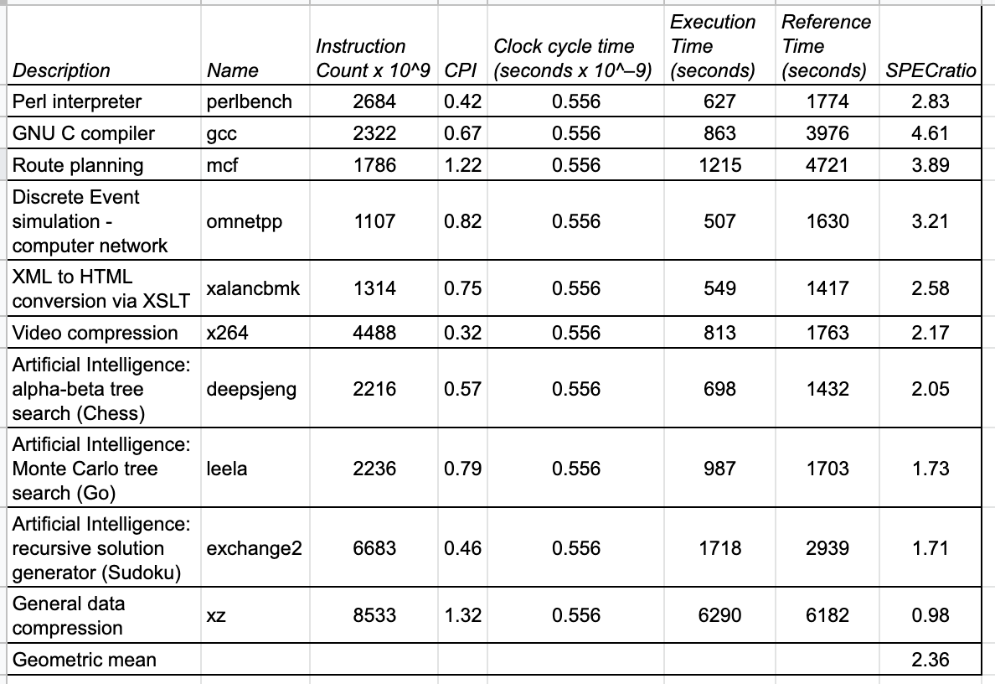
Example: SPECspeed 2017 Integer benchmarks on a 1.8 GHz Intel Xeon E5-2650L

Slide 34
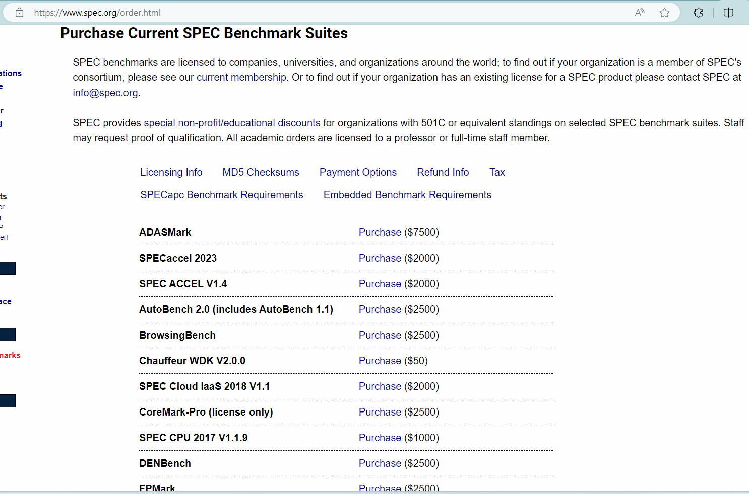
Cost of Spec benchmarks

Slide 35
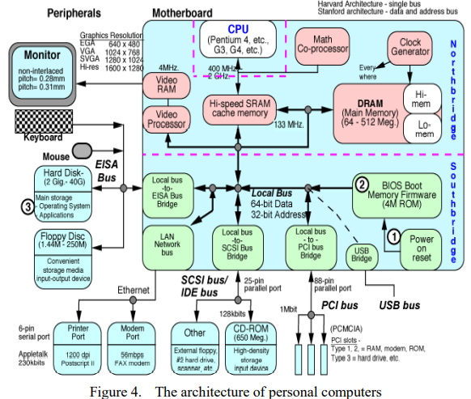
The PC / Laptop
Computer
Organization
Comprises:
CPU
Co-Proc / Accelerator
Memory Hierarchy
Bus Hierarchy
Input / Output
Peripherals
Power
A survey of ICT: Evolution of architectures, models and layers
August 2016, Conference: International Symposium on Intelligent Systems and Informatics, Serbia
Volume: 14, Imre Petkovic, Ármin Petkovics, Janos Simon

Slide 36
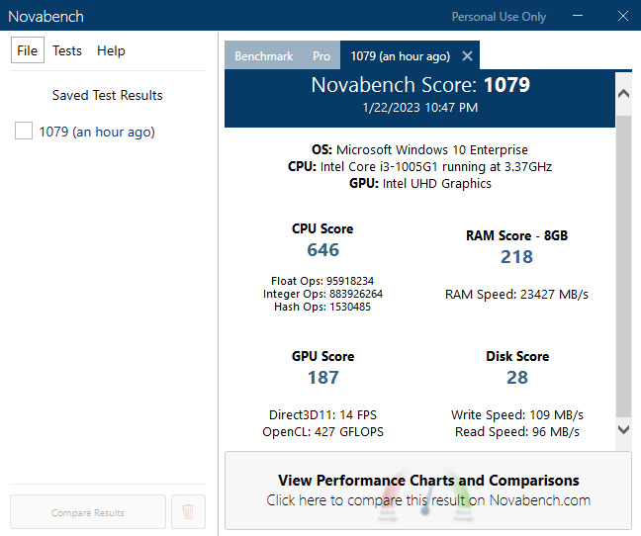
Novabench
Benchmark Suite

Slide 37
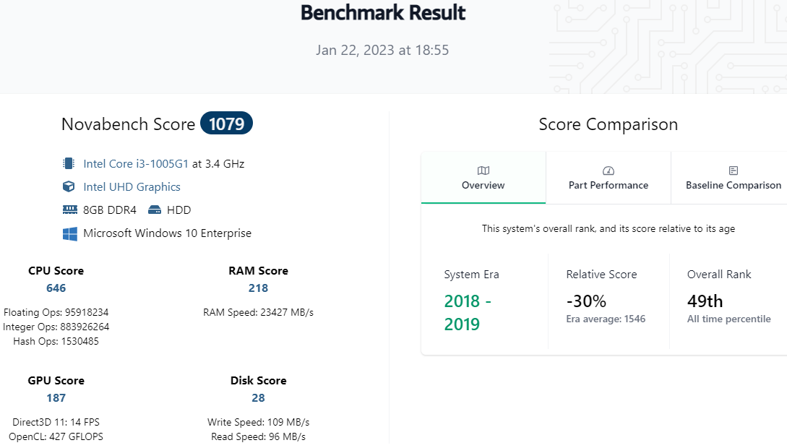

Slide 38
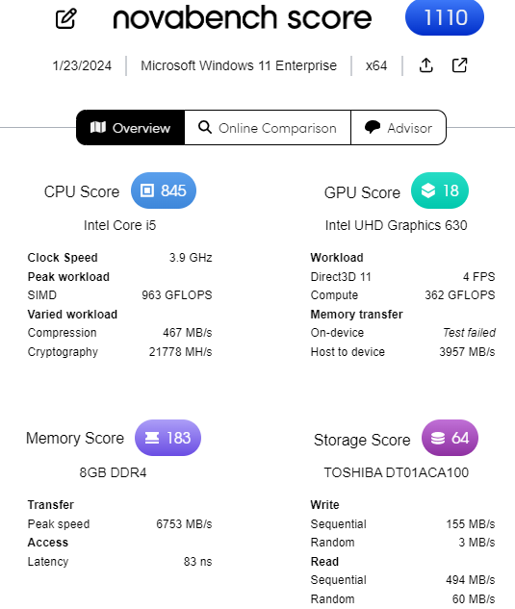
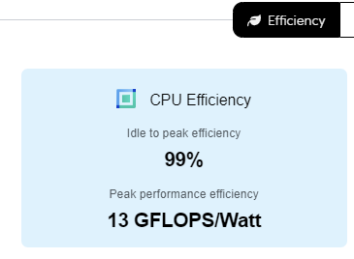
Novabench - today

Slide 39
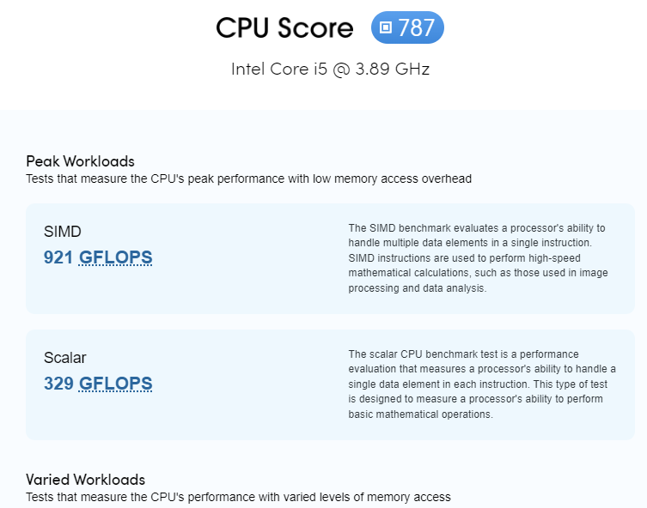
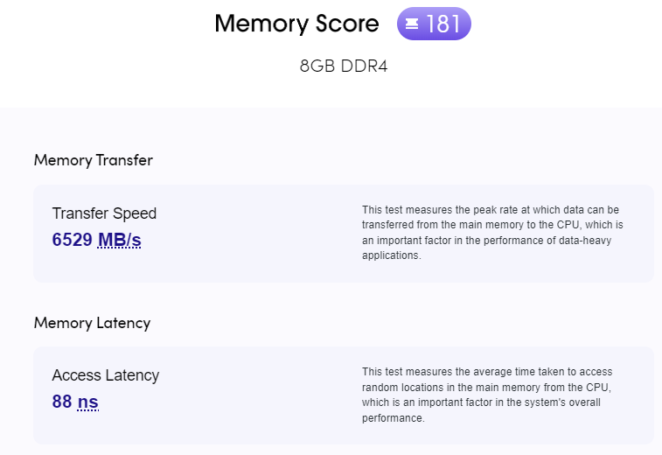
Novabench – latest version

Slide 40
Online CPU Benchmarks
https://cpux.net/cpu-benchmark-online online
https://cpu-benchmark.org/ online
https://www.matthew-x83.com/online/cpu-benchmark.php online
https://www.cpuid.com/softwares/cpu-z.html download
https://novabench.com/ download
https://www.userbenchmark.com/Software download

Slide 41
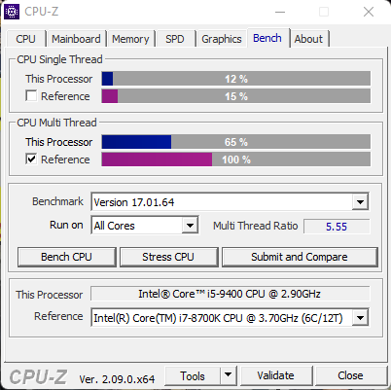
CPU-Z

Slide 42
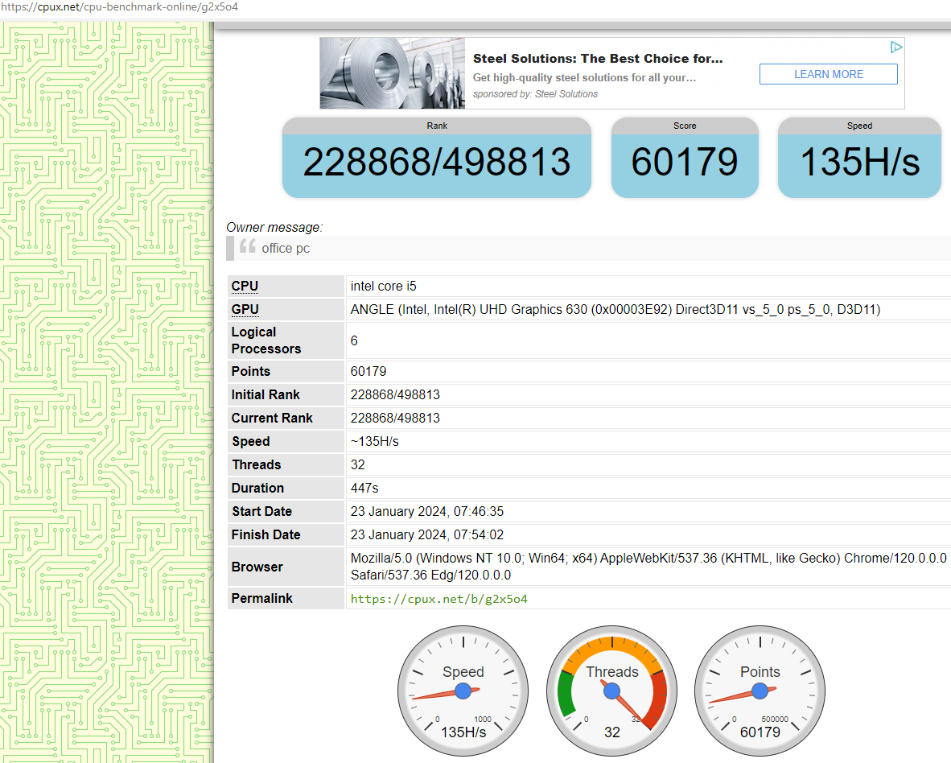
Cpux.net
online
Hash functions per second

Slide 43
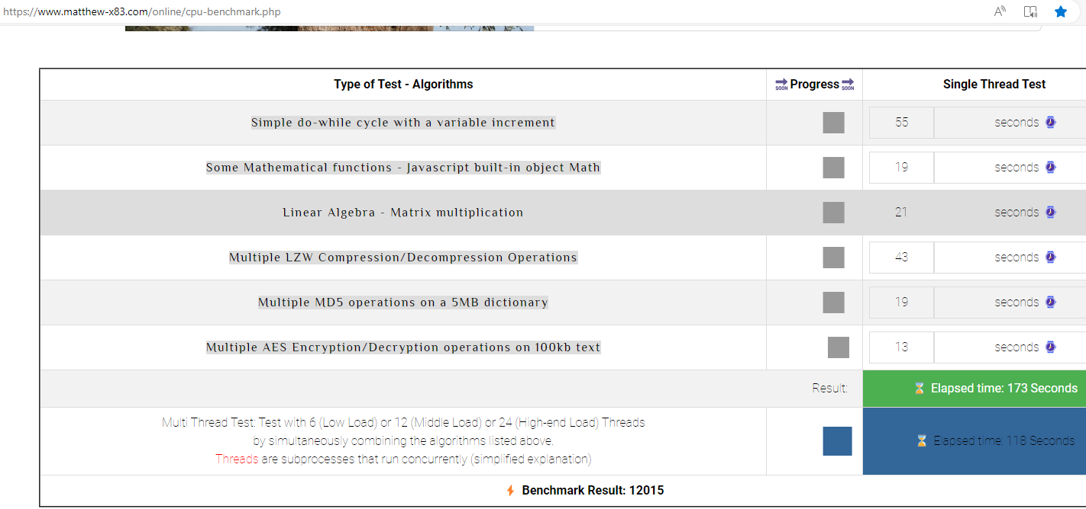
Matthew-x83.com online performance

Slide 44
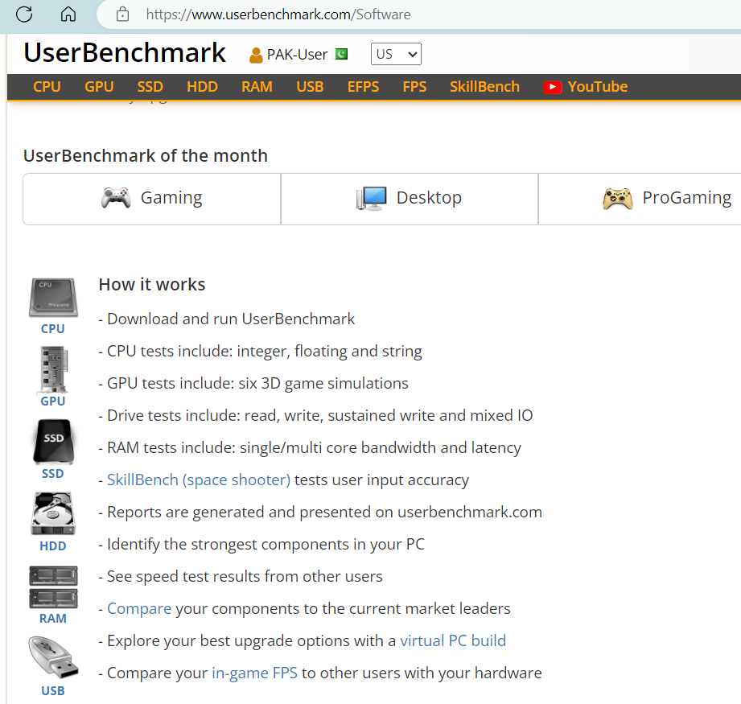
UserBenchmark

Slide 45
Readings
P&H Textbook, Sections 1.6 to the end of chapter 1.

