Slide 1
CS / EE 320
Computer Organization and Assembly Language
Spring 2025
Lecture 15
Shahid Masud
Topics: Building a Single Cycle MIPS CPU,
Adding Branch, Jump, etc. and Control Path

Slide 2
Important Announcement
Midterm Exam coming Friday, 14 March 2025

Slide 3
Topics
Remaining blocks of MIPS CPU
Architecture of simple instructions in Single Cycle MIPS
  J jump instruction
  ADD instruction
  ADDI instruction
  BEQ instruction
  LW load word instruction
  SW store word instruction
Control Path for Single Cycle MIPS CPU
Midterm Exam on Friday

Slide 4
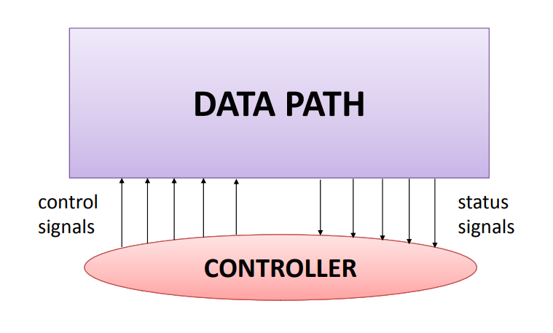
CPU consists of Data path and Control path

Slide 5
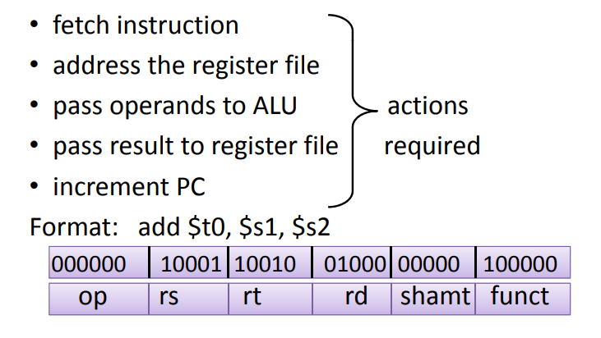
Develop Data path for add, sub, and, or, slt

Slide 6
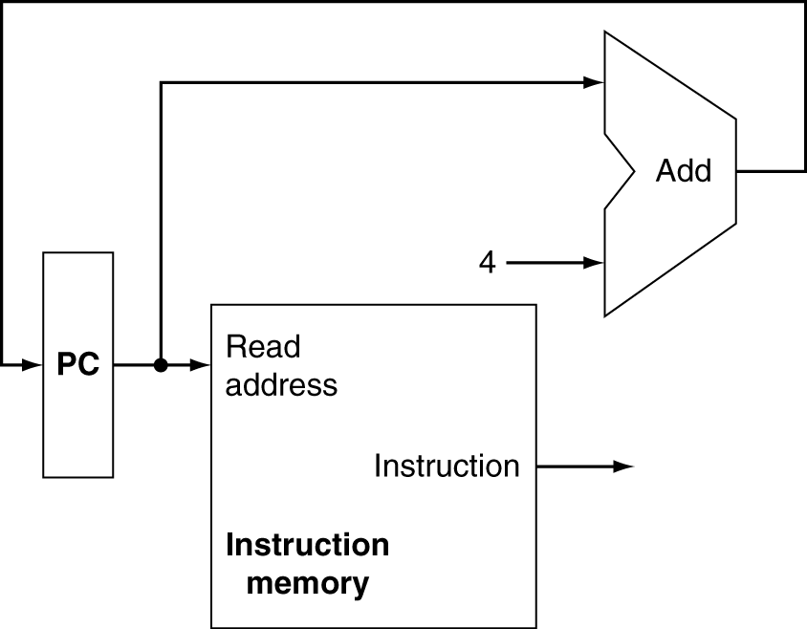
Instruction Fetch – PC Register operation
This block is needed for all instructions
Increment by 4 for next instruction
32-bit register

Slide 7
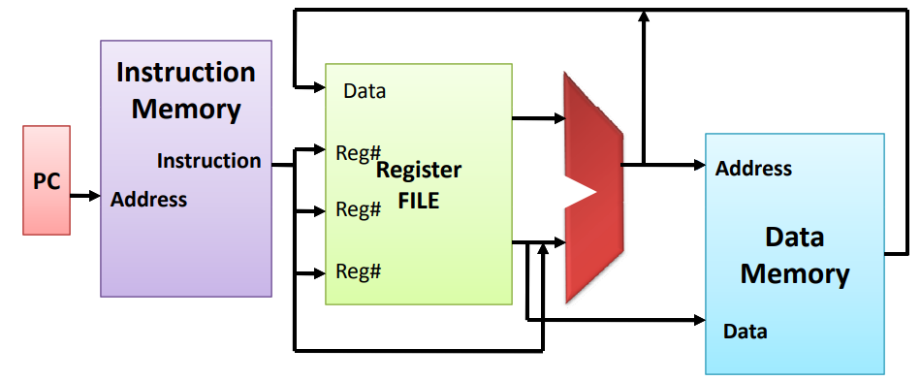
Overview of Simple CPU Design for R Format

Slide 8
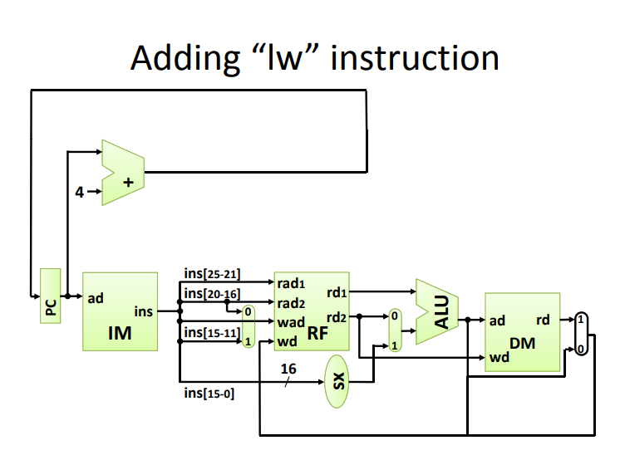
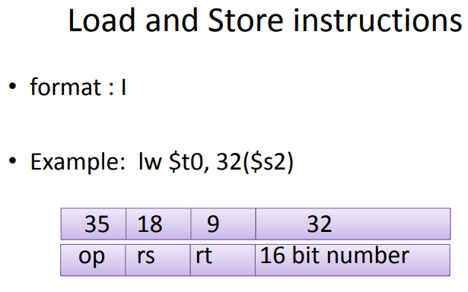









Implement the “lw” Instruction
Adding “lw” Instruction

Slide 9
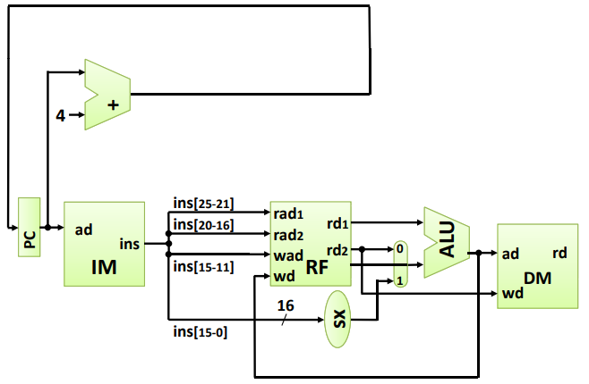
Implement the “sw” Instruction
Adding “sw” Instruction

Slide 10
Branch Instructions
Read register operands
Compare operands
  Use ALU, subtract and check Zero output
Calculate target address
  Sign-extend displacement
  Shift left 2 places (word displacement)
  Add to PC + 4
    Already calculated by instruction fetch

Slide 11
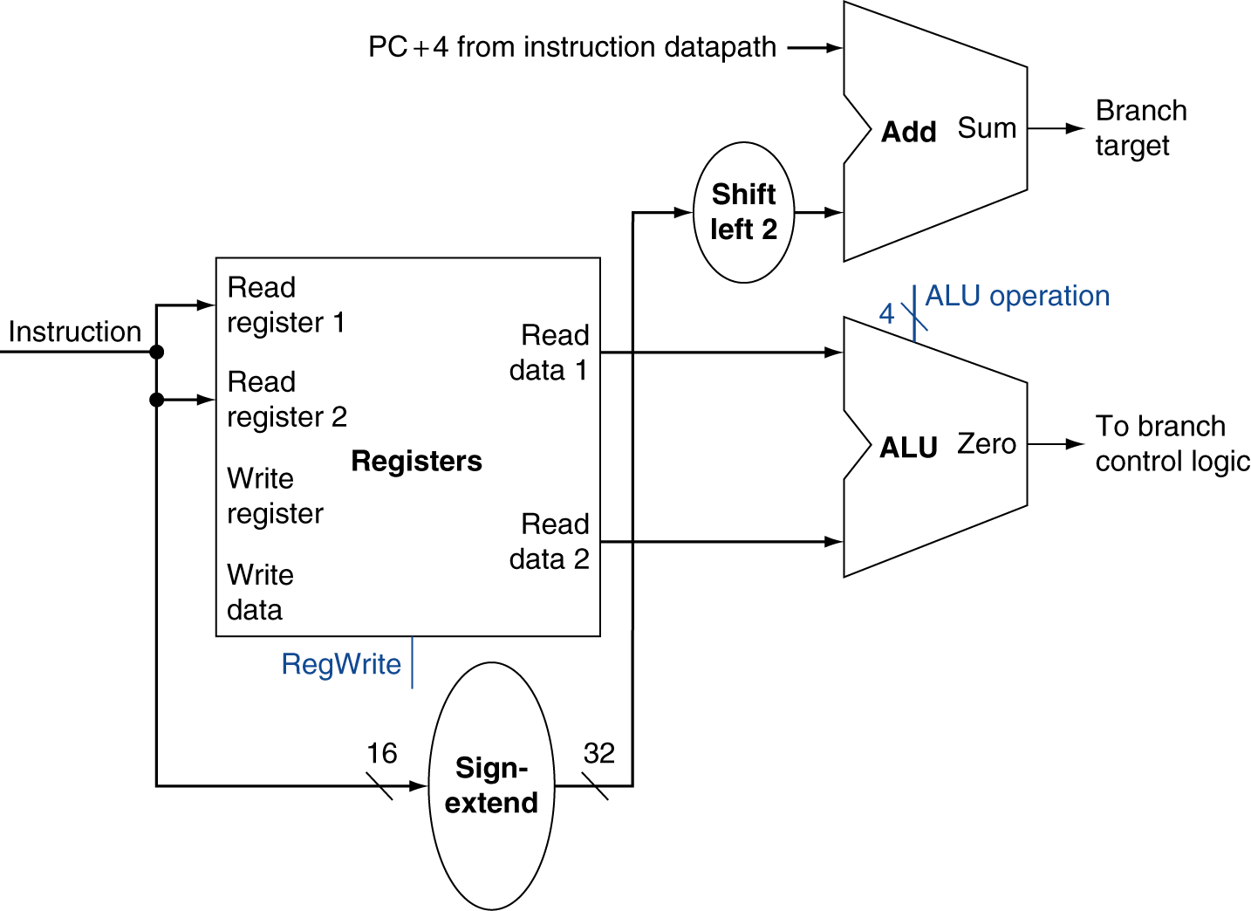
Datapath for Branch Instructions
Just
re-routes wires
Sign-bit wire replicated

Slide 12
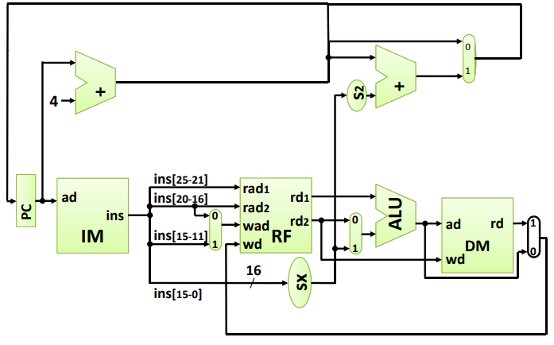
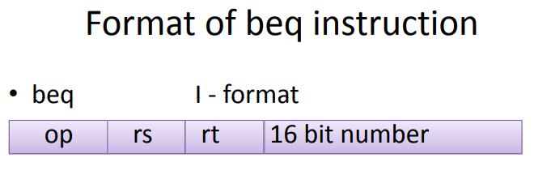
Implement “beq” Instruction
Adding “beq” Instruction

Slide 13
Implementing Jumps
Jump
2
address
31:26
25:0
Jump uses word address
Update PC with concatenation of
  Top 4 bits of old PC
  26-bit jump address
  00
Need an extra control signal decoded from opcode

Slide 14
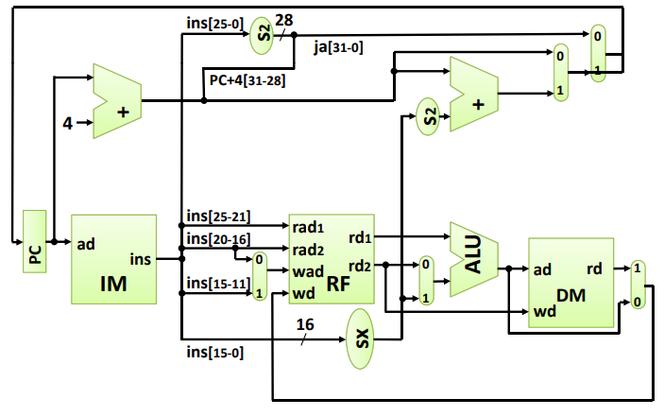
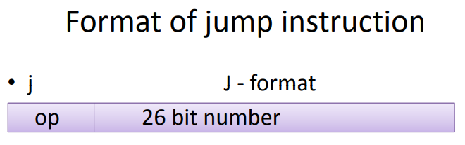
Implement Jump “j” instruction
Adding “j” Instruction

Slide 15
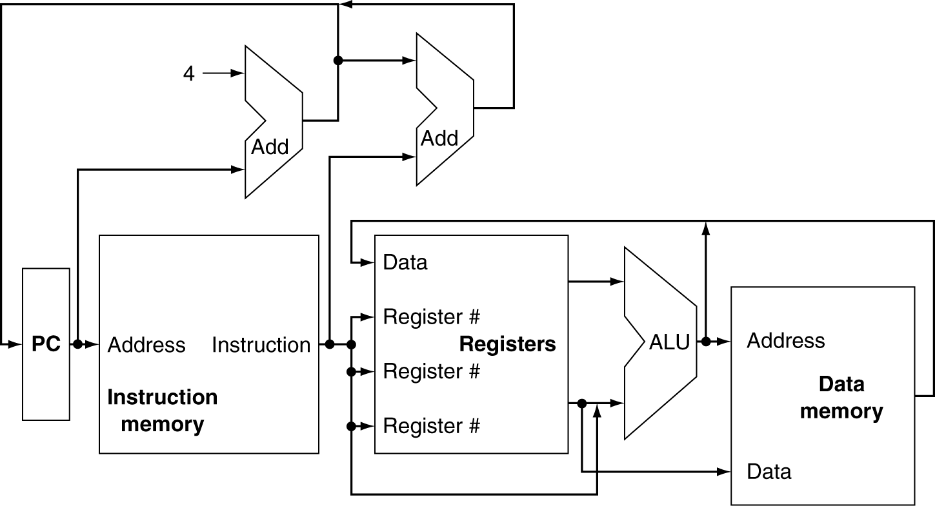
Basic CPU Overview

Slide 16
Multiplexers Needed
Can’t just join wires together
  Use multiplexers

Slide 17
Composing the Elements
First-cut data path does an instruction in one clock cycle
  Each datapath element can only do one function at a time
  Hence, we need separate instruction and data memories
Use multiplexers where alternate data sources are used for different instructions

Slide 18
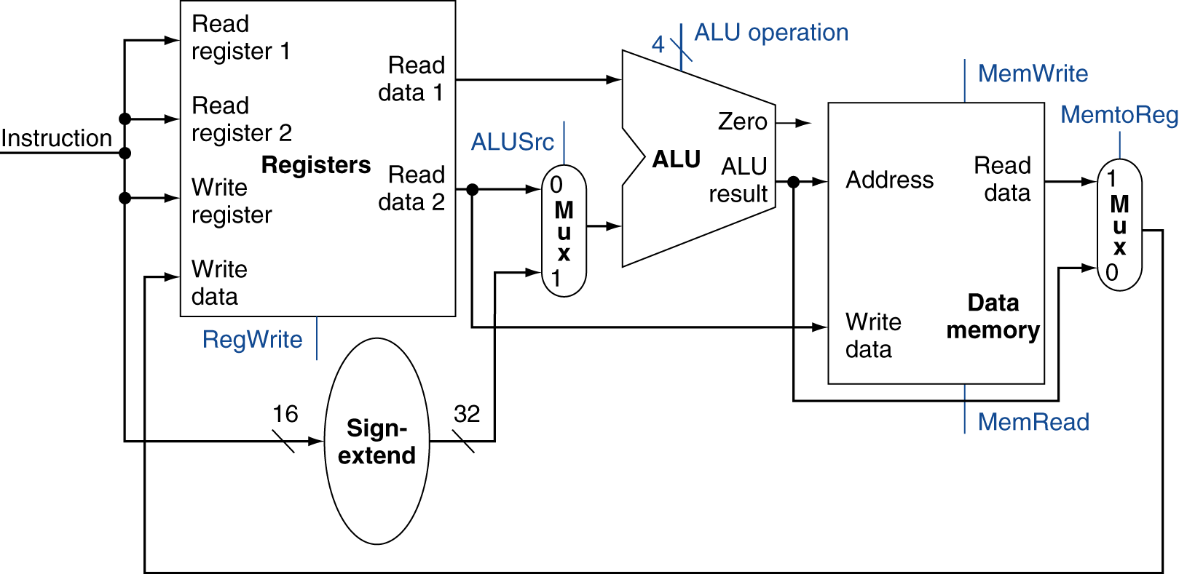
R-Type/Load/Store Datapath – Some Controls

Slide 19
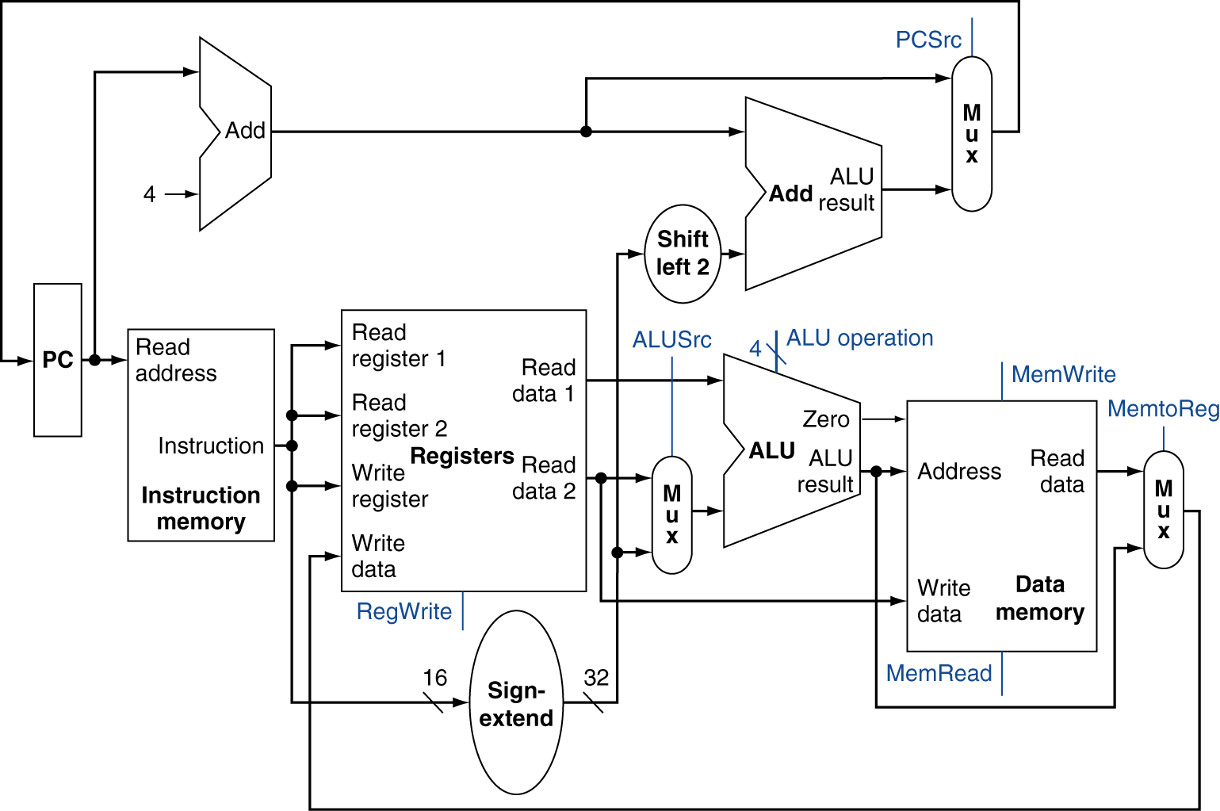
Full Datapath

Slide 20
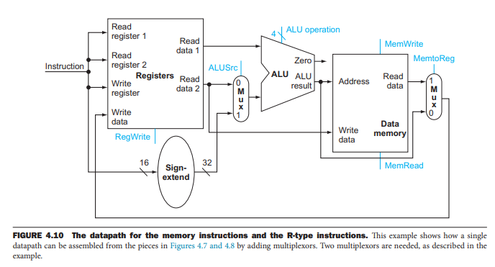
Data path for Memory Instructions

Slide 21
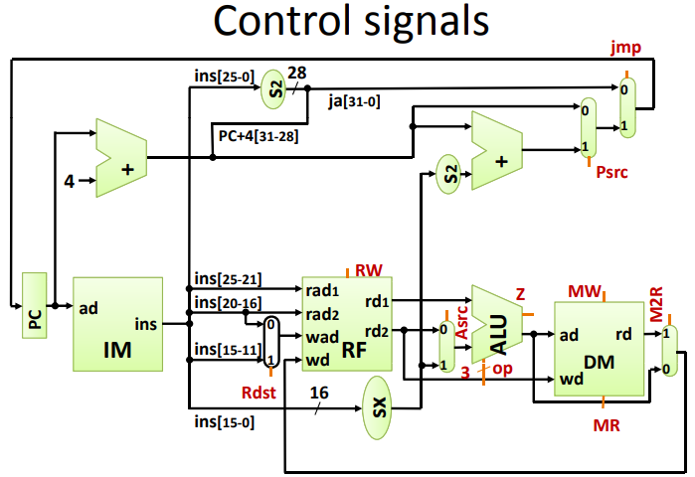
Identify Control Signals for Simple CPU

Slide 22
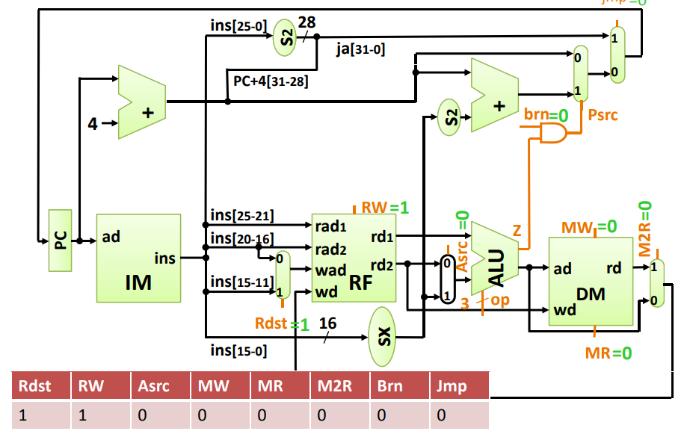
Control Inputs for R type Instructions

Slide 23
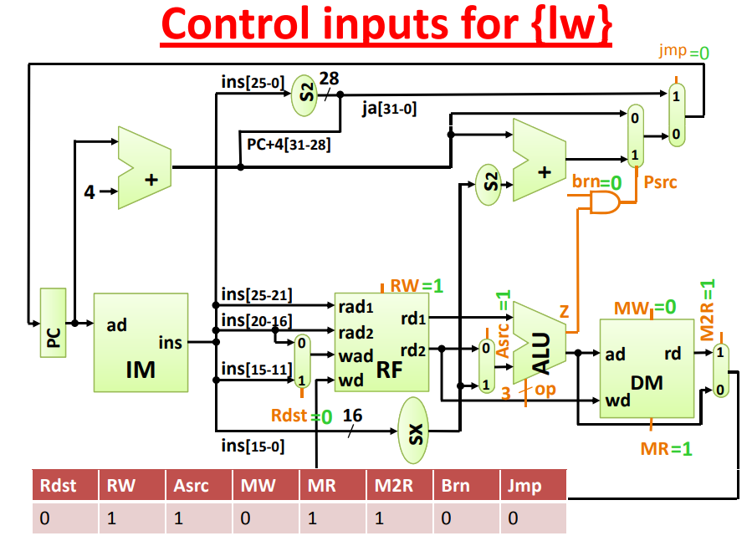
Control Inputs for lw Instruction

Slide 24
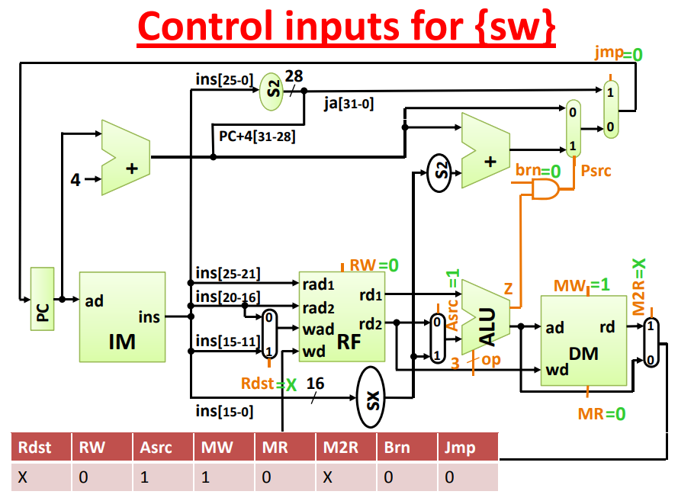
Control Inputs for sw Instruction

Slide 25
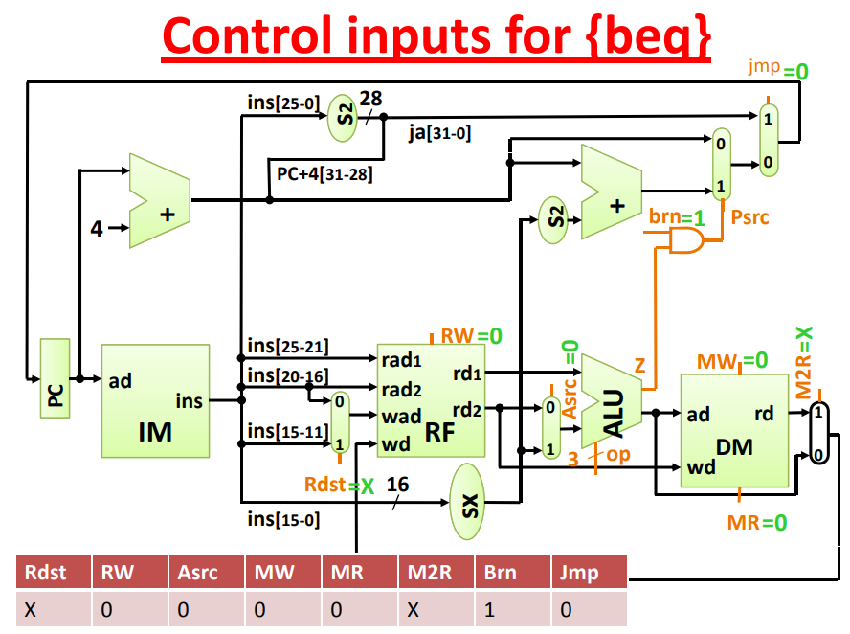
Control Inputs for beq Instruction

Slide 26
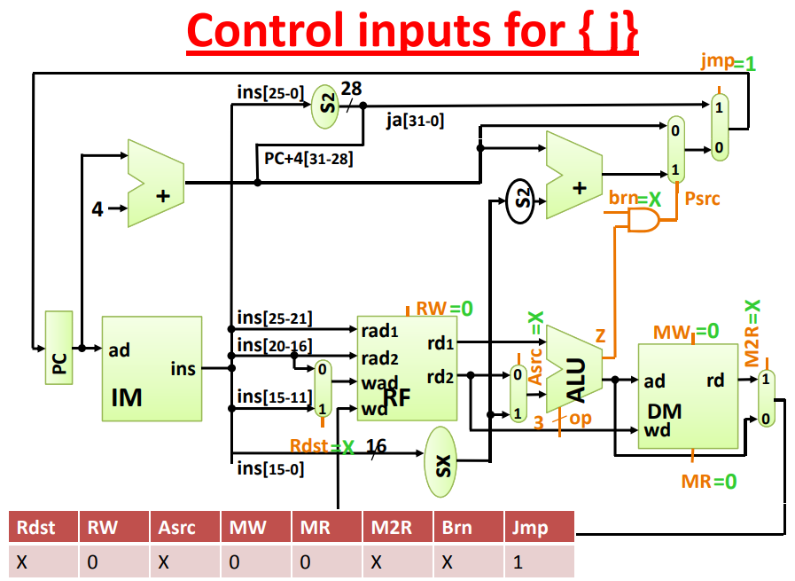
Control Inputs for j Instruction

Slide 27
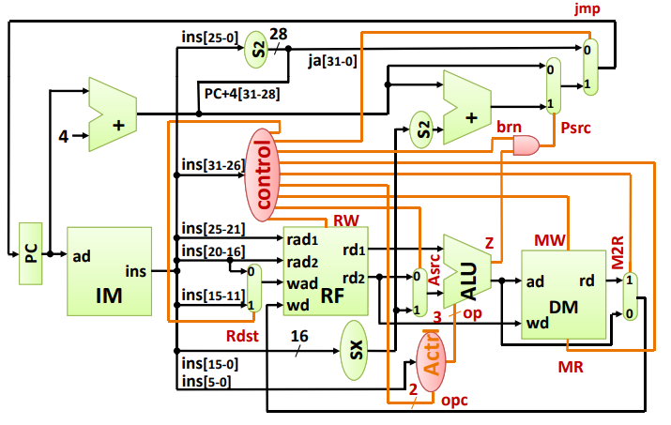
Combining Data path and Control path signals

Slide 28
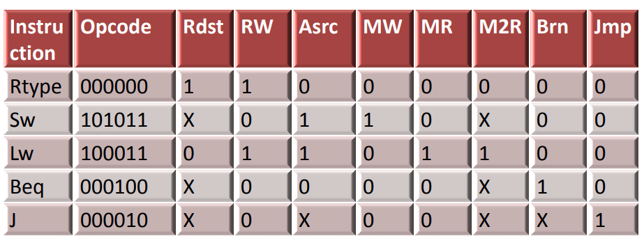
Control words in Simple MIPS CPU

Slide 29
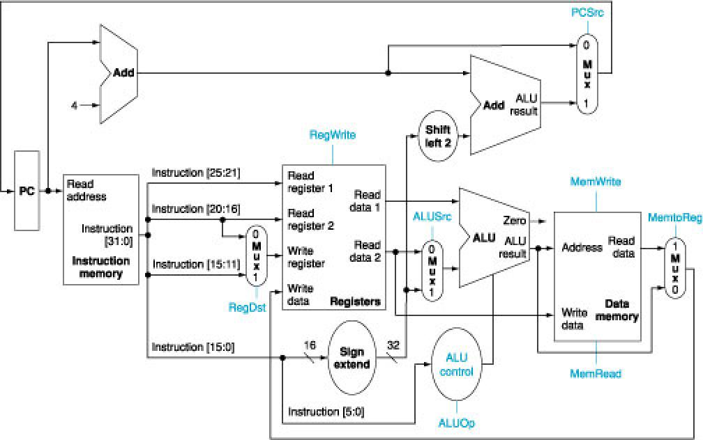
Control Signals needed in MIPS (P&H book style)

Slide 30
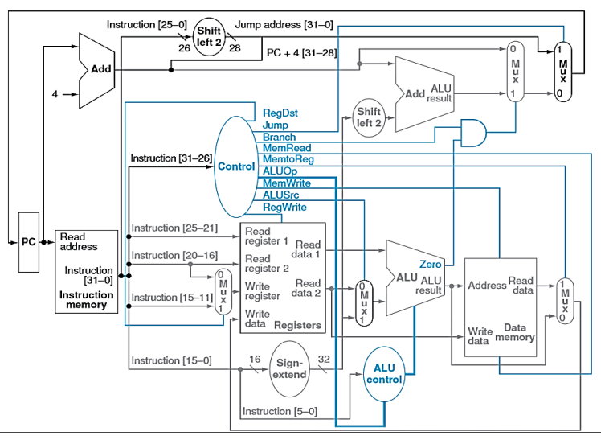
Data path with Control Signals in simple MIPS

Slide 31
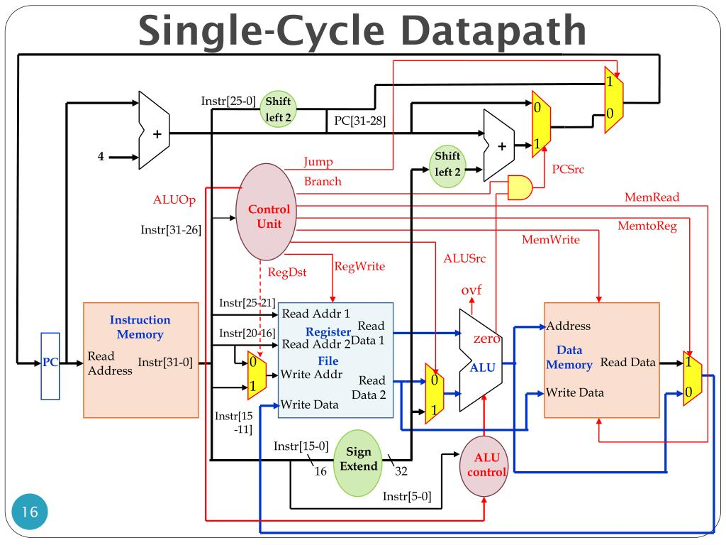
Another (clear) View of Control Signals

Slide 32
The Main Control Unit
Control signals derived from instruction
R-type
0
rs
rt
rd
shamt
funct
31:26
25:21
20:16
15:11
10:6
5:0
Load/
Store
35 or 43
rs
rt
address
31:26
25:21
20:16
15:0
Branch
4
rs
rt
address
31:26
25:21
20:16
15:0
opcode
always read
read, except for load
write for R-type and load
sign-extend and add

Slide 33
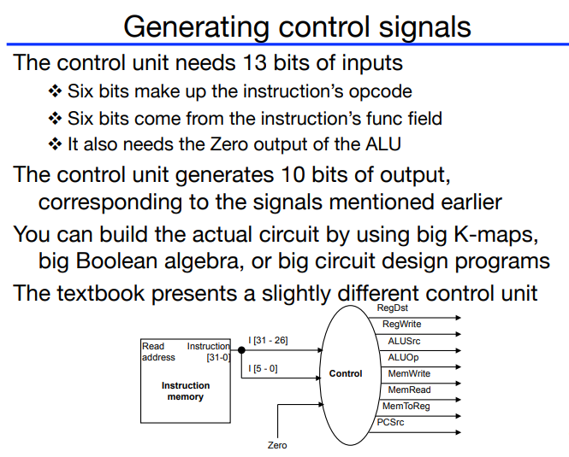
Generating Control Signals

Slide 34
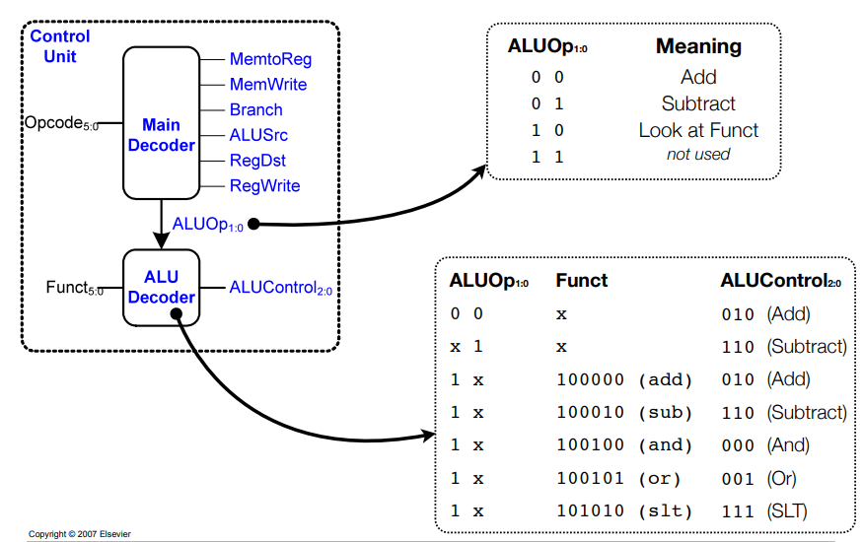
Control words with ALU Op codes

Slide 35
ALU Control
Assume 2-bit ALUOp derived from opcode
  Combinational logic derives ALU control
opcode | ALUOp | Operation | funct | ALU function | ALU control
lw | 00 | load word | XXXXXX | add | 0010
sw | 00 | store word | XXXXXX | add | 0010
beq | 01 | branch equal | XXXXXX | subtract | 0110
R-type | 10 | add | 100000 | add | 0010
 |  | subtract | 100010 | subtract | 0110
 |  | AND | 100100 | AND | 0000
 |  | OR | 100101 | OR | 0001
 |  | set-on-less-than | 101010 | set-on-less-than | 0111

Slide 36
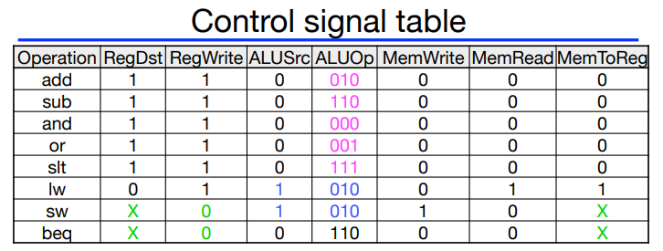
Control words for different Instructions

