Slide 1
CS / EE 320
Computer Organization and Assembly Language
Spring 2025
Lecture 23
Shahid Masud
Topics: Address Decoding Examples, Cache and Memory Hierarchy, Direct Mapped Cache, Some Examples

Slide 2
Topics
Examples of Memory Address Decoding
Caches and Memory Hierarchy
Direct Mapped Caches
Example of Direct Mapped Caches
Quiz in Next Week

Slide 3
Memory Organization and
Address Decoding Examples

Slide 4
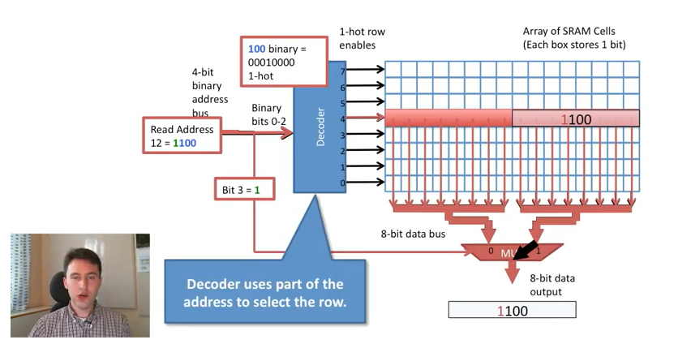
Typical Memory Organization
Question?
Is this
2D Memory organization
OR
2.5D Memory Organization

Slide 5
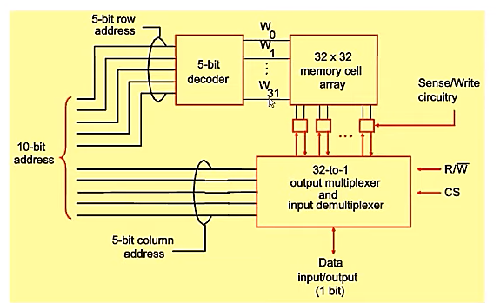
Organization of a 1Kx1 Memory Chip
2.5 D Memory Organization
of a 1K x 1 Chip made from
32 x 32 Memory Cell Array

Slide 6
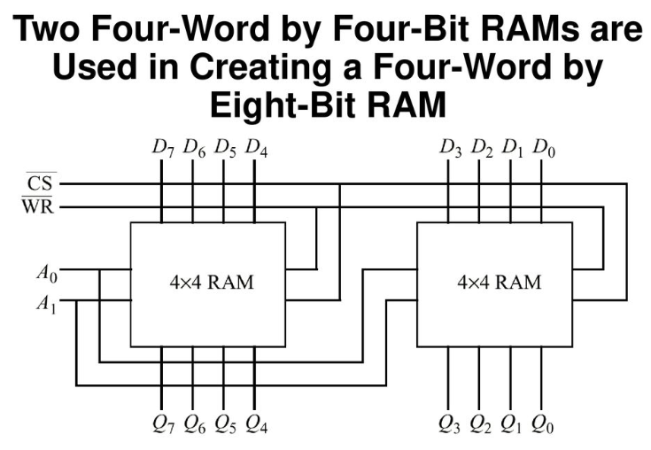
Example 2

Slide 7
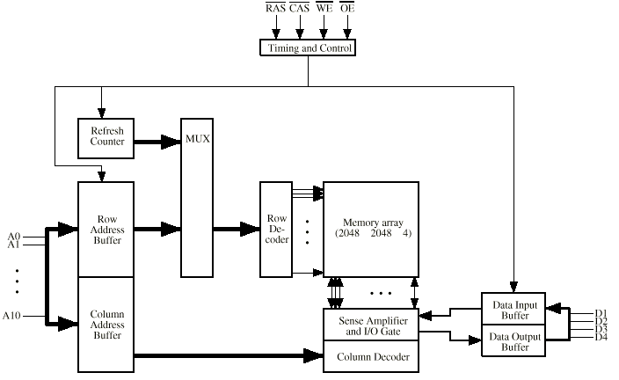
Typical 16 Mb DRAM (4M x 4)

Slide 8
Example 1 to Solve – Memory Organization
Design a 512 Bytes RAM Memory using blocks of size 128 x 8 bits
No of blocks needed?
Address Bits needed?
Size of Address Decoder?
Draw the Organization

Slide 9
Example 2 to Solve – Memory Organization
Design a 16 Kilo Bytes RAM memory using blocks of size 128 x 1 bit
No of blocks needed?
Address Bits needed?
Size of Address Decoder?
Draw the Organization

Slide 10
Locality of Reference in Memory Access

Slide 11
Locality of Reference
During the course of the execution of a program, memory references tend to cluster
e.g. loops

Slide 12
Principle of Locality
Programs access a small proportion of their address space at any time
Temporal locality
  Items accessed recently are likely to be accessed again soon
  e.g., instructions in a loop, induction variables
Spatial locality
  Items near those accessed recently are likely to be accessed soon
  E.g., sequential instruction access, array data

Slide 13
Taking Advantage of Locality
Distribute total Memory in hierarchy
Store everything on disk
Copy recently accessed (and nearby) items from disk to smaller DRAM memory
  Main memory
Copy more recently accessed (and nearby) items from DRAM to smaller SRAM memory
  Cache memory attached to CPU

Slide 14
The Memory Hierarchy
The BIG Picture
Common principles apply at all levels of the memory hierarchy
  Based on notions of caching
At each level in the hierarchy
  Block placement
  Finding a block
  Replacement on a miss
  Write policy

Slide 15
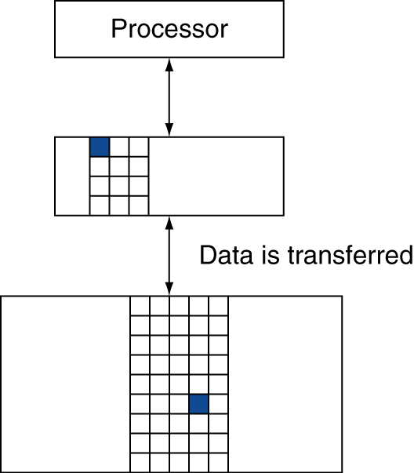
Memory Hierarchy Levels
Block (or line): one unit of copying
  May be multiple words
If accessed data is present in upper level
  Hit: access satisfied by upper level
    Hit ratio: hits/accesses
If accessed data is absent
  Miss: block copied from lower level
    Time taken: miss penalty
    Miss ratio: misses/accesses
    = 1 – hit ratio
  Then accessed data supplied from upper level
Reg file is
fastest
Small and
fast
Slow &
big

Slide 16
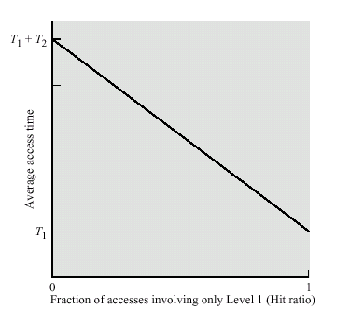
Average Access Time vs Hit Ratio

Slide 17
Cache Memory

Slide 18
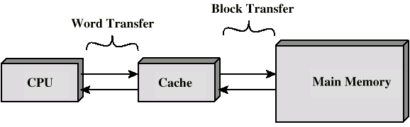
Cache and Memory
Small amount of fast memory
Sits between normal main memory and CPU
May be located on CPU chip or module

Slide 19
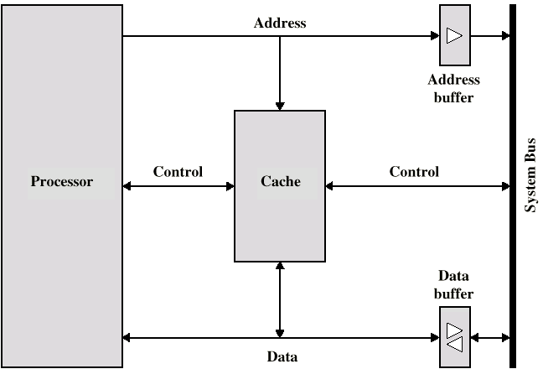
Typical Cache Organization

Slide 20
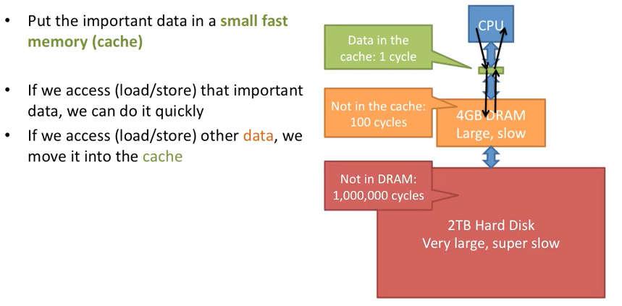
Idea of Cache Memory

Slide 21
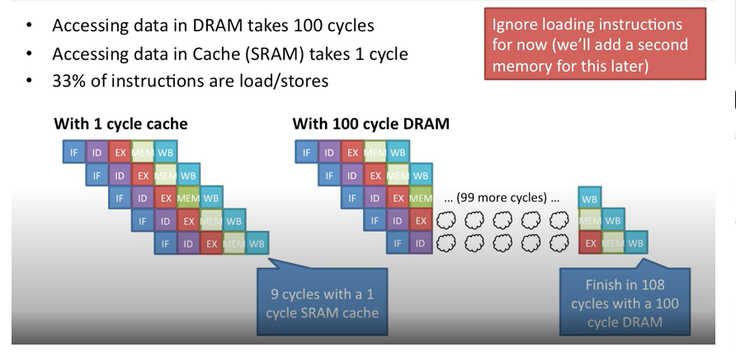
Performance of Caches and Memory

Slide 22
Cache operation - Overview
CPU requests contents of memory location
Check cache for this data
If present, get from cache (fast)
If not present, read required block from main memory to cache
Then deliver from cache to CPU
Cache includes tags to identify which block of main memory is in each cache slot

Slide 23
Cache Design Parameters
Size
Mapping Function
Replacement Algorithm
Write Policy
Block Size
Number of Caches

Slide 24
Cache Size vs Speed
Cost
  More cache is expensive
Speed
  More cache is faster (up to a point)
  Checking cache for data takes time

Slide 25
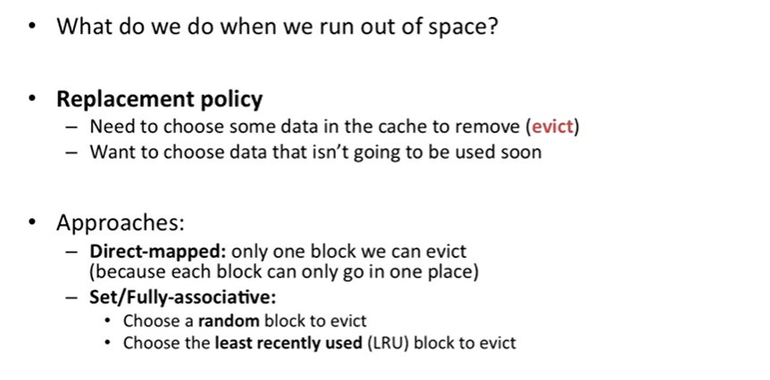
Cache Capacity Limits

Slide 26
Direct Mapped Cache

Slide 27
Direct Mapping
Each block of main memory maps to only one cache line
  i.e. if a block is in cache, it must be in one specific place
Address is in two parts
Least Significant w bits identify unique word
Most Significant s bits specify one memory block
The MSBs are split into a cache line field r and a tag of s-r (most significant)

Slide 28
Mapping Function
Cache of 64kByte
Cache block of 4 bytes
  i.e. cache is 16k (2¹⁴) lines of 4 bytes
16MBytes main memory
24 bit address
  (2²⁴=16M)

Slide 29
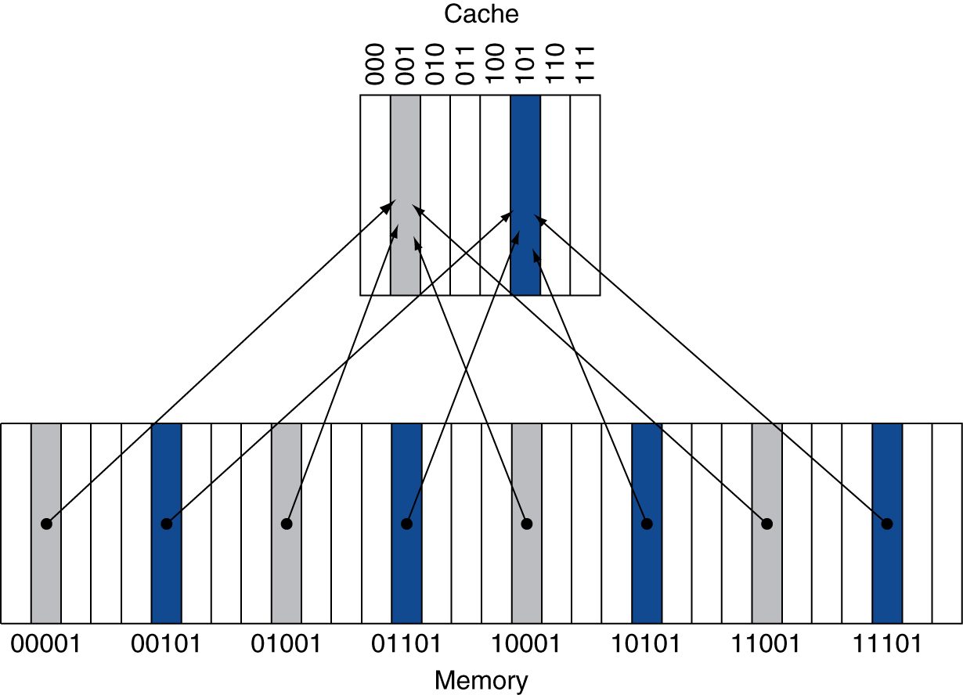
Direct Mapped Cache
Location determined by address
Direct mapped: only one choice
  (Block address) modulo (No. of Blocks in cache)
#Blocks is a power of 2
Use low-order address bits

Slide 30
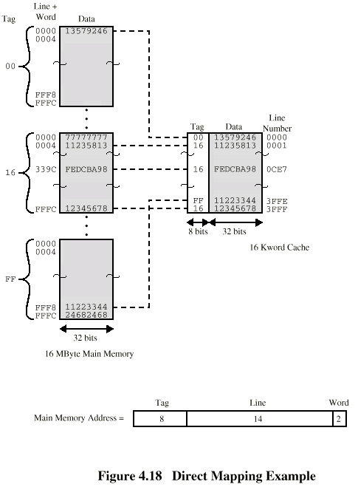
Direct Mapping Example

Slide 31
Direct Mapping Cache Line Table
Cache line Main Memory blocks held
0 0, m, 2m, 3m…, 2^{s}-m
1 1,m+1, 2m+1…., 2^{s}-m+1
…….
m-1 m-1, 2m-1, 3m-1, ….., 2^{s}-1

Slide 32
Direct Mapping Address Structure
Tag s-r
Line or Slot r
Word w
8
14
2
24 bit address
2 bit word identifier (4 byte block)
22 bit block identifier
  8 bit tag (=22-14)
  14 bit slot or line
No two blocks in the same line have the same Tag field
Check contents of cache by finding line and checking Tag

Slide 33
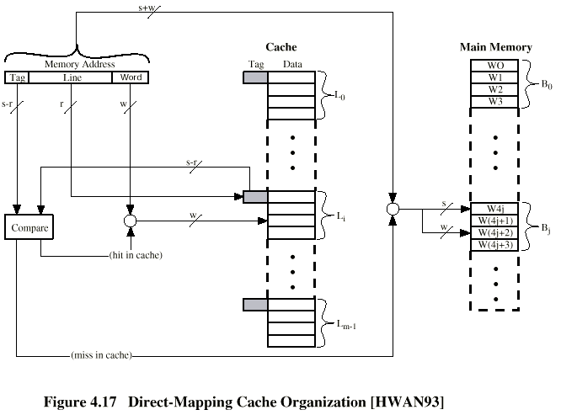
Direct Mapping Cache Organization

