Slide 1
CS / EE 320
Computer Organization and Assembly Language
Spring 2023
Lecture 10
Shahid Masud
Topics: Arithmetic and Logic Operations, Multipliers,
Dividers, Simple ALU Design

Slide 2
Topics
Recap – Basic ALU operations, digital logic building blocks
Binary Multiplier – Pencil and paper method
Binary Multiplier Hardware
Binary Divider – Method
Binary Divider Hardware
SIMD and Sub-Word Parallelism
32 – bit ALU Design with functions AND, OR, NAND, NOR, NOT, Adder, A+B, A-B, A<B, Check Overflow
QUIZ 2 TODAY

Slide 3
Dissecting an ALU
Opcode
Operation Selector
Logic Operations
Input Register A
Register Operations
Input Data Routing
Output Register
Operands
Input Register B
Fixed point Arithmetic
Floating point Arithmetic

Slide 4
Combined Adder and 2’s Complement Subtraction
Word 1
Word 2
For 2’s Complement,
Select the path through inverter and
Cin = ‘1’
MUX
Select (Add / Sub)
+
Cin
MUX
‘0’
‘1’
Select ‘1’ for 2’s Complement
Result

Slide 5
Other Digital Components in CPU Design
Decoders
  Select (turn to ‘1’) one out of eight available outputs. Rest of the outputs remain at ‘0’.
  Used in selecting a particular I/O Device or Memory based on Address lines
Multiplexers
  Has several inputs and one output
  Based on Select lines, connects one of the inputs to the output while other inputs are isolated from the output
Registers
  Temporary Storage made out of flipflop devices
  The data moves from input to the output only at the edge of Clock
  The output is isolated from input when there is no clock; state is retained

Slide 6
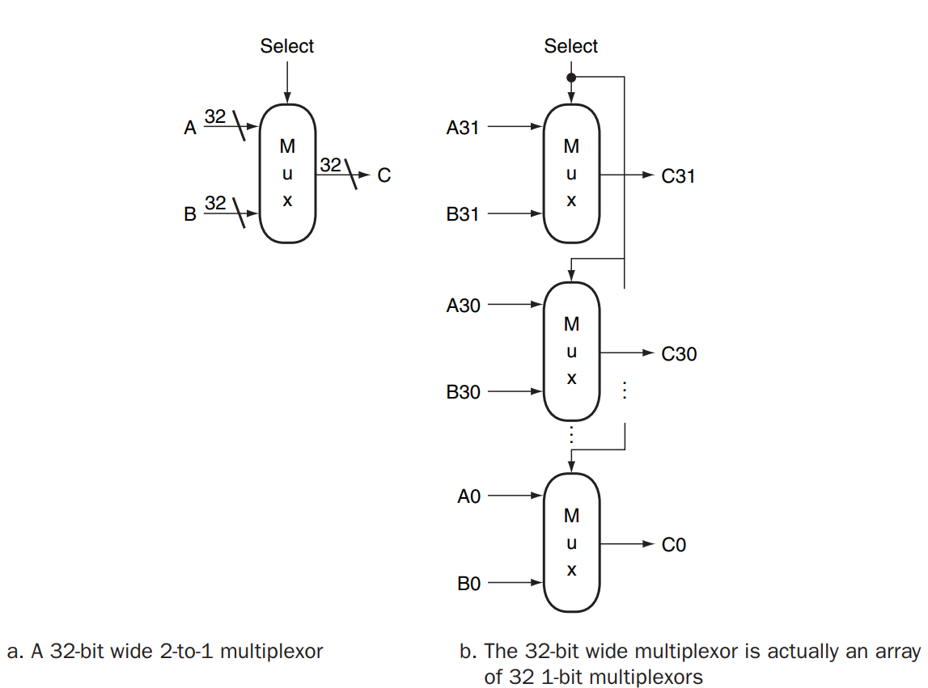
Multiplexers and Array of Multiplexers

Slide 7
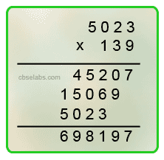
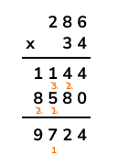
Binary Multiplication – Pencil and Paper Method

Slide 8

4-Bit Array Multiplier connected as AND and ADD
Multiplicand | Multiplicand | Multiplicand |  | A₃ | A₂ | A₁ | A₀
Multiplier |  |  | × | B₃ | B₂ | B₁ | B₀
 |  |  |  | A₃B₀ | A₂B₀ | A₁B₀ | A₀B₀
 |  |  | A₃B₁ | A₂B₁ | A₁B₁ | A₀B₁ | 0
 |  | A₃B₂ | A₂B₂ | A₁B₂ | A₀B₂ | 0 | 0
 | A₃B₃ | A₂B₃ | A₁B₃ | A₀B₃ | 0 | 0 | 0
Cout | P₆ | P₅ | P₄ | P₃ | P₂ | P₁ | P₀
HA = Half Adder
FA = Full Adder
Px = Partial Product

Slide 9
Binary Multiplication Examples continued
 |  |  |  | 1 | 1 | 0 | 1
 |  |  | x | 1 | 0 | 1 | 1
 |  |  |  | 1 | 1 | 0 | 1
 |  |  | 1 | 1 | 0 | 1 | X
 |  | 1 | 0 | 0 | 1 | 1 | 1
 |  | 0 | 0 | 0 | 0 | X | X
 |  | 1 | 0 | 0 | 1 | 1 | 1
 | 1 | 1 | 0 | 1 | X | X | X
1 | 0 | 0 | 0 | 1 | 1 | 1 | 1
Multiplicand
Multiplier
Shift Left by one
Partial product after first step
Another shift left
Partial product after second step
Another shift left
Partial product after final step
Answer = (10001111)₂ = (143)₁₀

Slide 10
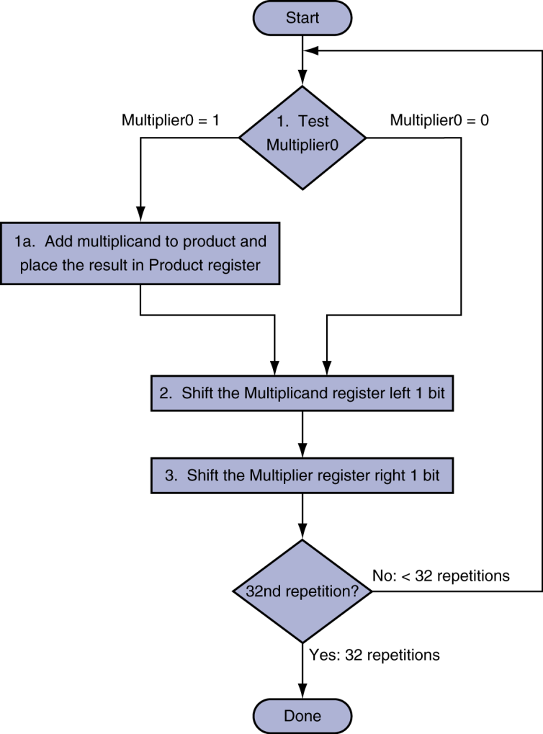
Direct Multiplication
Hardware
Basic Multiplication Algorithm using Hardware
If the least significant bit of the multiplier is ‘1’, add the
multiplicand to the product
If not, go to the next step
Shift the multiplicand left and the multiplier to the right in
the next two steps
These steps are repeated 32 times

Slide 11
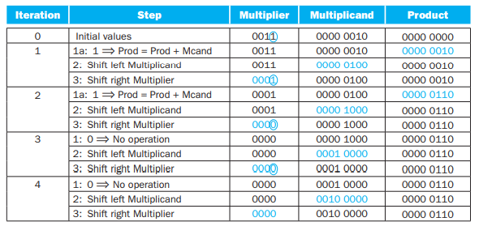
Application of Multiplication Algorithm
The bit examined to determine the next step is circled

Slide 12
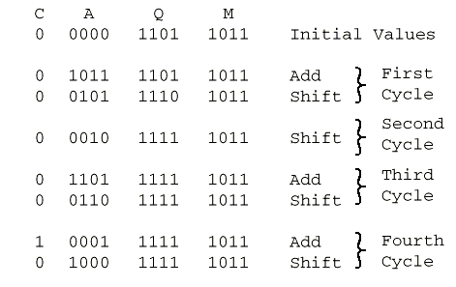
Execution of Sequential Multiplication
(unsigned numbers e.g.)
1011 Multiplicand (11 dec)
x 1101 Multiplier (13 dec)
1011 Partial products
0000 Note: if multiplier bit is 1 copy
1011 multiplicand (place value)
1011 otherwise zero
10001111 Product (143 dec)
Note: need double length result

Slide 13
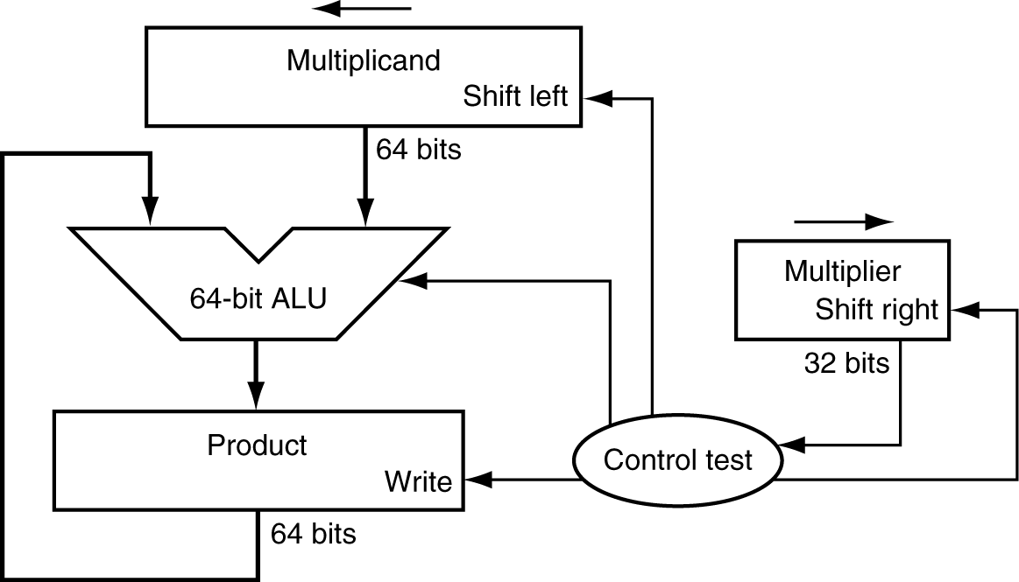
Multiplication Hardware
Start with long-multiplication approach
multiplicand
1000
× 1001
1000
0000
0000
1000
1001000
multiplier
product
Length of product is the sum of operand lengths
Initially 0

Slide 14
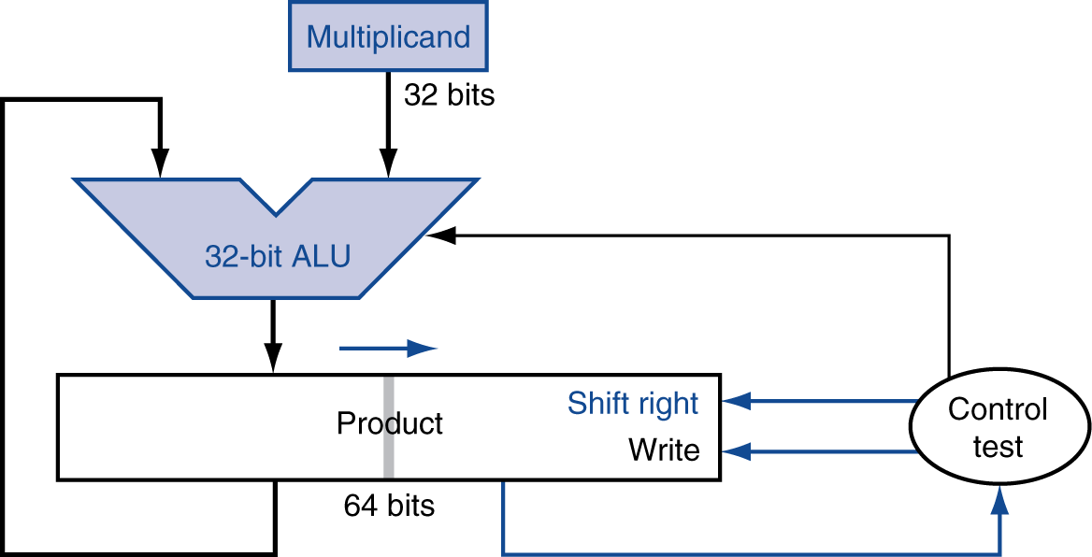
Refined Multiplication Hardware
Perform steps in parallel: add/shift
Improved Version of Multiplication Hardware
The Multiplicand Register, ALU and Multiplier Register are
32 bits wide
Only the Product Register is 64 bits
Now the Product is shifted right
Separate Multiplier register is not required, the multiplier
is placed in the right half of the Product register
One cycle per partial-product addition
  That’s ok, if frequency of multiplications is low

Slide 15
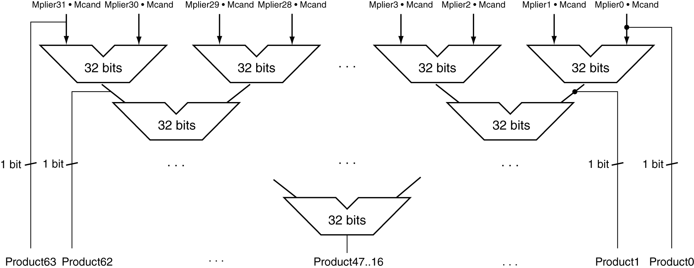
Faster Multiplier
Uses multiple adders
  Cost/performance tradeoff
Rather that using a single 32-bit Adder, this
Hardware ‘unrolls the loop’ to use 31 Adders
and then organizes them to minimize delay
Can be pipelined
  Several multiplication performed in parallel

Slide 16
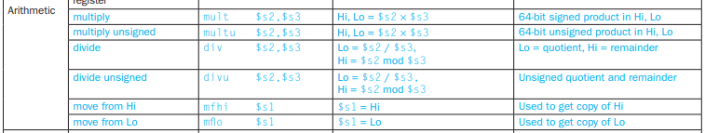
Assembly Instructions for Multiplication
Note: Use of Hi and Lo registers in CPU

Slide 17
MIPS Multiplication
Two 32-bit registers for product
  HI: most-significant 32 bits
  LO: least-significant 32-bits
Instructions
  mult rs, rt / multu rs, rt
    64-bit product in HI/LO
  mfhi rd / mflo rd
    Move from HI/LO to rd
    Can test HI value to see if product overflows 32 bits
  mul rd, rs, rt
    Least-significant 32 bits of product –> rd
MIPS provides a separate pair of 32-bit registers to
contain the 64 bit Product, called Hi and Lo registers
MIPS has two instructions: multiply (mult) and
multiply unsigned (multu)
To fetch the integer 32 bit Product, the programmer
uses move from lo (mflo).
MIPS Assembler also generates a pseudo instruction
for multiplier that specifies mflo and mfhi registers

Slide 18
Binary Division – Pencil and Paper Method

Slide 19
Division Operation in Decimal Numbers
Division of 274 ÷ 13
Quotient
 |  |  | 2 | 1
1 | 3 | 2 | 7 | 4
 | - | -2 | 6
 |  |  | 1 | 4
 |  | - | 1 | 3
 |  |  |  | 1 | Rem
Divisor
Dividend
Remainder

Slide 20
Decimal Division – another example
 |  | 1 | 0 | 0 | 4
 | 8 | 8 | 0 | 3 | 5
 | - | 8
 |  | 0 | 0 | 3 | 5
 |  | - |  | 3 | 2
 |  |  |  |  | 3
Quotient
Divisor
Dividend
Remainder

Slide 21
Division Operation in Binary – Example 1
Remainder
Quotient
Division of 274 ÷ 13
Divisor
 |  |  |  |  | 1 | 0 | 1 | 0 | 1
1 | 1 | 0 | 1 | 1 | 0 | 0 | 0 | 1 | 0 | 0 | 1 | 0
 |  |  | - | 0 | 1 | 1 | 0 | 1
 |  |  |  |  |  | 1 | 0 | 0 | 0 | 0
 |  |  |  |  | - |  | 1 | 1 | 0 | 1
 |  |  |  |  |  | 0 | 0 | 0 | 1 | 1 | 1 | 0
 |  |  |  |  |  |  | - |  | 1 | 1 | 0 | 1
 |  |  |  |  |  |  |  |  | 0 | 0 | 0 | 1 | Re
 |  |  | 2 | 1
1 | 3 | 2 | 7 | 4
 | - | -2 | 6
 |  |  | 1 | 4
 |  | - | 1 | 3
 |  |  |  | 1 | Rem
Dividend
Remainder

Slide 22
Division Operation in Binary – Example 2
Quotient
Division of 299 ÷ 15
Divisor
 |  |  |  |  | 1 | 0 | 0 | 1 | 1
1 | 1 | 1 | 1 | 1 | 0 | 0 | 1 | 0 | 1 | 0 | 1 | 1
 |  |  | - |  | 1 | 1 | 1 | 1
 |  |  |  |  | 0 | 0 | 1 | 1 | 1 | 0 | 1
 |  |  |  |  | - | 0 | 0 | 1 | 1 | 1 | 1
 |  |  |  |  |  | 0 | 0 | 1 | 1 | 1 | 0 | 1
 |  |  |  |  |  |  | - |  | 1 | 1 | 1 | 1
 |  |  |  |  |  |  |  |  | 1 | 1 | 1 | 0 | Re
Dividend
 |  |  | 1 | 9
1 | 5 | 2 | 9 | 9
 | - | 2 | 8 | 5
 |  |  | 1 | 4 | Rem
Remainder

Slide 23
Division – developing an Algorithm
Check for 0 divisor
Long division approach
  If divisor ≤ dividend bits
    1 bit in quotient, subtract
  Otherwise
    0 bit in quotient, bring down next dividend bit
Restoring division
  Do the subtract, and if remainder goes < 0, add divisor back
Signed division
  Divide using absolute values
  Adjust sign of quotient and remainder as required
quotient
dividend
1001
1000 1001010
-1000
10
101
1010
-1000
10
divisor
remainder
n-bit operands yield n-bit
quotient and remainder
SUBTRACTION: Use 2’s Compliment and ADD Circuits

Slide 24
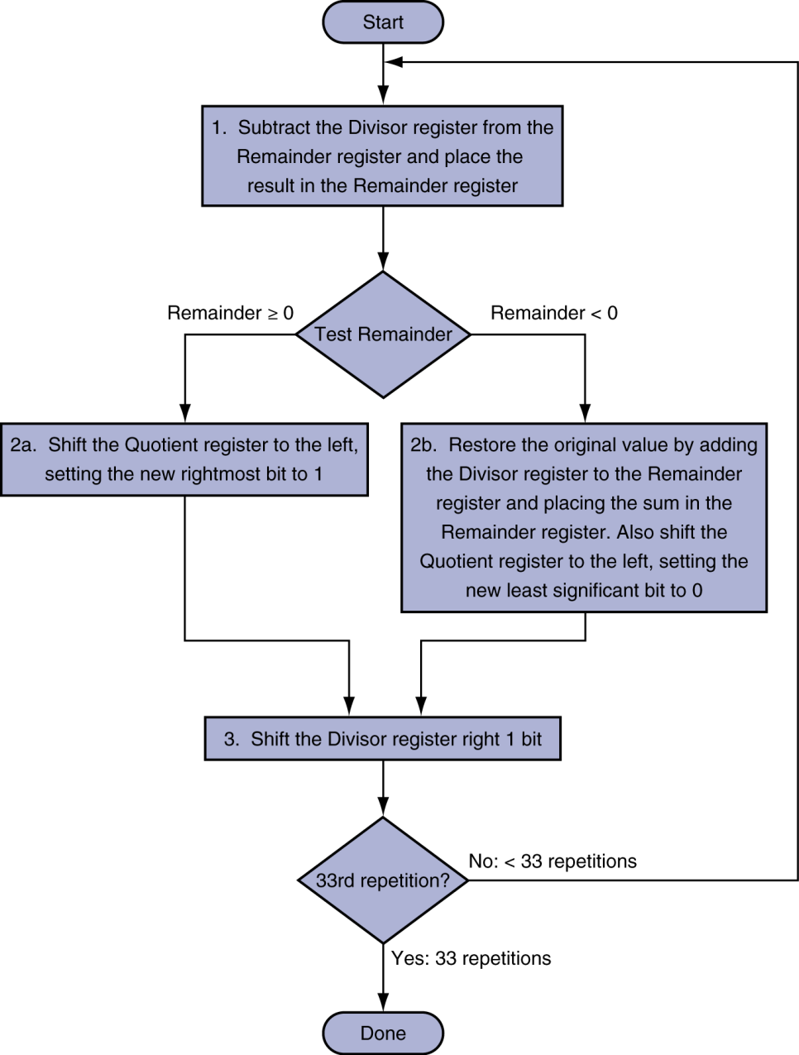
Simple Division Algorithm
Division Algorithm using the hardware
If the remainder is positive, the divisor goes into the dividend, so
step 2a generates a ‘1’ in the quotient
A negative remainder after step 1 means that the divisor did not
go into the dividend, so step 2b generates a 0 in the quotient and
Adds the divisor to the remainder. This reverses the subtraction
of step 1.
The final shift in step 3 aligns the divisor properly, relative to the
dividend for the next iteration
These steps are repeated 33 times

Slide 25
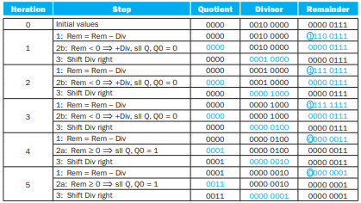
Applying Sequential Division Algorithm
The bit examined to determine the next step is encircled

Slide 26
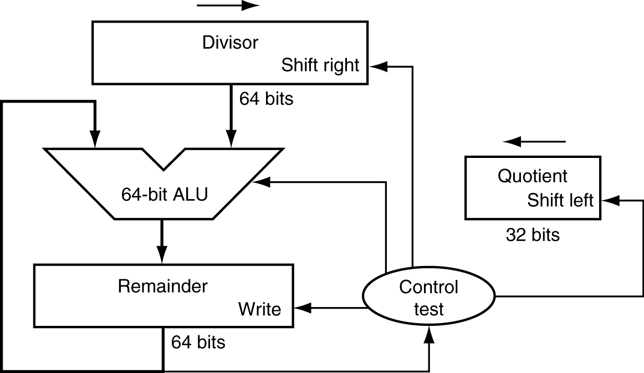
Simple Division Hardware Implementation
Initially divisor is in left half
Simple Division Hardware
The Divisor register, ALU and Remainder register are all
64 bits wide
Only the Quotient register is 32 bits
The 32 bits Divisor starts in the left half of the Divisor
register and it is shifted right 1 bit in each iteration
The Remainder is initialized with the Dividend
Control decides when to shift the Divisor and Quotient
registers and when to write the new value into the
remainder register
Initially dividend

Slide 27
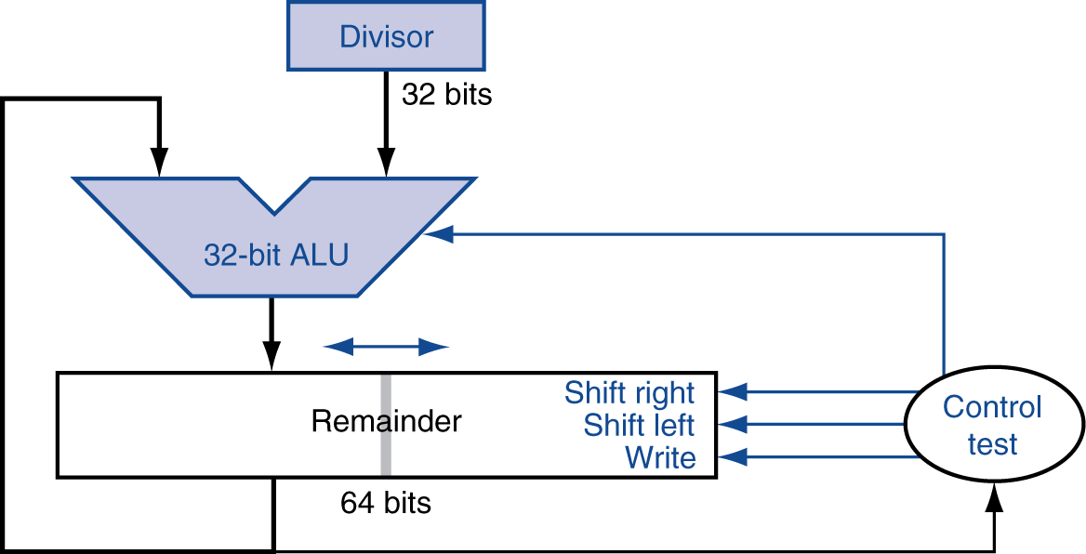
Optimized Divider
Improved Version of Division Hardware
The Divisor register, ALU, and Quotient register are all
32 bits wide
Only the Remainder register is 64 bits
The Quotient Register is combined with the right half of
the Remainder register
One cycle per partial-remainder subtraction
Looks a lot like a multiplier!
  Same hardware can be used for both

Slide 28
Right Shift and Division
Left shift by i places multiplies an integer by 2^{i}
Right shift divides by 2^{i} ?
  Only for unsigned integers
For signed integers
  Arithmetic right shift: replicate the sign bit
  e.g., –5 / 4
    11111011₂ >> 2 = 11111110₂ = –2
    Rounds toward –∞
  c.f. 11111011₂ >>> 2 = 00111110₂ = +62
Remember, each left shift is multiplication by 2

Slide 29
Assembly Instructions for Division
Note: Use of Hi and Lo registers in CPU

Slide 30
MIPS Division
Use HI/LO registers for result
  HI: 32-bit remainder
  LO: 32-bit quotient
Instructions
  div rs, rt / divu rs, rt
  No overflow or divide-by-0 checking
    Software must perform checks if required
  Use mfhi, mflo to access result
Divide instructions in MIPS
The same sequential hardware can be used for both multiply
and divide
The only requirement is that 64 bit register than can shift
left or right and a 32 bit ALU that adds or subtracts
MIPS uses the 32 bit Hi and 32 bit Lo registers for both
multiply and Divide instructions
Hi contains the Remainder
Lo contains the Quotient after the Divide instruction is
completed
div instruction is for signed numbers
divu instruction is unsigned numbers
MIPS assembler has pseudo instructions that specify three
registers to place desired result in a general-purpose register

Slide 31
Subword Parallellism
Graphics and audio applications can take advantage of performing simultaneous operations on short vectors
  Example: 128-bit adder:
    Sixteen 8-bit adds
    Eight 16-bit adds
    Four 32-bit adds
Also called data-level parallelism, vector parallelism, or Single Instruction, Multiple Data (SIMD)

Slide 32
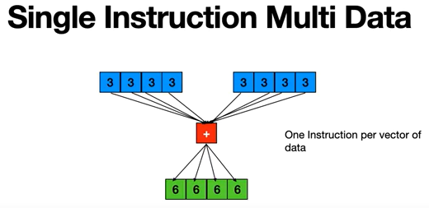
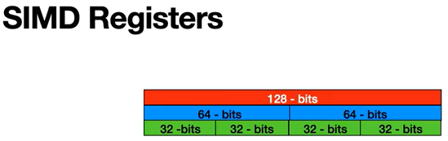
SIMD Introduction

Slide 33
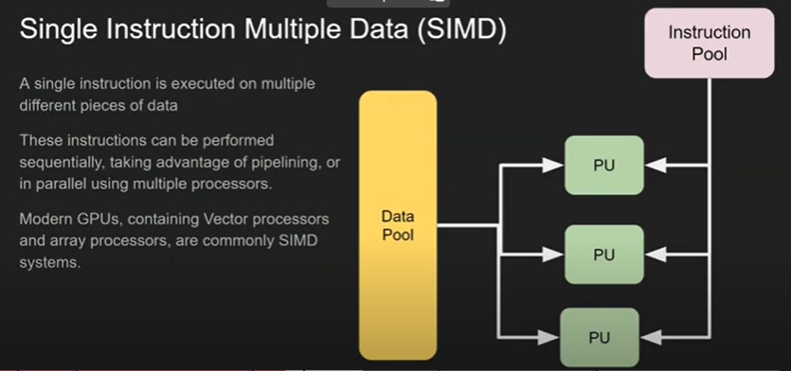
SIMD Processing

Slide 34
Streaming SIMD Extension 2 (SSE2)
Adds 4 × 128-bit registers
  Extended to 8 registers in AMD64/EM64T
Can be used for multiple FP operands
  2 × 64-bit double precision
  4 × 32-bit double precision
  Instructions operate on them simultaneously
    Single-Instruction Multiple-Data

Slide 35
Arithmetic for Multimedia
Graphics and media processing operates on vectors of 8-bit and 16-bit data
  Use 64-bit adder, with partitioned carry chain
    Operate on 8×8-bit, 4×16-bit, or 2×32-bit vectors
  SIMD (single-instruction, multiple-data)
Saturating operations
  On overflow, result is largest representable value
    2s-complement modulo arithmetic
  E.g., clipping in audio, saturation in video

Slide 36
Concluding Remarks
ISAs support arithmetic
  Signed and unsigned integers
  Floating-point approximation to reals
Bounded range and precision
  Operations can overflow and underflow
MIPS ISA
  Core instructions: 54 most frequently used
    100% of SPECINT, 97% of SPECFP
  Other instructions: less frequent

Slide 37
Readings
Chap 3 of P&H Textbook
Appendix C of P&H Textbook

