Slide 1
CS / EE 320
Computer Organization and Assembly Language
Spring 2025
Lecture 22
Shahid Masud
Topics: Memory Connections, Memory Arrays, Memory Organization, Memory Capacity and Configuration

Slide 2
Topics
Some review from previous lecture
Building Arrays from Memory Cells
Modular Approach to Building Complex Memory
CPU to Memory Connections
Address Decoding Schemes
2D and 2.5D Memory Organization
Examples of Address Decoding and Modular Memory Construction
QUIZ 4 TODAY

Slide 3
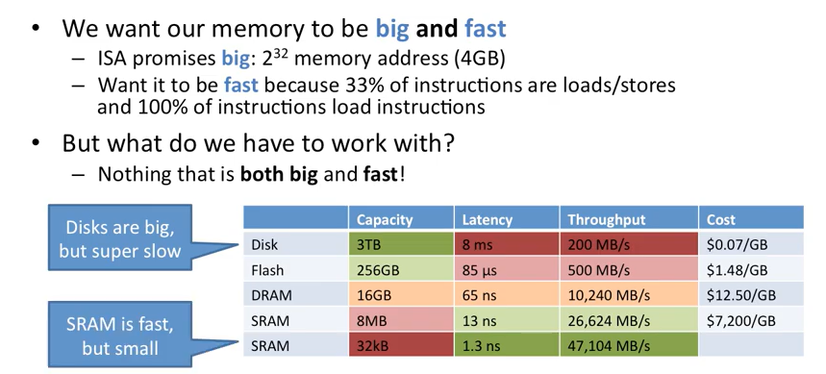
Ideal Memory Requirement

Slide 4
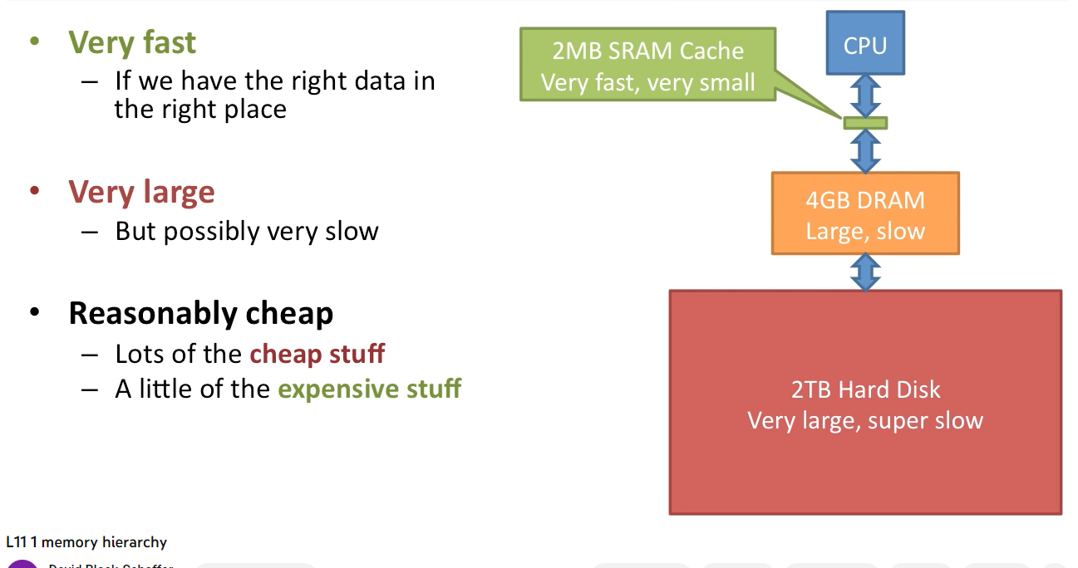
Advantages of Memory Hierarchy

Slide 5
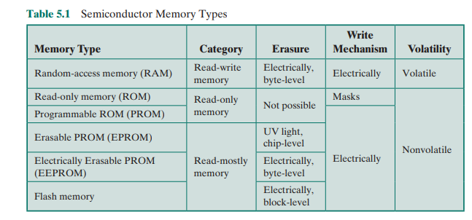
Semiconductor Memory Types - Summary

Slide 6
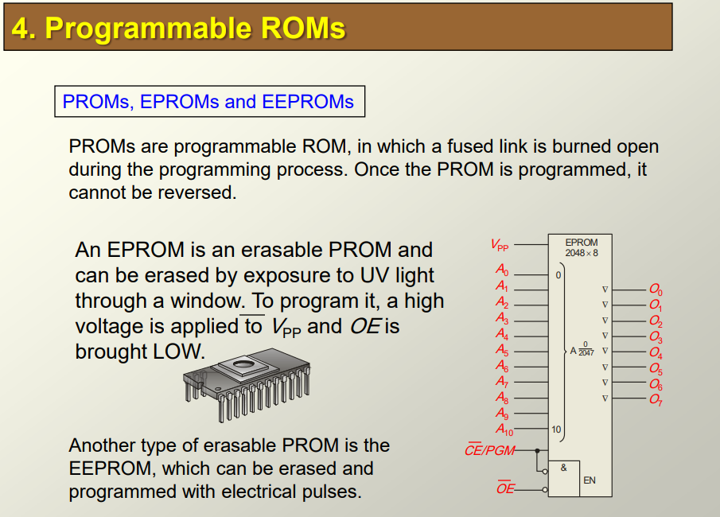
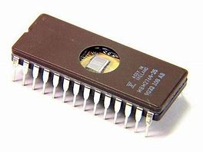
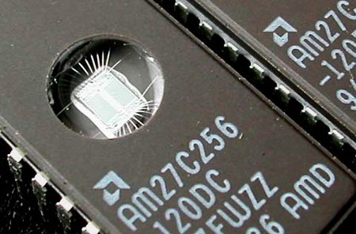
Programmable ROM EPROM

Slide 7
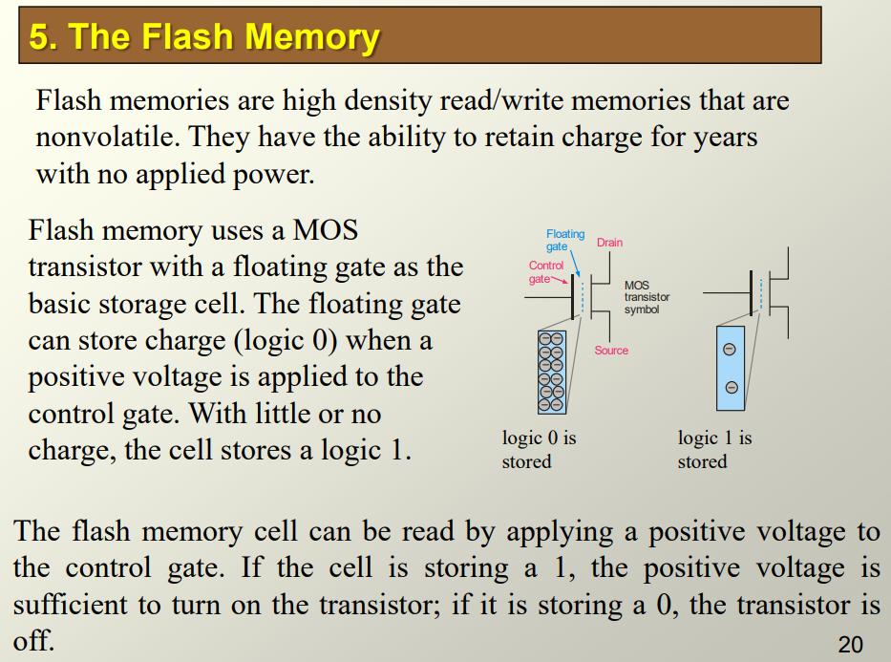
Flash Memory

Slide 8
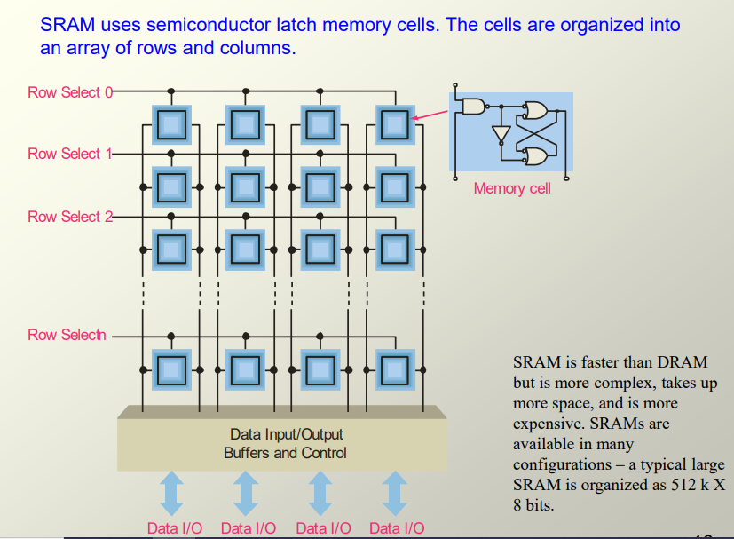
Memory Cell Organization as Array

Slide 9
Memory Ports and Connection to CPU

Slide 10
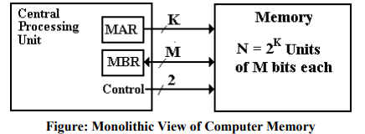
Monolithic View of Computer Memory

Slide 11
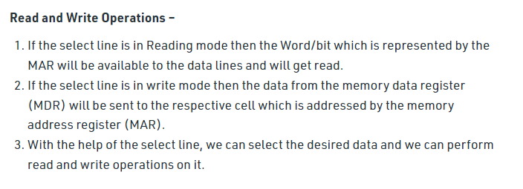
Read and Write Operations from CPU

Slide 12
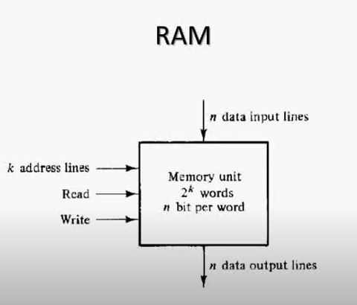
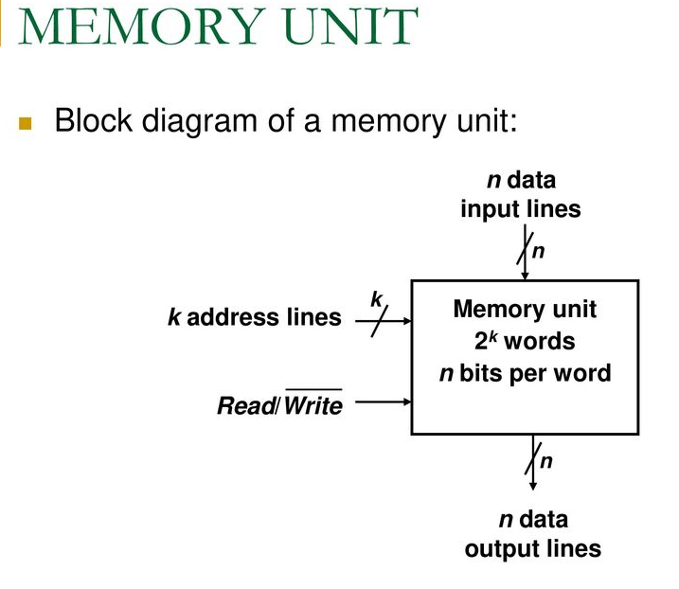
Memory at Block Level with Read / Write
Two Ways of Read / Write signals

Slide 13
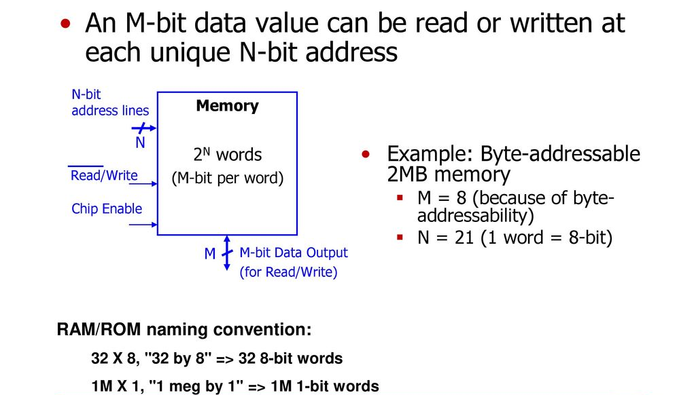
Block Diagram of Memory
Chip Enable

Slide 14
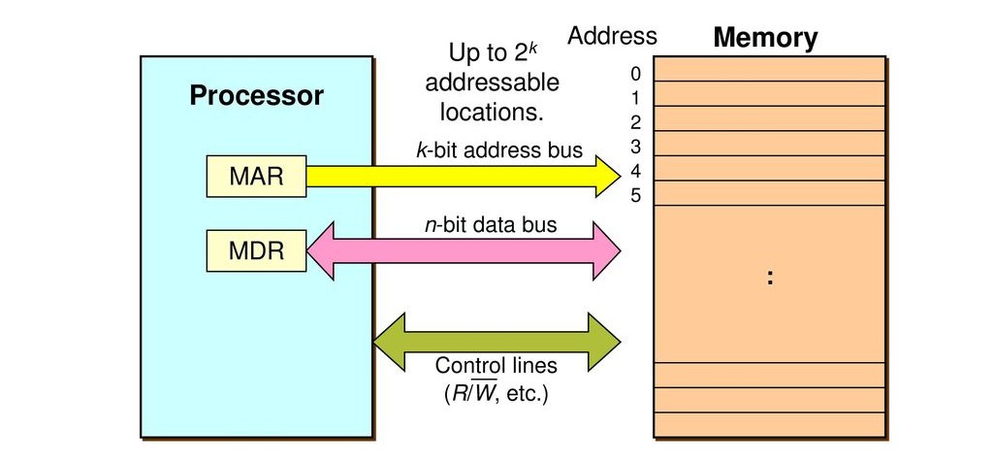
Memory Connections with CPU
Von Neumann Architecture

Slide 15
Memory Address Mechanism

Slide 16
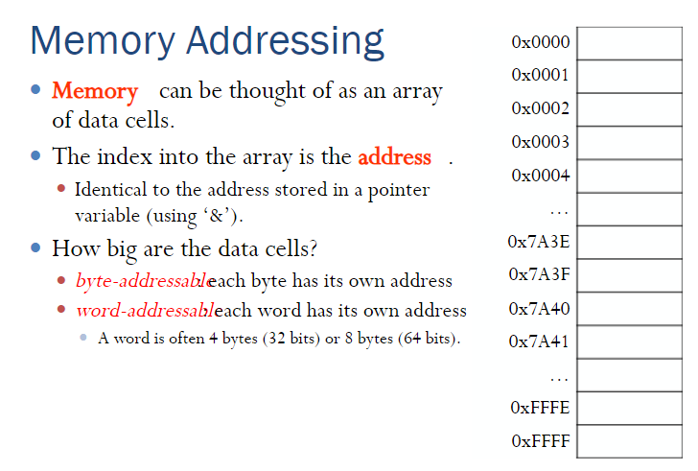
Memory Addressing

Slide 17
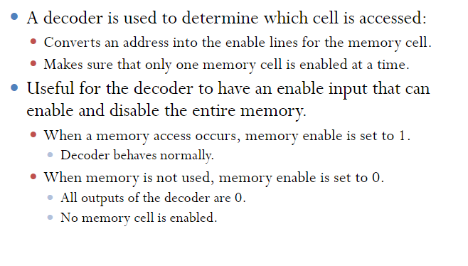
Decoding Memory Addresses

Slide 18
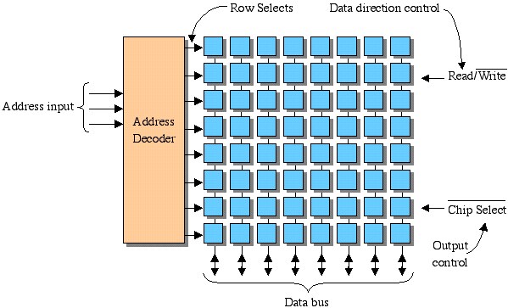
Row Select Decoders – 8 x 8 Memory Array
2D Array only selects entire ROW

Slide 19
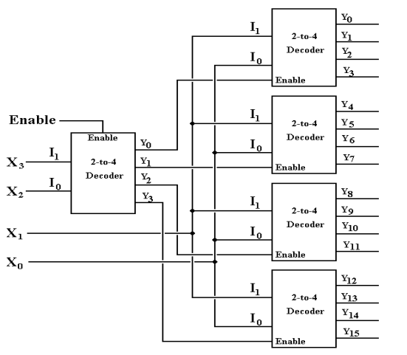
Address Row Decoders - Example
4 Bit Address

Slide 20
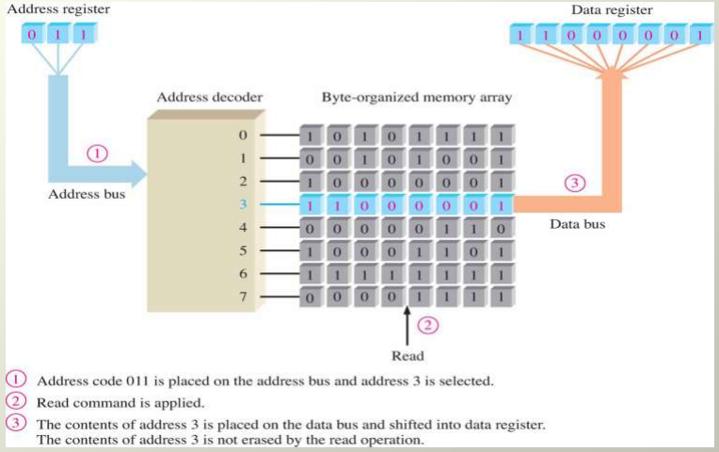
Memory Read Operation

Slide 21
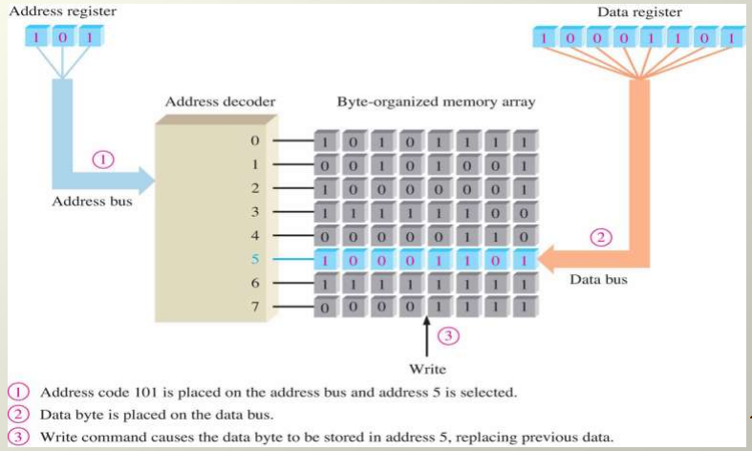
Memory Write Operation

Slide 22
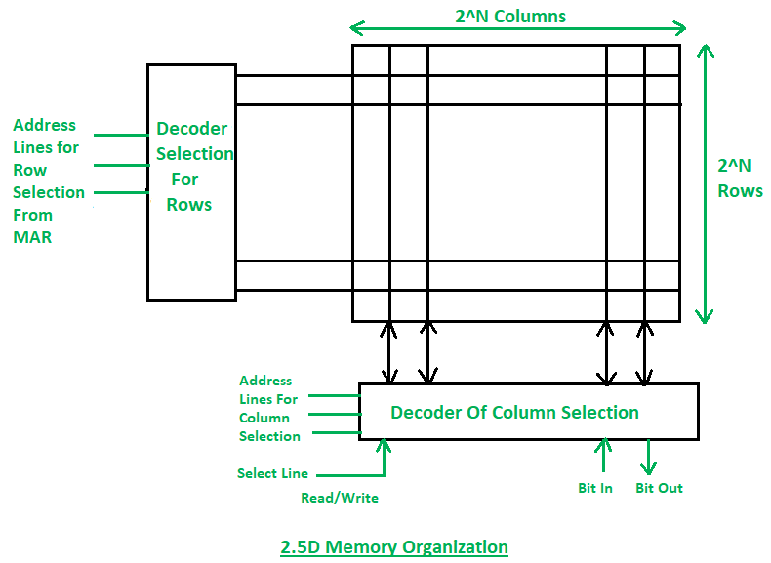
2.5D Memory Organization
2.5D Memory Organization can Select ROWs as well as COLUMNs

Slide 23
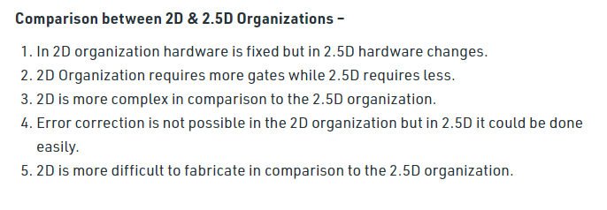
Comparison between 2 D and 2.5 D Organization

Slide 24
Expanding Memory Configuration through ADDRESS DECODING

Slide 25
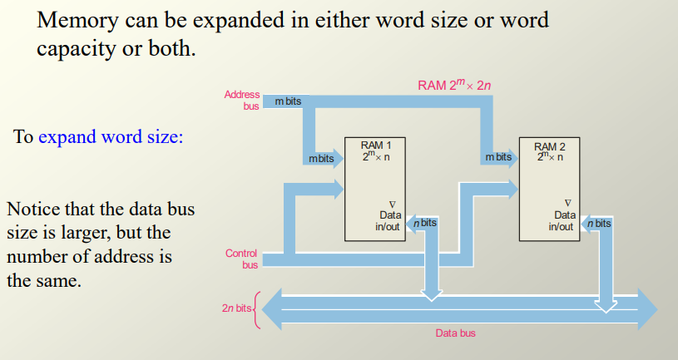
Expanding Memory Configuration

Slide 26
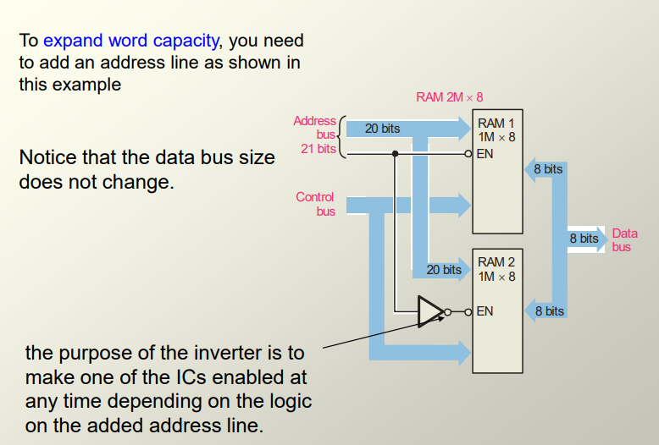
Expand Word Capacity

Slide 27
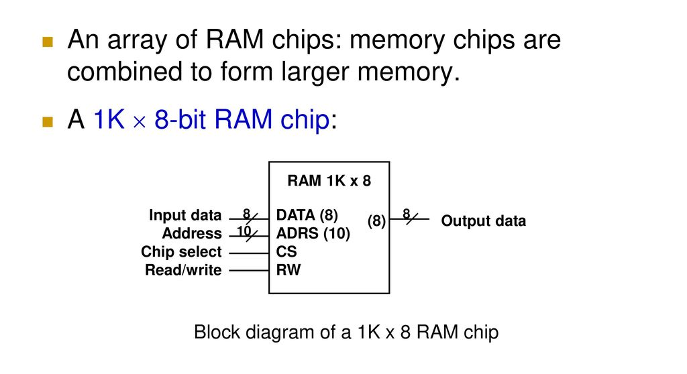
A Memory Array

Slide 28
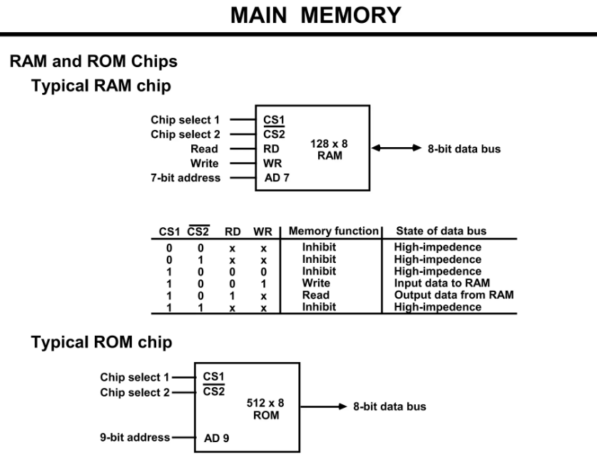
Example 3a
Given types of RAM and ROM

Slide 29
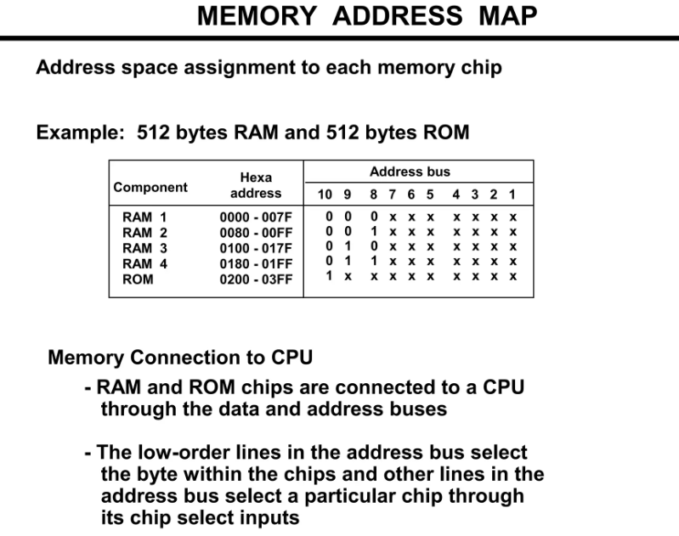
Example 3b
In Memory Map Space:
512 x 8 bits RAM is required
512 x 8 bits ROM is required

Slide 30
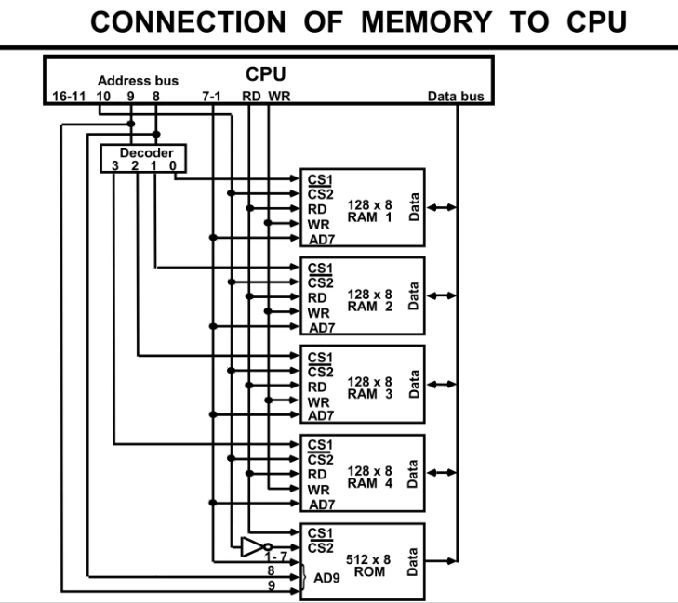
Example 3c
Look at How Address Bits
are connected to select the right
memory module for any address in
the Range.

Slide 31
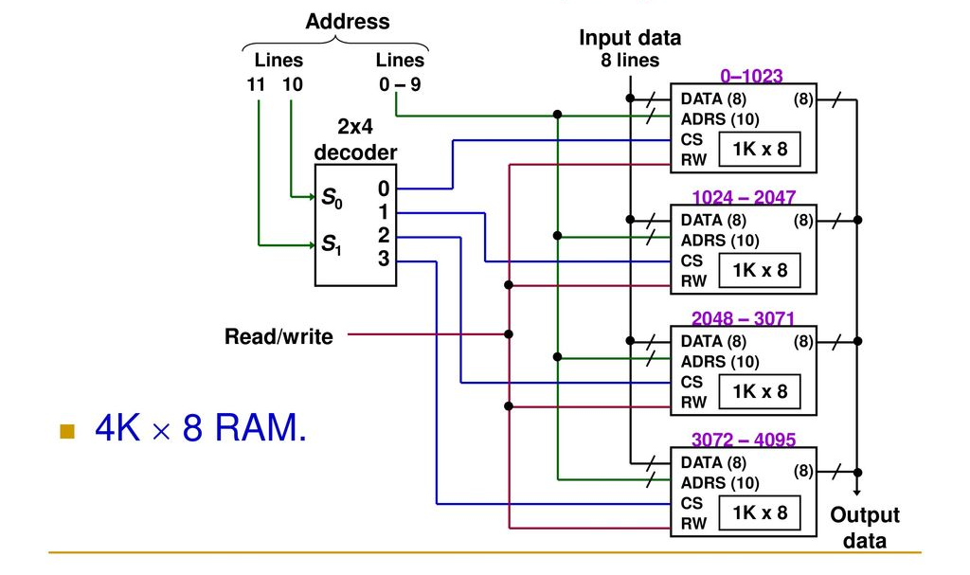
Memory Array Expansion with Decoder

Slide 32
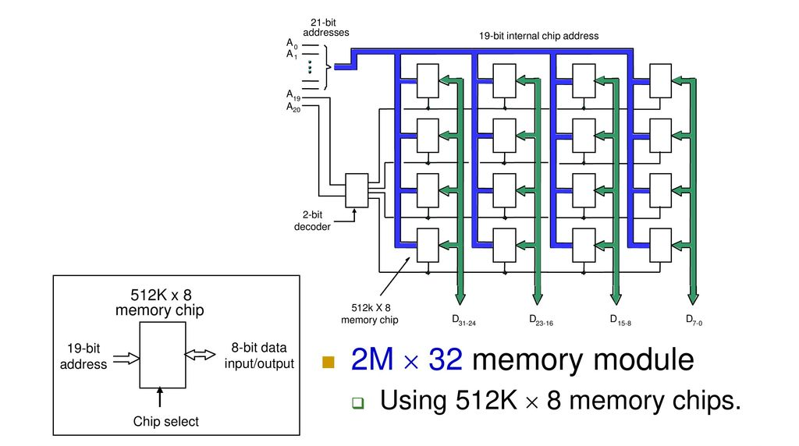
Complex Memory Arrays Expansion in 2 D
See how Address Lines are
Used to Select Relevant Module

