Slide 1

Data Types
Dr. Shahid Mahmood Awan
http://turing.cs.pub.ro/mas_11 curs.cs.pub.ro
shahid.awan@umt.edu.pk
University of Management and Technology

Slide 2
Getting to Know Your Data
Data Objects and Attribute Types
Basic Statistical Descriptions of Data
Data Visualization
Measuring Data Similarity and Dissimilarity
Summary

Slide 3
Types of Data Sets
Record
Relational records
Data matrix, e.g., numerical matrix, crosstabs
Document data: text documents: term-frequency vector
Transaction data
Graph and network
World Wide Web
Social or information networks
Molecular Structures
Ordered
Video data: sequence of images
Temporal data: time-series
Sequential Data: transaction sequences
Genetic sequence data
Spatial, image and multimedia:
Spatial data: maps
Image data:
Video data:

Slide 4
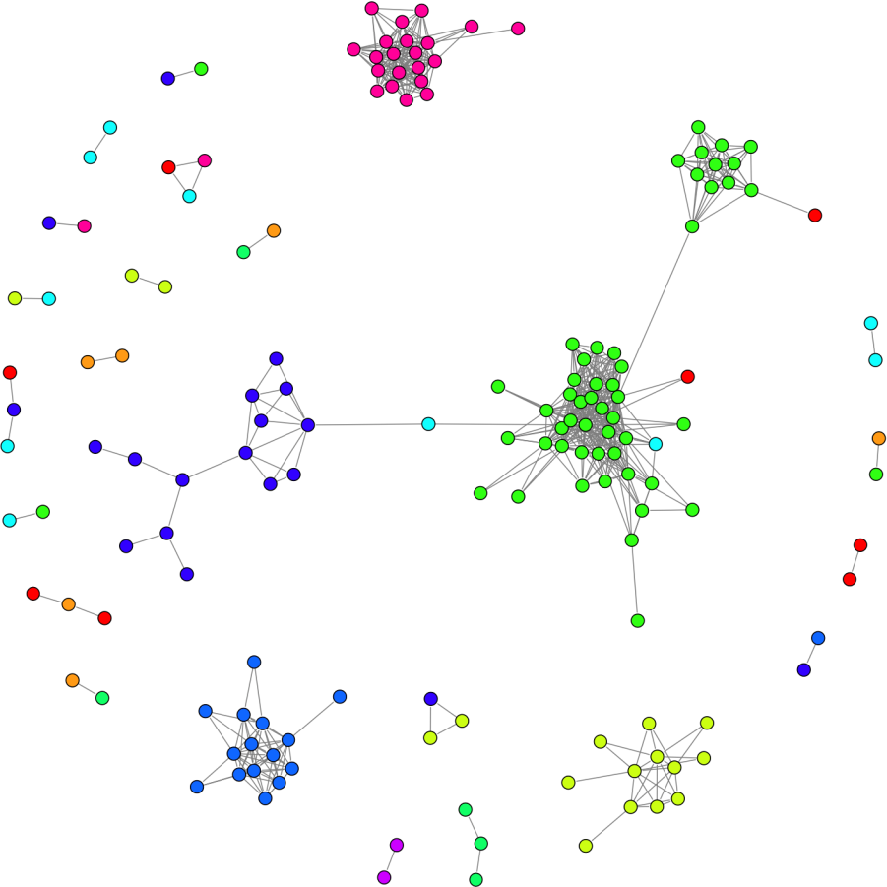
Important Characteristics of Structured Data
Dimensionality
Curse of dimensionality
Sparsity
Only presence counts
Resolution
Patterns depend on the scale
Distribution
Centrality and dispersion

Slide 5
Data Objects
Data sets are made up of data objects.
A data object represents an entity.
Examples:
sales database: customers, store items, sales
medical database: patients, treatments
university database: students, professors, courses
Also called samples , examples, instances, data points, objects, tuples.
Data objects are described by attributes.
Database rows -> data objects; columns ->attributes.

Slide 6
Attributes
Attribute (or dimensions, features, variables): a data field, representing a characteristic or feature of a data object.
E.g., customer _ID, name, address
observations.
Univariate, bivariate,
Types:
Nominal
Binary
Numeric: quantitative
Interval-scaled
Ratio-scaled

Slide 7
Attribute Types
Nominal: Relating to Names
categories, states, or “names of things”
Hair_color = {auburn, black, blond, brown, grey, red, white}
marital status = {single, married, divorced, and widowed}
Occupation = {teacher, dentist, programmer, farmer}
ID numbers, zip codes

Slide 8
Attribute Types
Binary
Nominal attribute with only 2 states (0 and 1)
Symmetric binary: both outcomes equally important
e.g., gender
Asymmetric binary: outcomes not equally important.
e.g., medical test (positive vs. negative)
Convention: assign 1 to most important outcome (e.g., HIV positive), the rarest one,

Slide 9
Attribute Types
Ordinal
Values have a meaningful order (ranking) but magnitude between successive values is not known.
Drink Size = {small, medium, large},
Shirt Size = {small, medium, large},
Class grades,
Army rankings
The values of such qualitative attributes are typically words representing categories.

Slide 10
Numeric Attribute Types
Measurable Quantity (integer or real-valued)
Numeric attributes can be interval-scaled or ratio-scaled.
Interval Scaled
Measured on a scale of equal-sized units
Values have order
Can be positive, 0 , or negative
E.g., temperature in C˚or F˚, calendar dates
temperature of 20˚C is five degrees higher than a temperature of 15˚C
No true zero-point

Slide 11
Numeric Attribute Types
Ratio-Scaled
Inherent zero-point
Start from ‘0’
We can speak of values as being an order of magnitude larger than the unit of measurement (10 K˚ is twice as high as 5 K˚).
e.g., temperature in Kelvin, length, counts, monetary quantities
You are 100 times richer with $100 than with $1

Slide 12
Discrete vs. Continuous Attributes
Discrete Attribute
Has only a finite or countably infinite set of values
E.g., zip codes, profession, or the set of words in a collection of documents
Sometimes, represented as integer variables
Note: Binary attributes are a special case of discrete attributes

Slide 13
Discrete vs. Continuous Attributes
Continuous Attribute
Has real numbers as attribute values
E.g., temperature, height, or weight
Practically, real values can only be measured and represented using a finite number of digits
Continuous attributes are typically represented as floating-point variables

