Slide 1

Data Exploration
Dr. Shahid Mahmood Awan
http://turing.cs.pub.ro/mas_11 curs.cs.pub.ro
shahid.awan@umt.edu.pk
University of Management and Technology

Slide 2
Basic Statistical Descriptions of Data
Motivation
To better understand the data: central tendency, variation and spread
Data dispersion characteristics
median, max, min, quantiles, outliers, variance, etc.

Slide 3
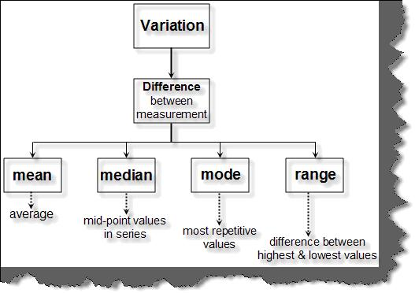

Slide 4
Basic Statistical Descriptions of Data
Numerical dimensions
correspond to sorted intervals
Data dispersion: analyzed with multiple granularities of precision
Boxplot or quantile analysis on sorted intervals
Dispersion analysis on computed measures
Folding measures into numerical dimensions
Boxplot or quantile analysis on the transformed cube

Slide 5
Measuring the Central Tendency
Mean (algebraic measure) (sample vs. population):
Note: n is sample size and N is population size.
Weighted arithmetic mean:
Trimmed mean: chopping extreme values

Slide 6
Activity
Calculate Mean,
Data: 3, 1, 5
Data: Class CGPA
Suppose we have the following values for salary (in thousands of dollars), shown in increasing order: 30, 36, 47, 50, 52, 52, 56, 60, 63, 70, 70, 110.

Slide 7
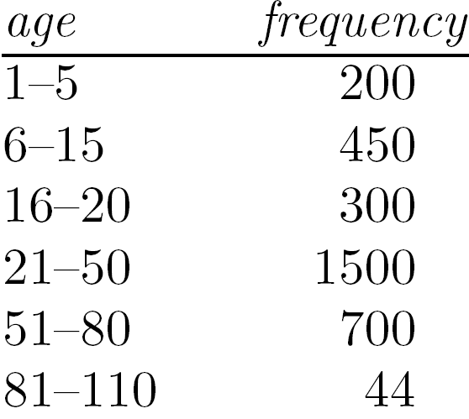
Measuring the Central Tendency…
Mode
Value that occurs most frequently in the data
1,2,3,3,3,4,4,5 (mode = 3)
Unimodal, bimodal, trimodal
Empirical formula:
Mode interval

Slide 8
Measuring the Central Tendency…
Median:
Middle value if odd number of values, or average of the middle two values otherwise
Estimated by interpolation (for grouped data):
Median interval

Slide 9
Measuring the Central Tendency…
Midrange
Average of max and min values
(Max + Min)/2

Slide 10
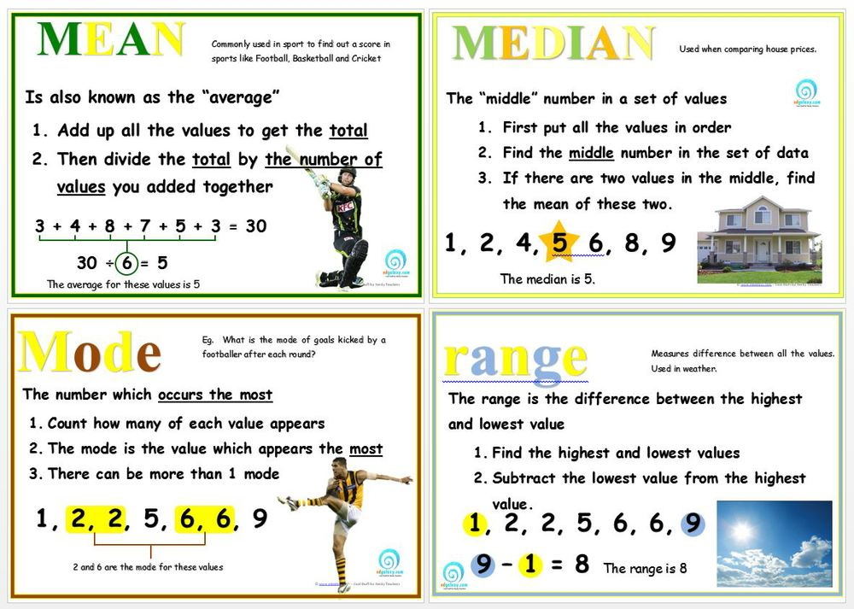

Slide 11
Activity
Calculate Median, Mode, Midrange
Data: 3, 1, 5
Data: Class CGPA
Suppose we have the following values for salary (in thousands of dollars), shown in increasing order: 30, 36, 47, 50, 52, 52, 56, 60, 63, 70, 70, 110.

Slide 12
Class Activity
A student has gotten the following grades on his tests: 87, 95, 76, and 88.
He wants an 85 or better overall. What is the minimum grade he must get on the last test in order to achieve that average?

Slide 13
A student has gotten the following grades on his tests: 87, 95, 76, and 88.
He wants an 85 or better overall. What is the minimum grade he must get on the last test in order to achieve that average?
The unknown score is "x". Then the desired average is:
(87 + 95 + 76 + 88 + x) ÷ 5 = 85
Multiplying through by 5 and simplifying, I get:
87 + 95 + 76 + 88 + x = 425 346 + x = 425 x = 79
He needs to get at least a 79 on the last test.

Slide 14
Measuring the Central Tendency
Mean (algebraic measure) (sample vs. population):
Note: n is sample size and N is population size.
Weighted arithmetic mean:
Trimmed mean: chopping extreme values
Median:
Middle value if odd number of values, or average of the middle two values otherwise
Estimated by interpolation (for grouped data):
Mode
Value that occurs most frequently in the data
Unimodal, bimodal, trimodal
Empirical formula:

Slide 15
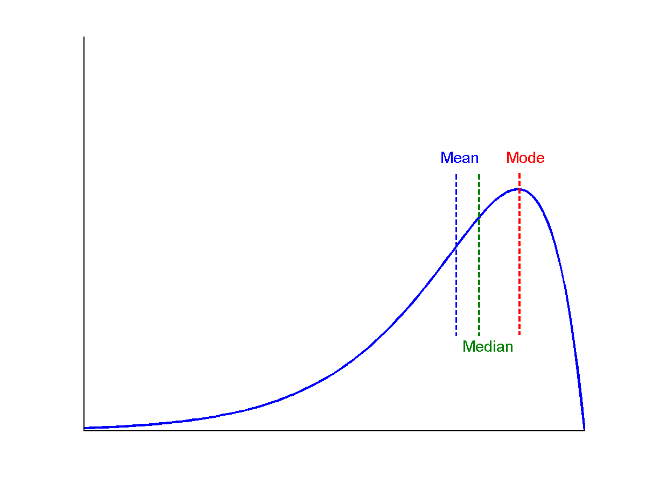
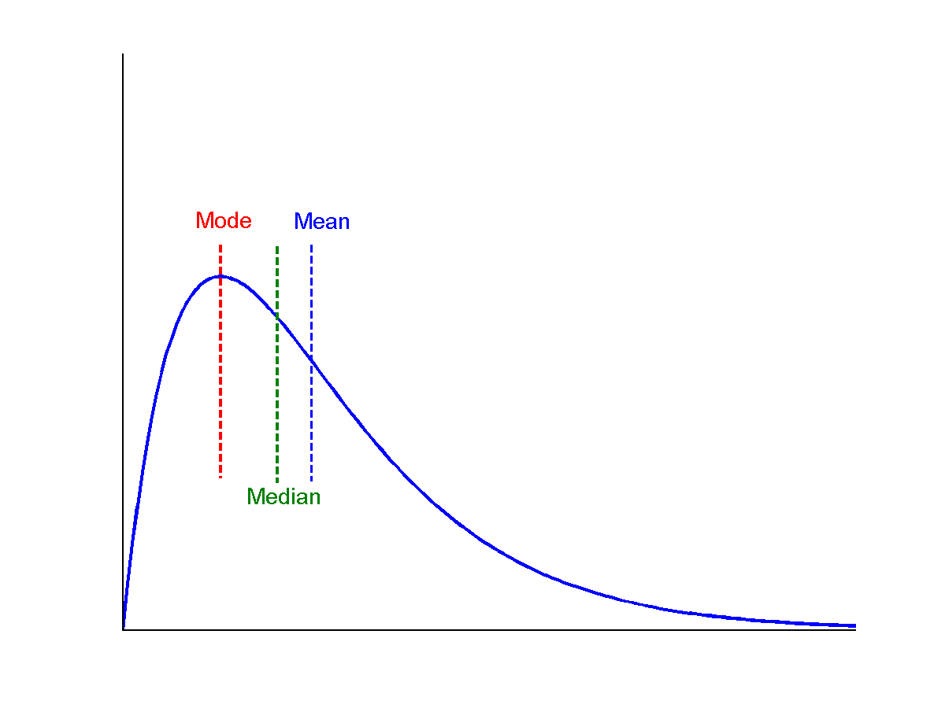
Symmetric vs. Skewed Data
Median, mean and mode of symmetric, positively and negatively skewed data
symmetric
positively skewed
negatively skewed

Slide 16
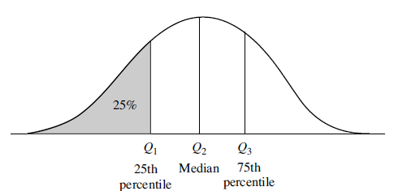
Measuring the Dispersion of Data
Quartiles, outliers and boxplots
Quartiles: Q₁ (25th percentile), Q₃ (75th percentile)
Inter-quartile range: IQR = Q₃ – Q₁
Five number summary: min, Q₁, median, Q₃, max
Boxplot: ends of the box are the quartiles; median is marked; add whiskers, and plot outliers individually
Outlier: usually, a value higher/lower than 1.5 x IQR
at least 1.5 x IQR above the third quartile or below the first quartile.

Slide 17
Measuring the Dispersion of Data
Variance and standard deviation (sample: s, population: σ)
Variance: (algebraic, scalable computation)
The average of the squared differences from the Mean.
Standard deviation s (or σ) is the square root of variance s² ⁽or σ²⁾
The Standard Deviation is a measure of how spread out numbers are.

Slide 18
Standard Deviation
http://standard-deviation.appspot.com/

Slide 19
Python Code Examples
Describing a numeric Series.
s = pd.Series([1, 2, 3])
s.describe()
count 3.0
mean 2.0
std 1.0
min 1.0
25% 1.5
50% 2.0
75% 2.5
max 3.0
Describing a categorical Series.
s = pd.Series(['a', 'a', 'b', 'c'])
s.describe()
count 4
unique 3
top a
freq 2
dtype: object
Notes:
https://pandas.pydata.org/pandas-docs/stable/generated/pandas.DataFrame.describe.html

Slide 20

Standard Deviation
A | C | E
Test Score (X) | X–Mean (d) | d²
100 | 50
110 | 40
120 | 30
130 | 20
140 | 10
150 | 0
160 | -10
170 | -20
180 | -30
190 | -40
200 | -50
SUM

Slide 21

Standard Deviation
A | B | C | D | E
Test Score (X) | Frequency (f) | X–Mean (d) | fd | fd²
100 | 8 | 50 | 400 | 20,000
110 | 13 | 40 | 520 | 20,800
120 | 17 | 30 | 510 | 15,300
130 | 20 | 20 | 400 | 8,000
140 | 21 | 10 | 210 | 2,100
150 | 22 | 0 | 0 | 0
160 | 21 | -10 | -210 | 2,100
170 | 20 | -20 | -400 | 8,000
180 | 17 | -30 | -510 | 15,300
190 | 13 | -40 | -520 | 20,800
200 | 8 | -50 | -400 | 20,000
SUM | 180 |  |  | 132,400

Slide 22
Example: Dispersion of Data
30, 36, 47, 50, 52, 52, 56, 60, 63, 70, 70, 110
Q1
Q2
Q3
IQR
Five Number Summary
Variance
SD

Slide 23
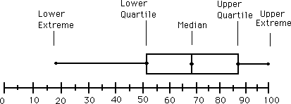
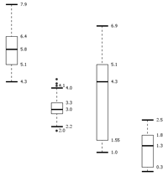
Boxplot Analysis
Five-number summary of a distribution
Minimum, Q1, Median, Q3, Maximum
Boxplot
Data is represented with a box
The ends of the box are at the first and third quartiles, i.e., the height of the box is IQR
The median is marked by a line within the box
Whiskers: two lines outside the box extended to Minimum and Maximum
Outliers: points beyond a specified outlier threshold, plotted individually

Slide 24
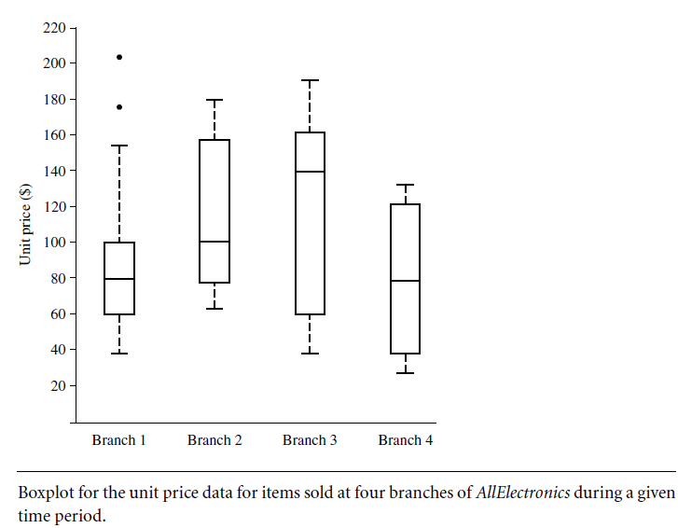

Slide 25
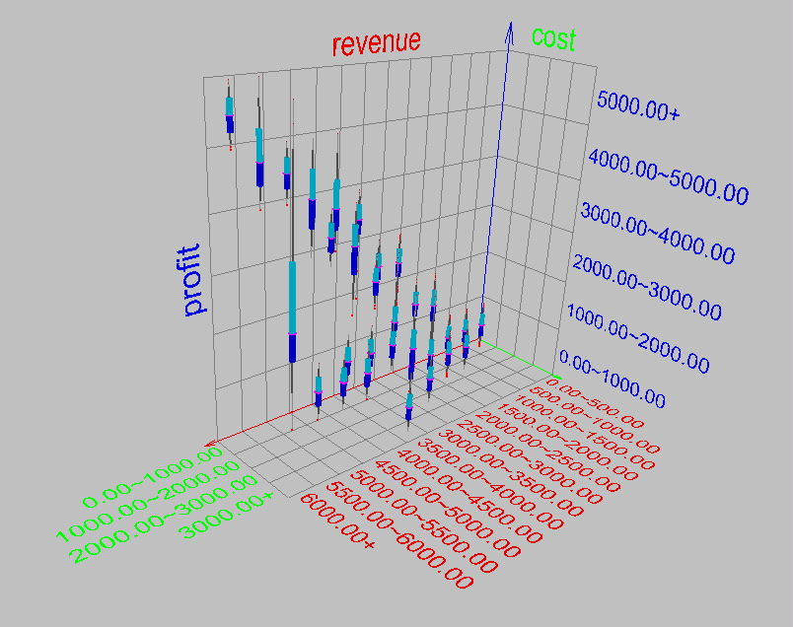
Visualization of Data Dispersion: 3-D Boxplots

Slide 26
Properties of Normal Distribution Curve
The normal (distribution) curve
From μ–σ to μ+σ: contains about 68% of the measurements (μ: mean, σ: standard deviation)
From μ–2σ to μ+2σ: contains about 95% of it
From μ–3σ to μ+3σ: contains about 99.7% of it

Slide 27
Graphic Displays of Basic Statistical Descriptions
Boxplot: graphic display of five-number summary
Histogram: x-axis are values, y-axis repres. frequencies
Quantile plot: each value x_{i} is paired with f_{i} indicating that approximately 100 f_{i} % of data are ≤ x_{i}
Quantile-quantile (q-q) plot: graphs the quantiles of one univariant distribution against the corresponding quantiles of another
Scatter plot: each pair of values is a pair of coordinates and plotted as points in the plane

Slide 28
Histogram Analysis
Histogram: Graph display of tabulated frequencies, shown as bars
It shows what proportion of cases fall into each of several categories
Differs from a bar chart in that it is the area of the bar that denotes the value, not the height as in bar charts, a crucial distinction when the categories are not of uniform width
The categories are usually specified as non-overlapping intervals of some variable. The categories (bars) must be adjacent

Slide 29
Histograms Often Tell More than Boxplots
The two histograms shown in the left may have the same boxplot representation
The same values for: min, Q1, median, Q3, max
But they have rather different data distributions

Slide 30
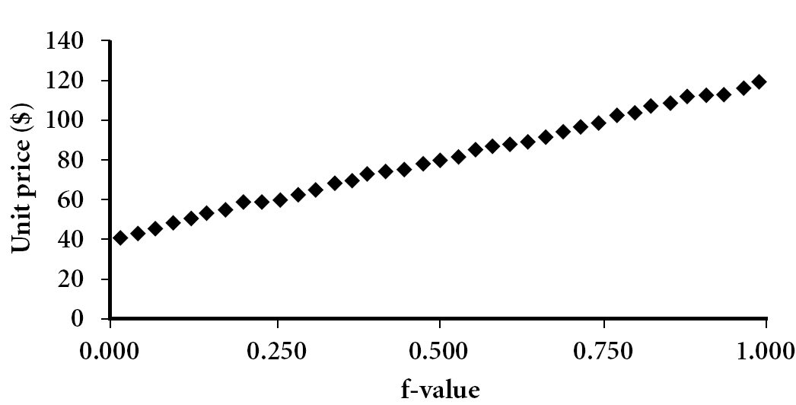
Quantile Plot
Displays all of the data (allowing the user to assess both the overall behavior and unusual occurrences)
Plots quantile information
For a data x_{i} data sorted in increasing order, f_{i} indicates that approximately 100 f_{i}% of the data are below or equal to the value x_{i}

Slide 31
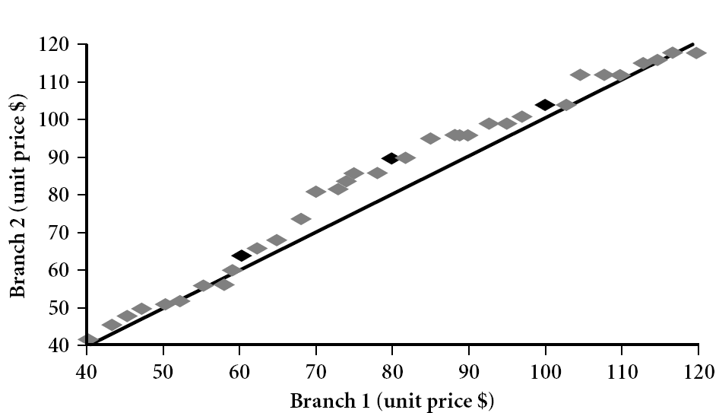
Quantile-Quantile (Q-Q) Plot
Graphs the quantiles of one univariate distribution against the corresponding quantiles of another
View: Is there is a shift in going from one distribution to another?
Example shows unit price of items sold at Branch 1 vs. Branch 2 for each quantile. Unit prices of items sold at Branch 1 tend to be lower than those at Branch 2.
Notes:
Note: We need to label the dark plotted points as Q1, Median, Q3 – that would help in understanding this graph.
Tell audience: There is a shift in distribution of branch 1 WRT branch 2 in that the unit prices of items sold at branch 1 tend to be lower than those at branch 2.

Slide 32
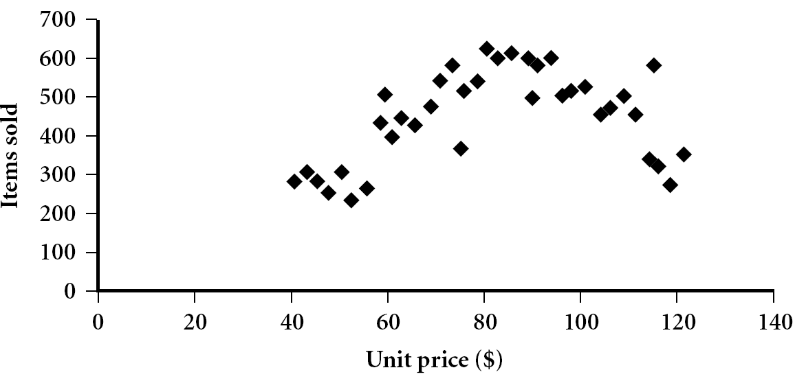
Scatter plot
Provides a first look at bivariate data to see clusters of points, outliers, etc
Each pair of values is treated as a pair of coordinates and plotted as points in the plane

Slide 33
Positively and Negatively Correlated Data
The left half fragment is positively correlated
The right half is negative correlated

Slide 34
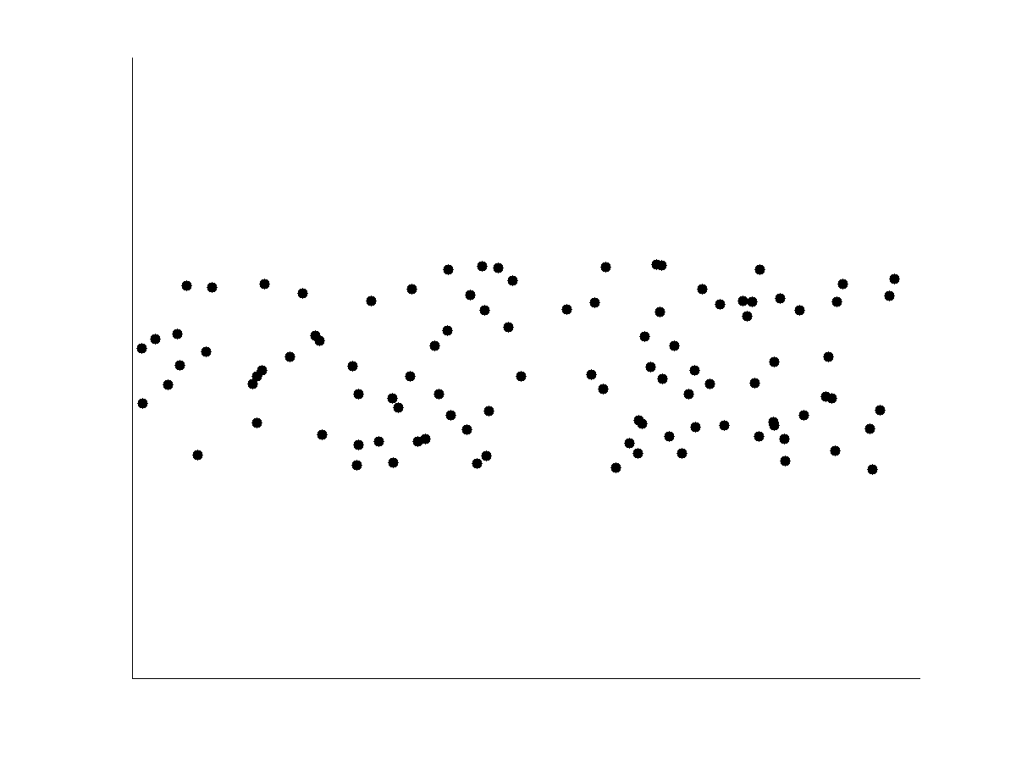
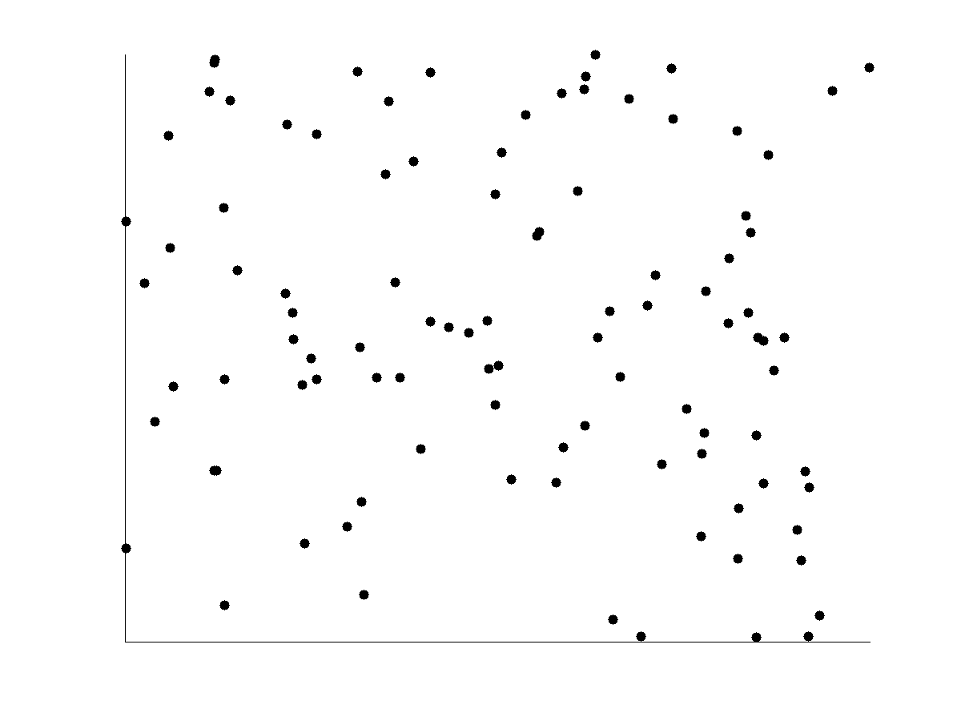
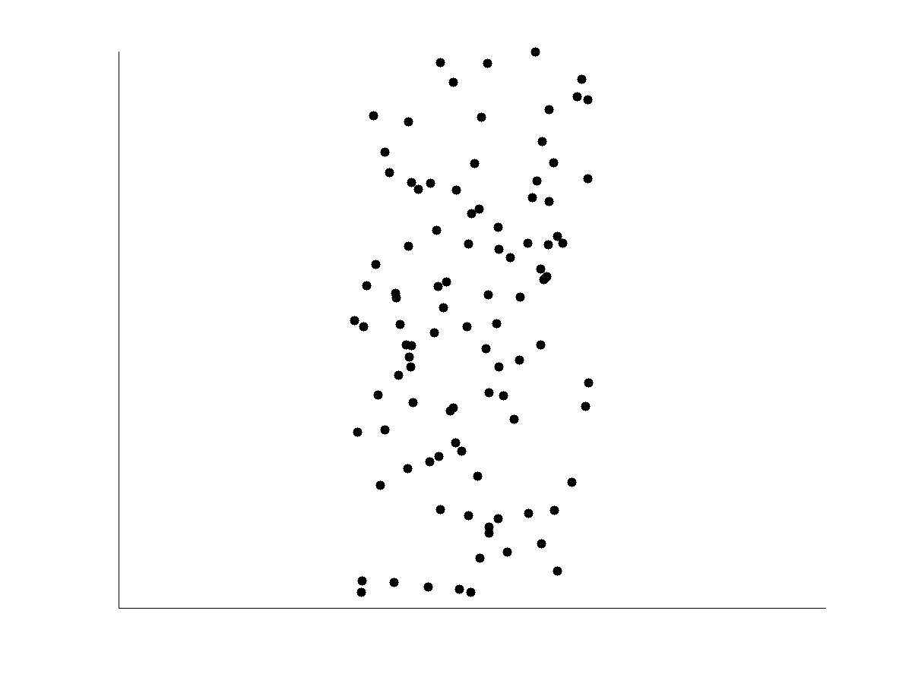
Uncorrelated Data

