Slide 1
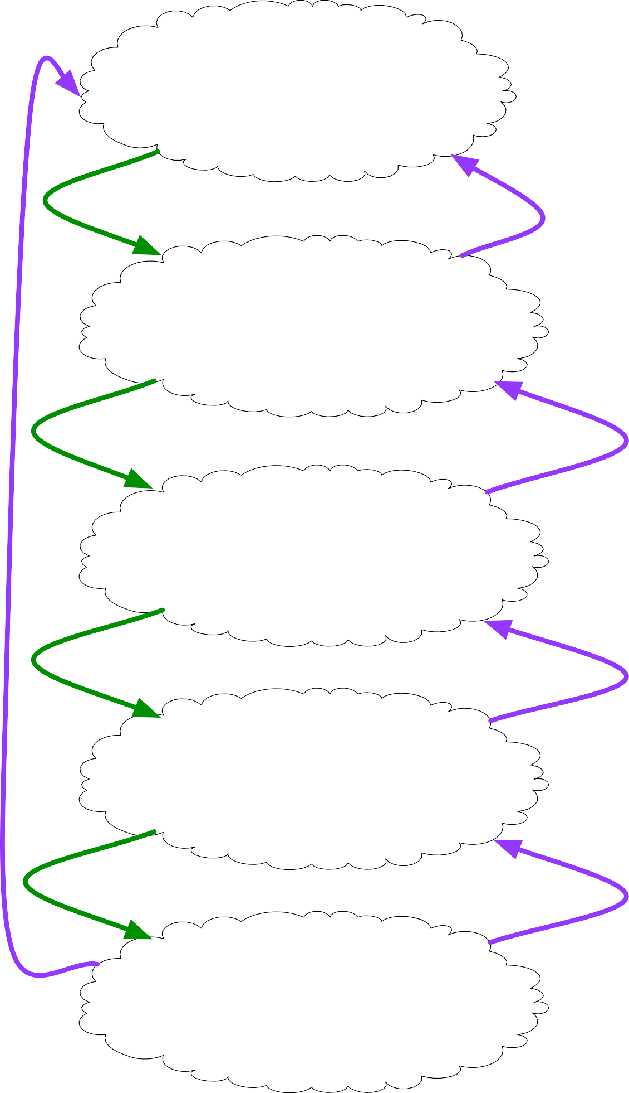
Ask an interesting question.
What is the scientific goal?
What would you do if you had all the data? What do you want to predict or estimate?
How were the data sampled?
Which data are relevant? Are there privacy issues?
Get the data.
Plot the data.
Are there anomalies? Are there patterns?
Explore the data.
Model the data.
Build a model.
Fit the model.
Validate the model.
Communicate and visualize the results.
What did we learn?
Do the results make sense?
Can we tell a story?

Slide 2
Data Dimensions

Slide 3
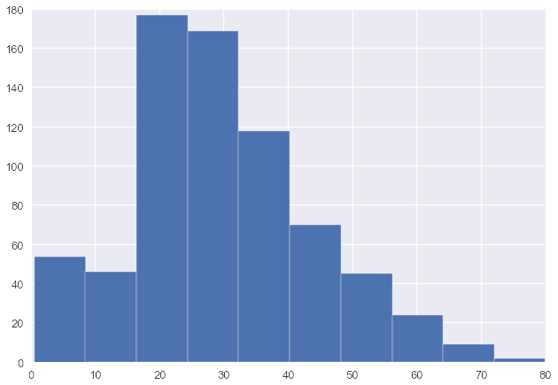
Univariate Data
# of passengers
age

Slide 4
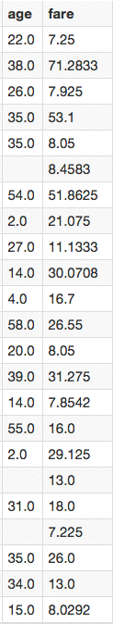
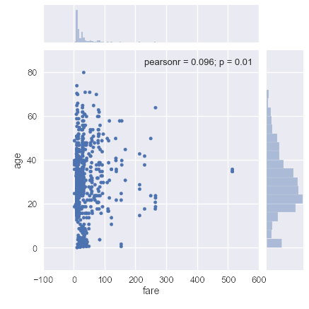
Bivariate Data

Slide 5
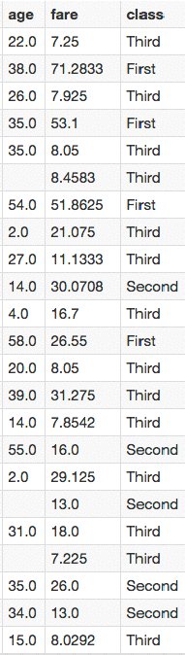
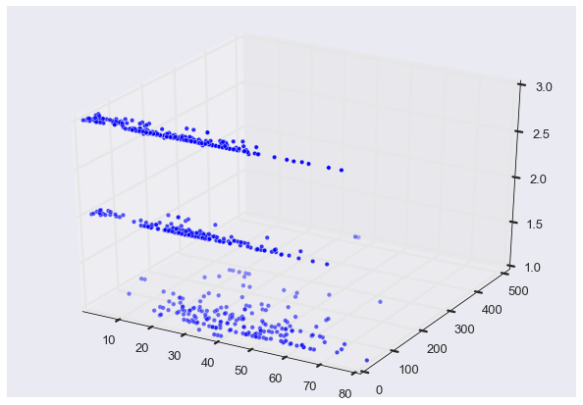
Trivariate Data
class
fare
age
Do NOT use 3D scatterplots!

Slide 6
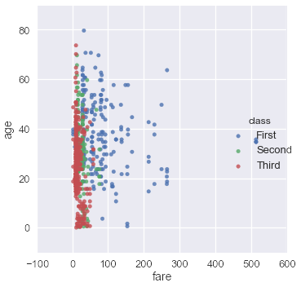
Trivariate Data
Map the third dimension to some other visual attribute

Slide 7
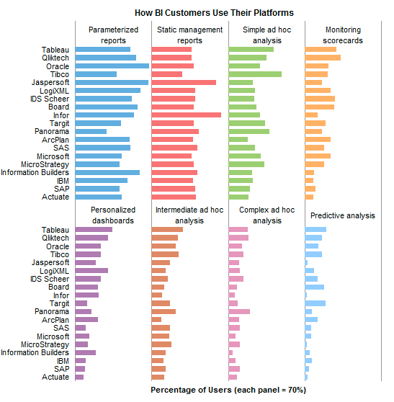
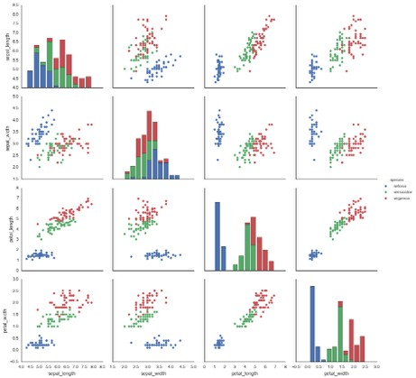
Multivariate Data
Give each attribute its own display (small multiples)
More next Tuesday!

Slide 8
Data Reduction
Filtering:
Eliminate some items or attributes
e.g., select range of interest, zoom in, remove outliers, etc.
Aggregation: Represent a group of elements by a new derived element
e.g., take average, min, max, count, sum
Attribute aggregation a.k.a. dimensionality reduction

Slide 9
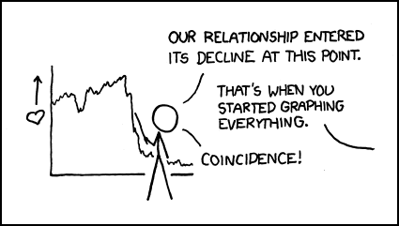
Statistical Graph Types
http://xkcd.com/523/

Slide 10
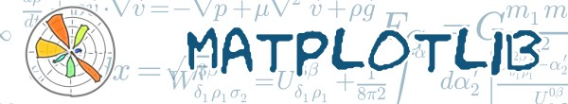
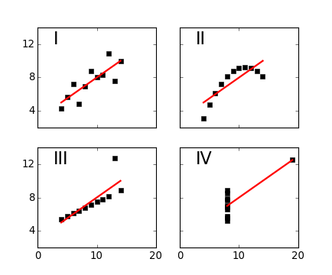
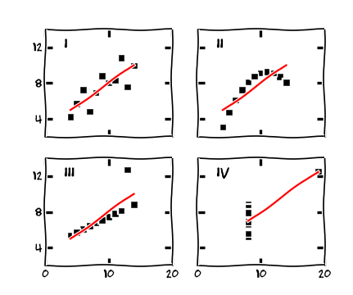
Side Note
XKCD-ify your plot
http://matplotlib.org/xkcd

Slide 11
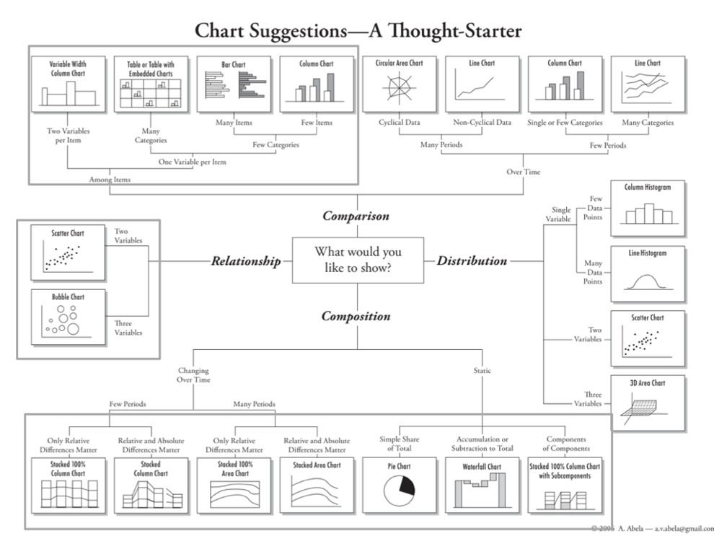
http://extremepresentation.typepad.com/blog/files/choosing_a_good_chart.pdf

Slide 12
Comparisons

Slide 13
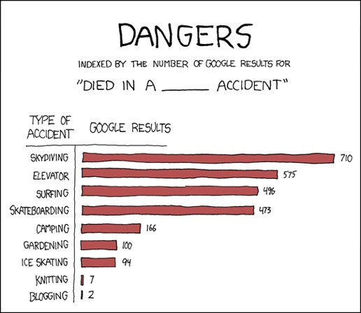
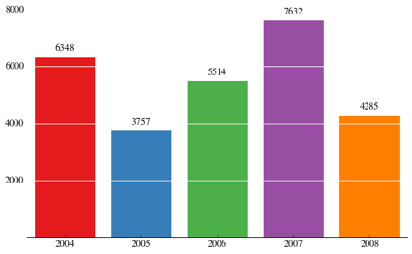
Bar Chart
http://nbviewer.ipython.org/gist/olgabot/5357268

Slide 14
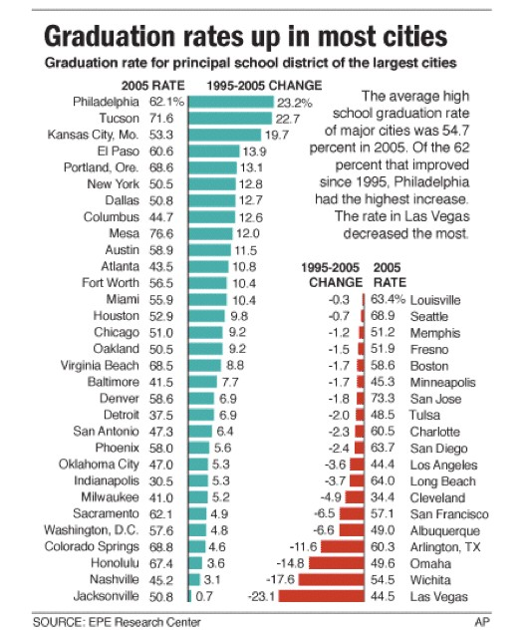
Direction
Nicolas Rapp

Slide 15
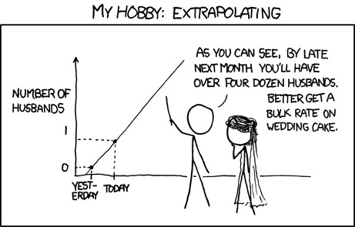
Trends Over Time
http://xkcd.com/605/

Slide 16
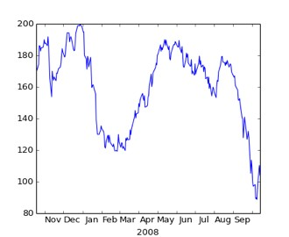
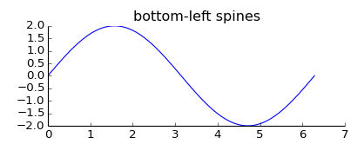
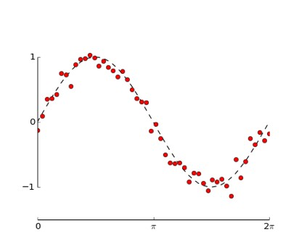
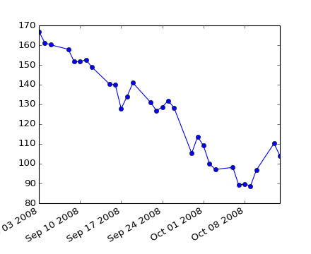
Line Charts
matplotlib gallery

Slide 17
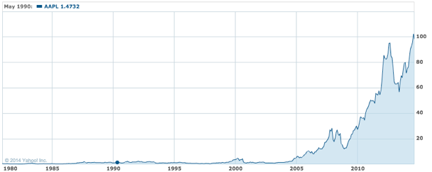
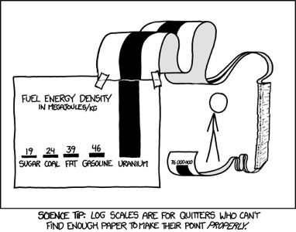
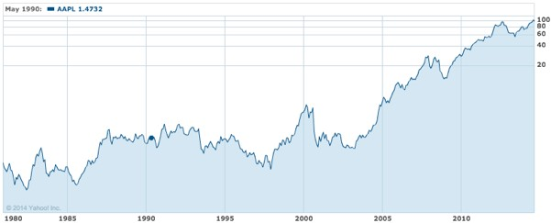
Linear vs. Logarithmic Scale
Linear Scale
Log Scale
http://xkcd.com/1162/
Apple Stock Price
http://finance.yahoo.com/echarts?s=AAPL

Slide 18
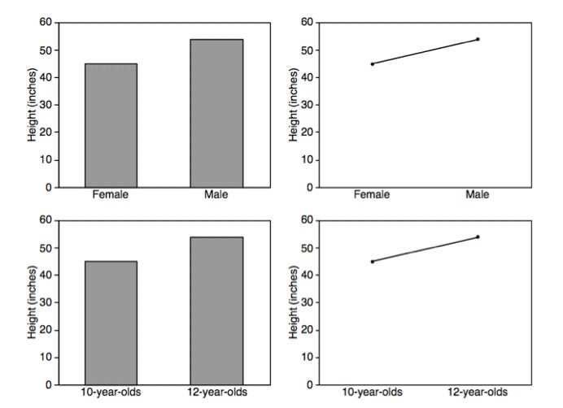
Bars vs. Lines
Lines imply connections - do not use for categorical data
Zacks 1999

Slide 19
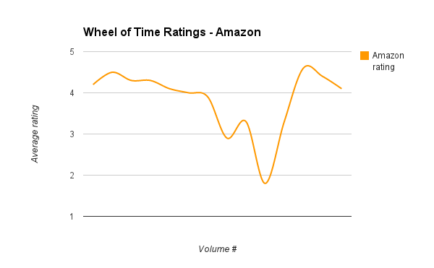
Don’t
Use bar charts to compare book ratings
“Visualizing The Wheel of Time: Reader Sentiment for an Epic Fantasy Series”, J. Siddle, Sept 2013

Slide 20
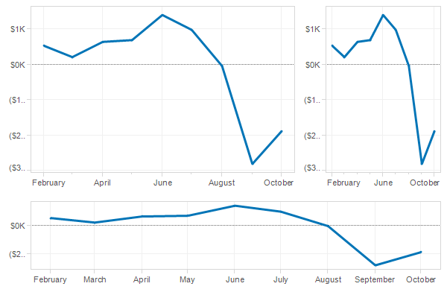
Aspect Ratios
eagereyes.org

Slide 21
Banking to 45°
Two line segments are maximally discriminable when
their average absolute angle is 45°
W. Cleveland
Slide based on J. Heer / M.Agrawala

Slide 22
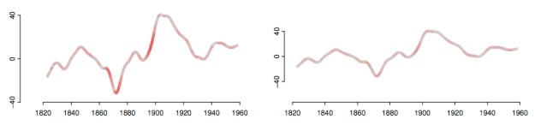
Banking to 45°
Error Prone
Optimal Aspect Ratio
An Empirical Model of Slope Ratio Comparisons, Justin Talbot, John Gerth, Pat Hanrahan

Slide 23
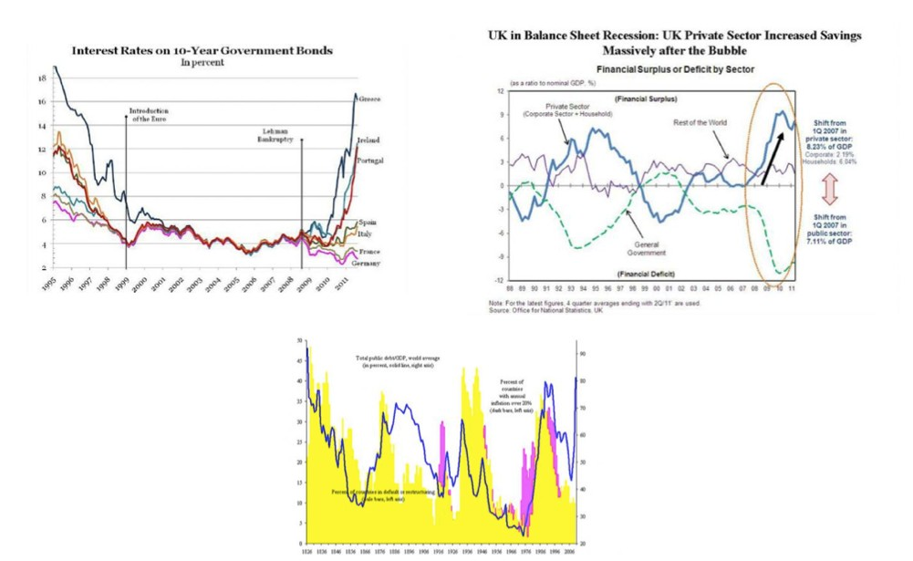
Don’t

Slide 24
Correlations

Slide 25
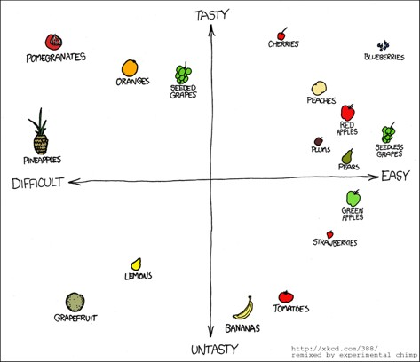
Scatterplots

Slide 26
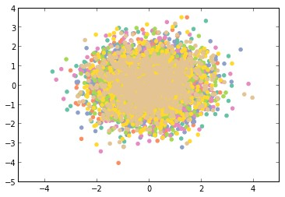
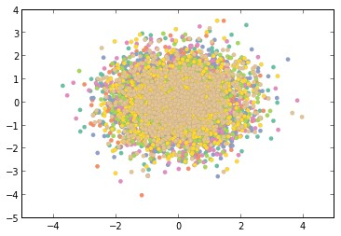
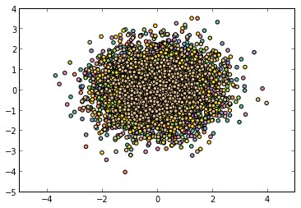
Scatterplots
Black Border
No Border
Light Grey Border
http://nbviewer.ipython.org/5357268

Slide 27
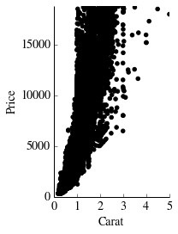
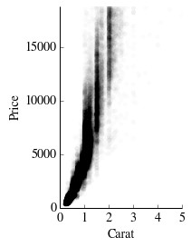
Overplotting
alpha = 1/100

Slide 28
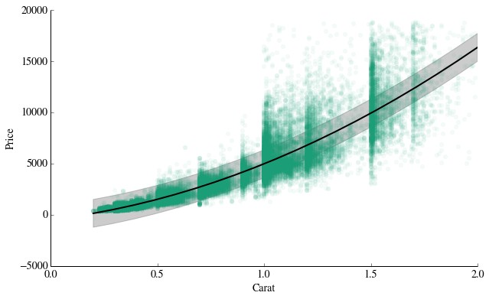
Trend Lines

Slide 29
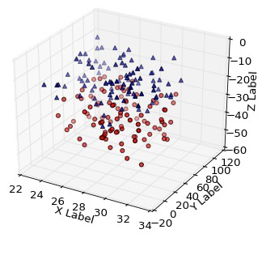
Don‘t
class
fare
age
matplot3d tutorial

Slide 30
Compositions

Slide 31
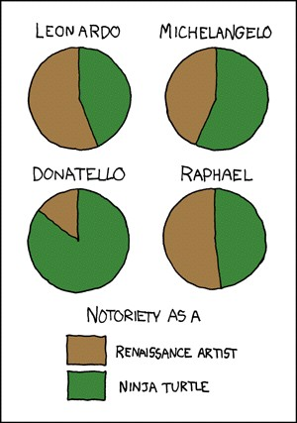
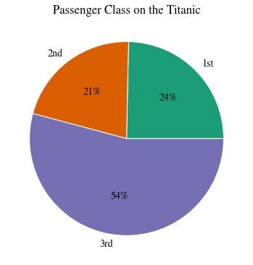
Pie Charts
http://xkcd.com/197/

Slide 32
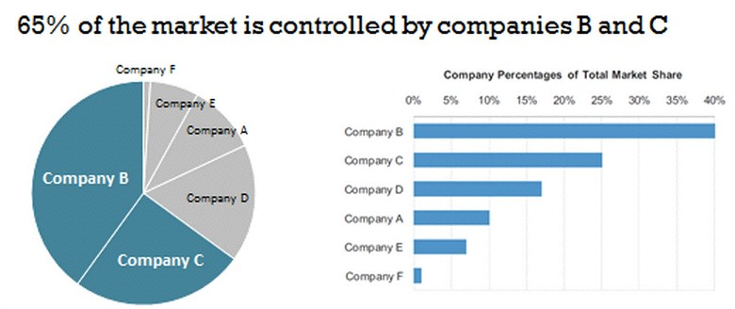
Pie vs. Bar Charts

Slide 33
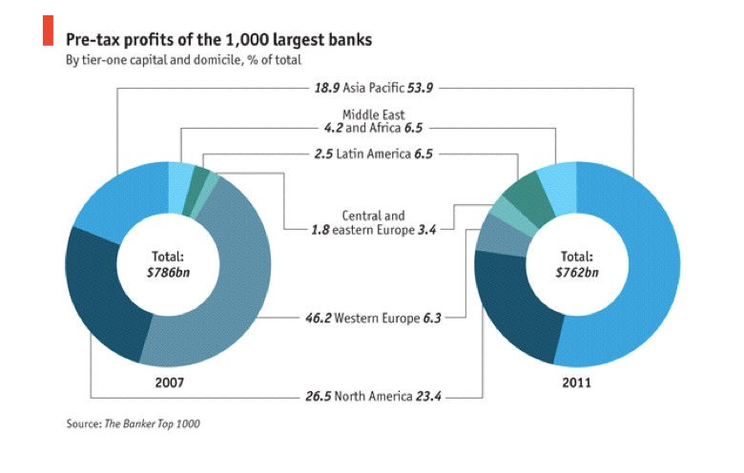
Donut Chart
The Economist Daily Chart

Slide 34
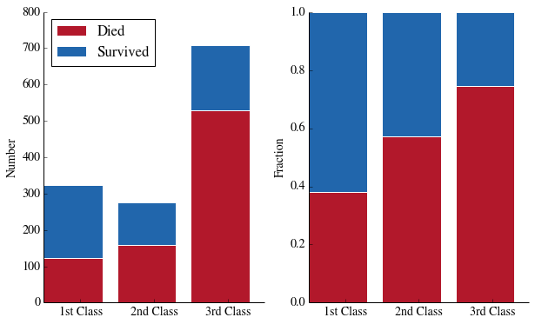
Stacked Bar Chart

Slide 35
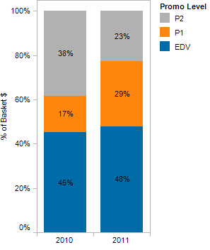
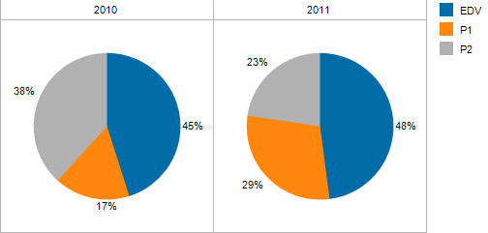
Stacked Bar Chart
vs.
VizWiz Blog

Slide 36
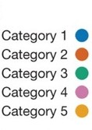
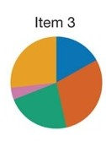
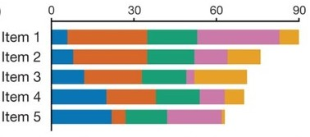
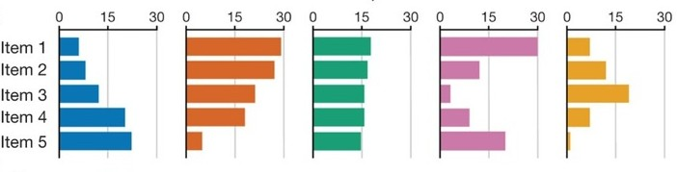
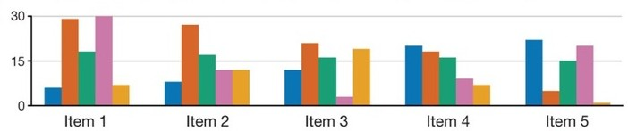
Comparison of bar chart types
Pie Chart
Stacked bar chart
Layered Bar Chart
Grouped Bar Chart
Small Multiples
Streit & Gehlenborg, PoV, Nature Methods, 2014

Slide 37

Stacked Area Chart
http://stackoverflow.com/questions/2225995/how-can-i-create-stacked-line-graph-with-matplotlib

Slide 38

100% Stacked Area Chart
http://stackoverflow.com/questions/16875546/create-a-100-stacked-area-chart-with-matplotlib

Slide 39


Stacked Area vs. Line Graphs
leancrew.com & Practically Efficient

Slide 40
Distributions

Slide 41

Histogram
# passengers
age
10 Bins
# passengers
age
20 Bins

Slide 42


Density Plots
http://web.stanford.edu/~mwaskom/software/seaborn/tutorial/plotting_distributions.html

Slide 43


Heat Maps
2D Density Plots

Slide 44


Box Plots
aka Box-and-Whisker Plot
http://xkcd.com/539/

Slide 45

Box Plots
aka Box-and-Whisker Plot
Wikipedia

Slide 46

Comparison
Streit & Gehlenborg, PoV, Nature Methods, 2014

Slide 47


Violin Plot
= Box Plot + Probability Density Function
http://web.stanford.edu/~mwaskom/software/seaborn/tutorial/plotting_distributions.html

