Slide 1

Measuring Data Similarity and Dissimilarity
Dr. Shahid Mahmood Awan
http://turing.cs.pub.ro/mas_11 curs.cs.pub.ro
shahid.awan@umt.edu.pk
University of Management and Technology

Slide 2
https://en.wikipedia.org/wiki/Standard_deviation
https://www2.stat.duke.edu/courses/Fall98/sta110b/minitab/mean-var.html
http://www.mathsisfun.com/data/standard-deviation.html

Slide 3
Chapter 2: Getting to Know Your Data
Data Objects and Attribute Types
Basic Statistical Descriptions of Data
Data Visualization
Measuring Data Similarity and Dissimilarity
Summary

Slide 4
Similarity and Dissimilarity
clustering, outlier analysis, and nearest-neighbor
classification,
we need ways to assess how alike or unalike objects are in comparison to one another.
A store may want to search for clusters of customer objects, resulting in groups of customers with similar characteristics (e.g., similar income, area of residence, and age)
A cluster is a collection of data objects such that the objects within a cluster are similar to one another and dissimilar to the objects in other clusters.

Slide 5
Similarity and Dissimilarity
Similarity
Numerical measure of how alike two data objects are
Value is higher when objects are more alike
Often falls in the range [0,1]
1 means object are identical, 0 for unalike

Slide 6
Similarity and Dissimilarity
Dissimilarity (e.g., distance)
Numerical measure of how different two data objects are
Lower when objects are more alike
Minimum dissimilarity is often 0, identical
Upper limit varies
Proximity refers to a similarity or dissimilarity
(closeness, nearness in space, time, or relationship.)

Slide 7
Data Matrix and Dissimilarity Matrix
Data matrix
(object-by-attribute structure):
(used to store the data objects)
This structure stores the n data objects in the form of a relational table,
or n-by-p matrix (n objects p attributes)
n data points with p dimensions
Each row corresponds to an object
Two modes
Two entities or “things,” namely rows (for objects) and columns (for attributes)

Slide 8
Data Matrix and Dissimilarity Matrix
Dissimilarity matrix
(object-by-object structure)
(used to store dissimilarity values for pairs of objects
represented by an n-by-n table
n data points, but registers only the distance
A triangular matrix
Symmetric
Single mode (dissimilarities)
Note that d(i, i)= 0; difference between an object and itself is 0.

Slide 9
Similarity can be obtained by other way

Slide 10
Proximity Measure for Nominal Attributes
Can take 2 or more states, e.g., red, yellow, blue, green
Method 1: Simple matching
m: # of matches, the number of attributes for which i and j are in the same state
p: total # of variables

Slide 11
Proximity Measure for Nominal Attributes
Can take 2 or more states, e.g., red, yellow, blue, green
Method : Simple matching
m: # of matches, p: total # of variables
Method 2: Use a large number of binary attributes
creating a new binary attribute for each of the M nominal states

Slide 12
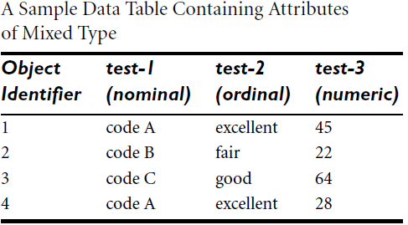
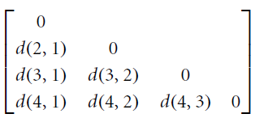
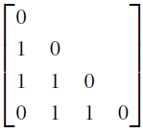
Example

Slide 13
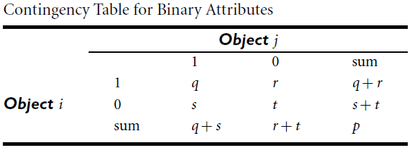
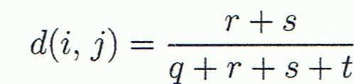
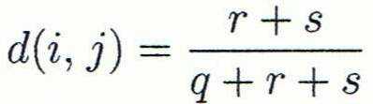
Proximity Measure for Binary Attributes
A table for binary data
Distance measure for symmetric binary variables:
The total number of attributes
is p, where p = q +r +s +t .
Distance measure for asymmetric binary variables:

Slide 14

Proximity Measure for Binary Attributes
Jaccard coefficient (similarity measure for asymmetric binary variables):

Slide 15
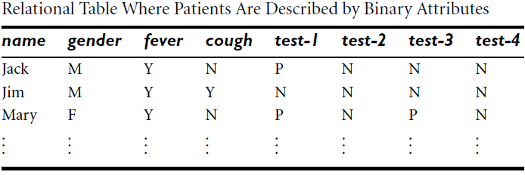
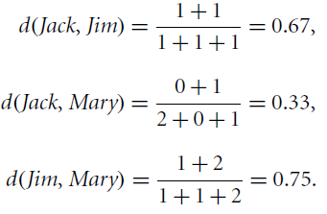
Dissimilarity between Binary Variables
Example
Gender is a symmetric attribute
The remaining attributes are asymmetric binary
Let the values Y and P be 1, and the value N is 0
Notes:
These measurements suggest that Jim and Mary are unlikely to have a similar disease because they have the highest dissimilarity value among the three pairs. Of the three patients, Jack and Mary are the most likely to have a similar disease.

Slide 16
Dissimilarity between Binary Variables
Example
Gender is a symmetric attribute
The remaining attributes are asymmetric binary
Let the values Y and P be 1, and the value N 0

Slide 17

Dissimilarity of Numeric Data: Euclidean Distance
Euclidean Distance:
Manhattan (or city block) distance:

Slide 18
Example: Data Matrix and Dissimilarity Matrix
Let x1= (1,2)
X2= (3,5)
Data Matrix
Dissimilarity Matrix
(with Euclidean Distance)

Slide 19
Dissimilarity of Numeric Data: Minkowski Distance
Minkowski distance: It is a generalization of the Euclidean and Manhattan distances.
It is defined as:
It represents the Manhattan distance when h = 1 (i.e., L1 norm) and Euclidean distance when h = 2 (i.e., L2 norm).

Slide 20
Distance on Numeric Data: Minkowski Distance
Minkowski distance: A popular distance measure
where i = (x_{i1}, x_{i2}, …, x_{ip}) and j = (x_{j1}, x_{j2}, …, x_{jp}) are two p-dimensional data objects, and h is the order (the distance so defined is also called L-h norm)

Slide 21
Both the Euclidean and the Manhattan distance satisfy the following mathematical properties:
Properties
d(i, j) > 0 if i ≠ j, and d(i, i) = 0 (Positive definiteness)
d(i, j) = d(j, i) (Symmetry)
d(i, j) ≤ d(i, k) + d(k, j) (Triangle Inequality)
A distance that satisfies these properties is a metric

Slide 22
Example: Minkowski Distance
Dissimilarity Matrices
Manhattan (L₁)
Euclidean (L₂)

Slide 23
Ordinal Variables
An ordinal variable can be discrete or continuous
Order is important, e.g., rank
Can be treated like interval-scaled
replace x_{if} by their rank
map the range of each variable onto [0, 1] by replacing i-th object in the f-th variable by
compute the dissimilarity using methods for interval-scaled variables

Slide 24
Attributes of Mixed Type
A database may contain all attribute types
Nominal, symmetric binary, asymmetric binary, numeric, ordinal
One may use a weighted formula to combine their effects
f is binary or nominal:
d_{ij}^{(f)} = 0 if x_{if} = x_{jf} , or d_{ij}^{(f)} = 1 otherwise
f is numeric: use the normalized distance
f is ordinal
Compute ranks r_{if} and
Treat z_{if} as interval-scaled

Slide 25
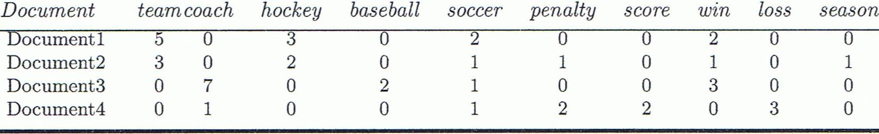
Cosine Similarity
A document can be represented by thousands of attributes, each recording the frequency of a particular word (such as keywords) or phrase in the document.
Other vector objects: gene features in micro-arrays, …
Applications: information retrieval, biologic taxonomy, gene feature mapping, ...
Cosine measure: If d₁ and d₂ are two vectors (e.g., term-frequency vectors), then
cos(d₁, d₂) = (d₁ • d₂) /||d₁|| ||d₂|| ,
where • indicates vector dot product, ||d||: the length of vector d

Slide 26
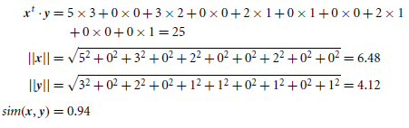
Example: Cosine Similarity
cos(d₁, d₂) = (d₁ • d₂) /||d₁|| ||d₂|| ,
where • indicates vector dot product, ||d|: the length of vector d
Ex: Find the similarity between documents 1 and 2.
d₁ = (5, 0, 3, 0, 2, 0, 0, 2, 0, 0)
d₂ = (3, 0, 2, 0, 1, 1, 0, 1, 0, 1)
d₁•d₂ = 5*3+0*0+3*2+0*0+2*1+0*1+0*1+2*1+0*0+0*1 = 25
||d₁||= (5*5+0*0+3*3+0*0+2*2+0*0+0*0+2*2+0*0+0*0)^{0.5}=(42)^{0.5} = 6.481
||d₂||= (3*3+0*0+2*2+0*0+1*1+1*1+0*0+1*1+0*0+1*1)^{0.5}=(17)^{0.5} = 4.12
cos(d₁, d₂ ) = 0.94

Slide 27

Example 2.23
The measure computes the cosine of the angle between vectors x and y. A cosine value of 0 means that the two vectors are at 90 degrees to each other (orthogonal) and have no match.
The closer the cosine value to 1, the smaller the angle and the greater the match between vectors
Therefore, if we were using the cosine similarity measure to compare these documents, they would be considered quite similar.

Slide 28
Chapter 2: Getting to Know Your Data
Data Objects and Attribute Types
Basic Statistical Descriptions of Data
Data Visualization
Measuring Data Similarity and Dissimilarity
Summary

Slide 29
Summary
Data attribute types: nominal, binary, ordinal, interval-scaled, ratio-scaled
Many types of data sets, e.g., numerical, text, graph, Web, image.
Gain insight into the data by:
Basic statistical data description: central tendency, dispersion, graphical displays
Data visualization: map data onto graphical primitives
Measure data similarity
Above steps are the beginning of data preprocessing.
Many methods have been developed but still an active area of research.

Slide 30
References
W. Cleveland, Visualizing Data, Hobart Press, 1993
T. Dasu and T. Johnson. Exploratory Data Mining and Data Cleaning. John Wiley, 2003
U. Fayyad, G. Grinstein, and A. Wierse. Information Visualization in Data Mining and Knowledge Discovery, Morgan Kaufmann, 2001
L. Kaufman and P. J. Rousseeuw. Finding Groups in Data: an Introduction to Cluster Analysis. John Wiley & Sons, 1990.
H. V. Jagadish, et al., Special Issue on Data Reduction Techniques. Bulletin of the Tech. Committee on Data Eng., 20(4), Dec. 1997
D. A. Keim. Information visualization and visual data mining, IEEE trans. on Visualization and Computer Graphics, 8(1), 2002
D. Pyle. Data Preparation for Data Mining. Morgan Kaufmann, 1999
S. Santini and R. Jain,” Similarity measures”, IEEE Trans. on Pattern Analysis and Machine Intelligence, 21(9), 1999
E. R. Tufte. The Visual Display of Quantitative Information, 2nd ed., Graphics Press, 2001
C. Yu , et al., Visual data mining of multimedia data for social and behavioral studies, Information Visualization, 8(1), 2009

