Slide 1

Data Mining
Dr. Shahid Mahmood Awan
http://turing.cs.pub.ro/mas_11 curs.cs.pub.ro
shahid.awan@umt.edu.pk
University of Management and Technology

Slide 2
Data Mining: Concepts and Techniques (3rd ed.) — Chapter 8 —
Jiawei Han, Micheline Kamber, and Jian Pei
University of Illinois at Urbana-Champaign &
Simon Fraser University
©2011 Han, Kamber & Pei. All rights reserved.
2
Notes:
2

Slide 3
Chapter 8. Classification: Basic Concepts
Classification: Basic Concepts
Decision Tree Induction
Bayes Classification Methods
Rule-Based Classification
Model Evaluation and Selection
Techniques to Improve Classification Accuracy: Ensemble Methods
Summary
3
Notes:
3

Slide 4
Bayesian Classification: Why?
A statistical classifier: performs probabilistic prediction, i.e., predicts class membership probabilities
Foundation: Based on Bayes’ Theorem.
Performance: A simple Bayesian classifier, naïve Bayesian classifier, has comparable performance with decision tree and selected neural network classifiers
Incremental: Each training example can incrementally increase/decrease the probability that a hypothesis is correct — prior knowledge can be combined with observed data
Standard: Even when Bayesian methods are computationally intractable, they can provide a standard of optimal decision making against which other methods can be measured

Slide 5
Some Basics
https://www.khanacademy.org/math/precalculus/prob-comb/dependent-events-precalc/v/bayes-theorem-visualized

Slide 6
Bayes’ Theorem: Basics
Total probability Theorem:
Bayes’ Theorem:
Let X be a data sample (“evidence”): class label is unknown
Let H be a hypothesis that X belongs to class C
Classification is to determine P(H|X), (i.e., posteriori probability): the probability that the hypothesis holds given the observed data sample X
P(H) (prior probability): the initial probability
E.g., X will buy computer, regardless of age, income, …
P(X): probability that sample data is observed
P(X|H) (likelihood): the probability of observing the sample X, given that the hypothesis holds
E.g., Given that X will buy computer, the prob. that X is 31..40, medium income

Slide 7
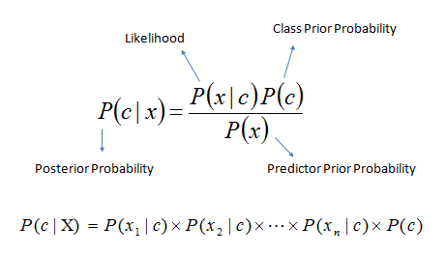
P(c|x) is the posterior probability of class (c, target) given predictor (x, attributes).
P(c) is the prior probability of class.
P(x|c) is the likelihood which is the probability of predictor given class.
P(x) is the prior probability of predictor.

Slide 8
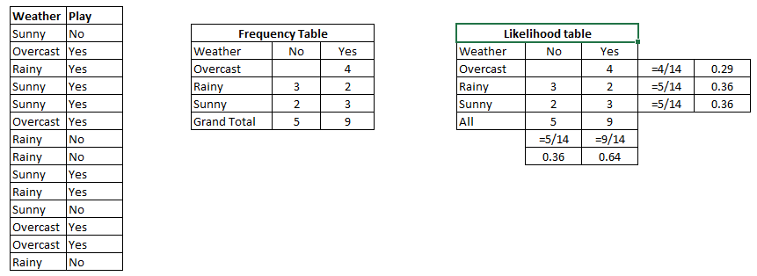
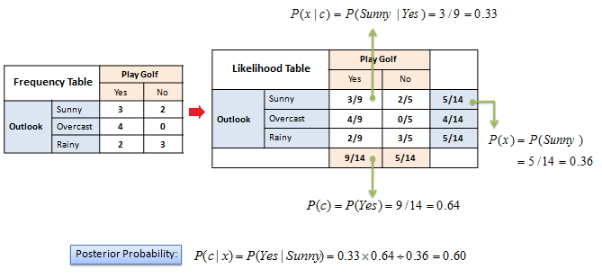
Example
Step 1: Convert the data set into a frequency table
Step 2: Create Likelihood table by finding the probabilities like Overcast probability = 0.29 and probability of playing is 0.64.

Slide 9
Steps
Step 3: Now, use Naive Bayesian equation to calculate the posterior probability for each class. The class with the highest posterior probability is the outcome of prediction.
Problem: Players will play if weather is sunny. Is this statement is correct?
We can solve it using above discussed method of posterior probability.
P(Yes | Sunny) = (P( Sunny | Yes) * P(Yes) )/ P (Sunny)
Here we have P (Sunny |Yes) = 3/9 = 0.33, P(Sunny) = 5/14 = 0.36, P( Yes)= 9/14 = 0.64
Now, P (Yes | Sunny) = (0.33 * 0.64) / 0.36 = 0.60, which has higher probability.
Naive Bayes uses a similar method to predict the probability of different class based on various attributes. This algorithm is mostly used in text classification and with problems having multiple classes.

Slide 10
Prediction Based on Bayes’ Theorem
Given training data X, posteriori probability of a hypothesis H, P(H|X), follows the Bayes’ theorem
Informally, this can be viewed as
posteriori = likelihood x prior/evidence
Predicts X belongs to C_{i} iff the probability P(C_{i}|X) is the highest among all the P(C_{k}|X) for all the k classes
Practical difficulty: It requires initial knowledge of many probabilities, involving significant computational cost

Slide 11
Classification Is to Derive the Maximum Posteriori
Let D be a training set of tuples and their associated class labels, and each tuple is represented by an n-D attribute vector X = (x₁, x₂, …, x_{n})
Suppose there are m classes C₁, C₂, …, C_{m}.
Classification is to derive the maximum posteriori, i.e., the maximal P(C_{i}|X)
This can be derived from Bayes’ theorem
maximum posteriori hypothesis
Since P(X) is constant for all classes, only
needs to be maximized

Slide 12
Naïve Bayes Classifier
A simplified assumption: attributes are conditionally independent (i.e., no dependence relation between attributes):
This greatly reduces the computation cost: Only counts the class distribution
If A_{k} is categorical, P(x_{k}|C_{i}) is the # of tuples in C_{i} having value x_{k} for A_{k} divided by |C_{i, D}| (# of tuples of C_{i} in D)
If A_{k} is continous-valued, P(x_{k}|C_{i}) is usually computed based on Gaussian distribution with a mean μ and standard deviation σ
and P(x_{k}|C_{i}) is

Slide 14
Naïve Bayes Classifier: Training Dataset
Class: C1:buys_computer = ‘yes’, C2:buys_computer = ‘no’
Data to be classified: X = (age =youth, Income = medium, Student = yes, Credit_rating = Fair)

Slide 15
Naïve Bayes Classifier: An Example
P(C_{i}): P(buys_computer = “yes”) = 9/14 = 0.643
P(buys_computer = “no”) = 5/14= 0.357
Compute P(X|C_{i}) for each class
P(age = youth | buys_computer = “yes”) = 2/9 = 0.222
P(age = youth | buys_computer = “no”) = 3/5 = 0.6
P(income = “medium” | buys_computer = “yes”) = 4/9 = 0.444
P(income = “medium” | buys_computer = “no”) = 2/5 = 0.4
P(student = “yes” | buys_computer = “yes) = 6/9 = 0.667
P(student = “yes” | buys_computer = “no”) = 1/5 = 0.2
P(credit_rating = “fair” | buys_computer = “yes”) = 6/9 = 0.667
P(credit_rating = “fair” | buys_computer = “no”) = 2/5 = 0.4

Slide 16
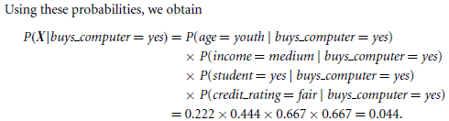
X = (age <= 30 , income = medium, student = yes, credit_rating = fair)
P(X|C_{i}) : P(X|buys_computer = “yes”) = 0.222 x 0.444 x 0.667 x 0.667 = 0.044
P(X|buys_computer = “no”) = 0.6 x 0.4 x 0.2 x 0.4 = 0.019
P(X|C_{i})*P(C_{i}) : P(X|buys_computer = “yes”) * P(buys_computer = “yes”) = 0.028
P(X|buys_computer = “no”) * P(buys_computer = “no”) = 0.007
Therefore, X belongs to class (“buys_computer = yes”)

Slide 17
Avoiding the Zero-Probability Problem
Naïve Bayesian prediction requires each conditional prob. be non-zero. Otherwise, the predicted prob. will be zero
Ex. Suppose a dataset with 1000 tuples, income=low (0), income= medium (990), and income = high (10)
Use Laplacian correction (or Laplacian estimator)
Adding 1 to each case
Prob(income = low) = 1/1003
Prob(income = medium) = 991/1003
Prob(income = high) = 11/1003
The “corrected” prob. estimates are close to their “uncorrected” counterparts

Slide 18
Naïve Bayes Classifier: Comments
Advantages
Easy to implement
Good results obtained in most of the cases
Disadvantages
Assumption: class conditional independence, therefore loss of accuracy
Practically, dependencies exist among variables
E.g., hospitals: patients: Profile: age, family history, etc.
Symptoms: fever, cough etc., Disease: lung cancer, diabetes, etc.
Dependencies among these cannot be modeled by Naïve Bayes Classifier
How to deal with these dependencies? Bayesian Belief Networks (Chapter 9)

