Slide 1
MapReduce
The Story of Sam
Saliya Ekanayake
SALSA HPC Group
http://salsahpc.indiana.edu

Slide 2
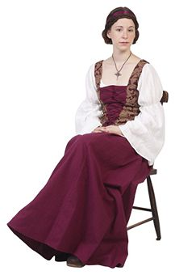
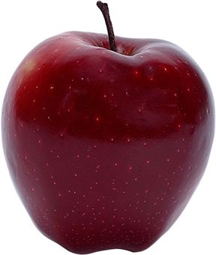

Sam’s Mother
Believed “an apple a day keeps a doctor away”
Mother
Sam
An Apple

Slide 3

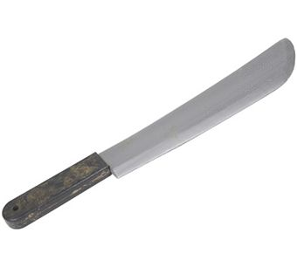
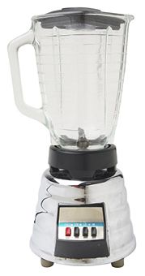

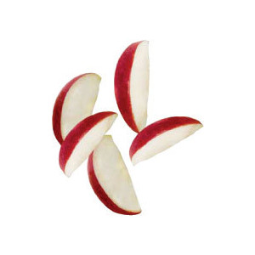
One day
Sam thought of “drinking” the apple
He used a to cut the and a to make juice.

Slide 4
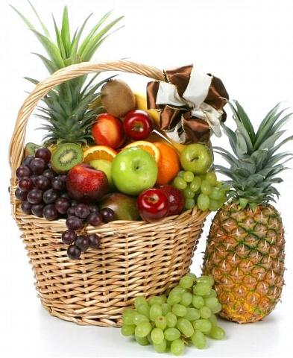
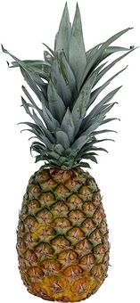
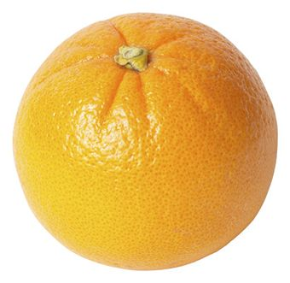

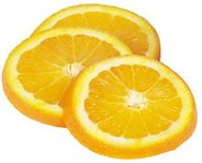
Next Day
Sam applied his invention to all the fruits he could find in the fruit basket
(map ‘( ))
A list of values mapped into another list of values, which gets reduced into a single value
( )
(reduce ‘( ))
Classical Notion of MapReduce in Functional Programming

Slide 5
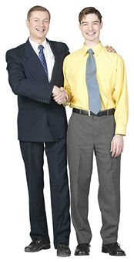
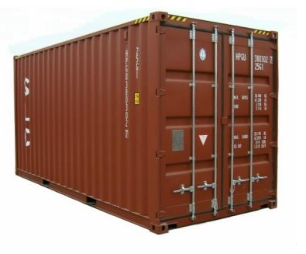
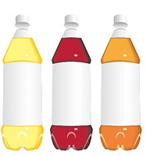
18 Years Later
Sam got his first job in JuiceRUs for his talent in making juice
Wait!
Now, it’s not just one basket but a whole container of fruits
Fruits
Large data and list of values for output
Also, they produce a list of juice types separately
But, Sam had just ONE and ONE
NOT ENOUGH !!

Slide 6



Brave Sam
Implemented a parallel version of his innovation
Fruits
Each input to a map is a list of <key, value> pairs
(<a, > , <o, > , <p, > , …)
Each output of a map is a list of <key, value> pairs
(<a’, > , <o’, > , <p’, > , …)
Grouped by key
Each input to a reduce is a <key, value-list> (possibly a list of these, depending on the grouping/hashing mechanism)
e.g. <a’, ( …)>
Reduced into a list of values

Slide 7
Brave Sam
Implemented a parallel version of his innovation
Fruits
A list of <key, value> pairs mapped into another list of <key, value> pairs which gets grouped by the key and reduced into a list of values
The idea of MapReduce in Data Intensive Computing

Slide 8
Afterwards
Sam realized,
To create his favorite mix fruit juice he can use a combiner after the reducers
If several <key, value-list> fall into the same group (based on the grouping/hashing algorithm) then use the blender (reducer) separately on each of them
The knife (mapper) and blender (reducer) should not contain residue after use – Side Effect Free
In general reducer should be associative and commutative

Slide 9
That’s All Folks!
We think Sam was you ☺

