Slide 1

Data Analysis Using Python
INNOMATICS RESEARCH LABS

Slide 2

About me
Graduate in B.Sc.(Computer Scie)-2020
I choose data science to build-up my career
I like the flexibility of Teaching with Innomatics
SHAHID PATEL

Slide 3
Agenda
History of Python
Why Python and its Applications
How Python is useful in Data Science
Data Science Life Cycle
Business Problem
Scrape Data from internet using Python

Slide 4
HISTORY OF PYTHON
Python developed by Guido van Rossum in late 1980
Write something about python like
Why it is called general purpose language
Libraries in python
Application where python is used
Why python is used in Data Science
Add more like above

Slide 5
Project Title:- Web Scraping on Flipkart Mobiles
Problem Statement:-
Which Brand is offering better product
at better price.

Slide 6
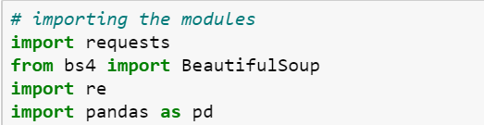
Data Extraction
Importing all the necessary modules for extracting data.
Here we are using Beautiful Soup to extract data from Flipkart Website.

Slide 7
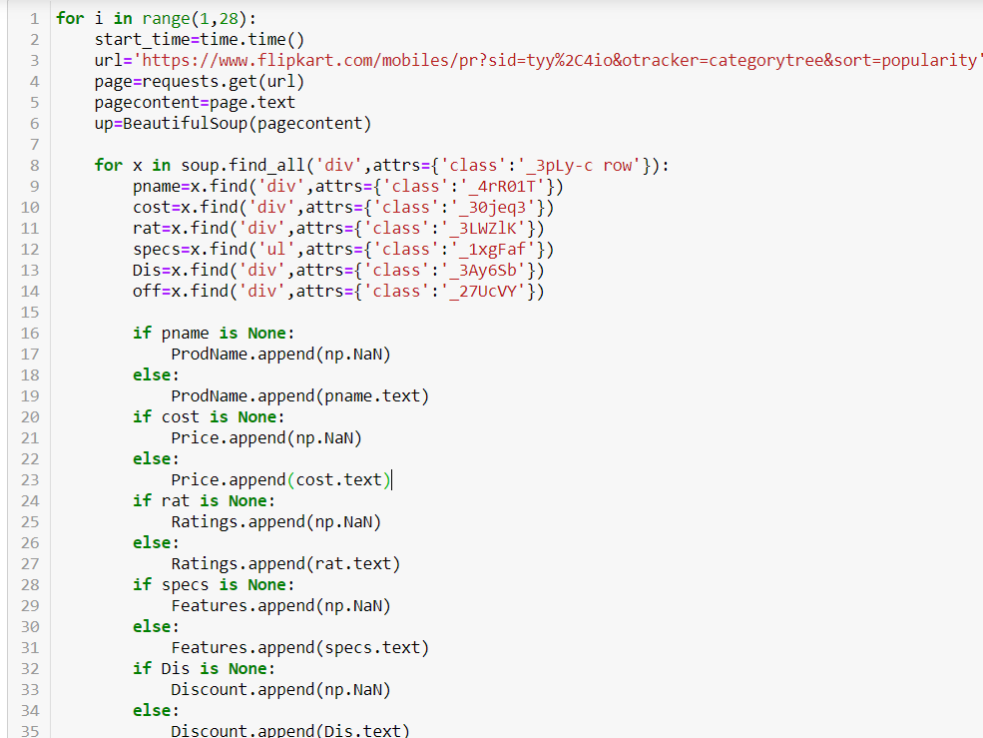
Data Extraction
We are gathering the information of each page and dividing the classes and storing the information in to lists.
Where each list of starting cell consisting of page1 information.
2 cell of list containing of page 2 information and 3 cell containing of page 3 information and so on.

Slide 8
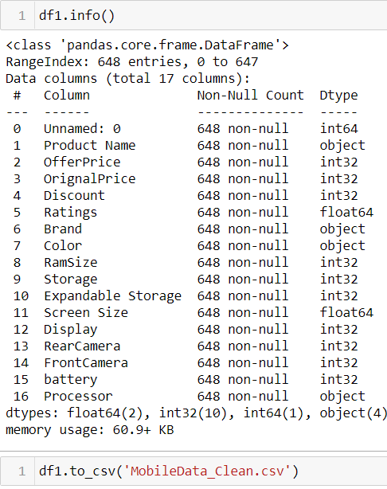
Data Extraction
We have extracted and imported around 17 Features and saved as .csv file.

Slide 9
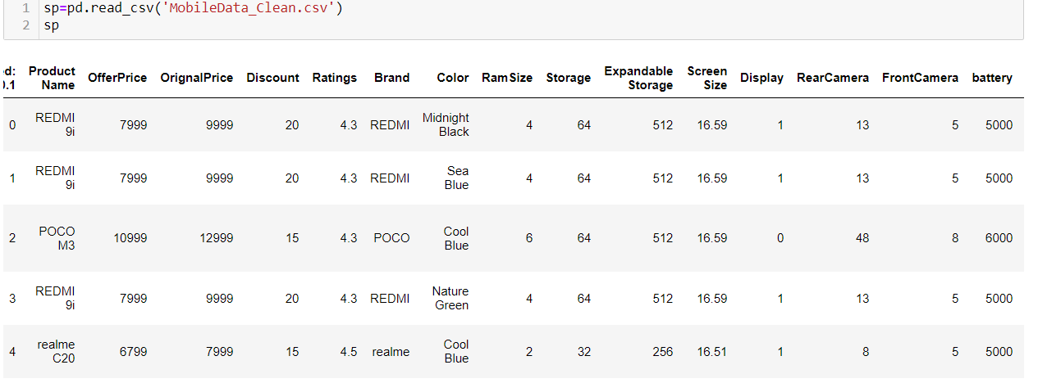
Data Cleaning
We are reading the saved .csv files and saving it in a sp variable.

Slide 10
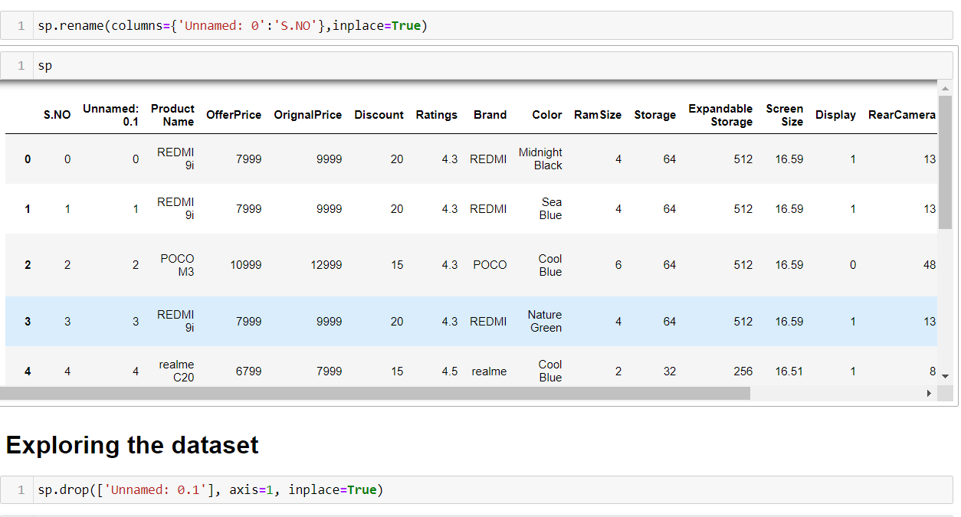
Data cleaning
While import the CSV file we found that index column is added to data frame.
we renamed that column with sno. But it contain two unnamed column.
We drop the unnamed: 0.1 column using drop( ) method.

Slide 11

Data Cleaning
Since we observe that mobiles does not having any NaN or float values so that we convert into an integer format.

Slide 12
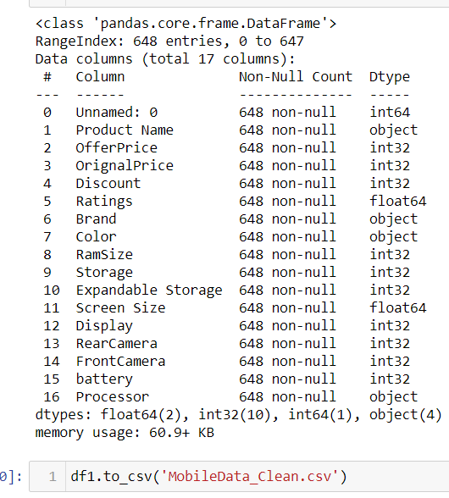
Data Cleaning
Found max data after cleaning and we are saving this in a .csv file which will be used in Data Analysis

Slide 13
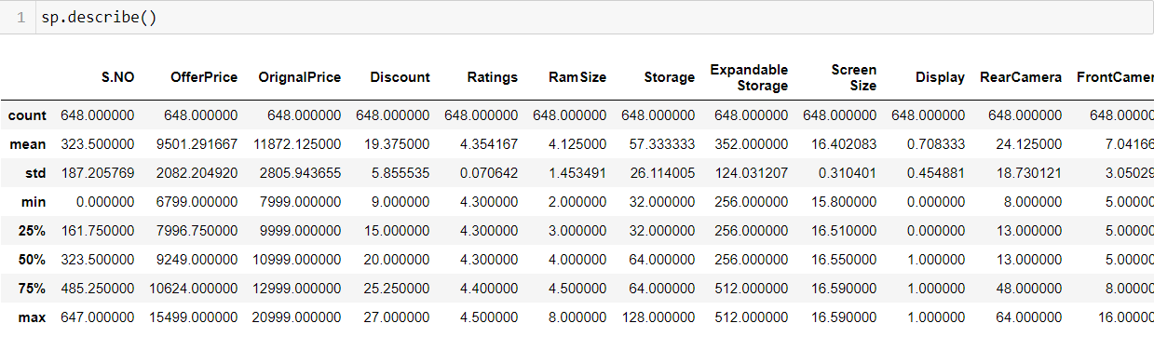
Data Analysis
Here we observe that some column contains mean and median are same.
Like Ratings,Expandable Storage,FrontCamera.
Excluding above column all column contains median higher than mean.

Slide 14
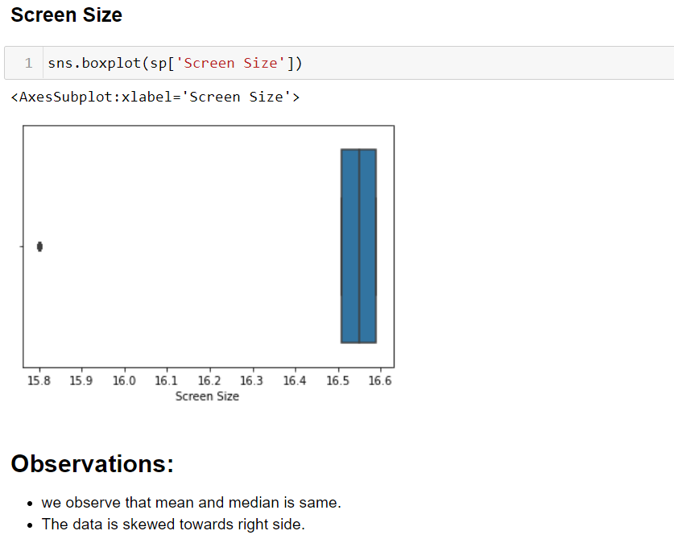
Data Analysis

Slide 15
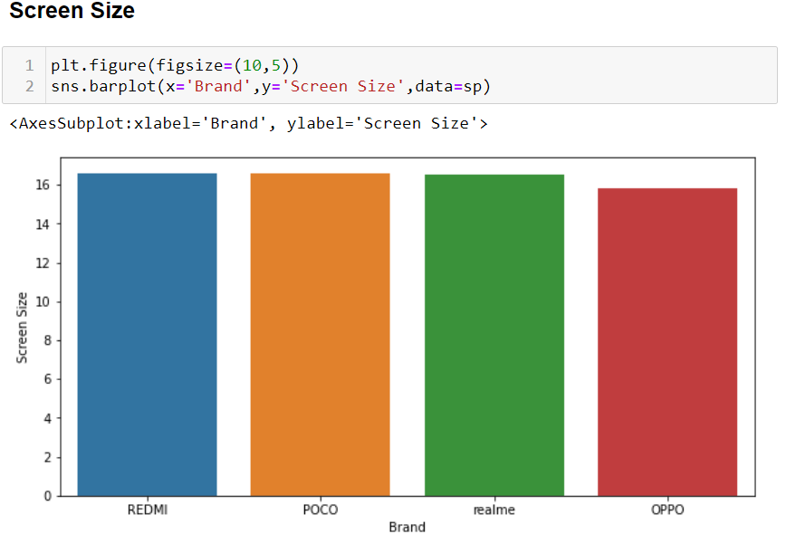
Data Analysis

Slide 16
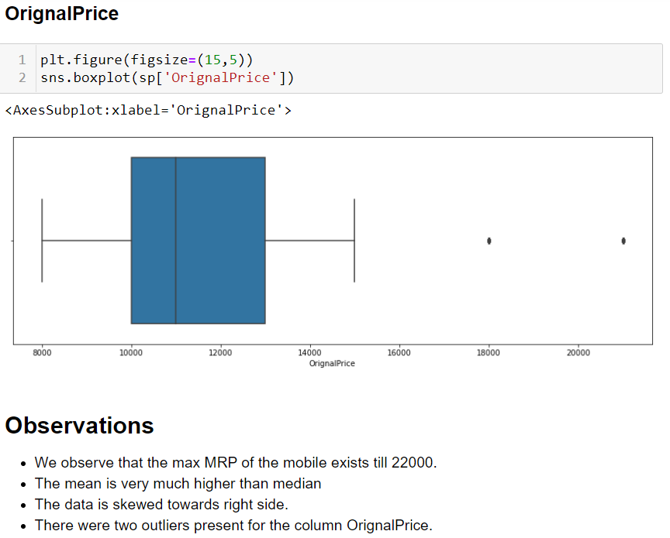
Data Analysis

Slide 17
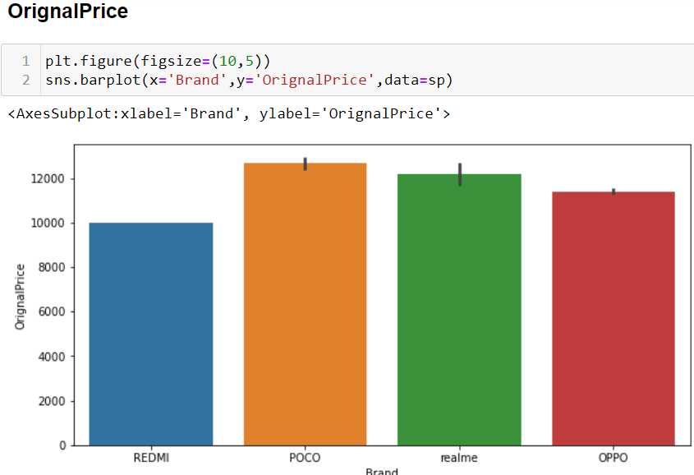
Data Analysis

Slide 18
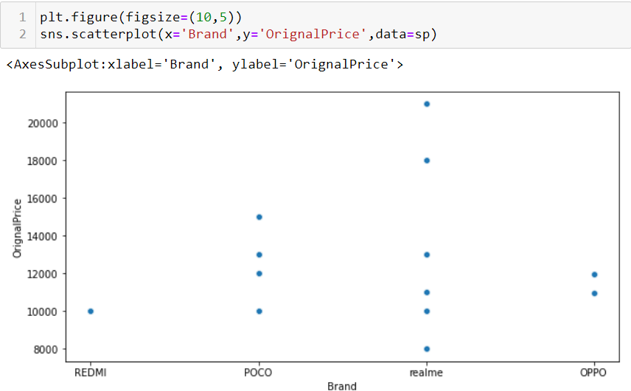
Data Analysis

Slide 19
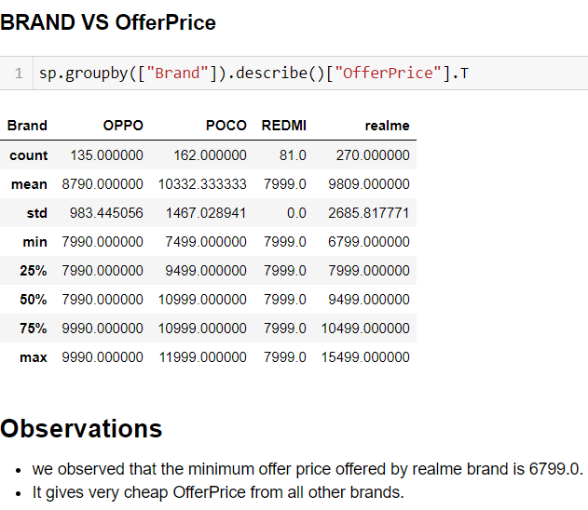
Data Analysis

Slide 20
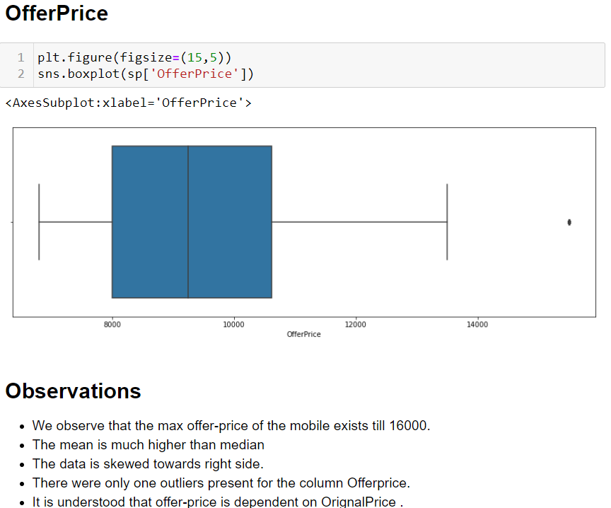
Data Analysis

Slide 21
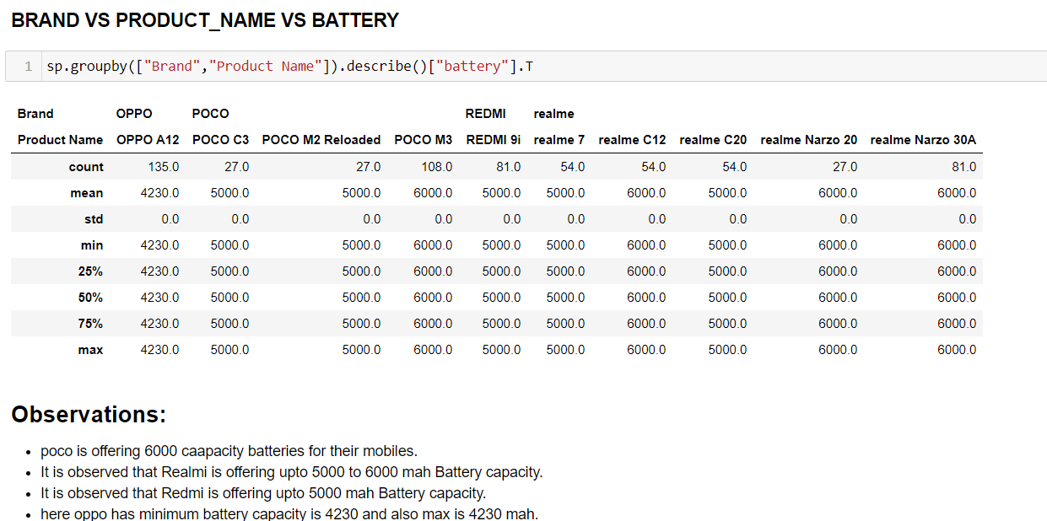
Data Analysis

Slide 22
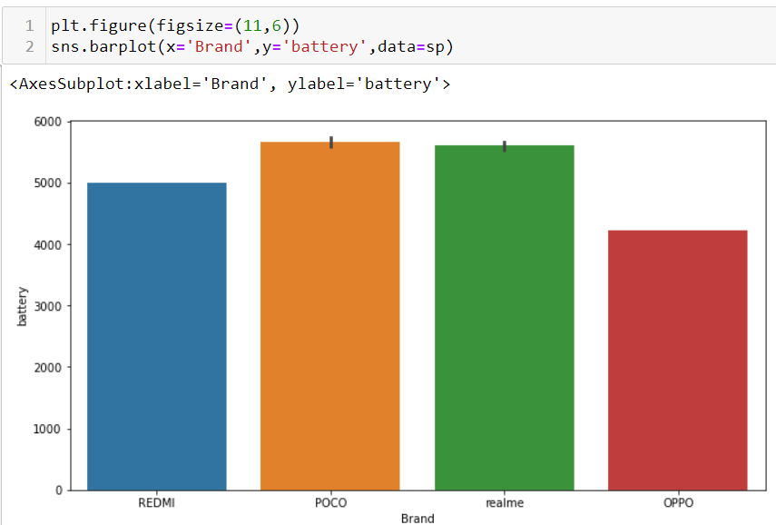
Data Analysis

Slide 23
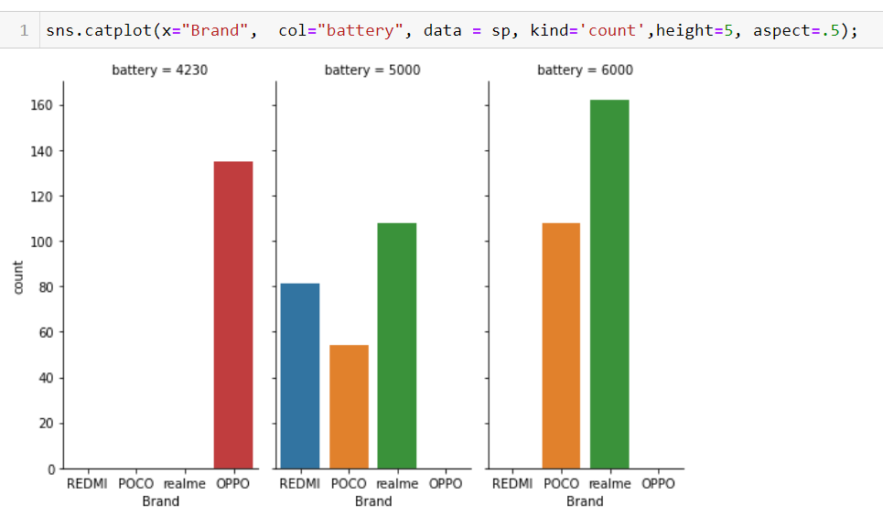
Data Analysis

Slide 24
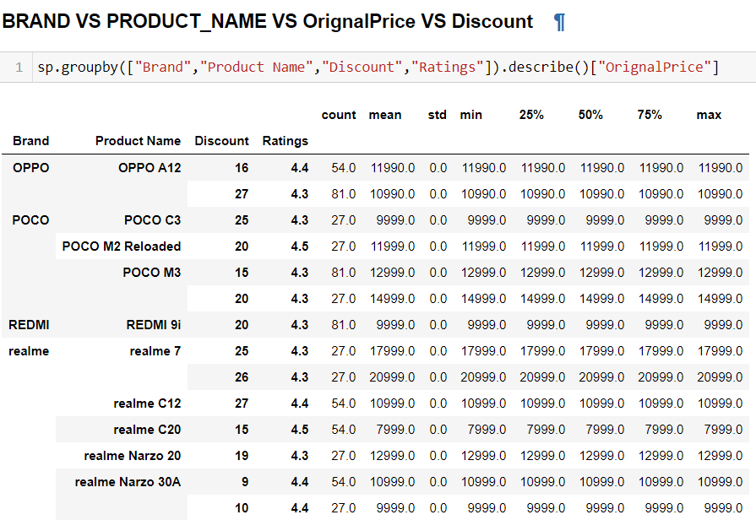
Data Analysis
It is observed that POCO M2 Reloaded,realme C20 with highest rating 4.5 from all of the products.
It is also Observed that from the Brand POCO and RealMe is with greater 4.5 Ratings.
It is also observed that the Brands like Oppo,Redmi are with above 4 Ratings.
We can observe that no one product is having 0 discount.
We also observe that the products brand POCO,OPPO&RealMe having more no. of discount like 25,26,27.
we also observe that the the Brand OPPO,RealMe is offering large amt of discount 27% over all other products.
We observe that RealMe offering min 9% discount to its product.

Slide 25
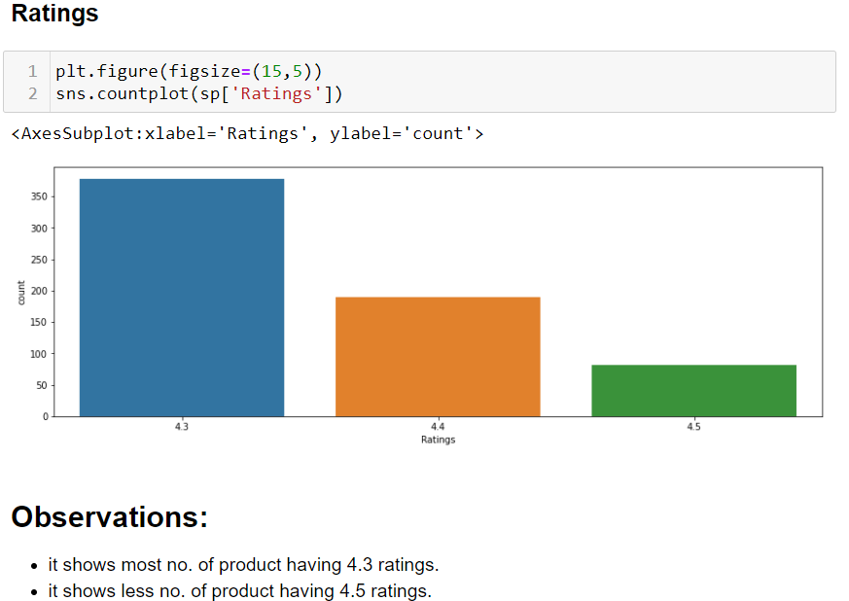
Data Analysis

Slide 26
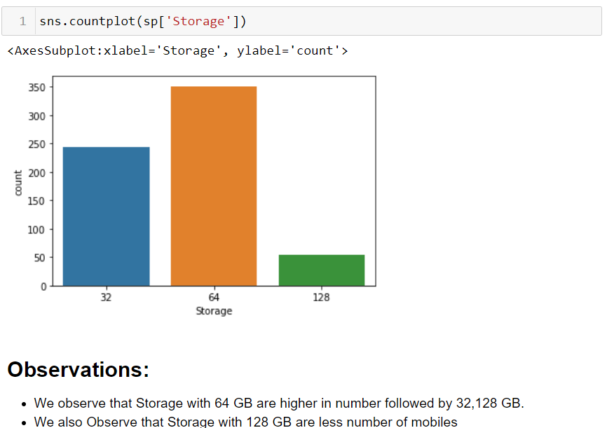
Data Analysis
Storage/ROM

Slide 27
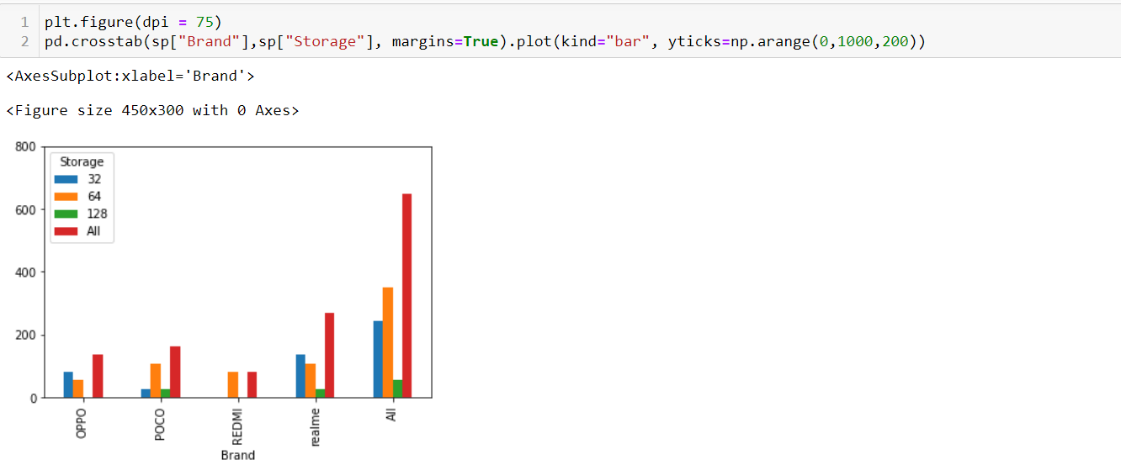
Data Analysis
Storage/ROM

Slide 28
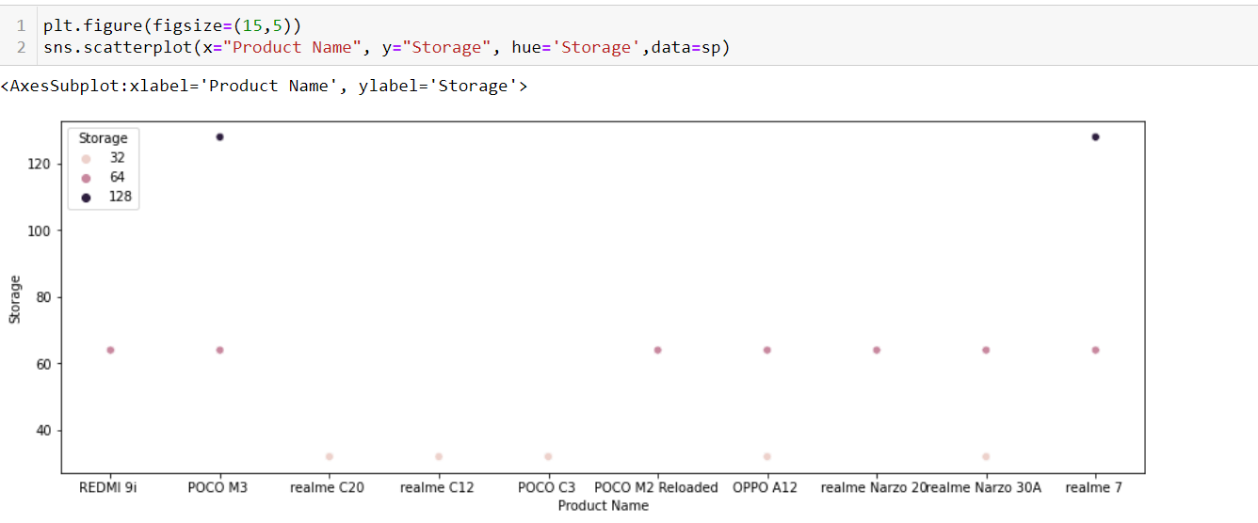
Data Analysis
Storage/ROM
Here we observe that the only POCO & RealMe products contains 128 GB Storage

Slide 29
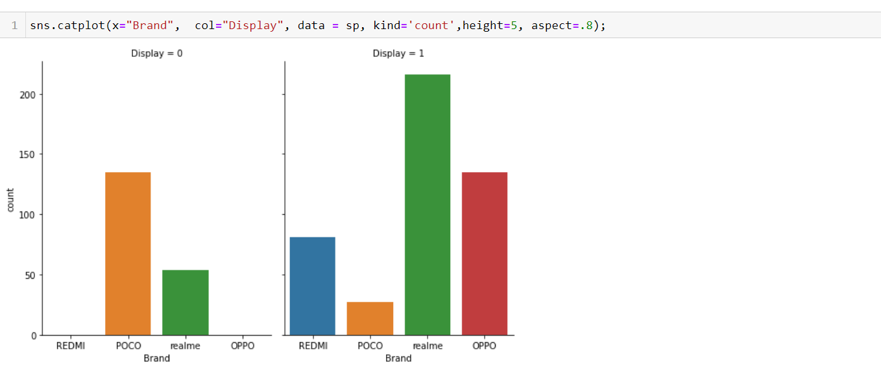
Data Analysis
Display
Full HD+ Display as 0
HD+ Display as 1
Here we observe that the POCO & RealMe contains Full HD+ Display.
Also all brand have HD+ Display.
Here we observe that RealMe have large number of count in HD+ Displays and also contains some of Full HD+ Display.
POCO have more number of count in Full HD+ display over other brands.

Slide 30
Conclusion:-
Through overall Analysis:-
It is found that the best specification and better memory is offering by POCO & RealMe.
But the cost of RealMe products are up to 22,000 Thous.
Which is affordable for all in now a days.
The next smartphone Brand OPPO is offering better specifications but the prices are compitative
to RealMe products.
OPPO mobile top spec phones are also not Affordable to all.
The other brand like Redmi are also offering mobiles at top specs missing some features like
battery capacity and memory at mid range prices.
So these were also considered to purchase alternatives to POCO and RealMe.
The Brand Realme which is found offering 8 GB RAM and 128 GB ROM.
Which is priced at 23000 which has become competitive to top spec mobiles of other brands
which are priced at double to this product.
The products from Realme are offering Class specifications at lowest prices.
Hence we conclude Realme is the Brand offering Better product for Better value.

Slide 31
THANK YOU!

