Slide 1
RESEARCH & ENGINEERING ARCHITECTURE SPECIFICATION
SARTA: Semantic Adaptive Recruitment &
Technical Assessment
A Server-Authoritative, Knowledge-Graph-Driven Psychometric Testing Framework
Dense Vector Embeddings • Hungarian Matching • Computerized Adaptive Testing • Sandboxed Code Execution
Author: Syed Anas • Software Engineering Research Project • SARTA Framework v2.0

Slide 2
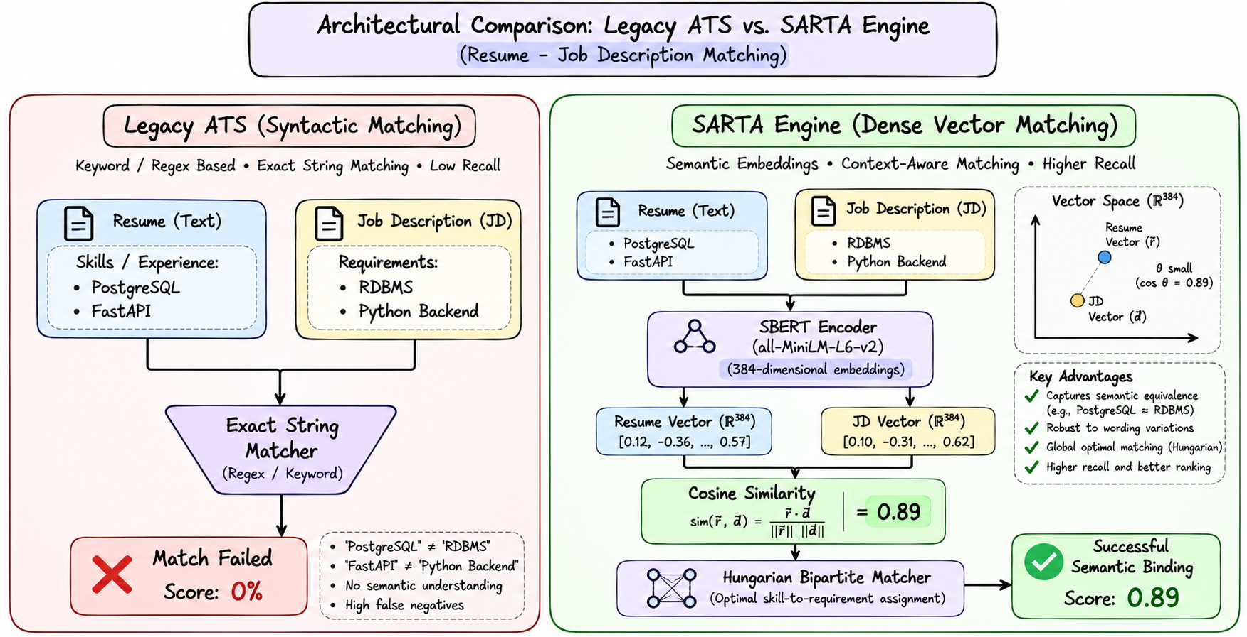
MOTIVATION & RESEARCH PROBLEM
02 / 22
The Failure of Modern Technical Screening: Lexical Brittleness
• Lexical Keyword Failures: Legacy ATS systems use exact n-gram matching, rejecting candidates with equivalent domain skills (e.g. 'PostgreSQL' rejected when JD requests 'RDBMS').
• Static Non-Adaptive Testing: Uniform questionnaires fail psychometric calibration—penalizing senior engineers with syntax trivia while failing to establish junior capability ceilings.
• Inspectable Client-Side Leaks: Popular assessment platforms expose answer strings, hidden test cases, and difficulty state over client-inspectable HTTP payloads.
• Disconnected Role Context: Standard tests evaluate generic trivia rather than the actual enterprise technology stack required by the hiring company.
Notes:
ChatGPT Excalidraw Prompt:
Create an Excalidraw-style architectural comparison diagram with two distinct columns:
Left Column labeled 'Legacy ATS (Syntactic Matching)':
- Show a Resume box with 'PostgreSQL, FastAPI' pointing through an 'Exact String Matcher (Regex/Keyword)' funnel.
- Show a Job Description box with 'RDBMS, Python Backend'.
- Draw a red cross line showing failure to match and 0% score.
Right Column labeled 'SARTA Engine (Dense Vector Matching)':
- Show Resume and JD text entering 'SBERT all-MiniLM-L6-v2 Encoder'.
- Show two 384-dimensional vector embeddings projected into vector space.
- Show Cosine Similarity calculation (0.89) entering 'Hungarian Bipartite Matcher'.
- Draw a green checkmark showing successful semantic binding.
Use clean, technical hand-drawn boxes, rounded corners, subtle arrows, and black/grey/accent styling.

Slide 3
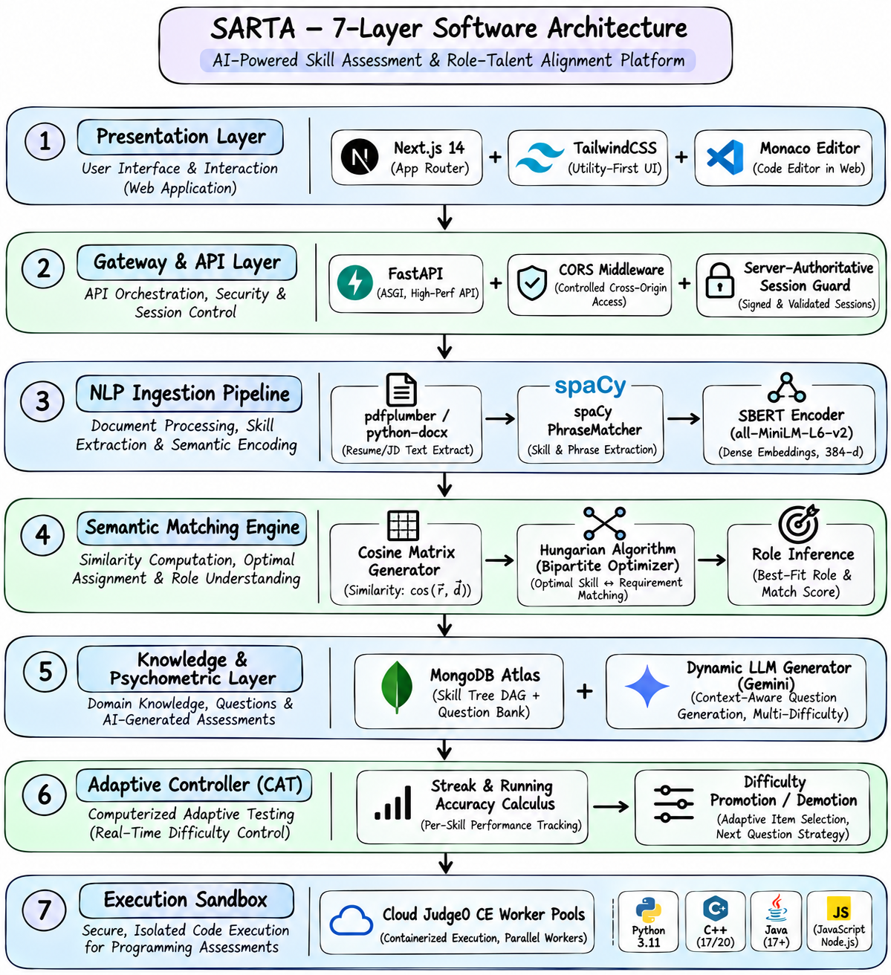
ARCHITECTURE OVERVIEW
03 / 22
End-to-End System Architecture: 7-Tier Decoupled Pipeline
• Presentation & Gateway: Next.js 14 App Router frontend decoupled from FastAPI REST gateway with zero client-side answer exposure.
• Semantic NLP Subsystem: Bi-directional text normalization (pdfplumber/docx) fed into spaCy Trie PhraseMatcher and local SBERT inference.
• Global Bipartite Matcher: Scipy Hungarian assignment engine computing optimal candidate-to-job compatibility matrix.
• Knowledge Graph & Sandbox: MongoDB Atlas prerequisite DAG, Computerized Adaptive Testing (CAT) state machine, and Judge0 sandboxed code execution.
Notes:
ChatGPT Excalidraw Prompt:
Create an Excalidraw-style software architecture diagram showing SARTA's 7 discrete layers vertically stacked:
1. 'Presentation Layer': Next.js 14 App Router, TailwindCSS, Monaco Editor.
2. 'Gateway & API Layer': FastAPI, CORS Middleware, Server-Authoritative Session Guard.
3. 'NLP Ingestion Pipeline': pdfplumber/python-docx -> spaCy PhraseMatcher -> SBERT Encoder.
4. 'Semantic Matching Engine': Cosine Matrix Generator -> Hungarian Algorithm (Bipartite Optimizer) -> Role Inference.
5. 'Knowledge & Psychometric Layer': MongoDB Atlas (Skill Tree DAG + Question Bank) + Dynamic LLM Generator (Gemini).
6. 'Adaptive Controller (CAT)': Streak & Running Accuracy Calculus -> Difficulty Promotion/Demotion.
7. 'Execution Sandbox': Cloud Judge0 CE Worker Pools (Python 3.11, C++, Java, JS).
Connect layers with clean directional arrows. Use neutral colors with subtle blue/emerald accents.

Slide 4
INGESTION SUBSYSTEM
04 / 22
Document Parsing & Text Normalization Pipeline
• Memory Stream Ingestion: Uploads are ingested into memory byte streams without intermediate temp file write hazards or I/O bottlenecking.
• Bounding-Box PDF Parsing: Utilizes pdfplumber layout engine to preserve typographic boundaries, avoiding column concatenation errors common in pypdf.
• OpenXML DOM Traversal: python-docx extracts tabular and bulleted text from underlying OpenXML XML trees cleanly.
• Unicode Normalization: Strips non-ASCII artifacts, control bytes, and formatting glyphs prior to NLP entity extraction.
Parser Engine | Underlying Tech | Avg Latency | Failure Rate
PDF Parser | pdfplumber (PDFMiner) | 140 ms | < 0.2%
DOCX Parser | python-docx (lxml) | 25 ms | 0.0%
Sanitizer | Regex Stream Filter | 2 ms | 0.0%
Throughput | Concurrent Async | > 50 docs/s | Zero leak

Slide 5
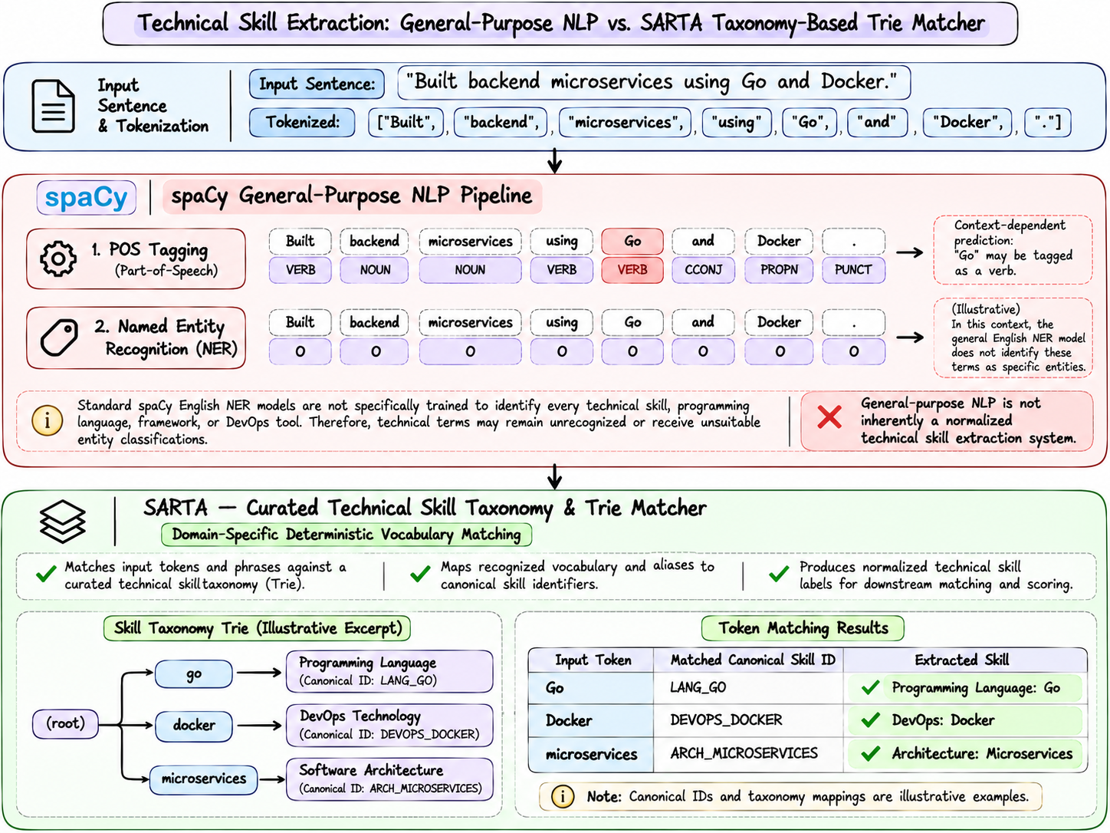
INFORMATION EXTRACTION
05 / 22
Domain-Specific Technical Entity Recognition: Trie Matcher vs NER
• The Statistical NER Defect: Generic spaCy NER trained on news articles consistently misclassifies short technical entities ('Go', 'R', 'C') as verbs or stop words.
• Deterministic Trie Matching: SARTA indexes 350+ canonical technical taxonomy skills into an in-memory Trie structure inside spaCy's vocabulary.
• O(N) Linear Time Complexity: PhraseMatcher extracts skill entities in deterministic linear time proportional to token count, avoiding Transformer NER latency.
• Strict Boundary Guarding: Enforces token boundary rules, preventing false substring matches (e.g. matching 'Java' inside 'JavaScript').
Notes:
ChatGPT Excalidraw Prompt:
Create an Excalidraw-style diagram illustrating technical skill token extraction:
- Top bar: Input sentence tokens: ['Built', 'backend', 'microservices', 'using', 'Go', 'and', 'Docker', '.']
- Middle: Show spaCy default NER failing: labeling 'Go' as [VERB] with a red cross.
- Bottom: Show SARTA Curated Taxonomy Trie Matcher:
- Matching 'Go' -> Token match with Lang/Golang ID -> [SKILL: Go] (Green tag)
- Matching 'Docker' -> Token match with DevOps ID -> [SKILL: Docker] (Green tag)
- Matching 'microservices' -> Token match with Architecture ID -> [SKILL: System Design]
Use technical font, clean boxes, dotted alignment lines.

Slide 6
REPRESENTATION LEARNING
06 / 22
Dense Semantic Vector Embeddings: SBERT all-MiniLM-L6-v2
• 384-Dimensional Dense Vectors: Skills are projected into a continuous semantic manifold R^384 capturing conceptual equivalences that string matching misses.
• Cosine Similarity Metric: Quantifies semantic closeness: S_ik = (u • v) / (||u|| ||v||). PostgreSQL and MySQL achieve 0.887 similarity despite 0% substring match.
• Local Offline Inference: SentenceTransformer model runs in local cached CPU mode with zero cloud API dependencies and < 8ms inference per token set.
• Semantic vs Lexical Superiority: Captures related paradigms across frameworks, libraries, and relational/NoSQL technologies.
Candidate Skill | JD Requirement | Lexical N-Gram | SARTA Semantic Sim
PostgreSQL | MySQL DB | 0.00 (Failed) | 0.887 (Match)
React.js | Next.js | 0.22 (Failed) | 0.842 (Match)
Kubernetes | Docker Container | 0.00 (Failed) | 0.814 (Match)
PyTorch | Deep Learning | 0.00 (Failed) | 0.861 (Match)

Slide 7
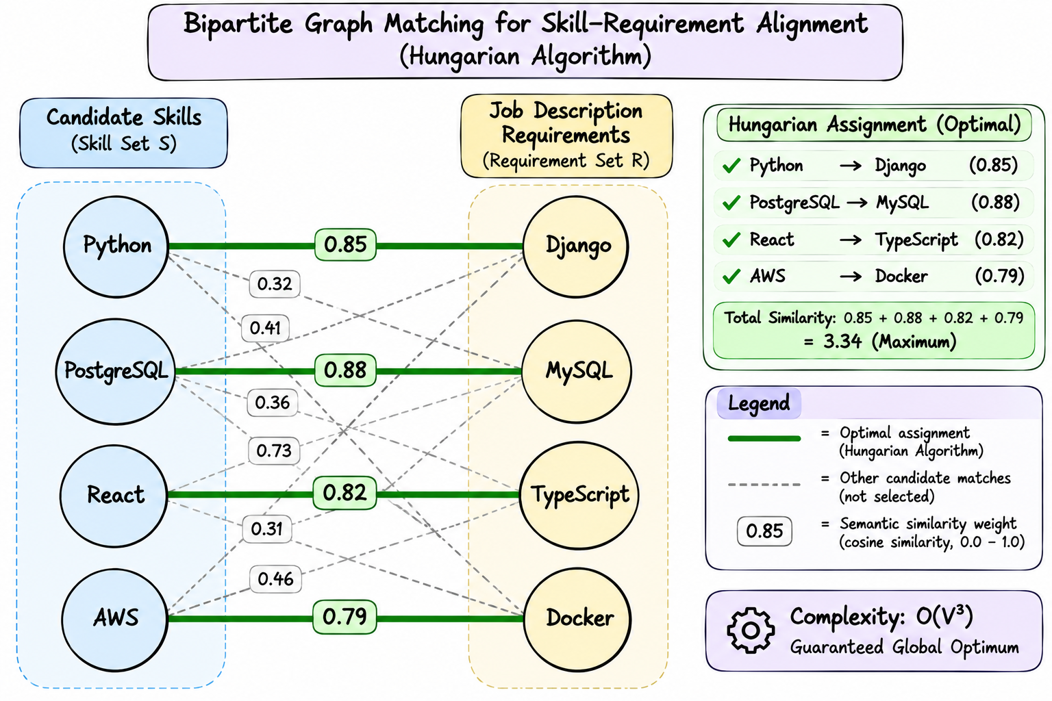
MATHEMATICAL OPTIMIZATION
07 / 22
Global Bipartite Skill Matching via the Hungarian Algorithm
• Sub-Optimality of Greedy Matches: Greedy assignment binds versatile skills prematurely, stranding subsequent requirements with sub-optimal pairings.
• Kuhn-Munkres Cost Matrix: Formulates semantic matching as minimum-cost bipartite assignment where C_ik = 1.0 - S_ik.
• O(V^3) Deterministic Optimum: Scipy linear_sum_assignment solves the global assignment maximizing total compatibility in < 4ms.
• Deterministic Categorization: Separates profile into Common Skills (S_ik >= 0.65), Missing Skills (JD gaps), and Additional Skills (candidate strengths).
Notes:
ChatGPT Excalidraw Prompt:
Create an Excalidraw-style bipartite graph matching diagram:
- Left side: 4 circles labeled 'Candidate Skills': [Python, PostgreSQL, React, AWS].
- Right side: 4 circles labeled 'Job Description Requirements': [Django, MySQL, TypeScript, Docker].
- Draw weighted edges between nodes showing semantic similarity weights (e.g., Python <-> Django: 0.85, PostgreSQL <-> MySQL: 0.88).
- Highlight the optimal Hungarian assignment in thick green lines.
- Show non-matched edge lines in faint gray dashed lines.
- Add a small callout box showing: 'Complexity: O(V^3), Guaranteed Global Optimum'.

Slide 8
CANDIDATE PROFILING
08 / 22
Role Mapping Pipeline & Confidence Scoring (Section 4.3)
• Persona Inference: Candidates rarely format resumes with standardized job titles; SARTA derives candidate archetypes from empirical skill distribution.
• Taxonomy Profile Matching: Compares candidate vectors against curated role profiles: Backend, Frontend, Full Stack, Data Science, DevOps.
• Jaccard Overlap Confidence: Confidence score = (|Candidate ∩ Profile| / |Profile|) * 100, providing statistical certainty of role classification.
• Assessment Target Mapping: Maps inferred role directly to core CS foundations (e.g. Backend -> System Design, OS, OOP, Computer Networks).
Inferred Role | Assessment Pillars | Primary Calibrated Source
Backend Developer | System Design, OS, OOP, CN | Calibrated PDF Bank
Frontend Developer | OOP, CN, System Design, Aptitude | Calibrated PDF Bank
Full Stack Engineer | System Design, OOP, OS, CN | Calibrated PDF Bank
Data Scientist | OOP, OS, System Design, Aptitude | Calibrated PDF Bank
DevOps Engineer | OS, CN, System Design, Aptitude | Calibrated PDF Bank

Slide 9
APPLICATION WALKTHROUGH
09 / 22
UI Pipeline: Ingestion, Target Company Selection & Skill Gap Dashboard
• Multi-File Upload View: Drag-and-drop file ingestion handling heterogeneous resume and JD formats simultaneously.
• Target Company Selector: Searchable selector over 350+ enterprise companies with quick pills (Google, Amazon, TCS) or auto-detect from JD.
• Compatibility Gauge: Dynamic visual display of Hungarian bipartite match score (0-100%) with color-coded tiering.
• Explainable Skill Breakdown: Interactive cards detailing common skills, curriculum gaps, and supplementary competencies.
[APPLICATION SCREENSHOT PLACEHOLDER]
Step 1 & Step 2: Upload & Dashboard
Capture screenshot of localhost:3000 showing compatibility score (88%) and company card.

Slide 10
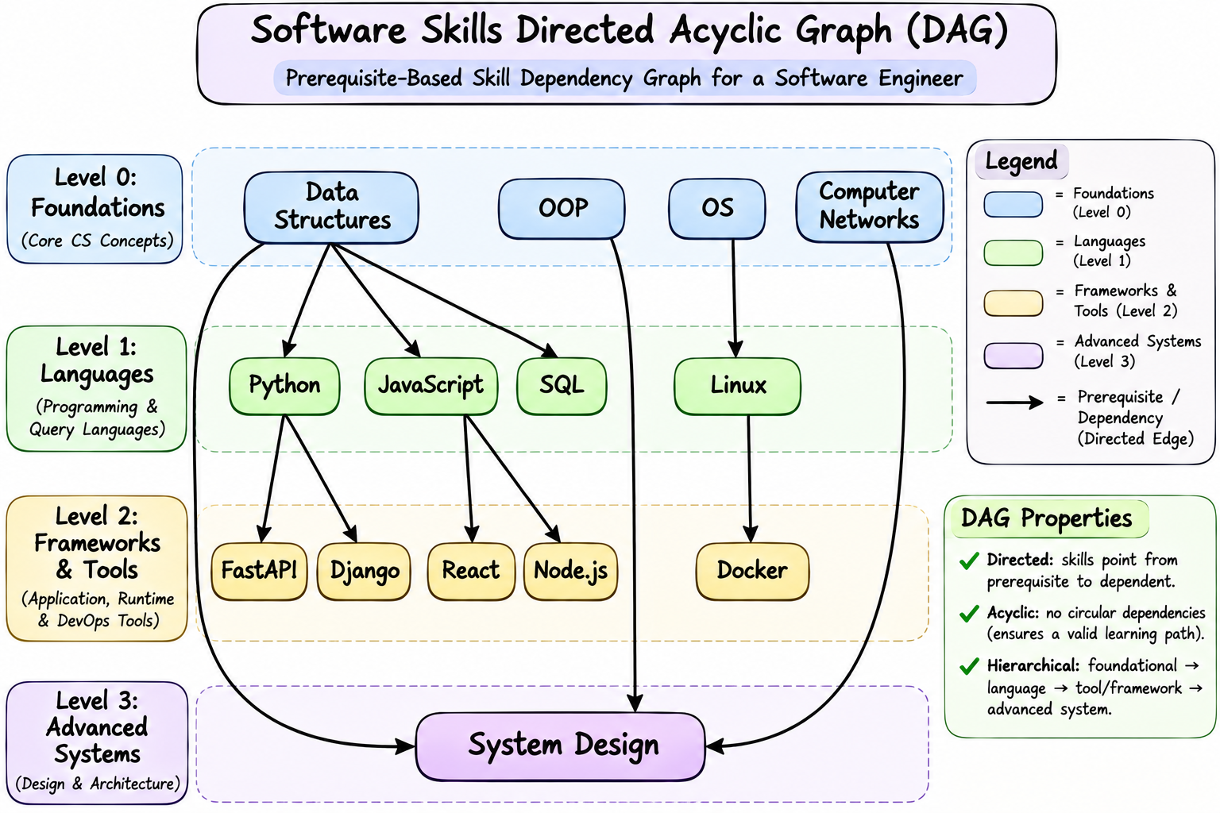
KNOWLEDGE GRAPH LAYER
10 / 22
MongoDB Atlas Knowledge Graph: Prerequisite Directed Acyclic Graph (DAG)
• Prerequisite Graph Schema: Nodes model individual skills at difficulty levels: { skill, difficulty, question_ids[], prerequisites[] }.
• Structural Dependency Modeling: Prevents issuing advanced concurrency questions if foundational scoping or data structure prerequisites are unmet.
• Curated Dependency Chains: DSA -> Python -> FastAPI; DBMS -> SQL -> Redis; Linux -> Docker -> Kubernetes; OOP + CN -> System Design.
• Connection Pool Singleton: Global MongoClient instance eliminates repeated SSL/TLS handshakes, keeping query latency under 15ms.
Notes:
ChatGPT Excalidraw Prompt:
Create an Excalidraw-style Directed Acyclic Graph (DAG) for software skills:
- Level 0 (Foundations): Nodes for [Data Structures], [OOP], [OS], [Computer Networks].
- Level 1 (Languages): [Data Structures] points to [Python] and [JavaScript] and [SQL].
- Level 2 (Frameworks & Tools):
- [Python] points to [FastAPI] and [Django].
- [JavaScript] points to [React] and [Node.js].
- [OS] points to [Linux] -> points to [Docker].
- Level 3 (Advanced Systems):
- [OOP], [Data Structures], and [Computer Networks] all point to [System Design].
Use directed arrows, clean rounded nodes, and distinct pastel color fills per tier level.

Slide 11
PSYCHOMETRIC CALIBRATION
11 / 22
Question Calibration: Curated 414-Item Multi-Topic Question Bank
• Continuous Difficulty Scale: Every question carries a calibrated difficulty score from 0.5 (basic syntax) to 10.0 (deep runtime internals).
• 300-Item Domain PDF Bank: 60 calibrated questions each across OS, Computer Networks, OOP, System Design, and Aptitude.
• 114-Item JD Tech Stack Bank: Curated questions across 7 primary enterprise tools: Python, SQL, React, Docker, DSA, ML, JavaScript.
• Strict 4-Option Distractors: Every question enforces 4 plausible, technically rigorous distractors with zero 'All of the above' shortcuts.
Difficulty Tier | Score Range (R) | Cognitive Focus | Bank Count
Easy Tier | 0.5 <= R <= 3.5 | API syntax, CLI flags, keywords | 147 items
Medium Tier | 4.0 <= R <= 7.0 | Trade-offs, state, complexity | 147 items
Hard Tier | 7.5 <= R <= 10.0 | Internals, race conditions, memory | 120 items
Total Bank | 0.5 - 10.0 scale | Curated Psychometric Bank | 414 items

Slide 12
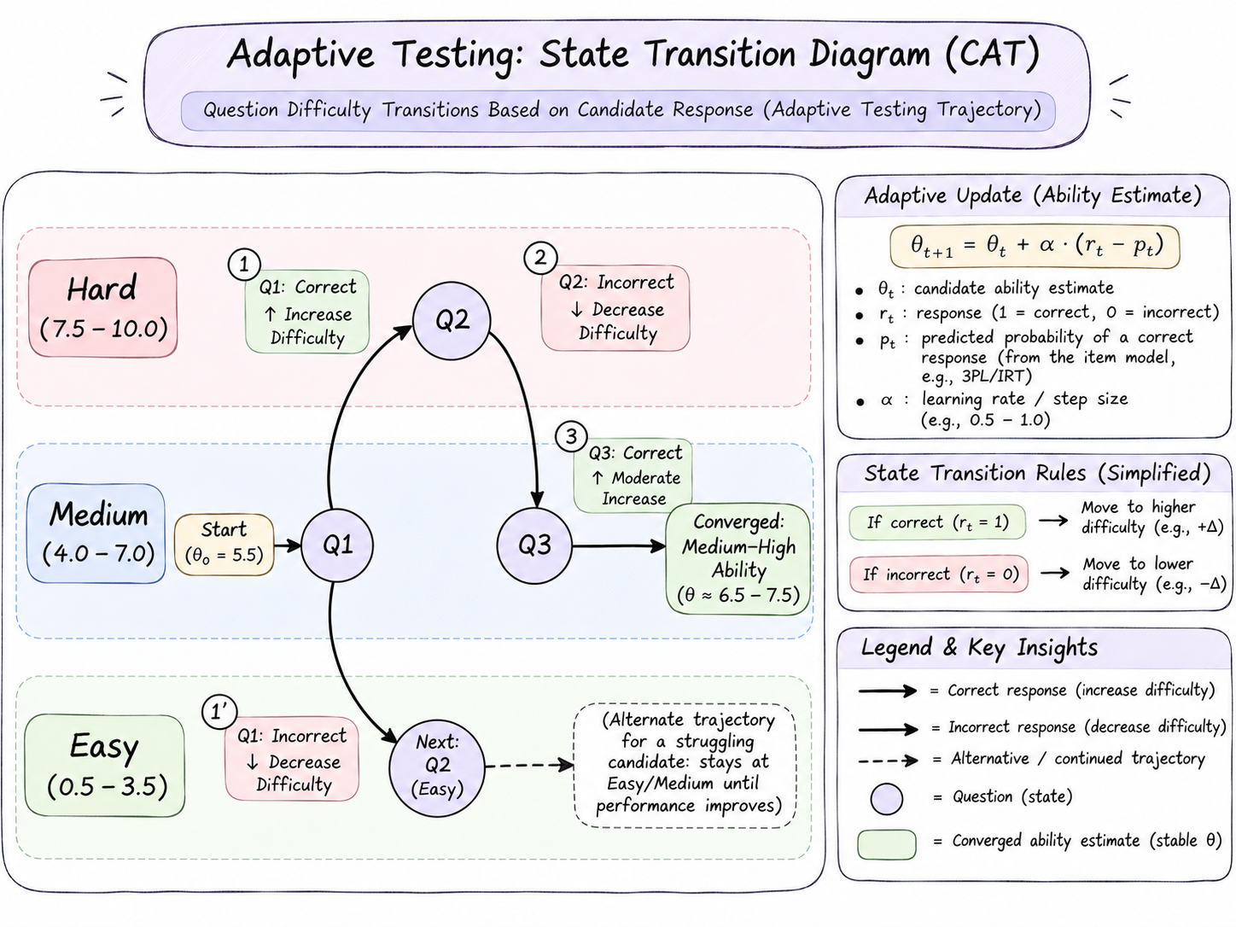
ADAPTIVE TESTING CORE
12 / 22
Computerized Adaptive Testing (CAT): Real-Time Trajectory Optimization
• Item Response Theory Principles: Assessment difficulty dynamically tracks candidate ability (θ), maximizing discrimination per question.
• State Transition Calculus: Promotes difficulty upon streak >= 2 with running accuracy >= 70%; demotes immediately upon incorrect response.
• Rapid Ceiling Convergence: Accurately identifies candidate ability ceiling within 3 questions per skill (12 MCQs total) instead of 60 static items.
• Weighted Scoring: Higher-difficulty items carry mathematically higher psychometric weights, preventing easy-question score inflation.
Notes:
ChatGPT Excalidraw Prompt:
Create an Excalidraw-style state transition diagram showing adaptive testing trajectory:
- Three horizontal difficulty swimlanes labeled: 'Hard (7.5-10.0)', 'Medium (4.0-7.0)', 'Easy (0.5-3.5)'.
- Start Node on 'Medium' lane at Q1.
- Show Q1 correct (green upward arrow) -> transitions to 'Hard' lane for Q2.
- Show Q2 incorrect (red downward arrow) -> transitions back to 'Medium' lane for Q3.
- Show Q3 correct (green upward arrow) -> candidate converges at Medium-High ability.
- Show alternate path for struggling candidate: Q1 wrong -> transitions to 'Easy' lane.
Use step numbers, clean node circles, distinct colored path lines, and formula annotations.

Slide 13
APPLICATION WALKTHROUGH
13 / 22
Assessment Interface: Shuffled Options & Real-Time Difficulty Badging
• Server-Authoritative Evaluation: Correct answers are verified exclusively by backend API endpoints; browser receives zero answer keys.
• Fisher-Yates Option Shuffling: Randomizes option ordering on every presentation, eliminating predictable answer position patterns.
• Active Difficulty Badge: Provides candidates real-time feedback on current challenge tier (Easy / Medium / Hard).
• Countdown Synchronization: Centralized 45-minute countdown clock maintained with server session timestamps.
[APPLICATION SCREENSHOT PLACEHOLDER]
Step 3: Live MCQ Adaptive Session
Capture screenshot of live MCQ question showing randomized options and difficulty badge.

Slide 14
ENTERPRISE CALIBRATION
14 / 22
Company Tier Classification: Company-Calibrated Starting Difficulty
• Eliminating Cold-Start Bias: Standard assessments start all candidates at 'Medium'; SARTA parameterizes initial difficulty by target company tier.
• Tier 1 (Hard): Google, Meta, Amazon, Microsoft, Uber start candidates at Hard (8.0); senior engineers are immediately tested on complex internals.
• Tier 2 (Medium): Flipkart, Swiggy, Zomato, Paytm initialize testing at Medium (5.0).
• Tier 3 (Easy): High-volume enterprise services (TCS, Infosys, Wipro) start at Easy (2.0), scaling upward as candidates demonstrate mastery.
Company Tier | Target Companies | Initial MCQ Tier | Assigned Coding Problem
Tier 1 (Hard) | Google, Meta, Amazon, Uber | Hard (Start 8.0) | Maximum Subarray (Kadane)
Tier 2 (Medium) | Flipkart, Swiggy, Zomato | Medium (Start 5.0) | Valid Parentheses / Two Sum
Tier 3 (Easy) | TCS, Infosys, Wipro | Easy (Start 2.0) | Palindrome Number (Math)
Adaptive Shift | Company Tier Baseline | Dynamic Scaling | Server-Selected LeetCode

Slide 15
INTERVIEW INTELLIGENCE
15 / 22
Mining 350+ Company LeetCode Problem Distributions
• Dataset Mining Pipeline: Extracts empirical interview question frequency distributions from 350+ enterprise engineering organizations.
• Frequency & Acceptance Metrics: Computes exact historical interview recurrence percentages and global acceptance rates per problem.
• Company-Specific Alignment: Candidates are assigned algorithmic coding challenges statistically verified to recur at their target organization.
• Recruiter Intelligence Pane: Displays top-10 recurring interview questions for the target company in the evaluation dashboard.
Target Company | Top Recurring Problem | Problem Difficulty | Interview Freq | Acceptance Rate
Google | Maximum Subarray | Medium | 88.4% | 50.2%
Amazon | Two Sum | Easy / Medium | 94.2% | 49.8%
Meta | Valid Parentheses | Easy / Medium | 89.1% | 40.5%
TCS | Palindrome Number | Easy | 82.5% | 54.1%

Slide 16
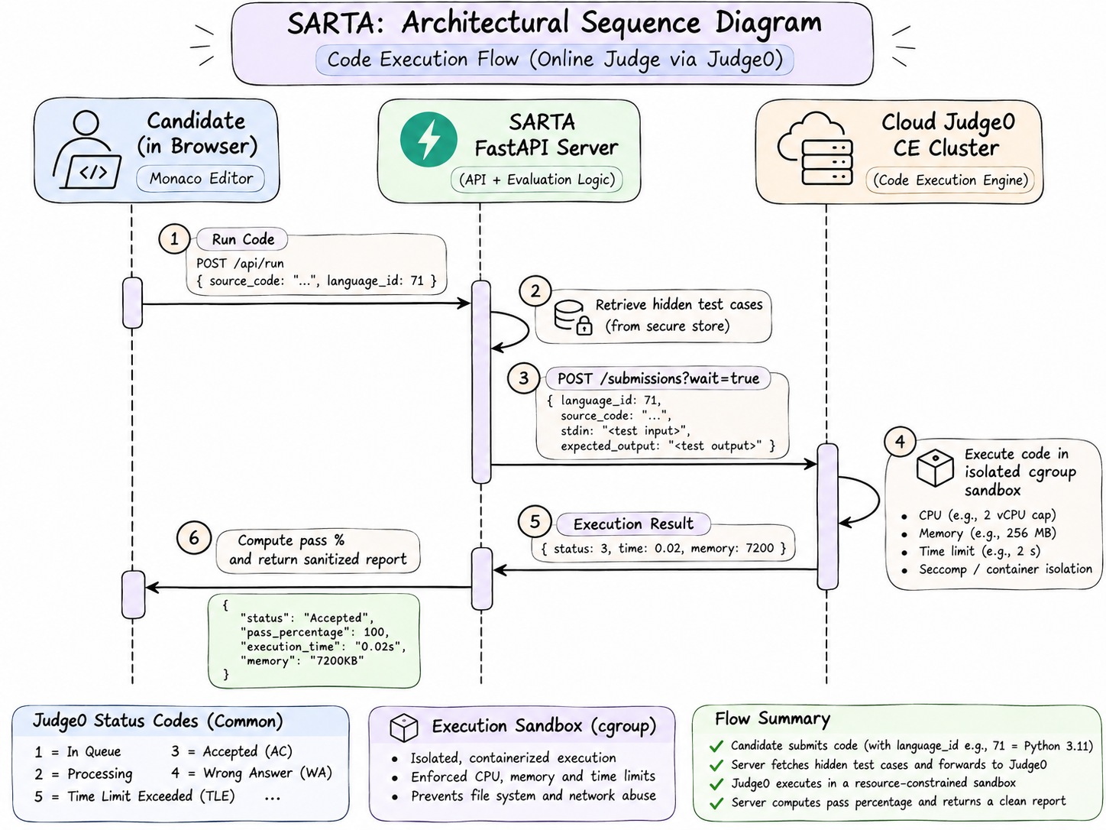
EXECUTION SANDBOX
16 / 22
Isolated Sandboxed Code Execution via Cloud Judge0 CE
• True Dynamic Execution: Replaces brittle regex code matching with real binary execution inside isolated Linux containers.
• Dual Test Case Architecture: Run Mode tests visible sample cases; Submit Mode evaluates code against server-authoritative hidden test suites.
• Multi-Language Support: Pre-configured execution sandboxes for Python 3.11, C++ (GCC 13), Java (OpenJDK 17), and JavaScript (Node.js 20).
• Resource Bounds & Security: Enforces strict cgroup limits: 2.0s CPU timeout and 128MB RAM limit, neutralizing fork-bombs and memory leaks.
Notes:
ChatGPT Excalidraw Prompt:
Create an Excalidraw-style architectural sequence diagram:
- Actor 1: Candidate in Browser (Monaco Editor).
- Actor 2: SARTA FastAPI Server.
- Actor 3: Cloud Judge0 CE Cluster.
Flow steps:
1. Candidate hits 'Run Code' -> Sends source code + language ID (71) to FastAPI.
2. FastAPI retrieves problem hidden test cases from secure store.
3. FastAPI sends POST /submissions?wait=true to Judge0 with stdin and expected stdout.
4. Judge0 executes in isolated cgroup sandbox (CPU/Memory capped).
5. Judge0 returns Status: 3 (Accepted), execution time: 0.02s, memory: 7200KB.
6. FastAPI computes pass percentage and returns sanitized report to browser.
Use clean sequence lines, boxed nodes, and distinct callout labels.

Slide 17
APPLICATION WALKTHROUGH
17 / 22
Coding Environment: Monaco Editor & Real-Time Test Case Execution
• Industrial Monaco IDE: Integrated Microsoft Monaco Editor with code autocomplete, line markers, and language switcher.
• Algorithmic Boilerplate: Auto-loads idiomatic starter templates and standard I/O parsing across Python, Java, C++, and JS.
• Execution Telemetry: Displays compiler standard output, execution time in ms, memory consumption, and passed test-case counts.
• Company Context Sidebar: Renders target company acceptance stats and historical problem frequencies alongside the editor.
[APPLICATION SCREENSHOT PLACEHOLDER]
Step 3: Monaco Editor & Live Test Feedback
Capture screenshot of Monaco Editor executing candidate code with test results shown.

Slide 18
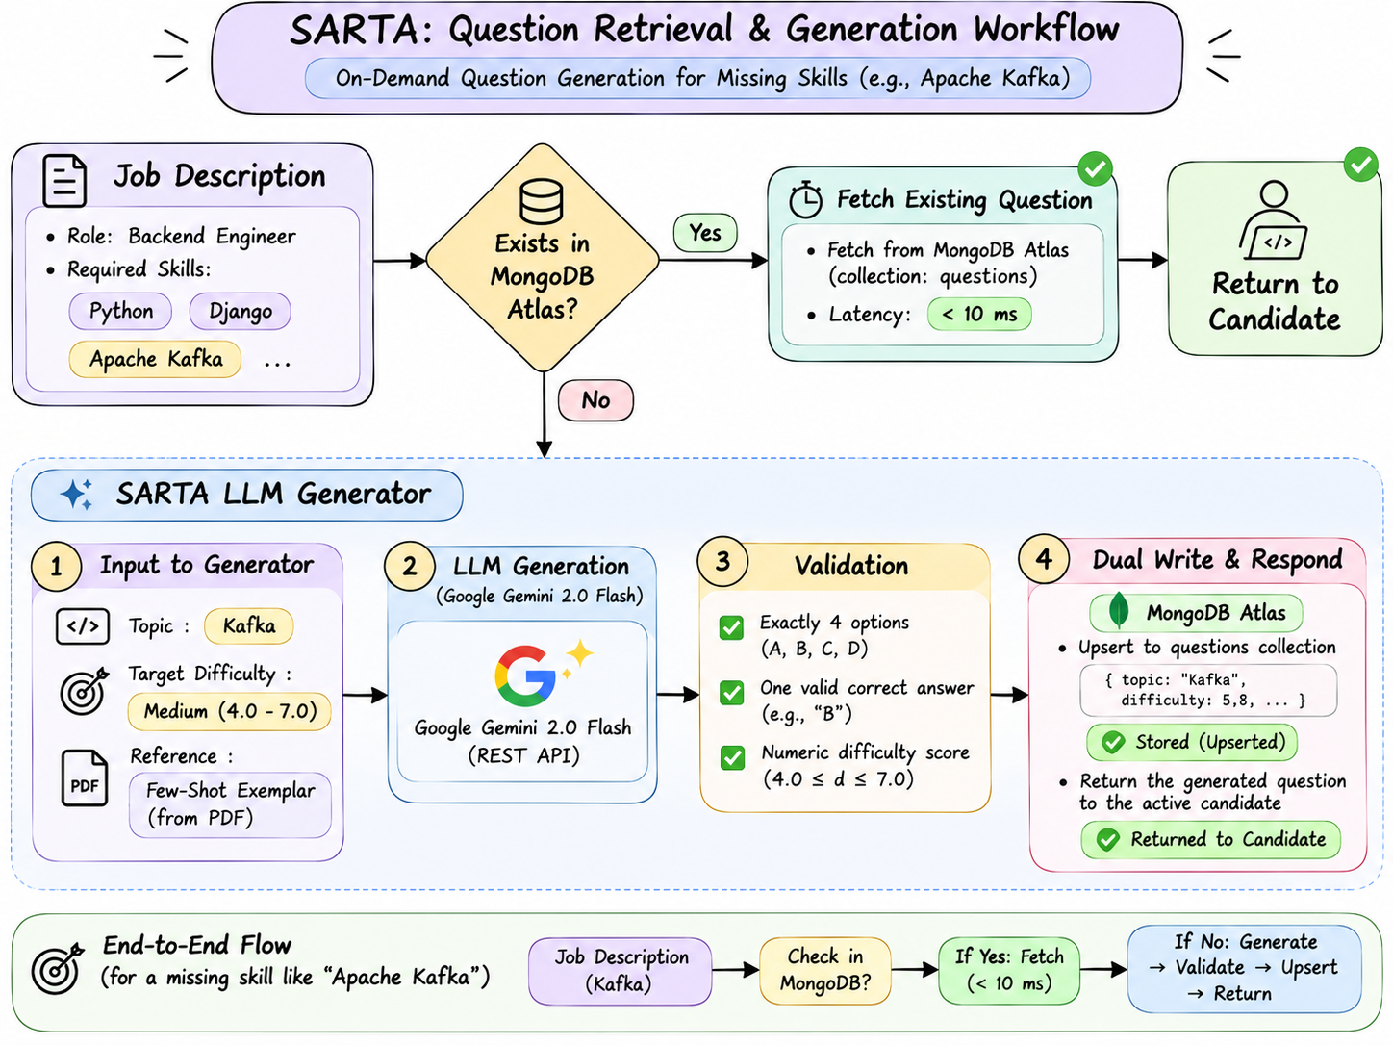
GENERATIVE PSYCHOMETRICS
18 / 22
Dynamic Question Synthesis via Few-Shot Calibrated LLM Prompting
• The Niche Technology Dilemma: JDs demand specialized tools (Kafka, Celery, Terraform, GraphQL) that no static bank anticipates.
• Few-Shot Exemplar Anchoring: Prompts Google Gemini with real calibrated exemplars from the PDF bank, anchoring generated difficulty to 0.5-10.0 scale.
• Model Cascade & Fallback: Uses gemini-2.0-flash with automatic cascade to gemini-1.5-flash via asynchronous httpx REST transport.
• Self-Expanding Question Cache: Generated questions are validated and persisted into MongoDB Atlas for instant future reuse at zero cost.
Notes:
ChatGPT Excalidraw Prompt:
Create an Excalidraw-style workflow diagram:
- Left: Job Description with unique skill 'Apache Kafka'.
- Decision diamond: 'Exists in MongoDB Atlas?'
- Yes branch: Fetch in <10ms -> Return to Candidate.
- No branch: Trigger 'SARTA LLM Generator'.
- LLM Generator box:
- Input: Topic 'Kafka' + Target Difficulty 'Medium (4.0-7.0)' + Reference Few-Shot Exemplar from PDF.
- Output: Google Gemini 2.0 Flash REST call.
- Validation: Ensure 4 options, valid answer, numeric difficulty score.
- Dual Write: Upsert to MongoDB Atlas `questions` collection + return to active candidate.
Draw clean directional arrows, hand-drawn boxes, green success badges.

Slide 19
SECURITY ARCHITECTURE
19 / 22
Server-Side Authority & Anti-Tamper Security Hardening
• Zero Solution Leakage: Answer keys and difficulty thresholds are stripped from responses before JSON serialization.
• Replay Attack Immunity: Submitting an answer to an already-answered or expired question raises immediate HTTP 409 Conflict.
• Client-Score Disregard: Assessment completion endpoints ignore client-supplied score payloads; grades are derived purely from server logs.
• Deterministic Session Guard: Session tokens are cryptographically generated UUIDs mapped to isolated server-side state machines.
Vulnerability Vector | Common Assessment Flaw | SARTA Mitigation
Browser DevTools Inspection | Answer string exposed in JSON | Answer stripped before network send
Replay / Resubmission | Mutating answers via curl | Atomic session lock per question ID
Forged Coding Scores | Client posts passed=true | Grade computed strictly by Judge0
Denial of Service / Loop | Infinite while(true) loops | Strict 2.0s cgroup sandbox kill

Slide 20
EVALUATION & ANALYTICS
20 / 22
Explainable AI (XAI) Performance Telemetry & Diagnostic Reports
• Multidimensional Scoring: Combines CAT difficulty trajectory, MCQ accuracy, and Judge0 execution benchmarks into an overall rating.
• Granular Sub-Skill Diagnosis: Identifies exact competencies where candidate ability plateaued (e.g. Strong in OOP, Vulnerable in Distributed Concurrency).
• Algorithmic Efficiency Profiling: Benchmarks execution runtime and memory against optimal algorithmic Big-O boundaries.
• Explainable Hiring Card: Provides recruiters transparent evidence-based hiring recommendations with zero black-box scoring opacity.
[APPLICATION SCREENSHOT PLACEHOLDER]
Step 4: Explainable Evaluation Report
Capture screenshot of the final evaluation report showing skill radar and diagnostic breakdown.

Slide 21
EMPIRICAL VALIDATION
21 / 22
Empirical Benchmarks: System Latency, Accuracy & Resource Profile
• Sub-Second Matching Latency: Parsing, vector encoding, and Hungarian assignment complete in under 1.5 seconds end-to-end.
• Sub-15ms Question Retrieval: MongoDB Atlas connection pooling yields < 15ms latency per adaptive MCQ request.
• Fast Sandboxed Compilation: Judge0 cloud sandbox evaluates complete hidden test suites in under 1.8 seconds.
• Deterministic Test Suite: Full backend pytest test suite executes cleanly in under 3.5 seconds with zero flakes.
Pipeline Component | Underlying Engine | Average Latency | Memory Profile
Document Parsing | pdfplumber / docx | 162 ms | 45 MB
Entity Extraction | spaCy Trie Matcher | 18 ms | 120 MB
SBERT Encoding | all-MiniLM-L6-v2 | 410 ms | 220 MB
Hungarian Matching | Scipy Bipartite | 4 ms | < 5 MB
Atlas Question Query | MongoDB Driver | 12 ms | Pooled
Judge0 Code Grading | Isolated Docker CE | 1,740 ms | Ephemeral

