Slide 1
Vessel Proximity Detection System
Optimized Code Walkthrough & Explanation
Using Python, Pandas, Geopy, Matplotlib, and Plotly
COMPLETED BY SHAHID RAZA
COURSE: BSC(HONS). COMPUTER SCIENCE

Slide 2
Libraries Used
- pandas: for data handling
- geopy: for geographical distance calculation
- matplotlib: for static visualization
- plotly: for interactive plots

Slide 3
Distance Calculation Function
- geodesic() from geopy calculates distance
- Returns real-world distance (in km)
- Accounts for Earth's curvature
Using Haversine formula

Slide 4
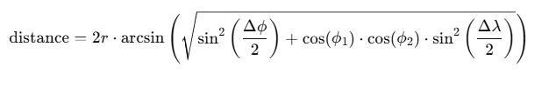
HAVERSINE FORMULA
The Haversine formula is a mathematical equation used to calculate the great-circle distance between two points on the surface of a sphere (like Earth), given their latitude and longitude.
WHY NOT EUCLIDEAN FORMULA???? : Because Earth is not flat. Using Euclidean distance formula will overestimates or underestimates the actual distance on a curved surface.
Haversine formula :

Slide 5
Proximity Detection
- Groups data per minute using timestamp
- Compares vessel pairs active in same minute
- Filters by unique MMSI and distance threshold

Slide 6
IMPLEMENTATION
def detect_proximity(data, distance_threshold):
proximity_events = []
data['rounded_time'] = data['timestamp'].dt.floor('min')
#GROUPS THE VESSELS THAT HAVE TIMESTAMP NEAREST TO THE MINUTE (ADDS AN EXTRA COLUMN)
PURPOSE: Limits comparisons to vessels active in the same minute

Slide 7
grouped = data.groupby('rounded_time')
# PURPOSE: rounding each timestamp down to the nearest minute (e.g., 2025-07-21 14:23:45 becomes 2025-07-21 14:23:00). This step creates a new column 'rounded_time'.
Limiting comparisons only to vessels that reported data around the same time.
Reducing computation from O(n²) over the full dataset to O(n²) within each small time group.

Slide 8
COMPLETE ALGO
def detect_proximity(data, distance_threshold):
proximity_events = []
# Group data by minute to avoid unnecessary comparisons
data['rounded_time'] = data['timestamp'].dt.floor('min')
grouped = data.groupby('rounded_time')
for time, group in grouped:
vessels = group.reset_index(drop=True)
for i in range(len(vessels)):
vessel1 = vessels.loc[i]
for j in range(i + 1, len(vessels)):
vessel2 = vessels.loc[j]
if vgessel1['mmsi'] != vessel2['mmsi']:
distance = haversine_distance(
(vessel1['lat'], vessel1['lon']),
(vessel2['lat'], vessel2['lon'])
)
if distance <= distance_threshold:
proximity_events.append({
'timestamp': time,
'mmsi_1': vessel1['mmsi'],
'mmsi_2': vessel2['mmsi'],
'distance_km': round(distance, 3)
})
return pd.DataFrame(proximity_events)

Slide 9
Data Loading and Cleaning
- Reads CSV using pandas
- Converts timestamp to datetime
- Ensures latitude and longitude are floats

Slide 10
IMPLEMENTATION
data = pd.read_csv('sample_data.csv')
# Purpose: Loads data from a CSV file named sample_data.csv into a Pandas DataFrame. Used to analyze structured data (rows and columns)
data['timestamp'] = pd.to_datetime(data['timestamp'])
# Converts the 'timestamp' column from string (text format) into datetime objects using pandas.to_datetime().
Before conversion: "2023-07-21 10:30:00“
After conversion: 2023-07-21 10:30:00

Slide 11
data['lat'] = data['lat'].astype(float)
data['lon'] = data['lon'].astype(float)
# PURPOSE: Ensures that latitude (lat) and longitude (lon) are floating-point numbers (decimal values).
"28.6139" → 28.6139 (float) "77.2090" → 77.2090 (float)

Slide 12
Proximity Detection Execution
- Sets distance threshold (e.g. 1 km)
- Calls detection function
- Stores results in DataFrame

Slide 13
IMPLEMENTATION
distance_threshold = 1.0 # in kilometers
proximity_df = detect_proximity(data, distance_threshold)

Slide 14
Matplotlib Visualization
- Plots vessel proximity events using static lines
- X-axis: Time
- Y-axis: MMSI IDs

Slide 15
IMPLEMENTATION
def plot_proximity_matplotlib(events_df):
plt.figure(figsize=(8, 5))
for _, row in events_df.iterrows():
plt.plot([row['timestamp'], row['timestamp']], [row['mmsi_1'], row['mmsi_2']], 'ro-')
plt.xlabel('Timestamp')
plt.ylabel('MMSI')
plt.title('Vessel Proximity Events')
plt.grid(True)
plt.tight_layout()
plt.show()

Slide 16
Plotly Interactive Plot
- Web-based interactive plot
- Shows hover info like distance & vessel IDs
- Allows dynamic exploration

Slide 17
IMPLEMENTATION
def plot_proximity_plotly(events_df):
fig = px.scatter(events_df, x='timestamp', y='mmsi_1',
color='mmsi_2', hover_data=['distance_km'],
title='Interactive Vessel Proximity Events',
labels={'timestamp': 'Time', 'mmsi_1': 'Vessel', 'mmsi_2': 'Near Vessel'})
fig.show()

Slide 18
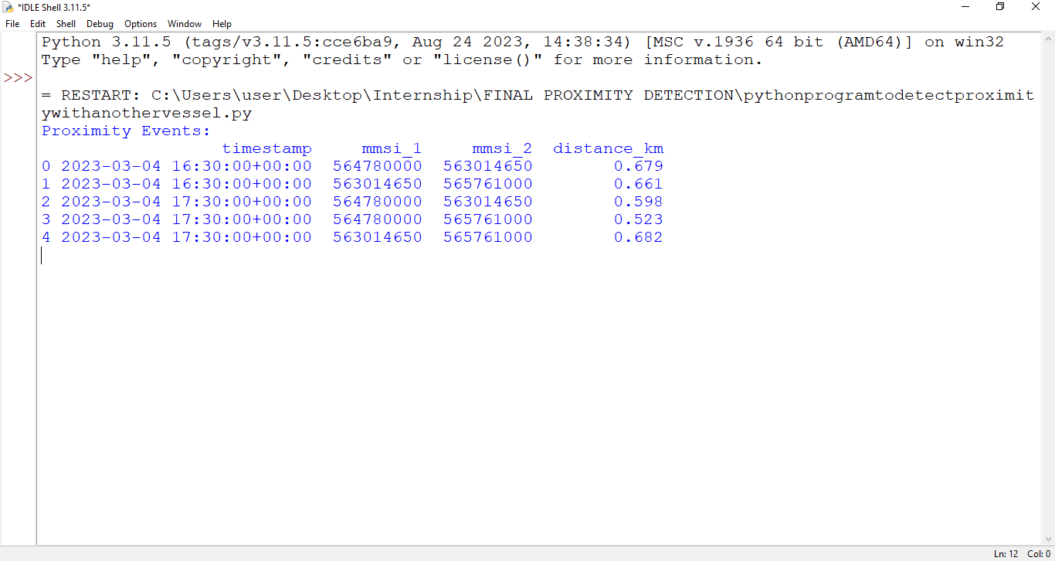
FINAL OUTPUT

Slide 19
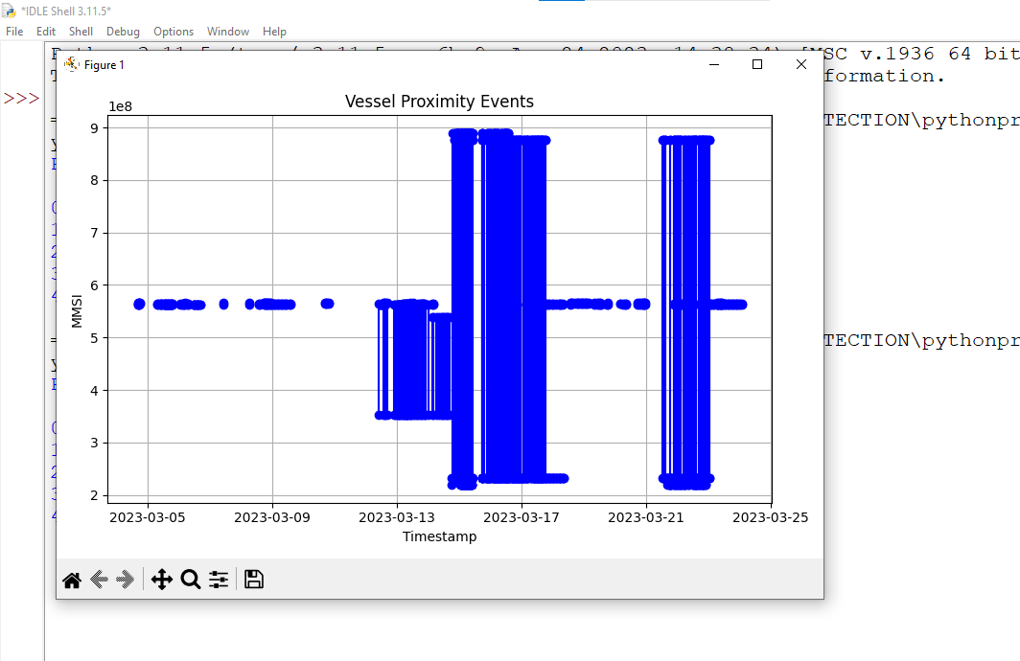

Slide 20
Summary of the System
- Efficient detection of vessels in proximity
- Uses geospatial logic and time-grouping
- Visualizes results clearly and interactively

Slide 21
THANK YOU! I HOPE YOU LIKED THE PRESENTATION

