Slide 1
TOASTMASTERS PATHWAYS
…your new learning experience.

Slide 2
Introduction to Pathways
The New Toastmasters Education
and Leadership Program

Slide 3
Pathways Terms
Assessment
Navigator
Base Camp
Base Camp Manager
Core Competencies
Paths
Levels
Projects (required and elective)

Slide 4
Definitions
ASSESSMENT
Online tool
Answer a series of questions
Helps identify your path

Slide 5
Definitions
NAVIGATOR
Online tool
Answer a series of questions
Helps identify your path
22 page booklet

Slide 6
Definitions
BASE CAMP
Gateway to Pathways
Here is where you work on projects
Has videos, quizzes, interactive activities and more

Slide 7
Definitions
BASE CAMP MANAGER
Can be the Educational Vice President, Secretary or President
Will receive emails about members completion and need to respond promptly
Verify completion for members working with printed materials
Approve external training (fulfilling requirements outside of the club)
Track Progress

Slide 8
Definitions
CORE COMPENTENCIES
Core competencies were identified by the Board of Directors
The primary core competencies represented in each path are listed in order of emphasis to the selected path

Slide 9
Definitions
PATHWAYS
Pathways is a modernized learning experience suited to our changing global society.
It offers you more benefits and more opportunities to learn, grow and meet personal and professional goals
There are currently 10 Paths and more will be developed in the future

Slide 10





Definitions
LEVELS WITHIN EACH PATH
Level 1: Mastering Fundamentals
Level 2: Learning Your Style
Level 3: Increasing Knowledge
Level 4: Building Skills
Level 5: Demonstrating Expertise

Slide 11
Definitions
PROJECTS
Each level has a series of projects that must be completed in order to progress to the next level
Some projects are required (10)
Some projects are elective (4)

Slide 12
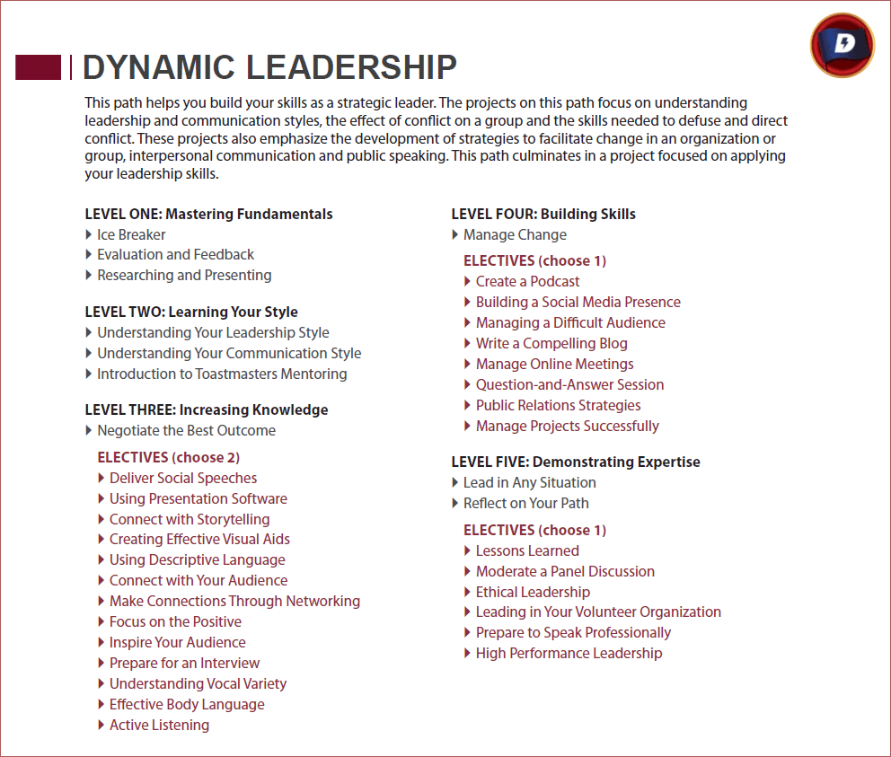

Slide 13
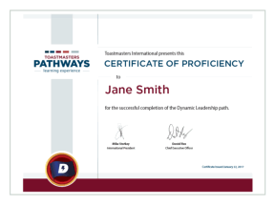


RECOGNITION
Certificate
Levels
Feedback

