Slide 1
Hypertension
Essential concepts for medical students

Slide 2

Definition & Classification
• BP ≥130/80 mmHg (ACC/AHA) or ≥140/90 mmHg (WHO)
• Primary (essential) vs. secondary hypertension
• Grades 1‑3 based on severity
• Isolated systolic hypertension common in elderly
Image: Servier Medical Art
Notes:
Explain the shift in thresholds between guidelines and why both are still used in practice. Emphasize that most cases are primary, with secondary causes accounting for <10% of cases. Classification guides treatment intensity.

Slide 3
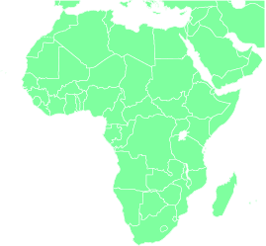
Epidemiology
• Affects ~1.13 billion people worldwide
• Prevalence rises with age; >60% >65 yr
• Higher rates in African‑American and low‑income groups
• Leading modifiable risk factor for cardiovascular death
Image: Servier Medical Art
Notes:
Highlight global burden and disparities. Mention that hypertension contributes to one‑third of all deaths, underscoring its public‑health importance.

Slide 4
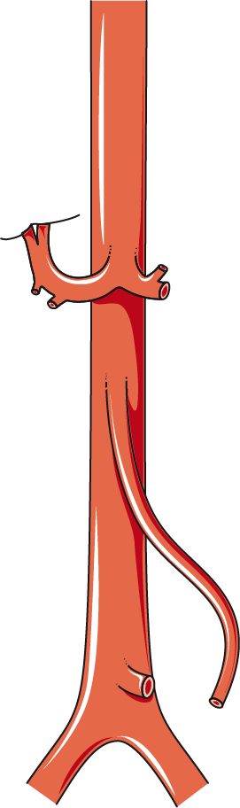
Normal Blood Pressure Regulation
• Baroreceptor reflex adjusts heart rate and vascular tone
• Renin‑angiotensin‑aldosterone system (RAAS) modulates volume
• Sympathetic nervous system influences peripheral resistance
• Endothelial nitric oxide maintains vasodilation
Image: Servier Medical Art
Notes:
Review the integrated neuro‑humoral mechanisms that keep BP stable. Disruption of any component can predispose to hypertension.

Slide 5
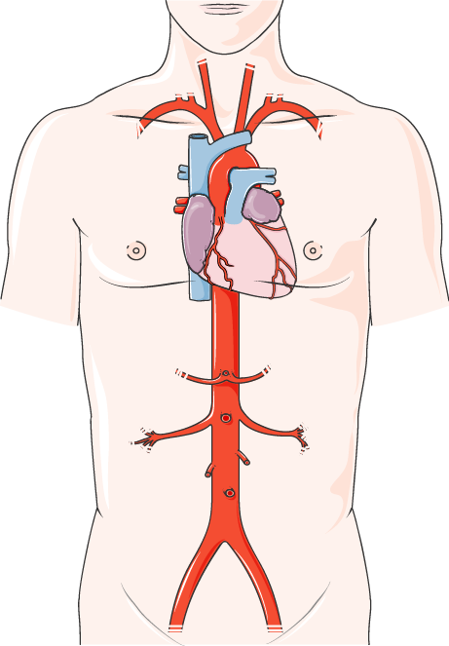
Pathophysiology of Essential Hypertension
• Genetic predisposition with polygenic inheritance
• Increased sympathetic activity and vascular tone
• Renal sodium handling abnormalities
• Endothelial dysfunction and arterial stiffness
Image: Servier Medical Art
Notes:
Essential hypertension is multifactorial. Emphasize the role of low‑grade inflammation and oxidative stress in vascular remodeling.

Slide 6
Major Risk Factors
• Age, male sex, African ancestry
• Obesity, high‑salt diet, excessive alcohol
• Physical inactivity, chronic stress
• Family history and metabolic syndrome
Notes:
Distinguish modifiable from non‑modifiable factors. Use this slide to segue into lifestyle interventions later.

Slide 7
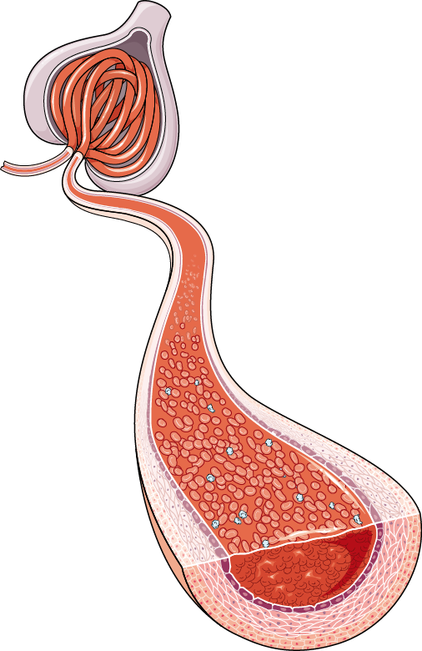
Clinical Presentation
• Usually asymptomatic; discovered on screening
• Headache, epistaxis, visual changes in severe cases
• Target‑organ damage may cause symptoms (e.g., dyspnea from LVH)
• White‑coat effect can mimic symptoms
Image: Servier Medical Art
Notes:
Stress that hypertension is often a silent killer. Teach students to probe for subtle signs of end‑organ involvement.

Slide 8
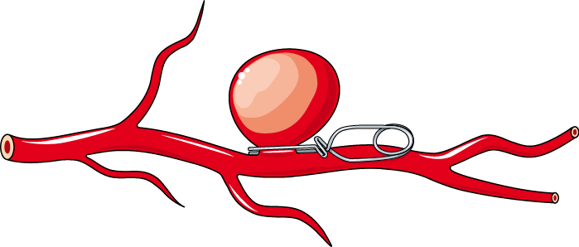
Accurate Blood Pressure Measurement
• Use calibrated cuff, appropriate size, seated 5 min
• Take ≥2 readings, 1‑min apart; average the last two
• Measure both arms initially; use higher reading
• Avoid caffeine, exercise, smoking 30 min prior
Image: Servier Medical Art
Notes:
Proper technique reduces misclassification. Mention automated devices versus manual auscultation and the importance of documenting position.

Slide 9
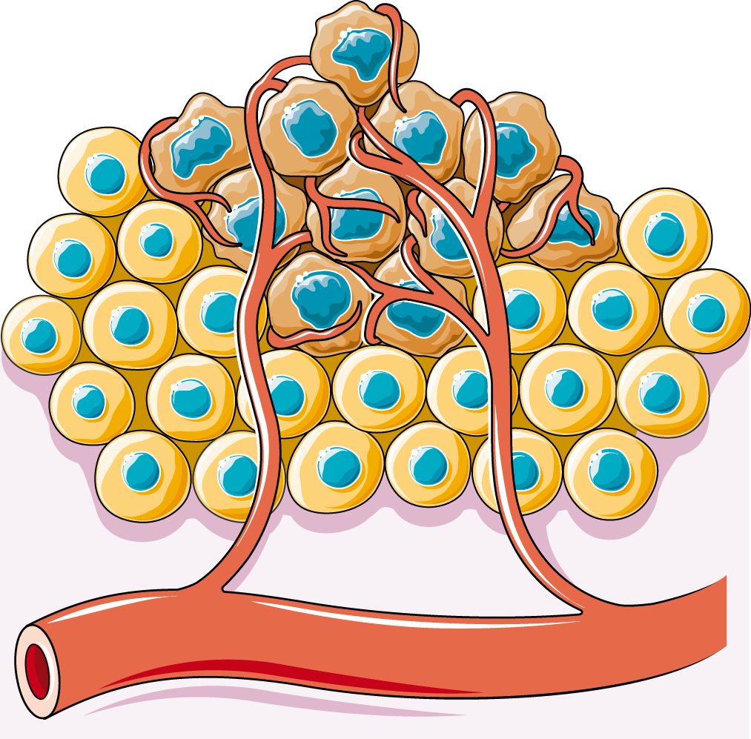
White‑Coat & Masked Hypertension
• White‑coat: elevated in clinic, normal at home
• Masked: normal in clinic, elevated on ambulatory monitoring
• Both increase cardiovascular risk
• Confirm with home BP or 24‑h ABPM
Image: Servier Medical Art
Notes:
Explain why out‑of‑office measurements are essential for accurate diagnosis and risk stratification.

Slide 10
Secondary Hypertension Overview
• Accounts for <10% of cases
• Consider when onset <30 yr, resistant, or abrupt
• Often curable with targeted therapy
• Common causes: renal, endocrine, vascular
Notes:
Encourage a high index of suspicion in atypical presentations. Briefly list categories before diving into specifics.

Slide 11
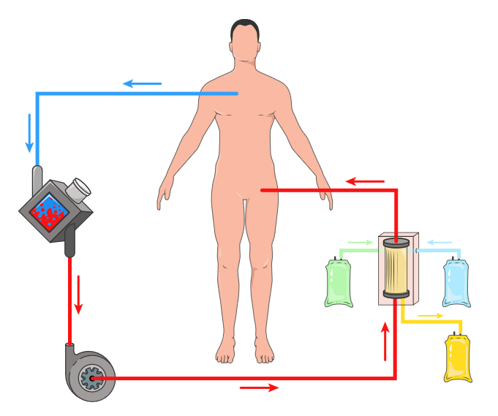
Common Secondary Causes
• Renal artery stenosis, chronic kidney disease
• Primary aldosteronism, Cushing’s syndrome
• Pheochromocytoma, coarctation of the aorta
• Obstructive sleep apnea, drugs (NSAIDs, steroids)
Image: Servier Medical Art
Notes:
Provide key clinical clues for each cause (e.g., hypokalemia in aldosteronism). Highlight that drug‑induced hypertension is reversible.

Slide 12
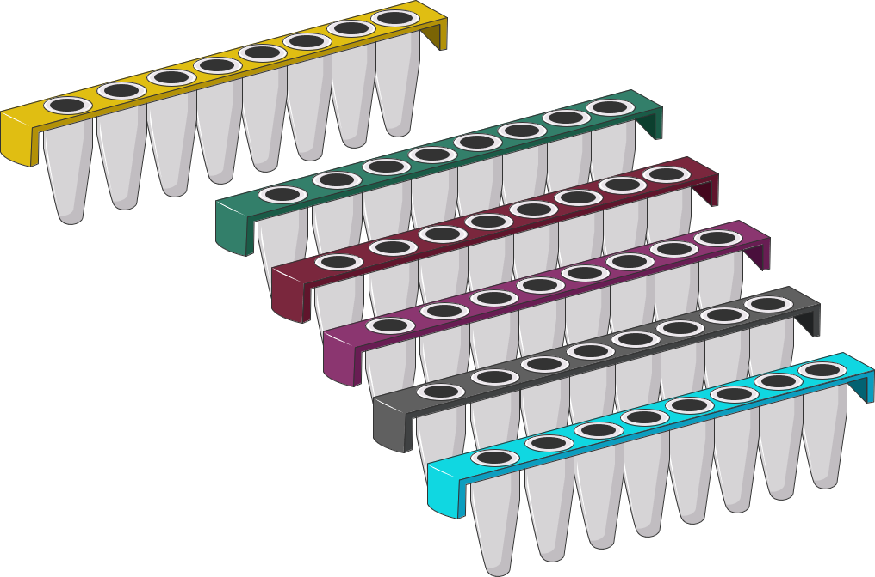
Initial Laboratory Evaluation
• CBC, electrolytes, fasting glucose, lipid panel
• Serum creatinine & eGFR, urinalysis for protein
• Plasma aldosterone/renin ratio if suspicion
• ECG and chest X‑ray for target‑organ assessment
Image: Servier Medical Art
Notes:
These tests identify end‑organ damage, metabolic contributors, and clues to secondary causes. Emphasize cost‑effective baseline work‑up.

Slide 13
Lifestyle Modification
• DASH diet: <1500 mg sodium, high potassium, fruits/veggies
• Weight loss: 5‑kg reduction lowers BP ≈5 mmHg
• ≥150 min/week moderate‑intensity aerobic activity
• Limit alcohol (<2 drinks/day men, <1 women)
Notes:
Lifestyle changes are first‑line and can reduce or replace medication. Cite evidence from major trials (e.g., DASH, TOHP).

Slide 14
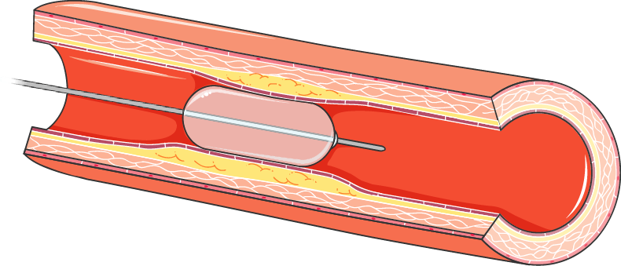
First‑Line Pharmacologic Therapy
• Thiazide‑type diuretics, ACE inhibitors, ARBs, calcium‑channel blockers
• Choice guided by comorbidities (e.g., ACE‑I for diabetes)
• Start low, titrate every 2‑4 weeks
• Goal: <130/80 mmHg for most patients
Image: Servier Medical Art
Notes:
Introduce the four major classes and their typical indications. Mention side‑effect profiles that influence selection.

Slide 15
Combination Therapy & Special Agents
• Fixed‑dose combos improve adherence (e.g., ACE‑I + CCB)
• Beta‑blockers for post‑MI, heart failure
• Mineralocorticoid antagonists in resistant HTN
• Avoid ACE‑I + ARB dual therapy
Notes:
Explain rationale for early combination in stage 2 hypertension. Highlight agents for specific scenarios.

Slide 16
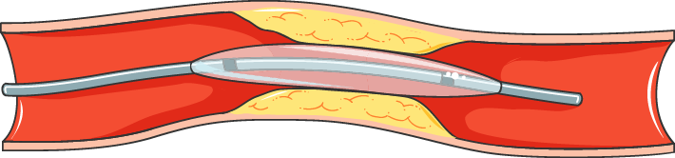
Treatment Algorithm (Step‑wise)
• Stage 1: lifestyle ± single drug
• Stage 2: lifestyle + 2 drugs (different classes)
• Reassess in 1‑3 months; intensify if BP not at goal
• Refer to specialist for resistant or secondary HTN
Image: Servier Medical Art
Notes:
Present a concise flowchart logic. Emphasize shared decision‑making and patient education.

Slide 17
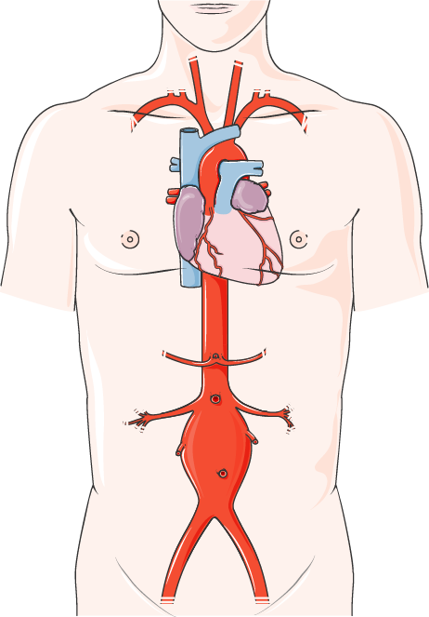
Resistant Hypertension
• BP uncontrolled despite ≥3 agents (incl. diuretic)
• Confirm adherence, correct technique, rule out white‑coat
• Add spironolactone or consider renal denervation
• Screen for secondary causes (e.g., sleep apnea)
Image: Servier Medical Art
Notes:
Define true resistance versus pseudo‑resistance. Discuss evidence for mineralocorticoid antagonists as fourth‑line agents.

Slide 18
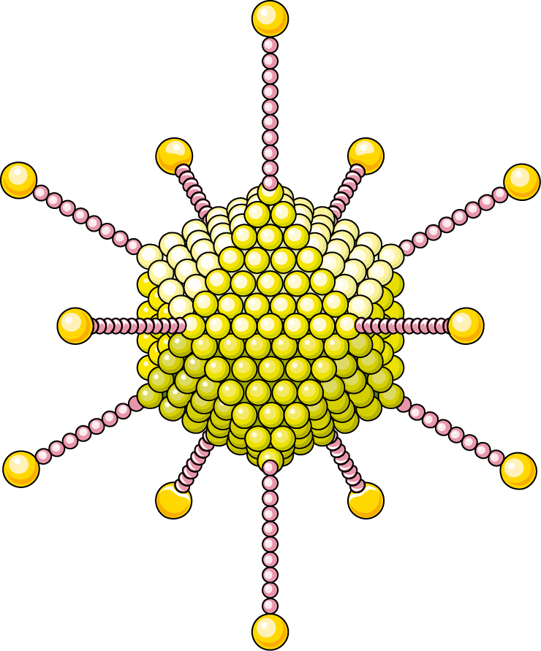
Complications of Uncontrolled Hypertension
• Ischemic/hemorrhagic stroke
• Coronary artery disease, myocardial infarction
• Chronic kidney disease progression
• Aortic aneurysm, heart failure with preserved EF
Image: Servier Medical Art
Notes:
Link elevated pressure to end‑organ damage via vascular remodeling and microvascular injury. Use statistics to stress morbidity.

Slide 19
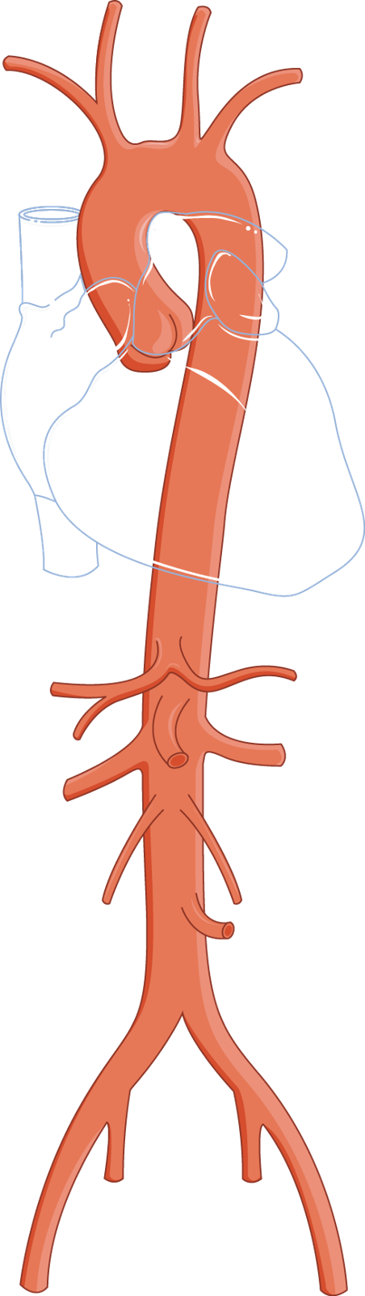
Special Populations
• Pregnancy: treat with labetalol, methyldopa; avoid ACE‑I/ARBs
• Elderly: start low, monitor orthostatic hypotension
• Patients with diabetes: ACE‑I/ARB first line
• African‑American: thiazide or CCB preferred initially
Image: Servier Medical Art
Notes:
Tailor therapy to physiologic differences and safety concerns. Highlight the importance of individualized targets.

Slide 20
Key Take‑aways
• Hypertension is common, often silent, and highly treatable
• Accurate measurement and risk‑factor assessment are foundational
• Lifestyle change + appropriate drug class yields rapid control
• Regular follow‑up prevents complications and identifies resistant cases
Notes:
Summarize the most actionable points for students. Encourage them to apply a systematic approach in clinical rotations.

Slide 21
Image credits
Definition & Classification: Servier Medical Art (smart.servier.com), CC BY 4.0 [CC BY 4.0] https://smart.servier.com/wp-content/uploads/2019/08/cropped-Logosmart-favicon.png
Epidemiology: Servier Medical Art (smart.servier.com), CC BY 4.0 [CC BY 4.0] https://smart.servier.com/wp-content/uploads/2016/10/africa-update.png
Normal Blood Pressure Regulation: Servier Medical Art (smart.servier.com), CC BY 4.0 [CC BY 4.0] https://smart.servier.com/wp-content/uploads/2016/10/aorte_abdo.png
Pathophysiology of Essential Hypertension: Servier Medical Art (smart.servier.com), CC BY 4.0 [CC BY 4.0] https://smart.servier.com/wp-content/uploads/2016/10/anev_01.png
Clinical Presentation: Servier Medical Art (smart.servier.com), CC BY 4.0 [CC BY 4.0] https://smart.servier.com/wp-content/uploads/2016/10/Artere_glomerule.png
Accurate Blood Pressure Measurement: Servier Medical Art (smart.servier.com), CC BY 4.0 [CC BY 4.0] https://smart.servier.com/wp-content/uploads/2016/10/Anevrisme_clip.png
White‑Coat & Masked Hypertension: Servier Medical Art (smart.servier.com), CC BY 4.0 [CC BY 4.0] https://smart.servier.com/wp-content/uploads/2016/10/Cancer_angiogenese.png
Common Secondary Causes: Servier Medical Art (smart.servier.com), CC BY 4.0 [CC BY 4.0] https://smart.servier.com/wp-content/uploads/2024/01/CRRT-ECMO.png
Initial Laboratory Evaluation: Servier Medical Art (smart.servier.com), CC BY 4.0 [CC BY 4.0] https://smart.servier.com/wp-content/uploads/2024/01/pcr-tubes.png
First‑Line Pharmacologic Therapy: Servier Medical Art (smart.servier.com), CC BY 4.0 [CC BY 4.0] https://smart.servier.com/wp-content/uploads/2016/10/vaisseau_13.png
Treatment Algorithm (Step‑wise): Servier Medical Art (smart.servier.com), CC BY 4.0 [CC BY 4.0] https://smart.servier.com/wp-content/uploads/2016/10/vaisseau_16.png
Resistant Hypertension: Servier Medical Art (smart.servier.com), CC BY 4.0 [CC BY 4.0] https://smart.servier.com/wp-content/uploads/2016/10/anev_05.png
Complications of Uncontrolled Hypertension: Servier Medical Art (smart.servier.com), CC BY 4.0 [CC BY 4.0] https://smart.servier.com/wp-content/uploads/2016/10/adenovirus_f.png
Special Populations: Servier Medical Art (smart.servier.com), CC BY 4.0 [CC BY 4.0] https://smart.servier.com/wp-content/uploads/2016/10/aorte.png
AI-generated content for education only. Verify clinical facts against current guidelines. Check each image's licence before reuse.

